Slide 1
evaluation and research
Building State Capacity under the Workforce Innovation and Opportunity Act (WIOA)
December 7, 2016
Office of Policy Development and Research

Slide 2
Gloria Salas-Kos, Moderator
Research and Evaluation Analyst
Office of Policy Development and Research
Employment and Training Administration
Molly Irwin, PhD
Chief Evaluation Officer
U. S. Department of Labor
Wayne Gordon
Director of Research and Evaluation
Office of Policy Development and Research
Employment and Training Administration

Slide 3
Keith Ewald, Project Manager
Workforce Analytics
Ohio Department of Jobs and Family Services
Joshua Hawley, Associate Professor and Director
Ohio Education Research Center
Ohio State University

Slide 4
WIOA Vision
The workforce system is characterized by three critical hallmarks of excellence:
The needs of business and workers drive workforce solutions;
One-Stop Centers (or American Job Centers) provide excellent customer service to jobseekers and employers and focus on continuous improvement; and
The workforce system builds and supports strong regional economies and plays an active role in community and workforce development.
Across the system, continuous improvement is supported through evaluation, accountability, identification of best practices, and data driven decision making.

Slide 5
Describe an Evidence-Based Evaluation and Research Agenda
Share Relevance to the Workforce Innovation and Opportunity Act
Provide a Perspective on State Evaluation and Research Activities
Share Resources and Build State Evaluation and Research Capacity

Slide 6
Evidence-Based Agenda
Creating a Culture and Environment that Fosters Evaluation and Research

Slide 7
DOL’s Chief Evaluation Office
Established in 2010 to coordinate, manage, and implement the DOL's evaluation program.
Independent evaluation office, located organizationally in the Office of the Assistant Secretary for Policy.
Works closely with all offices and agencies throughout DOL to develop and implement evaluations that address priorities set by the Secretary and the agencies.
Committed to institutionalizing an evidence-based culture.
Dedicated funding through appropriations for DOL evaluations

Slide 8
Chief Evaluation Officer Activities
Develop an evidence agenda
Plan and oversee evaluation projects
Outcome and Impact evaluations (experimental, non-experimental, behavioral economics)
Descriptive and Implementation evaluations, feasibility studies, exploratory studies, systems change
Literature reviews, evidence reviews, meta-analysis
Statistical analysis and surveys
Data analytics projects
Capacity development:
Scholars and grants program
Data quality and access
Program staff capacity
Disseminate evaluation findings and work with stakeholders to incorporate evidence into decisions

Slide 9
Evaluation Principles at DOL
Rigor
Relevant
Transparency
Independence
Ethics

Slide 10
DOL Evaluation Plan
Agency Learning Agendas
Strategic and Secretarial Priorities
Congressional Requirements
Evaluation Plan

Slide 11
Evaluation and WIOA
New Requirements to Promote
Research and Evaluation

Slide 12
The Law
Evaluation and Research Opportunities to Engage States
Evaluation of Title I programs; and others -
Job Corps
Career Pathways
Equivalent Pay Study
Coordination of state evaluations with Federal evaluations
System to disseminate promising practices
Clearinghouse for Labor Evaluation and Research (CLEAR)
Workforce System Strategies (WSS)
State research sites

Slide 13
State Evaluation Strategies
Coordinate and consult with other core programs and local workforce boards.
Cooperate with Federal evaluations to provide data, respond to surveys, and allow timely site visits to the extent practicable.
Conduct evaluations and research for workforce programs (youth, adult/DW, and WP) – and use state set-aside funds.

Slide 14
Assessing State Evaluation Needs
Lessons Learned to Date
National Convening – New Jersey and Washington State
State Plan Reviews – Mix of monitoring, assessing, and evaluating state activities
Regional Office Feedback – Interest in learning about ongoing evaluation activities and want to help states.
Moving Forward
NASWA State Scan
Assessment of functions, practices and resources
Develop a compendium of recent state evaluations and research reports
Develop a realistic understanding of states’ needs
DOL/ETA Tools
WIOA-cise existing evaluation tools and resources (WIF and TAACCCT)

Slide 15
Examples of Available Research Data
Wage Records
Workforce Innovation Performance System
Creates individual records to track performance outcomes
Captures quarterly and annual measurable gains
Workforce Data Quality Initiative/State Longitudinal Data Systems
Allows states to create longitudinal workforce data archives and partner with research centers
Creates and maintains a centralized network of data systems within each state
Provides a centralized set of research and evaluation reports for difference state agencies (workforce, higher education, k-12 education)
Generates series of data dashboards and outcome scorecards (student and workforce success measures) for stakeholders

Slide 16
Addressing Resource Concerns
Identify sources for funding evaluations
State funds – allowable under the Governors set-aside
Participate in Federal evaluations
Foundations
Universities
Local businesses and other stakeholders
Find Credible Evaluators
Appropriate training and experience for the activity
Credentials and related expertise
Independent and diverse disciplines

Slide 17
Ohio’s Evaluation and Research Efforts
A state’s perspective on building capacity.

Slide 18
Ohio Longitudinal Data Archive
Policy Council
Advocate for System
Set policy agenda for data use
Supervise Coordinating Board
Coordinating Board
Put policy agenda into practice
Supervise Data Stewards
Data Stewards
Serve as primary technical linkage to agency data staff

Slide 19
Department of Higher Ed (ODHE)
Department of Education (ODE)
Higher Education Information
(2000-2015)
Education Management Information System
(2004-2014)
Ohio Technical Centers
(2003-2015)
Adult Basic & Literacy Education
(2003-2015)
Job & Family Services (ODJFS)
Unemployment Insurance Wages
(1995-2015)
Quarterly Census of Employment Wages
(1998-2015)
Unemployment Insurance Benefits
(2004-2015)
Workforce Investment Act
(2006-2015)
Labor Exchange
Job Seekers
(2006-2015)
Opportunities for Ohioans with Disabilities
Vocational Rehabilitation
(2011-2015)
OhioAnalytics Partnership

Slide 20
Governance Model
Policy Council
Coordinating Board
Data Stewards
OMHAS
OHFA
ODE
K12 Data
GED Data
ODHE
Higher Ed.
Adult Ed.
JFS
Wages
Employer Data
WIOA
OOD
*VR Data
Other Data
COLLABORATING AGENCIES
PRIMARY AGENCY PARTNERS

Slide 21
Center for Human Resource Research
Ohio Longitudinal Data Archive
CHRR provides
A standardized data application process
Metadata, documentation and codebooks for research planning
Custom data extracts that are
Anonymized
Longitudinal
Linked across data sources (i.e. employment linked to education)

Slide 22
Create Clear Data Access Procedures
Application for data access
Data request form and data sharing MOU
Reviewed by OERC then forwarded to agencies for approval
Confidentiality forms, CITI certification, IRB notification
Extracts of approved data elements transferred via secure FTP
Agency review of findings
Data destruction affidavit

Slide 23
Ohio Longitudinal Data Archive Users
N=54 active or complete projects, 2013-2016

Slide 24
Explore OLDA Elements
Open www.chrr.osu.edu →Investigator
From the Welcome to Investigator page, select Search.
Under Select a study, choose Ohio Longitudinal Data Archive- Metadata Demo.
Select a sub-study

Slide 25
Applying for OLDA Access
Data Request
Research team contact info
Research question and intended product
Requested data elements
Timeline
MOU Template
Security and Privacy
Equipment and location
De-identification
Cell sizes

Slide 26
Applying for OLDA Access
Sharing Results
Agency review
Research brief of policy implications
Bibliography
Terminating Access
End dates
Remove data from computing systems for all team members
Affidavit

Slide 27
Ohio Education Research Center
A full-service research center, focuses on improving policy and practice in education, higher education, workforce development, and human services
Started in 2011 with Race to the Top Funding
A “joint venture” between the College of Social and Behavioral Sciences (CHRR), the John Glenn College of Public Affairs, and the College of Education and Human Ecology
Includes partnership agreements with a range of other universities (UC, OU, CWRU, and MU of Ohio)
Management is composed of a director and four lead faculty that handle data, agency cooperation, outreach and engagement, and internal communications

Slide 28
Current Research Agenda
Work within four public sector domains
Education (P-12)
Higher Education (post secondary, including vocational)
Workforce (and welfare)
Human Services and Health
Agenda is set annually with each agency and available for the whole system

Slide 29
Agenda-Setting in State Government
How does the State of Ohio determine what to study?
General research and evaluation needs can be determined in a few different ways.
By issuing RFP’s that require evaluation
services for the state government.
Through state legislation requirements (e.g.,
employment follow up reports).
Performance reporting requirements.
State evaluation or research priorities.
External requests (e.g., academic or research)

Slide 30
Research Examples
Study examined student outcomes on reading and kindergarten readiness
Merged data from a large set of student records in Cleveland.
Matched with health and social service data

Slide 31
Workforce Success Measures
Performance data for WIOA programs
Displayed at provider, county, region, and state level
Covers WIOA, Perkins, VR, and Higher Ed data.
Measures include employment and skills attainment

Slide 32
Central Ohio Compact Site
Site provides access to individual districts to data on K12, Higher Education, CTE, and Adult Education program outcomes.
Goal of the site is to move the region towards 60% of the adults having a post secondary degree.

Slide 33
In-Depth Study: Research Question
Does WIA-funded on-the-job training improve workforce outcomes for trainees in Ohio?
Kristin Harlow, Lisa Neilson, Josh Hawley (2014), Center for Human Resource Research

Slide 34
In-Depth Study: Research Design
OJT participants between 2006-2008
Literature indicates training benefits appear in the long term (3 to 5 years)
Outcomes measured after 4 years:
Employment
Wages

Slide 35
In-Depth Study: Data Sources
WIA Data
Services received, including OJT
Dates of service
Demographic variables
Wage Record Data
Quarterly wages reported to Ohio Department of Job and Family Services (ODJFS) for unemployment insurance purposes
Wage data excludes the following:
Wages from federal employers
Earnings from self-employment
Wages from employment outside the state of Ohio
Unemployment Data
Identifies individuals who receive unemployment insurance funds each calendar quarter

Slide 36
In-Depth Study: Comparison Group
Propensity Score Match
Pool – WIA service recipients (other than OJT)
Matched on:
Geographic region of Ohio
Demographic information
Prior workforce experience, including
Employment and number of employers
Earnings and earnings trend
Size and timing of earnings dip
High quality match found for almost 980 of 1,115 OJT participants

Slide 37
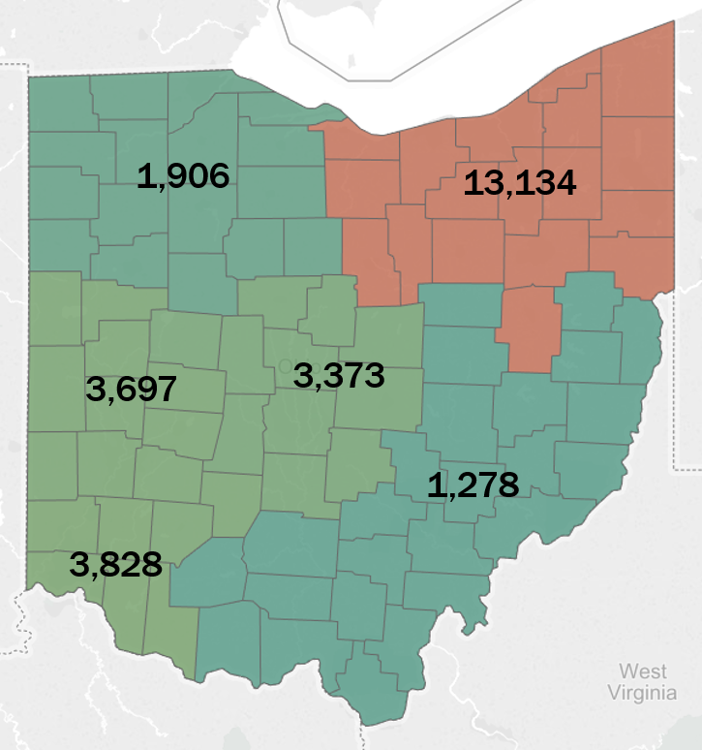
In-Depth Study: Data Analysis
OJT vs. Non-OJT WIA Participants 2006-2008

Slide 38
Results: Percent Found Working

Slide 39
Results: Wages Earned Comparisons

Slide 40
Results: Difference in Difference Models
Difference in Difference Model
Beginning fourth quarter before participation
Average of quarters 15 through 18
Average 11.0 percentage point difference in individuals found working
Average $1,100 difference in quarterly wages

Slide 41
Ohio Evaluation and Research Links
Ohio Education Research Center (http://oerc.osu.edu/)
Center for Human Resource Research (https://chrr.osu.edu/)
OhioAnalytics Partnership (www.ohioanalytics.gov)
Dashboards
Workforce (http://www.measures.workforce.ohio.gov/)
Higher Education (https://compact.chrr.ohio-state.edu/)
K12 (http://www.slideshare.net/OERC2012/ohios-student-success-dashboard)

Slide 43
Federal Evaluation and Research Activities
Current and Future USDOL Plans

Slide 44
Current DOL Evaluation Activities
Career Pathways (Required) – Complete an evidence review and builds on Green Jobs/Career Pathways Evaluation.
Equivalent Pay Study (Required) – Use a multi-pronged approach to build on existing Nontraditional Jobs study, apprenticeship, and the Women's Bureau.
WIOA Implementation Study – Builds on AJC and WIA Gold Evaluations.
Five-Year Research & Evaluation Plan – Gather stakeholder input; identify new research ideas, develop annual Learning Agenda through consultation with program offices.

Slide 45
Long-Term DOL E & R Activities
Planning
Cycle of Evaluations for WIOA Programs.
ETA Five-Year Strategic Research and Evaluation Plan (2017-2021).
Collaboration with CEO and other agencies
Address other research and evaluation projects in WIOA
Explore other information sharing areas and build on examples and experiences.
Budget Formulation
OMB requirement evidence-based strategies in Agency’s budget.
Evaluation Priorities – Opportunity Youth, long-term unemployment, work experience, customer service strategies for employers and workers.

Slide 46
USDOL Evaluation and Research Resources
Technical Assistance and Dissemination Activities

Slide 47
Resources Available
Office of Management and Budget
Evidence and Evaluation
USDOL/CEO - website
U.S. Department of Labor Evaluation Policy
Clearinghouse for Evaluation and Research
Current Studies
USDOL/ETA - website
Five-Year Research Plan for 2012-2017
ETA Research Publication Database
Workforce System Strategies

Slide 48
Identify and develop WIOA-specific evaluation and research toolkit
Supported by evaluation tools created for the WIF and TAACCT programs
Engage USDOL/ETA Regional and National Office staff
Work with WIOA technical assistance teams to
Develop evaluation and research materials and training for regional forums
Create a technical assistance plan for WIOA evaluation and research

Slide 49
When it comes to building state evaluation and research capacity, which answer is false?
Resources must be available to fund studies.
Regular program data alone does not explain long-term impact of services.
New interventions or services implemented need to be studied to understand outcomes.
Causal evidence does not explain economic impact.

Slide 50
Name two training or technical assistance resources that that you think states need to build or expand evaluation capacity?
Respond in comments

Slide 51
Department of Labor Evaluation and Research Contacts:
Molly Irwin, PhD
Irwin.Molly.E@dol.gov
Wayne Gordon
Gordon.Wayne@dol.gov
Gloria Salas-Kos
Salas-Kos.Gloria@dol.gov

