Slide 1

Participant Poll
What is your current role in the grant?
  Project Manager
  Faculty
  Dean/VP/Other Leadership Role
  Career Navigator/Coach
  Other (list in chat)
Were you a part of the past two Sustainability Virtual Institute webinars?

Slide 2
Fall Round 3 TAACCCT
Sustainability Virtual Institute:
Final Webinar
December 16, 2016
2 – 3:30 p.m. EST

Slide 3
TAACCCT Learning Network at a Glance
U.S. Department of Labor, Employment & Training Administration
(National)
Jobs for the Future
CalState/Merlot
Maher & Maher
American Association of Community Colleges
U.S. National Science Foundation
ATE Centers
Other Non-Federal Providers of TA and Resources for TAACCCT Grantees:
Creative Commons
CAST
The Transformative Change Initiative

Slide 4
Participant Poll
What is your current role in the grant?
  Project Manager
  Faculty
  Dean/VP/Other Leadership Role
  Career Navigator/Coach
  Other (list in chat)
Were you a part of the past two Sustainability Virtual Institute webinars?

Slide 5
Presenters
MODERATOR:
Cheryl Martin, Program Manager, TAACCCT Grants, U.S. Department of Labor, Employment, and Training Administration.
FACILITATORS:
Jennifer Freeman, Program Director, TAACCCT Learning Network, Jobs for the Future
Allysha Roth, Program Manager, TAACCCT Learning Network, Jobs for the Future

Slide 6
Agenda
Welcome and Introductions
Grantee Sustainability Round-Robin
What happens after the SVI?
Q&A
Closing and Wrap-up

Slide 7
Grantee Sustainability Round-Robin

Slide 8

Colorado Helps Advanced Manufacturing Project (CHAMP) Participants
Metropolitan State University of Denver
Emily Griffith Technical College
Aims Community College
Colorado Community System Colleges
  Community College of Denver
  Front Range Community College
  Lamar Community College
  Pikes Peak Community College
  Pueblo Community College
  Red Rocks Community College

Slide 9

Sustaining
  Advanced Manufacturing Science Institute established, director hired. Will be housed in the new Aerospace, Engineering and Science building
  New BS degree
  Fast track programs in Welding and production Technician
  Way to have Navigator for the division or select departments in the division.

Slide 10
Sustaining ….
  Positions: Program Director, Faculty, Employer Outreach Coordinator, Technicians
  Embedded professional development
  NIMS certification
  Manufacturer Mixer event for employers and program participants
  Embedded soft skills training
  Industry Outreach

Slide 11
Next Steps
  Update AMI curriculum
  Recruit students and transfer students into degree program
  Build more articulation agreements with community colleges
  Solicit and create and multidisciplinary projects from industry
  Build schedules to best meet industry needs
  Update course content

Slide 12
Next Steps….
  Build internship and apprenticeship opportunities
  Use and develop Pathways
  Expand scholarship opportunities
  Complete feasibility study to develop a Center for Integrated Manufacturing
  Build industry partnerships, i.e. CAMA, NoCo, Manufacturer’s Edge Career Wise Colorado
  Prepare strategic plan for college leadership

Slide 13

1. What are you sustaining?
(Planning to or know you are in fact sustaining)
We would like to sustain:
Career Coaches/Job Developers
  Prepare participant for employment
  Assist with placement
  Follow-up when employed

Slide 14
2. Next Steps
(Next 3 Months)
Clear plan to initiate conversations at individual colleges
  Continue seeking alternative funding sources (more grants; contract training)
  Using current data to show need for career coaches/job developers
  Strategic plan

Slide 15
Sustainability at the
Community College of Rhode Island
Thomas M. Sabbagh, Ph.D – TAACCCT -3 Program Director

Slide 16
TAACCCT Core Element:
Career Pathways with stacked or latticed credentials
Created and Implemented:
  Non-credit Boot camp =➔ For-credit Boot camp
  Five new certificate programs
  A new AS degree in Advanced Manufacturing
  Developed 3 new distance learning interdisciplinary pedagogy courses
  Advanced Learning Program for English, FLC for Math
  A new Industry Advisory Board
  A new Outreach Coordinator position
In addition:
  CCRI has installed new Advanced Manufacturing equipment and labs
  CCRI has made application for external accreditation through ATMAE
  CCRI now has a member on the Governor’s Workforce Advisory Board
  CCRI has joined with the RI Manufacturing Association
  Pending: Hire Director of Online/Instructional Design, position has been posted
  Pending: Purchase of SharePoint for institutional support to maintain within IT support budget
ALL are expected to be sustained by the College, inclusive of personnel

Slide 17
TAACCCT Core Element:
Accelerated Pathways & Credit for Prior Learning
Created and Implemented:
  a new CCRI Prior Learning Policy that may be used as a guide for other State Public Institutions
  a new State Public Institution Transfer Policy
  a new State Public Institution Reverse Transfer Policy
  12 new Financial Aid TV videos for media promotion and awareness of Accelerated Pathways
In addition:
  Conducted a Statewide Prior Learning Summit with CAEL and ACE representatives
  Begun a new employer engagement plan for earning ACE recommended transcripts for top 50 employers in the state, as well as those employers with whom CCRI has Standardized Credit Awards
  Developing new procedures for CCRI Departmental Challenge Exams and Prior Learning Assessment of Portfolios
  Implemented the CCRI Prior Learning Accelerator (Screening tool)
ALL are expected to be sustained by the College, inclusive of personnel

Slide 18

Sustainability
December 2016

Slide 19
Sustainability Planning - Achieving Results that Last – Draft Work Plan – SWACCC
Sustainability Planning for SWACCC Sector Partnership as of December 2016
Program Component to be Sustained or Expanded | Tactical Questions |  | Resources and Knowledge Needed | Sources/Partners | Barriers and Opportunities
Industry engagement: Maintain/expand current employer partnerships; add new ones; enhance existing ones. | How do we engage additional employers? Smaller employers? What are some strategies for maintaining (good) employer participation? Do we need an employer champion? How do we find experienced instructors? |  | Compilation of employer partners, levels of involvement. Visualization of evolution of a partnership Employer engagement strategies, including promising practices for engaging smaller employers | List of industry partners goes here. | Employer fatigue Employer demand for a more talented pipeline Already have employers at the table Employers not honoring commitments (change of leadership, down-sizing, etc.)
Action Plan: Industry engagement: Maintain/expand current employer partnerships; add new ones; enhance existing ones.
Activity: (Next step for moving toward desired state.) |  | Considerations |  |  | Timeline | Responsibility
Meet one-on-one with employers and ask them “How engaged do you feel?” “Why?” “What other challenges might we be able to solve together?” |  | Some employers want regular/concrete opportunities to engage, while others prefer less of a commitment.
Develop a timeline/visualization for engaging current employer partners (e.g. meetings, one-on-one meetings, employers attend program events and classes, employers participate in k-12 days, employers help leverage resources), demonstrating the evolution of a successful, working partnership. |  | Consider specific agenda items for group meetings when developing the timeline. (e.g. program and curriculum updates based on new hires; occupation growth stats; new industry information or opportunities, discussions on talent pipeline development)
Set a goal regarding the number of new employers you want at the table. Develop a strategy for identifying potential employer partners, reach out to those employers. |  | Make a list of your partners, what do they bring to the table? Are there individuals at certain levels of company that can help you in different ways?

Slide 20
Program Component to be Sustained or Expanded | Tactical Questions (Questions to help inform the action plan- below.) |  | Resources and Knowledge Needed | Sources/ Partners |  | Barriers and Opportunities
Partnership with K-12: Strengthen partnership with K-12 in order to increase enrollment and provide employers with a pipeline of workers; also, giving employers opportunities to market their industry. | How do we keep secondary school students interested in our programs? How can we leverage our career pathways as an advising tool for students? How do we bridge the gap between education and industry? How do we educate students, parents, and h.s. staff about today’s advanced manufacturing? |  | Career Pathway graphics Knowledge (of adv. mfg.) assessment of younger students Skills Gap analysis Best practices from NAM and other national orgs and/or other colleges | Secondary school leadership Employer advisory council members | Secondary Career Center on campus (dual enrollment) Educating parents, teachers, and guidance counselors about today’s mfg opportunities Career Coaches in h.s. Career pathways can open conversations Career days for younger students, including hands-on activities, tours of plants, etc. Employer participation in Career Day, mfg. day type activities is high
Action Plan: Strengthen partnership with K-12 in order to increase enrollment and provide employers with a pipeline of workers; also, giving employers opportunities to market their industry.
Activity: (Next steps) |  | Considerations |  |  |  |  | Timeline | Responsibility
Colleges develop an action plan (in partnership with schools) that outlines x number of activities for promoting adv. mfg to students, parents, teachers |  | Research tools and resources (preferably free ones!) that provide value when working with students. Think about outcomes when developing opportunities for employer engagement with students, parents, teachers. Use career pathways and information from o*net, etc. to help educate parents, teachers, and students about careers, salaries, labor market info. Create hands-on opportunities to engage students in mfg. technologies
Invite K-12 staff and leadership to campus and to advisory group meetings |  | Teachers and administrators must understand the value of technical training and the demand for skilled workers, so they are better able to communicate with students and parents. Liaising between employers and k-12 can help with barriers on both sides.

Slide 21
Program Component to be Sustained or Expanded | Tactical Questions Resources and (Questions to help inform the action plan- _{Knowledge Needed} ^{Sources/Partners Barriers and} below.) |  | Opportunities
Existing resources and partnerships: In order to increase enrollment and support tuition assistance for students. | How can we better leverage our partnership Better understanding of K-12 with DWS and other public agencies working how DWS can support our toward similar goals? sector partnership work ^{SWACCC colleg} How do we leverage RAMP 2 (ADHE pipeline CSW talent pipeline ^{ADHE Pipeline} grant), to increase enrollment and employer graphic ^{grant} ^{buy in?} Activities plan from ^{DWS, public} pipeline grant ^{agencies} | DWS has often had its own agenda in the past _{es} WIOA presents new opportunities for collaboration with DWS DWS must be well-informed about the benefits of our programs and pathways
Action Plan: Existing resources and partnerships: In order to increase enrollment and support tuition assistance for students.
Activity: (Next steps) Considerations |  | Timeline
The Public Workforce System should actively be involved in order Meet with DWS to discussion your programs and to use existing resources that bring employers and workers _{opportunities for partnership.} together: WIOA- sector partnerships, career pathways, work- based learning. Consider additional programs and services that they might enhance your employer partnerships.
Schedule partner meetings with SWACCC colleges involved in the pipeline grant and develop a plan for Not all SWACCC colleges are part of the pipeline grant leveraging curriculum and resources for marketing programs to increase enrollment.
Understand the population that will likely participate in Human Service Agencies; Community- or Faith-based your programs, to help identify programs and services to Organizations; Local and State Elected Officials; Philanthropic leverage with (potential) partners. partners; Others: depending on the needs of the industry, should be considered.
Responsibility

Slide 22

Advanced Manufacturing by Innovation and Design
Gail Brinkley – TAACCCT3 Program Coordinator Nashua Community College
Sustainability Planning

Slide 23


Programs and program elements to be sustained | Evidence of success | Mechanisms to sustain
Online and hybrid programs - technology enhancement, including AS Degrees and new 1 year Metrology Certificate | Course Evaluations Retention Rate for online/hybrid/face-to-face Employer feedback Wage levels/job levels obtained by NCC grads | Regular part of college offerings as long as there is demand NIMS Accreditation (will help ongoing demand)
Equipment – maintain and upgrade | Employer’s testimonials about equipment training being appropriate | Cooperative partnerships with employers for upgrades NH capital budget for upgrades

Slide 24
Programs and program elements to be sustained | Evidence of success | Mechanisms to sustain
Navigators (recruitment, retention, job placement, marketing) | ROI –instructor survey Student survey Retention compare to other programs (that do not have navigators) Data that shows fall->spring retention increase | Supported by Perkins Grant (for all programs)
Lab assistants | Ability to accommodate higher numbers of students through labs – better machine utilization | Integrate into college operating budget

Slide 25

LINCS Sustainability
What are you sustaining (planning to or know you are in fact sustaining)?
We will continue to offer education and certifications in Supply Chain Management.

Slide 26
LINCS Sustainability
What are your next steps after the SVI (next three months)?
In the coming months, we will work with our industry partner to streamline the certification exam process; select a payment system; and ensure that technology is configured for post-grant enrollment. We will also prepare outreach plans.

Slide 27



Employer Engagement
Advisory Board
Facility Tours
Instructors and Presenters
Job Postings
Interviews and Job Placement
Advisory Board Meetings
Employer Outreach
Campus Tours
Mailing Lists
Access to Students/Graduates

Slide 28


What are you sustaining (planning to or know you are in fact sustaining)?
  Health Information Technology program (A.A.S and Certificates)
  Alternative Energy (A.A.S and Certificates)
  Agriculture/Horticulture (A.A.S and Certificates)
  College Readiness Program – AEL/Tutoring/College Prep

Slide 29
What are you next steps after the SVI (next three months)?
  Our team will meet to begin discussing the steps needed to develop the plan to tie into our strategic plan.
  We will determine who will take specific actions.
  We will seek opportunity to secure the support of our stakeholders.
  We will document our steps in order to stay focused and our efforts become a permanent part of our institution.

Slide 30


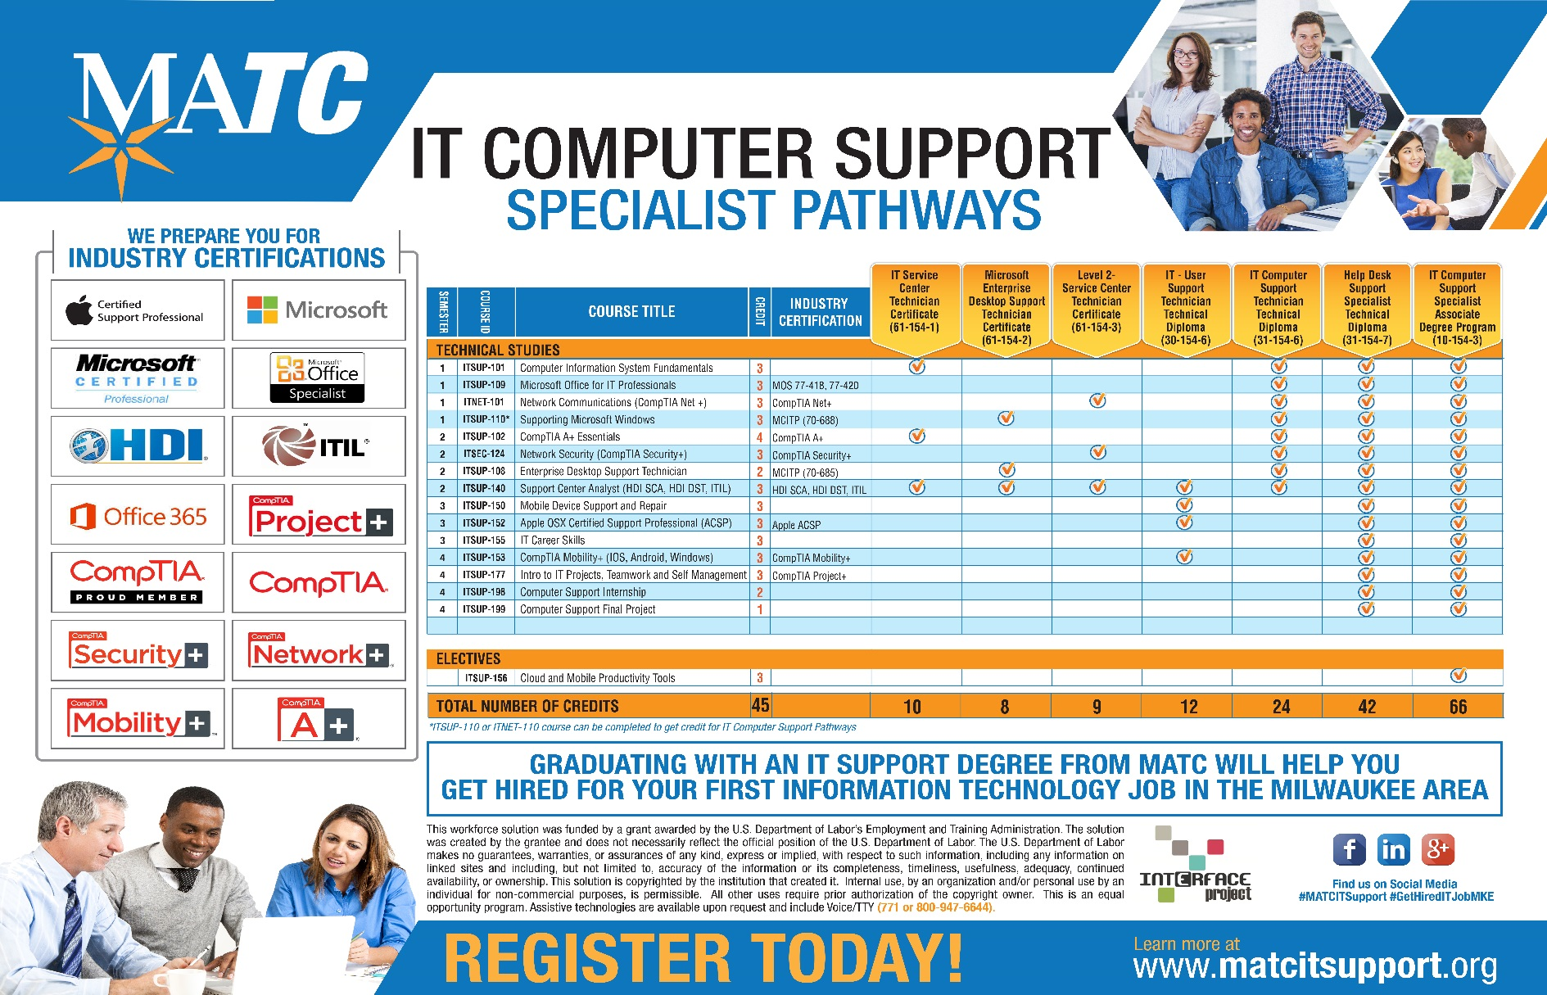
MilwaukeeAreaTechnical College

Slide 31

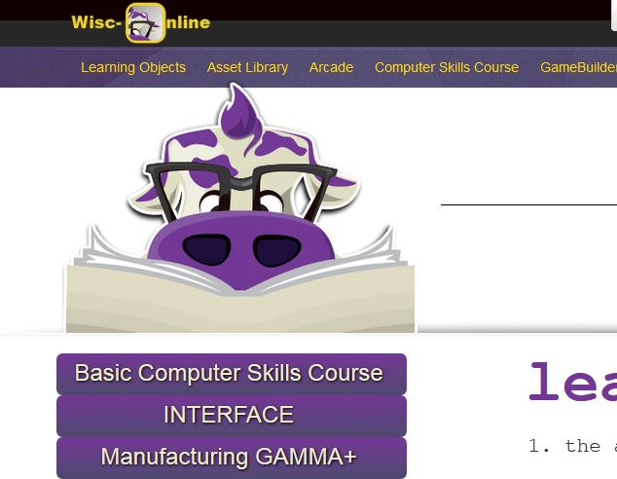
MilwaukeeAreaTechnical College www.wisc-online.com

Slide 32
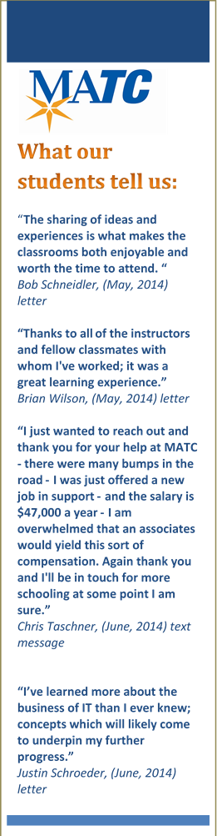


MilwaukeeAreaTechnical College
Learn what students are saying about MATC IT Computer Support Specialist program at: http://matcitsupport.org/it-support-student-testimonials/
4th Annual IT Career Symposium
“Becoming an IT Professional”
Bring your resume / Alumni Panel

Slide 33


Bridging the Gap Consortium
TAACCCT Round 3
BridgeValley Community and Technical College
Sustainability Virtual Institute
Jobs for the Future

Slide 34
Planning to Sustain:
Sector-Based Approach to Workforce Development
  Continue employer sector meetings
  Continue agency partner meetings
Guided Pathways to Success Initiative – continue use of:
  Academic Maps
  Stacked Credentials
  Embedded Certifications
  Proactive Advising
Prior Learning Assessment Initiative
  Maintain PLA website
  Continue to provide faculty training
Banner Data Analytics
  Continue for data-driven decision making
  Continue for increased student retention efforts

Slide 35
Planning to Sustain:
Innovative Program Delivery
  Accelerated Programs
  Open-entry, open labs concepts
  Simulation software purchased
Developmental Education Reform
  Continue the co-requisite delivery of developmental education
  All colleges 90% to 100% co-requisite delivery model
Learn and Earn Work-based Learning Model
  State Revenue Funded
Working with Local Workforce Development Boards and America’s Job Centers

Slide 36
Planned Activities
Final workshop on sustainability around the elements of the Toolkit
Review Teamwork (project management system) submissions by colleges
Submit draft Sustainability Plan for review by March 1, 2017
Submit final Sustainability Plan by March 31, 2017

Slide 37

Sustainability Virtual Institute
Presented by: Paul Casey
12/16/16

Slide 38

Methods for Innovation
  Building a More Resilient Workforce
  Faculty & Staff Professional Development
  Capacity Building & Innovation
  Program & Curriculum Development
  Marketing Strategy - Message the Outcomes
  to share the impact of the work. Help the data
  tell the story

Slide 39

Columbus State Community College
LINCS Consortium
Sustainability Goals:
Implementation:
Sustain key accomplishments that align with our institution’s goals and priorities
Create a sustainability plan specific to LINCS
Create a broader institutional framework that can be applied to CSCC’s other DOL and NSF grants
Leverage resources across and outside of the college to tell a rich, data-driven story
Create an impact report that focuses on our individual institution

Slide 40
Sustainability Efforts
Sustain new 1-credit certification courses and aligned college certificate
Further embed content into Supply Chain Management and Logistics Engineering Technology degrees
Retain a .5 FTE industry engagement representative to sustain employer outreach, industry training, and placement opportunities
Share key successes and contacts with our Round 4 TAACCCT project

Slide 41

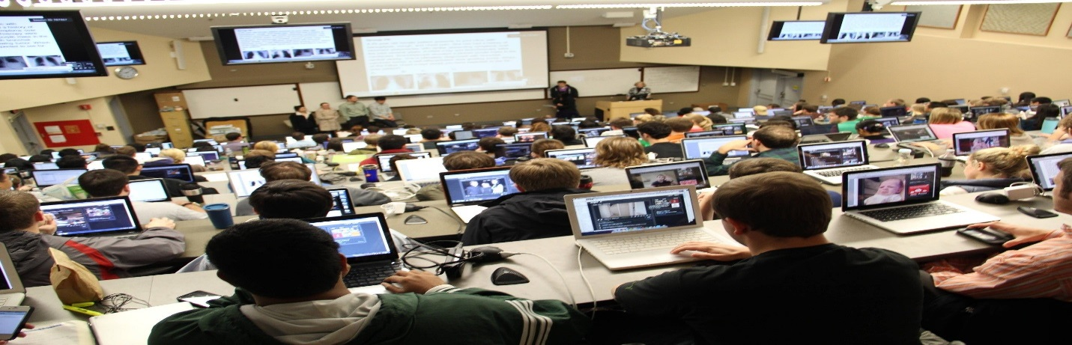
WCCC Sustainability Plan
One College Drive, Calais, Maine 04619

Slide 42
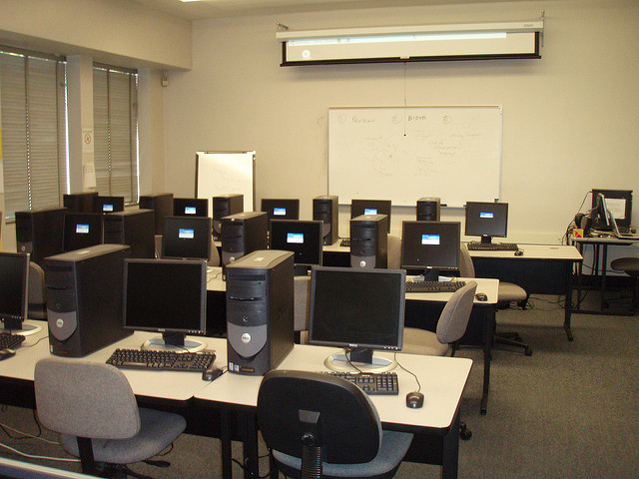
WCCC enhanced IT academic programming
WCCC will continue the program with the 2 faculty it has hired and provide them with professional development opportunities.
WCCC will continue to maintain the IT lab created with TAACCCT funds and encourage faculty to explore the use of OER materials in the classroom.
WCCC will incrementally expand the program with new course offerings such as Web Design and an online Information Technology Essentials course.

Slide 43

WCCC has expanded the number of student navigation staff through grant funding
A total of three student navigators will continue to be available to CTT Program students and the WCCC student body at large as the result of a Gorman grant funded initiative, Early College for ME, and Jobs for Maine Grads (JMG).

Slide 44
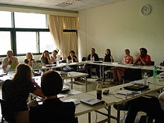
WCCC will continue to work with their employer partners
The faculty, the existing advisory committee members, and the administration plan to continue to support the Advisory Committee by hosting an annual meeting.
The faculty will continue to obtain input from the advisory council in order to inform curriculum revision decisions.

Slide 45
WCCC will continue the use of the following three strategies while developing campus policy
The Accessibility Specialist will continue to work collaboratively with the Instructional Technologist to ensure that all educational materials that are produced on campus comply with all the regulations intended to protect and support persons living with a disability.
The Academic Dean will continue to access labor market information to obtain guidance on policy decisions.
The Academic Dean will continue to work as part of a PLA Team on campus together with faculty and the Coordinator of Enrollment and Student Services to ensure that PLA is implemented on campus.
12/15/2016

Slide 46
Midlands Technical College
Sustaining BOOST Beyond Year 4
_____________________________________________
Curriculum
- Certificates
- Interdisciplinary Education
Health Sciences
Nursing
Corporate and Continuing Education
Associate Degree
Simulation Center
- Expand the size
- Increase the number of beds (from 2 to 6)
- Implement open labs
- Utilize for professional development

Slide 47
Midlands Technical College
Sustaining BOOST Beyond Year 4
___________________________________________
Personnel
- Pre-Health Care Programs Coordinator
- Simulation Technicians
- Faculty
Partnerships
- Midlands Technical College
- Midlands Technical College Foundation
- Lexington Medical
- Providence Hospital
- Palmetto Health Hospital Systems
- First Responders
- Employers
Next Steps
- Follow-up with MTC Foundation
- Transition the responsibilities of the local BOOST
office to the Pre-Health Care Programs Coordinator
- Collect data for reports

Slide 48
What happens after the SVI?

Slide 49
SVI Follow-Up
  Sustainability Affinity Group (immediately)
  Participant Exit Interviews (February)
  Spring 2017 Round 4 SVI (invited presenters)

Slide 50
Round 3 Closeout Webinar Series
  DOL Closeout Webinar
  SkillsCommons Closeout Requirements
  Leveraging TAACCCT for National Initiatives Webinar

Slide 51
Participant Poll
Would you participate in this virtual institute process again?
  Yes
  No
What best describes the timeline process of the SVI?
  Was the right amount of time
  Felt rushed
  Could have been condensed
How useful was it working with a sustainability coach?
  Very useful
  Somewhat useful
  Not useful

Slide 52
Participant Poll
How do you feel about the progress of your sustainability planning?
  Not where we expected to be
  Still have a lot of work to do
  Made considerable progress and feel confident moving forward
How useful was the TAACCCT Sustainability Toolkit in the process?
  What toolkit?
  Very useful
  Somewhat useful
  We didn’t use it during the process

Slide 53
Q&A

Slide 54
Thank You!
Download the new TAACCCT Sustainability Toolkit & Resources on WorkforceGPS
Connect with the NEW TAACCCT Community of Practice and search for TAACCCT resources at:
https://TAACCCT.workforceGPS.org
Ask questions and to connect with peers and resources at TAACCCT@dol.gov
If you want to learn more about peer mentoring email TAACCCT@dol.gov

