Slide 1
Data-Based Decision-Making: Understanding Labor Market Supply and Demographics
Webinar Date: February 25, 2016
Presented by:
U.S. Department of Labor
Employment and Training Administration

Slide 2
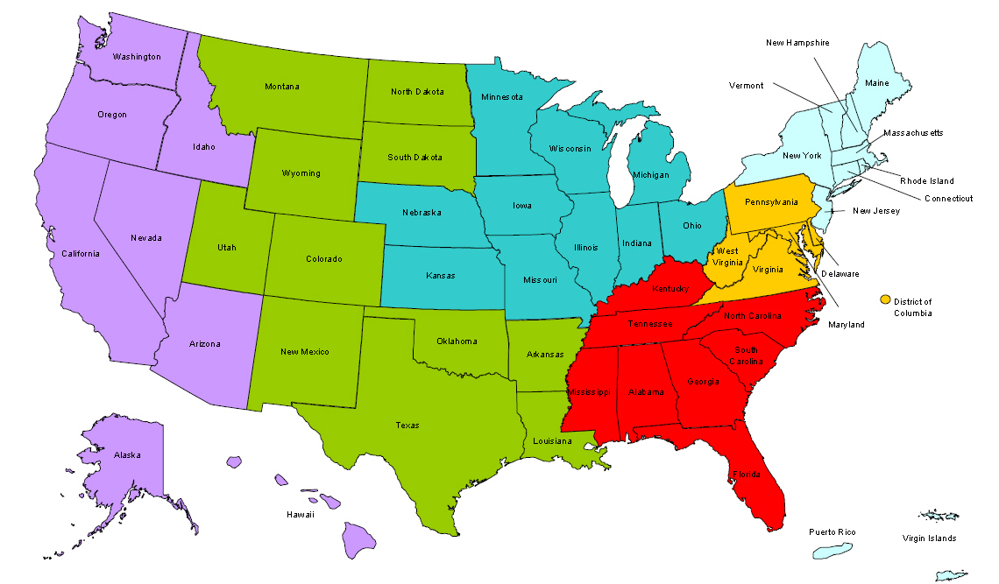
Where are you?
Enter your location in the Chat window – lower left of screen

Slide 3
Today’s Speakers
Moderator: Jeremy Kelley
Title: Senior Program Manager
Organization: Jobs For the Future
Presenter: Erin Sullivan
Title: Program Manager
Organization: World Business Chicago

Slide 4
Agenda
Introduction
Presentation: Erin Sullivan, Program Manager, World Business Chicago
Open Discussion

Slide 5
Title
1000 Jobs for Chicagoland Manufacturing Mapping Labor Supply and Demand February 25, 2016

Slide 6
WBC Mission
World Business Chicago (WBC) is a public-private partnership that:
Drives regional economic growth
Collaborate to create jobs, cultivate talent, and put Chicago at the forefront of the global economy
Engages business and community leaders to advance Chicago’s Plan for Economic Growth and
Convenes and facilitates partnerships among providers to develop new ideas and pilot initiatives.

Slide 7
The Plan for Economic Growth & Jobs
Excel as a leading advanced manufacturing hub
Enhance attractiveness as a center for business services and headquarters
Boost competitiveness as a national leader in transportation and logistics
Brand Chicago a premier destination for tourism and entertainment
Make Chicago a national leader in exports
Create demand-driven and targeted workforce development
Support innovation and entrepreneurship in emerging and mature sectors
Invest to create next-generation infrastructure
Develop and deploy assets in neighborhoods to align with regional economic growth
Create a business environment in which companies can flourish

Slide 8
The Problem
Manufacturers identified the need for support filling the estimated over 20,000 open manufacturing jobs in the Chicagoland area. In addition, with over 23,000 manufacturing workers nearing retirement, manufacturers need to better connect with a sustained pipeline of talent in order to meet current and future demands.
Detailed analysis of the workforce development and placement processes highlighted three major themes as drivers of the gap between supply and demand of manufacturing workforce.
1
2
3
Awareness
Capacity
Coordination
Low awareness, poor perception of manufacturing jobs
Job readiness of some job seekers, for both soft and technical skills
Geography limits access to resources in some areas
Individuals don’t know where to start finding a job, program, or case worker
Career coaching is costly and time consuming
Training programs disconnected from job needs
Placement metrics incentivize prioritizing skilled or easily trained workers
Training/hiring subject to proximity/chance, vs. objective evaluation of program merits
System too complex to navigate, post jobs, secure training funds, find a candidate/ training program
Most manufacturers too small for HR department
Skills of existing pipeline not suited to open jobs
Inconsistent formats limit candidate searchability
Low confidence in ability to find candidate
1000 Jobs was launched in January 2015 to test strategies to address this disconnect be job seekers and potential employment.

Slide 9
1000 Jobs Mission
Place 1000 Chicagoland job seekers on the path to manufacturing careers.
Link residents who need additional skills to training and apprenticeship programs.
Create a more robust pipeline for employers to connect with the skilled talent they require.
Gather and assess data to determine long-term improvements to the workforce-development system to prepare for the continued demands of the manufacturing sector.
1
2
3
Awareness
Capacity
Coordination
Launch awareness and outreach campaign to raise the profile of manufacturing careers, increase number of job candidates, and introduce advanced manufacturing.
Increase the capacity of existing workforce organizations to match candidates to jobs and training programs by adding resources and pooling information among Account Executives.
Drive job seekers, employers, and workforce trainers to centralized touchpoints to more efficiently match candidates to open manufacturing positions.
1
3

Slide 10
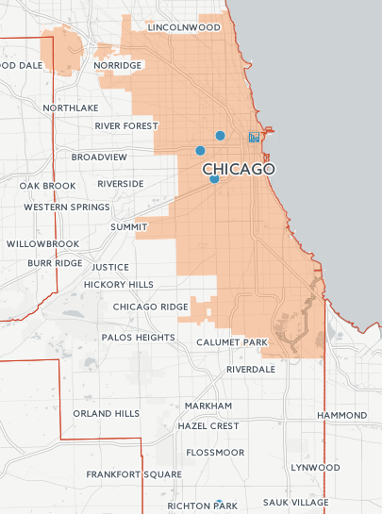
1000 Jobs Program Structure
For job placements, 1000 Jobs partners with 4 leading community-based organizations
Industrial Council of Nearwest Chicago
Instituto de Progresso Latino
(Manufacturing Works)
OAI, Inc.

Slide 11
1000 Jobs Outreach
The Strategy
Raise awareness of the quality and accessibility of careers in manufacturing and available positions through:
Digital & Print Advertising
Grassroots Community Outreach
Driving Media & PR Attention
The Challenges
Geographic dispersity of jobs and candidates
Program serves 7 counties in the Chicago metropolitan statistical area (MSA): Cook, Lake, McHenry, Kane, Dupage, Kendall, and Will
Limited resources to do effective outreach in high impact areas with large concentrations of manufacturers and supply of workers.

Slide 12
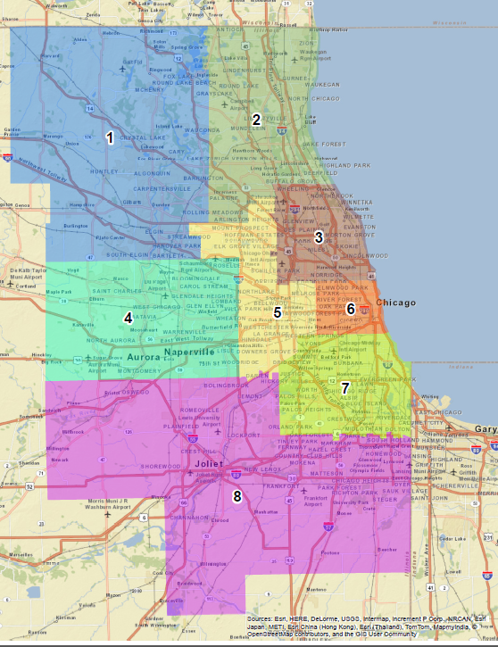
Initial Approach to Mapping
Problem Identified: Need for a more nuanced understanding of labor supply by sector, as indicated by the location of public, private, and nonprofit manufacturing workforce training providers
Vision: Produce a dynamic mapping platform that will help use data from training providers on graduates and types of credentials being offered to help employers, workforce development providers, and public officials target resources and better connect supply of labor to open positions by sector.
Barriers:
Requires buy-in and input from training providers
Using location of training providers limited indication of supply if do not have data on graduates.

Slide 13
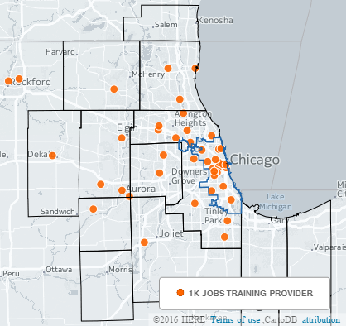
Training Provider Map
Manufacturing Training Providers in 1000 Jobs Target Region
Sources: 1,000 Jobs, County Business Patterns (2013), American Community Survey (2010-2014)
Data Retrieved: 02/18/2016

Slide 14
Using Mapping to Target Outreach

Slide 15
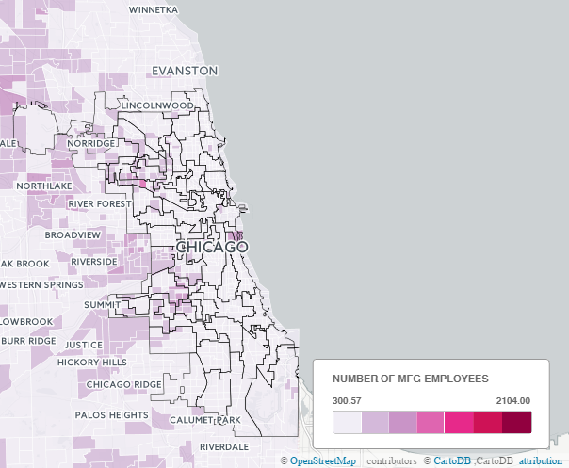
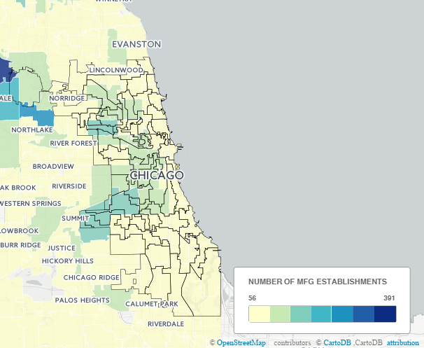
Mapping Manufacturing Concentrations
Number of Manufacturing Employees by Census Tract
Number of Manufacturers by Census Tract
Sources: 1,000 Jobs, County Business Patterns (2013), American Community Survey (2010-2014)
Data Retrieved: 02/18/2016

Slide 16
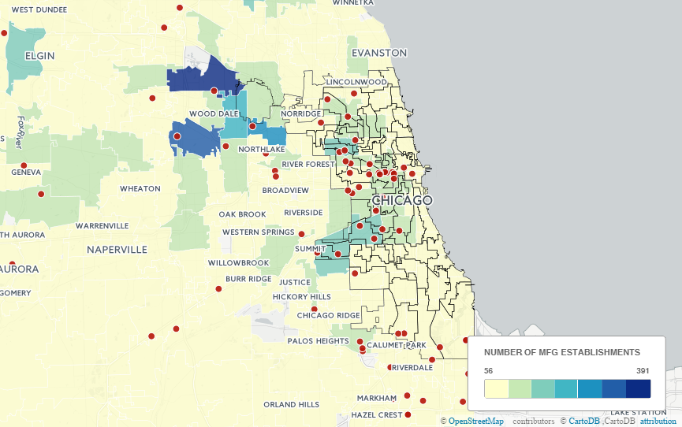
Mapping Gaps in Employer Outreach
1000 Jobs Employers and Concentration of Manufacturing Employers

Slide 17
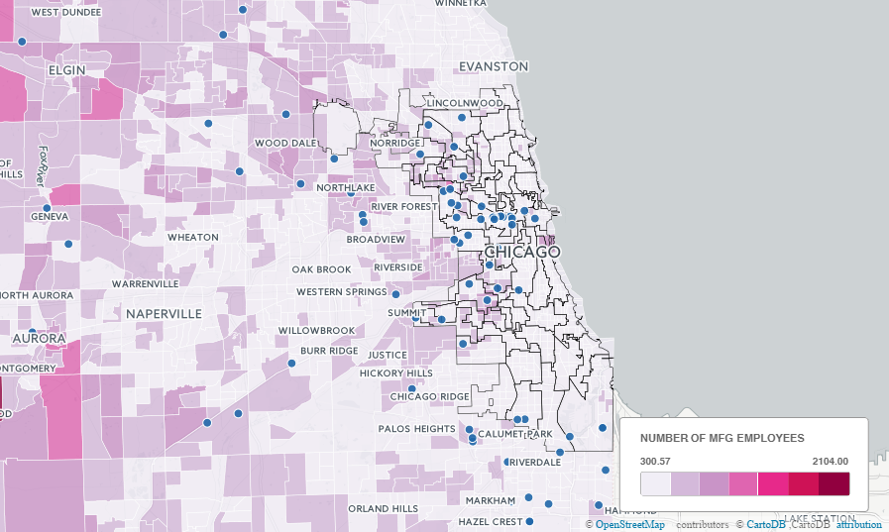
Mapping Gaps in Employer Outreach
1000 Jobs Employers and Concentration of Manufacturing Employees

Slide 18
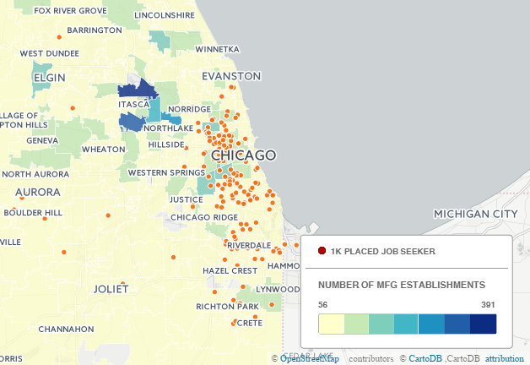
Mapping Gaps in Employer Outreach
1000 Jobs Employers and Concentration of Manufacturing Employees

Slide 19
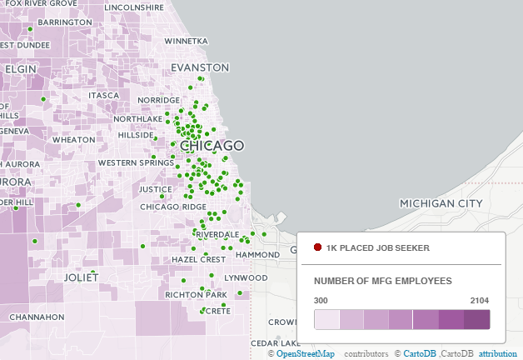
Mapping Gaps in Employer Outreach
1000 Jobs Employers and Concentration of Manufacturing Employees

Slide 20
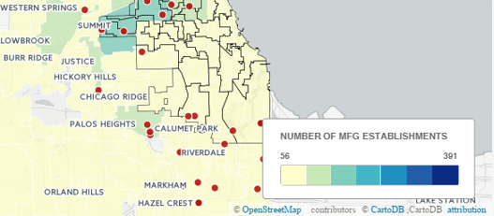
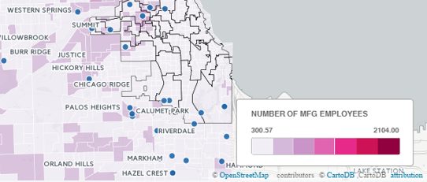
Plans for Using Maps
Plan: Strategically targeting outreach based on gaps in service in high manufacturing areas
1000 Jobs Employers/All Manufacturers
1000 Jobs Employers/Manufacturing Employees

Slide 21
Additional Data to Consider
Additional Layers of Interest
Local Industrial Corridors
Public transit
Additional services
Neighborhood boundaries
Building on process by subsector, ex:
Food manufacturing
Metals
Textiles
Cross-checking findings by average wage information

Slide 22
Programs & Data Used
Data Portals
County Business Patterns (US Census Bureau)
http://www.census.gov/econ/cbp/
American Community Survey (US Census Bureau)
http://www.census.gov/acs/www/data/data-tables-and-tools/
Data Portal: City of Chicago
https://data.cityofchicago.org/
Programs
CartoDB
Geographic Information Systems (GIS)
Google Maps Engine Lite
Internally Collected Data
Surveys
Member/participant data

Slide 23
Questions/Discussion
?

Slide 24
Speakers’ Contact Information
Speaker: Jeremy Kelley
Title: Senior Program Manager
Organization: Jobs For the Future
Email: jkelley@jff.org
Speaker: Erin Sullivan
Title: Program Manager
Organization: World Business Chicago
Email: esullivan@worldbusinesschicago.com

Slide 25
Find resources for workforce system success at:
www.workforce3one.org

