Slide 1
Make A New Year’s Resolution to Save in 2016: Financial Literacy for A Brighter Future!
Enough is Known for Action
Webinar Series
January 14, 2016
11am Pacific/2 pm Eastern

Slide 2
Polling Question:
What are your New Year’s resolutions for 2016?
Learn something new
Stick to a budget
Spend less, save more
Stay fit and healthy
Improve credit score
Lower and get out of debt

Slide 3
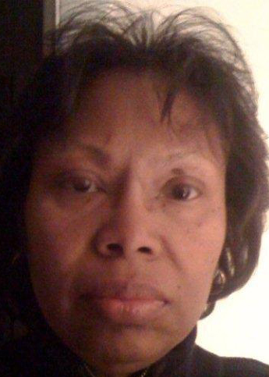
Moderator
Renee Browne
Workforce Development Specialist
Youth Policy and Performance
Division of Youth Services
Office of Workforce Investment
Employment and Training Administration
U.S. Department of Labor
browne.renee@dol.gov

Slide 4
Today’s Agenda
Welcome and overview
WIOA’s focus on financial literacy
America Saves Week and tips on saving
Disability perspective
Q & A

Slide 5
Presenter
Jennifer Kemp
Unit Chief
Youth Policy and Performance
Division of Youth Services
Office of Workforce Investment
Employment and Training Administration
U.S. Department of Labor kemp.jennifer.n@dol.gov

Slide 6
WIOA
WIOA prepares vulnerable youth for successful employment through increasing use of proven service models services.
Local areas must increase percentage of youth formula funds used to serve out-of-school youth to 75% from 30% under WIA.
Local areas must spend at least 20% of youth formula funds on work experience activities such as summer jobs, pre-apprenticeship, on-the-job training, and internships so that youth are prepared for employment.
Eligibility criteria are changed for the youth formula program: In school youth are ages 14-21 and out of school year are ages 16-24.
5 new program elements to the youth formula program.
Additional allowable activities include financial literacy education and entrepreneurial skills training.

Slide 7
Why integrate?
Workforce + Financial Counseling =
Higher average monthly incomes
Higher job placement rates
Higher average salary a year later

Slide 8
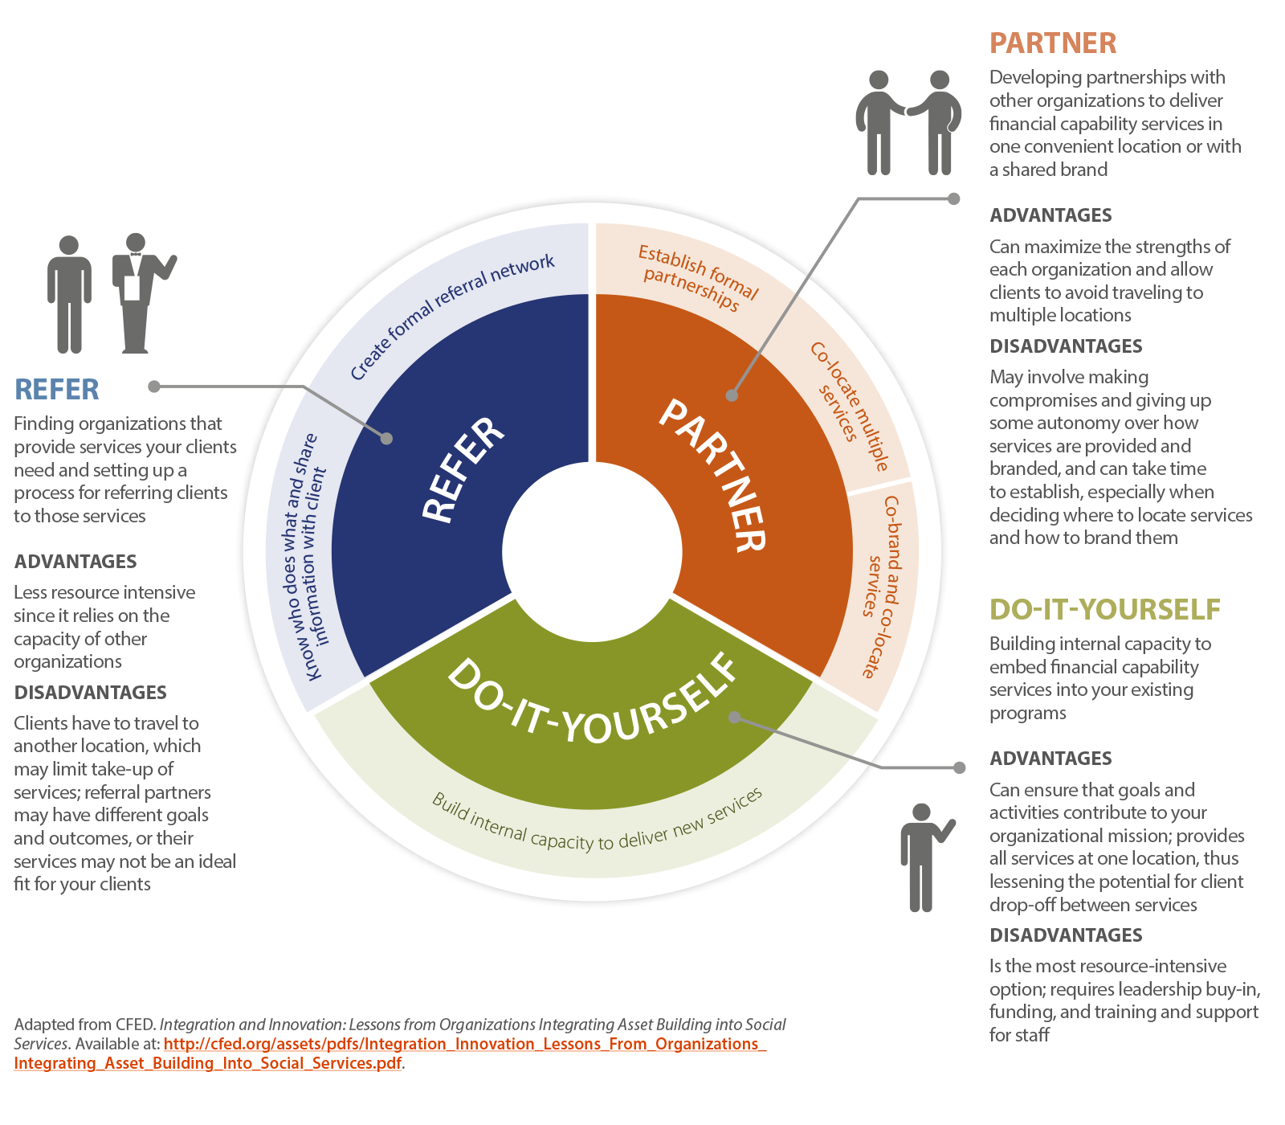
Integration Approaches

Slide 9
Presenter
George Barany
Director of Financial Education
America Saves
gbarany@att.net

Slide 10
About Us
George Barany
Director of Financial Education
America Saves
gbarany@consumerfed.org

Slide 11
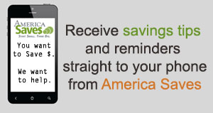
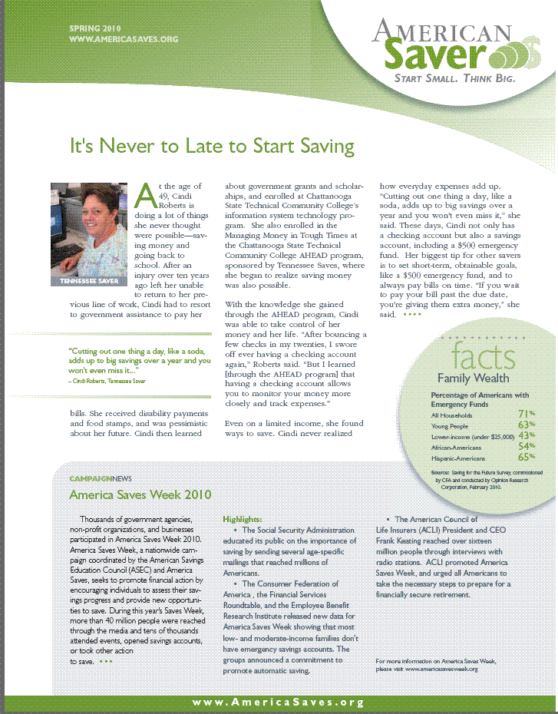
About Us
America Saves is a national campaign that seeks to motivate and support low to moderate income households to save and build wealth.
Text Messages
Newsletters and Emails
AmericaSaves.org
Social Media

Slide 12
Saving is Important
The core of financial management and opportunity.
To meet the expenses of emergencies and avoid utilization of high cost and predatory credit.
To support peace of mind.

Slide 13
Impact of Lack of Savings
Barrier to asset development -CFA study of single women head of households: greatest barrier to asset development – no savings for emergencies.*
Path to increased debt - Repeat payday loans account for 76% of total volume *
Barrier to Peace of Mind - Mental energy and anguish finding money to meet expenses
Contributes to lost productivity - The average employee spends 28 hours each month worried about, calculating, or stressed over finances, costing employers $5,000 a year in lost productivity. *
* CFA Study "Women on Their Own" in Much Worse Financial Condition Than Other Americans, December 2, 2008.
*By Leslie Parrish and Uriah King Center for Responsible Lending July 9, 2009
*The Federal Reserve, 2010

Slide 14
Lack of Emergency Savings
A 2012 survey found that 51% of Americans do not have extra funds (not including lines of credit) available to pay for an unexpected expense of $1,000.
Source: 13th annual holiday spending survey conducted by the Consumer Federation of America (CFA) and the Credit Union National Association (CUNA) - http://www.consumerfed.org/news/615
Notes:
14

Slide 15
People Don’t Think They Can Save: We Need to Change Their Minds
50% of household decision‐makers believe they “just don’t earn enough money to save regularly.”
Majority of those in the under $25,000 (61%) and $25,000‐$49,999 (64%) income brackets feel discouraged from saving for this reason.
$50,000‐$99,999 category, half (50%) feel their income level is a barrier to saving regularly.
And one‐ quarter (26%) in the $100,000 or more category are inclined to believe that their income is insufficient to allow them to save on a regular basis.
2012 HOUSEHOLD FINANCIAL PLANNING SURVEY A Summary of Key Findings July 23, 2012
Prepared for: Certified Financial Planner Board of Standards, Inc. and the Consumer Federation of America
Prepared by: Princeton Survey Research Associates International

Slide 16
Almost Everyone Can Save
Set A Goal – more likely to succeed
Make A Plan – twice more likely to succeed than those who do not*
Save Automatically – pay yourself first
Source: CFA Annual Savings Survey February 17, 2012

Slide 17
America Saves Annual Savings Survey
Having a savings plan with specific goals can have beneficial financial effects, even for lower-income families
 | Have Savings Plan | No Plan
All Families
Spend less than income | 85% | 44%
Sufficient emergency savings | 56% | 43%
Saving enough for retirement | 75% | 24%
Families With Income Under $25,000
Spend less than income | 63% | 30%
Sufficient emergency savings | 69% | 27%
Saving enough for retirement | 37% | 8%
Families With Incomes $25,000-$50,000
Spend less than income | 79% | 57%
Sufficient emergency savings | 79% | 52%
Saving enough for retirement | 63% | 29%

Slide 18
America Saves Surveys of Savers
Savers who joined America Saves in 2011 reported saving $3,000* since joining America Saves
Savers of all income levels reported being able to save – including savers making less than $25,000 who reported saving $500* since joining America Saves.
The most important saving goals for savers include: Debt Repayment, Emergency Fund, and Retirement
Savers tell us that since they joined America Saves they feel more hopeful about their financial situation, they are saving more, and they are managing their debt better
* Median Amount Saved

Slide 19
America Saves Survey of Savers: Accounts
Ongoing Saver Survey 2014

Slide 20
America Saves Survey of Savers: Savings Method
Ongoing Saver Survey 2014
Notes:
d.

Slide 21
Resources For Savers
Monthly Email with Tips and Advice
Quarterly E-News with Information and Stories

Slide 22
Resources For Savers
Goal-based texting tips & reminders encourages continued saving.
Text Examples:
America Saves: With each savings deposit, you are one step closer to getting out of debt. Have you made your deposit this month? Reply YES or NO.
America Saves: Need to pay off debt from last holiday? Pay off debt with double-digit interest rates. http://bit.ly/14j3CkX
America Saves: Once a month, use records to review what you've purchased. Reallocate some of this spending to emergency savings.
America Saves: Want to deck your own halls this holiday season? You can afford a home if you make a savings plan. http://bit.ly/18johZu

Slide 23
Resources For Savers
Website and Social Media:
-website provides savings resources and links
-social media keeps savers engaged

Slide 24
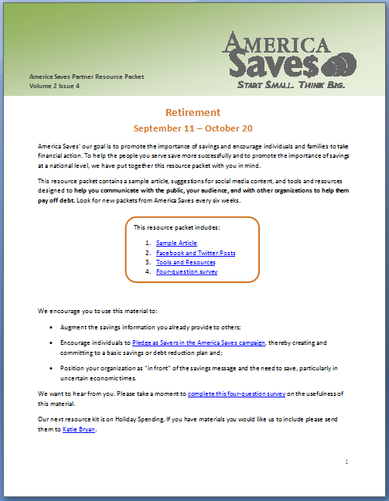
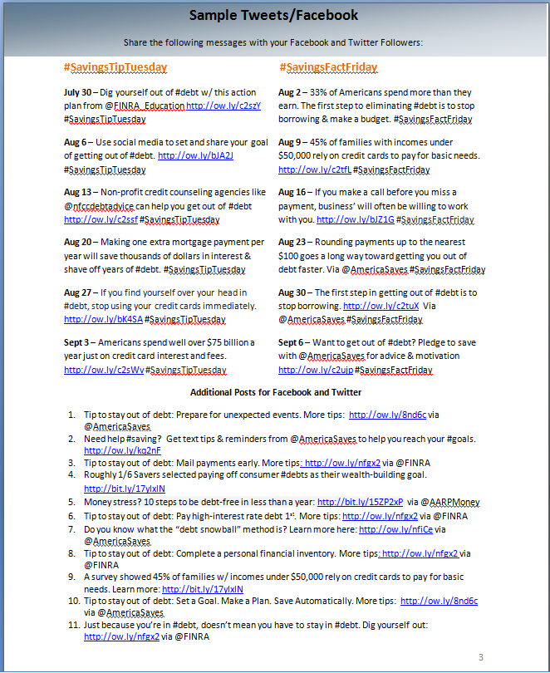
Resources for Organizations

Slide 25
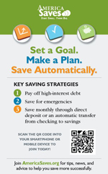
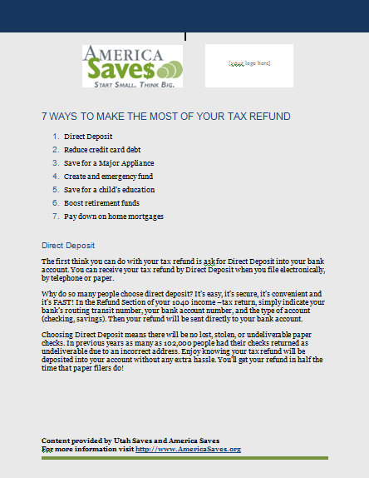
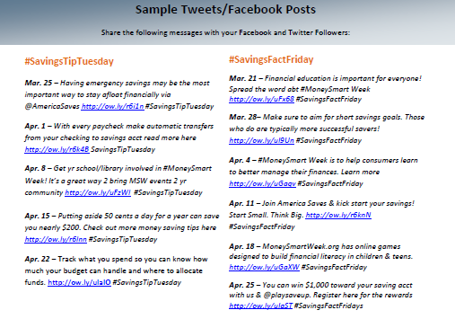
Resources for Organizations Free Materials & Support
Posters and fliers
for statement envelopes
to put in branches
Content for websites, newsletters, and social media
Sample press releases
PowerPoint presentations

Slide 26
Resources for Organizations
Info We Share With You:
# people pledged
Zip code
Referral source
Savings goals
Amount pledged (total and median)

Slide 27
Partner Resource Packets
Money Smart Week
March 17 – May 4
Saving for Emergencies
May 5 – June 15
Credit & Debt
June 16 – July 27
Saving for College
July 28 – Sept. 7
Retirement
Sept. 8 – October 19
Holiday Spending & Saving
October 20 – November 30
Visit AmericaSaves.org and click the “For Organizations” tab to sign up to receive our packets

Slide 28
America Saves Week
Co-coordinated by America Saves and the American Savings Education Council
An annual opportunity for Americans to assess their financial condition and goals
A dedicated time for financial action
A time for organizations and institutions to emphasize Saving
February 23 – February 28, 2015

Slide 29
America Saves Week
America Saves - Holly Petraeus of the Consumer Financial Protection Bureau talks about the need to save

Slide 30
America Saves Week 2014 Results
The largest organization participation to date: over 2,000 organizations signed up across 48 states
Media reach of over 35 million people
Employers reached 179,898 employees with savings messages
245,200 people were reached through Financial Counseling and Workshops
Over 129,000 people were reached through tax site outreach
Over 33,000 people making a savings commitment with a goal and plan by joining America Saves
Almost $40 million in committed savings

Slide 31
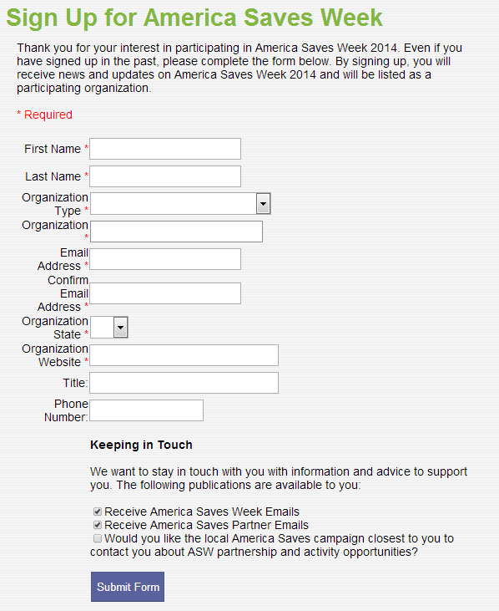
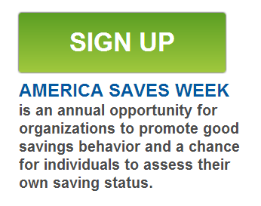
How Organizations Can Participate in America Saves Week 2015
STEP 1:
AmericaSavesWeek.org

Slide 32
How Organizations Can Participate in America Saves Week 2015
STEP 2:
Plan Activities
Sign Up Savers
Create Your Own Materials
Host an Event
Spread the Word
Share Savings Messages through Social Media
Contact the Media
Work with Local Government
Hold a Competition
AmericaSavesWeek.org

Slide 33
How Organizations Can Participate in America Saves Week 2016
STEP 3:
Download Materials
Flyers, Poster, & Payroll Stuffers
Logos, Web Buttons, and Banners
Social Media Kit
QR Code
Sample Newsletter, Email, and Blog Content
Sample Press Release
Sample Proclamation
PowerPoint Presentations
AmericaSavesWeek.org

Slide 34
How Organizations Can Participate in America Saves Week 2015
FINANCIAL ACTION
Financial action most effective when provided at a point in time when people feel that the information is relevant to their lives.

Slide 35
How Organizations Can Participate in America Saves Week 2015
POPULATION
50% age 16 – 24 are unbanked or underbanked.
Check cashing in Chicago.

Slide 36
America Saves for Young Workers
Having Youth Save Effectively and Automatically

Slide 37
What We Do
Show youth how to save:
By using a pledge for a goal of their choice
By signing up for direct deposit
By opening accounts with financial institutions and setting up automatic savings
Support youth to save:
Information and resources
Reminders through text messages and emails
Opportunities such as VITA Tax prep & Save Your Refund

Slide 38
America Saves for Young Workers video testimony
America Saves Youth in Chicago talk about savings and personal finance

Slide 39
Summer 2015
Chicago, St. Louis, Cleveland, Milwaukee, Houston, Washington, DC, Indianapolis, New York, Miami
23,262 youth employees reached through the ASYW Program
21,744 opting to use direct deposit
4,480 new savings and 4,886 new checking accounts opened
1,293 opened checking with linked savings accounts
12,335 youth pledged to save through America Saves a total of $5,657,980 over a 7 month period.

Slide 40
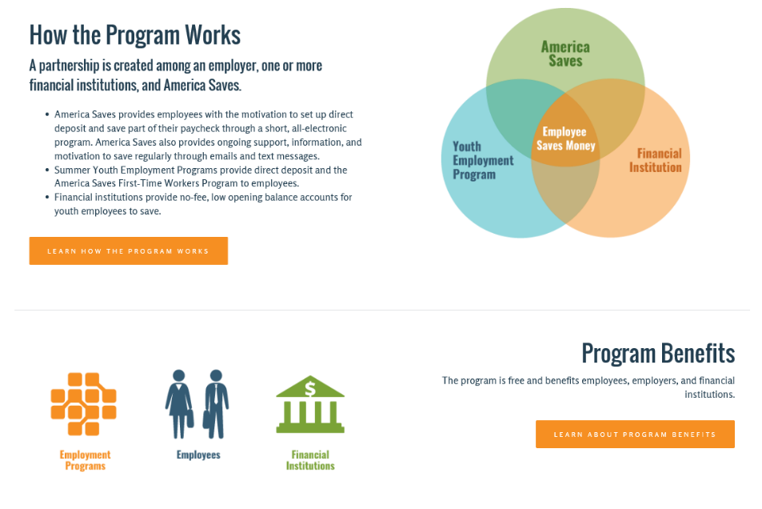
How the Program Works

Slide 41
America Saves for Young Workers

Slide 42
America Saves for Young Workers is positively impacting teen savings
Direct Deposit
Savings and Savings Accounts
America Saves Communication
Teens made use of Direct Deposit tools this summer, and continue to do so now
Teen exposure to the America Saves program continues to increase their savings, with most expecting to maintain their savings habits in the future
Teens are recognizing, and remembering, the communications they are receiving from America Saves
are aware of the America Saves
emails they are currently receiving, indicating the teens are paying attention when they receive them.
Half of teens find the content of the emails very helpful.
60% of teens
41%
88%
91% of teens
with a
choice in
how they were paid this summer, chose direct deposit.
of teens who didn’t have a savings account prior to summer employment, set one up when they started their summer job.
of teens are still saving after the summer program.
8 in 10 teens expect to maintain or increase their level of savings in the next three months.

Slide 43
America Saves for Young Workers
ASYW Program to interested organizations including: technical assistance, training for program staff, support in securing financial institution partners, real time data, materials and resources.
For youth: America Saves will provide on going support, motivation and resources through emails and text messages including Tax Time information and Save your Refund opportunity.
Contact: George Barany gbarany@consumerfed.org
Lee Davenport ldavenport@consumerfed.org

Slide 44
Polling Question:
What are the saving needs of youth in workforce development programs?
Emergency funds
Consumer goods such as electronics, autos, etc.
College or other education expenses
Rent for an apartment or money to buy a home
Long term goals such as retirement, investment
Other

Slide 45
Michael Morris Executive Director National Disability Institute Co-Director Disability Employment Initiative (DEI) Training and TA Team Co-Chair Public Policy Team LEAD Center
Presenter

Slide 46
LEAD
The National Center on Leadership for the Employment and Economic Advancement of People with Disabilities (LEAD) is a collaborative of disability, workforce and economic empowerment organizations led by National Disability Institute with funding from the U.S. Department of Labor’s Office of Disability Employment Policy, Grant No. #OD-23863-12-75-4-11.
This document does not necessarily reflect the views or policies of the U.S. Department of Labor’s Office of Disability Employment Policy, nor does the mention of trade names, commercial products, or organizations imply endorsement by the U.S. Government.

Slide 47
Disability Employment Initiative
Since 2010, the US Department of Labor (DOL) has awarded over $109 million to forty-three projects within twenty-seven states under the Disability Employment Initiative (DEI) to improve education, training, and employment outcomes of youth and adults with disabilities.
The DEI is jointly funded and administered by the DOL’s Employment and Training Administration (ETA) and the Office of Disability Employment Policy (ODEP).

Slide 48
Disability Employment Initiative
Starting in 2014, DEI grantees will increase the participation of adults and youth with disabilities (including individuals with significant disabilities) in existing career pathway systems and programs in the public workforce system in partnership with community colleges and other education partners, human services, businesses, and other partners.
Training and Technical Assistance to DEI Projects is provided under U.S. DOLETA contract with NDI Consulting, Inc. and the National Disability Institute (NDI).

Slide 49
What We Do
National Disability Institute
Advancing financial capability, inclusion, and economic self-sufficiency
Changing thinking and behavior at systems and individual level (policy and practice)
Conducting research, training, technical assistance, and knowledge translation activities

Slide 50
What We Know About People With Disabilities
Disability in America cuts across the dividing lines of gender, race, ethnicity, and age. The most common characteristic across these dividing lines is living at or below poverty and trying to make ends meet.

Slide 51
What We Know: Type of Disability
There are 20 million working age adults with disabilities (ages 16-64)
Difficulty Seeing: 13.9%
Difficulty Hearing: 11.2%
Difficulty with Speech: 5.9%
Difficulty Walking 39.9%
Learning Disability: 9.9%
Mental Health: 22.2%
Developmental Disability: 5.6%

Slide 52
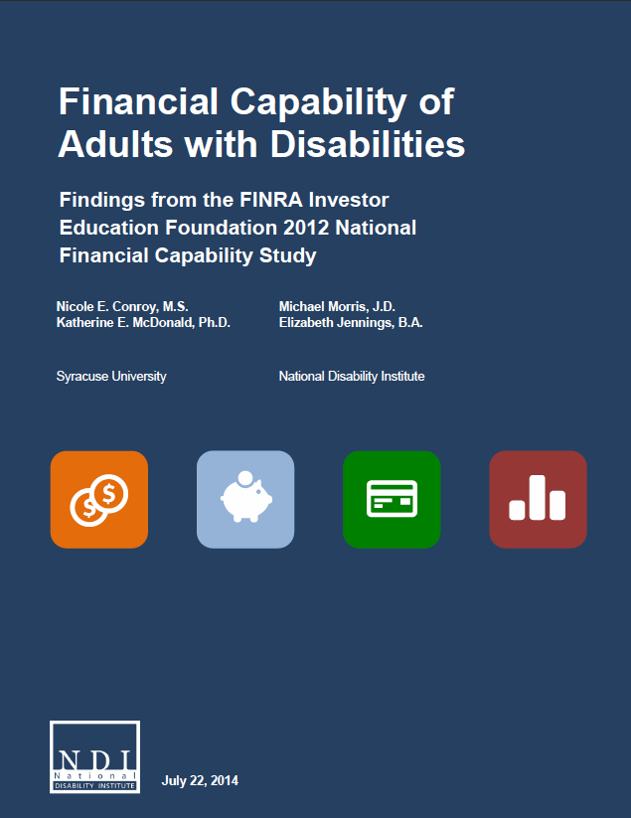
Financial Capability Research
Financial Capability of Adults with Disabilities Findings from the FINRA Investor Education Foundation 2012 National Financial Capability Study

Slide 53
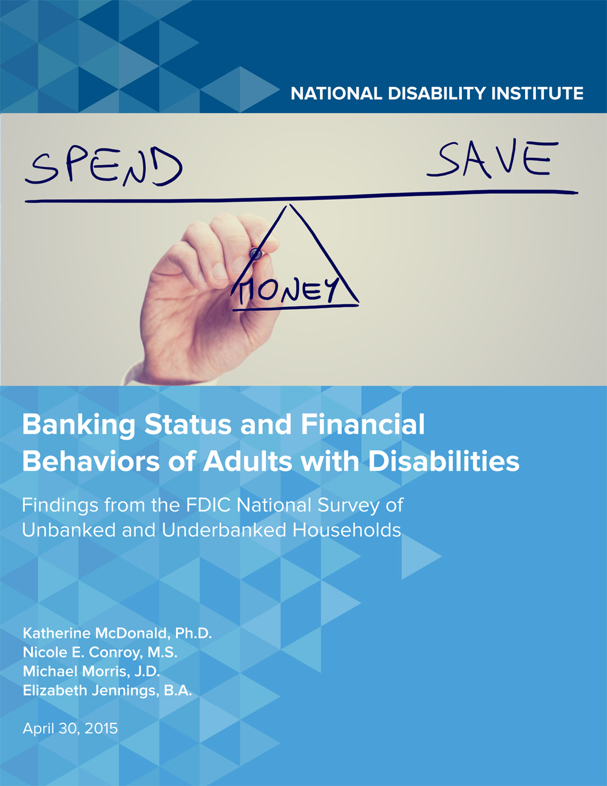
NDI Study of Banking Status of Adults with Disabilities
Banking Status and Financial Behaviors of Adults with Disabilities Findings from the FDIC National Survey of Unbanked and Underbanked Households

Slide 54
What Did We Learn
Over 8.9 million households headed by a working age adult with a disability is unbanked or underbanked.
Almost one in two working age adults with disabilities are unbanked or underbanked.

Slide 55
Comparison
7.7 percent of US households were unbanked in 2013
18.4 percent of US households headed by a person with a disability were unbanked
20 percent of US households were underbanked in 2013
28.1 percent of US households headed by a person with a disability were underbanked

Slide 56
Major Findings
Checking and Savings Account Ownership and Automatic Transfers
• Less likely to have both checking and savings accounts
• Less likely to have a savings account
• More likely to use direct deposit/automatic transfer

Slide 57
Major Findings
Alternative Financial Services
• More likely to have ever used alternative financial services
• More likely to use transaction and credit alternative financial services
• More likely to use more than one alternative financial service

Slide 58
Focus
WIOA and Financial Literacy
Relationship Between Financial Literacy and Employment
From Promise to Practice

Slide 59
WIOA (P.L. 133-128)
Purpose Statement
Increase employment, retention, and earnings
Increase economic self-sufficiency

Slide 60
WIOA (P.L. 133-128)
Employment with career pathways is critical to attaining a stronger economic future for American workers.
The development of financial capability strategies and financial literacy skills are vital in order for employment to increase self-sufficiency and promote financial security.

Slide 61
Definition of Financial Literacy in
WIOA Section 129(b)(2)(D)
Support the ability of participants to:
Create budgets.
Manage spending, credit, and debt effectively
Initiate savings plans.
Make informed financial decisions.
Understand, evaluate and compare financial products and services.
Understand credit scores and how to correct inaccuracies.

Slide 62
Definition of Financial Literacy in
WIOA and WIOA NPRM
WIOA-- §129(b)(2)(D)-Use of funds for youth workforce investment activities. | NPRM-- §681.500-Youth Activities Under Title I, What is financial literacy education?
(i) supporting the ability of participants to create household budgets, initiate savings plans, and make informed financial decisions about education, retirement, home ownership, wealth building, or other savings goals; | (a) Support the ability of participants to create budgets, initiate checking and savings accounts at banks, and make informed financial decisions;
(ii) supporting the ability to manage spending, credit, and debt, including credit card debt, effectively; | (b) Support participants in learning how to effectively manage spending, credit, and debt, including student loans, consumer credit, and credit cards;
(iii) increasing awareness of the availability and significance of credit reports and credit scores in obtaining credit, including determining their accuracy (and how to correct inaccuracies in the reports and scores), and their effect on credit terms; | (c) Teach participants about the significance of credit reports and credit scores; what their rights are regarding their credit and financial information; how to determine the accuracy of a credit report and how to correct inaccuracies; and how to improve or maintain good credit;

Slide 63
Definition of Financial Literacy in
WIOA and WIOA NPRM
WIOA-- §129(b)(2)(D)-Use of funds for youth workforce investment activities. | NPRM-- §681.500-Youth Activities Under Title I, What is financial literacy education?
(iv) supporting the ability to understand, evaluate, and compare financial products, services, and opportunities; and | (d)Support a participant’s ability to understand, evaluate, and compare financial products, services, and opportunities and to make informed financial decisions;
 | (e) Educate participants about identity theft, ways to protect themselves from identify theft, and how to resolve cases of identity theft and in other ways understand their rights and protections related to personal identity and financial data;
(v) supporting activities that address the particular financial literacy needs of non-English speakers, including providing the support through the development and distribution of multilingual financial literacy and education materials; and | (f)Support activities that address the particular financial literacy needs of non-English speakers, including providing the support through the development and distribution of multilingual financial literacy and education materials;

Slide 64
Definition of Financial Literacy in
WIOA and WIOA NPRM
WIOA-- §129(b)(2)(D)-Use of funds for youth workforce investment activities. | NPRM-- §681.500-Youth Activities Under Title I, What is financial literacy education?
 | (g)Provide financial education that is age appropriate, timely, and provides opportunities to put lessons into practice, such as by access to safe and affordable financial products that enable money management and savings; and
 | (h)Implement other approaches to help participants gain the knowledge, skills, and confidence to make informed financial decisions that enable them to attain greater financial health and stability by using high quality, age-appropriate, and relevant strategies and channels, including, where possible, timely and customized information, guidance, tools, and instruction.

Slide 65
From Promise to Practice
State and Local Plan Development
The unified state plan could include state-wide financial literacy activities in the description of how the state intends to use set aside funds at the governor’s level.
Local plan could describe how a comprehensive set of financial literacy education and support services will be provided to youth and to adult participants.

Slide 66
From Promise to Practice
Service Delivery – Adults
Financial literacy services is one of 11 specific services to be provided to adults “if determined to be appropriate in order for an individual to obtain or retain employment.” Section 134(c)(2)(A)
Service Delivery – Youth
Financial literacy education is one of 15 elements youth programs must provide “in order to support the attainment of a high school diploma, entry into postsecondary education, and career readiness” for youth participants. Section 129(c)(2)

Slide 67
From Promise to Practice
Workforce Board Engagement
Create at the state workforce board level a working group on financial literacy.
Create at the area workforce board level a working group on financial literacy.
Involve financial institutions, asset building coalitions, state treasurers’ offices, and mayors’ offices on financial empowerment.

Slide 68
From Promise to Practice
Create inclusive financial literacy activities
Materials available in alternative formats
Accessible website with all pictures and graphs tagged and videos captioned
Offer individual training in addition to group classes
Offer peer support and/or mentors
Utilize disability community partners for sensitivity and accessibility training for your staff

Slide 69
From Promise to Practice
Integrating Financial Capability and Asset Building Strategies into the Public Workforce Development System
July 2015
Integrating financial health assessment into intake process at AJCs.
Offering financial education classes at AJCs.
Offering free tax preparation assistance and becoming a VITA site.
Offering financial coaching.
Referring participants to existing community services.

Slide 70
Louisville Workforce Development & Financial Empowerment Collaborative
Demonstration in Kentucky

Slide 71
Workforce Development/Financial Empowerment Collaborative Workgroup
Louisville Metro Community Services Center For Accessible Living
Goodwill Industries
Jewish Family & Career Services
KentuckianaWorks
Kentucky Office for the Blind
Kentucky Office of Employment & Training
Kentucky Office of Vocational Rehab
Louisville Metro Community Services
Office for Aging and Disabled Citizen
Options Unlimited
ResCare
Zoom Group
Bank On Louisville
Federal Reserve Bank
Fifth Third Bank
Old National Bank
PNC Bank
Republic Bank
US Bank
Chase Bank
BB&T
United Way
Community Action Partnership (CAP)

Slide 72
Workforce Development/Financial Empowerment Collaborative Workgroup
The purpose of this collaborative is to:
Identify opportunities for universally designed services and supports that advance financial capability related to employment goals and
Improve positive financial behavior for individuals with disabilities.
Particularly those who use the workforce system

Slide 73
Workforce Development/Financial Empowerment Collaborative Workgroup
Integration of Financial Capability and Human and Social Services Delivery
Creation and Refinement of an Inclusive Model in Bank On Louisville
Community Financial Empowerment Certification and Training program
https://louisvilleky.gov/government/community-services/community-financial-empowerment-certification

Slide 74
Resources
Financial Health Assessment Tool
Aids service providers in engaging clients in financial empowerment services and developing strategies to address financial issues.
Louisville Community Financial Empowerment Resource & Referral Guide
Lists organizations offering financial empowerment related services to the Louisville community
Kentucky Disability & Accessibility Resource & Referral Guide
Lists organizations offering disability related services to the Louisville community
Financial Empowerment Information cards including information on:
Credit,
The dangers of relying on check cashing services,
Myths related to working while receiving social security benefits, and
Ways to maximize income through saving and financial education

Slide 76
Financial Capability in Hip Hop Genre
Interview: NDI and 4 Wheel City
Google Play link
iTunes link
Amazon link (with preview)

Slide 77
“Mainstream”
4 Wheel City lyrics
GOOD MORNING AMERICA,
LET’S TALK ABOUT THE MONEY, LET’S TALK ABOUT THIS CASH.
CHORUS: I CAN WORK I CAN DREAM I CAN BE SO MAINSTREAM/ I CAN WORK I CAN DREAM I CAN BE SO MAINSTREAM/ I CAN WORK I CAN DREAM I CAN BE SO MAINSTREAM/

Slide 78
“Mainstream”
4 Wheel City lyrics
SURVIVAL IS MY REALITY SO DON'T WANT YOUR PITY OR YOUR CHARITY/ I'M WORTHY AND ABLE TO BECOME FINANCIALLY STABLE/ LOOK POVERTY IS NO VANITY ITS A DON'T MESS WITH ME PROFANITY/
SO NO MORE BENJAMINS FROM THE PAWN SHOP/ BANK OF AMERICA MY FIRST STOP/ SO COUNT ME IN COUNT ME UP / LAND OF THE FREE LOTS OF LUCK /
WE NEED MORE BREAD TO GET AHEAD CAUSE THIS STATUS QUO IS LIKE BEING DEAD SO EXTEND ME CREDIT GIVE ME A CHANCE I’M READY TO DO THE MONEY DANCE/ I’M READY TO DO THE MONEY DANCE/

Slide 79
Hip Hop on Financial Capability
“Mainstream”
4 Wheel City

Slide 80
From Promise to Practice
Additional Resources
Employee Benefits Security Administration (EBSA)
Savings Fitness: A Guide to Your Money and Your Financial Future
Federal Deposit Insurance Corporation (FDIC)
Money Smart
National Disability Institute
Financial Education
CFPB
Your Money Your Goals

Slide 81
Questions and Answers

Slide 82
ION Commercial

Slide 83
Other Resources
Building Financial Capability in Workforce Programs
Link to the series: https://www.workforce3one.org/view/5001601238457538075/info
Part 1: Financial Capability Integration in Workforce Programs: https://www.workforce3one.org/view/3001528739466961987
Part 2: Envisioning Your Clients’ Financial Capability: https://www.workforce3one.org/view/3001528739641699299
Part 3: Building the Team: https://www.workforce3one.org/view/3001528739715426370
Part 4: Moving Into Action: https://www.workforce3one.org/view/3001528739780812063
Part 5: Making the Case: https://www.workforce3one.org/view/3001528739848323635

Slide 84
Contacts
Jennifer Kemp kemp.jennifer.n@dol.gov
George Barany gbarany@consumerfed.org
Michael Morris mmorris@ndi-inc.org

Slide 85
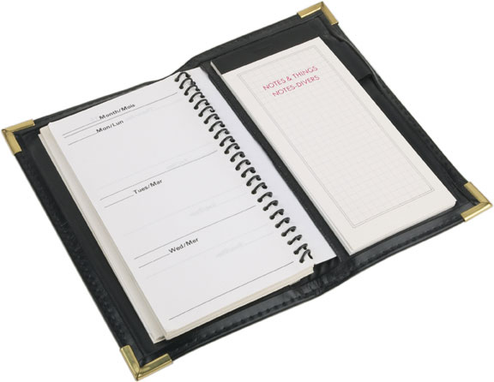
Upcoming Webinars
Past webinar recordings on Workforce3one.org
TANF Partnerships
October 28th – 2:00pm EDT
System-Involved Youth December 16th- 2:00pm EDT

Slide 86
Input on Future Webinar Topics
Please let us know what topics would be of interest and importance to you and your local areas for future webinars in 2016.

Slide 87
Implementing WIOA in Rural Areas
Thank You!

