Slide 1
WIOA at Two Years
Continuing the Conversation
WIOA Federal Interagency Partners
07/19/16

Slide 3
Polls – Tell us who you are
Federal
State
Local
Labor and Workforce
Adult Education
Vocational Rehabilitation
TANF
Other

Slide 4
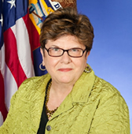
Today’s Moderator
Gerri Fiala, Deputy Assistant Secretary, Employment and Training Administration, U.S. Department of Labor

Slide 5
Who’s read what so far?
I’ve read all 5 rules and the title-specific rule for my program once, and I’m starting on a second reading.
Yes, I read the joint rule cover to cover, but I’m still digesting the content.
I have reviewed the provisions of most interest to me.
So far, I’ve managed to find the final rules on the website.

Slide 6
Susan Golonka, Acting Director of the Office of Family Assistance, Administration for Children & Families, U.S. Department of Health & Human Services
Janet LaBreck, Commissioner, Rehabilitation Services Administration, Office of Special Education and Rehabilitative Services, U.S. Department of Education
Sue Swenson, Acting Assistant Secretary, Office of Special Education and Rehabilitative Services, U.S. Department of Education

Slide 7
Johan E. Uvin, Acting Assistant Secretary, Office of Career, Technical, and Adult Education, U.S. Department of Education
Portia Wu, Assistant Secretary, Employment and Training Administration, U.S. Department of Labor

Slide 8
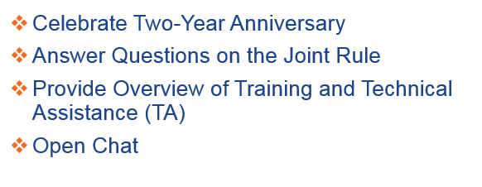
Celebrate Two-Year Anniversary
Answer Questions on the Joint Rule
Provide Overview of Training and Technical Assistance (TA)
Open Chat

Slide 9
Happy Anniversary!

Slide 10
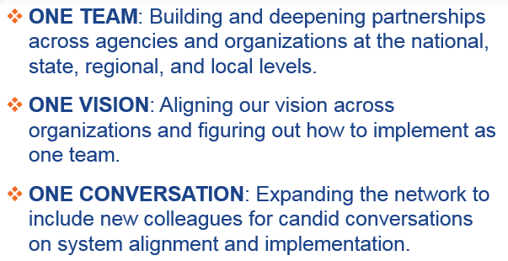
What We’ve All Been Up To…
ONE TEAM: Building and deepening partnerships across agencies and organizations at the national, state, regional, and local levels.
ONE VISION: Aligning our vision across organizations and figuring out how to implement as one team.
ONE CONVERSATION: Expanding the network to include new colleagues for candid conversations on system alignment and implementation.

Slide 11
Rate your team on its cross-agency coordination and readiness to meet the future.
We are fully coordinated and having regular meetings and communications.
We are somewhat coordinated and have semi-regular meetings and communications.
We are not coordinated at all but we know each other.
Just starting to coordinate and work together.

Slide 12
What areas of the regulations are generating the most questions for you?
OPEN CHAT

Slide 13
Big Questions
Why WIOA Matters
One-Stop Competition
One-Stop Infrastructure
Accessibility of American Job Centers
Career Pathways & Sector Strategies
Performance Questions
Joint Final Rule

Slide 14
Why WIOA Matters
How is WIOA ensuring that job seekers are prepared for the employment opportunities emerging from the recent economic recovery?

Slide 15
One-Stop Competition
One-Stop operator competitive procurement may be a challenge for States and local areas. How might we help the States, and, in turn, help local areas meet this requirement?

Slide 16
One-Stop Infrastructure
What are some of the opportunities to developing an equitable One-Stop infrastructure strategy?

Slide 17
Accessibility of American Job Centers (AJCs)
Each state must develop standards for evaluation of AJC physical and programmatic accessibility. Will there be more guidance that helps create more consistency among state standards?

Slide 18
Career Pathways & Sector Strategies
How does WIOA specifically support the development and sustainability of career pathways and sector partnerships?

Slide 19
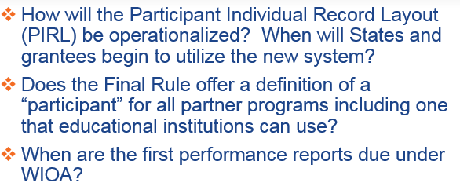
Performance Questions
How will the Participant Individual Record Layout (PIRL) be operationalized? When will States and grantees begin to utilize the new system?
Does the Final Rule offer a definition of a “participant” for all partner programs including one that educational institutions can use?
When are the first performance reports due under WIOA?

Slide 20
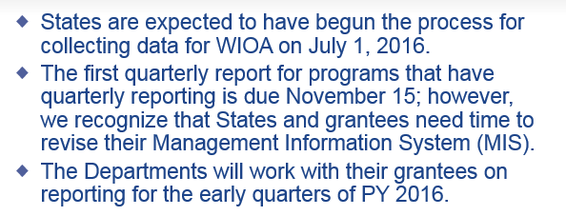
When are the first performance reports due under WIOA?
States are expected to have begun the process for collecting data for WIOA on July 1, 2016.
The first quarterly report for programs that have quarterly reporting is due November 15; however, we recognize that States and grantees need time to revise their Management Information System (MIS).
The Departments will work with their grantees on reporting for the early quarters of PY 2016.

Slide 21
Final Rule
I want to print the version of the WIOA Joint Final Rule from the Website, but it is too long.
https://ion.workforcegps.org/

Slide 22
1 Team, 1 Location
Is there a dedicated website to pull all the required partner information together in one location? It would go a long way in tearing down the barriers between agencies if all the WIOA information was on a dedicated website.

Slide 23
https://ion.workforcegps.org/

Slide 24
Have you used the resources on ION?
Not yet, but I plan to.
I did take a peek once, and I will go again soon.
I use it regularly to find great WIOA resources!
ION is great! I’m on it daily.

Slide 25
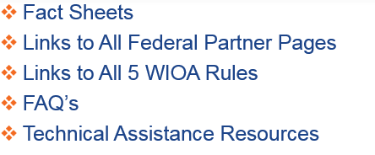
What’s On ION?
Fact Sheets
Links to All Federal Partner Pages
Links to All 5 WIOA Rules
FAQ’s
Technical Assistance Resources

Slide 26
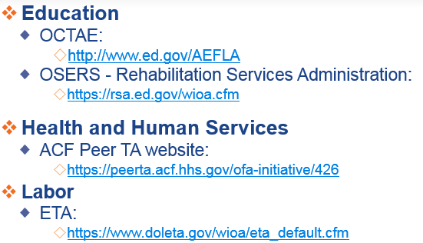
WIOA Resource Pages
Education
OCTAE:
http://www.ed.gov/AEFLA
OSERS - Rehabilitation Services Administration:
https://rsa.ed.gov/wioa.cfm
Health and Human Services
ACF Peer TA website:
https://peerta.acf.hhs.gov/ofa-initiative/426
Labor
ETA:
https://www.doleta.gov/wioa/eta_default.cfm

Slide 27
Sample of Joint TA Calendar
Dates | Event
July 19 | Two-Year Anniversary (Webinar)
August 9 | OSERS/RSA Regional Training Meeting (In-Person)
August 30 – September 1 | Annual State Directors of Adult Education Conference (In-Person)
September 21 | Paying for the One-Stop Delivery System (Joint Webinar)
September 27-29 | NASWA Annual Meeting (In-Person)
November 5-9 | CSAVR Fall Conference: OSERS/RSA Presentations on VR Regulations Conference (In-Person)

Slide 28
Performance Accountability
Eligible Training Provider List and Reporting
Governance
One-Stop Operations
Enhancing Services for Individuals with Barriers to Employment
Career Pathways and Sector Strategies
Work-Based Learning
State Plans

Slide 29
How do you want to receive TA?
Written Guidance
Webinars or Other Virtual Methods
In-Person Training Events
Peer-to-Peer Sharing
Other?

Slide 30
What do you believe is the most important next step in support of WIOA implementation? And who needs to take that step?
OPEN CHAT

Slide 31
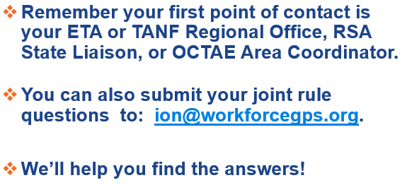
Still Have Questions?
Remember your first point of contact is your ETA or TANF Regional Office, RSA State Liaison, or OCTAE Area Coordinator.
You can also submit your joint rule questions to: ion@workforcegps.org.
We’ll help you find the answers!

Slide 32
Let’s keep the conversation going!

