Slide 2
Implementation of Fiscal Year 2016 RESEA Grants
Office of Unemployment Insurance
Employment and Training Administration
U.S Department of Labor

Slide 4
Gay m. Gilbert
Administrator
Office of Unemployment Insurance
Employment and Training Administration
U.S. Department of Labor
Betty Castillo
Chief
Division of UI Operations
Employment and Training Administration
U.S. Department of Labor
Lawrence Burns
Reemployment Program Coordinator
Division of UI Operations
Employment and Training Administration
U.S. Department of Labor

Slide 5
Ann Astin
RESEA Program Coordinator
Division of Employment and Training
Wisconsin Department of Workforce Development
Kristine Porter
Bureau Director, Job Service
Division of Employment and Training
Wisconsin Department of Workforce Development
Beth Goguen
Central Programs Manager
Massachusetts Department of Career Services

Slide 6
2:00 | Introductions
2:05 | RESEA Vision/Opening Remarks
2:10 | Wisconsin Case Study
2:30 | Massachusetts Case Study
2:50 | Research Highlights
3:05 | FAQs
3:15 | Q&A and Wrap Up

Slide 7
Who is attending?
Choose the answer that best reflects you (or your group):
State Workforce Agency
State Unemployment Insurance Agency
Local Workforce Development Board
Front-line American Job Center Staff
Other Workforce Partner

Slide 8
The RESEA Vision
A national Perspective

Slide 9
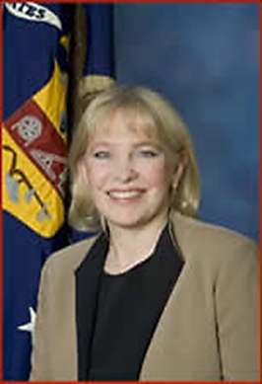
Opening Message
Gay Gilbert
Administrator
Office of Unemployment Insurance
Employment & Training Administration
U.S. Department of Labor

Slide 10
Where are you in the process?
Transition to RESEA Model
Fully transitioned and operational (3 months or more)
Recently transitioned (less than 3 months)
Currently in the process of transitioning
Still in planning stage but about to start (no later than October 1st)

Slide 11
Peer Exchange
Wisconsin

Slide 12
Wisconsin RESEA Re-design Project
Kristine Porter
Bureau Director, Job Service
Division of Employment and Training
Department of Workforce Development
Ann Astin
RESEA Program Coordinator
Division of Employment and Training
Department of Workforce Development

Slide 13
Opportunities for Improvement
Only able to serve RES participants in-person at local job centers.
During peak unemployment levels, only 25% of eligible persons were served.
One-size fits all approach; did not address level of need.
Sessions were scheduled without considering attendees actual availability.
Attendance rates were low.

Slide 14
Key Components
Online Orientation
Online Assessment
Scoring/Automated Triaging
Online Tutorials
Self Scheduling
Use of Email for Communication
Increased UI/DET coordination
Law/Policy Changes
Communications

Slide 15
Key Components:
Online Orientation

Slide 16
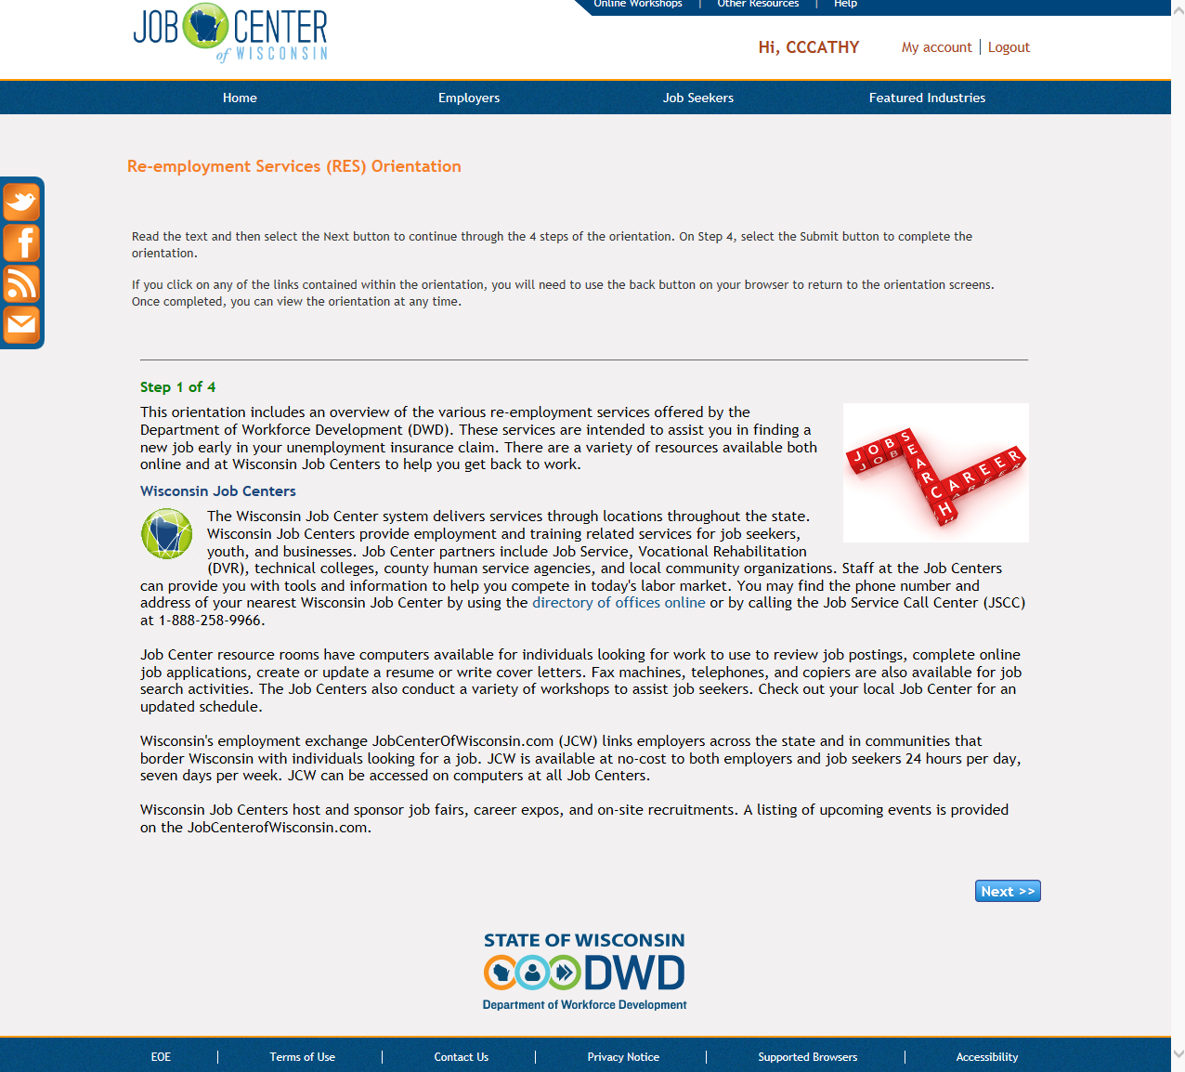
Key Components:
Online Orientation

Slide 17
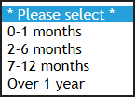
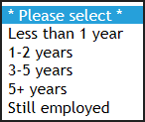
Key Components:
Online Assessment - Questions

Slide 18
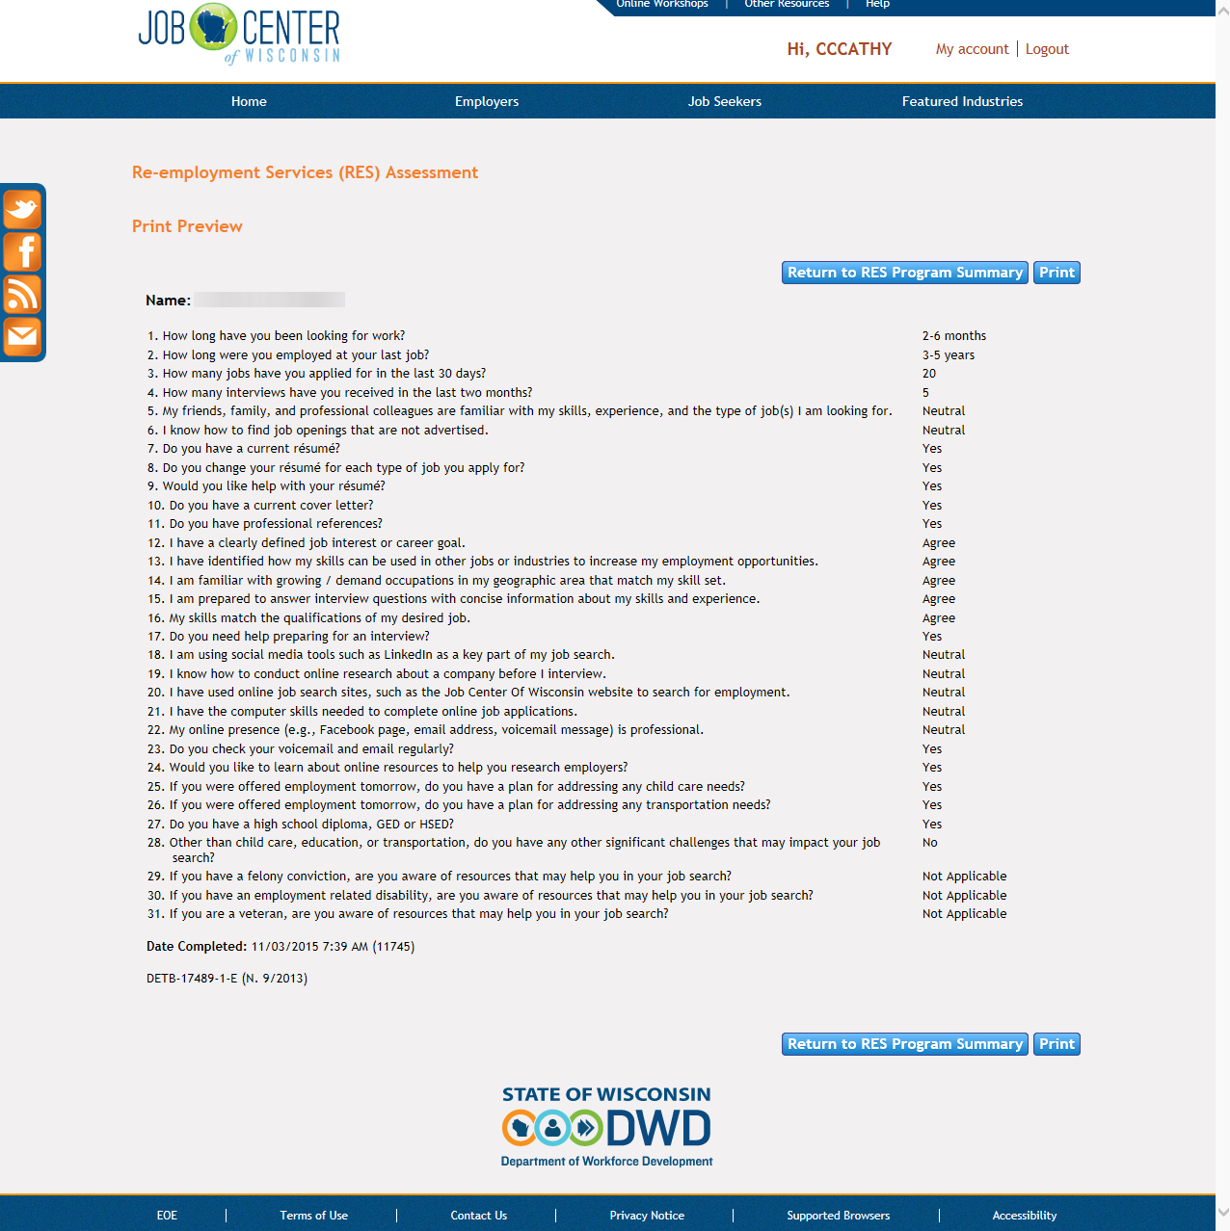
Key Components:
Online Assessment - Results

Slide 19
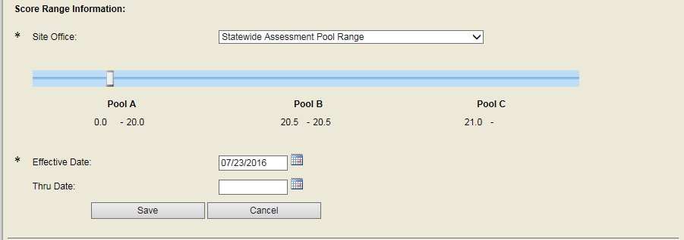
Key Components:
Scoring/Automated Triaging
Scoring Bar

Slide 20
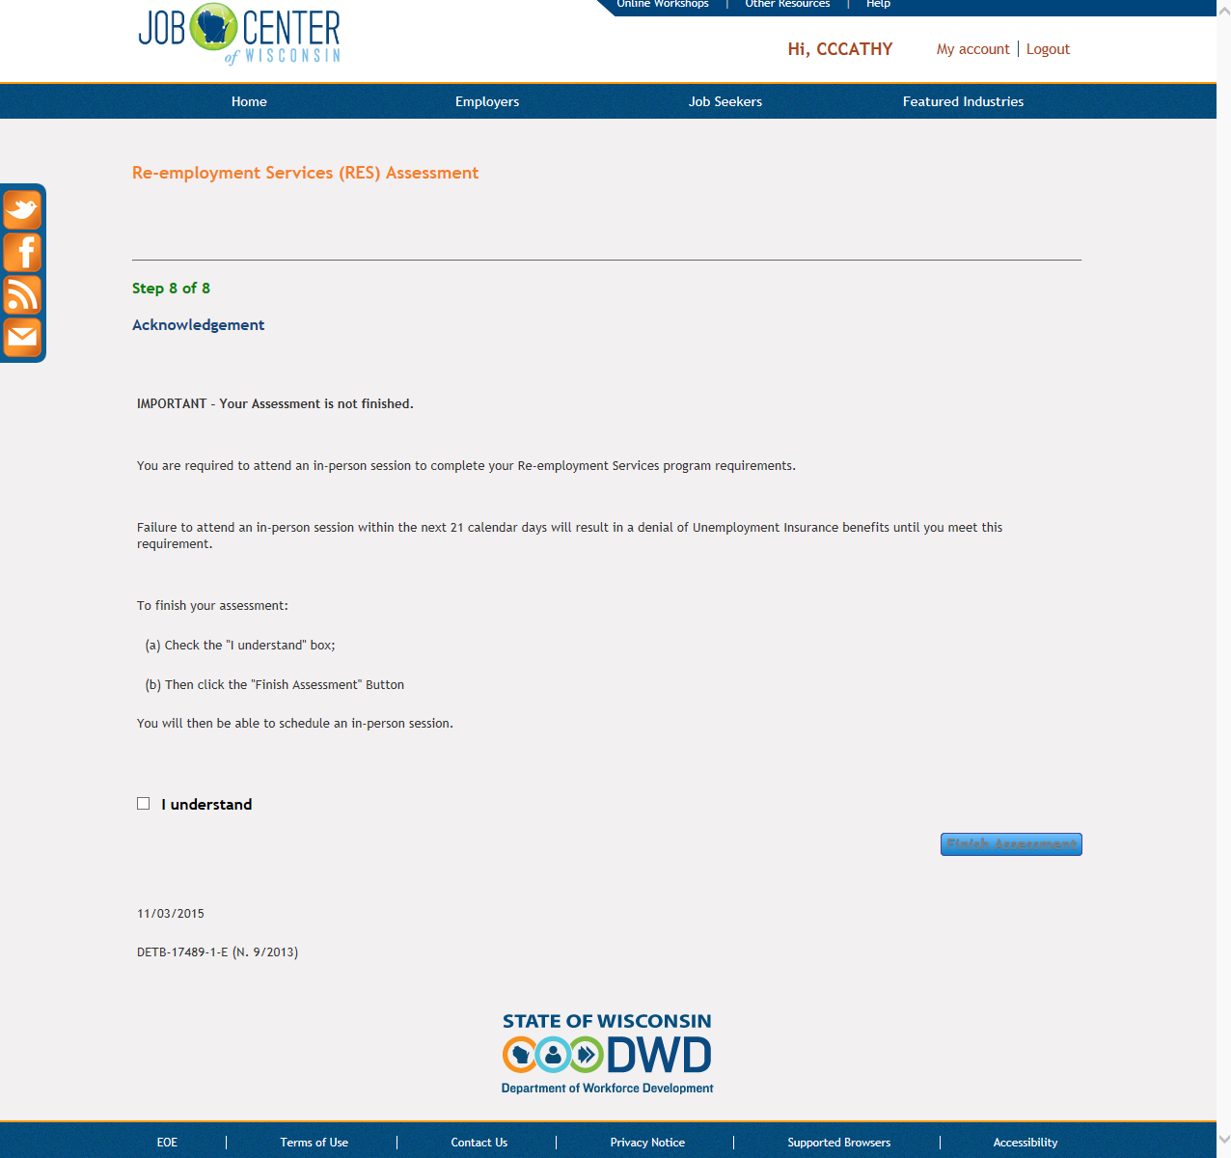
Key Components:
Scoring/Automated Triaging - Results

Slide 21
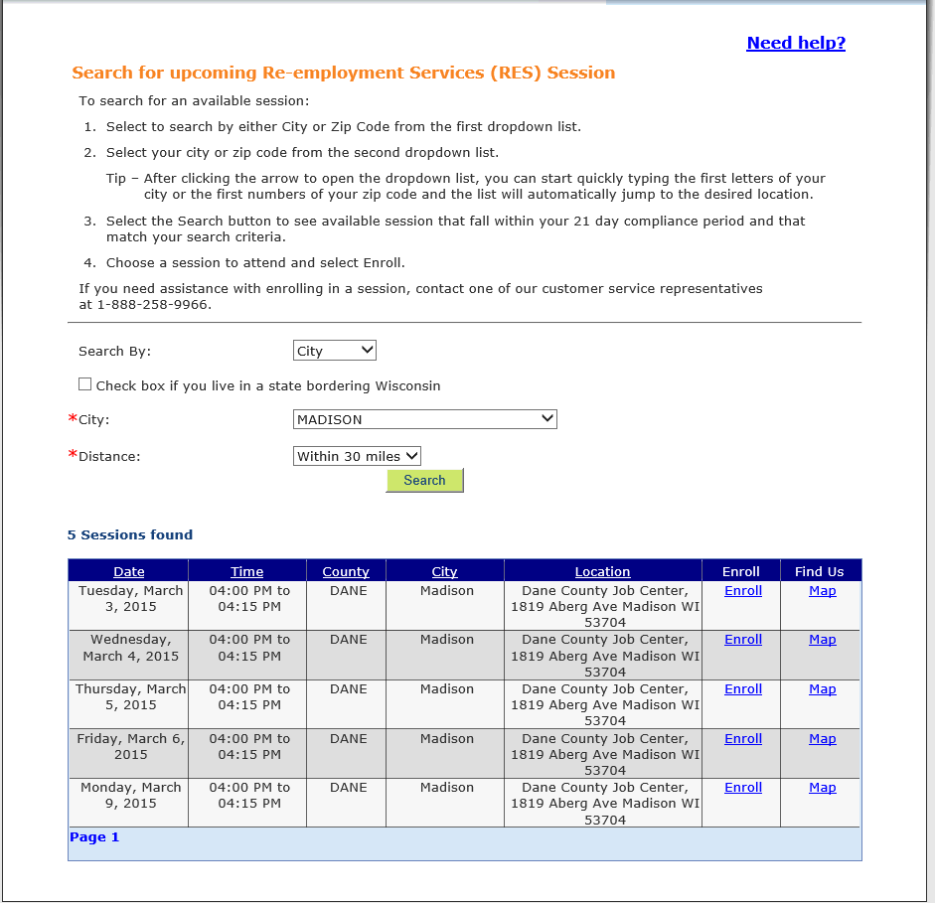
Key Components:
Self Scheduling

Slide 22
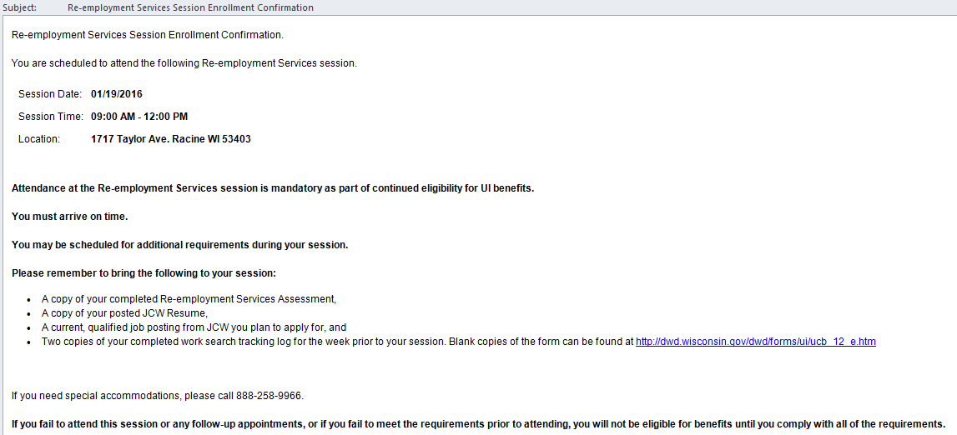
Key Components:
Email Communications

Slide 23
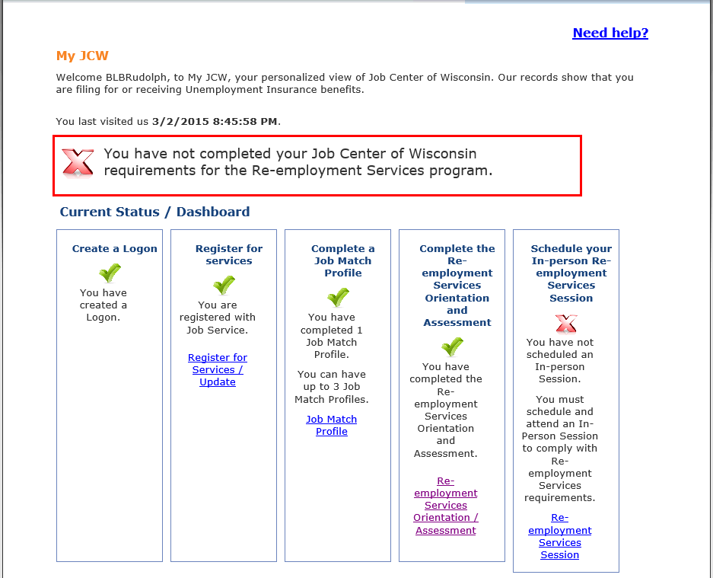
Key Components:
Increased UI/DET coordination
s

Slide 24
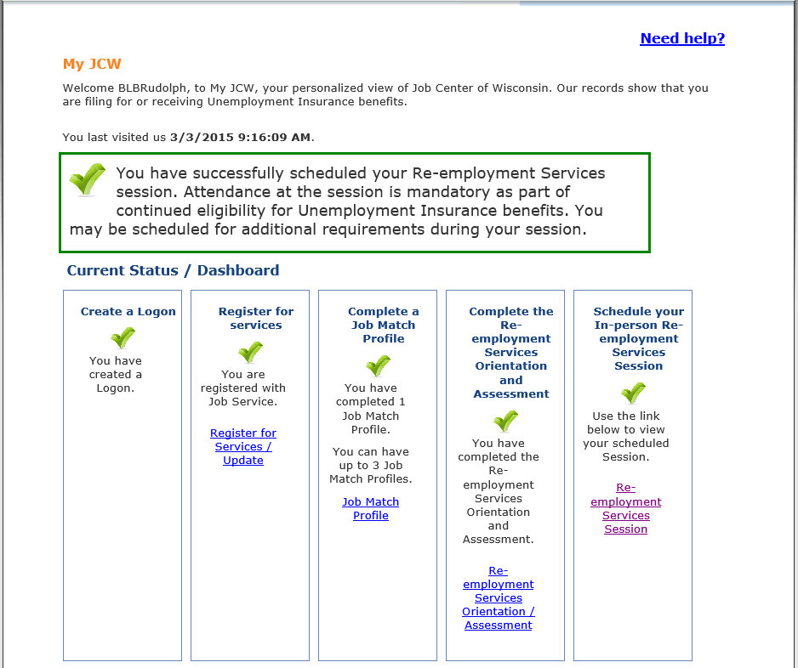
Key Components:
Increased UI/DET coordination

Slide 25
Lessons Learned
Dedicated cross-division test environment
Formalizing external communications planning
Create cross divisional team with open communication
Shared Statement of Work
Early definition of reporting and performance requirements

Slide 26
Best Practices
Use of tableau for dashboards, metrics, local management reporting
Executive commitment
Self-automated scheduling
Fluid cross-divisional communication
Real time integration for compliance

Slide 27
Outcomes
Increased Compliance
Increased Class Attendance
New Metrics and Reporting Numbers

Slide 28
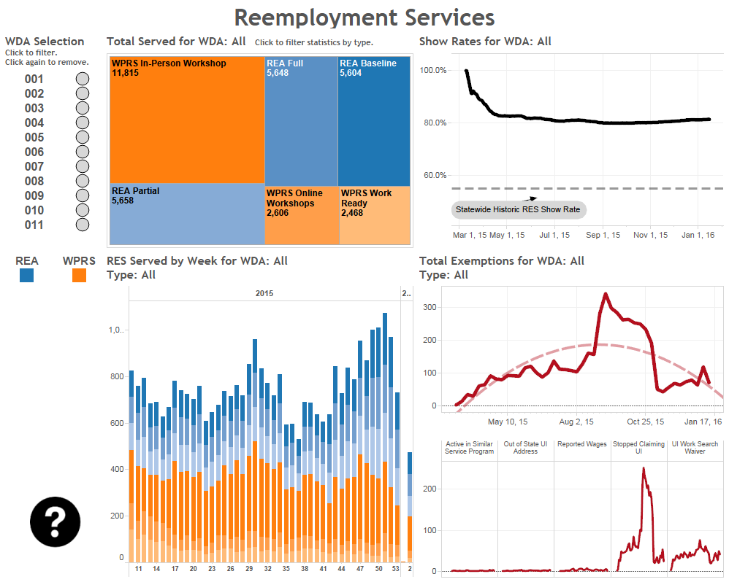
Outcomes:
Reemployment Services Dashboard

Slide 29
Outcomes:
Completion Times

Slide 30
Peer Exchange
Massachusetts

Slide 31
2016 Reemployment Services Eligibility Assessment Program (RESEA)

Slide 32
RESEA Grant
The Massachusetts RESEA Program is a UI Program that is administered by DCS, DUA and the One Stop Career Centers to:
Provide individual re-employment services to each job seeker
Determine continued eligibility for UI payments and detect and prevent improper UI Payments
All eligible UI claimants are job seekers and must be
able, available and actively seeking work

Slide 33
RESEA Enrollment Process
Up to 2000
Enrolled with 1st UI Payment
60-Dayer Enrolled with 1st UI Payment
Notification Letter
No Letter – CC staff outreach to customer
If CCS not attended by day 10 after enrollment, then second notification is sent in the form of a Robo call
Must be contacted by Career Center to attend initial RESEA
RESEA Review is scheduled at the Initial RESEA
RESEA Review Reminder in the form of a Robo call is made on the
fourth week from enrollment
Meets Program Requirements
If not, indefinite sanction
33

Slide 34
RESEA Notification Schedule
1st Notification | Claimants are enrolled at the time they receive their first check. CCS/Initial RESEA notification letters are sent out by DUA notifying claimants of their mandatory participation in the RESEA Program and attendance at CCS/Initial RESEA and deadline dates.
2nd Notification | CCS second notice reminder in the form of a Robo Call is made on the tenth day from the Saturday after enrollment to those RESEA enrollments who have not attended a CCS.
3rd Notification | A RESEA Review Reminder in the form of a Robo call is made on the fourth week from enrollment reminding job seeker that they have one (1) week left to complete their RESEA Review.
All letters are sent out in English and twelve (12) other languages. For the foreign languages, a sentence is added to the letter with a foreign language help line. The Robo calls are also made in both English and Spanish.

Slide 35
RESEA Program Overview
Week 3
Week 5
Career Center Seminar (CCS)
(If not, 1 week sanction)
Initial RESEA
RESEA Review
(if not, indefinite sanction)
To be done on same day
35

Slide 36
RESEA Program Overview
Career Center Seminar (CCS) (If not,1 Week Sanction)
Complete an Individual Needs Assessment (INA) also called a Job Search Inventory
Begin to develop a Career Action Plan (CAP)/Individual Reemployment Plan (IRP)
Register for JobQuest
Introduction to Labor Market Information & Labor Market Tools
Introduction to Career Center Services
36

Slide 37
RESEA Program Overview
Initial RESEA Review (To be done on the same day as CCS)
One-on-One/Group Meeting
Review Individual Needs Assessment (INA)
Review Work Search Requirements
Review Resume
Discuss Labor Market Information
Sign up for additional career center services
Develop and sign-off on Career Action Plan
Schedule RESEA Review
37

Slide 38
CAP Form

Slide 39
RESEA Review
RESEA Review
One-on-One Meeting
Review LMI Exploration Results
Verify JobQuest Registration
Verify Work Search Activity
Verify Resume
Establish a Future Goal/Event
Complete RESEA Review

Slide 40
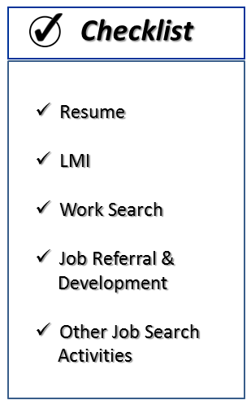
Conducting the RESEA Review
Work Search
Other
Job Search
Activities
LMI
Job Development
&
Referral
Resume

Slide 41
Conducting the RESEA Review
“Big Picture” Approach

Slide 42
Communicating with DUA

Slide 43
UI Potential Issue & Return to Work Forms

Slide 44
2016 RESEA Plan vs. Actual
RESEA Enrollments as of May 31, 2016 | 31,088
Scheduled: | 51,065
Completed: | 48,124
Completion Rate: | 94%
% of Plan: | 52% (10% Above Target of 42%)
Sanctions: | 17,405

Slide 45
Partnerships and Reemployment Services
Choose the answer that best reflects you (or your group):
The state has maintained strong, long-standing partnerships that are being leveraged.
RESEA implementation has resulted in new partnerships being formed.
We are still developing necessary partnerships but, in general, the process has been going smoothly.
Significant challenges with partnership development exist, but are being worked out.

Slide 46
Research and Evaluations
Highlights from Recent DOL Studies

Slide 47
#1 Behavioral insight Study
Goal of the trial: to test whether a series of short email messages could prompt more UI claimants to schedule and attend their mandatory Reemployment and Eligibility Assessment (REA) sessions
New emails were sent to 357 claimants .
Another group of 374 claimants received no messages other than the UIA’s call-in letter
The messages tested the four behavioral principles:
personalized interactions and an empathetic tone,
clarifying the benefits of participating in REA,
providing clear, concise steps for scheduling and preparing for the REA sessions,
providing timely reminders for the scheduled sessions

Slide 48
Results
Results: Increased service initiation by 16% and program completion by 14%
Briefs: a short brief on the design and early findings from this study : https://www.dol.gov/asp/evaluation/BIStudy/

Slide 49
Key Findings
UI claimants who were sent email messages were more likely to start the REA program by scheduling their first session.
UI claimants who received email messages were also more likely to complete the REA program.
Once individuals attended their first REA session, they were equally likely to complete the program regardless of whether they had received emails or not.

Slide 50
#2 Outreach to UCX Population
Goal: A four state demonstration– Georgia, North Carolina, Illinois, and Texas– testing a variety of strategies intended to:
create strong collaborative partnerships among the UI system, the public workforce system, and the three components of the Army;
improve data sharing to better understand UCX claimants and their outreach and service needs; and
increase outreach, exposure to jobs, and reemployment strategies for UCX claimants that combine existing resources with innovative service delivery approaches.
A detailed implementation study summarizing strategies used, challenges, and potential promising practices: https://www.dol.gov/asp/evaluation/completed-studies/ArmyUCX_ImplementReport_Final.pdf

Slide 51
Promising Practices and Recommendations for Future Research
Social media. Illinois developed a social media campaign that covered multiple platforms and directed targeted viewers to well-designed resources for further information and interaction. Metrics were tracked and showed the success of the campaign in expanding outreach to veterans.
Military skills translation tools. Effectively communicating to a civilian employer, both on a resume and in an interview, the skills and abilities developed in the military was uniformly cited as a critical need.
(https://www.mynextmove.org/vets/)
Resume development. Presenting a high quality, civilian style resume to an employer is an important step toward getting hired, but military members are accustomed to resumes of a very different format and content.
Reemployment Eligibility Assessment program. Both North Carolina and Georgia observed positive benefits of their REA programs for the UI recipients who participated and used grant funds to expand the program to UCX claimants.
Form and process creation and revision. Three states enhanced intake forms, triage tools, signage, processes, and/or policies in response to the refocusing guidance. This initiative ensures that veterans with significant barriers to employment are are correctly identified and routed to services.
(Response to TEGL 19-13 and TEGL 20-13)

Slide 52
More Evaluations and Research at http://clear.dol.gov/

Slide 54
Most Frequent
What is the status of the 9128x and 9129x reports?
Will the 9128 and 9129 forms change?
We conduct RESEA statewide, is the 9048 and 9049 still required?
Must reemployment services be delivered by merit staff?
How do I report an individual who reported to both training and reemployment services in the same quarter?
Can I get help with updating profiling models?
When will the UIPL for 2017 be published?

Slide 55
What technical assistance topics should DOL prioritize?
Outreach to UCX Population
Performance Reporting
Updating Profiling Models
Delivery of Reemployment Services to Those Likely to Exhaust
Delivery of Reemployment Services to UXC population
Other (please insert in chat box)

Slide 56
What forms of technical assistance are most helpful?
Written guidance (UIPLs, TEGLS, etc)
Webinar
Virtual meetings (i.e. conference calls)
Other (please insert in chat box)

Slide 58
Lawrence Burns
Reemployment Program Coordinator
Division of Unemployment Insurance Operations
Burns.Lawrence@dol.gov

