Slide 1
TAACCCT Performance Reporting Q&A
U.S. Department of Labor
Employment & Training Administration
June 15, 2016

Slide 2
TAACCCT Learning Network at a Glance
U.S. Department of Labor, Employment & Training Administration
(National)
Jobs for the Future
CalState/Merlot
Maher & Maher
American Association of Community Colleges
U.S. National Science Foundation
ATE Centers
Other Non-Federal Providers of TA and Resources for TAACCCT Grantees:
Creative Commons
CAST
The Transformative Change Initiative

Slide 3
Sign up for the TAACCCT Weekly Digest

Slide 4
Presenters
Cheryl Martin, Moderator
Program Manager, TAACCCT Grants
Kristen Milstead, Presenter
Staff Lead for Performance, TAACCCT Grants

Slide 5
Agenda
Questions from YOU
Special Topic: Industry-Recognized Credentials
Open Question Period (Limited)

Slide 6
Question #1
When we ask our FPO to re-open a previous APR to enter new or additional information, is this limited to employment follow-up only (B.8, B.9 and B.10) or may we modify all entries?

Slide 7
Question #2
Will the current year’s APR be unavailable until we submit the previous year’s?

Slide 8
Question #3
If someone becomes TAA-eligible during training, are we to report them as TAA-eligible in the grant year the TAA certification happened or the year they entered the program? This question is for both C.9. and Section F.

Slide 9
Question #4
Do employment/follow-up outcomes achieved in the 3rd and 4th quarters of the year count for that year's reporting or the following year?

Slide 11
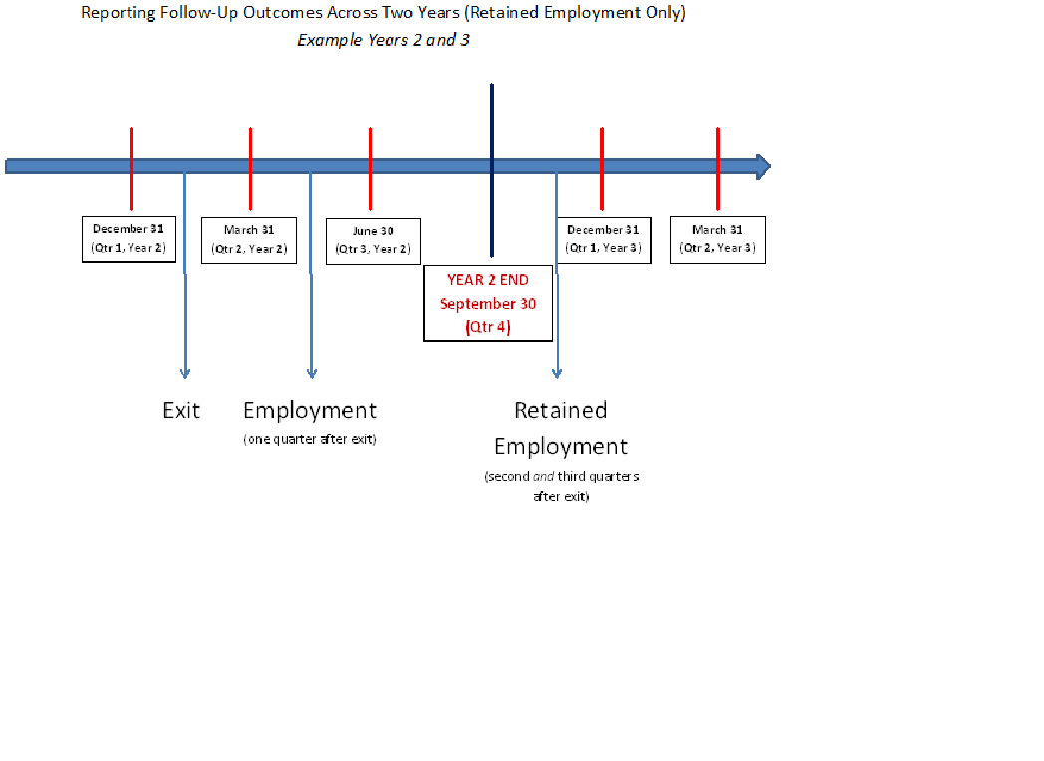

Slide 13
Question #5
If not placed in employment in the first quarter after exit, are participants ineligible to be counted as employed if hired after that first quarter?

Slide 14
Question #6
What if a student is in a paid internship during their last semester then continues with same employer?

Slide 15
Question #7
For B10 does the incumbent employment need to be in a program-related job, and the wage increase as well in the program related employment?

Slide 16
Question #8
Does it count as employment for a non-profit organization volunteer? Such as Habitat for Humanity office worker

Slide 17
Question #9
Please provide more information and go over once again how to track completers if we are using the six-month extension of program activities.

Slide 18
A: For those operating on traditional semester schedule:
Certain outcomes may not be relevant
 |  |  |  |  |  |  |  |  |  |  |  |  | Closeout
Outcome | Oct | Nov | Dec | Jan | Feb | Mar | Apr | May | Jun | Jul | Aug | Sep | Oct | Nov | Dec
B1 (participants) | x | x | x | x | x | x
B2/B2a (completers) | x | x | x
B3 (retained) | x | x | x | x | x | x
B4 (retained in other) | x | x | x | x | x | x
B5/B5a (credits) | x | x | x
B6/B6a/B6b/B6c (credentials) | x | x | x
B7 (further education) | x | x | x | x | x | x | x | x | x | x | x | x
B8 (employment) | x | x | x | x | x | x | x | x | x | x | x | x | x | x | x
B9 (emp retention) | x | x | x | x | x | x | x | x | x | x | x | x | x | x | x
B10 (wage increase) | * | * | * | * | * | * | * | * | * | * | * | *
*incumbent workers only

Slide 19
Industry-Recognized Credentials
What You Need to Know for Reporting Purposes

Slide 20
Can I Count My Credentials For Reporting Purposes?
QUESTIONS TO ASK YOURSELF:
Do the credentials satisfy the definition as set forward in the OMB package, specifically, are they “industry-recognized?”
Are the specific types of credentials referenced in the OMB package awarded, specifically, certificates and/or degrees?

Slide 21
REFERENCES
1. TEGL 15-10
2. Attachment 2
3. OMB Reporting Package

Slide 22
Question #1: Does it meet the definition of an acceptable credential?
Four Components of Career-Enhancing Credentials
Industry-Recognized
Portable
Stackable
Accredited

Slide 23
“Industry-Recognized”
Developed, offered or recognized by industry association or accepted by companies for purposes of hiring
Also:
Portable
Stackable
Accredited

Slide 24
Question #2: Am I awarding the type(s) referenced?
OMB package Annual Performance Report form and instructions reference two types of credentials (educational credentials)
Certificates
Degrees

Slide 25
Where Does this Matter in the APR?
Relevant outcome categories on the Annual Performance Report
Certificates/Degrees awards
B6
B6a
B6b
B6c

Slide 26
Putting the two questions together: Does it meet the definition of an acceptable credential (#1) and is it an acceptable type (#2)?
TEGL 15-10 & Attachment 2
Licenses
Certifications
OMB Package
Certificates
Degrees

Slide 27
What About Other Types of Credentials that are not Certificates or Degrees?
Examples: licenses, certifications, other
Use the Additional Comments section of the APR to report the progress
Required: If you have included a target
Optional: If you are enrolling participants in these types of programs of study

Slide 28
Summary: Can I Count This Credential?
Is it a career-enhancing certificate or degree?
TEGL 15-10 specifies qualities these two types of acceptable credentials must have
No master list
Document how your credential satisfies the definition

Slide 29
Questions?

Slide 30
Poll question: Which performance-related topic would you like to see a short presentation on in a future monthly Webinar?
Type your answer into the chat box. Please choose the topic you would like to see a presentation on the most even if you have more than one.
BRYAN: PLEASE SEE NOTE BELOW

Slide 31
Poll question: When do you typically start entering your data after the APR becomes available for data entry? (there is no right or wrong answer)
Within the first week
2-3 weeks after the APR opens
Within the first month
Toward the end of the 45 day reporting period

Slide 32
Poll question: Of the outcomes listed below, which do you have the most difficult time comprehending?
Participants enrolled (B1)
Participants completed training and/or retained in training (B2/B3/B4)
Participant employment outcomes (B8/B9)
An outcome not listed

Slide 33
Poll question: How many people at your institution are attending this Webinar in the room with you?
It’s just me
2
3
4
5 or more

Slide 34
Poll question: Who at your institution completes the Annual Performance Report?
The project manager
A project-dedicated data manager or analyst
An evaluator
A different person with a title not listed above
Several people work on different aspects of the APR

Slide 35
UPCOMING WEBINARS
TAACCCT Employment Outcomes:
Alternative Strategies
June 30, 2016 2:00 pm EST
Next Month’s TAACCCT Performance Reporting Q&A
July 27, 2016 4:00 pm EST

Slide 36
Send performance-related questions to the TAACCCT mailbox (taaccct@dol.gov)
by July 22, 2016

Slide 37
Thank you
for attending!

