Slide 1
Best Practices in Retention & Supportive Services of Women in the Construction Industry

Slide 3
Moderator
Felecia Hart
WANTO Federal Project Officer
U.S. Department of Labor
Employment and Training Administration
Office of Apprenticeship

Slide 4
WANTO Overview
The Women in Apprenticeship and Nontraditional Occupations (WANTO) Act of 1992 authorizes the U.S. Department of Labor to award grants to assist employers and registered apprenticeship programs in promoting the recruitment, training, employment and retention of women in apprenticeship and nontraditional occupations.

Slide 6
Polling Question
1. Registered Apprenticeship Program
2. Employer
3. WIOA / American Jobs Center
4. Community College
5. Community-based service program
6. Government
7. Other

Slide 7
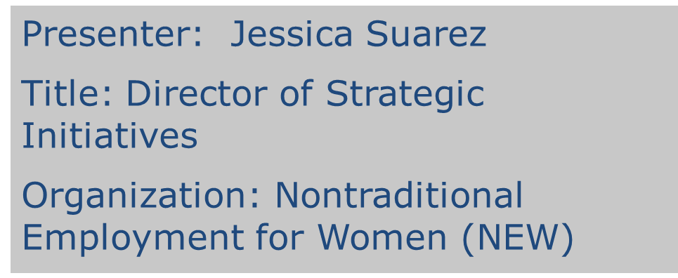
Presenters

Slide 8
Presenters
Presenter: Meg Vasey
Title: Executive Director
Organization: Tradeswomen Inc.
Presenter: Linda Hannah
Title: Director of Programs
Organization: Chicago Women in Trades

Slide 9
Why Retention Matters
Minorities tend to cancel at higher rates than their white counterparts – 49% of minorities vs. 44% of whites
Women cancel out of construction apprenticeships at higher rates than men – 51% of women cancelled vs. 46% of men
Nearly 57% of the cancelled apprenticeships overall within first 24 months

Slide 10
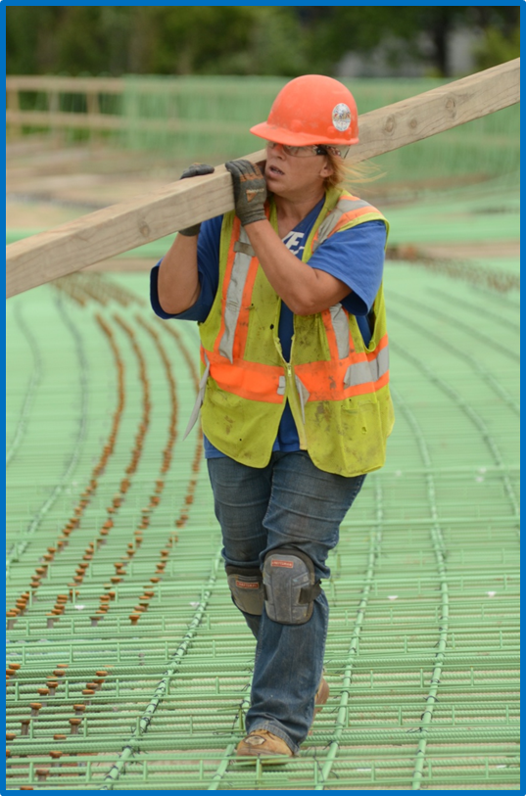
Barriers to Retention
Isolation
Lack of work
Training
Harassment
Discrimination
Health & Safety

Slide 11
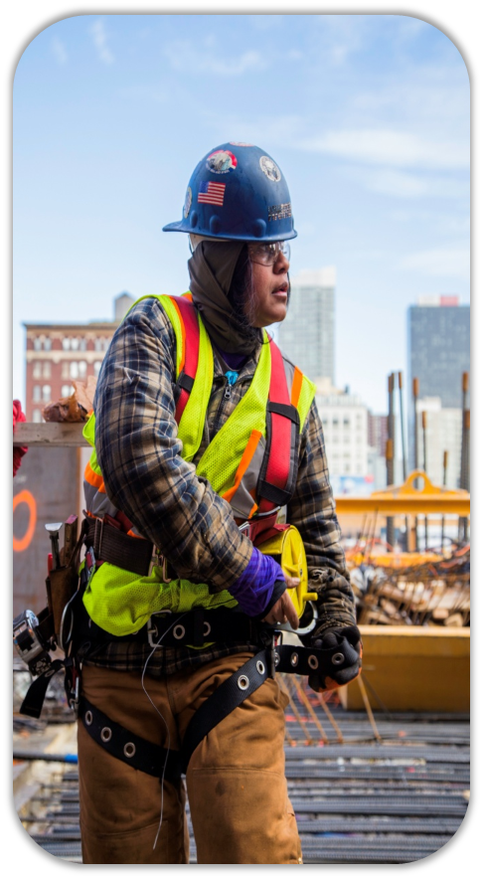
Barriers to Retention
Sanitary facilities
Personal Protective Equipment
Ergonomics
Workplace culture
Reproductive hazards
Health and safety training
Injury and illness data

Slide 12
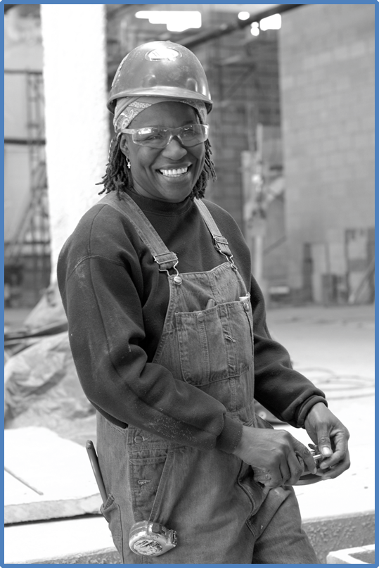
Removing the Barriers & Improving Outcomes
Supportive Services
Delivery Model
Value of Networking
Mentoring

Slide 13
Nontraditional Employment for Women
Supportive Services

Slide 14
NEW Candidate Intake Assessment
Interview Selection
Sample Screening Questions
How will you feel if you are the only woman in your shop and/or on the jobsite?
Do you have other career goals?
What do you expect your day to be like as a tradeswoman?
(Scenario) You are faced with a foreman that is giving instruction in a manner that may sound offensive to you. How do you react?

Slide 15
NEW Candidate Intake Assessment
Intake Assessment
Categories include:
Family Information
Housing Status
Source of Income/Benefits
Health Information
Supportive Service Referrals are made
Determines candidate readiness and start date

Slide 16
NEW Supportive Services - Training
Week 1
Wellness Workshop
Sexual Harassment Identification and Management
Weeks 2-4
Conflict Resolution
Domestic Violence Workshop
Midterm Evaluation
Weeks 5-8
Financial Literacy
Exit Evaluation

Slide 17
NEW Supportive Services – Throughout Apprenticeship & Career
Track 3, 6, 9, and 12-month milestones
Networking events
Advanced skills training
Union dues and financial assistance
NEW Signature Projects Program
House and support union women’s committees

Slide 18
Contact Information
Jessica Suarez
Director of Strategic Initiatives
jsuarez@new-ncy.org
Linda Young
Director of Social Services
jsuarez@new-ncy.org
NEW NYC 243 W 20th St, New York, NY 10011 (212) 627-6252
www.new-nyc.org

Slide 19
Tradeswomen Inc.
Building a Tradeswomen Network

Slide 20
Building the Tradeswomen Community
ABOUT TRADESWOMEN INC.
OUTREACH, RECRUITMENT, RETENTION and
LEADERSHIP DEVELOPMENT
for women in the skilled trades
Established in 1979
By tradeswomen and tradeswomen advocates
Provides direct services as well as policy support
Located in Northern California
For more information about Tradeswomen Inc.
and its programs, please see our website at www.tradeswomen.org

Slide 21
Building the Tradeswomen Community
EARLY NETWORKING STRATEGIES
Social get-togethers served to break isolation
Word of Mouth (no FB, cell-phones, email)
Poker nights, potlucks, informal women’s groups by craft
“Big Job” Meetups, apprenticeship classes
Media of the day:
Word of Mouth (no FB, cell-phones, email)
Tradeswomen Quarterly,
Cut and paste Newsletters
Women’s Bureau sponsored Conferences
Regional and national
Less structured, broad non-traditional inclusion
Single Craft Union Women’s Conferences
Regional (IBEW Electricians 1987)
National (IBEW 1997, Carpenters 2002)

Slide 22
Building the Tradeswomen Community
BUILDING TRADES SPONSOR MULTI-CRAFT CONFERENCES
Women Building California Conference
California State Building Trades, Tradeswomen Inc.
Tradeswomen came from all over from 2002 beginning
Many states, Canada, Australia
Women Building California and the Nation, 2012
International Presidents participate
IBEW President Hill with Liz Schuler, AFL-CIO
Many others have followed
Listening as well as speaking
Participating in their craft caucus
National Building Trades Women's Committee
Women Building Nations 2016
1500 women including several countries
First time out of California with Chicago Women in the Trades

Slide 23
Building the Tradeswomen Community
OTHER EVENT MODELS
Smaller, Regional Conferences
Sisters to Sisters
Maintaining local network of journey level, supporting incoming and new apprentices
Share substantive information
Increase mentoring opportunities
Weekend events allow working tradeswomen to participate
Women Can Build Hands on Career Fairs
Working closely with Apprenticeship Coordinators
Include tradeswomen as presenters, volunteers, speakers
Internet and Social Media also link and build the community
WANTO partners have web presence
Women Build Nations FB, Tradeswomen only chat groups, Pride and a Paycheck online, Tradeswomen Tuesdays
Single craft online groups
Social Media needs face-to-face

Slide 24
Building the Tradeswomen Community
BEST PRACTICES
Women lead
Women organize, choose the agenda
Women dominate the podium
Women lead the workshops
Use Inclusion and Balance
Union, Independent tradeswomen voices
Inter-craft disputes not allowed on floor
Welcome Men to participate, not to "Mansplain"
Inter-craft disputes not allowed on floor
General union priorities through a gender lens
Put on an organized event
Be respectful of presenters and participants
Feed people
Plan well, enforce time constraints
Followup and continue the connections

Slide 25
Contact Information
Meg Vasey
Executive Director
meg@tradeswomen.org
Tradeswomen, Inc.
337 17th Street Suite 204
Oakland, CA 94612
510-891-1243 general
510-922-8480 direct line
www.tradeswomen.org

Slide 26
Chicago Women in Trades
Mentoring as A Retention Tool

Slide 27
Chicago Women in Trades
Founded by tradeswomen in 1981
Mission: to improve women’s economic equity by increasing their participation in high-wage blue collar occupations
Began operating the Technical Opportunities Program (TOP) in 1987
Serve an average of 75 women per year, 70% graduation rate and 70% placement rate

Slide 28
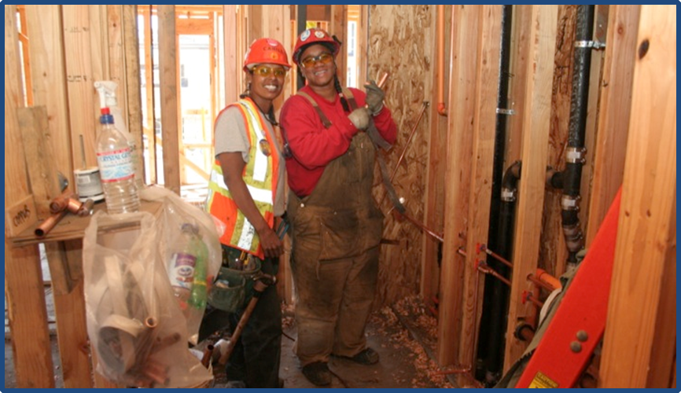
Mentoring as a Retention Tool
Mentoring should begin immediately upon acceptance into an apprenticeship program.
The mentor establishes a weekly check-in (text) and schedule a face-to-face with the new mentee.
Vicky Hamlin for Tradeswomen Inc.

Slide 29
Communications Plan
Shared responsibility mentor and mentee
Each mentee identifies specific needs, issues, and or challenges
Practical and rapid skill development
Introduction to union meetings (go as a group)

Slide 30
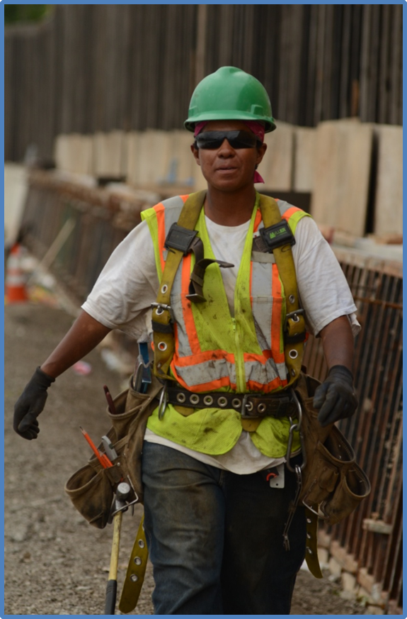
Skills & Strategies Development
Productivity and safety practices
Technical training/skill development
Self evaluation

Slide 31
Sustaining the Program
As the mentee progress they are trained to become mentors to the next cohort.
Value of being mentored by your peers.
Prevents burn-out and develops future leaders!
“Getting in, moving up, giving back!”

Slide 32
Contact Information
Linda Hannah
Director of Programs
lhannah@cwit2.org
Chicago Women in Trades
2444 W.16th Street Suite 3E
Chicago, IL 60608
312-942-1444
www.cwit2.org
http://chicagowomenintrades2.org/mtac

Slide 34
Resources
Office of Apprenticeship Pre-Apprenticeship Toolkit
http://www.doleta.gov/oa/preapp
Women’s Bureau Nontraditional Occupations Portal
http://www.dol.gov/wb/NTO

Slide 35
For More Information
For more information on the WANTO grant, please contact the U.S. Department of Labor:
Felecia Hart, WANTO Federal Project Officer
U.S. Department of Labor
Employment & Training Administration
202-693-3792
Hart.Felecia@dol.gov

