Slide 2
H1-B Ready to Work
Data-Driven Decision Making: Tools to Review and Manage Performance Webinar!
H-1 B Ready to Work Grants

Slide 4
Polling Question
Polling Question # 1
Let’s get to know who is on the call today. Using the poll, select the role that you play in your H-1B RTW grant, or if you are an existing H-1B Grantee.
For this grant initiative I am the:
Authorized Representative
Program Director/Manager
IT/Data Manager or staff
Training Partner
Employer Partner
Service Provider
Other (case manager, job developer or employment specialist)
H-1B Technical Skills Training
H-1B Jobs Accelerator
H-1B Make it in America

Slide 5
Ayreen Cadwallader
Workforce Analyst
ETA
Division of Strategic Investments
Washington DC

Slide 6
Angel Harlins
RTW Project Lead
Performance Excellence Partners, Inc.
Washington D.C.
Kevin Mauro
RTW Performance Lead
High Impact Partners, Inc.
Washington D.C.

Slide 7
Heather Henry
Chief Innovation Officer
Anne Arundel Workforce Development Corporation

Slide 8
Learn numerous ways your performance data can benefit your RTW grant
Learn how to use the RTW Grantee Performance Data Indicators Tool
Learn how RTW Grantee Anne Arundel tracks their performance outcomes
Learn about the action steps you can take to start using the data for your organization benefits
Discuss strategies for incorporating the data to help with employer engagement and partnership

Slide 9
Why Data?
Data-Driven Decision Making
Progress Indicator Tool
MTC Dashboard
Performance Reporting Q & A

Slide 10
The Value of Performance Reporting
Performance data is used to:
Illustrate Success
Show Continuous Improvement
Promote your Programs for Employer and Partner Engagement
Ensure Sustainability and Evaluate Effectiveness
Identify Areas for Opportunity
Great Programs + Great Data + Great Outcomes =
Greater Success for American Workers!

Slide 11
Data- Driven Decision Making
Team Effort
Effective
Attainable
Map in Your Glove Box
Grantee Assessment
Program Analysis
Performance Achievement

Slide 12
Quarterly Stoplight Q’s
It’s OK to Ask For Directions!
What should you already know?
What are your target outcomes?
How is your performance to date?
What else do you need to know?

Slide 13
Participant Polling Question
We review our performance data…
(Select which answer is most applicable)
Every day
Every month
Quarterly
Annually

Slide 14
Performance Data
Process Indicator Tool

Slide 15
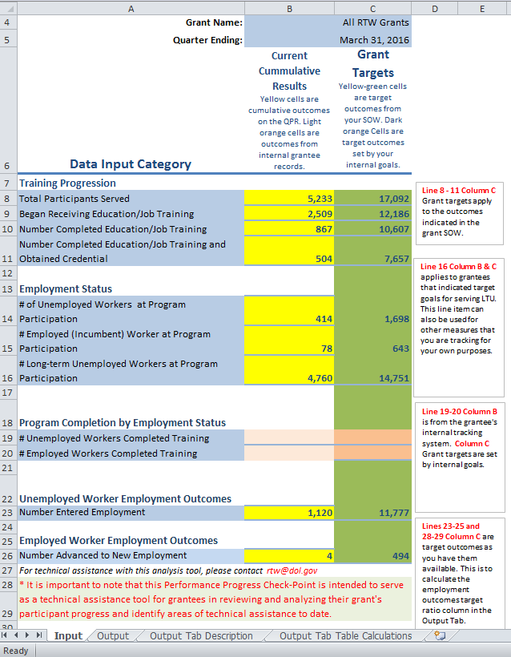
Performance Progress Check- Point Tool

Slide 16
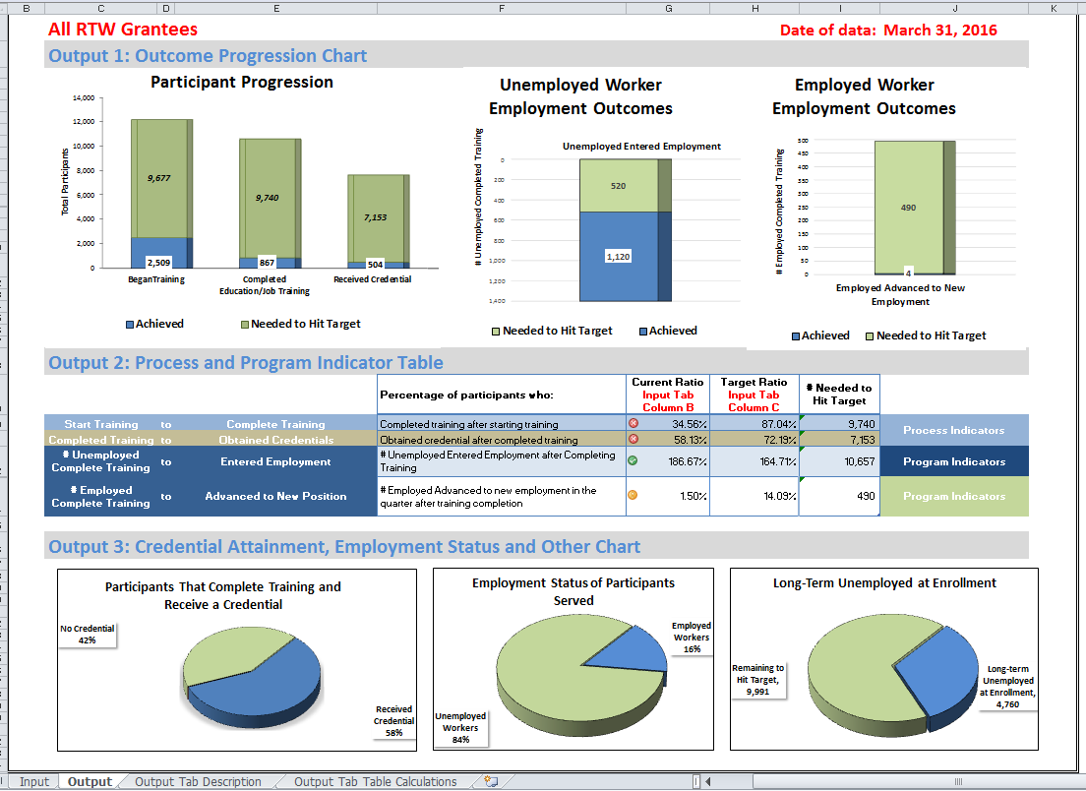
Performance Progress Check- Point Tool

Slide 17
Performance Progress Check-Point Tool - Output 1

Slide 18
Performance Progress Check- Point Tool- Output 2

Slide 19
Performance Progress Check- Point Tool- Output 3

Slide 21
H-1B RTW Grants Program Outcomes Quarter Ending 3.31.16
RTW Grant Starts 10/1/2014
Q 3/31/16
RTW Grant Ends 9/30/18
Q 6/30/16
Q 9/30/16
Q 12/31/16
Q 3/31/17
Q 6/30/17
Q 9/30/17
Q 12/31/17
Q 3/31/18
Q 6/30/18
Q 12/31/15
Q 9/30/15
Q 6/30/15
Q 3/31/15
Q 12/31/15

Slide 22
RTW Grants to Date
Performance Accomplishments to Date- Quarter ending March 31, 2016
5,233 participants served
4,760 are LTU
2,509 participants began job training and education services
867 have completed training
504 participants obtained a credential or certification
Total of 1,120 participants have entered employment

Slide 23
Data Assessment Questions
What is happening with this data?
What area needs improvement?
How would you address these areas for improvement?
What have you done or will do resolve it?

Slide 24
Making Program Decisions Based on Data
Data Factors
Recruitment and Enrollment
Length of Training Design
Program Completion
Credential Attainment
Challenges to Employment
Industry and Occupations

Slide 25
Making Program Decisions Based on Data
Strategies for Changing Direction
Program Management Changes
Statement of Work Changes
A modification to your Statement of Work takes careful consideration and should be discussed with your Federal Project Officer (FPO).

Slide 26
FAQ: Reporting Employment Outcomes
How are employment outcomes reported to RTW grants?
Employment outcomes should be measured against the number of participants that complete training by the type of worker served.
Unemployed Worker Outcomes
Employed Worker Outcomes (Incumbent Workers Only)
Can I report employment outcomes even if the participant has not yet completed the training program?
Yes, in the Ready to Work program, you are allowed to capture employment outcomes at any time, regardless of whether the participant has already completed the program, or if they accept a job offer mid-way through the program.

Slide 28
Maryland Tech Connected (MTC) Dashboard
Anne Arundel Workforce Development Corporation

Slide 29
Importance of Data Analysis
Allows You to Know Where You Stand
Where you are in relation to your deliverables
Where each site fits in the big picture
How it’s being reported out
Informs Your Successes and Areas of Improvement
Identify local successes and best practices
Identify the indicators that lead to success
Identify where the gaps are in service
Predict areas that need more support

Slide 30
What Data Elements Do We Focus On?
DOL Deliverables
Goal vs Actual
Site Comparisons
Trends
Focus on Training and Supportive Services
Incoming Participant Flow
Programmatic to Budget
Top Trainings Enrolled
CSX Cybersecurity Training - 20
IT Foundation (A+/Net+/Sec+) - 18
Penetration Testing - 9
Work and Learn - 6
Project Management - 6
CISSP - 4
IT Management - 4
Tech Leap - 3
Lab Associate - 2

Slide 31
Tools We Use
Monthly Reports from Sites
MTC Outcomes by Site with Analysis
Monthly cross-site calls to review
Quarterly Dashboard Summary
Communicated to stakeholders

Slide 32
MTC Dashboard
DOL Grant Goals odometer
Site Comparisons
Incoming Participant Flow
Key Training and Supportive Services Delivered

Slide 33
What Do We Do With It?
Improve Data Entry
Improve Services
Use in our outreach
Focused regional efforts on training
Formalized certification study groups
Connect the Program to the Budget
Intensive Services

Slide 35
Technical Assistance Checklist
H-1B Performance Reporting Handbook
HUB System
Technical Error vs. User Error
Data File
Code Values
Edit Check Rules
Logic Check
Aggregation Rules
WorkforceGPS Community of Practice (COP) Performance Resources
https://h1breadytowork.workforcegps.org/resources/browse?id=6D5C7D4E1AE94398A0687C529EA4E160

Slide 36
H-1 B Technical Assistance Resource: Performance Reporting Handbook
H-1B Ready to Work Performance Reporting Handbook
Download Now! https://h1breadytowork.workforcegps.org/resources/2015/05/13/13/06/H-1B-Ready-to-Work-Performance-Reporting-Handbook

Slide 37
Introduction to Quarterly Performance Reporting and Hub
https://www.workforcegps.org/events/2015/01/29/12/18/H-1B_Ready_to_Work_Grantees
In addition, a series of short tutorials has been created to get you started in the HUB system, and they can be found at this link:
https://www.workforcegps.org/resources/2016/04/11/08/23/Ready_to_Work_Grant_HUB_tutorials
LinkedIn Platform
Have you joined our LinkedIn page yet?
https://www.linkedin.com/groups/H-1B-Ready-Work-RTW-7018078/about
WorkforceGPS Ready to Work Community of Practice (COP)
https://h1breadytowork.workforcegps.org/
Upcoming Technical Assistance
H-1 B Ready to Work (RTW) Long- Term Unemployed (LTU) Subject Matter Expert Series: Refining Business Development and Employer Engagement Strategies
July 21st at 2pm

Slide 38
Ready to Work Grantee Mailbox RTW@dol.gov To Reach your Federal Project Officer, DOL National Office and Technical Assistance Providers

Slide 39
Post Webinar Feedback Tool
Thank you for participating in the H-1B RTW: Data-Driven Decision Making: Tools to Review and Manage Performance Webinar!
Please take a minute to complete this brief feedback tool regarding the Webinar on today June 30, 2016.
The input you provide will help us better the delivery of future webinars and create technical assistance meaningful for your work.

