Slide 1
utility industry workforce initiative webinar series:
Opportunities in the Energy Utility Sector for Veterans
DOL VETS and Department of Energy

Slide 3
Pam Frugoli
O*NET/CareerOneStop/Competency Assessment Team Lead
Employment and Training Administration
U.S. Department of Labor

Slide 4
Opportunities in Energy
U.S. Departments of:
Energy
Labor
Defense
Veterans Affairs
Private Sector Partners
Center for Energy Workforce Development
American Gas Association
Nuclear Energy Institute
Edison Electric Institute
National Rural Electric Cooperative Assn.
American Public Power Assn.
Utility Workers Union of America
International Brotherhood of Electrical Workers

Slide 5
Dr. Elizabeth Sherwood-Randall
Deputy Secretary, United States Department of Energy
Elizabeth Sherwood-Randall has served as Deputy Secretary, U.S. Department of Energy since October 2014. She is the chief operating officer overseeing a diverse workforce of more than 100,000 people at Department headquarters, National Labs and sites across the country, and at U.S. missions around the world.
Dr. Sherwood-Randall has spent the majority of her career in public service, and her leadership role at DOE enables her to work on two major global challenges of our times: ensuring nuclear security and combating climate change.
An additional priority she has emphasized at the Department of Energy is lifting up the work of dedicated professionals across the enterprise. She seeks to inspire the next generation to tackle hard problems and contribute meaningfully to the national security and economic strength of the United States and its allies and partners.
Dr. Sherwood-Randall joined the Obama Administration in January 2009, serving throughout the President’s first term as Special Assistant to the President and
Senior Director for European Affairs on the National Security Council.
In 2013 she was appointed as White House Coordinator for Defense Policy,
Countering Weapons of Mass Destruction, and Arms Control. In this position
she served as the President’s Sherpa for the 2014 Nuclear Security Summit
in The Hague.

Slide 6
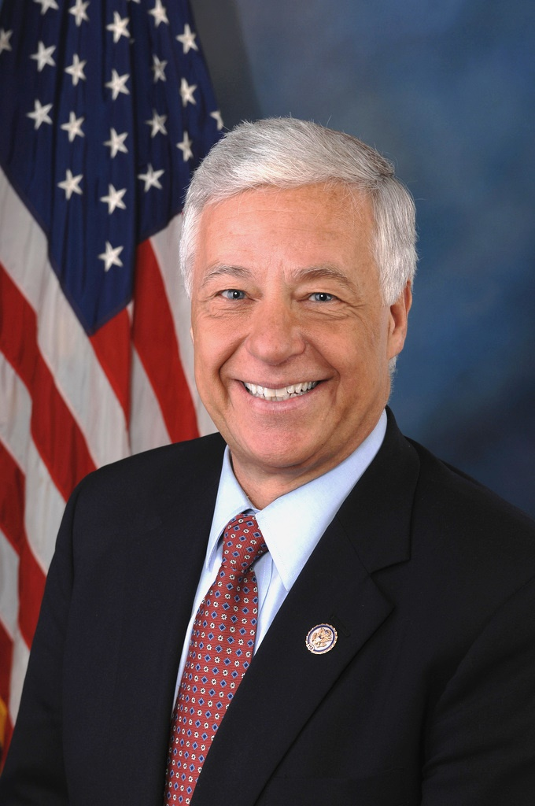
Mike Michaud
Assistant Secretary, Veterans’ Employment & Training (VETS)
Department of Labor

Slide 7
Ann Randazzo
Executive Director
Utility Industry Workforce Initiative
Center For Energy Workforce Development
Washington, D.C.
Marion Cain
Associate Director
Force Training
Office of the Assistant Secretary of Defense (Readiness), Washington, DC
Richard passarelli
Program Coordinator
Utility Workers Union of America
Utility Workers Military Assistance Program (UMAP)

Slide 8
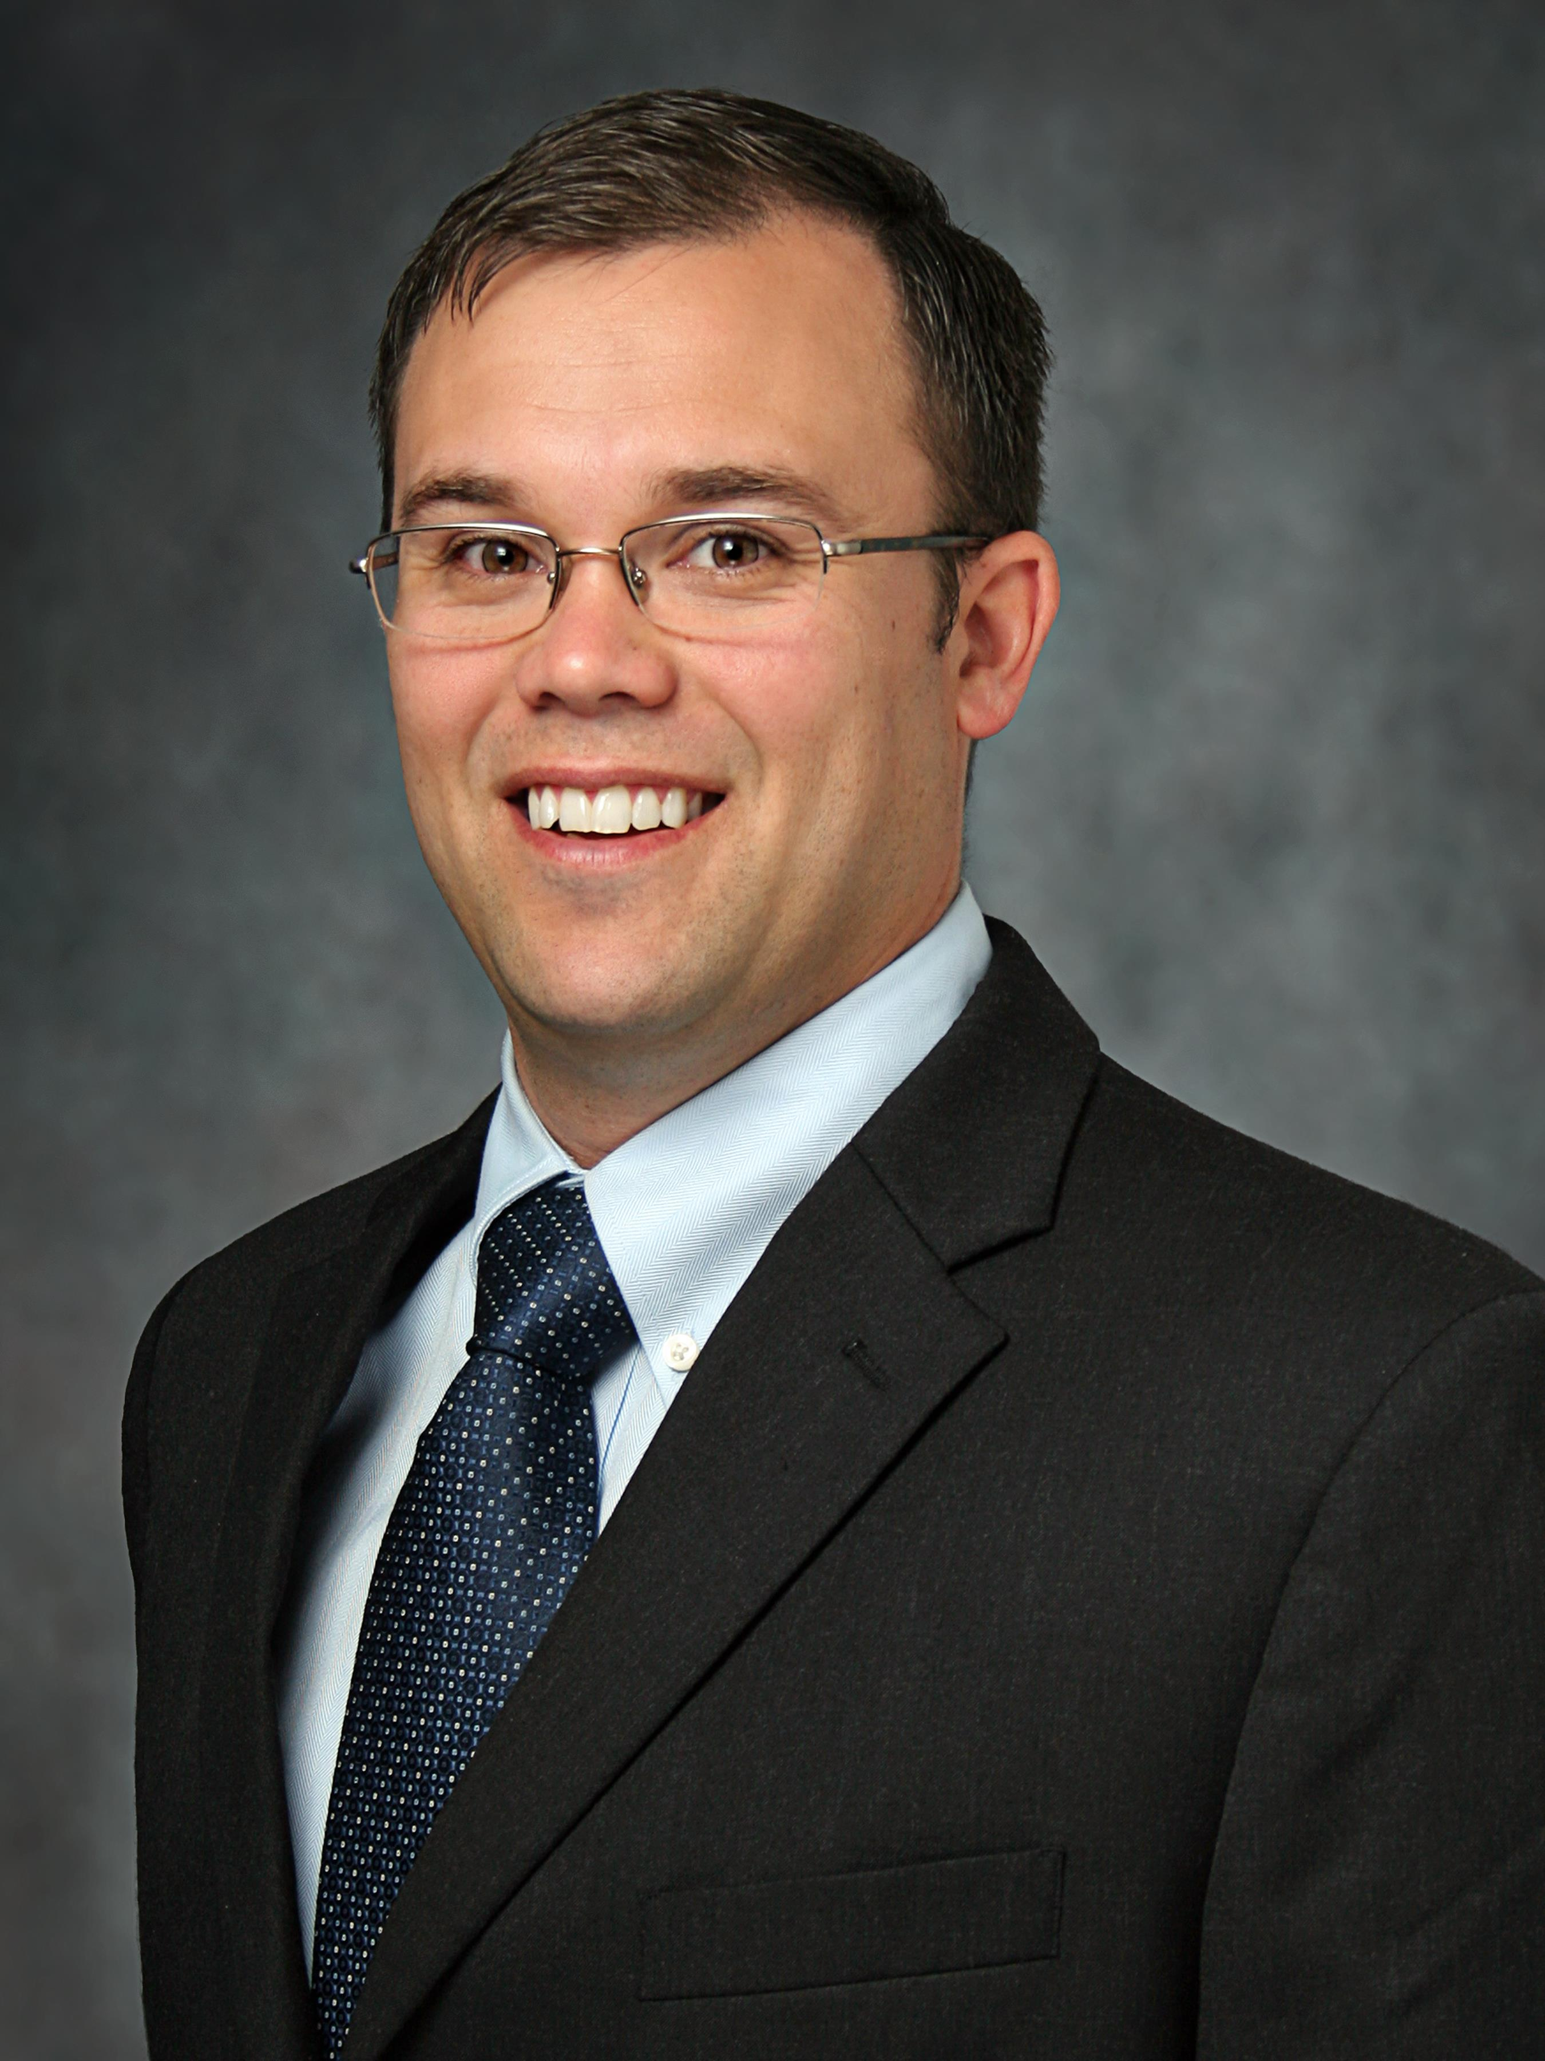
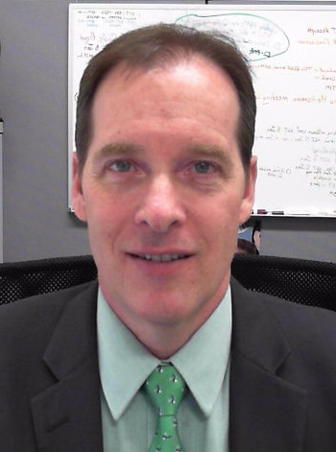
Dick Wilson
International Representative
International Brotherhood of Electrical Workers (IBEW) Utility Department
Randall Lazaro
Veterans Benefits Advisor
Department of Veteran Affairs
Veterans’ Benefits Agency
Washington, DC
Randall Smith
National Veterans’ Employment Manager
DOL, Veterans’ Employment and Training Service
Employment Outreach Team
Washington, DC

Slide 9
Objective #1
Highlight employment growth and opportunities in the energy sector
Objective #2
Highlight employment opportunities in the utility sector, training and education programs to prepare veterans and transitioning service members for available opportunities and other tools and resources to better understand how veterans and transitioning service members can access these opportunities.
Objective #3
Inform and educate AJC and TAP personnel, who are the first point of contact for transitioning service members and veterans who are seeking employment and transitioning who are preparing to enter the civilian workforce.
Objective #4
Highlight apprenticeship programs and how they are preparing veterans and service members for opportunities in the utility sector.

Slide 10
I. The Big Picture: Opportunities in Energy
Deputy Secretary Elizabeth Sherwood-Randall, DOE
Assistant Secretary Mike Michaud, DOL
II. Why Veterans and Service Members
Marion Cain, DOD
III. Utility Jobs, Skills and Training Programs
Ann Randazzo, Center for Energy Workforce Development
IV. Labor Union Apprenticeship Programs
Dick Wilson, IBEW
Richard Passarelli, UWUA
V. Education and Training Benefits Program for Veterans and Service members
Randall Lazaro, Department of Veterans Affairs
VI. DOL Resources
Randall Smith, DOL-VETS

Slide 11
The Big Picture: Opportunities in Energy
Presented by: Assistant Sec Michaud
Dept of Labor
Deputy Sec Sherwood-Randall,
Dept of Energy

Slide 12
Why Veterans & Service members?
Presented by: Marion Cain, DOD

Slide 13
Why Veterans and Service members?
There is no better way to honor our nation's veterans, than to provide support for successful transition by creating a pathway into a rewarding energy sector career.
The nation's electric and gas industries believe that veterans have spent their military careers protecting national security and are, among many things, battle-tested, self-motivated and safety-conscious—traits that translate well into a second career into the utility industry.
By hiring veterans into the industry, energy companies are ensuring the continued production and delivery of safe, reliable power to American homes and businesses, and that servicemen and women are continuing to protect national security as they work to deliver a product that fuels our lives and powers our economy.

Slide 14
DoD SkillBridge
Allows Service members to participate in job training -- including apprenticeships and internships -- beginning up to six months before their service obligation is complete.
For employers:
Participating employers gain early access to highly skilled Service members as prospective employees before those Service members become Veterans.
Training must be provided at low or no cost to Service member.
Offer a high probability of employment.
For Service members:
Participation authorized by first field grade commander in chain of command
Service member participation is voluntary and based upon mission requirements.
To date, more than 4,500 military personnel, at 27 installations, have already successfully participated in the program.

Slide 15
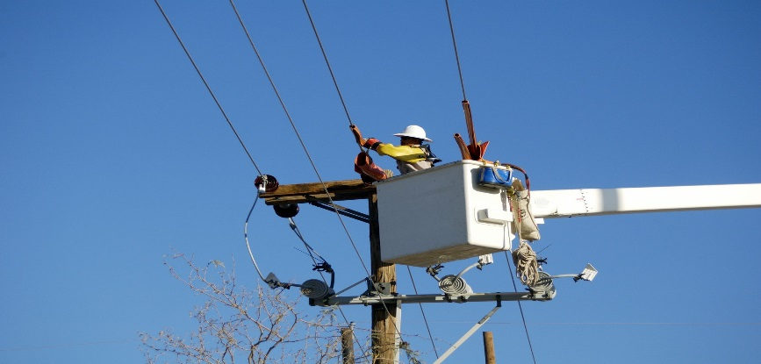
Utility Jobs, Skills and Training Programs
Presented by Ann Randazzo, Center for energy workforce Development

Slide 16
Energy Jobs and the Utility Industry
Jobs in the Electric and Natural Gas Utility offer promising opportunities for experienced workers or those just starting their careers, and provide competitive compensation and professional growth opportunities.
Utility jobs cover the full spectrum of careers from skilled technician positions in generation, transmission, and distribution to security, information technology, communication, training, management, and other supporting positions.
Skilled Utility Technician positions are active, hands-on, rewarding, and available in every state, in an industry that is stable and growing.
How can veterans find out about these great jobs?

Slide 17
What is Troops to Energy Jobs?
A national effort connecting utilities across the country
A way to make it easier for veterans to find out more about utility jobs and what is required
A website to link directly to a utility company and open positions in any state
A step by step guide on how to enter a utility career
www.troopstoenergyjobs.org

Slide 18
Veteran’s Roadmap to Utility Careers
Need more Education
Ready Now
www.troopstoenergyjobs.org

Slide 19
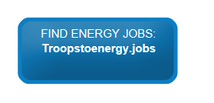
Troops to Energy Jobs Website
Step by Step Roadmap for Veterans
Registration site for Veterans and Hiring Companies
Job Posting site for all CEWD member company positions with exclusive occupation translation
Virtual Coach at any point in process
www.troopstoenergyjobs.com

Slide 20
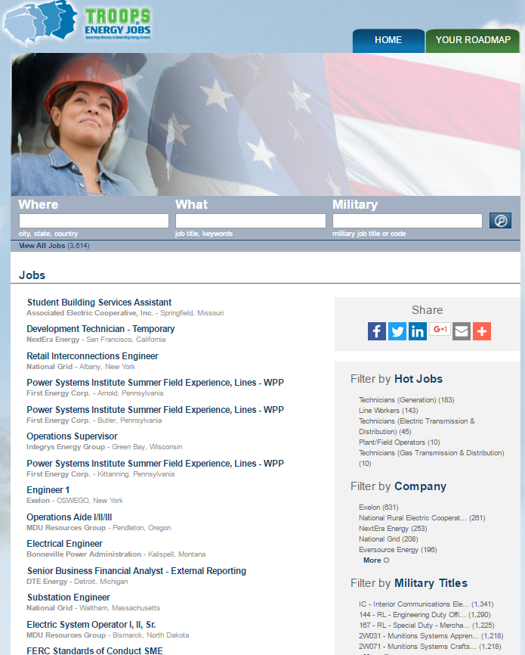
Troops to Energy Jobs Opportunities in Electric and Natural Gas Utilities
Veterans and transitioning servicemen and women can search by:
Hot Jobs
Location
Military Occupation
Company
Military or Civilian Job Title

Slide 21
Apprenticeship And Training Programs

Slide 22
Utility Workers Union of America
A Public-Private Partnership
Presented by Richard Passarelli

Slide 23
Peoples Gas UWUA Local 18007
The UMAP Program was developed in 2012 and to date, through a 6 month partnered training to placement program, has placed over 200 Veterans with gainful careers in the Utility Gas Sector Industry. It is supported by the Department of Defense, The U.S. Army, Department of Veterans Affairs, Department of Labor and is currently partnering with the Department of Energy’s Utility Workforce Initiative .

Slide 24
UMAP Partners
Military Partners
Veterans Affairs/VA Organization Support
Joint Chiefs of Staff
Department of Defense
Soldier For Life
Marines for Life
Great Lakes Naval Base
TRADOC
U.S. Army Fort Sill, Oklahoma
IMCOM – Installation Management Command
Veterans Affairs
Obama Administration Joining Forces
American Legion
Easter Seals Dixon Center
Department of Labor
Women for Wounded Warriors
Department of Energy

Slide 25
UMAP Funding Partners
AFL-CIO /Chicago Federation of Labor
City of Chicago / City Colleges
Public Private Partnering support
3.5 Million Dollar Investment
UWUA, Peoples Gas, CFL Partnership
City Colleges of Chicago

Slide 26
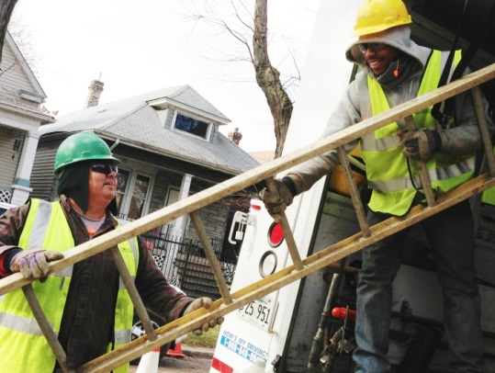
STUDENT QUOTES
"The utility worker program afforded me the opportunity to start a career in a well paying field. I would like to thank Rick Passarelli for providing this amazing chance at a new life. Veterans need to be looked out for after coming home and Mr. Passarelli did just.“ Brett Paquette (1st Cohort)
"Due to the successful joint effort among Peoples Gas, Local 18007, Power 4 America, and UWUA I got a job. Most importantly I thank my Lord and my God for being given this opportunity." Roy Kim (3rd Cohort)
"This program is allowing me apply the technical skills that I learned in the military to the civilian world. It is also been helpful to me in the rough transition that most veterans face from military to civilian life. I'm going to class with like minded people that have served their country like I have." Joshua Parra (6th Cohort)

Slide 27
UMAP Training Facility –Kennedy King

Slide 28
January 16, 2015 UMAP Symposium
On January 16 UMAP hosted a symposium
Partners from across the country attended
City of Chicago, Mayor Rahm Emanuel
“The City of Chicago is committed to ensuring that those who have made the sacrifice to serve our country are welcomed home with open arms,” said Mayor Emanuel. “The extension of the Utility Workers Military Assistance Program will help more veterans transition into a new career with the necessary resources and support. Expanding career opportunities and other initiatives for our veterans will help them continue their success here at home.”
Veterans Affairs Secretary Robert McDonald
Peoples Gas, President John Kleczynski
City of Chicago, Mayor Rahm Emanuel
Senator Richard Durbin
City Colleges Chancellor Cheryl Hyman
UMAP National Director Rick Passarelli

Slide 29
UWUA, first on the front lines with Utility Sector and Veterans Employment
UMAP takes the lead
UWUA Resolution April 2012
In April of 2012 UWUA made a commitment
In April 2015 the company signed an five extension to continue the program with UMAP

Slide 30
2015 Extension - UMAP Visiting Supporters

Slide 31
UMAP’s CUSTOM CURRICULUM
The Gas Utility Worker Program is a 50 credit hour Advanced Certificate program that consists of general education and core courses featuring specific competencies in the safe construction and operation of natural gas distributions systems.
Program consists of six 4-week modules that include the following courses:
Tech 435: Tools and Equipment | Math 107: Math for Technicians I
Tech 434: Introduction to Plumbing | CMGT 609: Construction Safety II
Tech 448: Vocational Physical Training I | Tech 462: Vocational Physical Training II
Tech 463: Vocational Physical Training III | History 113: U.S. Labor History
CIS 120: Introductions to Microcomputers | Tech 452: Basic Electrical Theory
Tech 449: Professional Development | English 107: Technical Writing
Speech 101: Fund. of Speech Communication | Gas Utility Training 1-4

Slide 32
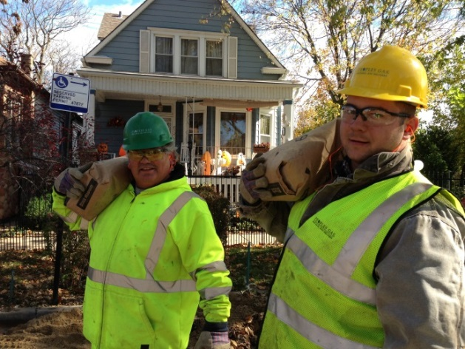
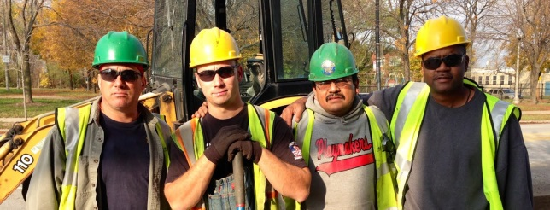
Overview of UMAP Program Mentoring
Critical Component to the UMAP Program
All participants are mentored during internship period by experienced UWUA journey-level workers
Mentors receive structured training prior to working with participants
Mentors will observe, coach and mentor participants during the month long internship
Mentors provide constructive structured feed-back to Peoples Gas regarding participants performance during this period
Mentee
Mentor
Peoples Gas South Shop Mentors

Slide 33
UWUA UMAP National Outreach
Since Conception
UMAP visitors and supporters
Department of Energy
Joining Forces
Department of Labor
Department of Veterans Affairs, Secretary McDonald
U.S. Army Major General James McConville

Slide 34
U.S. Army Training to Placement
UMAP – Fort Sill
UWUA_ UMAP
Department of Defense Instruction (DoDI) 1322.29 allows approved civilian training on military installations
UMAP / P4A has been invited to participate with national UWUA companies to participate and house training at Fort Sill
National MOU to be determined 2015-2016
UMAP National Veterans Chairman Richard Passarelli and P4A Executive Director, John Harmon exploring installation operations with UWUA employers

Slide 35
UMAP - Peoples Gas – Recognized Panel Experts
Participating Presenters at:
Media and Publication recognition :
American Legion Licensing and Credential Summit
Soldier for Life Regional Conferences
Rand Corporation
Department of Labor Veterans Conference
Blue Green Alliance
American Legion National Magazine
Chicago Federation of Labor
Illinois Department of Veterans Affair's State wide publications
City Colleges of Chicago News
NBC Today Show
Military Times
Huffington Post
Chicago Tribune
CBS Chicago

Slide 36
International brotherhood of electrical Workers
Outside Lineman Training
Presented by Dick Wilson

Slide 37
IBEW Outside Lineman Training
Outside Lineman Duties Include:
Planning and starting assignments
Implementing OSHA and customer safety requirements
Establishing towers as well as poles and creating other devices to aid transmission/distribution cables
Developing work positions for preserving and fixing overhead distribution or transmission lines
Stringing new wire or maintaining outdated wire
Installing and maintaining insulators
Installing and maintaining transformers and other devices
When it comes to performing these types of duties linemen utilize climbing tools, hand tools, and heavy equipment every single day.
During apprenticeship training, linemen will experience a substantial amount of technical knowledge.
Knowledge Required:
How to work with energized circuits
How to execute an emergency rescue
First Aid
Connections to be made for many different transformers
Exactly what makes a wooden pole unsafe to climb
Delta and Wye transformer connections
Particular job safety rules
Appropriate hand signals to use with ground crew or equipment operators
The suitable knot to tie in different situation

Slide 38
IBEW Outside Lineman Training
Important Skills To Be Learned:
Skill at working on high voltage lines while wearing protective equipment such as rubber glove
Skill at performing CPR
Skill at rigging equipment
Skill at tying knots
Skill at operating a bucket truck
Skill at splicing high voltage cable
Skill at splicing aluminum or copper cable
Working Conditions:
Working as Outdoor Lineman can be difficult and dangerous at times. Be prepared to work outdoors in extreme temperatures, weather, and environmental conditions. This trade requires considerable amount of physical effort for lifting, carrying materials, erecting poles and climbing.
Since much of the work is performed from ladders, poles or powered lifts. Applicants must be comfortable working at a variety of heights
How to Apply?

Slide 39
IBEW Outside Lineman Training
How to Apply?
Customer Service 1.888.652.4007
http://www.electricaltrainingalliance.org/

Slide 40
Veterans and Service members Education and Training Program Benefits
Presented by: Randall Lazaro
Department of Veterans Affairs
Post-9/11 GI Bill, Chapter 33
Other VA Education Programs
Resources

Slide 41
Post-9/11 GI Bill ®
Post-9/11 GI Bill, Chapter 33
36 months of benefits
Expires 15 years after last period of active duty service of at least 90 days.
Usable for any VA-eligible program; can be college, technical school, on-the-job training, apprenticeships
Transferable

Slide 42
Post-9/11 GI Bill ®, cont.
Tuition and Fees payment (paid to school)
Public schools (in-state) at 100%
Private and overseas schools (capped at $21,084.89 per year
Monthly Housing Allowance (paid to student)
Based on training time (more than half-time)
Pays E-5 with dependent BAH based on school zip code
Not payable to active duty members
Books and Supplies Stipend (paid to student)
Pays up to $1,000 per year ($41.67 per credit up to 24 credits per year)

Slide 43
Other VA Education Programs
Montgomery GI Bill
Up to 36 months
Benefits range from $447.25- $1,789.00 per month, based on training time, paid to Veteran
Expires 10 years after release from active duty
Survivors’ and Dependents’ Educational Assistance
45 months of entitlement
$1,021.00 per month (full-time)
18-26 years old for children
Surviving spouse has 10 years from date of death of the Veteran, or from the date VA finds him or her eligible. If the Veteran died on active duty, 20 years

Slide 44
Resources
www.benefits.va.gov/gibill
1-888-442-4551 (1-888-GIBill-1)
Choosing A School - http://www.benefits.va.gov/gibill/school_decision.asp
Comparison Tool - https://www.vets.gov/gi-bill-comparison-tool
Submit A Question - https://gibill.custhelp.com/app/utils/login_form/redirect/ask/session/L3RpbWUvMTQ2NzAzNDgxNC9zaWQvM1NBTUo1VW0=
FAQs - https://gibill.custhelp.com/app/answers/list

Slide 45
Department of Labor Resources
Randall Smith
Veterans’ Employment and Training Service (VETS)
VETERANS.GOV
DOL Apprenticeship Information

Slide 46
VETERANS.GOV

Slide 47
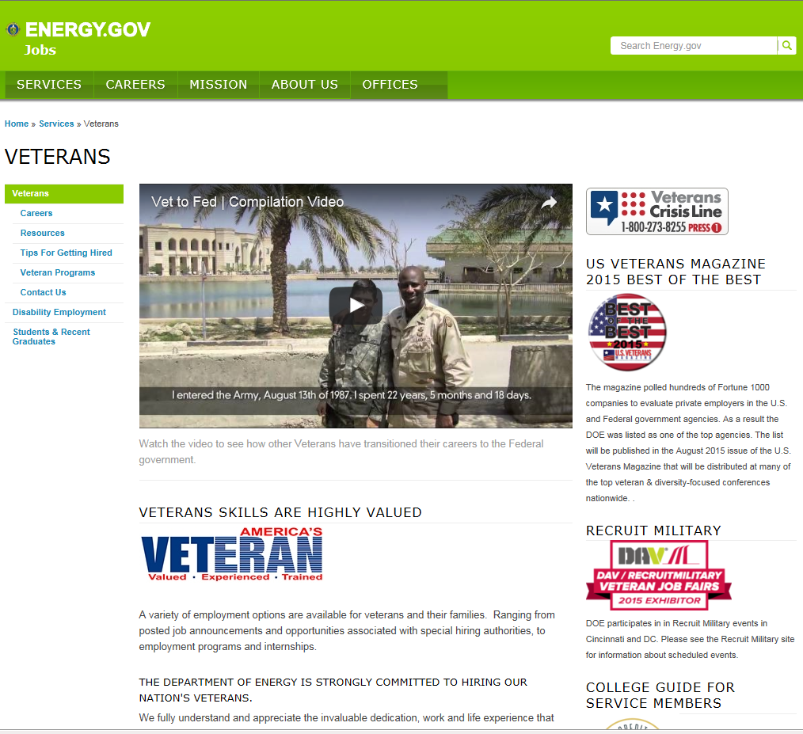
Veterans.Gov link to Energy

Slide 48
Apprenticeships

