Slide 1
LEADER 2016 Strategic Vision and Engagement Strategy Session
Leader of Excellence in Apprenticeship Development, Education and Research
March 2, 2016

Slide 2
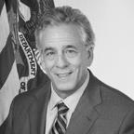
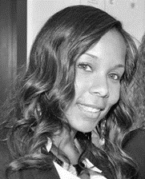
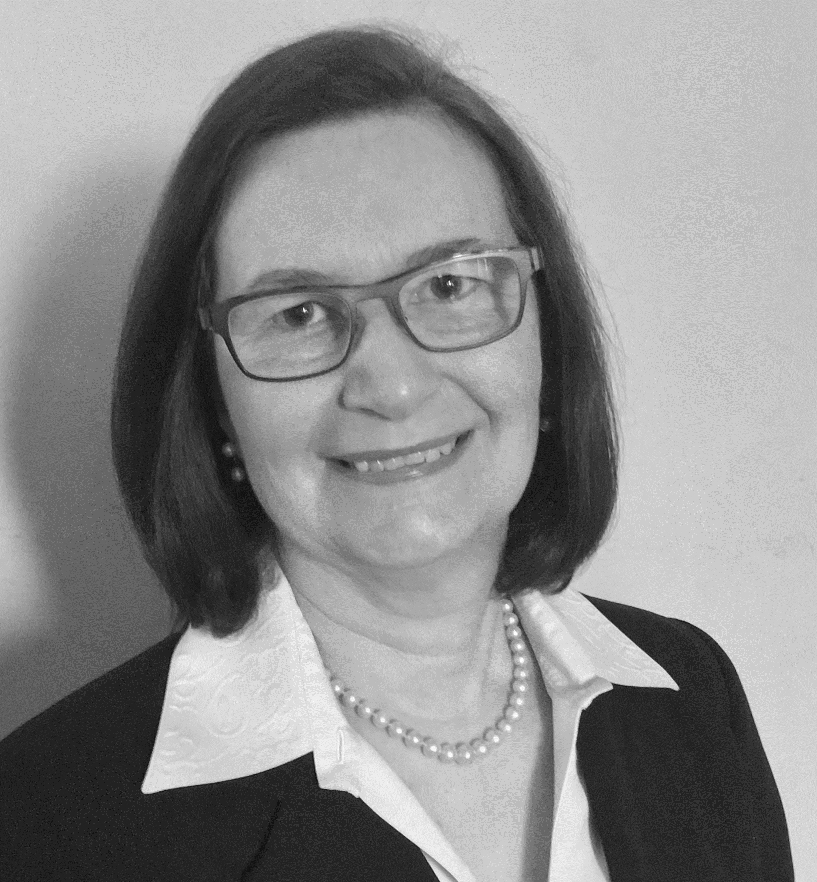
Your Hosts for Today
Eric M. Seleznow
Deputy Assistant Secretary
Employment and Training Administration
Zach Boren
Senior Advisor Office of Apprenticeship
Employment and Training Administration
Cierra Mitchell
Analyst Office of Apprenticeship
Employment and Training Administration
Rachel David
Analyst Office of Apprenticeship
Employment and Training Administration
Laura Ginsburg
Team Lead Office of Apprenticeship
Employment and Training Administration

Slide 3
Last year you answered the call as a LEADER and helped support the expansion of ApprenticeshipUSA.

Slide 4
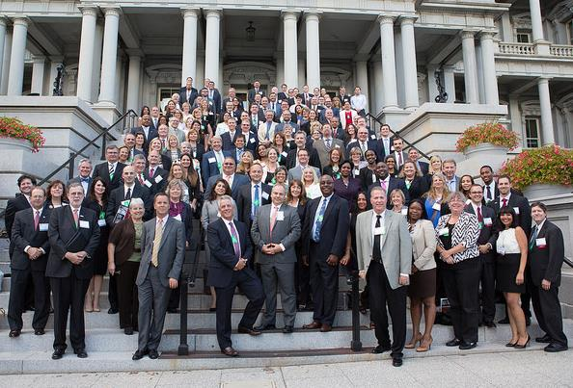
You joined sector gatherings in the summer which culminated at the White House LEADER convening in September.

Slide 5
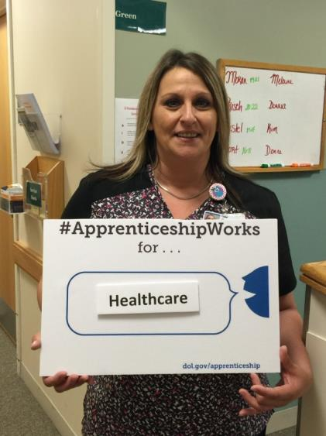
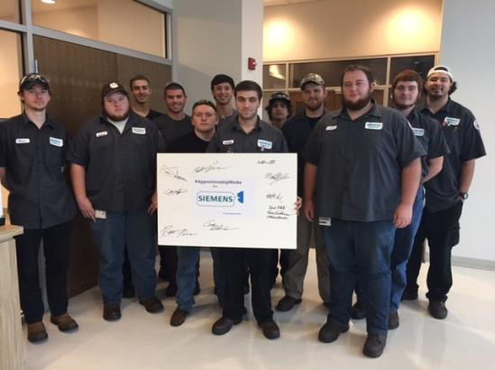
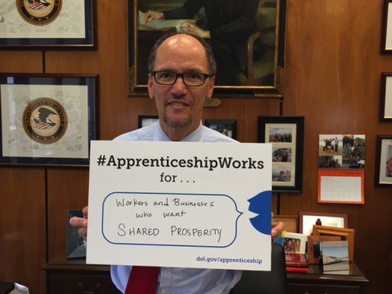
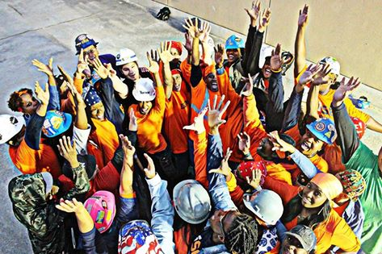
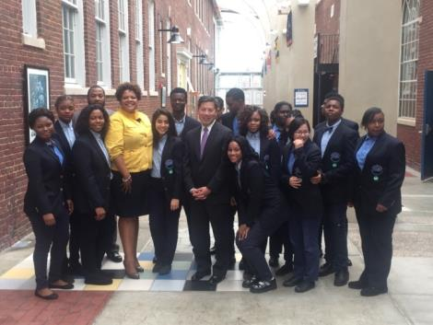
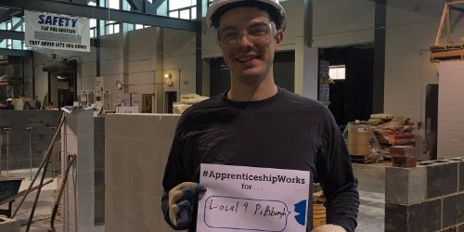
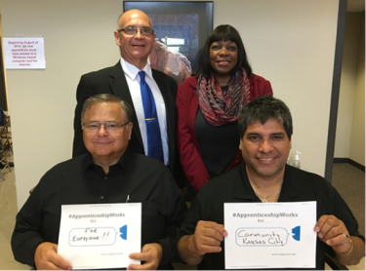
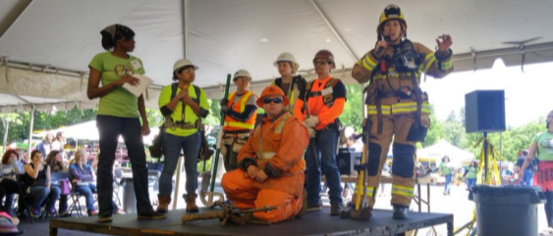
Your leadership and involvement was a critical part of the success of National Apprenticeship Week in November 2015.
Number of Events – 300+
States with NAW Event – 47+
Proclamations – 54
Presidential
Senate Resolution
House Resolution

Slide 6
So, what ideas do we have for 2016?

Slide 7
Today’s Session
Updates
Vision & Goals
2016 Events

Slide 8
ApprenticeshipUSA continues to grow.
750,000
500,000
FY 16 Annual Goal
451,423
Quarter 1 - FY 16
Number of Active Apprentices
375,000

Slide 9
FY 16 $90 Million Apprenticeship Appropriation
Programmatic Resources for Apprenticeship
Annual Funding
Branding: ApprenticeshipUSA Funding
Combination of Grants (States) & Contracts (National Partners and Activities)

Slide 10
Strengthening the LEADER network moving forward.
LEADER Web Portal
Conference Calls with Sector Groups
DOL is considering developing a portal for LEADERs to collaborate virtually. In 2016, DOL plans to launch the portal – stay tuned!
Office of Apprenticeship hosting calls with Sectors of Excellence in Apprenticeship (SEAs)
LEADERs.

Slide 11
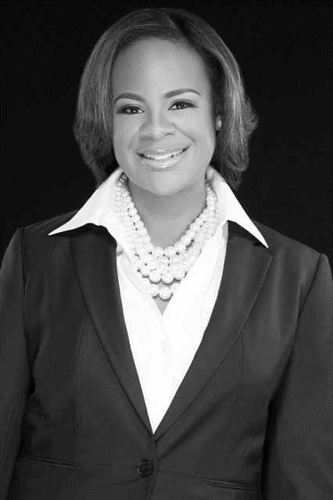
Updates from LEADERs
Nicole Collier
Nestle
Director, Government Relations

Slide 12
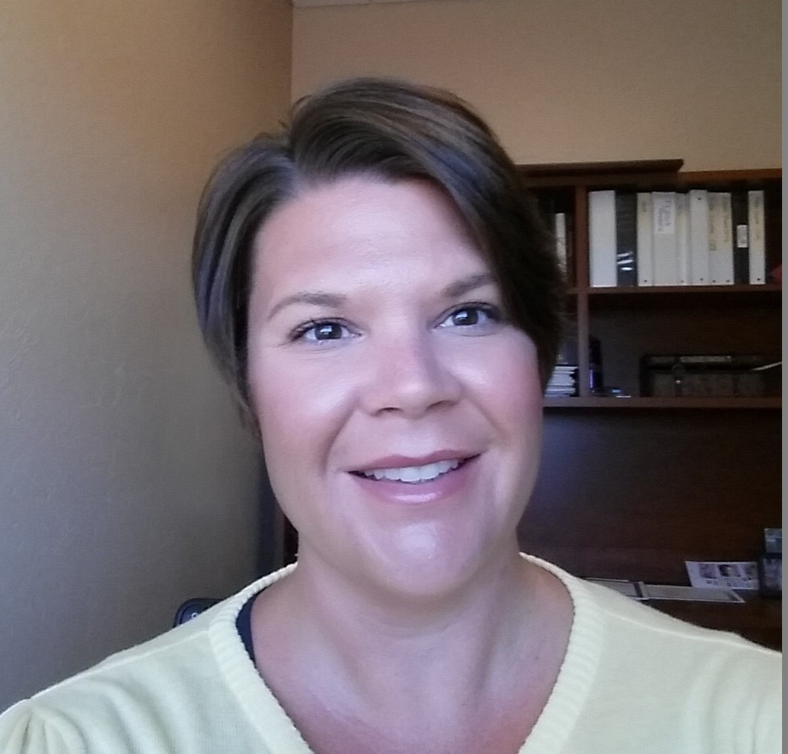
Updates from LEADERs
Becky Holton
American Health Information Management Association (AHIMA)
Vice President of Development

Slide 13
Updates from LEADERs
Makeeda Holley
AFSCME-1199 Trading and Upgrading Fund
Director of Workforce Development

Slide 14
Vision & Goals
2016

Slide 15
Continue to rapidly expand ApprenticeshipUSA across both traditional and non-traditional industries.
1

Slide 16
Grow the LEADER community to
300+ members
2

Slide 17
Support and raise visibility of LEADERs using ApprenticeshipUSA to meet training and talent development needs
3

Slide 18
Continue to expand rapidly ApprenticeshipUSA across both traditional and non-traditional industries.
2016
Goals
Grow the LEADER community to 300+ members
Support and raise visibility of LEADERs using ApprenticeshipUSA to meet training and talent development needs
What are other important goals for
LEADERs in 2016?

Slide 19
2016 LEADER Events

Slide 20
ApprenticeshipUSA Accelerator Sessions
Opportunity for businesses and other industry stakeholders to rapidly develop and register apprenticeship programs.
Focus on Advanced Manufacturing, Construction, Energy, Healthcare, IT, Transportation and Logistics, and others TBD

Slide 21
Helping Business Accelerate Apprenticeship
Businesses who attend Accelerators will access:
Experts in apprenticeship in their industry
Resources to help them quickly build apprenticeship programs
Help connecting to partners and leveraging funding
Standards Builder facilitates rapid registration of apprenticeship programs

Slide 22
ApprenticeshipUSA Accelerator Process
Facilitate intensive assistance to jump start development of a customized talent development solution and find resources to support the program
Overview – Benefits of RA
Facilitate Consultation & ID Resources
Build understanding of bottom-line benefits of Apprenticeship
Tailored Assistance in Program Development
Provide a roadmap with on-going technical assistance in building a registered apprenticeship program that seamlessly integrates into HR and training strategies.

Slide 23
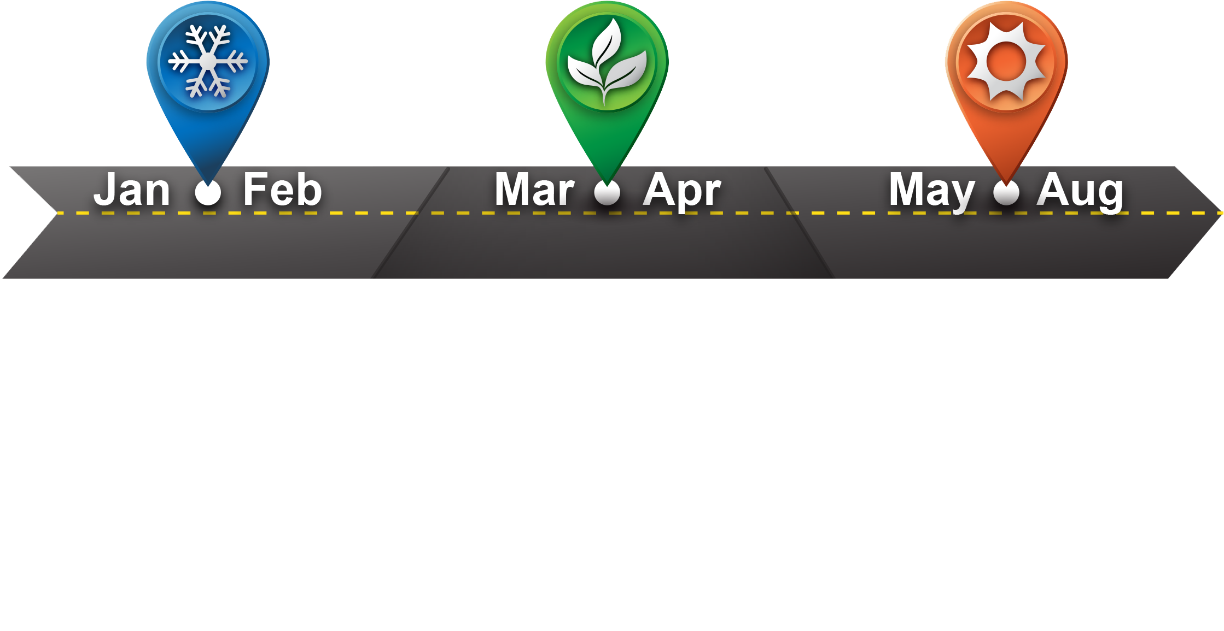
Road to ApprenticeshipUSA Accelerators
Gather input from stakeholders to shape the design of Accelerators
Identify industry champions to serve as advisors for Accelerators
Announce dates and locations of Accelerators
Identify businesses to participate in the meetings and rapidly develop and register apprenticeships
Hold ApprenticeshipUSA Accelerators in targeted industries across the country

Slide 24
ApprenticeshipUSA Accelerators
Champion apprenticeship in your industry
Shape agenda to ensure results
Help recruit businesses and partners
Attend events to lend expertise
Interested in joining the planning committee?
Critical LEADER Roles

Slide 25
National Manufacturing Day October 7, 2016
Encourage LEADERs to participate in National Manufacturing Day .
Share success stories, pictures, press releases, and highlights with us.
More information to come about Manufacturing Day in August to give plenty of time to plan an event.

Slide 26
600+
Goal to double the number of NATIONAL APPRENTICESHIP WEEK events this year.
National Apprenticeship Week 2016

Slide 27
What ideas or questions do you have?

Slide 28
We invite you to continue your important role to expand ApprenticeshipUSA.

Slide 29
Thank You for Participating in Today’s Webinar
2016 LEADER Event Recap
Spring-Summer – ApprenticeshipUSA Accelerators
Spring-Summer – Capitol Hill Event
October 7, 2016 – Manufacturing Day
Fall 2016 – National Apprenticeship Week

