Slide 1
March 16, 2016
TAACCCT Partnerships: Registered Apprenticeship (RA) and Registered Apprenticeship-College Consortium (RACC)

Slide 2
Question #1
Please respond with the Round of your TAACCCT Grant:
  Round 1
  Round 2
  Round 3
  Round 4

Slide 3
TAACCCT LEARNING NETWORK
AT A GLANCE
U.S. Department of Labor, Employment & Training Administration
(National)
Jobs for the Future
CalState/Merlot
Maher & Maher
American Association of Community Colleges
U.S. National Science Foundation
ATE Centers
Other Non-Federal Providers of TA and Resources for TAACCCT Grantees:
Creative Commons
CAST
The Transformative Change Initiative

Slide 4
TODAY’S AGENDA
Welcome and Introductions
Overview of Registered Apprenticeships (RA) and Registered Apprenticeship-College Consortium (RACC)
Presentations
  Heather Weber, Ed.D., Dean of Occupational Education, Estrella Mountain Community College (Arizona)
  Vikki Gordon, Ed.D., Apprenticeship Coordinator, Macomb Community College (Michigan)
Available Resources

Slide 5

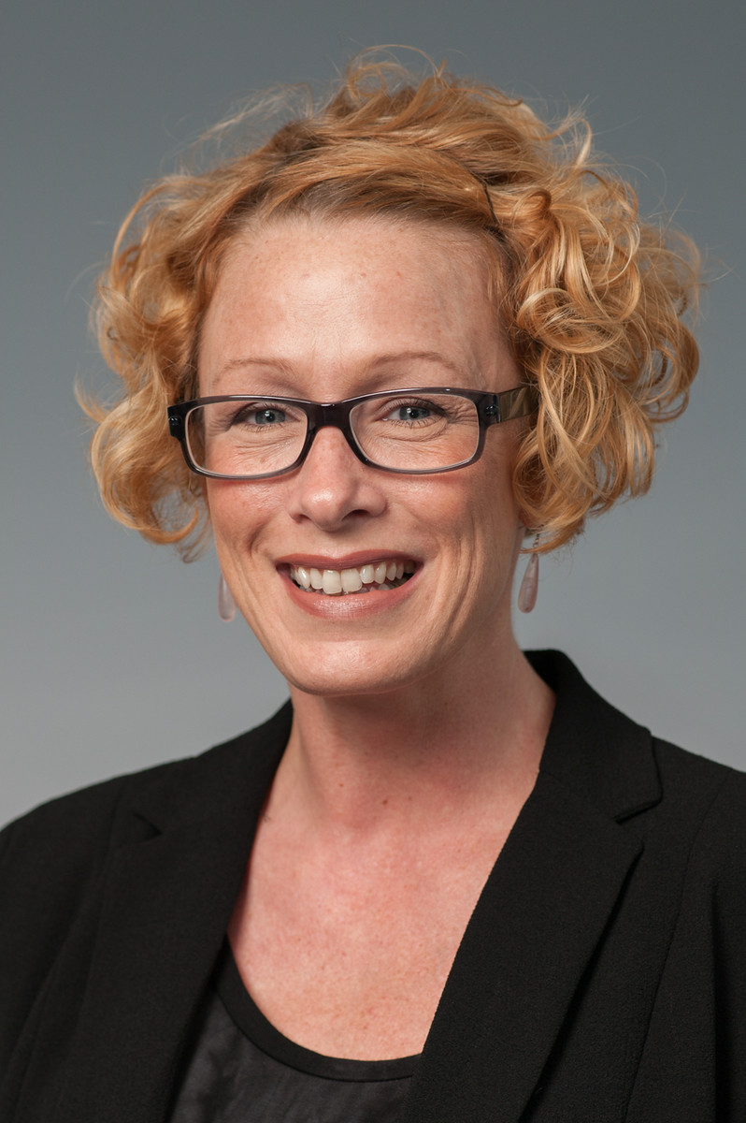


Presenters/Moderators
Laura Ginsburg
Team Leader, Office of Apprenticeship
U.S. Department of Labor
Vikki Gordon, Ed.D.
Apprenticeship Coordinator
Macomb Community College (Michigan)
Heather Weber, Ed.D.
Dean of Occupational Education
Estrella Mountain Community College (Arizona)
Samantha Brown, Ph.D.
Workforce Analyst, TAACCCT Grants
U.S. Department of Labor

Slide 6
Question #2
How familiar are you with Registered Apprenticeship?
  Very Familiar
  Familiar
  Somewhat Familiar
  Not Familiar

Slide 7
Question #3
Are you a member of the Registered Apprenticeship-College Consortium (RACC)?
-Yes
-No

Slide 8
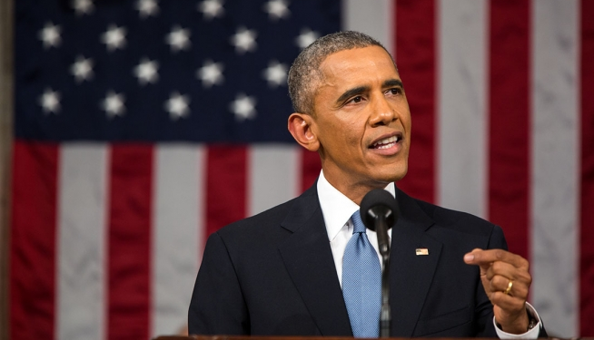
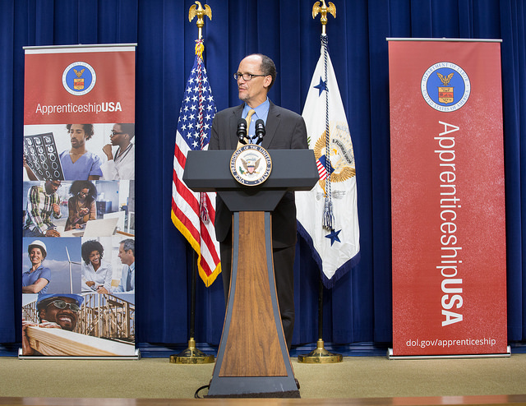
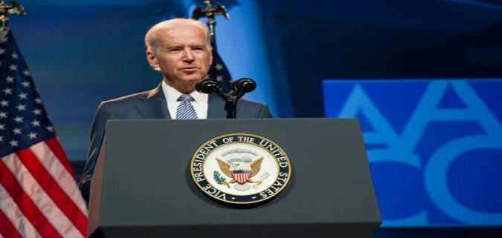
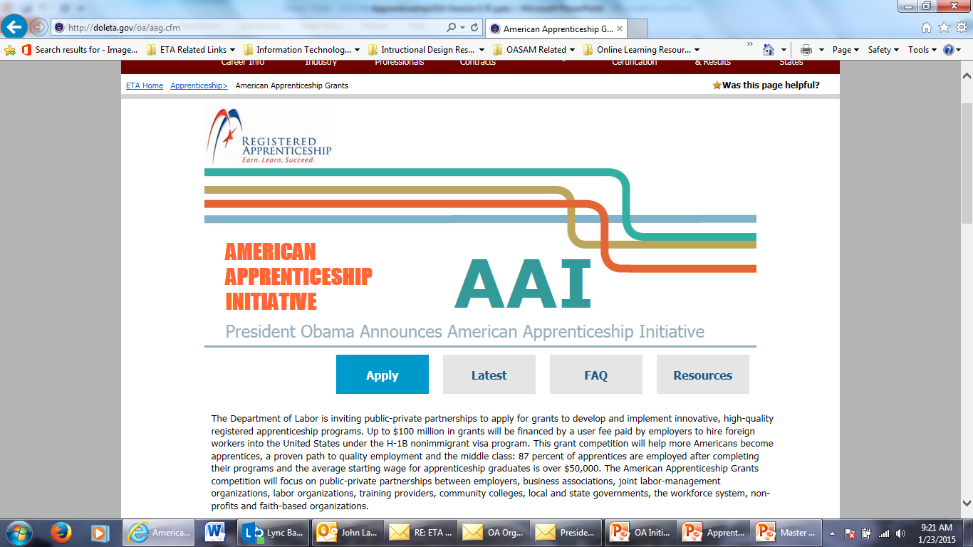
Today and over the past 18 months, Registered Apprenticeship has been in the workforce-development spotlight.
Tonight, I'm also asking more businesses to follow the lead of companies like CVS and UPS, and offer more educational benefits and paid apprenticeships -- opportunities that give workers the chance to earn higher-paying jobs even if they don't have a higher education.
– President Obama, State of the Union - 2015
LEADER White House Convening
September 2015
…Train Americans with the skills employers need, and match them to good jobs that need to be filled right now. That means more on-the-job training, and more apprenticeships…
- President Obama, State of the Union - 2014
Vice President Biden (AACC Conference) on April 7, 2014 , announcing the launch of the RACC.
American Apprenticeship Grants
$175 Million!

Slide 9

ApprenticeshipUSA continues to grow.
750,000
500,000
FY 16 Annual Goal
451,423
Quarter 1 - FY 16
Number of Active Apprentices
375,000

Slide 10
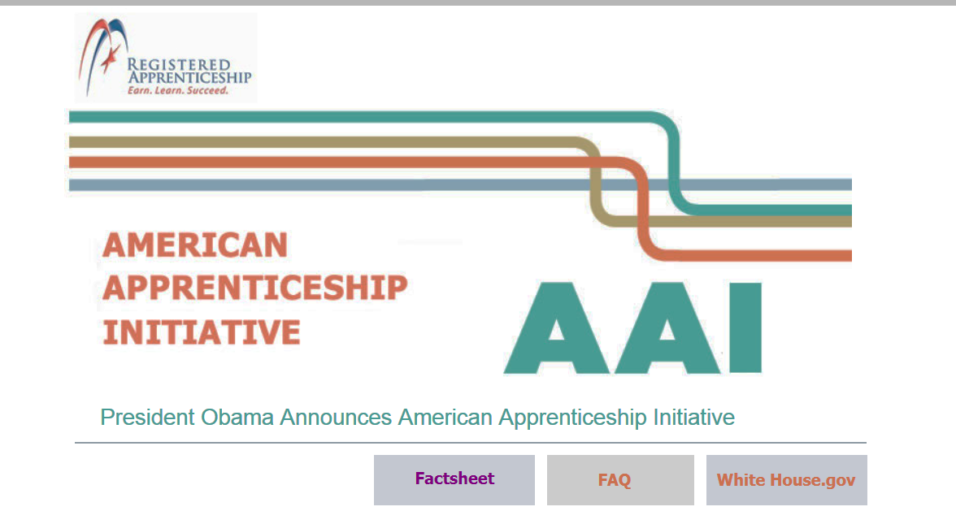
The President announced the winners of the American Apprenticeship Grant SGA on September 9, 2015.
American Apprenticeship Initiative
$175 Million – 46 Grants
Launch apprenticeship in new, high growth fields.
Scale models that work.
Align apprenticeships to pathways for further learning & career advancement.
Learn more at http://doleta.gov/oa/aag.cfm

Slide 11

Expansion for Fiscal Year 2016: $90 Million for American Apprenticeship Grant program
This historic new program has the potential to increase alignment with more Community Colleges by providing classroom instruction for apprenticeships and ensuring States support college credit for apprenticeship:
States: Build state capacity to administer RA programs;
Industry: Build on American Apprenticeship grant and expand apprenticeship beyond H1B targeted occupations and industries;
Under-Represented Populations: Support community-based organizations and workforce intermediaries on innovative strategies for career pathways;
National Activities: Increase national outreach, technical assistance, and capacity building needs;
Office of Apprenticeship
US Department of Labor | Employment and Training Administration

Slide 12
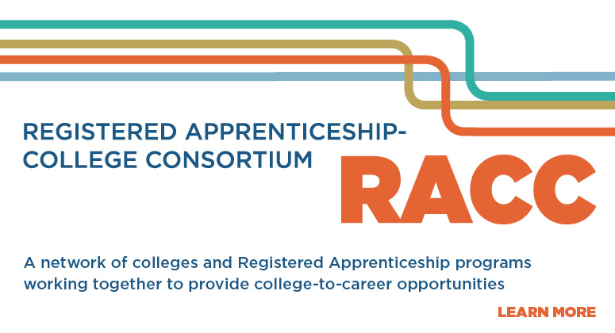
Postsecondary Pathway
GOALS:
Attain better completion via diverse pathways to postsecondary degrees.
Facilitate articulation of the Registered Apprenticeship certificate for college credit on a national scale to enable apprentices to earn a college degree
Strengthen relationships among Registered Apprenticeship and two- and four-year post-secondary institution representatives nationwide.
Office of Apprenticeship
US Department of Labor | Employment and Training Administration

Slide 13

240 colleges joined the RACC
956 Apprenticeship Training Centers
Electrical Training ALLIANCE
Finishing Trades Institute
Heat & Frost Insulators & Allied Workers
Sheet Metal and Air Conditioning Industry
National Elevator Industry Educational Program
United Association of Plumbing & Pipefitting
14 National, Regional, State Organizations
American Association of Community Colleges
AFL-CIO Building and Construction Trades
Council on Adult and Experiential Learning (CAEL)
Colorado Community College System
North Carolina Community College System
Ohio Association of Community Colleges
Ohio Board of Regents
Oregon Department of Community Colleges
and Workforce Development
Collegiate Consortium for Workforce and Economic Development
South Carolina Technical College System
Southeast Maritime & Transportation Center (SMART)
Technical College System of Georgia (TCSG)
University of Alaska System
VA Tidewater Consortium for Higher Education
Wisconsin Technical College System

Slide 14
Question #4
How important is the role of Registered Apprenticeship in your TAACCCT Grant?
  Very Important
  Important
  Somewhat Important
  Not Important

Slide 15
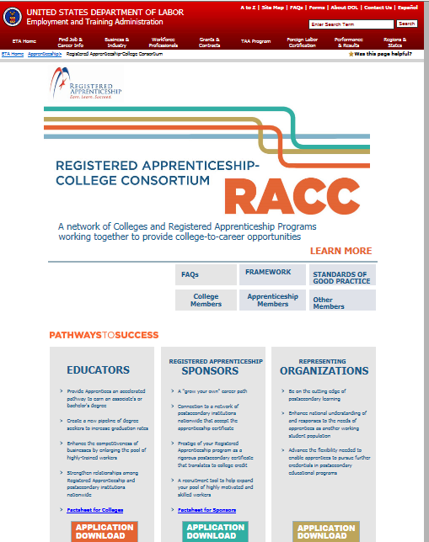
Web Tour of RACC Website and Resources http://www.doleta.gov/oa/racc.cfm

Slide 16

Innovations: Colleges as RA Sponsors
Colleges can also be sponsors
Benefits:
Qualify for state-based tax credits related to apprenticeship programs.
Access resources from federal programs to help reduce costs and support your apprentices.
Join the apprenticeship system and leverage a nationwide network of expertise and support at no cost.
Model: Harper College
Office of Apprenticeship
US Department of Labor | Employment and Training Administration

Slide 17

Innovations: Federal Student Aid to Support RA Programs
Federal Pell Grants
Apprentices who qualify for Federal Pell Grants can receive funding to cover all or most of the cost of tuition and fees, and books and supplies for the students’ enrollment in the technical instruction portion of an apprenticeship if part of an eligible academic program.
Federal Work Study (FWS)
Institutions can use FWS funds to pay a portion of the training wages of eligible students who are apprentices while they are enrolled in eligible certificate or degree programs.
Institutions can leverage their FWS funds, individually or as part of a group of institutions, to create a Job Location and Development (JLD) program to help identify and support employers in creating apprenticeships for enrolled students.
Office of Apprenticeship
US Department of Labor | Employment and Training Administration

Slide 18
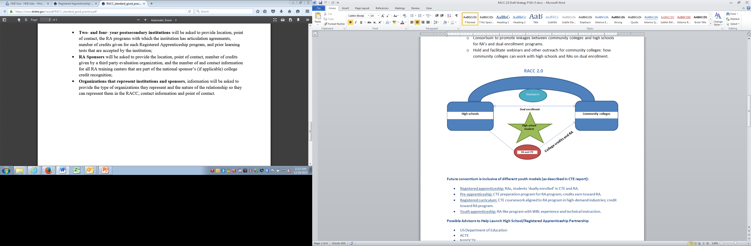
Innovations: High Schools and Youth Focus
Opportunity:
Employers interested in working with high school students
Increase linkages between high school career and technical education courses with apprenticeships
High schoolers are in dual enrollment programs and receive college credit
Office of Apprenticeship
US Department of Labor | Employment and Training Administration

Slide 19
Question #5
What kinds of Technical Assistance (TA) about Registered Apprenticeship or RACC would you be interested in?
  Open Comments

Slide 20
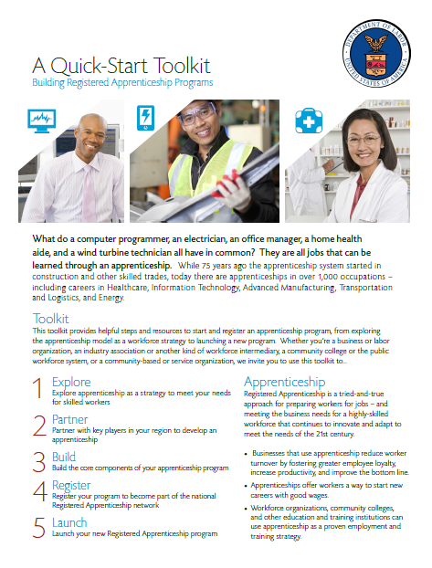
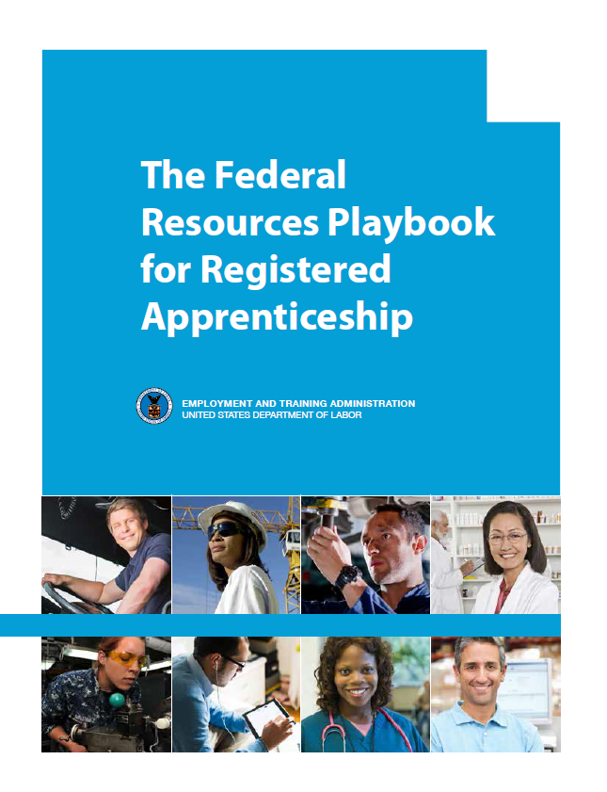
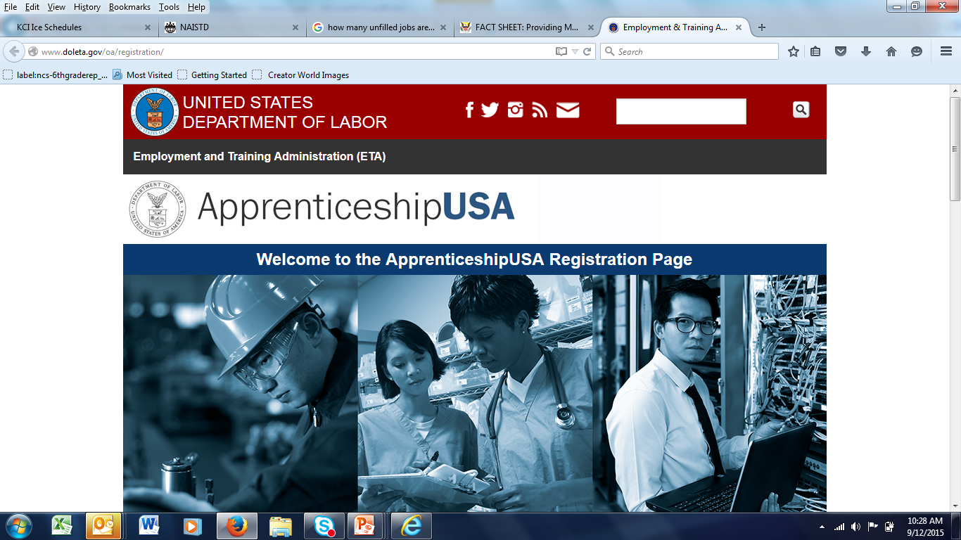
DOL.GOV/Apprenticeship: New Resources
Quick-Start Toolkit
5 Step Format to take you from “exploring” to “launching” a Registered Apprenticeship Program.
http://www.doleta.gov/oa/employers/apprenticeship_toolkit.pdf
Federal Resources Playbook for Registered Apprenticeship
Guide to resources from the Departments of Labor, Education, Veterans Affairs, Agriculture, Transportation, and Housing and Urban Development to support Registered Apprenticeship
http://www.doleta.gov/oa/federalresources/playbook.pdf
DOL Registration Site
An electronic apprenticeship standards builder that allows potential new sponsors to build and register their program online.
http://www.doleta.gov/oa/registration/
RACC Site
Find information on becoming a RACC member and a database of college members and sponsors.
https://www.doleta.gov/oa/racc.cfm

Slide 21
Question #6
Are you interested in learning more about how your institution could become a member of RACC?
  Yes
  Maybe
  No
  Already a Member

Slide 22
Program at Macomb Community College
Macomb Community College (MCC), Department of Applied Technology & Apprenticeship
  Providing education and training in the industrial trades to local industry for more than 60 years
  Serving both employer-sponsored (apprentices) and non-employer-sponsored students
  Currently working with approximately 70 companies that send more than 400 apprentices overall to MCC for training

Slide 23
MCC TAACCCT Award
Michigan Coalition for Advanced Manufacturing (M-CAM)
  Macomb Community College, Bay De Noc Community College, Grand Rapids Community College, Kellogg Community College, Lake Michigan College, Lansing Community College, Mott Community College, & Schoolcraft College
  TAACCCT funding supports M-CAM's efforts to leverage growing opportunities in advanced manufacturing
    Computer numerical control (CNC) machining, welding/fabrication, multi-skilled technician and production operations
    Targeted populations include displaced workers, employed workers who require skills upgrading and veterans

Slide 24
MCC TAACCCT + Apprenticeship
Reciprocal benefits
  Apprenticeship helps MCC succeed with TAACCCT
  TAACCCT helps MCC succeed with Apprenticeship
  Employers need employees with skill in advanced manufacturing
    M-CAM provides employees with entry-level skill in an advanced manufacturing sector
    Articulations between MCC non-credit (M-CAM) and credit (Applied Technology & Apprenticeship) programs benefit employers and students (both apprentices and non-employer-sponsored students)

Slide 25
MCC CNC Machining Articulation
M-CAM Computer Numerical Control (CNC) Machining program aligns with MCC apprenticeship and certificate programs in several advanced manufacturing sectors
  Students who transition receive 9 college credits (160 hours of RTI) to use toward aligning apprenticeship or certificate program
    Employer's apprenticeship program in CNC Machining, Tool & Die Making, Mold Making, . . .
    MCC certificate program in CNC Machinist, CAM Technologist, Industrial Maintenance Mechanic, Machine Repair, . . .
  Additional "steps" are available to students who desire to pursue additional or advanced certificates, associate's degrees, and bachelor's degrees

Slide 26
MCC CNC Machinist Apprentice Articulation Example
TAACCCT-funded CNC Machining program (non-credit)
ABC Tool & Die CNC Machinist Apprenticeship Program
(26 additional credits/416 hours RTI)
Macomb CC Associate of Applied Science in Manufacturing Technology
(27 additional credits)
9 CR/160 hours RTI
35 CR

Slide 27
MCC Welding/fabrication Articulation
M-CAM Welding/fabrication program aligns with MCC apprenticeship and certificate programs in several advanced manufacturing sectors
  Students who transition receive 11 college credits (192 hours of RTI) to use toward aligning apprenticeship or certificate program
    Employer's apprenticeship program in Welding, Weld Maintenance, Machine Repair, Pipefitter, . . .
    MCC certificate program in Basic Welding, Millwright, Industrial Maintenance Mechanic, Machine Repair, . . .
  Again, additional "steps" are available to students who desire to pursue additional or advanced certificates, associate's degrees, and bachelor's degrees

Slide 28
MCC Welding Technician Apprentice Articulation Example
TAACCCT-funded Welding/fabrication program (non-credit)
ABC Tool & Die Welding Technician Apprenticeship Program
(24 additional credits/384 hours RTI)
Macomb CC Associate of Applied Science in Manufacturing Technology
(27 additional credits)
11 CR/192 hours RTI
35 CR

Slide 29
MCC (M-CAM) TAACCCT Grant Beneficiaries
Many career pathways are available for TAACCCT grant beneficiaries
  From entry level gained with basic certificate to apprentice to Engineering Technology, Industrial Management & Supervision, Tool Design, . . .
  Additional education may be required; articulations and transfer agreements ease the way

Slide 30
MCC TAACCCT + Apprenticeship Success Stories
Student success stories
Employer success stories

Slide 31
Partnerships with TAACCCT
ASC-GIE Consortium Overview
Goal: develop a comprehensive and strategic approach to enhancing the energy technician pipeline in the Arizona Sun Corridor megaregion
$13.5 million award
  ($5.5 million to EMCC)
Five Arizona community colleges
Three year performance period (10/1/2012 – 9/30/2015 )
  6 month extension (3/31/2016)
  Evaluation and reporting period (9/30/16)

Slide 32

State-wide Industry Partners

Slide 33
ASC-GIE Consortium Highlights
97% completion of action items in 3 years
EMCC’s IT and Power Systems Security received Center for Academic Excellence designation for two-year institutions
Diversity & Outreach Symposium- best practices shared with colleges nationwide
Pathway Mapping for Employers and Students
Prior Learning Assessment - common policy approved across districts within the ASC-GIEC
Veteran Resource Guide template developed to better serve veteran students

Slide 34
ASC-GIE Consortium Outcomes
1,746 official participants served statewide
124% participant growth from year 1 to year 2, and 149% growth from year 2 to year 3
Target populations
  155 Veterans served
  141 TAA-eligible workers served
1,927 total industry credentials awarded
420 degree or college certificate completers
182 students hired

Slide 35
EMCC GIE Outcomes
452 unique voluntary participants reported to DOL
569 total program students served and impacted by the grant
Credentials earned
  National Career Readiness Certificate (NCRC) – 395
  Skills USA Employability Skills Certificate – 124
  Energy Industry Fundamentals Certificate (EIF) – 344
53 degree completers
70 students hired by industry
Development of EMCC Cyber Security Program
Registered Apprenticeship – College Consortium Member (RACC)

Slide 36
EMCC
Registered Apprenticeship Program
EMCC-APS Palo Verde Nuclear Generating Station (PVNGS) partnership
  In 1986, APS-PVNGS expanded apprenticeship program to include an internship component.
  In 2001, EMCC launched the Power Plant Technology (PPT) program to offer a credit-bearing courses for a Registered Apprenticeship program.
  In 2008, APS - PVNGS added the completion of the EMCC PPT degree as a requirement for the maintenance apprenticeship program.
  Over 300 students in the PVNGS internship and apprenticeship programs have earned college credits.
  Students who complete the NCRC and EIF certifications, an apply for an intern and/apprenticeship position with APS-PVNGS are automatically invited to sit for the pre-employment test.

Slide 37

RACC Webpage https://www.doleta.gov/oa/racc.cfm
RACC Fact Sheet https://www.doleta.gov/oa/pdf/RACC_One_Pager_for_Colleges.pdf
For the Application: https://www.doleta.gov/oa/pdf/RACC_college_application.pdf
Next Steps

Slide 38
Thank You!
Find resources for TAACCCT success at:
https://etagrantees.workforce3one.org
Subscribe to TLN resources, ask questions or connect with peers at TAACCCT@dol.gov

