Slide 2

21st Century Job Centers:
A Practitioner’s guide

Slide 4



Virginia Hamilton
Regional Administrator, Region 6
San Francisco Employment and Training Administration
U.S. Department of Labor
Ben Kushner
Workforce Analyst
Independent Contractor
Los Angeles, CA
Matthew A. Poland
Senior Program Manager
Jobs for the Future
Oakland, CA

Slide 5


Candace Moody
Vice President, Communications
CareerSource Northeast Florida
Jodi Leipold-Mostel
Operations Manager
Pennsylvania CareerLink – Allegheny East

Slide 6

First, Some Context…

Slide 7
Preview the Practitioner’s Guide
Hear from experts in the field
Answer your questions

Slide 8
21st Century Job Centers:
A Practitioner’s guide

Slide 9


Tools for Assessment
8

Slide 10

Tools for Assessment
Interest assessments
Skill assessments
Work style assessments

Slide 11
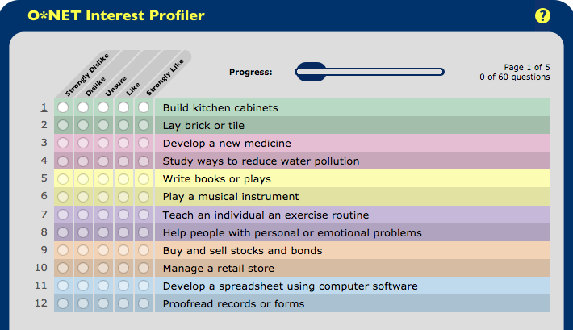
Interest Assessments
10
My Next Move

Slide 12

Work Style Assessments
11

Slide 13




Evaluating the Tools
Accuracy
Expert Opinions
Difficulty
Cost

Slide 14

Tools for Career Exploration
13

Slide 15
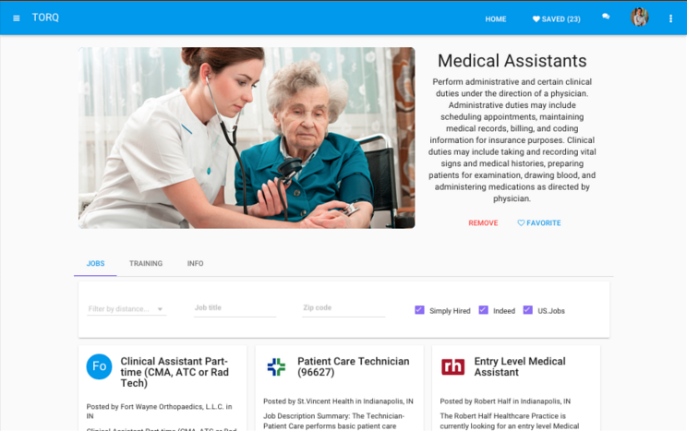
Tools for Career Exploration

Slide 16
Tools for Career Exploration
NRF: National Retail Federation
National Association of Manufacturers
ANA: American Nurses Association

Slide 17




Evaluating the Tools

Slide 18

Tools for Skill-Building
17

Slide 19
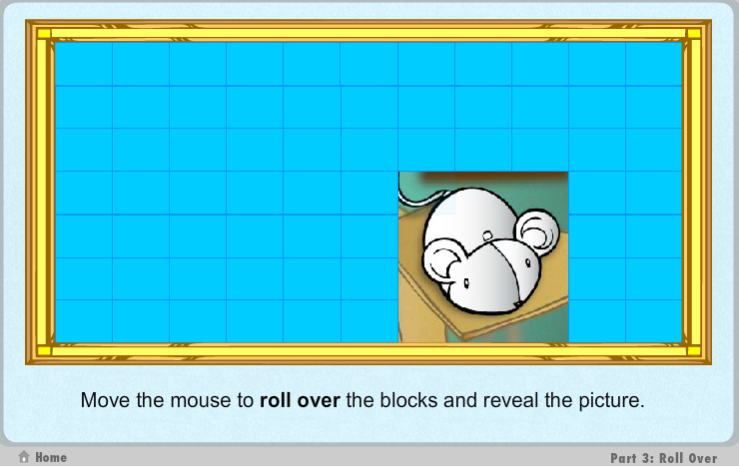
Tools for Skill Building
18
Source: GCF LearnFree.org

Slide 20
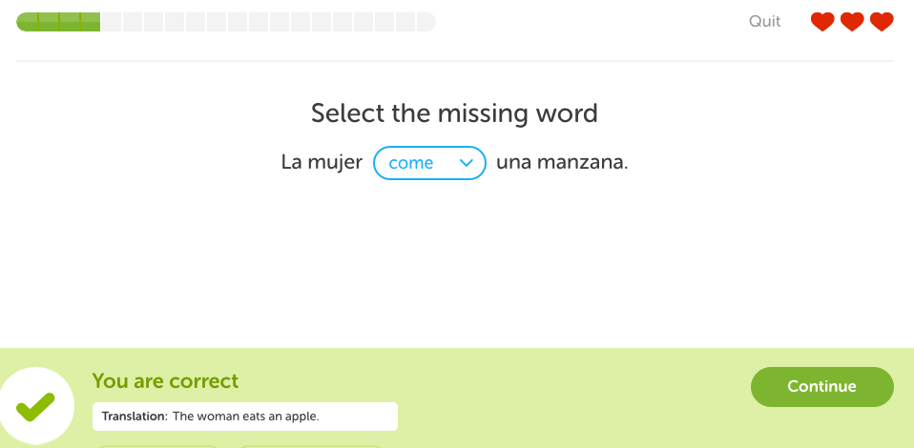
Tools for Skill Building
19
Source: duoLingo

Slide 21



Evaluating the Tools
Ask employers, educators, support service providers:

Slide 22

Tools for Job Search and Job Matching
21

Slide 23

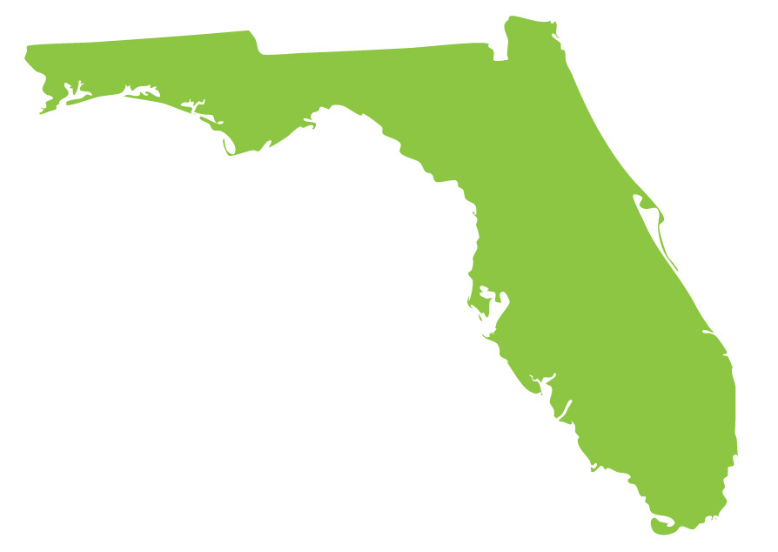


Tools for Job Search and Job Matching

Slide 24




Evaluating the Tools

Slide 25
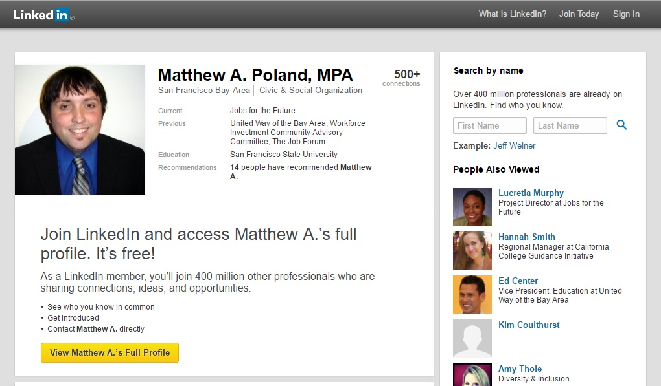
Social Media
24

Slide 26


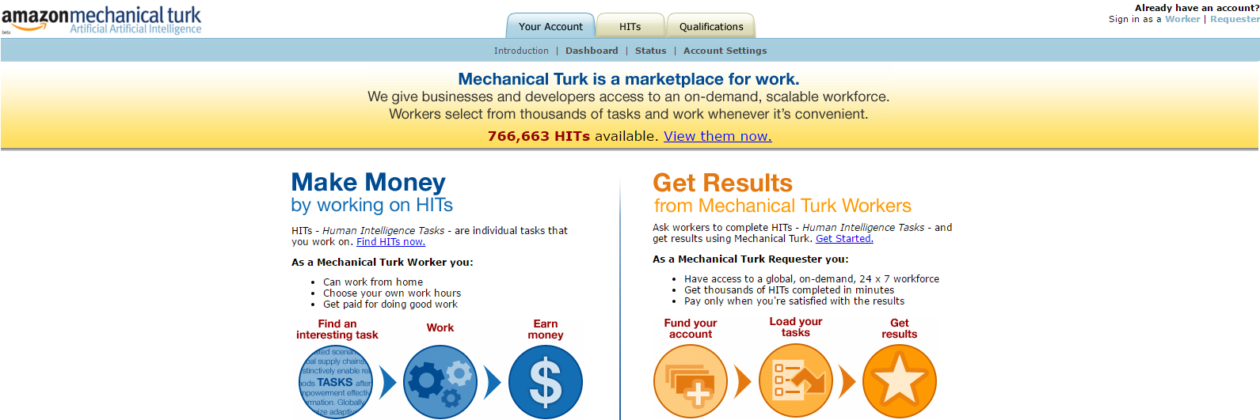
On-Demand Economy
25

Slide 27
Incorporating New Tools
Evaluate
Incorporate
Scan

Slide 28

Promising Practices at
Job Centers
27

Slide 29
Candace Moody
Vice President, Communications
CareerSource Northeast Florida

Slide 30


Tools for Career Exploration

Slide 31
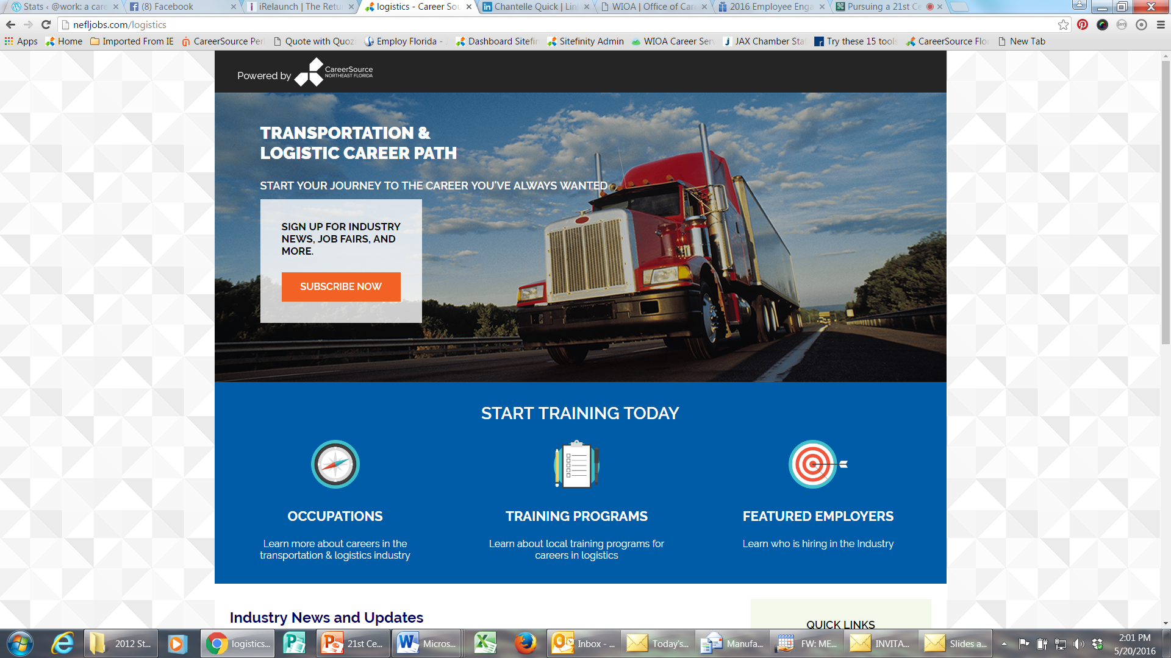
Tools for Career Exploration
31

Slide 32
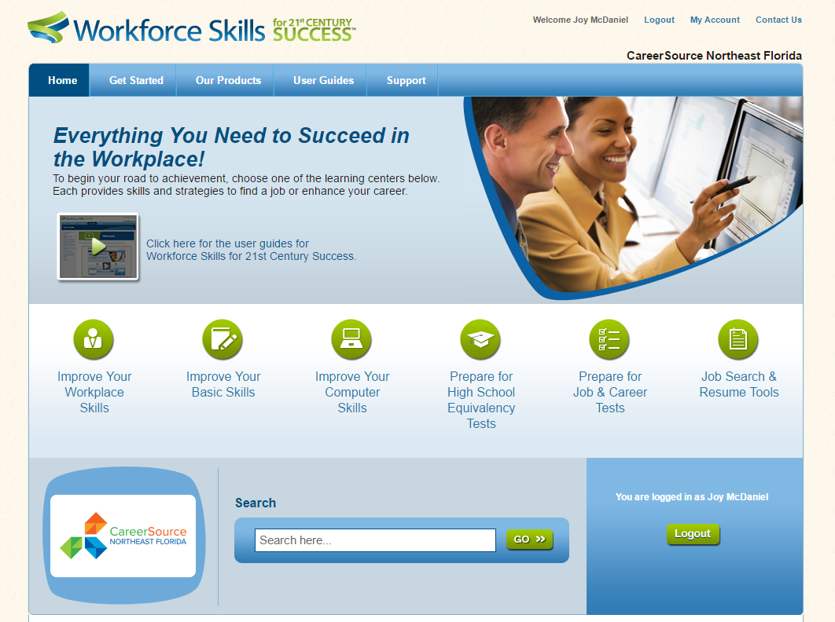
Tools for Skill Building

Slide 33

Tools for Job Matching
32

Slide 34
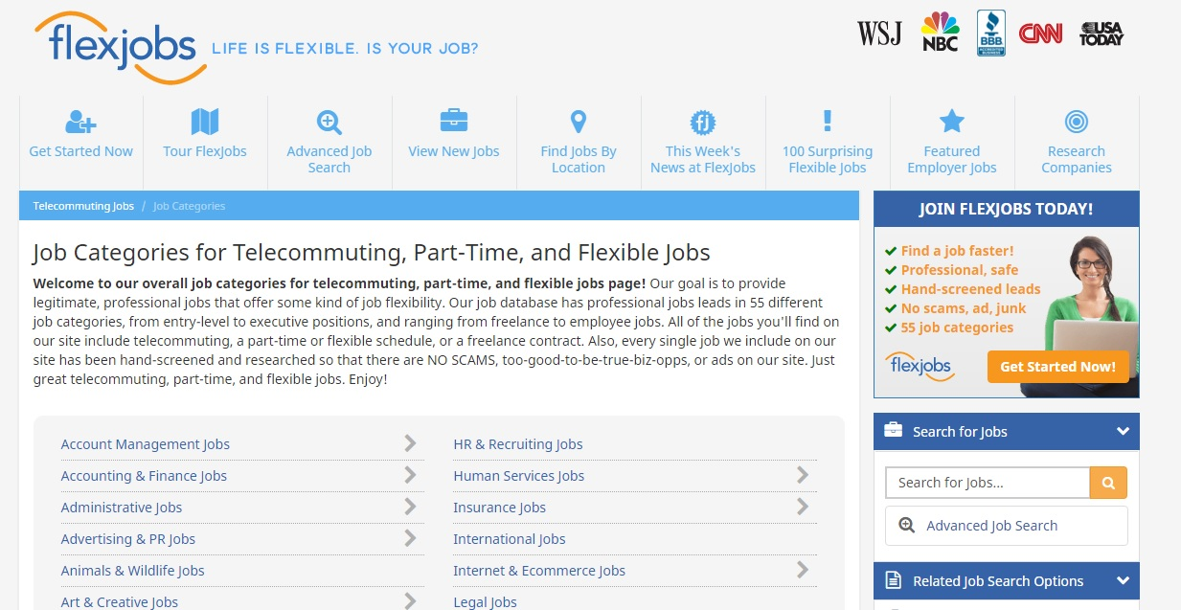
Tools for Job Matching
33

Slide 35

Using Social Media
34

Slide 36
Jodi Leipold-Mostel
Operations Manager
Pennsylvania CareerLink – Allegheny East

Slide 37
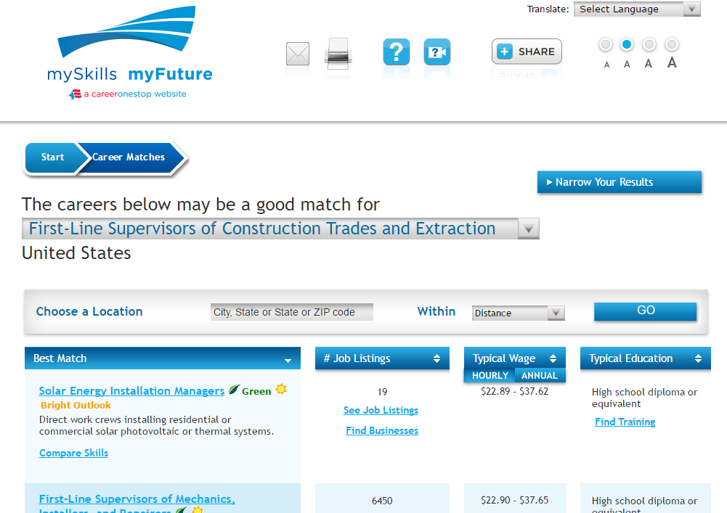
Assessments
36

Slide 38
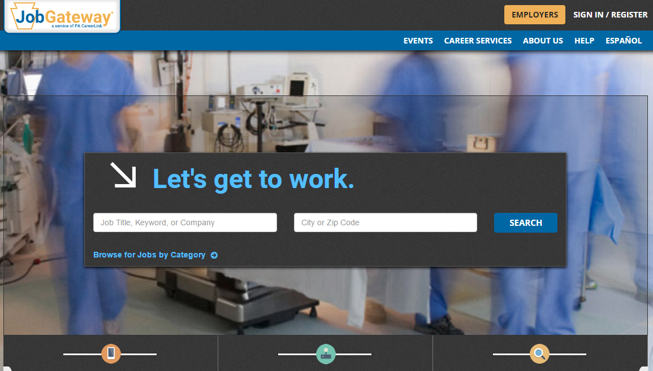

JobGateway®
37

Slide 39

Adapting to Your Local Customer Base
Everyone needs a locally tailored One Stop!
Local
Job Boards
Local
Networking Groups
Local
Resources
Local Connections and Partnerships

Slide 41
Matthew A. Poland
Senior Program Manager
Jobs for the Future
mpoland@jff.org

Slide 42


About Us
Jobs for the Future (JFF) completed this project with federal funds awarded to Maher & Maher under contract number DOLQ131A22098 DOL-ETA-14-U-00011, from the U.S. Department of Labor, Employment and Training Administration. The contents of this publication do not necessarily reflect the views or policies of the Department of Labor, nor does mention of trade names, commercial products, or organizations imply endorsement by the U.S. Government.
Jobs for the Future (JFF) designs and drives the adoption of innovative, scalable approaches and models—solutions that catalyze change in our education and workforce delivery systems.
Maher & Maher is a specialized change management and talent-development consulting firm focused on advancing the collaboration between workforce, education and economic development.

