Slide 2

Strategies for Implementing OJT Simply and effectively

Slide 4
Speakers
Andrew Ridgeway
  USDOL, ETA
David Altstadt
  Jobs for the Future
Tom Hooper
  Jobs for the Future
Geri Scott
  Jobs for the Future
Oswaldo Alvarez
  Chicago Cook Workforce Partnership
Sue Thompson
  Lane Workforce Partnership

Slide 5
Provide an overview of key changes to OJT in WIOA and common misperceptions
Outline benefits of OJT to businesses, workers, and the workforce system
Identify solutions to common OJT challenges
Provide examples of OJT in action

Slide 6
Brief overview of OJT
Delivered by eligible businesses
Customized to address gaps in trainees knowledge or skills
Time-limited
Reimbursement for the extraordinary costs of training
Adaptable to a wide range of occupations and skills
Effective strategy for employing a diverse array of clients

Slide 7
Five Key Changes To OJT Under WIOA
No prescribed sequence of services for engaging or enrolling in OJT
Enhanced reimbursement (up to 75%) in special cases
WIOA’s performance measures are well-aligned with effective OJT
WIOA encourages training that focuses on high-demand jobs
Links between OJT and Registered Apprenticeship

Slide 8
Benefits of OJT to Businesses
Benefits include:
Ensures new hires are trained to specifications
Widens pool of job ready talent
Mitigates risks and training costs of hiring a new employee
Can help avert layoffs by up-skilling current employees

Slide 9
Benefits of OJT to Workers
Benefits include:
Improves chances of long-term employment retention
Alternative to classroom training
Helps secure employment with businesses committed to training
Game plan for resolving skill deficiencies
Offers business-provided training that brings out-of-date skills up to current standards

Slide 10
Benefits of OJT To Workforce System
Benefits include:
A resource for building and expanding business services
Supports small businesses’ training needs
Increases likelihood that training will produce successful outcomes
Satisfies employment and training needs of a range of clients, including hard-to-serve (i.e. dislocated workers)
OJT and ITA funds can be used to support Registered Apprenticeship

Slide 11
Solutions to Common OJT Challenges
Challenge: Lack of staff capacity to identify business targets for OJT
Potential solutions:
  Cross-train Employment Services staff and other partners on an OJT sales pitch
  Empower jobseekers to include OJT as a part of their self-initiated job searches

Slide 12
Solutions to Common OJT Challenges
Challenge: Business perception that OJT is a burdensome government program
Potential Solution - Simplify and streamline documentation and reporting for businesses:
  Take on as much of the paperwork as feasible
  Use a short checklist to review OJT legal obligations with businesses
  Reduce the length of the OJT contract
  Utilize a master training agreement and seek signatures annually

Slide 13
Solutions to Common OJT Challenges
Challenge: Amount of time, effort, and
complexity in developing OJT training plans
Potential Solutions:
  Employ dedicated staff responsible for developing, executing, and monitoring OJT training plans and contracts
  Offer to help businesses write job descriptions
  Maintain an archive of similar job descriptions that have been cross-referenced to O*NET Online
  Minimize the length and detail of the training plan to essential elements and competencies

Slide 14
Solutions to Common OJT Challenges
Challenge: Incorporating OJT into career pathways strategies
Potential Solutions:
  Blend funding sources to support participant progression along a career pathway
  Link OJT and Registered Apprenticeship programs
  Add advanced skills in OJT contracts

Slide 15
Local OJT Innovations
Spokane Workforce Development Council:
  Trains clients in behavioral interviewing techniques.
  Streamlined paperwork by creating a master worksite agreement, which contains essential business information and assurances that remain in effect for all OJT training plans.
Southeast Missouri WIB:
  Utilizes a sequence of employment service options to place hard-to-serve individuals.
  Has a flexible model for engaging TAACCCT students in OJT—after the completion of one or more stackable certificates or a two-year degree.
Westmoreland-Fayette WIB:
  Obligates about half of all available training funds (e.g., WIOA formula, special grants) to OJT.
  Service providers can authorize OJT contracts without prior approval, reducing hurdles to the start of OJT.

Slide 16



Slide 17
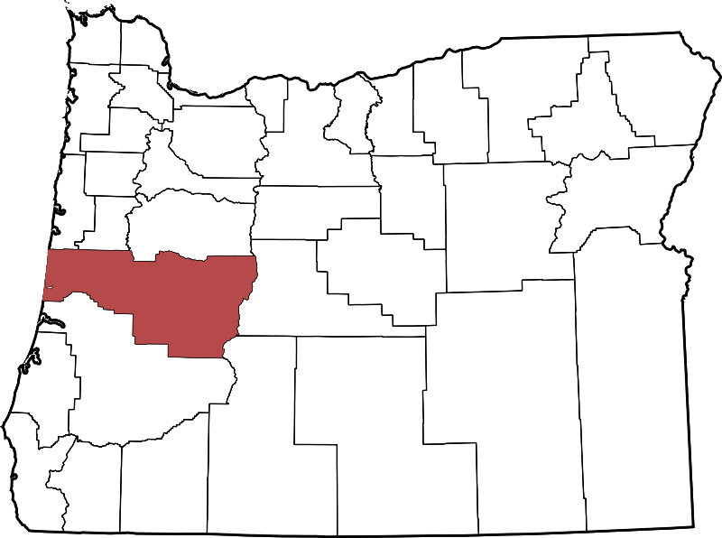
About Lane County
Lane County is the 4th most populous county in Oregon with a population of 356,212.
Lane County is unique in that its boarders stretch from the Oregon Coast to the Cascade Mountains with Eugene/Springfield being the urban hub in the middle of the county.
Lane County is a large county in Oregon with a diverse economy base, with Manufacturing, Healthcare and High Tech as our high demand/high wage sectors.

Slide 18

Applicants who are pre-qualified by our office and referred to the employer
OR
Applicants the employer send to us for eligibility screening and are notified if they qualify for OJT

Slide 19
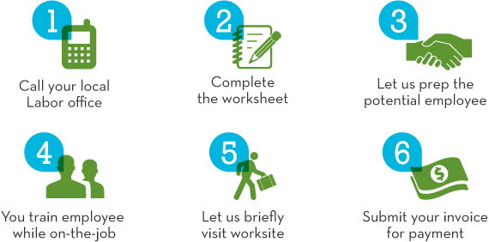
We market OJT’s that in six steps. You can hire and train an employee to your own specifications.

Slide 20

We ask employers to notify us when they start their recruitment, list their job opening in our labor exchange, let us refer job seekers right along with other job candidates and then once a candidate is chosen we will screen the job seeker for an OJT.

Slide 21

Through Coaching, Mentoring, Observation and hands-on activities you have a productive employee and a thriving business.

Slide 22
OJT Outcomes
OJT’s are not for every company or every position, but if the company has the capacity and there is a job seeker out there with the basic skills and ready to learn - OJT could be for them.
Once employers came to the realization that the people who are applying for their jobs are the same people who are customers at the WorkSource center, they did not see the center or the centers referrals as second rate or broken some how.

Slide 23
Chicago Cook Workforce Partnership

Slide 24

Chicago Cook Workforce Partnership
Who are we?
  Nation’s 2nd largest Local Workforce Development Area (non-profit administrative agency)
  Oversee network of 53 delegate agencies, 10 One-Stops, 8 satellite centers, 4 sector centers (Manufacturing, IT, Hospitality/Retail)
  Nearly 30,000 placements since 2012 reconfiguration
  Serve 140,000 people per year,
  approximately 15,000 trainees
  $60M Budget

Slide 25

Chicago Cook Workforce Partnership
Business Relations and Economic Development divided in industry sectors:
  Manufacturing
  Transportation, Distribution, and Logistics
  Information Technology
  Healthcare
  Retail
  Hospitality
  Business Services

Slide 26

Chicago Cook Workforce Partnership
OJT implementation
  In 2015, The Partnership engaged in an initiative that aimed to increase the utilization of OJTs with funding from the JP Morgan Chase Foundation
  Conducted surveys:
  Employers
  Agencies executing the OJTs
  Participants that used OJT
  (both that completed and that
  dropped-out)

Slide 27

Chicago Cook Workforce Partnership
Provider recommendations for improving the current process included:
  Simplify paperwork for the employers whenever possible;
  Develop marketing materials for both employers and job seekers;
  Provide agency staff with more training on the program

Slide 28

Chicago Cook Workforce Partnership
Most employers were satisfied with the OJT candidates
  A third of employers felt the reimbursement process took a lot more time than they expected it to take
  All employers indicated they would still use an OJT even if the
  reimbursement was
  less than 50%

Slide 29
Chicago Cook Workforce Partnership
  Division of labor needs to be clear:
    Career Coach duties: Participant outreach, orientation, initial assessment, registration/intake, track participant status
    Job Developer duties: Employer outreach and education on OJT, pre-award survey, OJT agreement, develop job description with employer, skills gap analysis, complete the Skills Acquisition Training Outline (SATO), be the main employer contact
    OJT Manager duties: Review participant files for eligibility, review OJT master agreement, review the SATO

Slide 30

Chicago Cook Workforce Partnership
Spreadsheet to track OJTs
Allow us to evaluate agencies and identify which agencies need TA
Allows us to see which industries
and occupations make more use
of OJT
Allows us to see average wage per industry and occupation

Slide 31
ETA OJT Toolkit
    Will be available soon on Workforce GPS
Strategies for Implementing OJT Simply and Effectively
  An On-the-Job Training Brief and Resource Guide
    Available Here
Strategies for Implementing OJT Simply and Effectively – Helpful Tools
  Appendix A: On-the-Job Training Employer Checklist
  Appendix B: On-the-Job Training Master Worksite Agreement
  Appendix C: On-the-Job Training Worksheet and Employer Agreement
  Appendix D: On-the-Job Training Plan
  Appendix E: On-the-Job Training Agreement
  Appendix F: On-the-Job Training Evaluation Questionnaire
    Available Here

Slide 33


About Us
Jobs for the Future (JFF) completed this project with federal funds awarded to Maher & Maher under contract number DOLQ131A22098 DOL-ETA-14-U-00011, from the U.S. Department of Labor, Employment and Training Administration. The contents of this publication do not necessarily reflect the views or policies of the Department of Labor, nor does mention of trade names, commercial products, or organizations imply endorsement by the U.S. Government.
Jobs for the Future (JFF) designs and drives the adoption of innovative, scalable approaches and models—solutions that catalyze change in our education and workforce delivery systems.
Maher & Maher is a specialized change management and talent-development consulting firm focused on advancing the collaboration between workforce, education and economic development.

Slide 34
Tom Hooper Geri Scott
Senior Director, Director
Regional/Sector Regional/Sector
Strategies Strategies
Jobs for the Future
thooper@jff.org gscott@jff.org

