Slide 1
21st Century Apprenticeship
An avenue for sustaining your project’s benefits for years ahead
Coffey Consulting, LLC

Slide 3
Caroline Hertel Michael Lawrence
Office of Workforce Investment
Coffey Consulting, LLC
Moderators
Laura Ginsburg
U.S. Department of Labor’s
Office of Apprenticeship

Slide 4
Susan Thomas
Industry Partnership Coordinator
District 1199C Training & Upgrading Fund
Philadelphia, PA
Debby Hopkins
Workforce Officer & Project Dir.
Shenandoah Valley Workforce Development Board
Harrisonburg, VA

Slide 5
Describe recent developments in Registered Apprenticeship & benefits to your program
Learn what resources are available to develop your program
Describe strategies that can be used to transition your project to the apprenticeship model
Learn of challenges faced by grantees in accessing apprenticeship programs and how they have been overcome

Slide 6
ApprenticeshipUSA
Apprenticeship as a Talent Development Strategy
Laura Ginsburg | Office of Apprenticeship
May 24, 2016

Slide 7
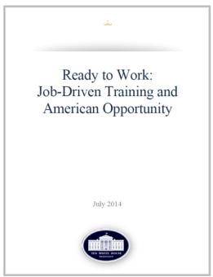
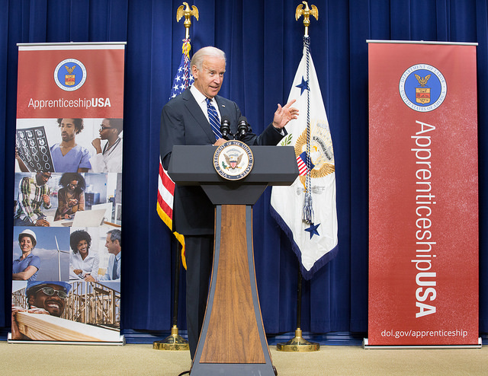
ApprenticeshipUSA has been a growing part of workforce development in the United States
Tonight, I'm also asking more businesses to follow the lead of companies like CVS and UPS, and offer more educational benefits and paid apprenticeships -- opportunities that give workers the chance to earn higher-paying jobs even if they don't have a higher education.
– President Obama, State of the Union Address, January 20, 2015
FY 2016 Congress Invests $90 Million in Apprenticeships
American Apprenticeship Grants
$175 Million

Slide 8
Expansion for Fiscal Year 2016: $90 Million for American Apprenticeship Grant program
This historic new program has the potential to increase alignment with more Community Colleges by providing classroom instruction for apprenticeships and ensuring States support college credit for apprenticeship:
States: Build state capacity to administer RA programs;
Industry: Build on American Apprenticeship grant and expand apprenticeship beyond H1B targeted occupations and industries;
Under-Represented Populations: Support community-based organizations and workforce intermediaries on innovative strategies for career pathways;
National Activities: Increase national outreach, technical assistance, and capacity building needs;
Office of Apprenticeship
US Department of Labor | Employment and Training Administration

Slide 9
Registered Apprenticeship can be used for a variety of industries:
Energy
Healthcare
Transportation
IT
Manufacturing

Slide 10
Adaptable and Flexible
Employer Involvement
Structured
On-the-Job Learning
Related Instruction
Rewards for Skill Gains
National Occupational Credential
Five Core Components of
Registered Apprenticeship

Slide 11
Registered Apprenticeship Facts and Figures
Did You Know?
Did You Know?
150,000 Employers and Labor Management Organizations Participate in Registered Apprenticeship.
456,989 Registered Apprentices Nationwide in More than 1,000 Occupations.
$50,000 Average Starting Salary of Apprentices Per Year While Earning a Credential Equivalent to a 2 or 4 Year College Degree
$300,000
Amount Workers Who Complete Registered Apprenticeship Programs Earn More Over a Lifetime Than Peers
$1.47 per $1.00
For Every $1 Spent on Registered Apprenticeship, Employers Get an Average of $1.47 Back in Increased Productivity

Slide 12
170 LEADERS and Still Growing!

Slide 13
Benefits to Registering Program with USDOL
Access to Federal Resources
New Registered Apprenticeship Funds
Pell, Federal Work Study, GI Bill, WIOA, etc.
Employers Benefits
Nationally Recognized Apprenticeship Credential
Apprenticeship Community
Connections to other companies and LEADERs
Ability to connect with USG technical assistance
Third Party Validation from USDOL

Slide 14
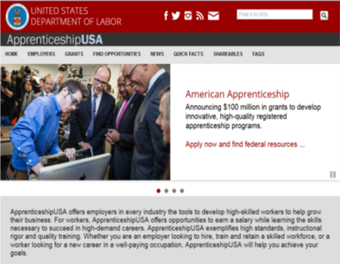
ApprenticeshipUSA Resources
Quick-Start Toolkit
5 Step Format to take you from “exploring” to “launching” a Registered Apprenticeship Program.
Federal Resources Playbook for Registered Apprenticeship
Guide to resources from the Federal Gov’t Development to support Registered Apprenticeship
DOL Apprenticeship Website
New Registered Apprenticeship website launched with additional resources and streamlined design.
www.dol.gov/apprenticeship/

Slide 15
District 1199C Training & Employment Fund
Registered Apprenticeship –
The Employer Advantage

Slide 16
What Does It Look Like?
Key Components
List of competencies to be mastered
Agreement Form
Standards of Apprenticeship
Present to State Apprenticeship Council for Approval – very simple if documents in order; NOTE – good offer to do these for the employer
Receive a certificate for the particular program
Up to employer how to document progress; we recommend OJT forms that check monthly progress

Slide 17
Community Health Worker Competencies
OJT 2200 Hours:
Orientation to Community Health Worker –
Intro to job and employer 90 hours
Technical Knowledge Overview 150 hours
Safety Med/Community Environment 150 hours
Ethical and Professional Practice 150 hours
Networking and Advocacy 335 hours
Health Literacy 350 hours
Communication 350 hours
Teaching/Supporting Others 350 hours

Slide 18
Classroom Training 150 Hours – Temple U College Credit
Topic Classroom Hours
Role of the CHW 12
Understanding Healthcare from a Cultural Context 6
HIPAA and Patient Confidentiality 6
Group Facilitation, Planning and Presentation 9
Foundation of Communication and Interpersonal Skills 12
Advanced Communication and Interpersonal Skills 12
Motivational Interviewing 12
Recognition of Health Issues (Sick and Non-Sick) 30
Teamwork and the Healthcare Team 6
Legal Considerations for CHWs 3
Advocating for Patients 3
Community Resource Asset Mapping 6
Documentation Protocol for the CHW 15
Professional Expectations for the CHW 18
TOTAL 150

Slide 19
What’s Working at Phila FIGHT
3 Community Health Worker Apprenticeships, one in each federally qualified health clinic
All employees finished Apprenticeship and working
All previously unemployed
Varied work experience but all connected to HIV/AIDS
One international AIDS Advocate
One with Behavioral Health Training
One came as a volunteer after layoff from other fields
Completion of 150 hour training at Temple; college credit
Supervised/trained by a current Care Navigator
All on the path to a new career with good future options!!!

Slide 20
Current and Future Plans
Supervisor will be FQHC Manager, not Program Manager
Will hire out of the current CHW Training class – better to get this piece done before the job starts
May bring on a dental CHW
One of the CHWs promoted to a “concierge position” when the actual job started in January
Option in the grant to provide OJT wages as well; current incentive is payment to employer for management.
New Non-Traditional Apprenticeship Grant - $1200 stipend per Apprentice, looking at Nurse Aide, Behavioral Health, Coding, LPN, CHW
Development of a Supervisory Manual, Mentor Manual

Slide 21
National Center for Healthcare Apprenticeships an Initiative of SEIU & AFSCME
1700 apprenticeships in six states
Categories
Advanced homecare
Community Health Worker
Medical Coding
Competency Based Apprenticeship Model

Slide 22
Valley to Virginia $4 Million Registered Apprenticeship Grant
Awarded to Shenandoah Valley Workforce Development Board Oct. 2015
Primary Partners: Virginia Department of Registered Apprenticeship (state apprenticeship agency); Blue Ridge, Dabney S. Lancaster, and Lord Fairfax Community Colleges; Massanutten Technical and Valley Career and Technical Centers; and Virginia Manufacturing Association
Many additional workforce partners will assist in implementation

Slide 23
V2V Apprenticeship Initiative $175 Million Awarded; 46 grants; 37 states; 12 multi-state initiatives

Slide 24
RA Process VDOLI – Apprenticeship Consultant
Develop training plan (related instruction), delivery methods, vendors
Identify Occupation
Define
Work
Process
VDOLI registration
National Credential
Your VDOLI Apprenticeship Consultant assists in design of your apprenticeship program, registration of the program, and provides ongoing technical assistance through award of Journeyman Credential

Slide 25
Valley OJT/SVWDB Process for Funding
Application for Funding; Letter of Commitment (50%
to $2650 currently)
Request Reimbursement/Issue check
Employer Agreement
VDOLI
Forms +
Supplement
Valley OJT provides assistance throughout the RA registration process and grant enrollment and reimbursement process.

Slide 26
Open Chat
What tips would you advise for those starting out?

Slide 28
Apprenticeship White House Fact Sheet
AN INTRODUCTORY ANNOUNCEMENT AND VISION FOR APPRENTICESHIP FROM THE WHITE HOUSE
https://www.whitehouse.gov/the-press-office/2016/04/21/fact-sheet-investing-90-million-through-apprenticeshipusa-expand-proven
Apprenticeship Accelerator Grants
RECENTLY ANNOUNCED ACCELERATOR GRANTS
https://www.doleta.gov/oa/grants.cfm
TEGL: http://wdr.doleta.gov/directives/corr_doc.cfm?DOCN=5364
Apprenticeship USA Introduction
INTRODUCTION HOME PAGE OF US DEPARTMENT OF LABOR APPRENTICESHIP INFORMATION
https://www.dol.gov/featured/apprenticeship
Apprenticeship USA
INFORMATION AND REGULATIONS RELATED TO APPRENTICESHIP
https://www.doleta.gov/oa/regulations.cfm
Apprenticeship Brochure
INFORMATIONAL BROCHURE ON APPRENTICESHIP
https://www.doleta.gov/oa/regulations.cfm

Slide 29
Laura Ginsburg
Office of Apprenticeship
U.S. Department of Labor -- ETA
202.693-2803
Ginsburg.Laura@dol.gov
Susan B. Thomas, Industry Partnership Director
District 1199C Training & Upgrading Fund
100 S. Broad Street, 10th Floor
Philadelphia, PA 19110
Telephone: 215.568.2220, x5102
Email: sthomas@1199ctraining.org
Debby Hopkins, Workforce Officer & Project Director
Shenandoah Valley Workforce Development Board
P.O. Box 869
Harrisonburg, VA 22803
Telephone: 540.442.7134
Email: dhopkins@valleyworkforce.com

