Slide 1
POLLING QUESTION
If you file TAA petitions, do you file online?
Always
Yes, but only sometimes
No, I do not use the online filing application
I have never filed a TAA petition

Slide 2
HOW TO FILE A TAA PETITION ONLINE
OFFICE OF TRADE ADJUSTMENT ASSISTANCE

Slide 4


Bunmi Sanusi
Program Analyst
Office of Trade Adjustment Assistance
U.S. Department of Labor
Washington, DC
Jacquelyn Mendelsohn
Certifying Officer
Office of Trade Adjustment Assistance
U.S. Department of Labor
Washington, DC

Slide 5
Petition Overview
Filing Online vs. Other Methods
Online Filing Demo
Additional Resources/Recap

Slide 6
ONE –
Petition Overview

Slide 7
4 Petition Sections
Section 1 - Petitioner Information
Section 2 - Workers’ Firm
Section 3 - Trade Effects on Separations
Section 3 - Affirmation

Slide 8
Section One – Petitioner Information
Petitioner Type
Name
Title
Address
Phone
E-mail
Worker Separation Date
Describe the worker group on whose behalf the petition is being filed

Slide 9
Section Two – Workers’ Firm
Name of Firm
Street Address
Phone
How many workers have been or may be separated (if known)
Describe the article produced or service supplied by this firm
Is the firm closing?

Slide 10
Section Three –
Trade Effects On Separation
Provide reasons that worker separations may be due to foreign trade
If addition documents – please attach
Provide Contact information of Officials
        - Name, Title, Phone E-mail and Fax

Slide 11
Section 4 – Affirmation of Information
Electronic Signature- Checkbox
Print Name
Date of Petition

Slide 12
TWO –
Filing TAA Petition Online Vs. Other Methods

Slide 13
Filing Online - Advantages
Instant Transmission to Dedicated Inbox
Instant Transmission to State
Instant Petitioner E-Receipt
Consistently Legible
Required data guaranteed

Slide 14
Not Filing Online- Disadvantages
Inconsistent legibility
Dates and Signature missing
Incomplete pages
Fax Machine out of Networks
Paper Jams

Slide 15
THREE –
Online Filing Demo

Slide 16
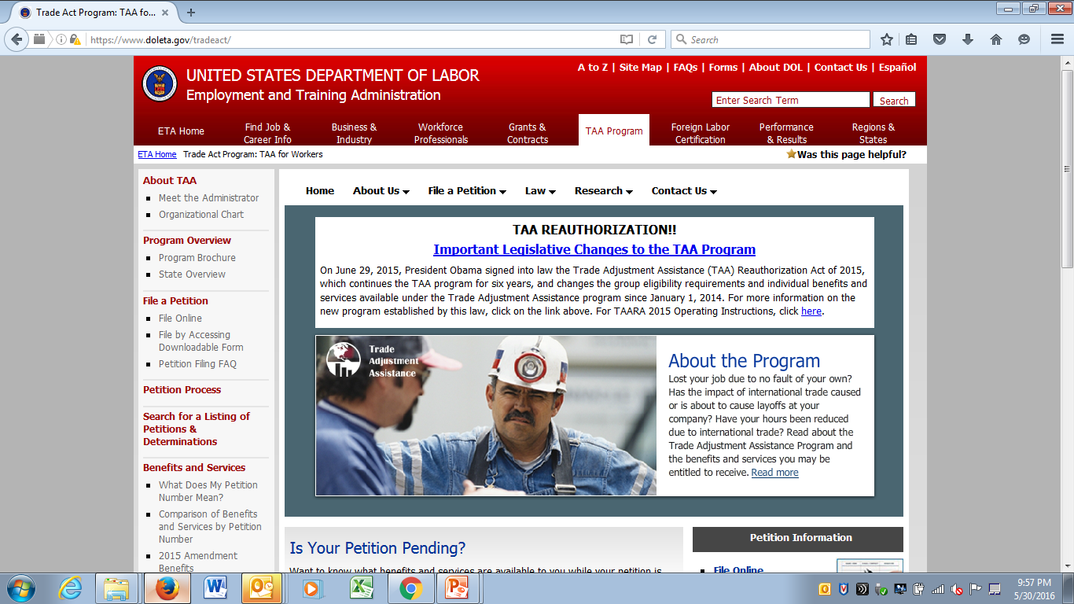
www.doleta.gov/tradeact

Slide 17
After the Petition is Submitted
Immediately
  Petitioner receives confirmation email of successful transmission
Within 24 hours
  Petition is on the web
  Petitioner receives email with investigator contact and case number (TA-W number)

Slide 18
Best Practices
PART FOUR: Tips/Resources for Effective Petition Filing

Slide 19
Tips for Faster Processing
File Online
Provide Complete Contact Information
Help Us Understand Why Trade Is Affecting the Company or the Firm
Attach Any and All Relevant Documents
Assist us to Assist You – the more information provided on the petition, the faster the determination!

Slide 20

TAA Petition Resources
For Your Reference
How -To Guide for Completing a Petition for the Trade Adjustment Assistance (TAA) Program and Partnering with Rapid Response Teams to Improve the Quality of State-Filed Petitions: TEN 23-14
Electronic Posting of Petitions for Trade Adjustment Assistance: TEN 40-11

Slide 22
Susan Worden
Supervisory Program Analyst
Office of Trade Adjustment Assistance
worden.susan@dol.gov
Bunmi Sanusi
Program Analyst
Office of Trade Adjustment Assistance
sanusi.owulabunmi@dol.gov
Jacquelyn Mendelsohn
Certifying Officer
Office of Trade Adjustment Assistance
Mendelsohn.jacquelyn@dol.gov

