Slide 1

(Re)Using Free Online Educational Resources on the SkillsCommons.org Repository: Part I – Introduction
U.S. Department of Labor
Employment & Training Administration
November 3, 2016

Slide 2

Participant Poll
Which best describes your organizational affiliation?
Community or technical college
Other educational institution
Local workforce development entity
Other non-profit workforce training entity
For-profit workforce training entity
Other (please enter in chat box)

Slide 3
Participant Poll
Which best describes your relationship to TAACCCT Grants?
I work(ed) on a TAACCCT grant
Others at my organization have/had TAACCCT grant(s)
We don’t have a TAACCCT grant
What is TAACCCT?

Slide 4
Participant Poll
Are you an Eligible Training Provider under WIOA in one or more states?
Yes
No
I don’t know
Which best describes your experience with OER?
I have used OER
I would like to learn how to use OER
What is OER?

Slide 5
Presenters
Cheryl Martin, Moderator
  Program Manager, TAACCCT Grants
Rick Lumadue & Gerry Hanley, Presenters
  SkillsCommons (California State University-MERLOT)
Maria Fieth, Presenter
  Project Manager, “Consortium for Healthcare Online” (CHEO) Round 2 Grant Project
Kathy Spada, Presenter
  Project Manager, “Intentional Networks Transforming Effective and Rigorous Facilitation of Assessment, Collaboration, and Education” (INTERFACE) Round 3 Grant Project
Sarah Stubblefield, Presenter
  Project Manager, “Industrial Automation Manufacturing innovative Strategic Training Achieving Results” (I AM iStar) Round 4 Grant Project

Slide 6
SkillsCommons.org
Rick Lumadue
  Program Manager and Grantee Relations, SkillsCommons.org
Gerry Hanley, Ph.D.
  Director, SkillsCommons.org and PI for TAACCCT repository cooperative agreement
  Assistant Vice Chancellor, Academic Technology Services, California State University, Office of the Chancellor
  Executive Director, MERLOT
  Director, Center for Usability in Design and Accessibility at California State University, Long Beach

Slide 7


Trade Adjustment Assistance Community College and Career Training (TAACCCT)
TAACCCT is an investment of
impacting 62% of the nation’s community colleges.
Design innovative and effective programs that address specific industry needs and lead to improved learning, completion and career outcomes for TAA-eligible workers and other adults.

Slide 8
Agenda
What is OER and why should I care?
Demonstrate the ease of finding OER in SkillsCommons to reuse
Showcases of OER reuse
Get connected with people, technologies, and resources that you can leverage and help your project achieve its goals
  SkillsCommons CONNECT Center
  SkillsCommons Makeover Strategy
  SkillsCommons IMPACTCommunities
  Additional OER Resources

Slide 9
What is OER and Why Should I Care?
Open Educational Resources (OER)
SkillsCommons is the world’s largest OER project featuring job-driven workforce development materials!
  Anyone can freely:
            Reuse
            Revise
            Retain
            Redistribute
            Remix

Slide 10
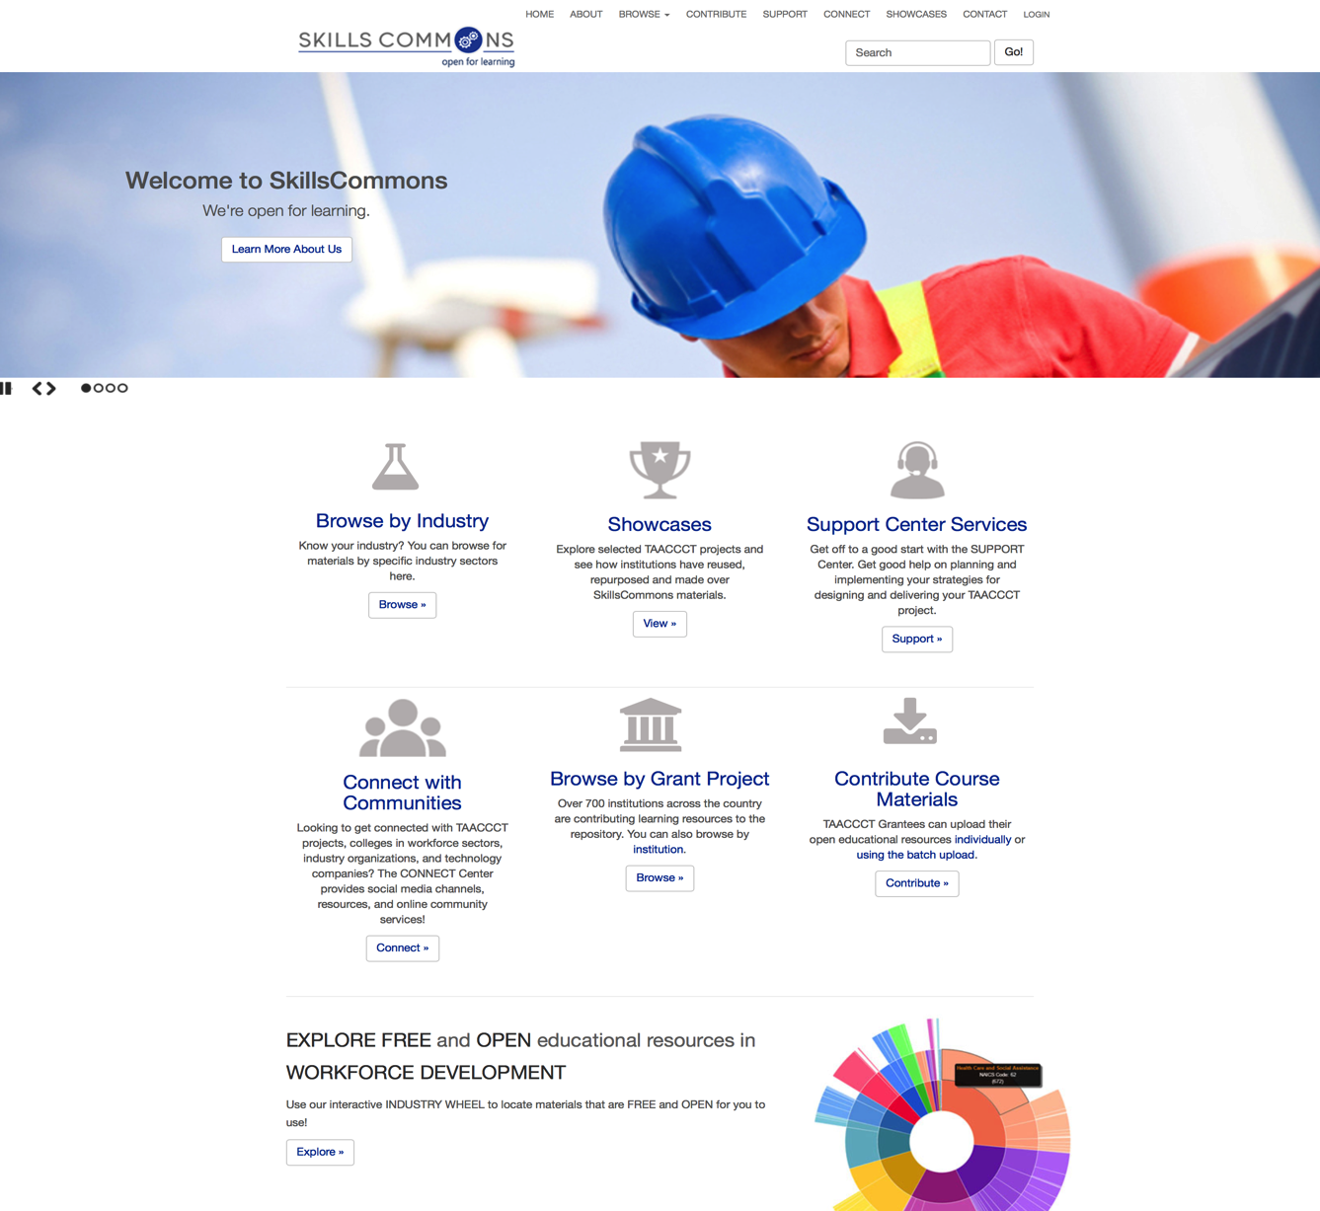
SkillsCommons: TAACCCT Library of Free OER

Slide 11
Participant Poll
Have you used the free online educational resources on skillscommons.org?
Yes
No

Slide 12
Implications of CC-BY License
“The purpose of the CC BY licensing requirement is to ensure that materials developed with funds provided by these grants result in work that can be freely reused and improved by others.”

Slide 13
SkillsCommons Goals
  Capture and preserve the products of TAACCCT grantees
  Enable the discovery and reuse of the products of TAACCCT grantees
  Develop and support communities within workforce development to advance the goals of TAACCCT and SkillsCommons
  Develop and support sustainability strategies for TAACCCT so it can deliver the many “returns on investments”

Slide 14
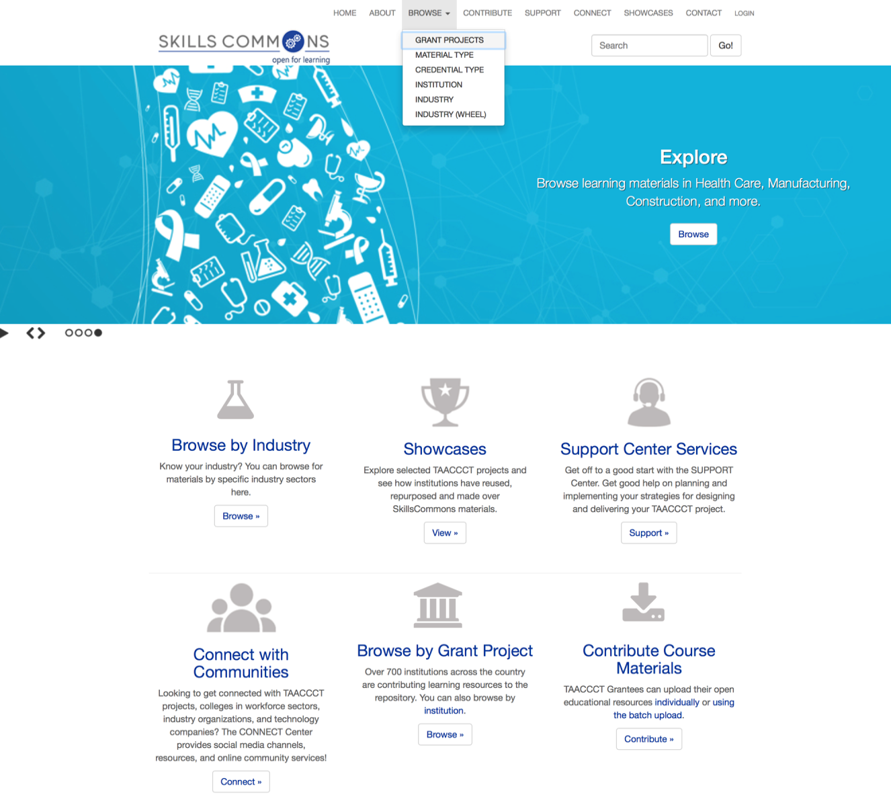
Find & Review SkillsCommons OER

Slide 15
Participant Poll
Which best describes the Industry Sector of your workforce development program or your area of interest?
Manufacturing
Healthcare
Information Technology
Energy
Transportation
Other (please enter in chat box

Slide 16
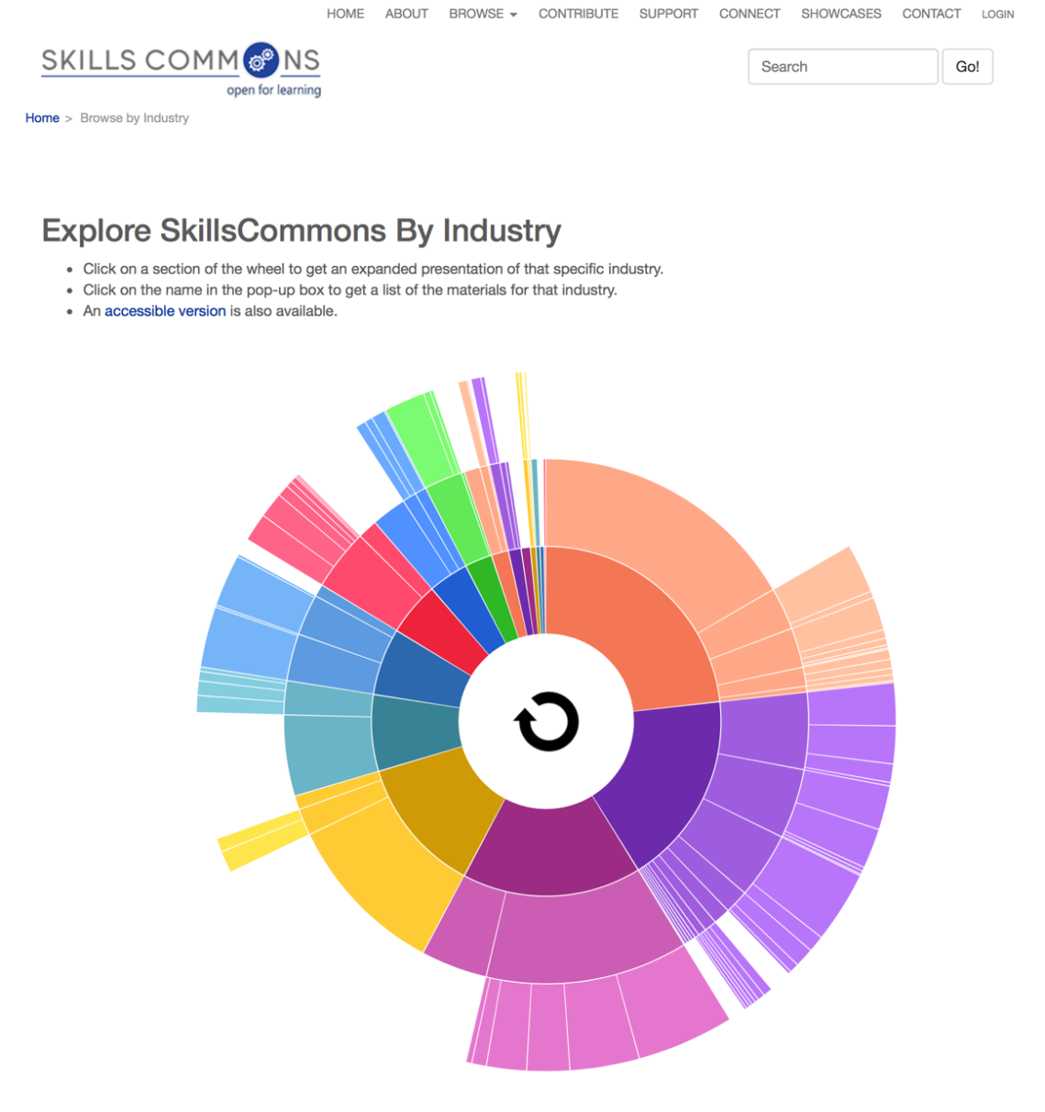
Browsing by Industry

Slide 17
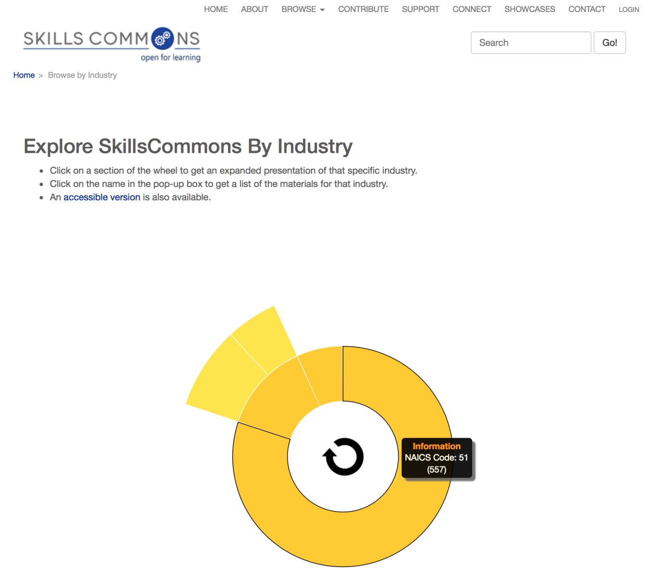
Browsing by Industry
Browsing by Industry

Slide 18
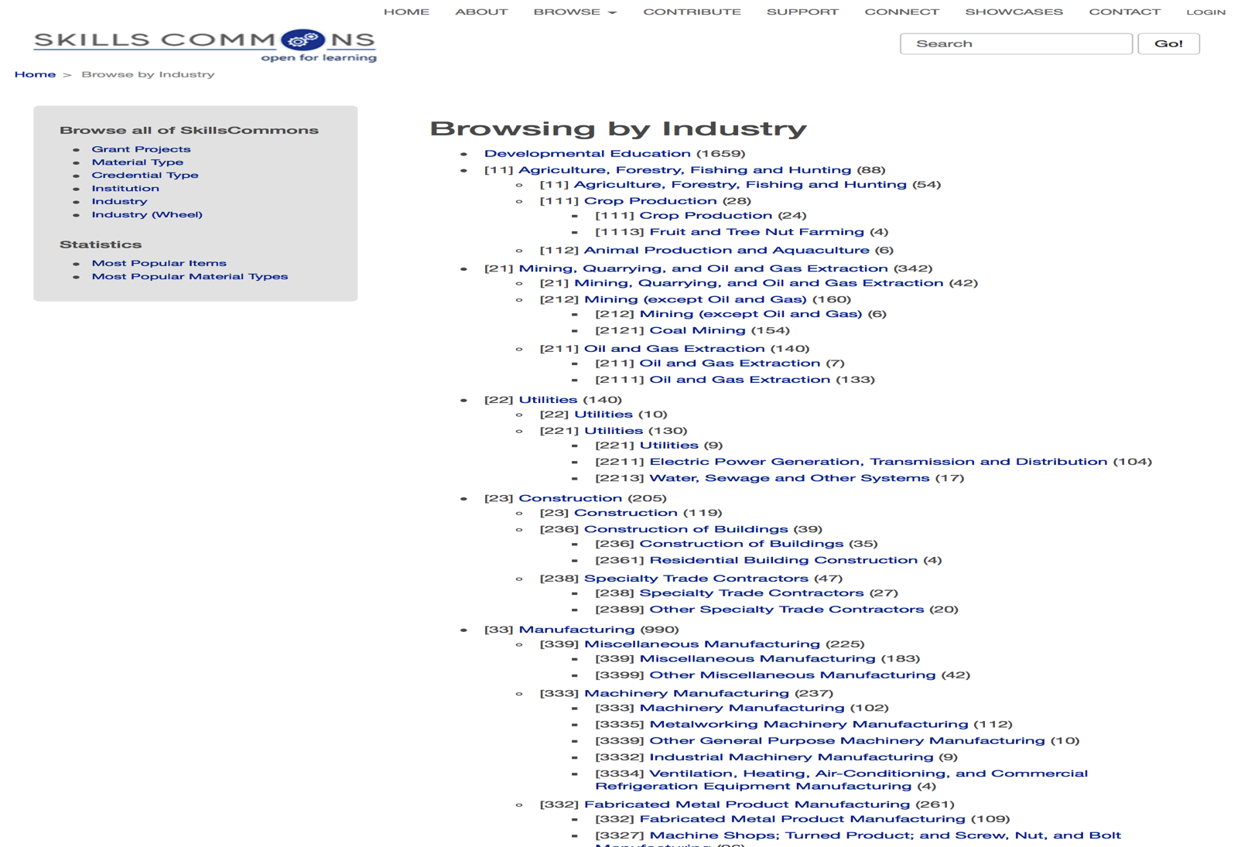
Browsing by Industry
Browsing by Industry

Slide 19
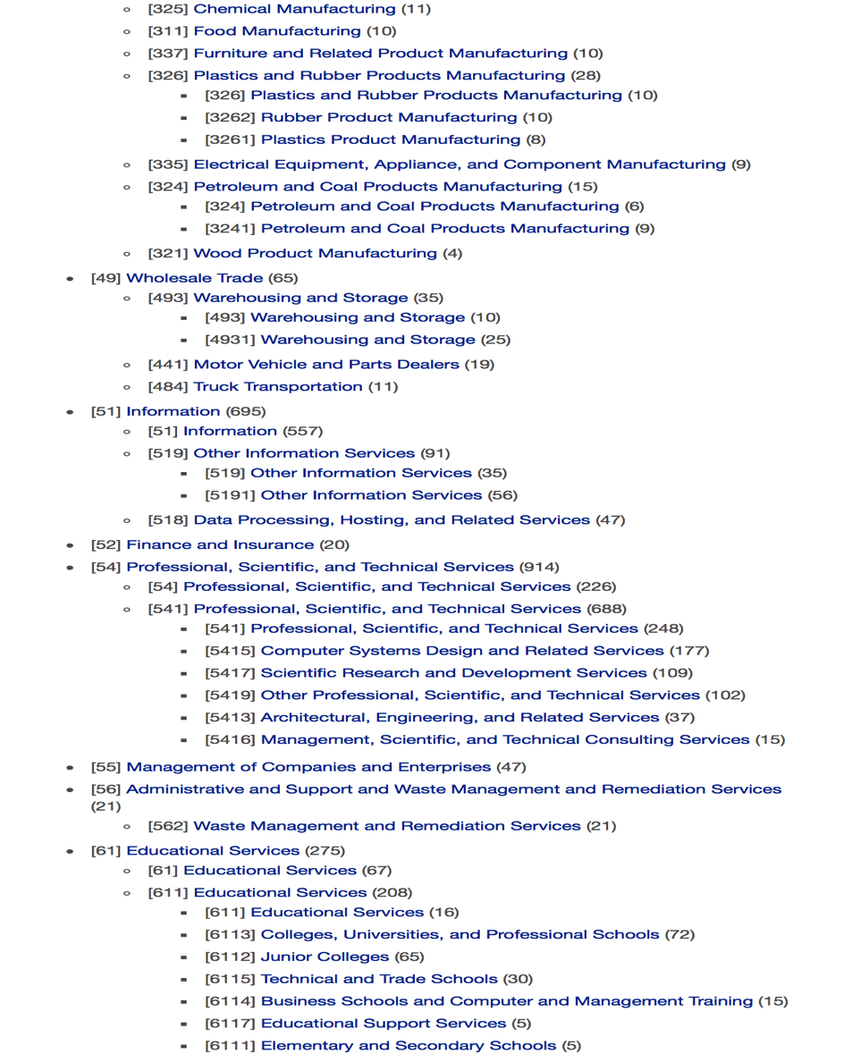
Browsing by Industry
Browsing by Industry

Slide 20
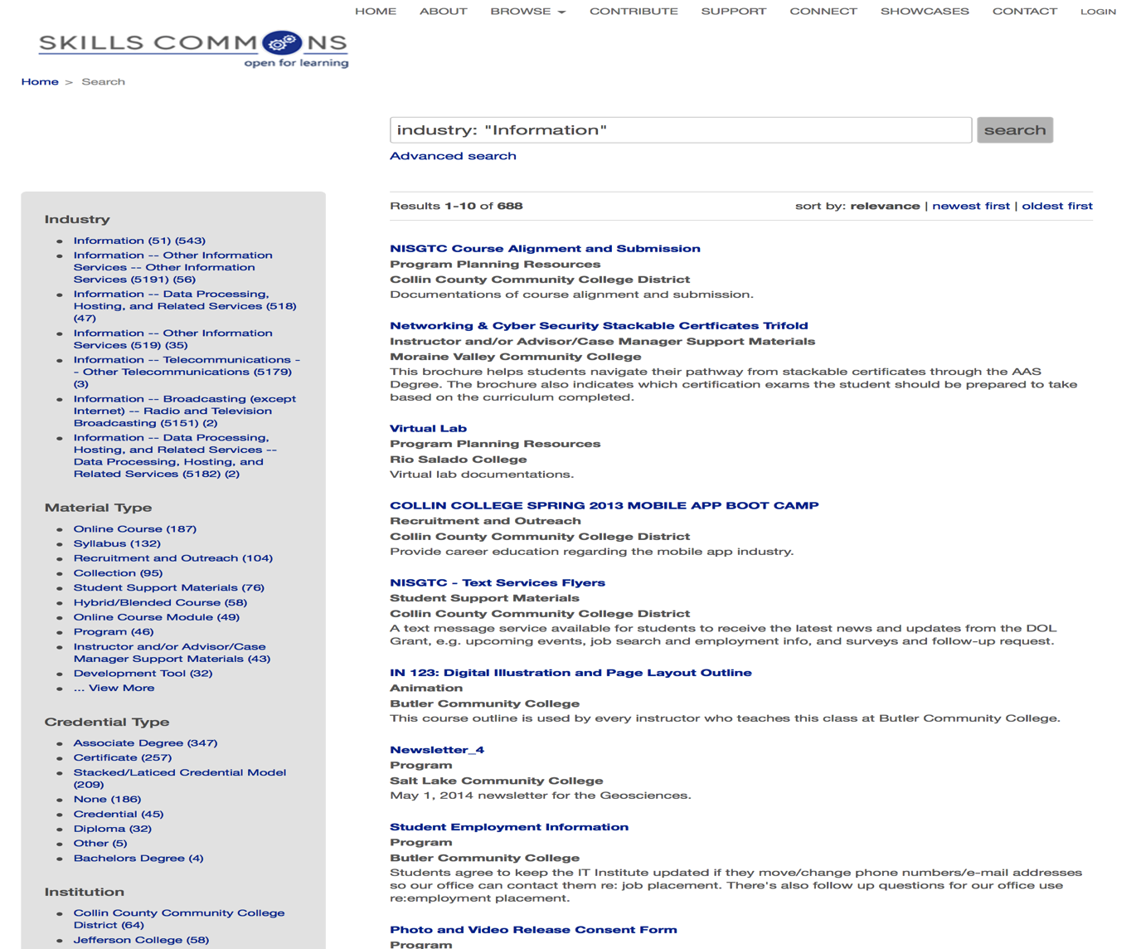
Refine Search Results
Refine Search Results

Slide 21
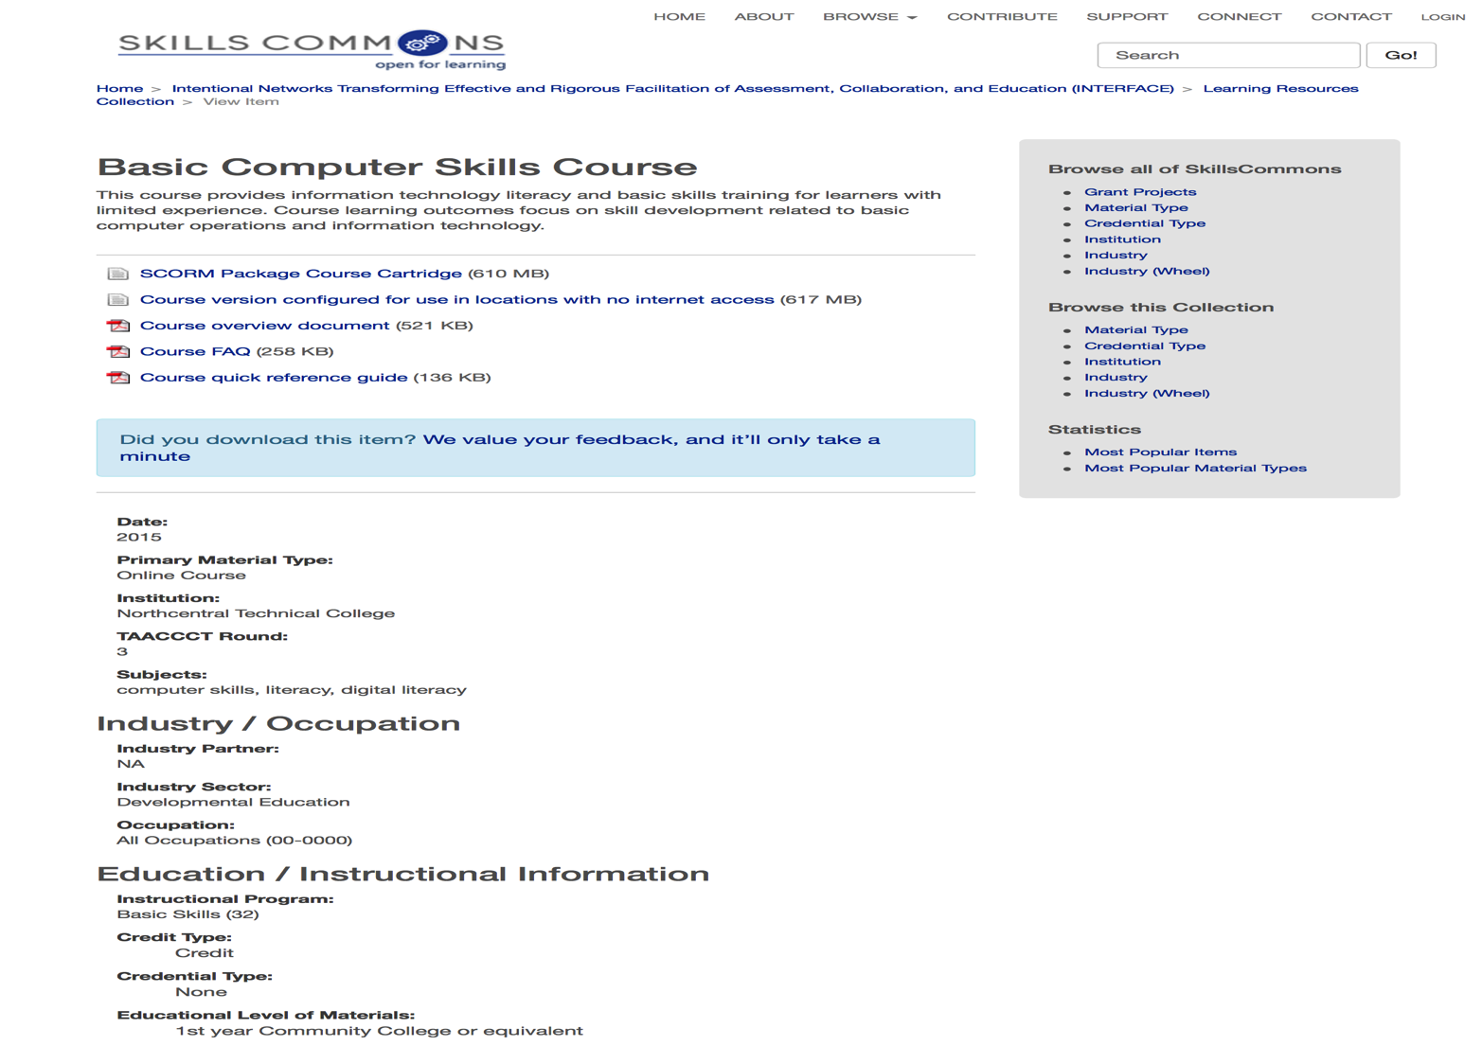
Description of Content
Description of Content

Slide 22
Preview Content
Download Content

Slide 23
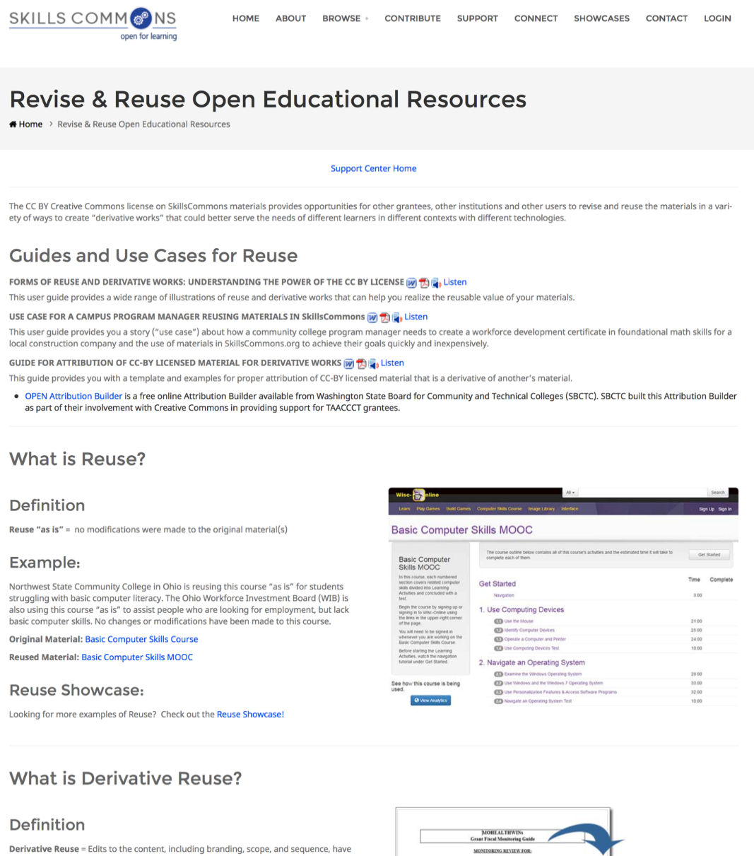
Types of OER Reuse

Slide 24
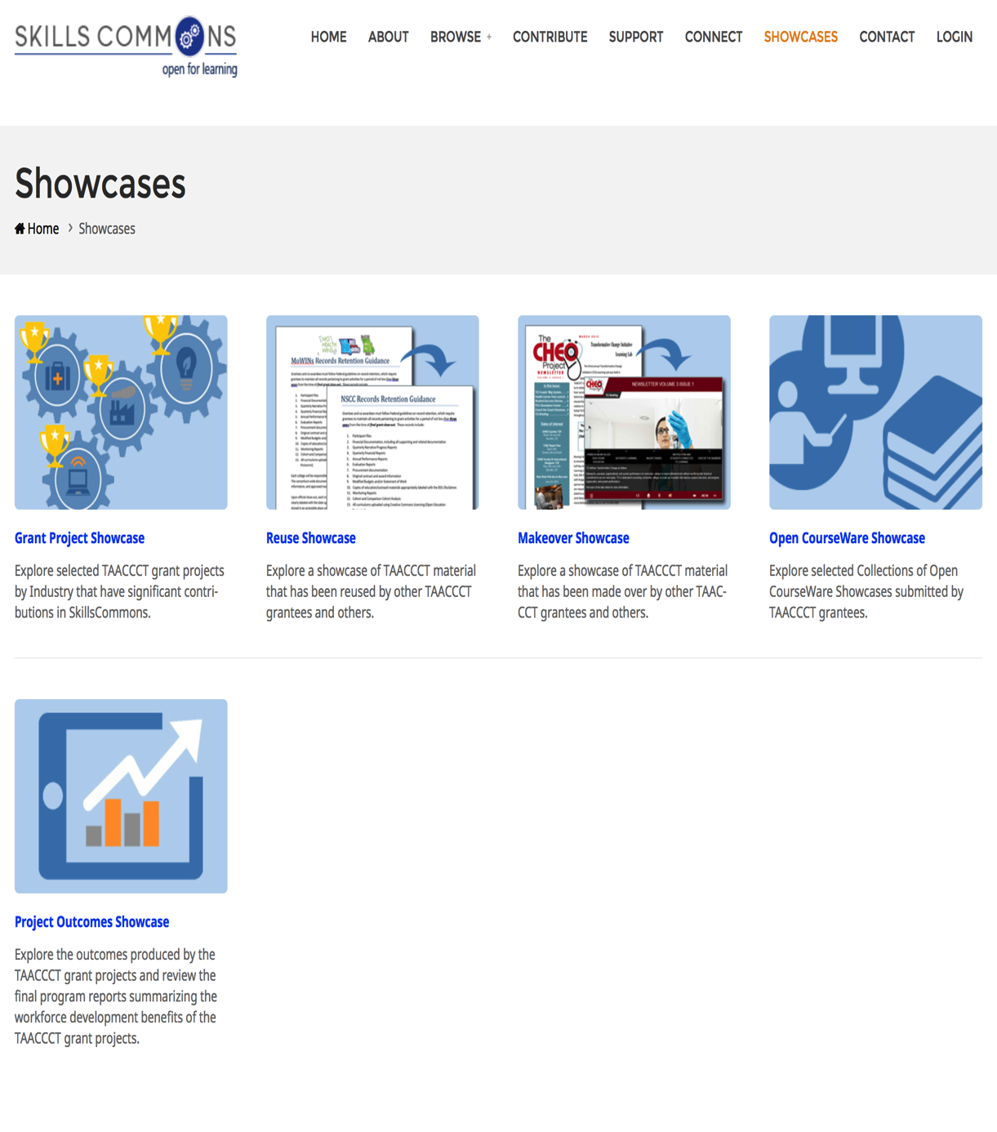
OER Reuse Showcases

Slide 25
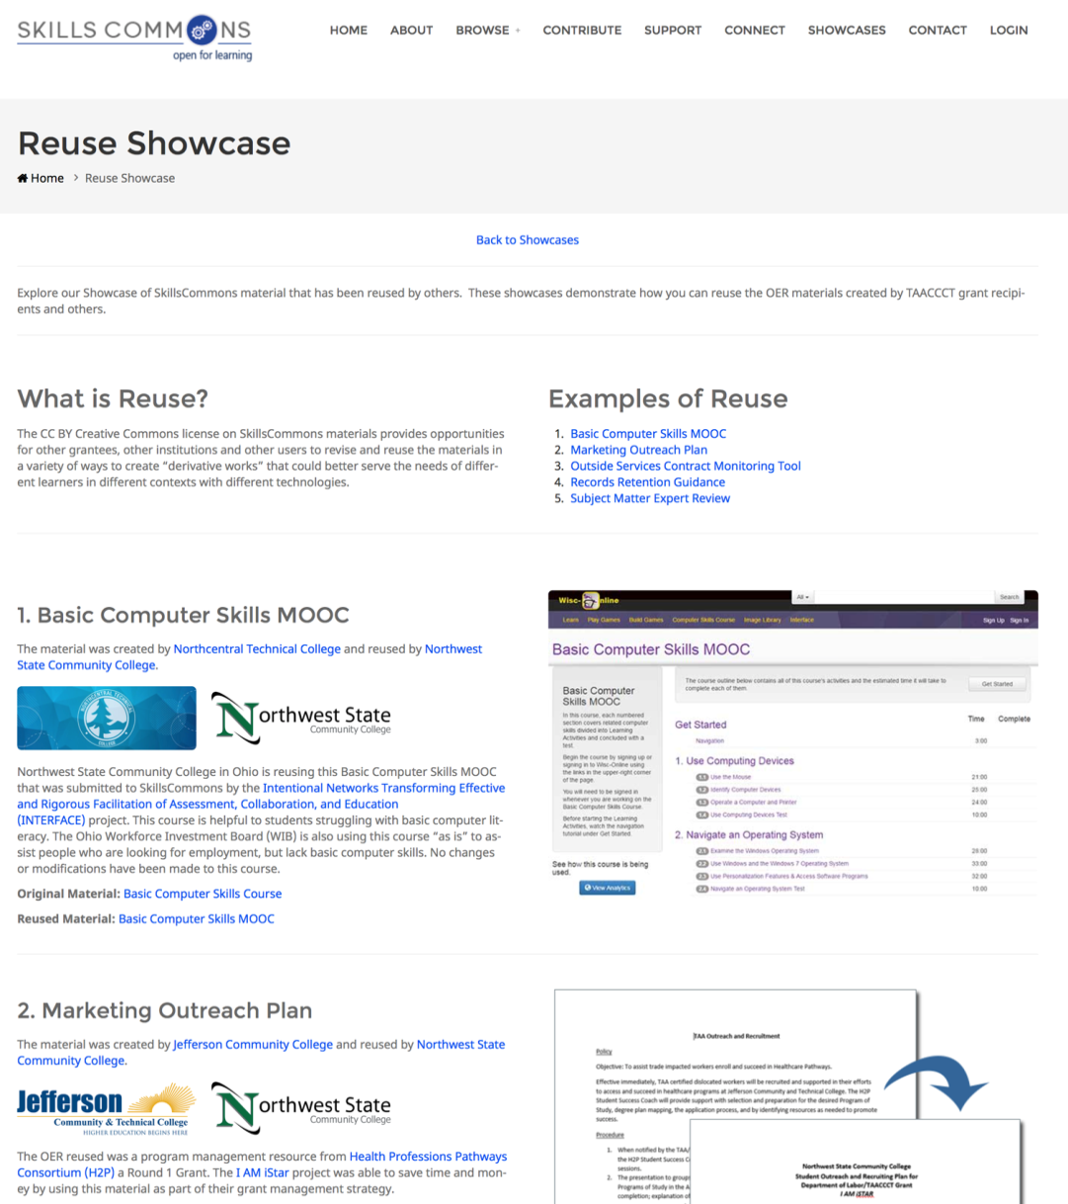
OER Reuse Showcases

Slide 26
Showcase of OER Reuse
Experience of TAACCCT Grantee’s
Reuse of existing OER

Slide 27
Showcase of OER Reuse
Maria Fieth
  Project Manager, “Consortium for Healthcare Online” (CHEO) Round 2 Grant Project

Slide 28
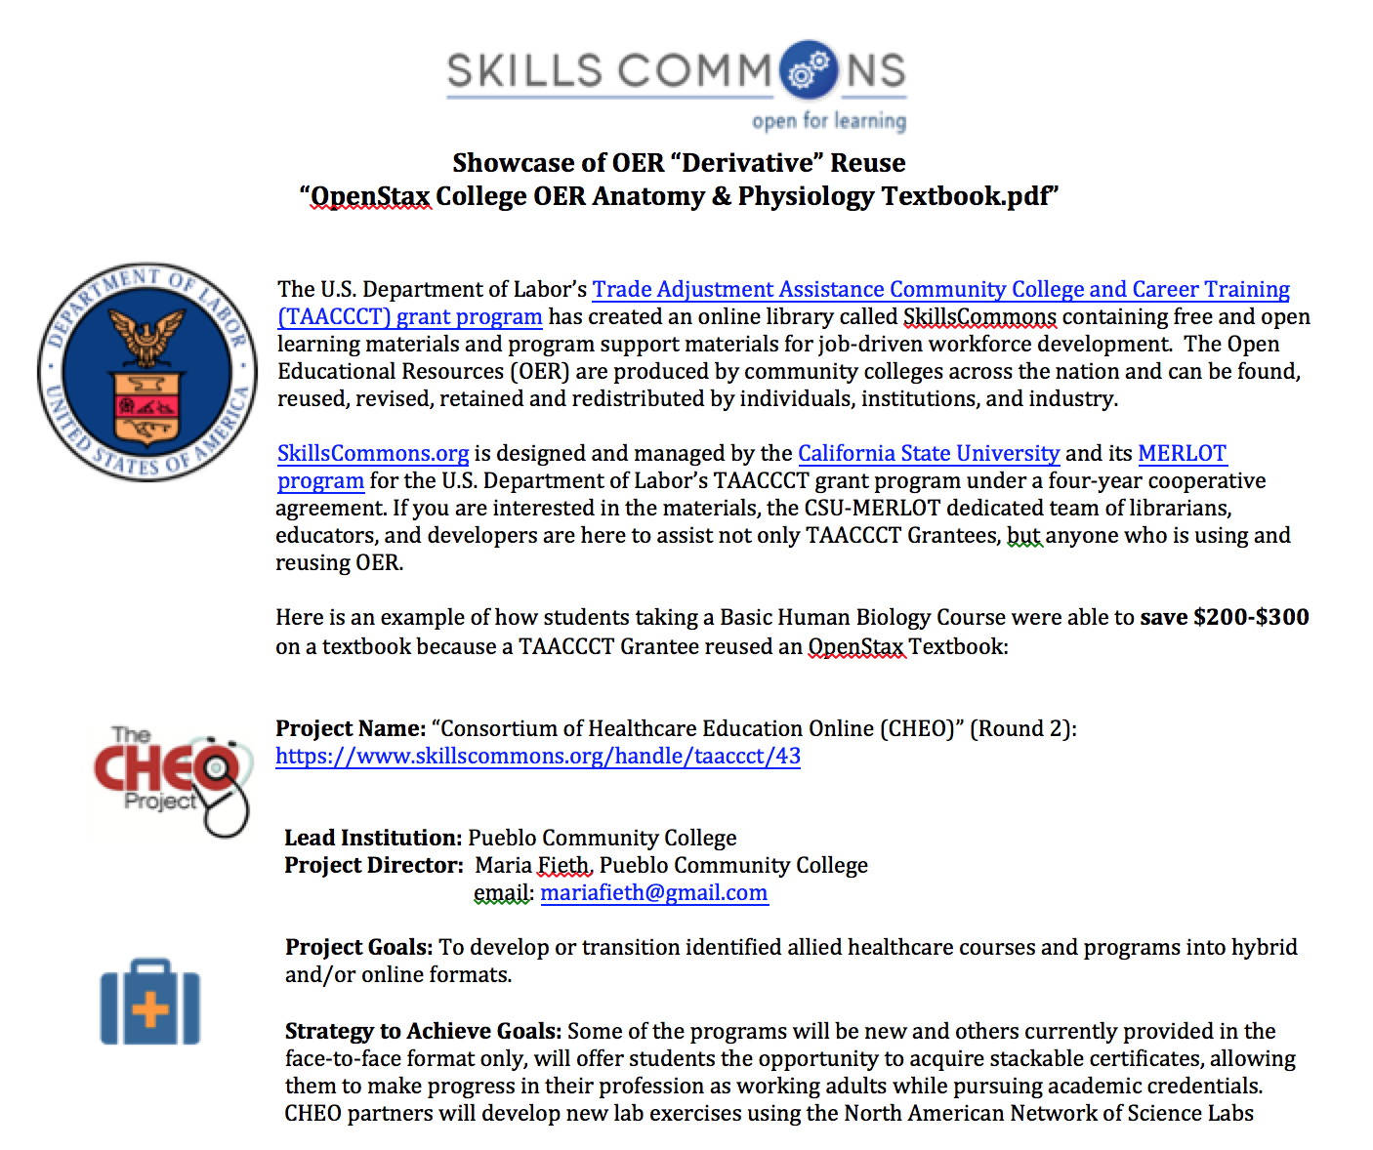
CHEO Grant Project
CHEO Grant Project

Slide 29
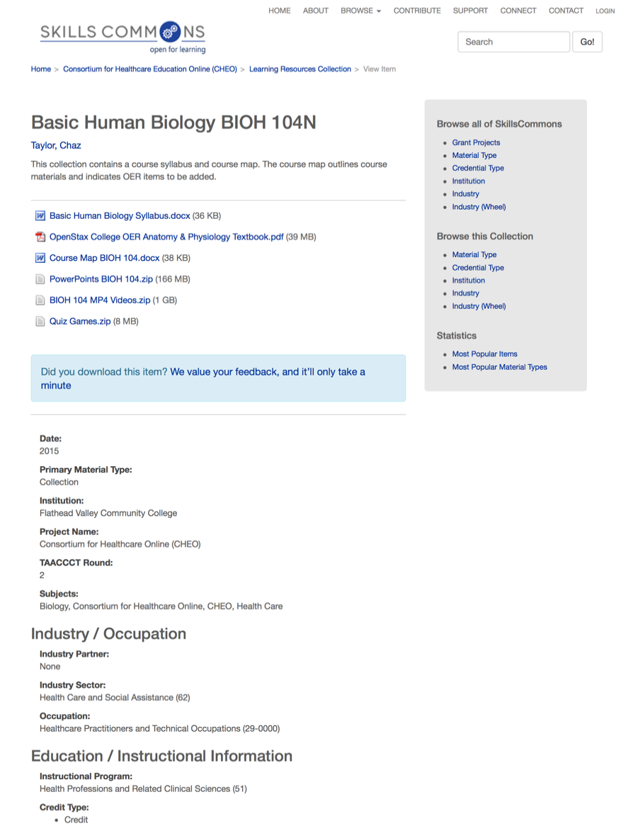
Description of Content
Description of Content

Slide 30
Showcase of OER Reuse
Experience of TAACCCT Grantee’s OER
for Reuse Hosted on SkillsCommons

Slide 31
Showcase of OER Reuse
Kathy Spada
  Project Manager, “Intentional Networks Transforming Effective and Rigorous Facilitation of Assessment, Collaboration, and Education” (INTERFACE) Round 3 Grant Project

Slide 32
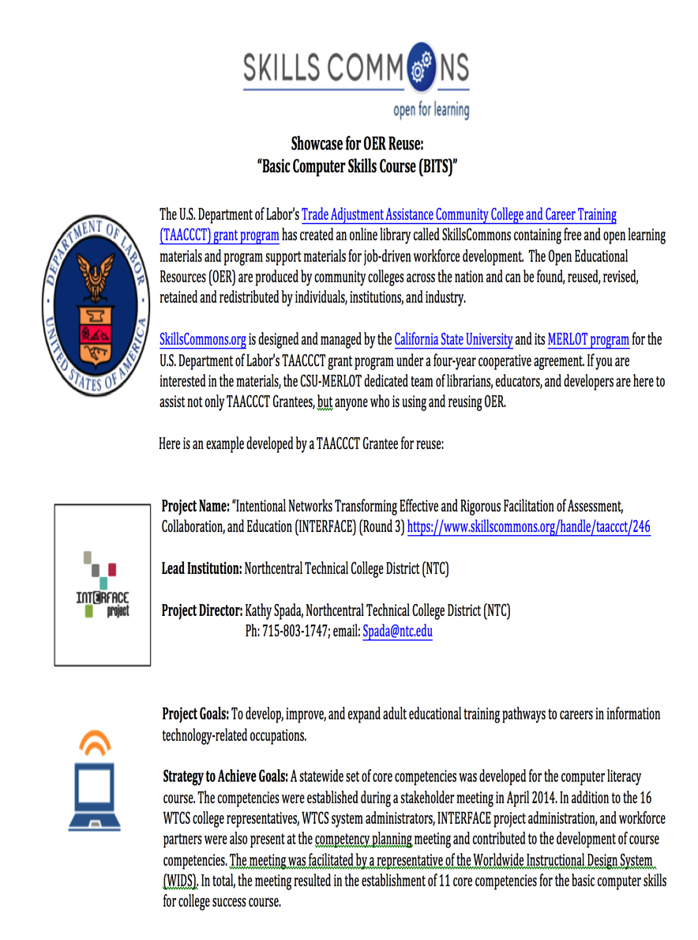
INTERFACE Grant Project

Slide 33
Description of Content
Description of Content

Slide 34
Showcase of OER Reuse
Experience of TAACCCT Grantee’s Reuse
of OER Hosted on SkillsCommons

Slide 35
Showcase of OER Reuse
Sarah Stubblefield
  Project Manager, “Industrial Automation Manufacturing Innovative Strategic Training Achieving Results” (I AM iStar) Round 4 Grant Project

Slide 36
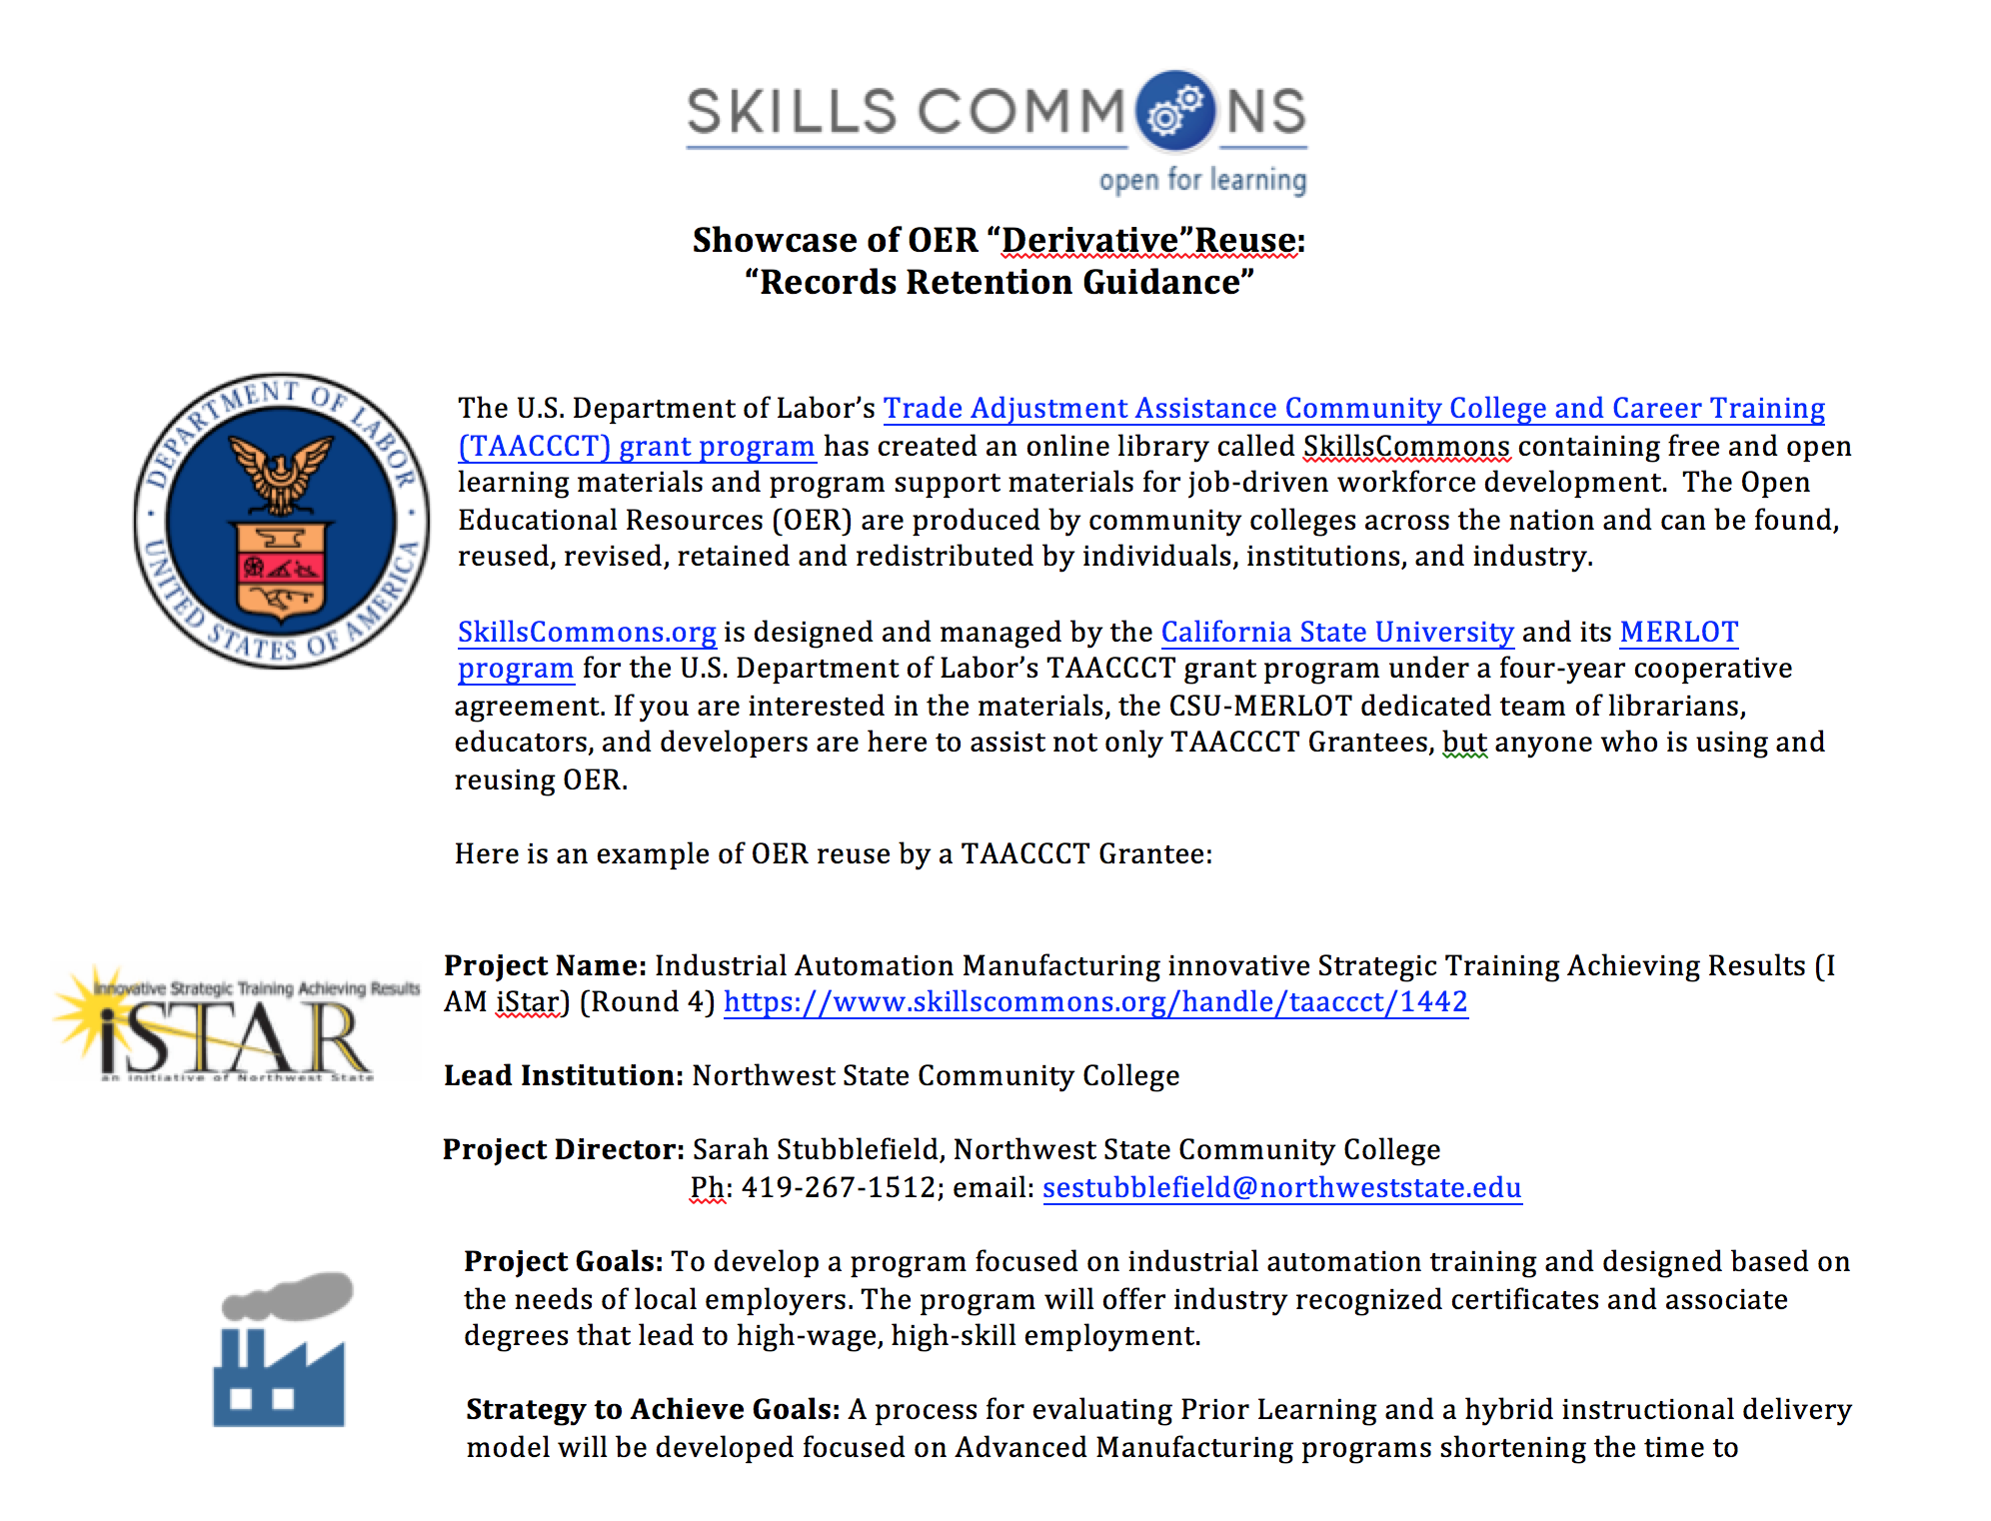
IAM iSTAR Grant Project

Slide 37
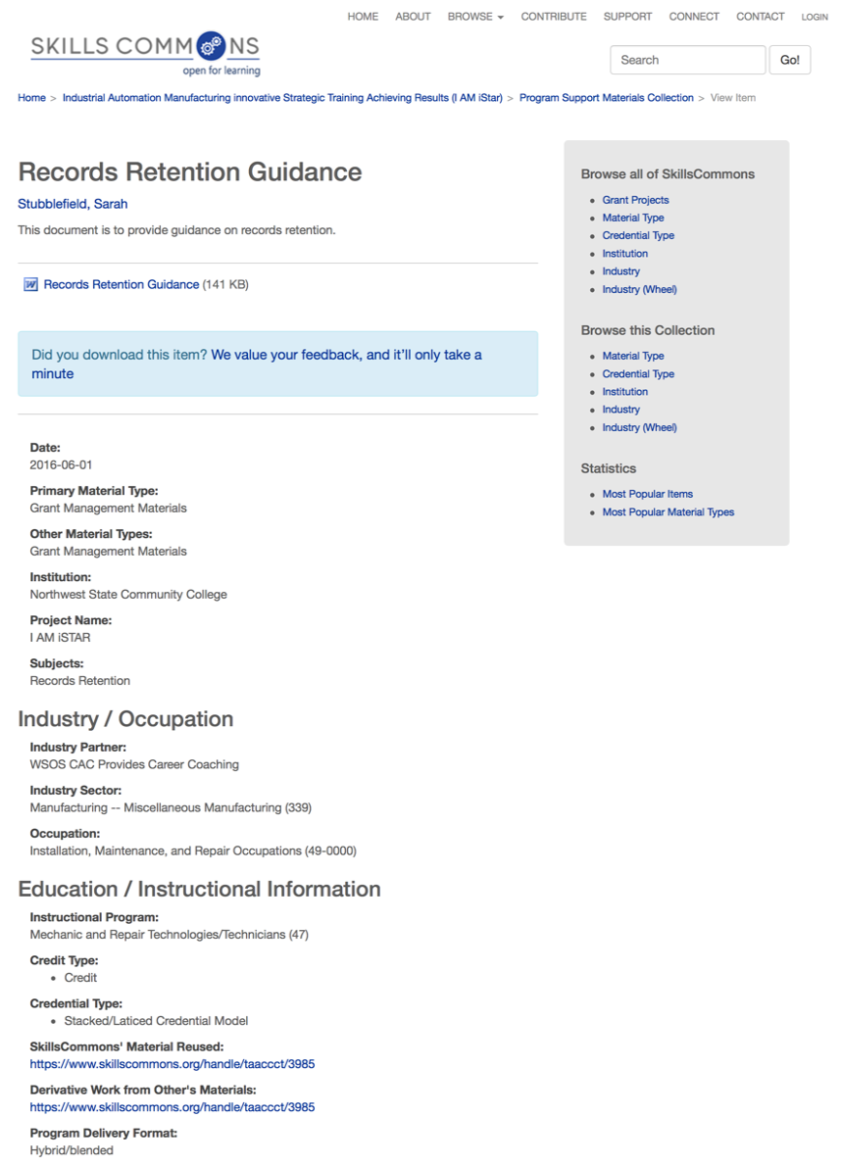
Description of Content
Description of Content

Slide 38
Upcoming Webinar: Utilizing Free Online Educational Resources on the SkillsCommons.org Repository: Part 2 – Makeover
When: Thursday, November 17, 2016
Time: 3:00 – 4:00 pm ET

Slide 39
Participant Poll
What type of OER resources are you interested in reusing?
Hybrid/Blended Course
Simulation
Presentation
Video
Program Administration Material
Textbook
Learning Activities
Other (please enter in chat box)

Slide 40
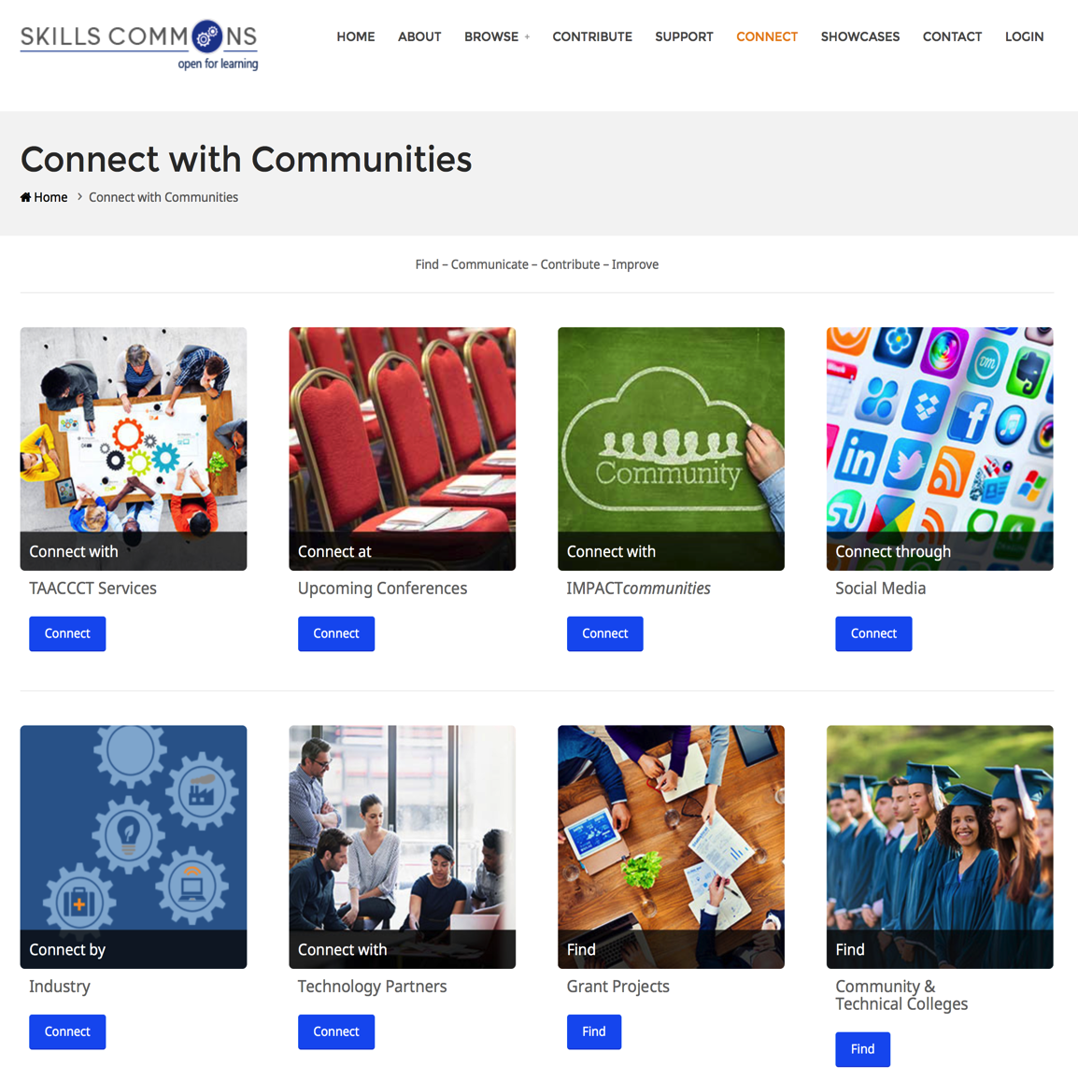
SkillsCommons CONNECT Center

Slide 41
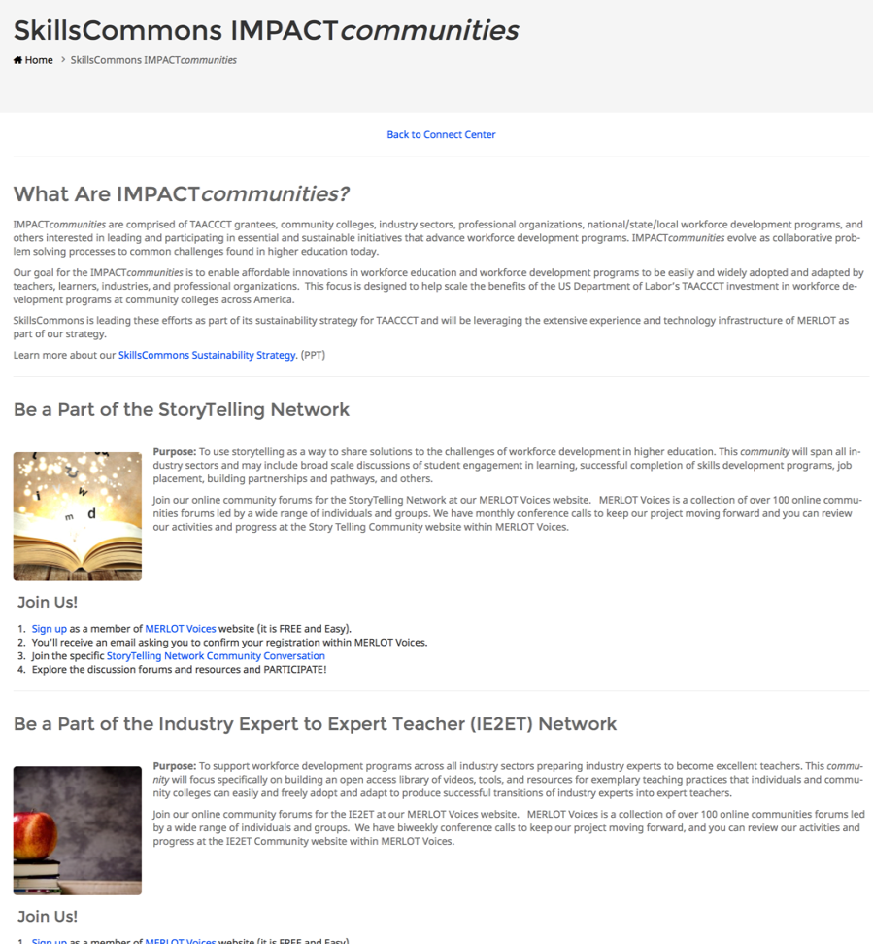
SkillsCommons IMPACTCommunities

Slide 42
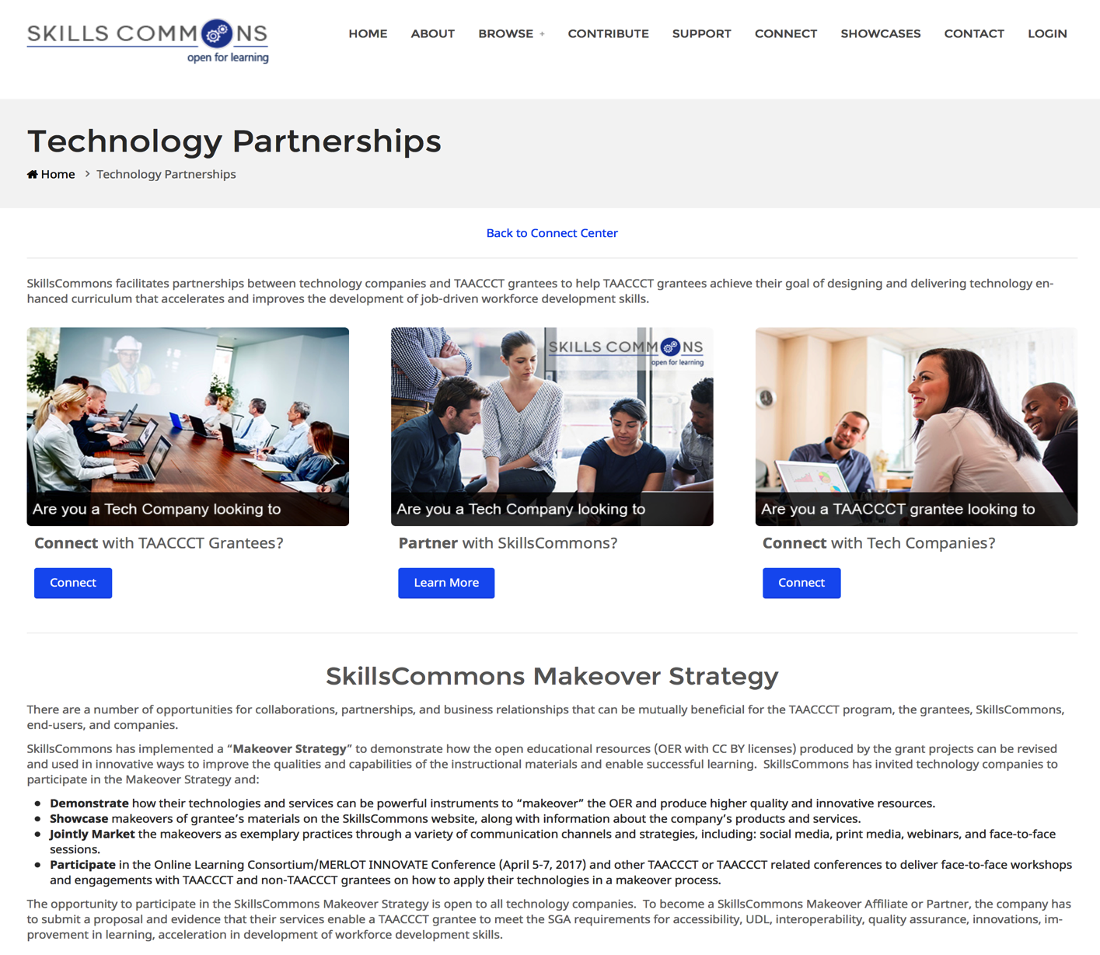
SkillsCommons “Makeover” Strategy

Slide 43
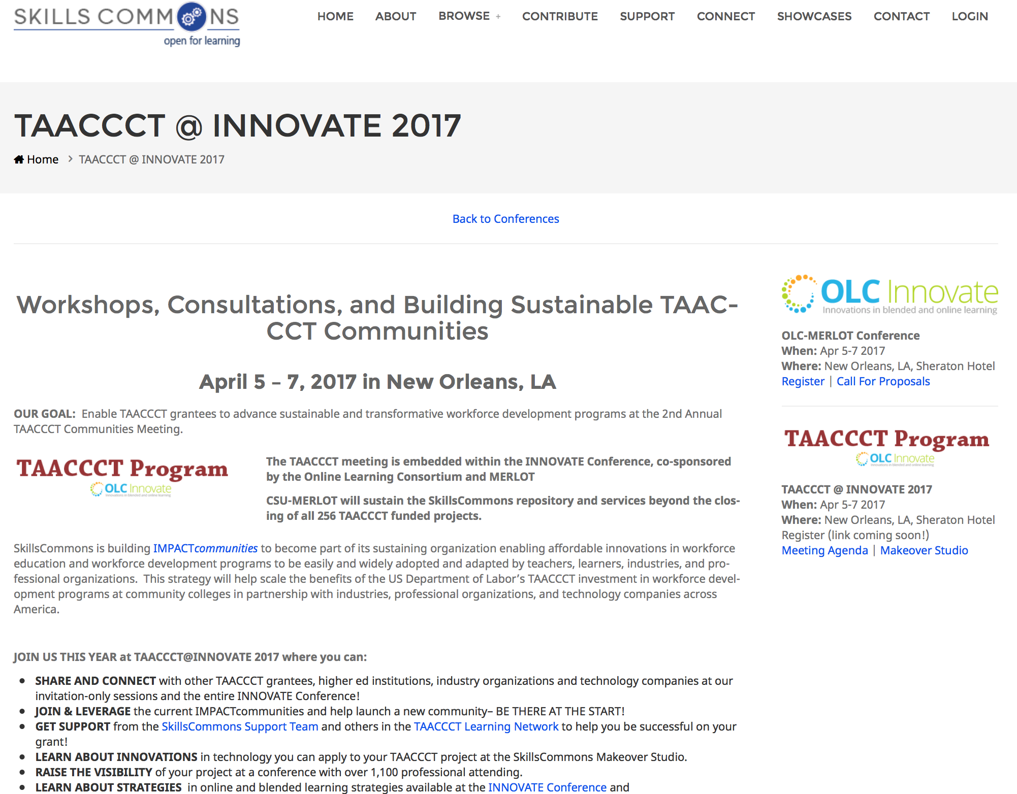
Join Us!

Slide 44
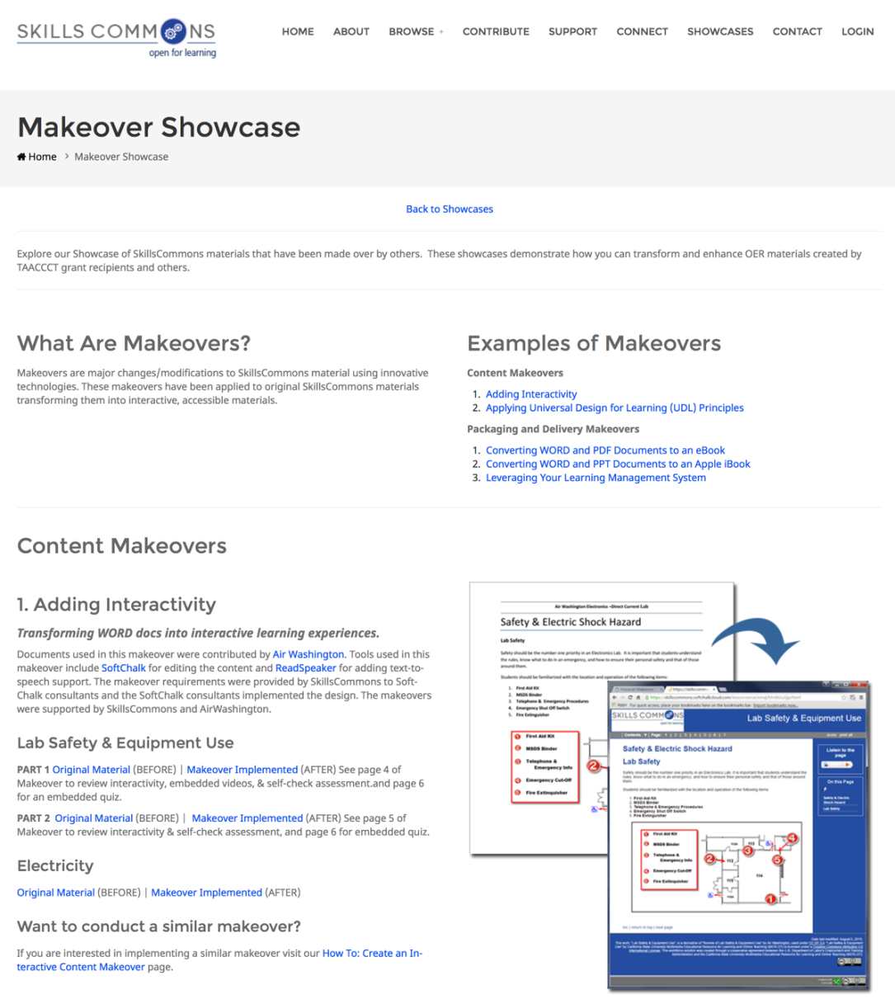
OER Makeover Showcases

Slide 45
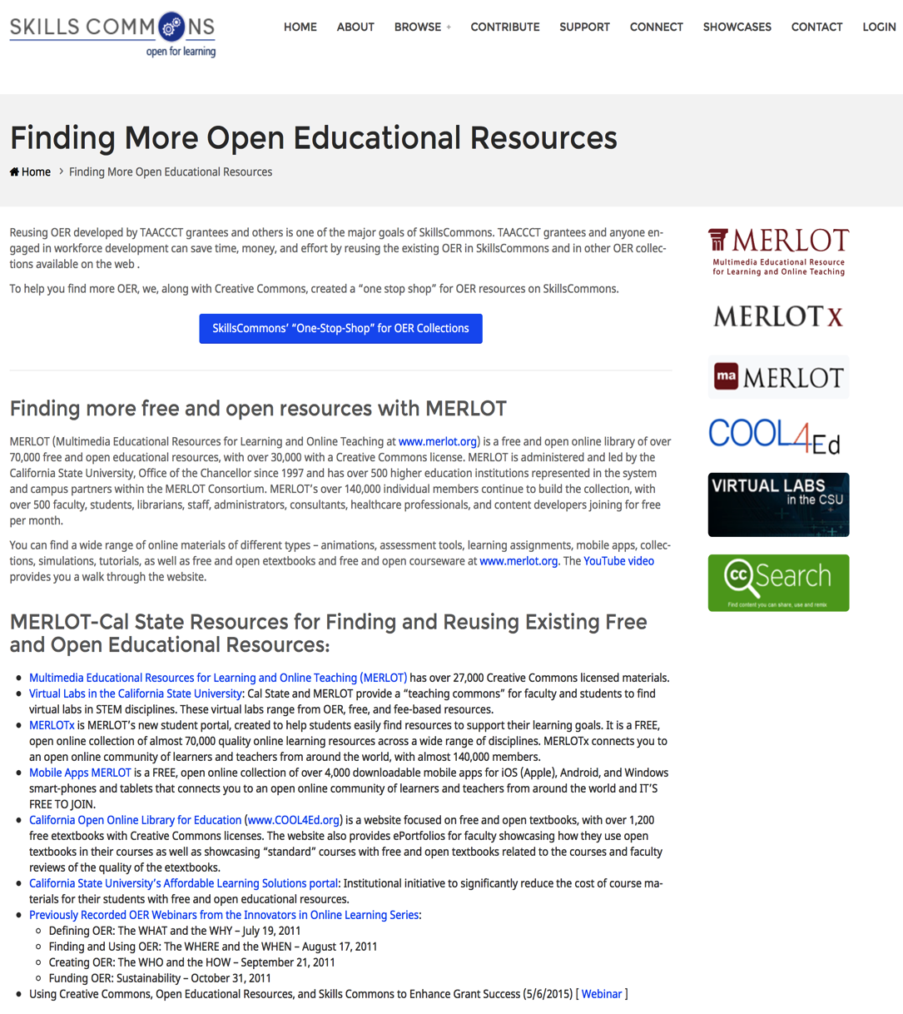
Additional OER Resources

Slide 46
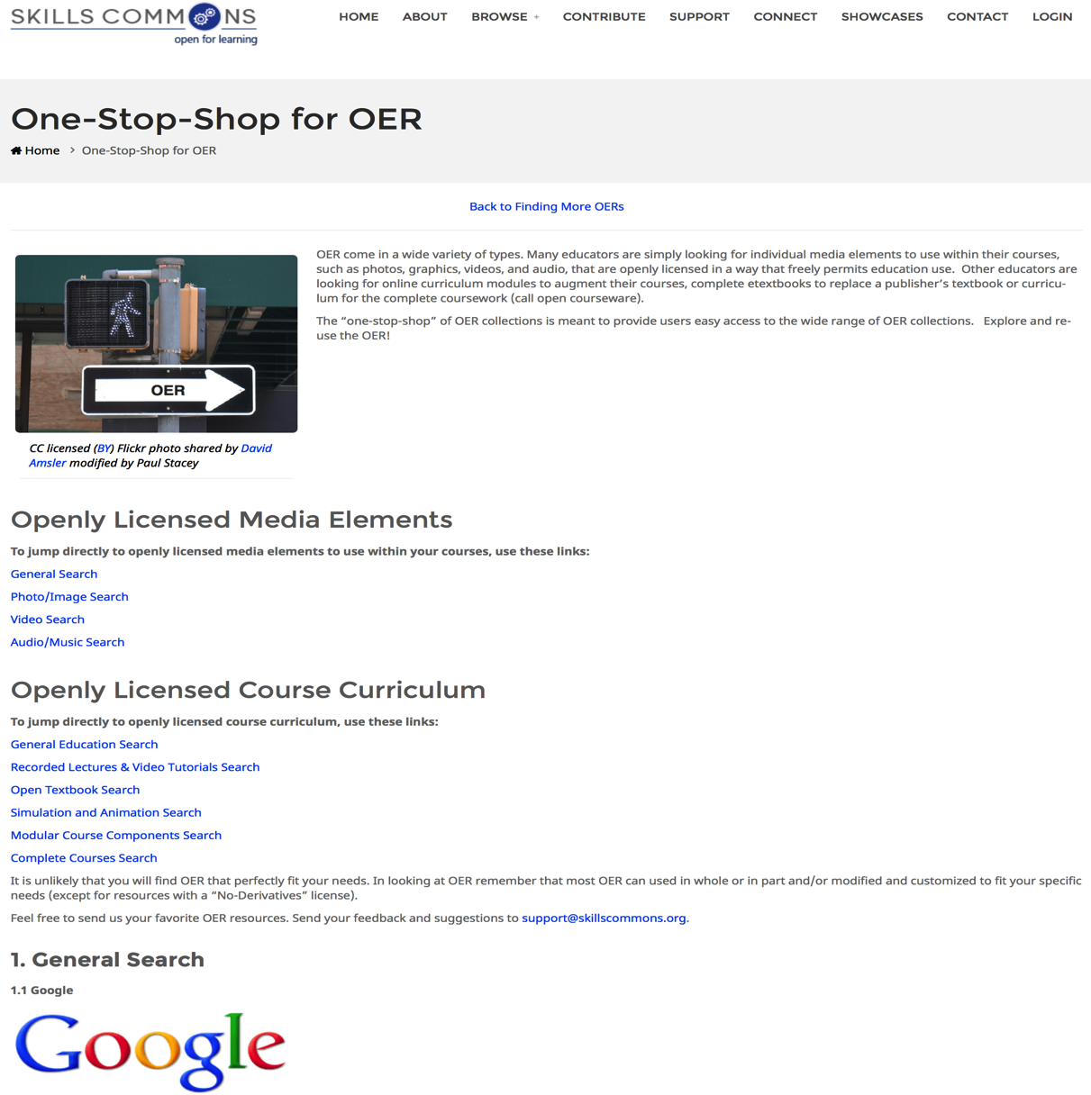
One-Stop-Shop for OER

Slide 47
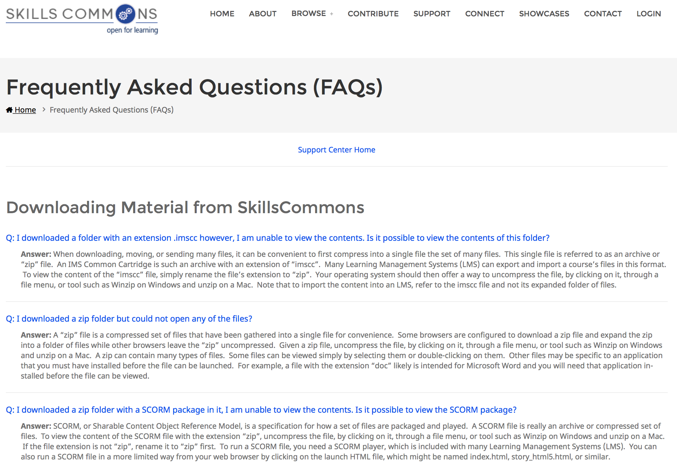
FAQs for Downloading

Slide 48
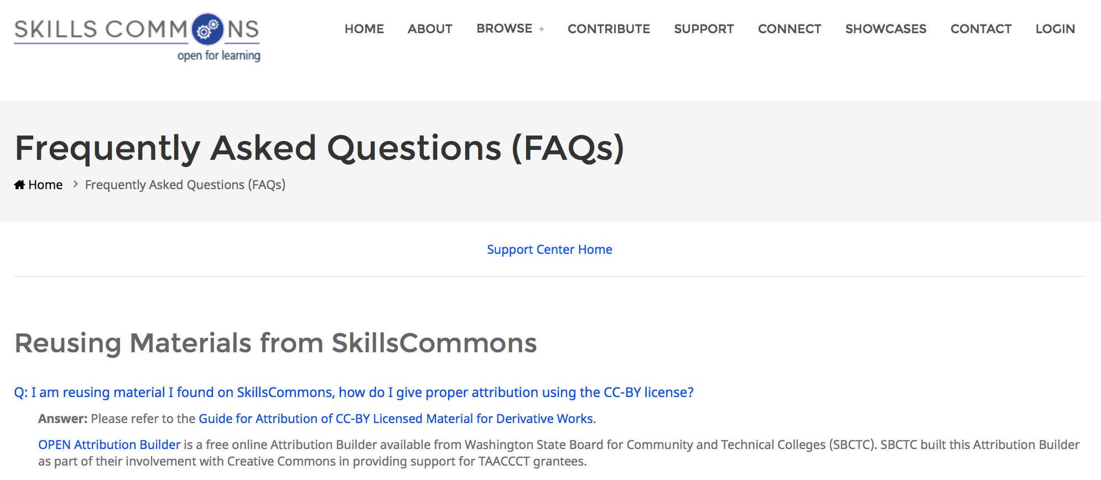
FAQs for Downloading

Slide 49
Questions?
support@skillscommons.org
Rick Lumadue: Program Manager & Grantee Relations, SkillsCommons:
rlumadue@calstate.edu

Slide 50
OER on SkillsCommons.org Repository:
Part II – Makeover
Utilizing Free Online Educational Resources on the SkillsCommons.org Repository: Part II – Makeover
  Thursday, November 17, 2016
  3:00 PM ~ 4:00 PM ET
  In this webinar, participants will discover the benefits of working with a technology company to create a “makeover” of existing OER that has been deposited on SkillsCommons.

Slide 51
2017 Workforce Development Institute
2017 Workforce Development Institute: Inspiring Innovation
  January 25-28, 2017, Newport Beach, CA.
Next year’s institute will host a special TAACCCT Private Meet-Up on Wednesday, January 25 from 1-4 p.m., PT. In line with the 2017 WDI theme, “Inspiring Innovation,"
TAACCCT Grantees are welcome to join us for a robust conversation where you will share your innovations and their impacts, your sustainability efforts, and get help to overcome sustainability challenges.

Slide 52
2017 Workforce Development Institute
Space is limited, so please RSVP by completing this short form by Friday, January 6, 2017, to reserve your spot!

Slide 53
THANK YOU
This work is licensed under a Creative Commons Attribution 4.0 International License.
This workforce solution was created through a cooperative agreement between the U.S. Department of Labor's Employment and Training Administration and the California State University-Multimedia Educational Resource for Learning and Online Teaching (MERLOT).

