Slide 1
High Impact Workforce Boards
November 9, 2016
WIOA Wednesday
11/9/16

Slide 3
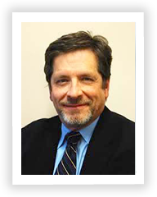
Amanda Ahlstrand
Administrator, Office of Workforce Investment, Employment and Training Administration
Beth A. Brinly
Vice President of Workforce Innovation, Maher & Maher
Ron Painter
Chief Executive Officer, National Association of Workforce Boards

Slide 4
Objectives for Today’s Call
Reinforce the importance of strategic boards at the state and local levels
Discuss the formation and evolution of KY’s High Impact Workforce Boards Initiative from WIA to WIOA
Examine KY’s criteria for a High Impact Board
Hear firsthand how the process transformed the work of one local board

Slide 5
Strategic State and Local Boards…
Serve as the keeper of a guiding vision, and engage funders, partners, employers, and community members around that vision
Are committed to identify employer centric solutions through strategic partnerships and collaborative service
Have an effective structure and measurement process including assessing, reporting and seeking to improve program outcomes

Slide 6
WIOA Vision
WIOA drives a vision for more strategic action by Workforce Boards, with particular focus on a unified vision for workforce development shared by all levels of Boards within a state, more extensive collaboration with partners and employers, and expanded accountability and transparency.
In the realm of strategic activities, Boards will want to consider items such as:
The impact of common performance measures,
New employer measures,
Career pathways for adult and youth populations,
Sector strategies,
Today, we will talk more about becoming a more strategic board, leading a state effort to evolve how we serve our customers into what WIOA envisioned.
The re-envisioning of American Job Centers (AJC),
Staff capacity building,
One Stop / AJC procurement, cost sharing, and certification, along with many other issues.

Slide 7
Polling Question 1
Where are you positioned in the workforce system? (Select one of the following)
I’m staff to the State Workforce Board
I’m staff to the Local Workforce Board
I’m a State Workforce Board Member
I’m a Local Workforce Board Member
I’m a State Agency Staff Member
I’m a Local Agency Staff Member
Other: please write in the chat box your role and interest in boards!

Slide 8
Polling Question 2
How long have you been involved in State or Local Workforce Development Boards? (Select one of the following)
1-2 years
3-5 years
6-10 years
10+ years
Other: Please write your answer in the chat box

Slide 9
High Impact Workforce Boards
Strategic
Thinking,
Planning
& Acting

Slide 10
Strategic Board Roles

Slide 11
Your Board’s Role in Strategic Thinking and Acting
Vision
Structure
Ownership
Integration of Initiatives
Leveraged Investments
Manage resources with the customer in mind
Operate as a system
Braid resources with system partners

Slide 12
Kentucky High Impact Board Project Vision
Grow strong and engaged local boards
Set clear and strategic goals that are efficient and result driven
Manage and leverage resources

Slide 13
Goals for WDBs
Work strategically
Effectively and efficiently attract and manage their resources
Have a strong and engaged board that drives the strategy development and implementation for their local workforce system

Slide 14
Process
Action Item in the Kentucky WorkSmart Strategic Plan
Established a Steering Committee
Baseline Assessment Process
Refined Standards, Elements and Criterion
Technical Assistance Funds based on Assessment
Standard Year
Updated Standards including WIOA

Slide 15
Understanding the Criteria

Slide 16
Strategic Planning & Implementation
Planning comprehensive and inclusive
Aligns with other community plans
Measurable goals beyond WIOA
Living document focused on continuous improvement
Sectors approach to employer engagement and career pathways development

Slide 17
Developing and Managing Resources
Reviews and approves budget in alignment with strategic goals
The budget leverages funds and assets of other community agencies and partners
Effective use of technology to manage, deliver and maximize the efficient use of programs

Slide 18
Managing the Work of the Board
Membership is diverse, represents the targeted sectors, and is business driven
Measures its effectiveness and that of the workforce system
Focused on continuous improvement based on federal, state and local measurements

Slide 19
Polling Question 3
In terms of measuring the impact of Workforce Development Boards, where would you, candidly, place the board with which you work?
We have not developed specific metrics to measure the impact of our board
We have developed specific criterion, but have not yet measured our impact
We have developed criterion, have begun measuring our impact metrics, and are seeing mixed results
We have been measuring our impact metrics, have made adjustments to our methods, and are seeing improving metrics
We are successfully meeting our metrics, and have a proven track record of attracting resources and representing a vision of growth for our community’s businesses and workers

Slide 20
Possible Exercise
Identify a reporter and scribe for your table. Discuss the following responsibility:
Each group or team will be assigned a Criterion for a High Impact Workforce Board, and the team will review the related Standard Area, Goal, Definition, assigned Criterion and elements under it.
Then select an element under the Criterion to discuss at your table.


Discuss possible activities a Local Workforce Development Board could undertake to achieve the element and how you might go about them. The reporter should be prepared to share a few of the activities identified during the table top discussion.

Slide 21
From Policy to Practice

Slide 22
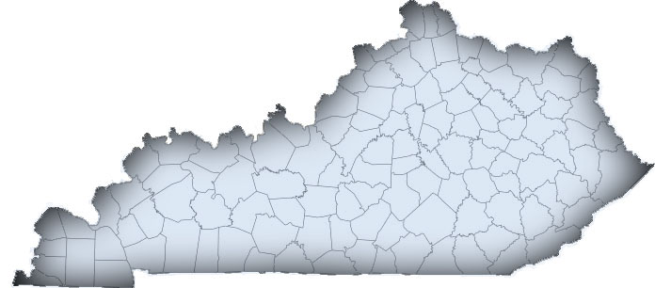
Northern KY High Impact Board
Results!
Key Performance Indicators
Collective Impact
Economic Impact (NKU study)

Slide 23
Impact of NKY WIB Employment Outcomes…
By Employment in All Sectors
 | Employment | Labor Income | Output
Direct | 12,000 | $472,521,606 | $1,098,695,536
Indirect | 2,575 | $108,494,371 | $288,820,866
Induced | 4,098 | $154,493,912 | $436,127,790
Total | 18,673 | $735,509,889 | $1,823,644,192
By Employment in Targeted Sectors
 | Employment | Labor Income |  | Output
Direct | 7,647 | $334,688,215 | $849,332,302
Indirect | 2,062 | $87,183,785 | $232,639,629
Induced | 2,975 | $112,176,705 | $316,668,293
Total | 12,684 | $534,048,705 | $1,398,640,224

Slide 24
Voices of Experience
https://ion.workforcegps.org/resources/2016/04/11/13/16/Strategic_Local_Boards

Slide 25
Polling Question 4
What is getting in the way of your board becoming a high impact one? (insufficient funds is NOT an OK answer!)
Please enter your comments into the chat box, and feel free to include ways in which you are working toward a solution.

Slide 27
For More Information
Please visit the Strategic Boards Tool Kit on ION
https://ion.workforcegps.org/resources/2016/06/27/11/23/Strategic_Boards_Materials
For information on how you might best use the Strategic Boards Tool Kit, download the document included with this presentation

