Slide 1
Promoting self-sufficiency and employment opportunities for older adults
Senior Community Service Employment Program (SCSEP)
National Grantee Orientation
Employment and Training Administration

Slide 3
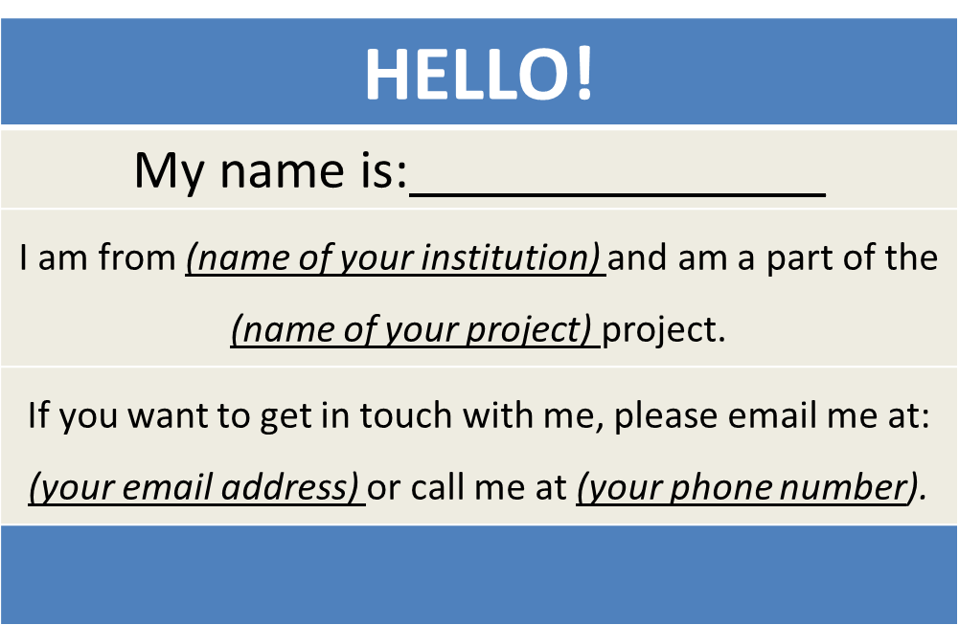
SCSEP Grantees
Create a virtual name tag…

Slide 4
Michi McNeace
U.S. Department of Labor
National SCSEP Team

Slide 5
Introductions
SCSEP History & Overview
Grant Office Process & Reporting Requirements
Financial Management
SCSEP the Program
Communication Process
Next Steps

Slide 6
FRANCIS PERKINS BUILDING - Washington, DC
INTRODUCTION NATIONAL OFFICE

Slide 7
Steven Rietzke
Division Chief
U.S. Department of Labor
Employment and Training Administration
Division of National Programs, Tools, and Technical Assistance

Slide 8
DNPTTA – Our Mission
The mission of the Division of National Programs, Tools, and Technical Assistance is to contribute to the implementation of an integrated national workforce investment system that provides workers with the job search assistance and information on labor markets, occupations, careers, and supportive services they need to get and keep good jobs, that delivers employment and training services to targeted populations, and that improves the workforce system’s capacity to deliver integrated high quality programs to jobseeker and employers.

Slide 9
OLDER WORKERS UNIT
Manages and oversees grants and investments, manages SCSEP national grant solicitations, and provides support for regional Federal Project Officers in managing SCSEP grantees.
Oversees national reporting system for SCSEP grantees, SPARQ, and reviews program and performance data to continuously improve program operations.
Develop and promote system-wide capacity for delivery of services to older workers.

Slide 10
Introductions – National Program Office
Program Office
Division of National Programs, Tools, and Technical Assistance, Senior Community Service Employment Program (SCSEP) Unit
The Program Office has several functions:
Support Federal Project Officers (FPOs)
Provide Technical Assistance and Training (TA)
Manage, Collect and Negotiate Performance and Data
Provide Policy and Guidance

Slide 11
SCSEP UNIT
Support Federal Project Officers (FPOs)
Grant Submission Reviews and Modifications
Technical Assistance and Training
Technical Assistance (TA) & Training – Together With Our SCSEP Contractors
BCT Partners
PM Solutions

Slide 12
SCSEP UNIT
Manage, Collect and Negotiate Performance and Data
Program Guidance Materials (i.e. Data collection & validation handbook, QPR handbook, customer satisfaction survey, goal negotiations, performance and data validation reports, etc.) and much more
Policy Guidance
Federal Regulations
Funding Opportunity Announcements
Training and Employment Guidance Letters (TEGL)
Training and Employment Notices (TENS)

Slide 13
National SCSEP Team

Slide 14
National SCSEP Office
Supervisory Workforce Analyst/ Unit Chief
U.S. Department of Labor
Employment and Training Administration
Older Worker Unit

Slide 15
National SCSEP Office
Irene Jefferson
Judith Gilbert
Workforce Analyst
U.S. Department of Labor
Employment and Training Administration
Workforce Analyst
U.S. Department of Labor
Employment and Training Administration

Slide 16
National SCSEP Office
Simisola Atolagbe
Susanna Troxler
Workforce Analyst
U.S. Department of Labor Employment and Training Administration
Presidential Management Fellowship
U.S. Department of Labor
Employment and Training Administration

Slide 17
National SCSEP Contract Team
Michi McNeace
Dawn Mitchell
U.S. Department of Labor
PM Solutions
U.S. Department of Labor
PM Solutions

Slide 18
National SCSEP Contract Team
Ted Romero
Bennett Pudlin
U.S. Department of Labor
PM Solutions
U.S. Department of Labor
BCT Partners

Slide 19
National SCSEP Contract Team
Terry Cram
Baron Hilliard
U.S. Department of Labor
BCT Partners
U.S. Department of Labor
BCT Partners

Slide 20
Have you interacted with any member of the SCSEP team?
I think so.
I definitely have!
No – this is the first time I’ve heard of them.
Who are they again?

Slide 21
LaMia Chapman
U.S. Department of Labor
Employment and Training Administration National SCSEP Team

Slide 22
SCSEP History & Overview
Authorized by the Older Americans Act of 1965, the Senior Community Service Employment Program (SCSEP) is designed to foster individual economic self-sufficiency and promote useful employment and training opportunities through community service training assignments for unemployed low-income persons (particularly those who have poor employment prospects), who are age 55 or older, and to increase the number of persons who can and want to benefit from unsubsidized employment.
SCSEP continues to provide important employment and training opportunities for low-income seniors to improve their employment outcomes and contribute to the overall enrichment of communities across the nation. SCSEP provides various community service assignments and job training opportunities at non-profits and public facilities.
Over the years, SCSEP has enhanced their services to participants by providing occupational, work skills and aptitude assessments, skills development and other job training opportunities, and employment assistance through the American Job Centers.
Program grants are awarded to eligible applicants, which includes States, U.S. Territories, and public and private non-profit entities other than political parties (Section 506 of Act). The relative amount of funding for each type of eligible applicant has historically occurred at proportions of 22 percent to State and territorial agencies and 75 percent to national grantees.

Slide 23
Grant Overview
Twenty grants have been awarded to 19 national non-profit organizations through the program’s general funds or funds set aside by statute to serve Native Americans and Asian–Americans and Pacific Islanders.
These grants will support more than 34,000 positions. In addition, state and territorial grantee are awarded separately from this competition through a formula process and will provide services for an additional 10,000 positions.
These awards provide funding through the end of the Program Year 2016. After Program Year 2016, it is expected that the national grantees will receive approximately $337 million annually for an additional three years, subject to appropriation.
October to January 31, 2107 – SCSEP will be in transition and on February 1, 2017, all 19 national grantees will officially begin SCSEP operation for the remainder of PY 16 and prepare for PY 17.

Slide 24
POLL
Do you know what the Office of Grants Management does?
Of course!
Well kind of, I think
Not really
Huh!!

Slide 25
Jimmie Curtis
Grant Officer
U.S. Department of Labor
Employment and Training Administration
National Programs Unit

Slide 26
Introduction - OGM
Program Office – Office of Grants Management (OGM)
The Grant Officer performs official grant duties:
Maintains official grant documents such as modifications, no-cost extensions, and other relevant documents
Approves equipment purchases over $5,000
ETA Grant Officer: Jimmie Curtis
SCSEP Specialist: Jeannette Flowers

Slide 27
Grant Award Package
Grant Award Letter
Grant Agreement
Signature Page / Notice of Obligation (NOO)
Condition of Award Page
Terms and Conditions
Application for Federal Assistance
Budget
Statement of Work (SOW)
Indirect Cost Rate Agreement (if applicable)

Slide 28
Grant Award Package and Reporting Requirements
Acknowledgements of Award
Payment Management System
Information and forms on www.doleta.gov under Payment Information
ETA’s on-line Grantee Fiscal Reporting System
ETA 9130
Information to access system on www.doleta.gov/grants under Financial Reporting
Passwords/PINs are sent separately after supplying the necessary information
Once you receive this please do not lose it

Slide 29
SCSEP Reporting
For awarded grantees – SCSEP grantees are required to submit the following reports to ETA:
Quarterly Submissions (Due no later than 45 calendar days after the end of each reporting quarter
9130 – See Training and Employment Guidance Letter (TEGL) No. 02-16, Revised ETA-9130 Financial Report, Instructions, and Additional Guidance
Quarterly Narrative Performance Report - see grant package
Annual Submissions
SF 424 & 424A
Budget Narrative
Program Narrative
Programmatic Assurance
Special Optional Requests

Slide 30
Grant Award Package
Project Title – SCSEP
Grant Awardees’ Identifying Information
Agreement number
Period of Performance
Award Amount
Regulations and Cost Principles
Signatures

Slide 31
Grant Award Package
Equipment purchases with a per unit acquisition cost of $5,000 or more, and a useful life of more than one year need prior approval from Grant Officer.
Submit a detailed equipment purchase list with descriptions of each item to your Federal Project Officer (FPO) for review. We encourage you to submit this request as early as possible in the period of performance, with as many planned pieces of equipment as possible.
Your FPO will review the items and submit the list for OGM review. If the equipment purchases are approved, a modification to your grant will be processed.

Slide 32
Grant Award Package
Review of Grant Terms and Conditions
Assistance from FPO, DNPTTA, and OGM
Grant Transparency Process
Please continue to work on the redaction request materials and send your redacted project narratives to SCSEP.national@dol.gov due 14 days after receipt of your grant award.

Slide 34
Irene Jefferson
U.S. Department of Labor
Employment and Training Administration
National SCSEP TEAM

Slide 35
Financial Management – What you should have in your toolbox
Super Circular 2 CFR Part 200
Uniform Administrative Requirements
Cost Principles
Audit Requirements
Federal Regulations 20 CFR Part 641
Administrative Requirements
Cost Restrictions
Optional Special Requests

Slide 36
Financial Management
Accountability Requirements
Grantees assumes full responsibility for program activities
Accountable for meeting federal standards in the area of financial management, internal controls, audit and reporting to DOL

Slide 37
Financial Standards
Have an appropriate method for implementing financial management systems
An accounting structure that provides accurate and complete information about all financial transactions related to the program – this should include both expenditures of grant funds and match contribution

Slide 38
Internal Controls Standards
Grantees must provide safeguards for all grant property whether
its cash or other assets
Assure that it is used solely for authorized purposes
Have a financial team handling all aspects of financial transactions from beginning to the end of the grant period
Effective techniques for providing internal controls can be very simple –
Have written conflict of interest policies
Have a signatory authority policy
Petty cash funds should be entrusted to a single custodian
Payments to vendors should be issued only after invoices are approved

Slide 39
Other Standards
Procurement – Grantee must develop procurement standards for Federal grants that include conflict of interest statements
Purchases under $3,000 (micro-purchases) may be made without bids
Purchases over $3,000 and less than $150,000 are defined as small purchases – these must go through a form of competition
Audit – Grantees are expected to maintain a state of audit readiness
Records/documents pertinent to the financial and programmatic aspect of the grant is readily accessible for audit
Reporting – The reporting requirements is spelled out in the grantee award package

Slide 40
Do you know what the fiscal responsibility test is?
I’m not sure
Yes I do
No I don’t
I think I do – tell us just to make sure

Slide 41
Fiscal Responsibility Test
Make sure all costs are -
Allowable
Allocable
Necessary
Reasonable

Slide 42
Federal Regulations Administrative Requirements
Cost Restrictions
Administrative Cost
Programmatic Cost
Optional Special Requests (OSRs)
There are seven special requests

Slide 43
Administrative Cost
641.867 – What are the limitation on amount of SCSEP administrative cost?
13.5% of the grant award can be increased to not more than 15%
641.870 - Under what circumstances may the administrative cost limitation be increased?
Grantees may request an increase of up to 15% if they meet the requirements set forth in this section of the regulations, with DOL’s approval

Slide 44
Administrative Cost
Requests to Increase Administrative Cost from 13.5% to 15%
The Department will determine if the request is necessary to carry out the project
The grantee must demonstrates that –
Major administrative cost increases are being incurred are necessary
program components; and
The number of community service assignment positions in the
program or the number of minority eligible participants in the program will decline; or
The size of the program is so small that the that administrative cost amount incurred to carry out the program exceeds 13.5%
ALL OSRs requires DOL approval prior to implementation

Slide 45
Programmatic Cost
Participant Wages and Fringe Benefits
641.873 – minimum expenditure levels required for participant wages and benefits
Not less than 75 percent of the SCSEP funds must be used to pay for wages and fringe benefits
641.874 – What conditions apply to request to use additional funds for training and supportive services cost?
Grantee may submit a request to the Department for approval to use not less than 65% of the grant funds to pay PWFB
Can use up to10% of grant funds that would otherwise be devoted to wages and benefits
To provide skills training and supportive services to enable participants to successfully participate in the program, described in a work plan
Grantee must pay wages from the percentage requested, for those individual participants who are receiving training, outlined in the work plan

Slide 46
Optional Special Requests (OSRs)
Grantees may submit requests for –
Change 48-Month Individual Durational Limit Waiver Options
Request to change your current IDL policy
Additional Training and Supportive Services Funds
Permits an exception to the 75% minimum level of expenditure on participant wages and fringe benefits (PWFB). This allows the use of not less than 65% of program funds for PWFB.
Increase in Administrative Cost Limitation
An increase in the amount available for administrative costs to not more than 15%
Extension of Average Project Duration
Request to increase your maximum average duration to 36 months
On The Job Experience (OJE)
If Grantee wish to utilize OJE
Cross Border Agreements
For State Grantees only – who wish to enter into agreements to permit cross border enrollment
Rotation Policy
If grantee wish to establish a policy of rotating participants to a new host agency or a different assignment within the current host agency.

Slide 47
Any OSR must include, But not limited to
Explanation –
How the provision of the activities will improve the effectiveness of the program
How the activities will improve program outcome
Other OSRs will require additional and more detailed information, such as the Additional Funds for Training and Supportive Services (ATSS), which requires more specifics such as:
Provide the number of participants that will be displaced
A description of the activities that the grant funds will spent the grant be used
Provide the number of positions that will be eliminated
An explanation of whether any displacement of participants or elimination of positions for such participants will occur
Proposed budget and work plan for the activities, to include detail description of how the funds will be spent on skill training and supportive services
Prohibition – Can not use these funds for administrative cost

Slide 48
General Financial Overview
641.853 - All costs must be classified as “administrative costs” or “programmatic activity costs
SCSEP Cost Categories
Administrative Cost
13.5% to 15%
Programmatic Cost
75% to 65%
Other Programmatic Cost (OPC)
11.5% – 10.0%

Slide 50
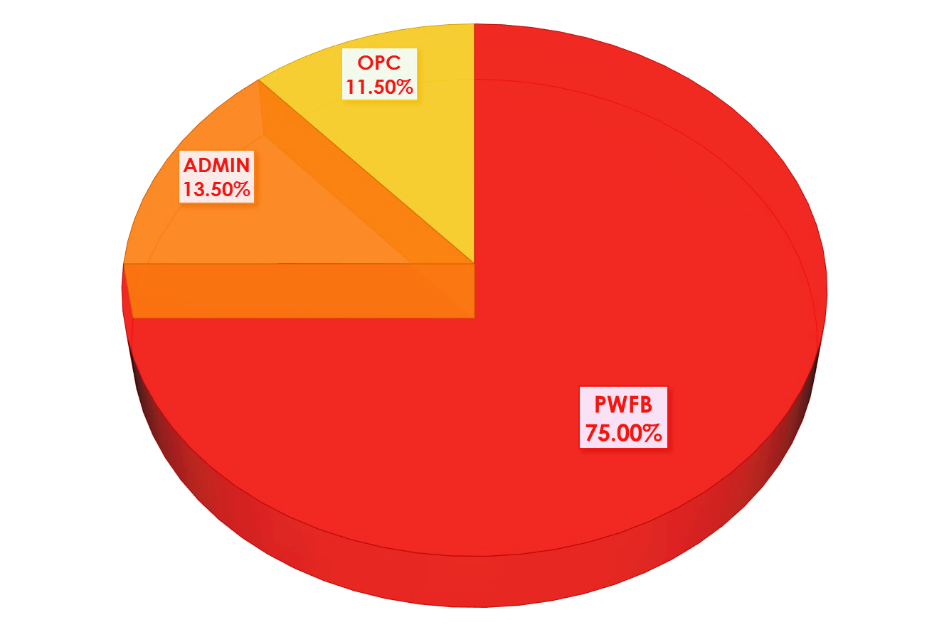

Slide 51
ARE YOU PLANNING ON REQUESTING ANY OF THE OSR?
Change 48 month IDL Waiver Option
Additional Training and Supportive Service
Increase in Admin Cost
Extension of Average Project Duration
OJE
Cross – Border Agreement
Rotation Policy

Slide 52
DO YOU NEED TO PUSH AWAY FROM COMPUTER AND STRETCH?
Yes Yes Yes
Been there - Done that
No – I’m good

Slide 54
LaMia Chapman
U.S. Department of Labor
Employment and Training Administration
National SCSEP Team
Michi McNeace
U.S. Department of Labor
National SCSEP Team
Notes:
.

Slide 55
SCSEP the Program
ADMINISTRATIVE MANAGEMENT
PROGRAMMATIC ASSURANCES
GRANT MANAGEMENT
SUB-GRANTEE MANAGEMENT
PROGRAM OPERATIONS
SERVICE DELIVERY MODEL
PERFORMANCE MANAGEMENT
CORE PERFORMANCE MEASURES
DATA MANAGEMENT & REPORTS
SPARQ

Slide 56
Programmatic Assurances
Outlines standard grant requirements that are required by the law and/or those that are consistent with program practices.
Grantees certifies when checking the boxes that they will conform to the assurances and will continue to conform to these assurances throughout the grant period.

Slide 57
The Assurances
Recruitment and Selection of Participants
Assessments
Individual Employment Plan (IEP)
Community Service Employment Assignments
Recertification of Participants
Physical Examinations
Orientation
Participant Benefits
Durational Limits
Maximum Duration of Program Participation 48 months
Termination Procedures
Written Termination Policies are in Effect
Equitable Distribution
Over- Enrollment
Administrative Systems
Sub-Recipient Selection if applicable
Complaint Resolution
Maintenance of Effort
Procedures for Payroll and Payment of Workers’ Compensation
Maintenance of Files and Privacy Information
Documentation
Data Collection and Reporting

Slide 58
Managing your SCSEP Grant
Standard Operating Procedures
Guide the day to day operation
Organization staffing structure
Program Monitoring
Performance Management
Data Entry and Integrity
Program Policies
Durational Limit Policy
Termination Policy
Complaint / Grievance Policy
SCSEP Budget
Managing your PWFB – budget vs. Actual
Ensure that you do not exceed cost limitations

Slide 59
Sub-Recipients
SCSEP Grantees operate their program by self administering, sub-awarding, or using a combination of both.
Grantees are responsible for managing and monitoring of their subreceipients and ensuring that the terms and conditions of the subrecipient contract are in compliance with all applicable regulations and the terms and conditions of your award.
The provisions of your grant terms and conditions must be applied to any subrecipient under this SCSEP award.

Slide 60
Do You Sub-Grant?
Not us
Well YES we do
We do both – Sub and Run it ourselves
Still thinking

Slide 62
Service Delivery Model
Participant Services
Host Agency Partners
Workforce and Aging Partnerships
Employer Engagement

Slide 63
Participant Services
Recruit and serve eligible low income older adults from the targeted most in need and minority populations – those individuals with the greatest economic needs
Pay wages and benefits as required by federal, state and local laws
Provide comprehensive SCSEP services and appropriate community service assignments that are related to the participant’s employment goal
Provide additional skills training that aligns with their employment goal and is documented in their Individual Employment Plan (IEP)
Provide appropriate supportive services (through shared resources, if possible) that are necessary to enable participant to successfully participate in the program and retain employment
Coordinate with other aging and workforce partners to provide additional referrals and related resources for participants
Assist the participants in obtaining unsubsidized employment
Adhere to the project duration

Slide 64
Host Agency – Community Service Assignment
Host Agency - A public agency or private nonprofit organization exempt from taxation under 501(c)(3) of the Internal Revenue Code of 1986 which provides a training work site and supervision for one or more participants.
Grantees should:
Recruit viable host agencies that will provide soft skills training and skills development for participants
Maintain a variety of host agencies that reflects the current in-demand labor market industries
Ensure a safe and healthy training environment
Adhere to Maintenance of Effort requirements

Slide 65
Workforce and Aging Partnerships
Workforce
Coordination with WIOA
SCSEP is a required partner – grantees need to be familiar with WIOA requirements
Follow all applicable rules under WIOA
Collaborate with the States and other national grantees, if necessary, to provide a comprehensive framework for the State Plan
Americans Job Centers – One Stop Career Centers
Referral Services – Core and Intensive services
Co-Enrollment – with other Title I programs
SCSEP recruitment
Workforce Investment Boards (WIBS)
Continue collaborating and communicating with local WIBs

Slide 66
Partnership – Workforce and Aging
Aging
Coordination with the Department of Health and Human Services, Administration for Community Living (ACL) and other aging programs
Department of Aging
Area Agency on Aging
Aging and Disability Resource Centers
Advisory Groups

Slide 67
Employer Engagement
Create and maintain strong long-lasting relationships with national and local employers
Develop and nurture partnerships with employers that are of mutual support and understanding of the SCSEP
Create opportunities for on-the-job experience (OJE) and direct hires
Market the program to employers to get more involvement in the program and with the participants

Slide 68
DO YOU NEED TECHNICAL ASSISTANCE AND/OR TRAINING?
Yes more TA
Yes more Training
No, we got this
Not right now, but I‘ll let you know when we do!

Slide 70
Performance Measures
Program Year 2016 | Goals
Entered Employment | 50.0%
Retention | 73.0%
Average Earnings | $7,800
Service Level | 160.0%
Community Services | 80.0%
Most In Need | 2.65

Slide 71
Data Management System
SPARQ – SCSEP Performance and Results QPR System
SPARQ provides SCSEP and its Grantees an automated system for managing participant data and evaluating performance
WDCS – Web Data Collections System
WDCS interface is a tool which allows grantees to input data into the SCSEP National Database

Slide 72
SCSEP COMMUNICATION PLAN
Grantee
FPO
National Office
Grant Office
TA & Training Contractors

Slide 73
SCSEP GRANTEE COMMUNICATION PLAN
WITH FPO APPROVAL
Grantee
National Office
Grant Office
TA & Training Contractors

Slide 74
Grantee Communicating with DOL
First Point of Contact is with your Federal Project Officer (FPO)
FPOs works directly with -
National Office
Grant Office
Technical Assistance and Training Contractors
With the FPO’s approval
Grantees can work directly with -
National Office – regarding policy guidance
Grant Office - regarding Grant related issues
SPARQ & SCSEP TA and Training Contractors

Slide 75
Which Region are you in!
Region One
Region Two
Region Three
Region Four
Region Five
Region Six
I have no idea

Slide 76
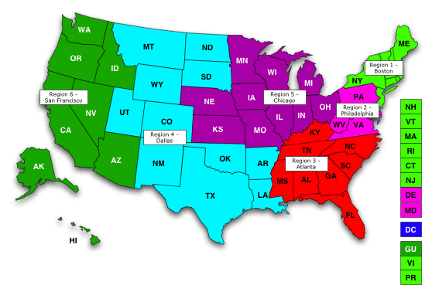
Introduction - Regional Offices
https://www.doleta.gov/regions/

Slide 77
Your Federal Project Officers
Region One – Boston MA
Region Two – Philadelphia PA
Suzanne Pouliot
Matthew Capucini

Slide 78
Your Federal Project Officers
Region Three –Atlanta GA
Region Four – Dallas TX
Has no national grantees assigned
Charles Cox
Edgar Garcia

Slide 79
Your Federal Project Officers
Region Five – Chicago IL
Region Six – San Francisco CA
Gary Lewis
John Jacobs
Marjorie Fong

Slide 80
Next Steps
Upcoming Transition Webinar
Webinar Transition #3 on December 1, 2016
Important Dates
February 1, 2017 – Effective Transfer Date

Slide 81
SCSEP Webpage
http://www.doleta.gov/seniors/
WorkforceGPS
https://olderworkers.workforcegps.org/
Performance Reporting Information
http://www.doleta.gov/Seniors/html_docs/GranteePerf.cfm
Guidance and Resources
Http://www.doleta.gov/Seniors/html_docs/TechAssist.cfm
HTTP://scsep-help.com/
HTTP://www.sparq.doleta.gov
HTTP://scseped.org
Laws and regulations
http://www.doleta.gov/Seniors/HTML_DOCS/regs.cfm

Slide 82
So... Do you feel you’re ready for February 1?
I’m getting there
Ready to Rock-n-Roll!!!
Huh…what happens on Feb. 1?
Ask me next month

