Slide 2
Promoting self-sufficiency and employment opportunities for older adults
Senior Community Service Employment Program (SCSEP)
National Grantee Orientation
Employment and Training Administration

Slide 4
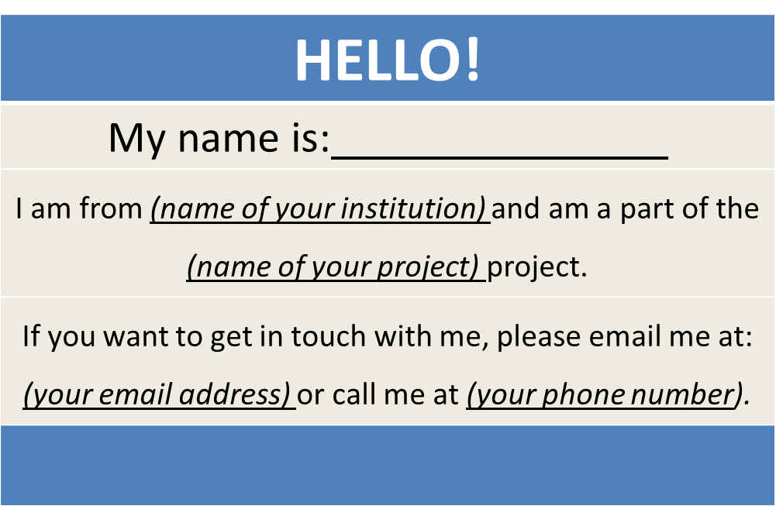
SCSEP Grantees
Create a virtual name tag…

Slide 5

Michi McNeace
U.S. Department of Labor
National SCSEP Team

Slide 6
Introduction to SCSEP Performance and Data Management Systems
SPARQ Overview
QPRs
Performance Measures for PY 2016 and 2017
Next Steps

Slide 7
Bennett Pudlin
U.S. Department of Labor
National SCSEP Team
Terry Cram
U.S. Department of Labor
National SCSEP Team

Slide 8
What Do You Know About the SCSEP Performance System?
It won at Daytona last year
It keeps your staff motivated
Something related to the Common Core Curriculum?
The performance measures and related data collected by SCSEP

Slide 9
OVERVIEW OF SCSEP PERFORMANCE SYSTEM

Slide 10
What is the SCSEP Performance System
Core and additional performance measures mandated by Congress
Customer satisfaction surveys
Minority Report
Data collection system mandated by the regulations and grant agreements
Data validation
InfoSPACE

Slide 11
Core Measures
Three measures of service to participants
    Service level
    Community service
    Most-in-need
Three employment outcome measures
    Entered employment
    Retention at 6 months
    Average earnings

Slide 12
Additional Measures
Retention at 1 year
Customer satisfaction of participants, host agencies, and employers
Entered volunteer work

Slide 13
Negotiating Goals for Core Measures
Goals for core measures negotiated in spring for following program year
Proposed goals use each grantee’s own baseline performance through Q3 with continuous improvement increment and various adjustments
Consequences of bad data or small denominators
Negotiations must be based on data
Goals published; right to comment on process
Right to seek adjustment during the year

Slide 14
Evaluation of Grantee Performance
Performance evaluated after close of the program year around September 30
Report on actual performance and percent of goal achieved on each goal
Calculation of aggregate percent of performance achieved on all 6 measures
Corrective action plan for grantees not achieving 80% of goal in the aggregate
Sanctions for state grantees failing three consecutive years and national grantees failing four consecutive years
TA provided for not doing well on individual measures
Results published and reported to Congress

Slide 15
Resources
Title V of Older Americans Act, Section 513
SCSEP Final Rule, Subpart G, Sections 641.700-641.750; Section 641.140 (definitions)
SCSEP Web page and Older Worker Community of Practice for annual grantee goals and evaluation of grantee performance and various presentations on the performance measures

Slide 16
Customer Satisfaction Surveys
Participant and host agency surveys conducted annually by mail house, usually in fall; grantees inform participants and host agencies to that surveys are coming and that it is important to complete them
Employer surveys conducted continuously by sub-grantees with qualified employers only. Management report lists all qualified employers and when they need to receive the survey

Slide 17
Resources
Title V of Older Americans Act, Section 513
SCSEP Final Rule, Section 641.700(c)(2)
Older Worker COP for copies of survey reports and the Employer Survey Kit
Pending Employer Surveys management report

Slide 18
What Is the Minority Report?
A report presented by less than half of the members of a committee
The 2002 movie with Tom Cruise
Annual report of SCSEP service to minorities

Slide 19
Minority Report
Annual report of SCSEP service to minorities required by Congress
Two components: participation and outcomes
Participation compares enrollment in SCSEP of each minority group against its proportion in the population. Based on weighted Census data for each county in a state served by a grantee
Outcomes compares employment outcomes in SPARQ achieved by each minority group against the outcomes of non-minorities
Grantees must address any disparities in their annual grant application narrative

Slide 20
Resources
Title V of Older Americans Act, Section 516
Annual Planning Guidance TEGL (#28-12), Attachment B (Program Narrative)
Older Worker COP for latest Minority Report and a recorded Webinar on the how to use the Minority Report

Slide 22
What Is SPARQ?
Yes, my son just bought a pair
Speed, power, agility, reaction, and quickness
The SCSEP data collection and reporting system
It precedes a flame
A very nasty disease

Slide 23
sCSEP Performance and results QPR System
(SPARQ)

Slide 24
Data Collection and Reporting System
SPARQ is the online system for entering data and reporting on measures
    Web Data Collection System: (WDCS)
    Quarterly Progress Reports (QPRs)
    Management reports
    Various utilities and functions
InfoSPACE provides ability to analyze the data at a record level over time

Slide 25
SPARQ
All grantees and sub-grantees have access
Security rules strictly enforced
Functions:
    Data collection
    QPRs
    Management reports
    Searching for participants and organizations
    Transferring participants or moving them from one sub-grantee to another
    Extending durational limit of participants
    Data validation
    Managing users
    Data extracts

Slide 26
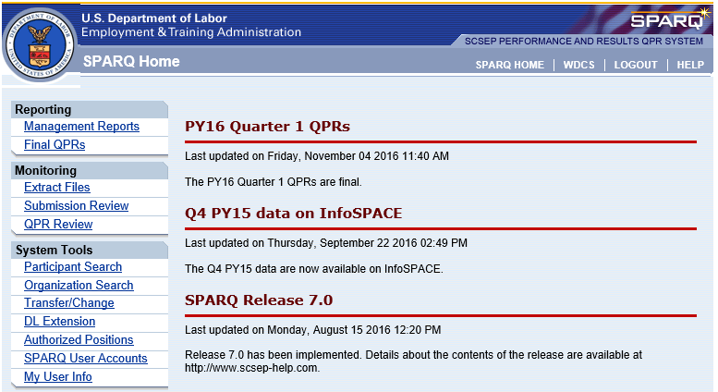
Access and Security

Slide 27
Data Collection
All grantees are required to use the Web Data Collection System (WDCS) to enter required data on participants
Grant assurances require timely and accurate data entry
Grantees should establish data standards in their sub-grant agreements
Contains required fields and values and optional fields
Numerous edits protect data quality
    Specified values
    Screen rejects
    Enrollment Data Quality Problems (EDQP)
    Data Quality Report (DQR)

Slide 28
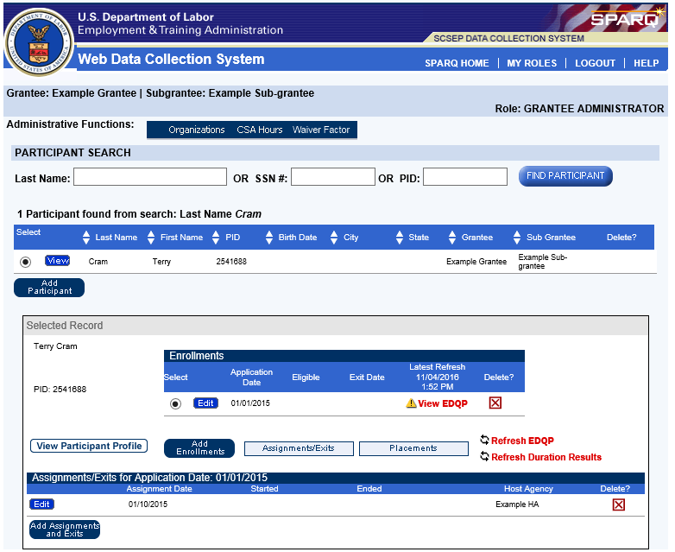
Data Collection (WDCS)

Slide 29
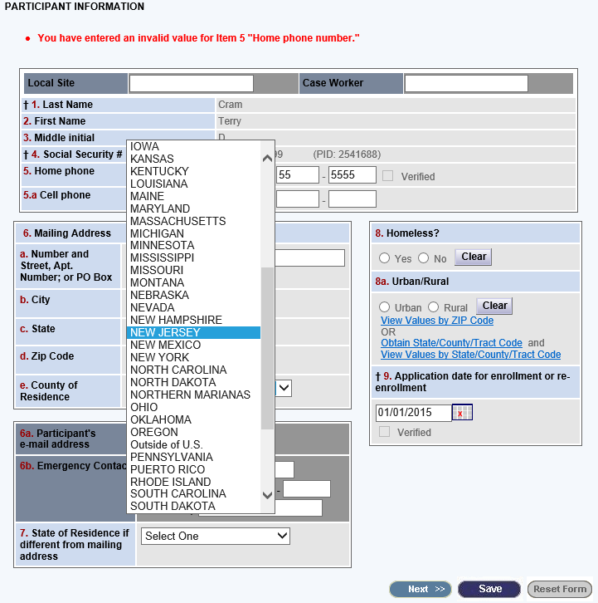
Data Collection (WDCS)

Slide 30
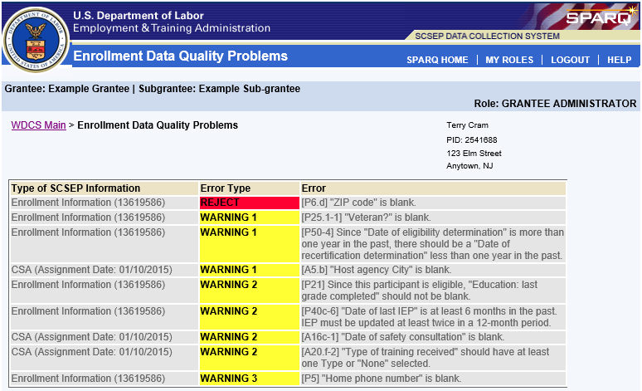
Data Collection (WDCS)

Slide 31
SPARQ Home Page

Slide 32
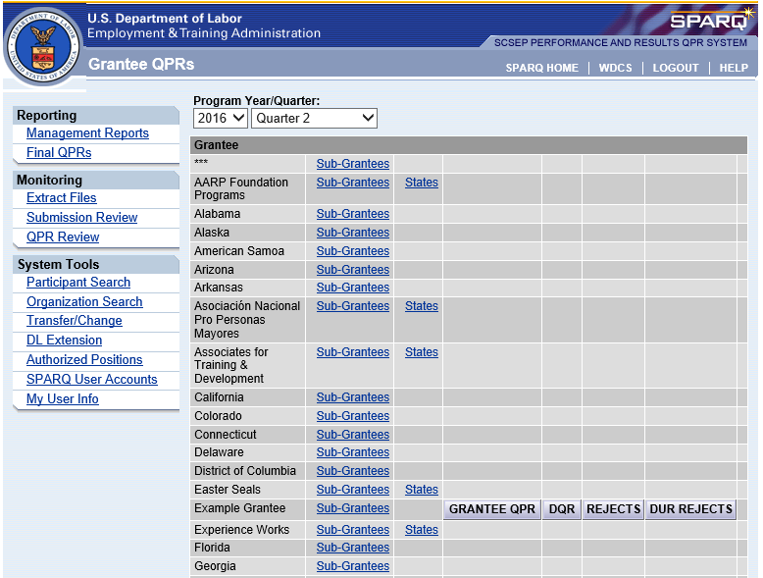
QPRs

Slide 33
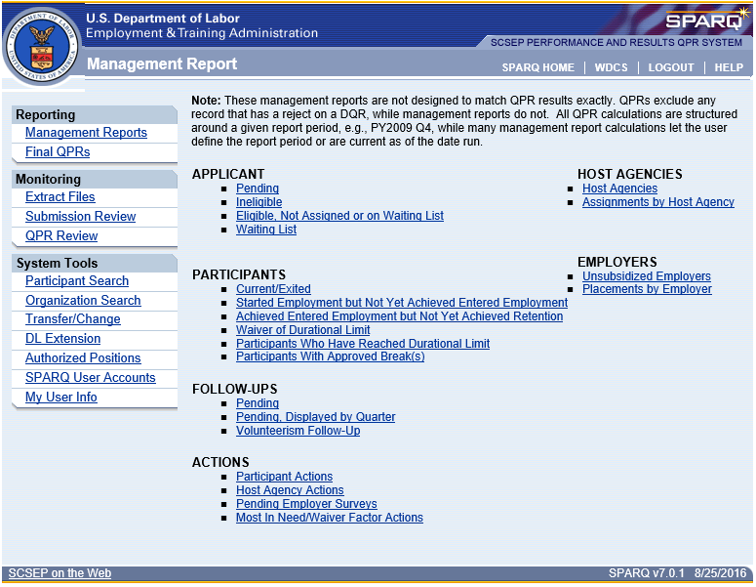
Management Reports

Slide 34
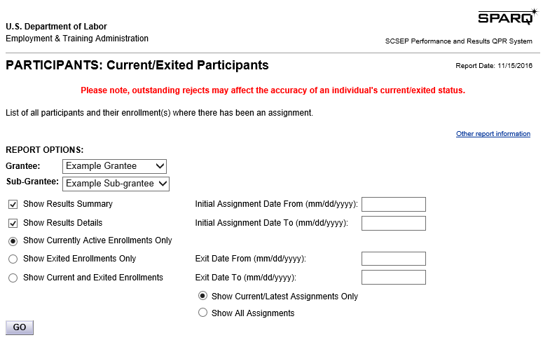
Management Reports

Slide 35
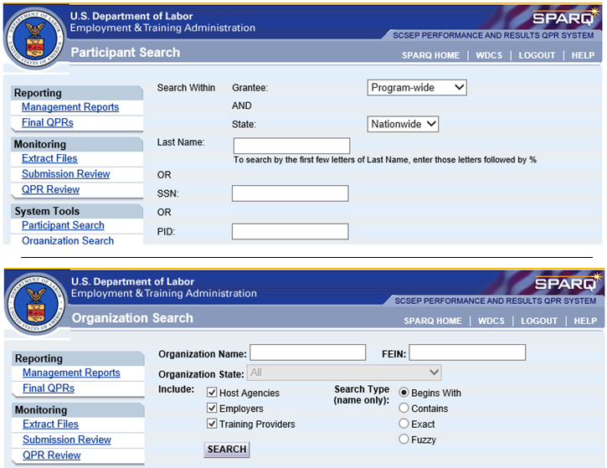
Searches

Slide 36
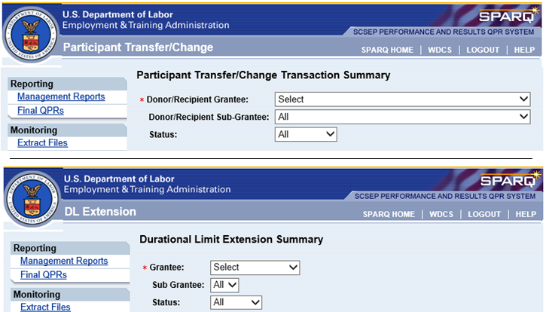
Transfers and Moves
Extending Durational Limit

Slide 37
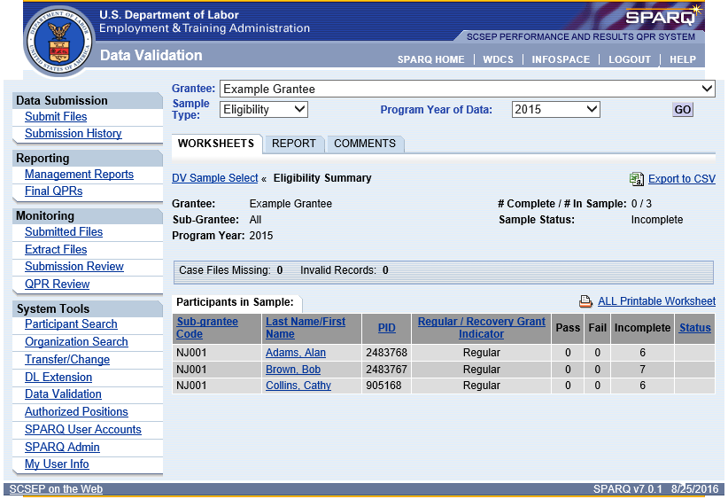
Data Validation

Slide 38
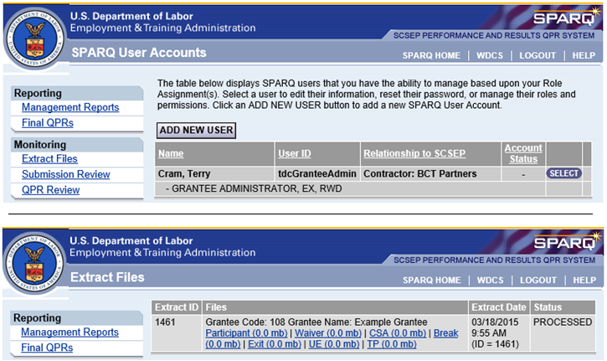
Managing Users
Data Extracts

Slide 39
InfoSPACE
Uses SPARQ data but maintained by DOL Data Warehouse team
Advanced query and analysis functions using de-identified record level data
Provides analysis of all active participants and of core measures by participant characteristics and services
Currently available to grantee administrators only
Will be made incrementally available to sub-grantee administrators

Slide 40
Resources
SCSEP Final Rule, Section 641.879(b)-(h)
Annual Planning Guidance TEGL (#28-12), Attachment C (Grant Assurances)
OMB-approved hard copy data collection forms
Data Collection Handbook
    Ask the Experts Forum
SPARQ tutorials, specifications, other resources
SPARQ online Help

Slide 41
Data Validation
Conducted annually after close of program year; grantees have 6 months to complete
Random sample of records based on size of grantee; not valid at sub-grantee level
Independent grantee evaluation of whether data in SPARQ comply with program rules; validator checks against underlying documentation in case file
Two separate samples: eligibility and performance
Worksheets and reports in SPARQ
Grantees should use to identify need for sub-grantee training and oversight

Slide 42
Resources
2016 FOA for national grantees
Annual grant assurance for all grantees
TEGL 3-03
October 16, 2007, Data Validation Guidance
Data Validation Handbook
SPARQ Data Validation samples, work sheets, and reports

Slide 44
Do You Understand Your QPR?
Well, yes I do!
Some of it
Too many numbers
No way!

Slide 45
Quarterly Progress Report
(QPR)

Slide 46
How Program Elements Relate to Performance Measures
The measures required by Congress support the two main goals of the program and relate to critical program elements
Simplified flow chart on next slide identifies major program activity clusters and the performance measures that relate to them
The measures are also related to each other; increased performance on one measure will enhance performance on another measure

Slide 47
SL
MiN
MiN
CS, CSS
SL
CS
EE, Ret, AE, CSS
EE, Ret, AE
EE, Ret, AE, Vol, CSS

Slide 48
QPR
The QPR is designed to report performance on each of the performance measures in Sections E and F.
The QPR also contains critically important information in the other sections:
    Section B shows customer flow and placement activity
    Section C reports on community service performed
    Section D presents participant demographics and characteristics
In trainings and TA sessions, we look at relevant QPR fields to explore each performance measure in depth
The next slides show you which QPR elements are related to which measures.

Slide 49
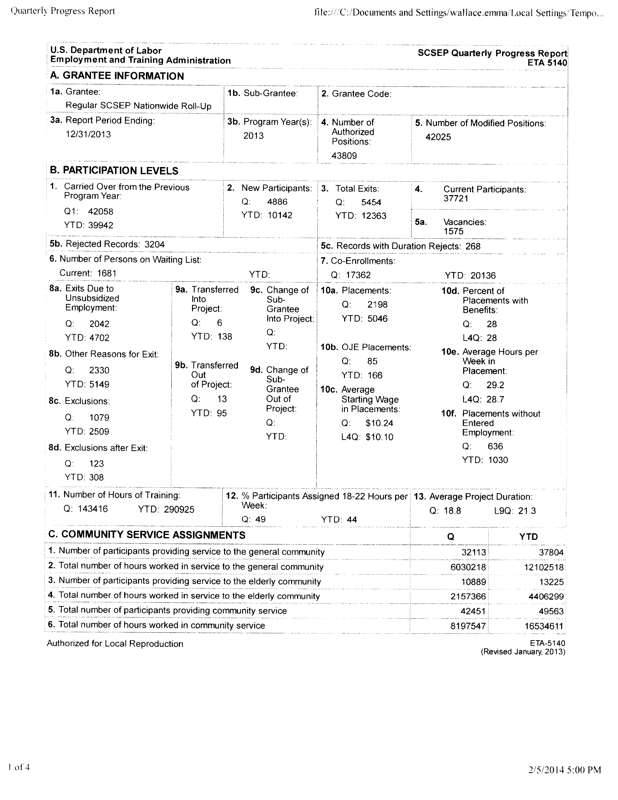
CS, SL
SL, MIN
SL, MIN
SL, MIN
CS, SL
CS, SL, MIN
EE
EE
AE
EE, ER, AE
AE
EE
AE
EE, ER, AE
EE
CS
SL
CS
CS
CS = community service (E1)
EE = entered employment (E2)
ER = employment retention (E3)
AE = average earnings (E4)
SL = service level (E5)
MIN = most-in-need (E6)

Slide 50
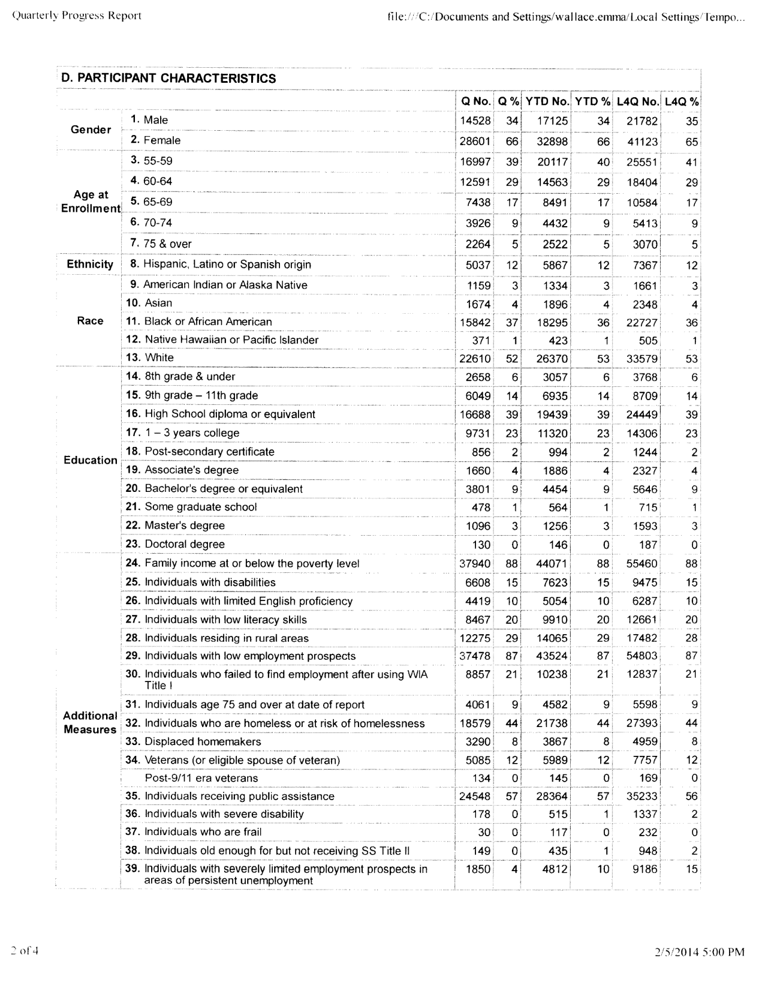
MIN priority of service
MIN waiver factor

Slide 51
Final QPRs
Final QPRs are produced roughly 30 days after the quarter closes and are the official reports of activity for that quarter
The final QPR for the program year is produced on September 30 of the following program year
The extra time after the close of the calendar quarter allows grantees to clean up their data and to complete undone follow-ups
A final QPR is frozen and never changes. New and changed data will be reflected in subsequent QPRs for that program year in the fields for Year to Date (YTD) and Last 4 Quarters (L4Q)
Final QPRs at any level (nationwide, grantee, sub-grantee, and national grantee by state) are public records and are available to all SPARQ users

Slide 52
QPR Review
The QPR Review reflects the current quarter’s data until the quarter is closed
Once the quarter is closed and the final QPR for the quarter is produced, the QPR Review will show the Final QPR values for that quarter
Because the data in the QPR Review are preliminary and will always change, this function is only accessible by users with appropriate permissions

Slide 53
Generating the QPR
The QPR must be generated to present the latest data in SPARQ
The system automatically generates all QPRs each weekend so users will see the latest data reflected when they come to work on Monday morning
Sub-grantee and grantee users can generate the QPR at any time if they want to see the effect of changes they have made to their data

Slide 54
Resources
Data Collection Handbook
Ask the Experts Forum
QPR Handbook

Slide 56
Do You Know What Your Performance Goals Are?
I think so
Of course I do!
A 10-minute mile
No – this is the first time I’ve heard of them

Slide 57
Performance measures for py 2016 and py 2017

Slide 58
Performance Measures in PY 2016
Current national grantees negotiated their performance goals for PY 2106 last spring. Can seek adjustment of those goals until September 30, 2017 if newly awarded territory produces a significant change in circumstances
New national grantees are assigned the average of the national grantees’ goals as targets for PY 2016. They too can seek adjustments if warranted
FOA, Section VI(C)(2)(c)(2)

Slide 59
Performance Measures in PY 2017
OAA amendments make modest changes in the SCSEP performance measures:
    3 common measures slightly redefined and recalculated, but still use data we currently collect
    3 SCSEP participation measures unchanged
    Additional measures eliminated but one new core measure for effectiveness in serving our three customer groups
Amendments require DOL to put in place the new performance measures no later than December 31, 2017. We think this means that they will be finalized by then and used in the spring 2018 goal setting. If so, they will first be officially reported in PY 2018, starting July 1, 2018

Slide 61
NEXT STEPS
If you need assistance with the SCSEP performance measures or other aspects of the SCSEP performance system, contact Michi at mcneace.meche@dol.gov, with a copy to your FPO
If your staff needs training or support in using SPARQ, contact HELP@SCSEP-help.com
If there is general interest, we will schedule additional trainings on the performance measures and how to use the tools in SPARQ to manage your performance

Slide 62
Do You Need Technical Assistance and/or Training?
I need SPARQ TA
I need Performance TA
I need TA on both
I need SPARQ Training
I need Performance Training
I’ll take both

