Slide 1
(Re)Using Free Online Educational Resources on the SkillsCommons.org Repository: Part 2 – Makeover
U.S. Department of Labor
Employment & Training Administration
November 17, 2016

Slide 2
Participant Poll
Which best describes your organizational affiliation?
Community or technical college
Other educational institution
Local workforce development entity
Other non-profit workforce training entity
For-profit workforce training entity
Other (please enter in chat box)

Slide 3
Participant Poll
Which best describes your relationship to TAACCCT Grants?
I work(ed) on a TAACCCT grant
Others at my organization have/had TAACCCT grant(s)
We don’t have a TAACCCT grant
What is TAACCCT?

Slide 4
Participant Poll
Which best describes your experience with OER?
I have used OER
I would like to learn how to use OER
What is OER?

Slide 5
Participant Poll
Which best describes your experience with a Makeover of OER from SkillsCommons?
We are interested in creating a Makeover of OER from SkillsCommons
We are in the process of creating a Makeover of OER from SkillsCommons
We have created a Makeover of OER from SkillsCommons and/or other sources
Please share a little more about your answer in the chat window

Slide 6
Trade Adjustment Assistance Community College and Career Training (TAACCCT)
TAACCCT is an investment of
impacting 62% of the nation’s community colleges.
Design innovative and effective programs that address specific industry needs and lead to improved learning, completion and career outcomes for TAA-eligible workers and other adults.

Slide 7
Utilizing Free OER on the SkillsCommons.org Webinar Series
Utilizing Free Online Educational Resources on the SkillsCommons.org Repository: Part I–Introduction Thursday, November 03, 2016 3:00 PM ~ 4:30 PM ET
Utilizing Free Online Educational Resources on the SkillsCommons.org Repository: Part II – Makeover Thursday, November 17, 2016 3:00 PM ~ 4:00 PM ET
https://taaccct.workforcegps.org/announcements/2016/10/24/17/09/Announcement_SkillsCommons_Webinar_Series

Slide 8
Presenters
Moderator
Cheryl Martin
Program Manager, TAACCCT Grants
Presenters
Rick Lumadue
SkillsCommons (California State University-MERLOT)
Jeff Kahn
SkillsCommons (California State University-MERLOT)

Slide 9
Agenda
SkillsCommons Makeover strategy
Showcases of Makeovers
Learn how to get connected with a technology company to create a customized Makeover of OER for your Project

Slide 10
Why Would You Be Interested in a Makeover?
You Have Programmatic Needs to Find:
FREE instructional materials for workforce development
QUALITY materials that enable people to learn job-driven skills and knowledge

Slide 11
Goal
You Want to Improve and Customize the OER to Meet Your Needs

Slide 12
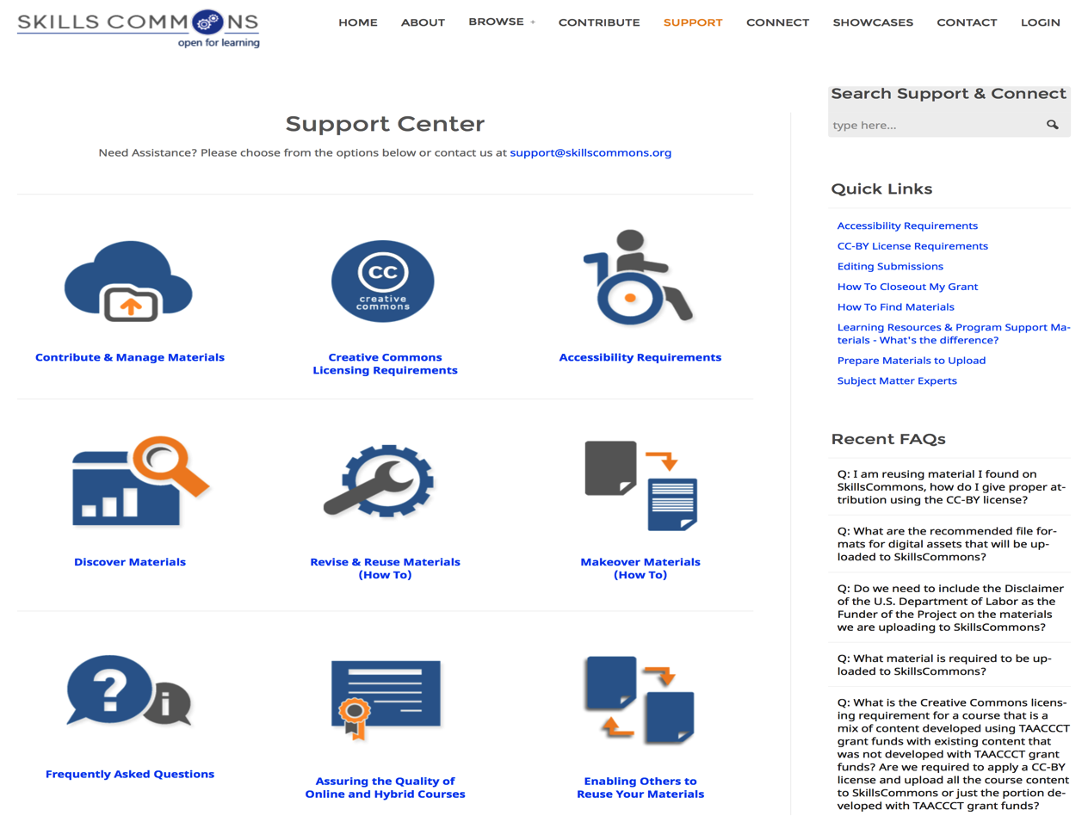
Creative Commons License
“The purpose of the CC BY licensing requirement is to ensure that materials developed with funds provided by these grants result in work that can be freely reused and improved by others.”

Slide 13
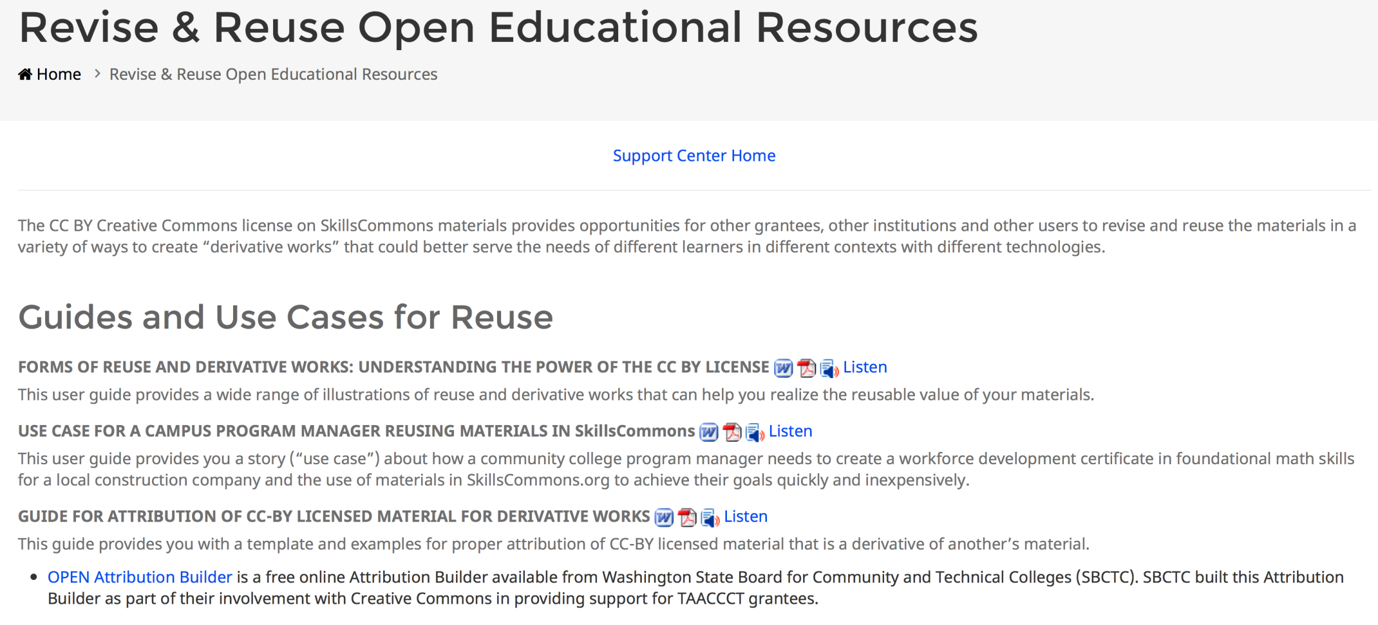
Creative Commons Attribution Statement

Slide 14
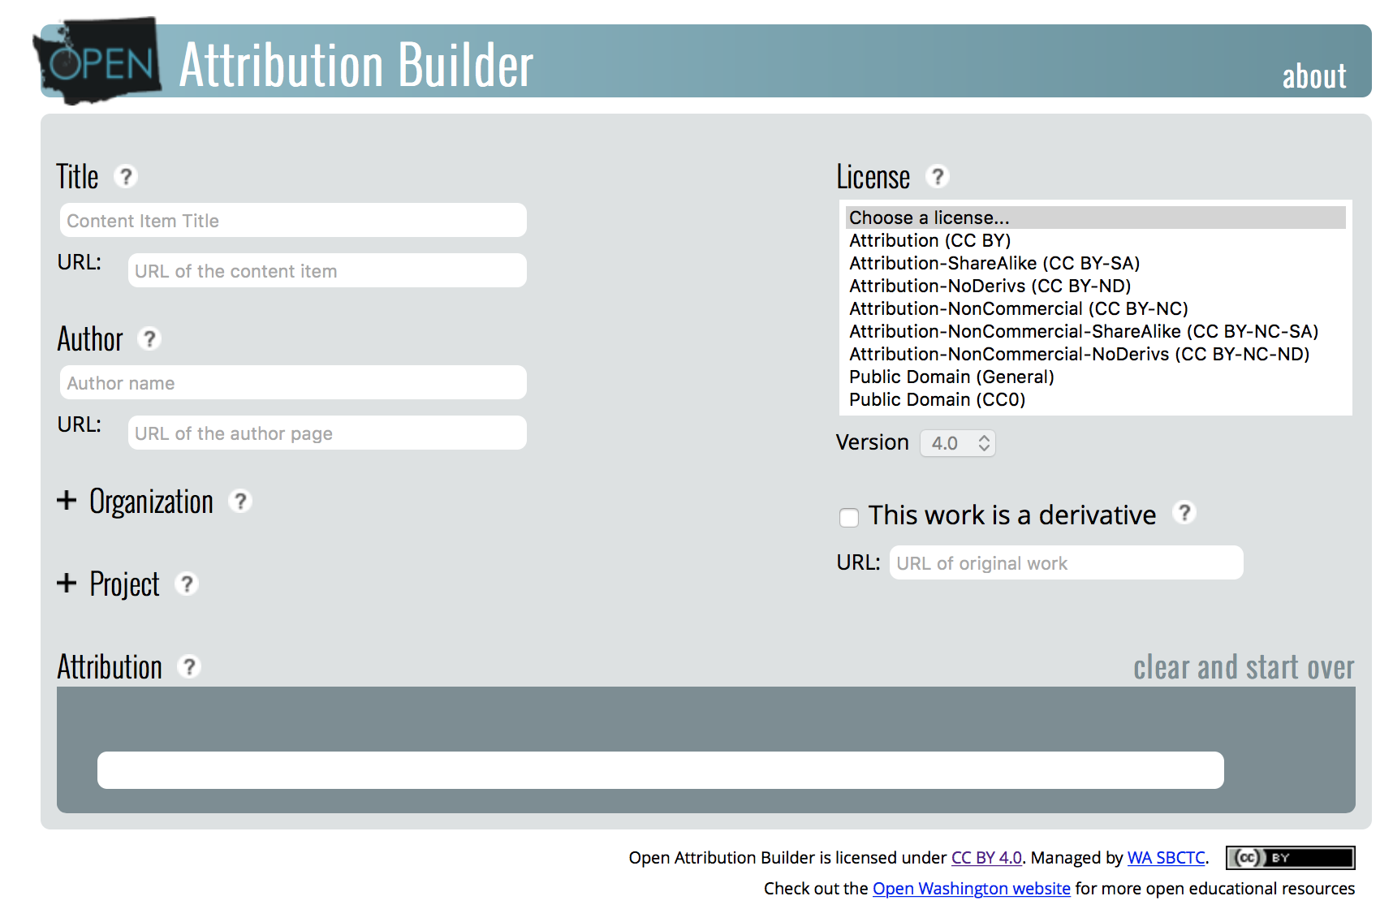
Open Attribution Builder

Slide 15
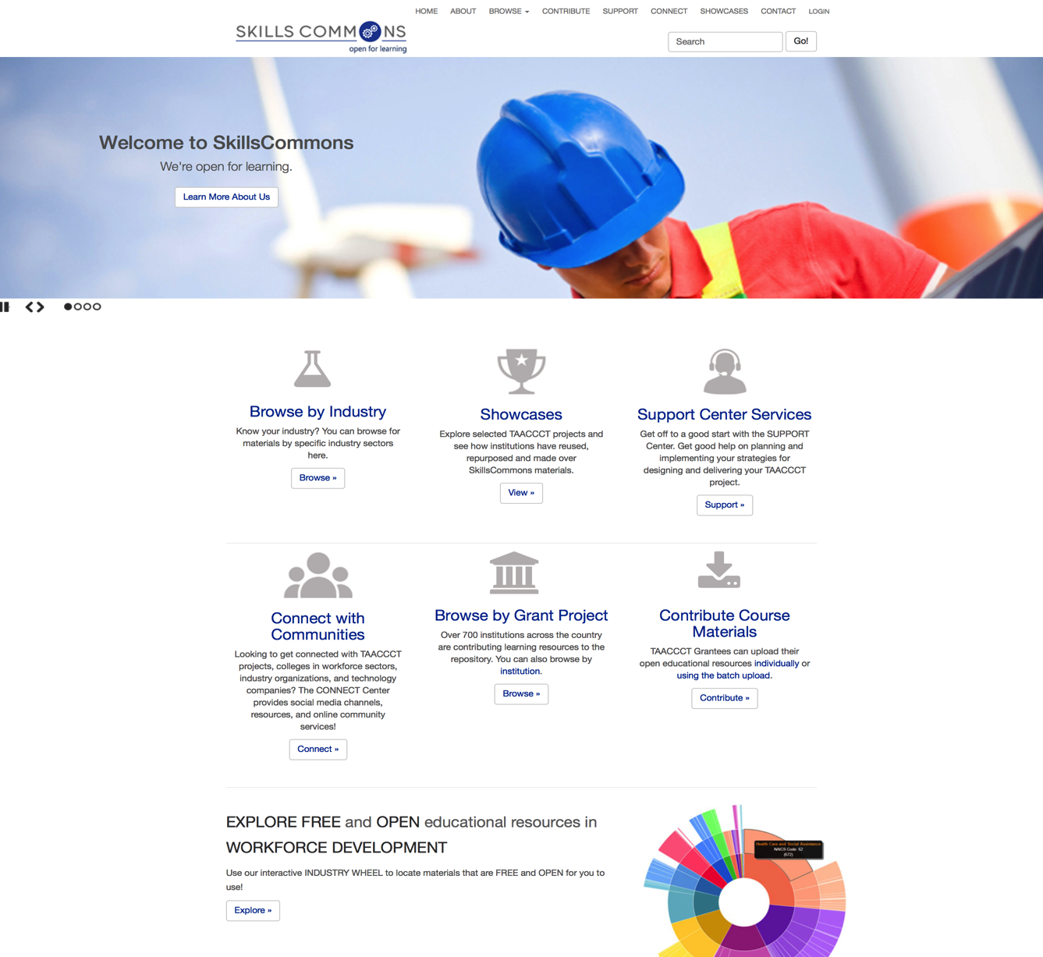
SkillsCommons: TAACCCT Library of Free OER

Slide 16
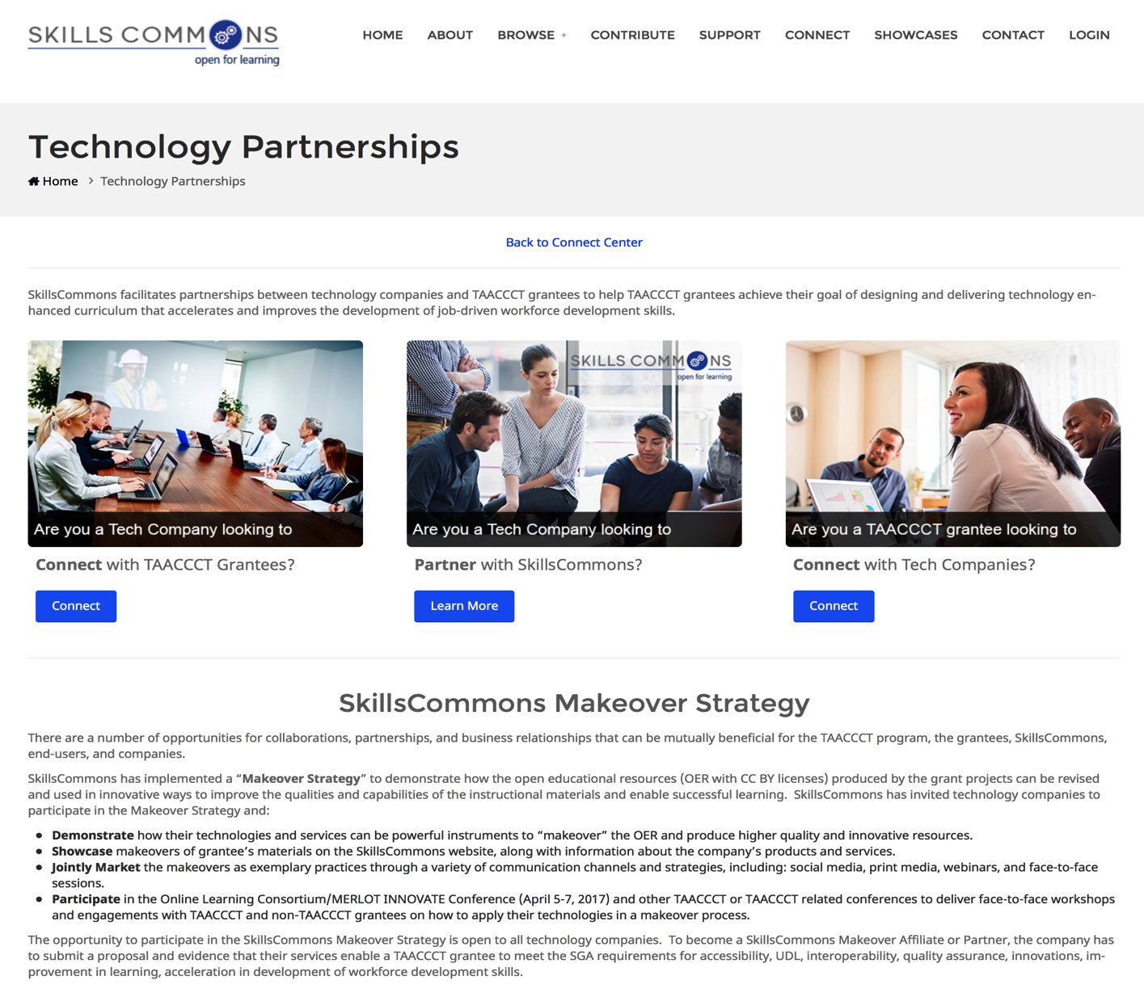
SkillsCommons Makeover Strategy

Slide 17
Participant Poll
Have you used the free online educational resources on skillscommons.org?
Yes
No

Slide 18
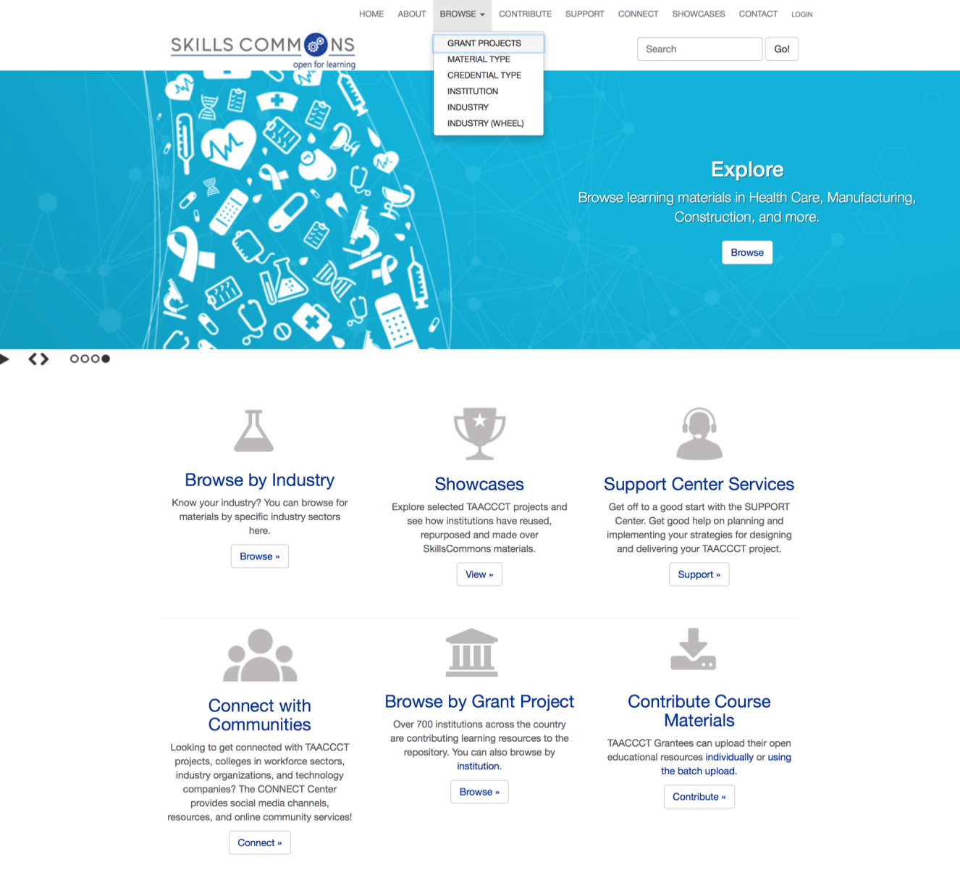
Find & Review SkillsCommons OER

Slide 19
Participant Poll
Which best describes the Industry Sector of your workforce development program or your area of interest?
Manufacturing
Healthcare
Information Technology
Energy
Transportation
Other (please enter in chat box

Slide 20
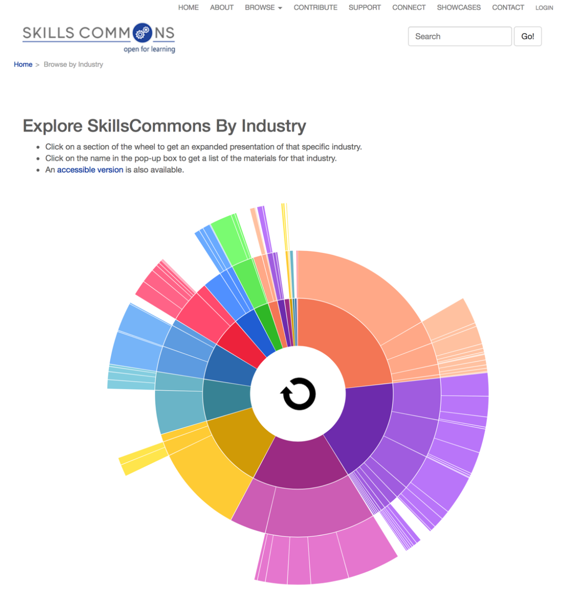
Browsing by Industry

Slide 21
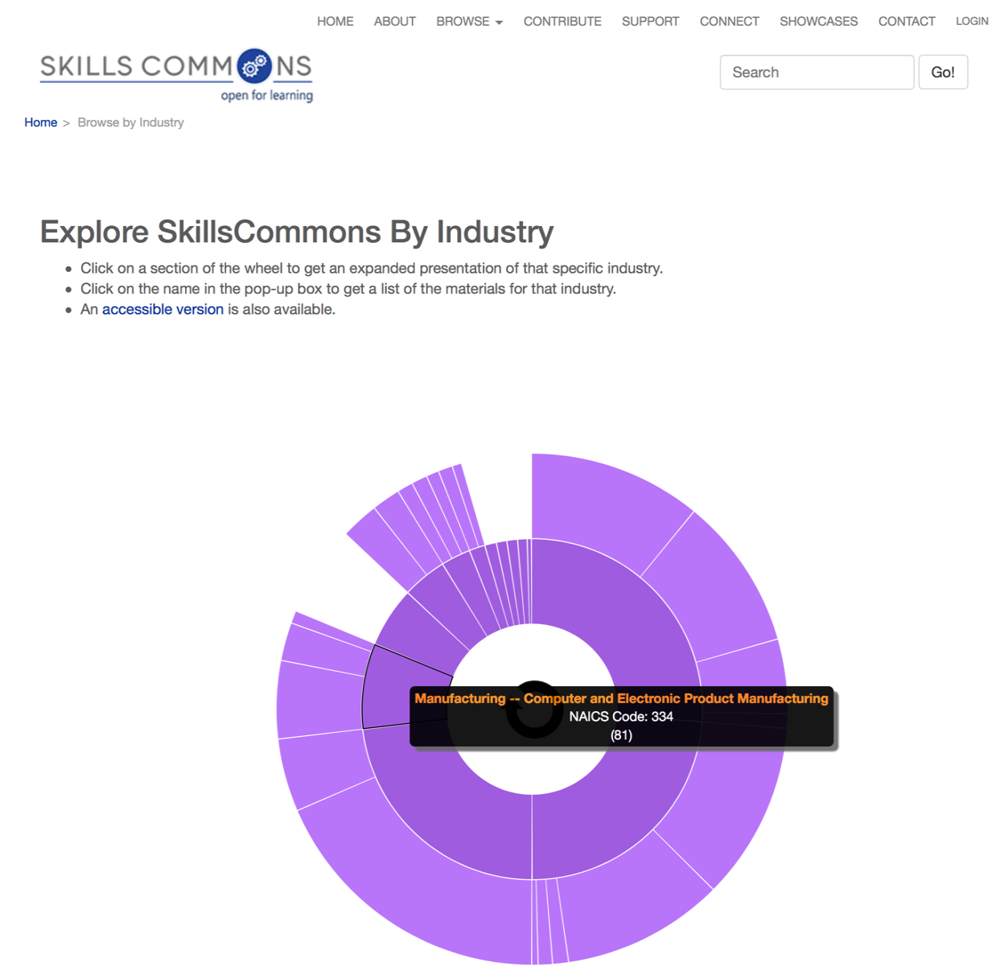
Browsing by Industry
Browsing by Industry

Slide 22
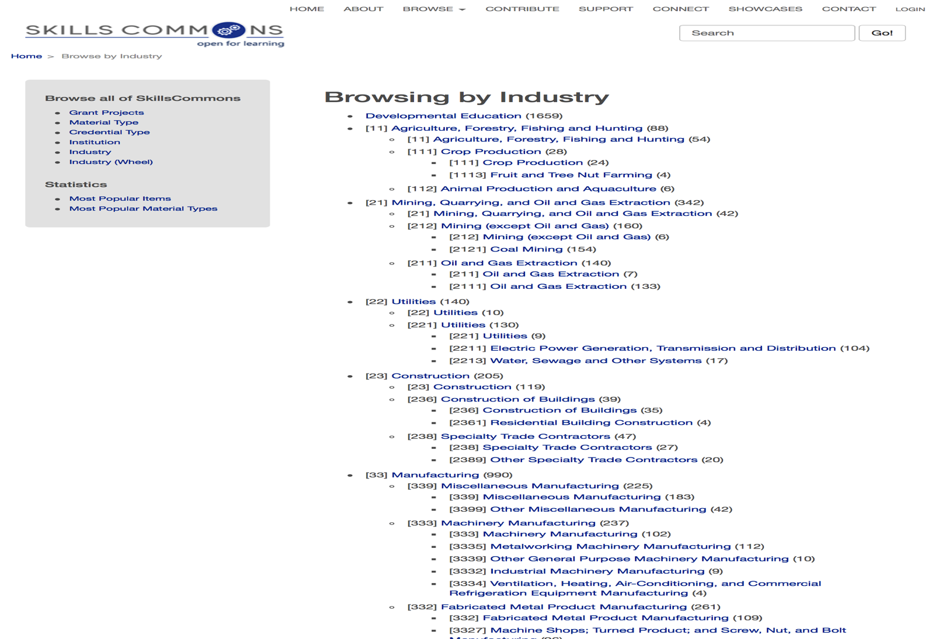
Browsing by Industry
Browsing by Industry

Slide 23
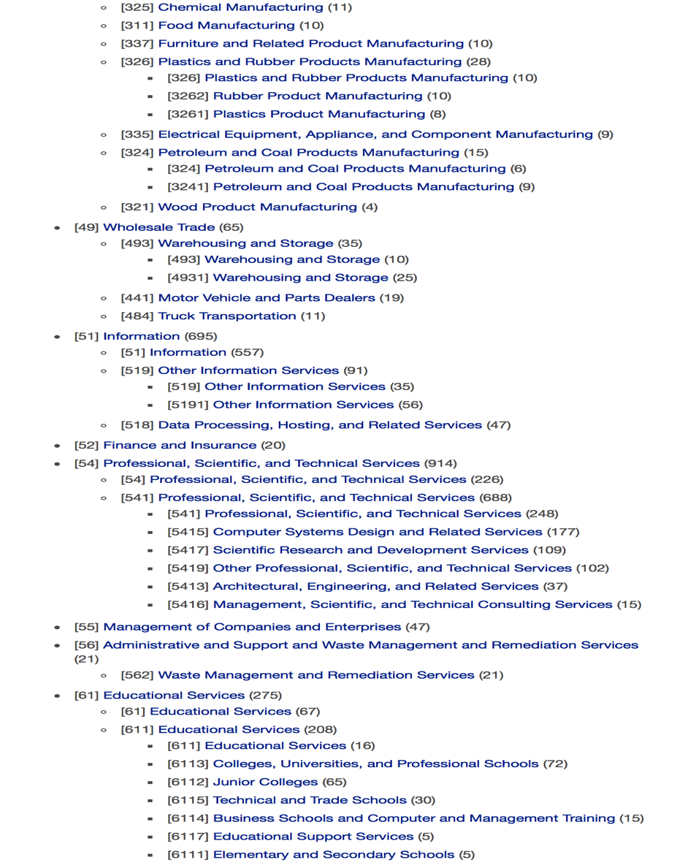
Browsing by Industry
Browsing by Industry

Slide 24
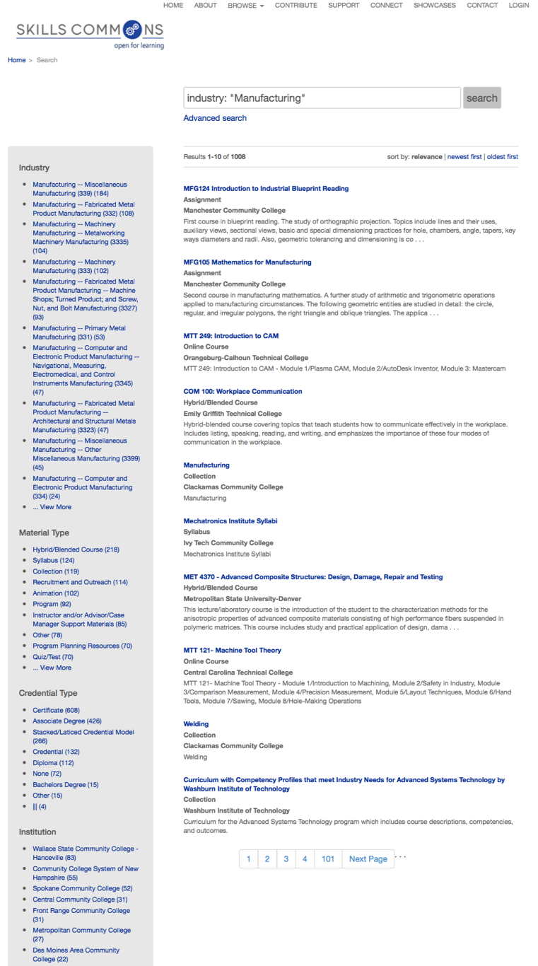
Refine Search Results
Refine Search Results

Slide 25
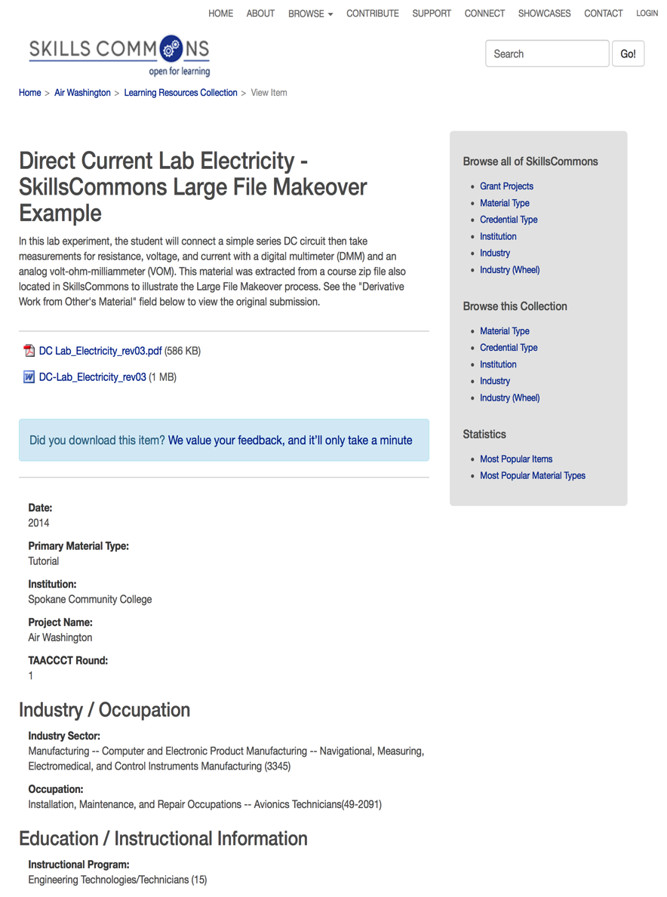
Description of Content
Description of Content

Slide 26
A Makeover Example

Slide 27
What is a Makeover?

Slide 28
Benefits of Makeovers
Reduce Production Time
and Financial Costs

Slide 29
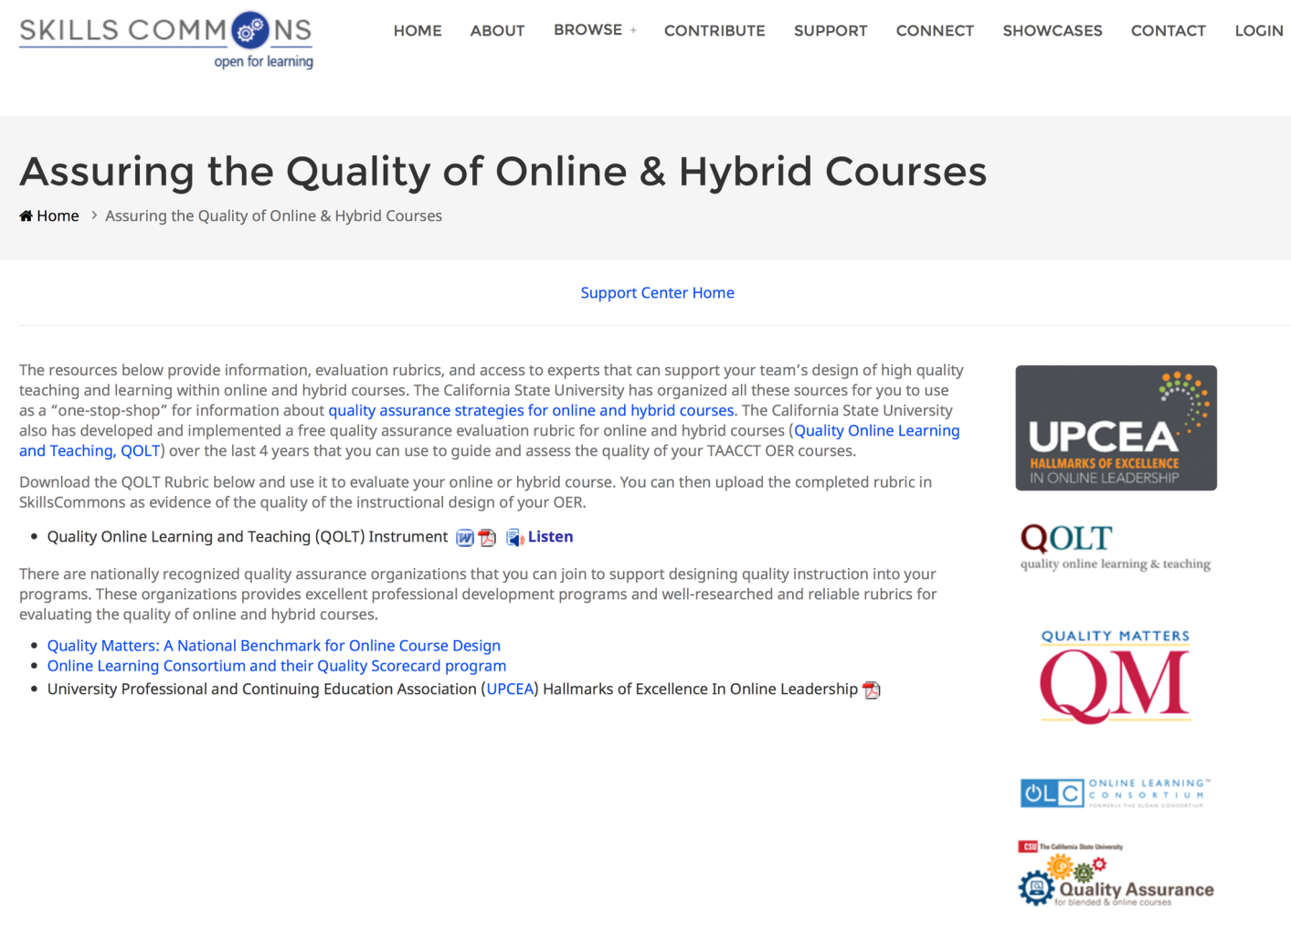
DIY Makeovers
How do I make sure that I design a good online learning experience?

Slide 30
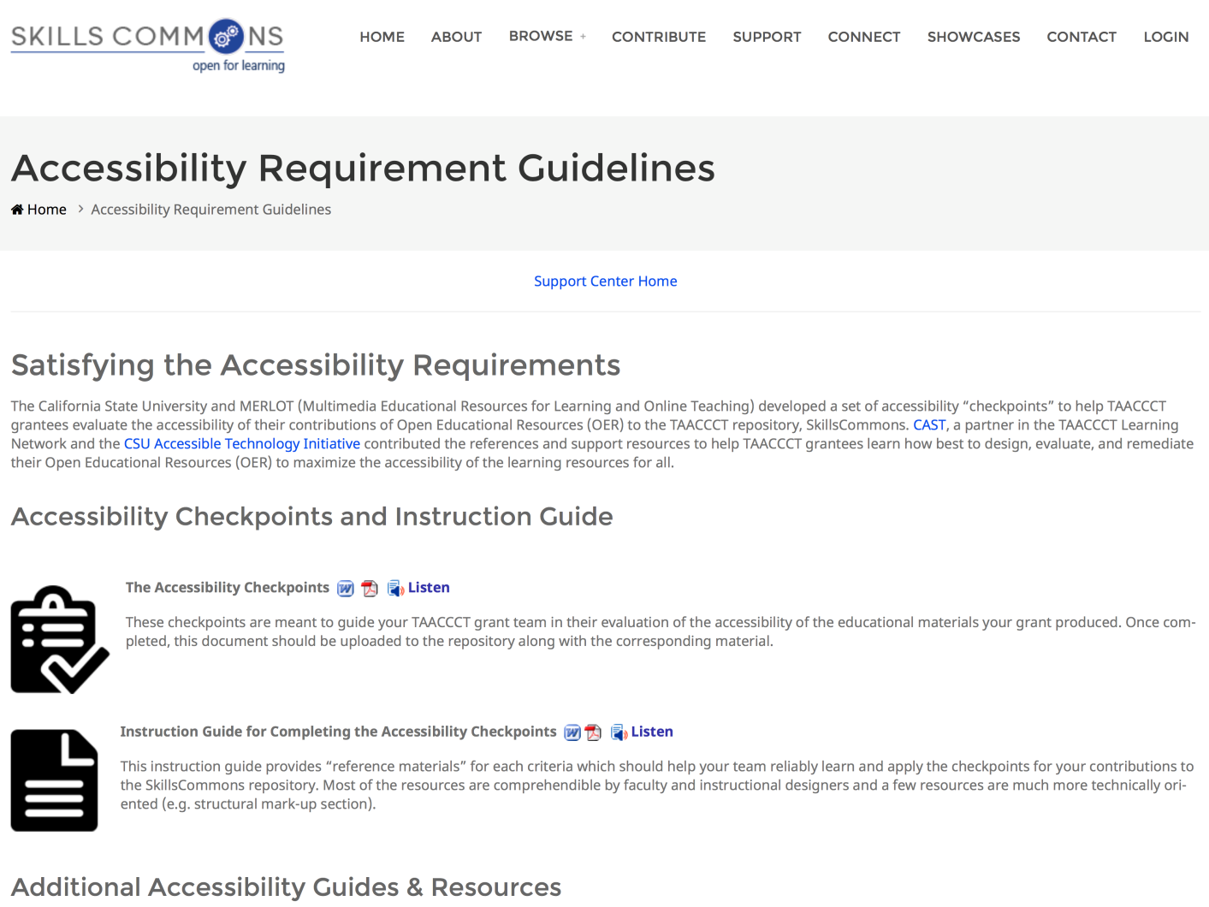
DIY Makeovers
How do I make sure that the materials are accessible? (Section 508 compliant)?

Slide 31
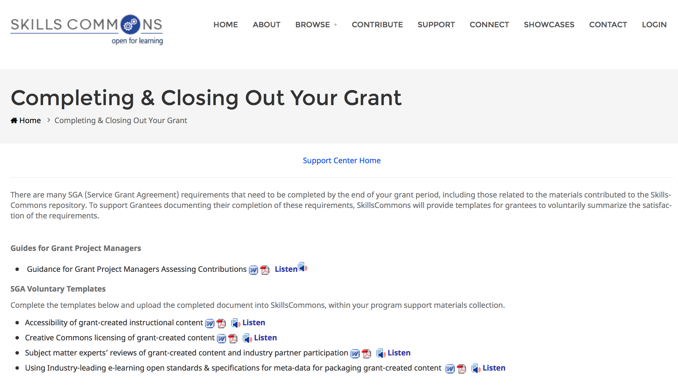
TAACCCT Standards for OER in SkillsCommons

Slide 32
Professional Makeovers

Slide 33
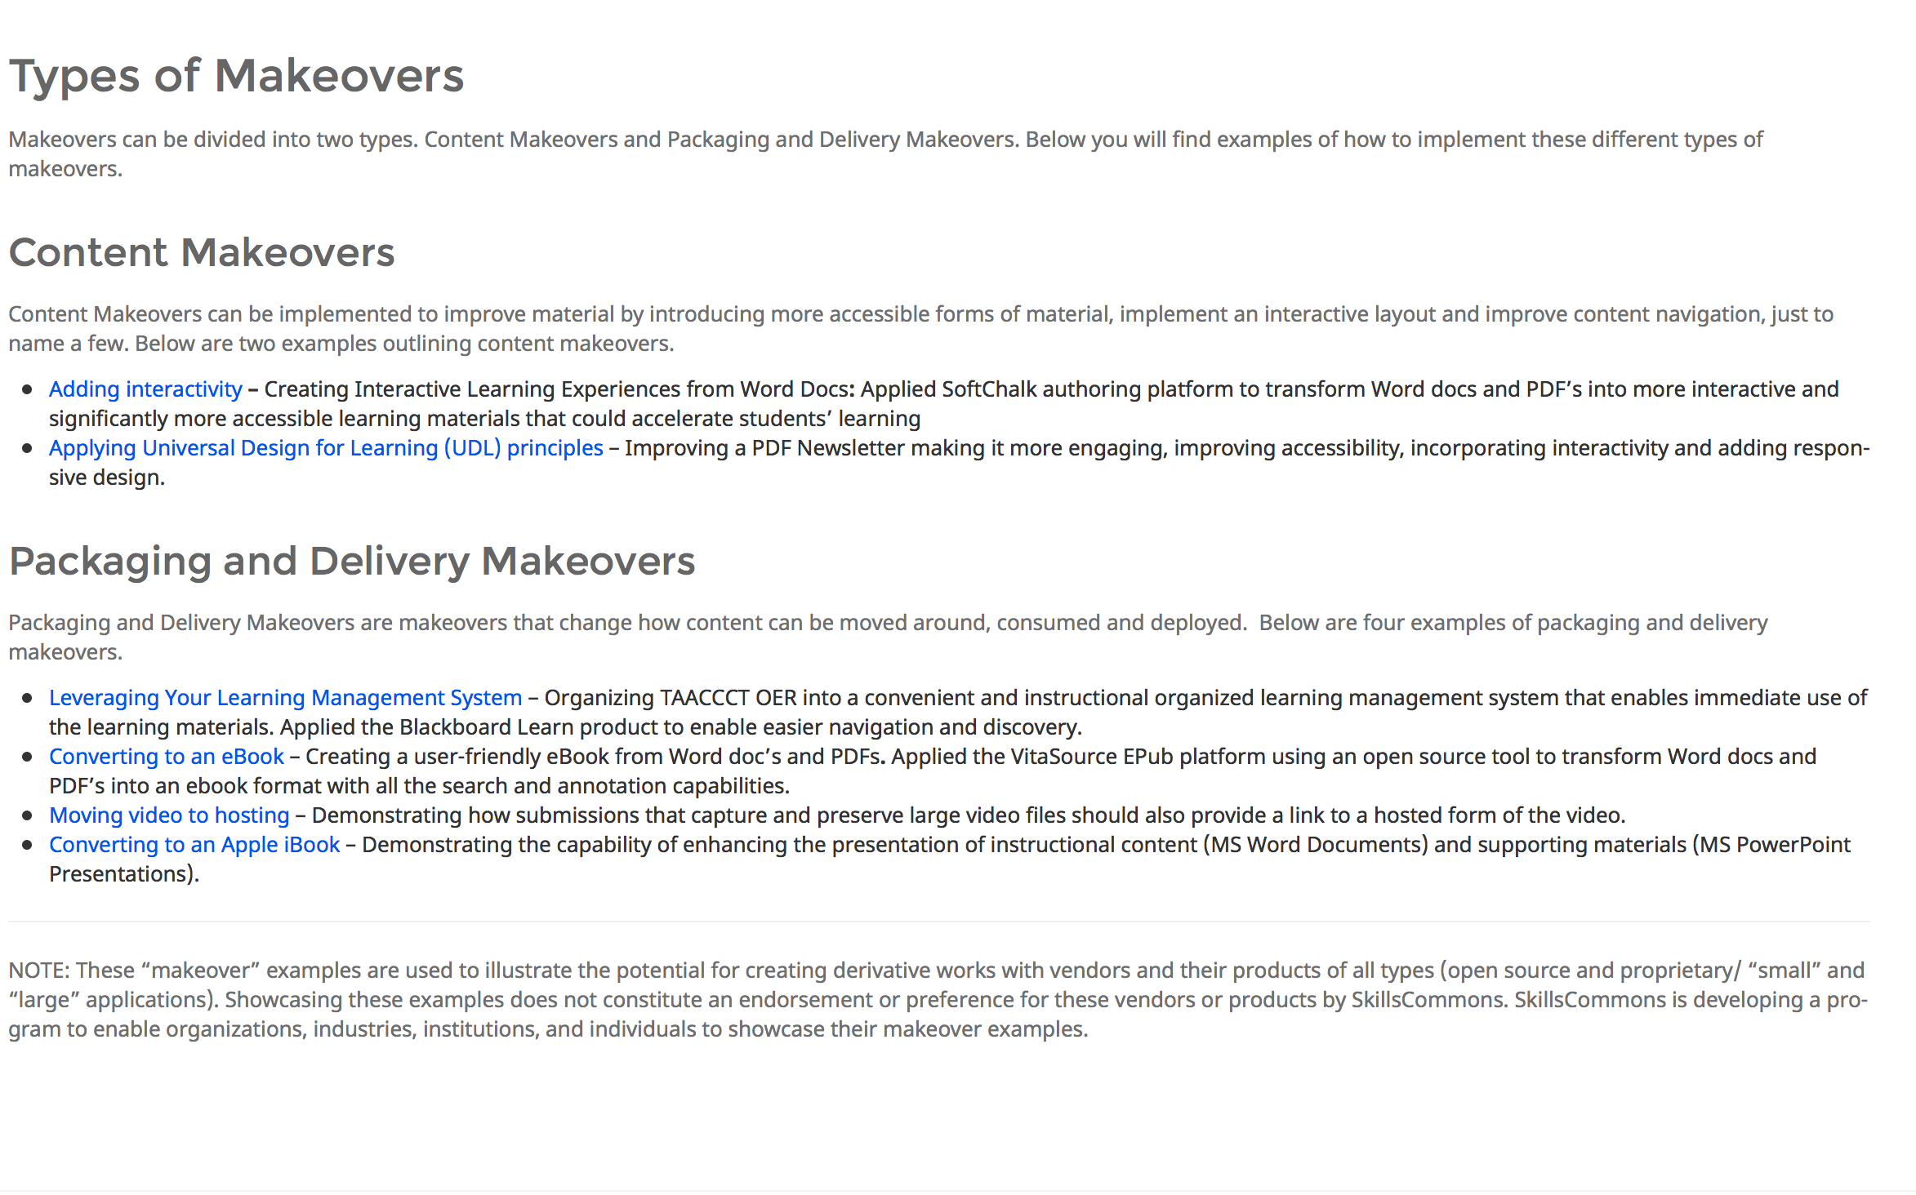
Types of Makeovers

Slide 34
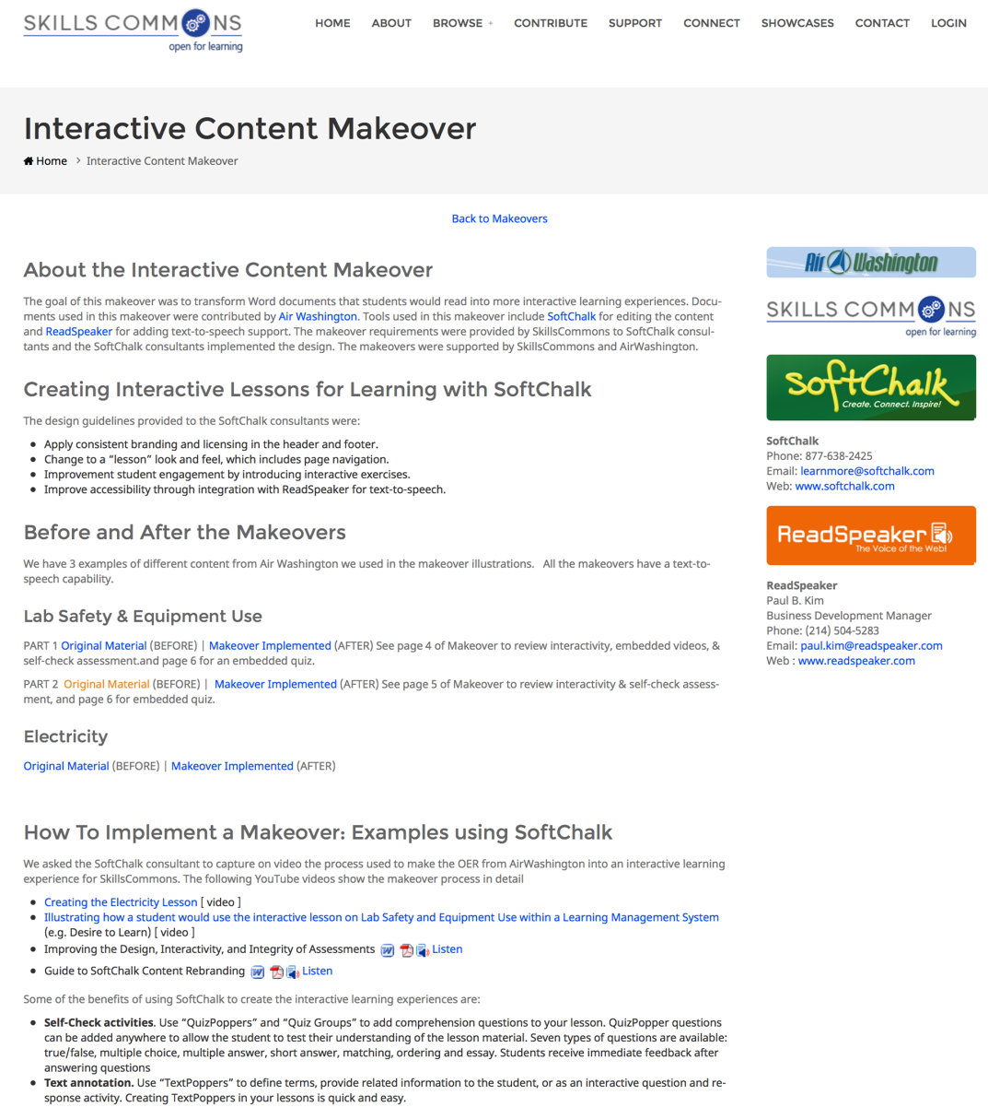
Content Makeover

Slide 35
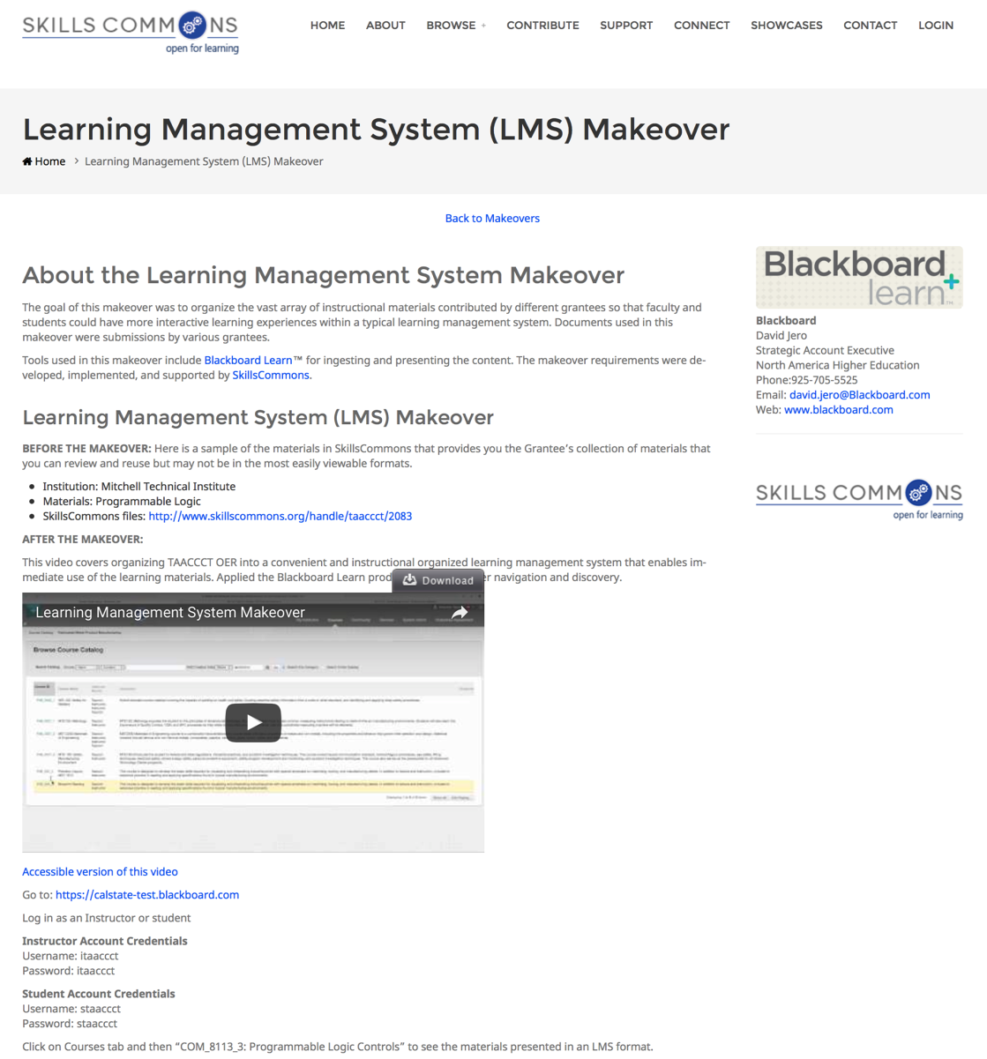
Packaging and Delivery Makeover

Slide 36
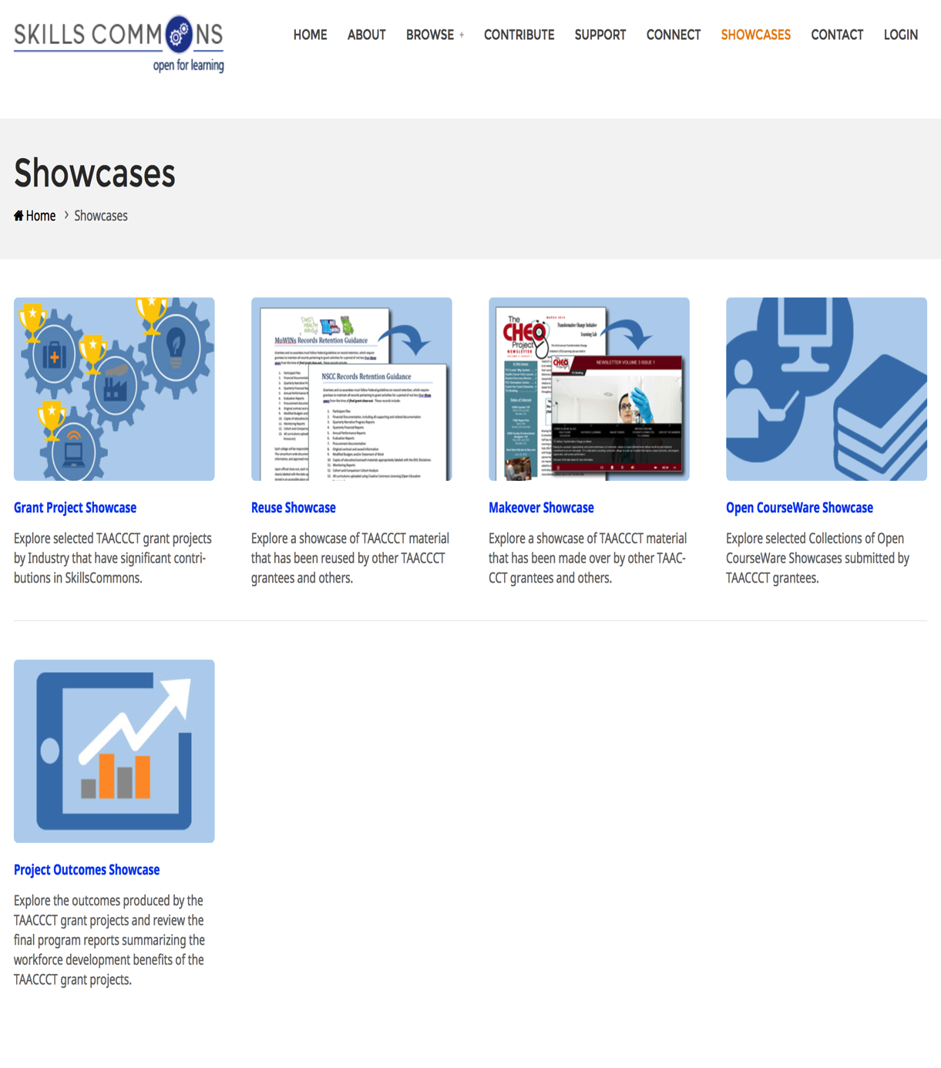
Showcases

Slide 37
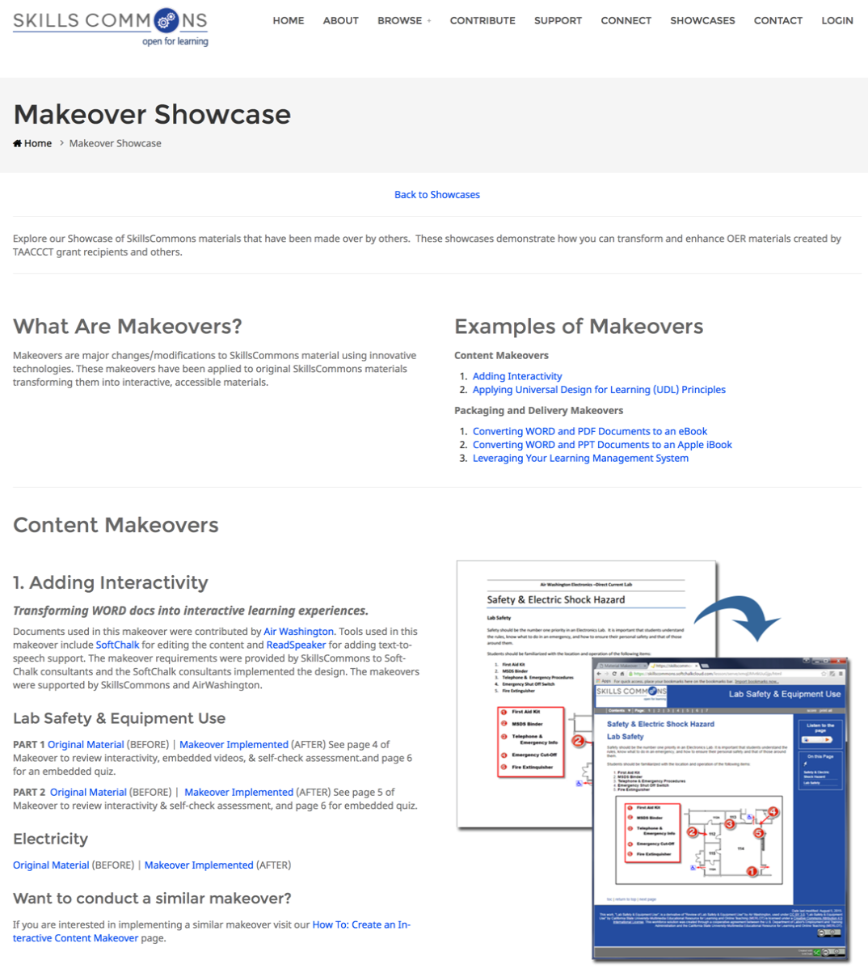
Makeover Showcases

Slide 38
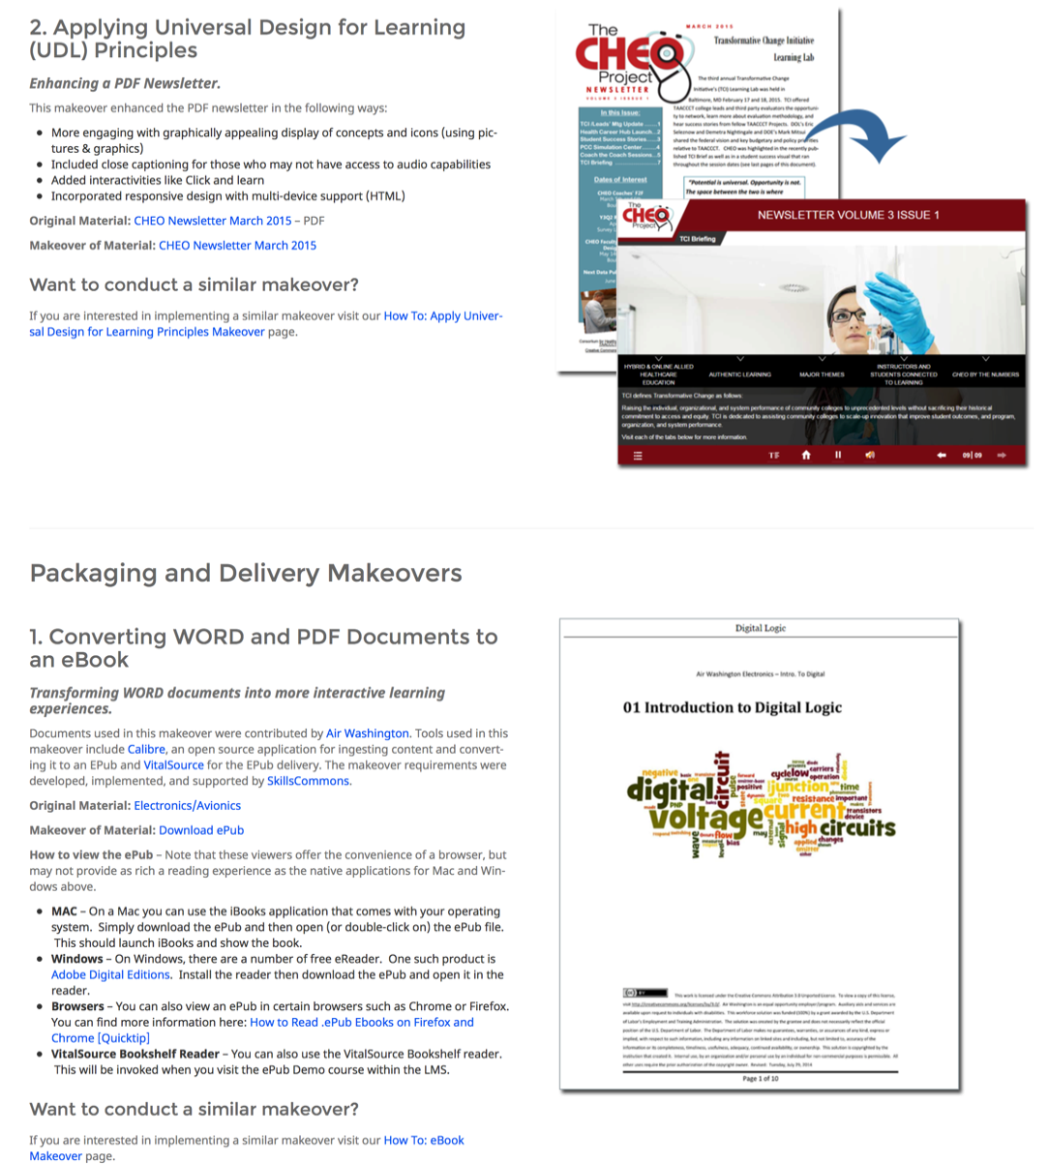
Makeover Showcases

Slide 39
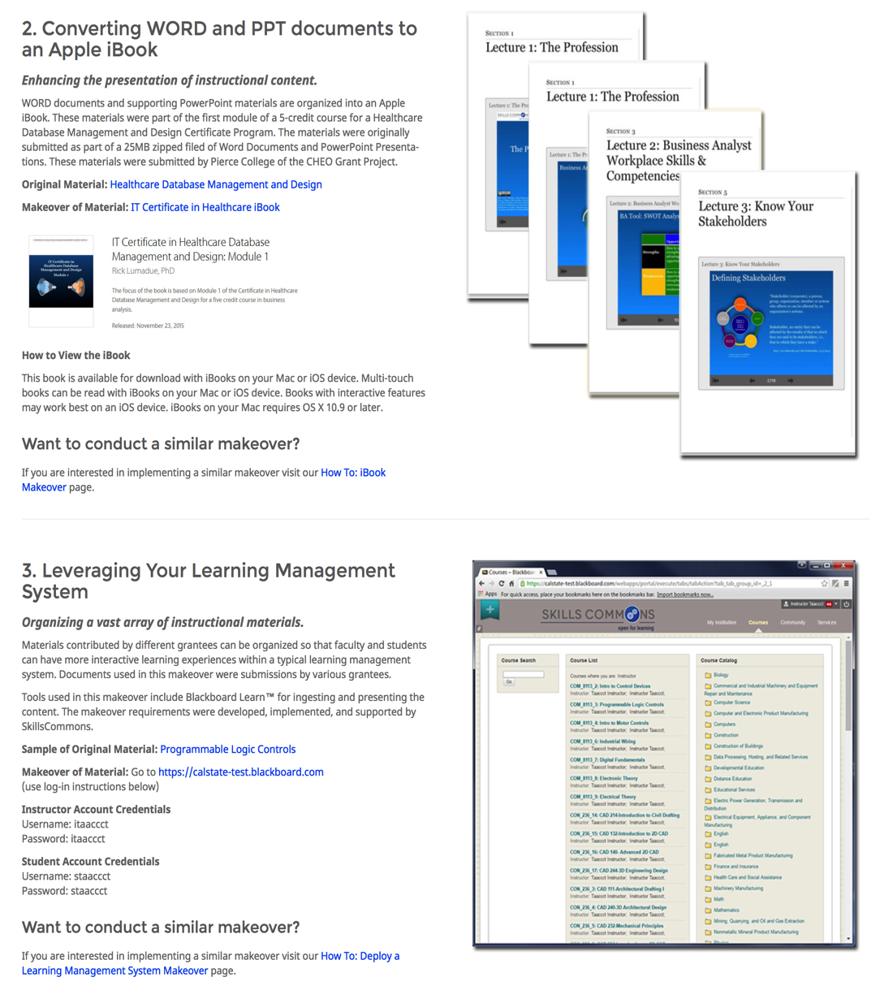
Makeover Showcases

Slide 40
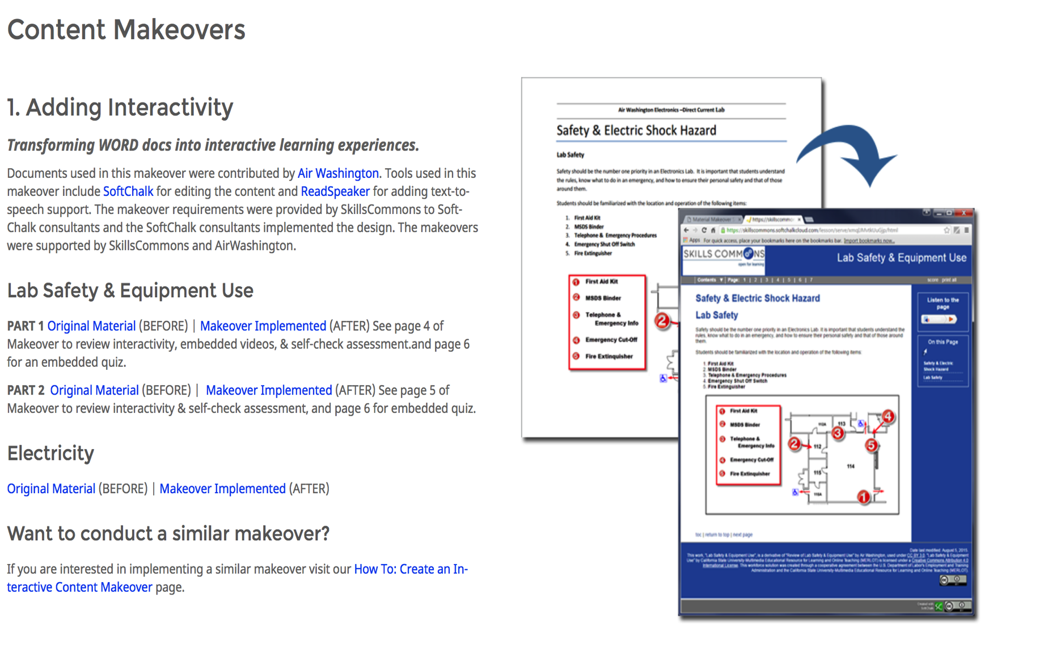
Content: “Before” and “After”

Slide 41
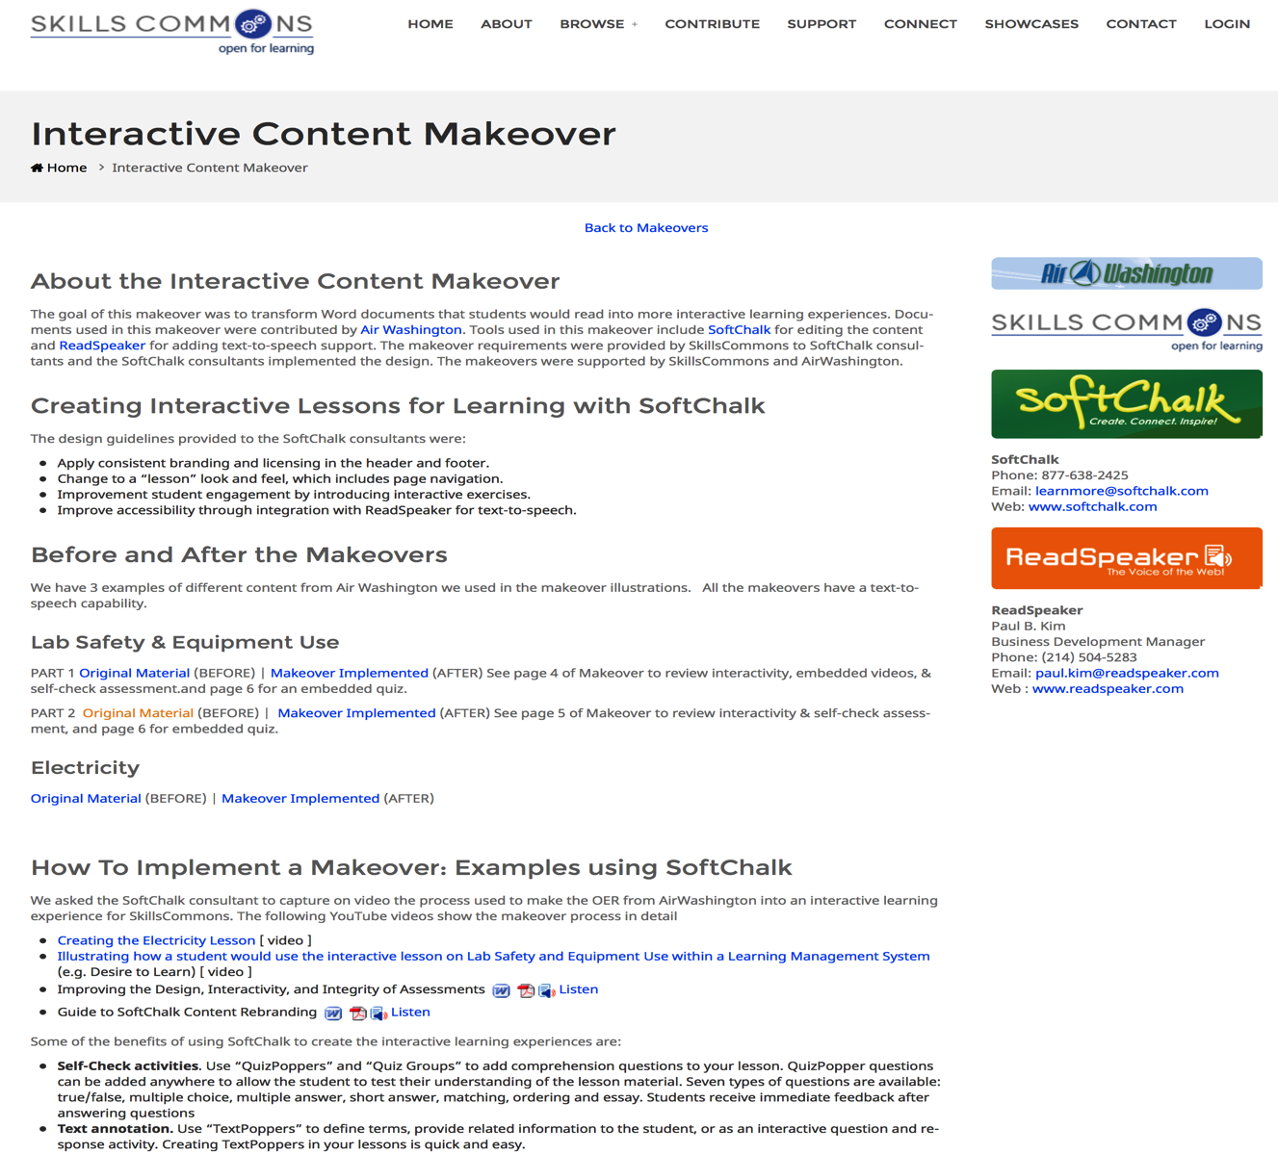
About the Content Makeover

Slide 42
Packaging and Delivery: “Before” and “After”

Slide 43
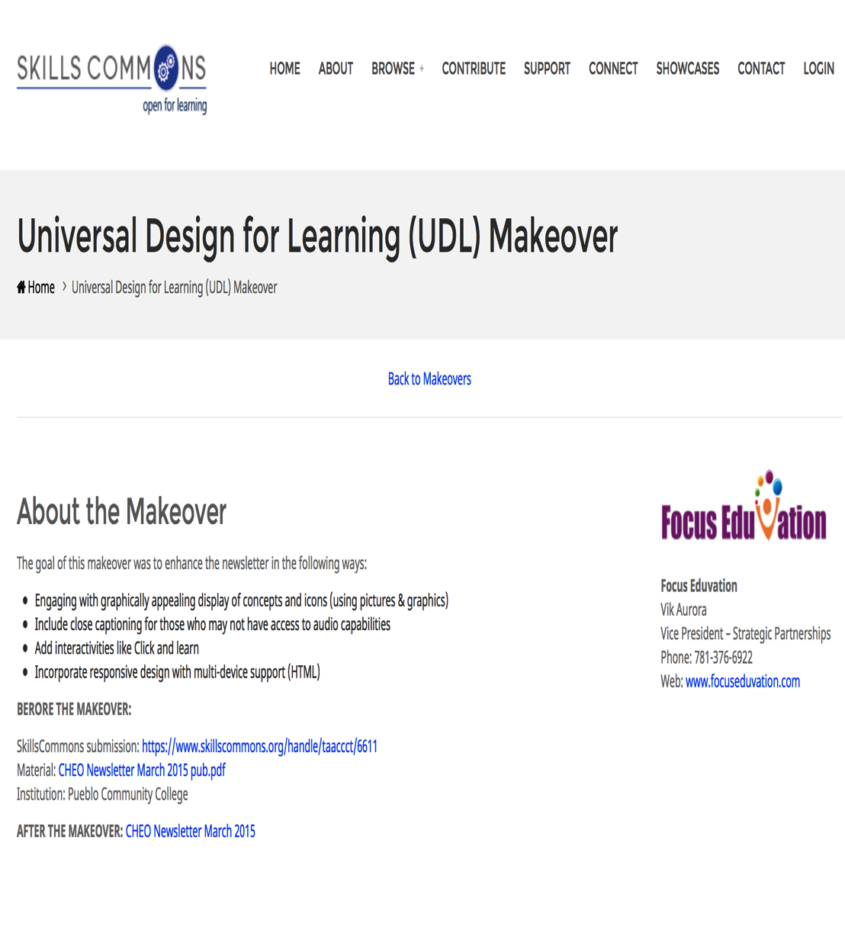
About the Packaging and Delivery Makeover

Slide 44
Participant Poll
Which type of Makeover would you be interested in creating?
Content
Packaging and Delivery
Both
Neither
Other (please enter in chat box)

Slide 45
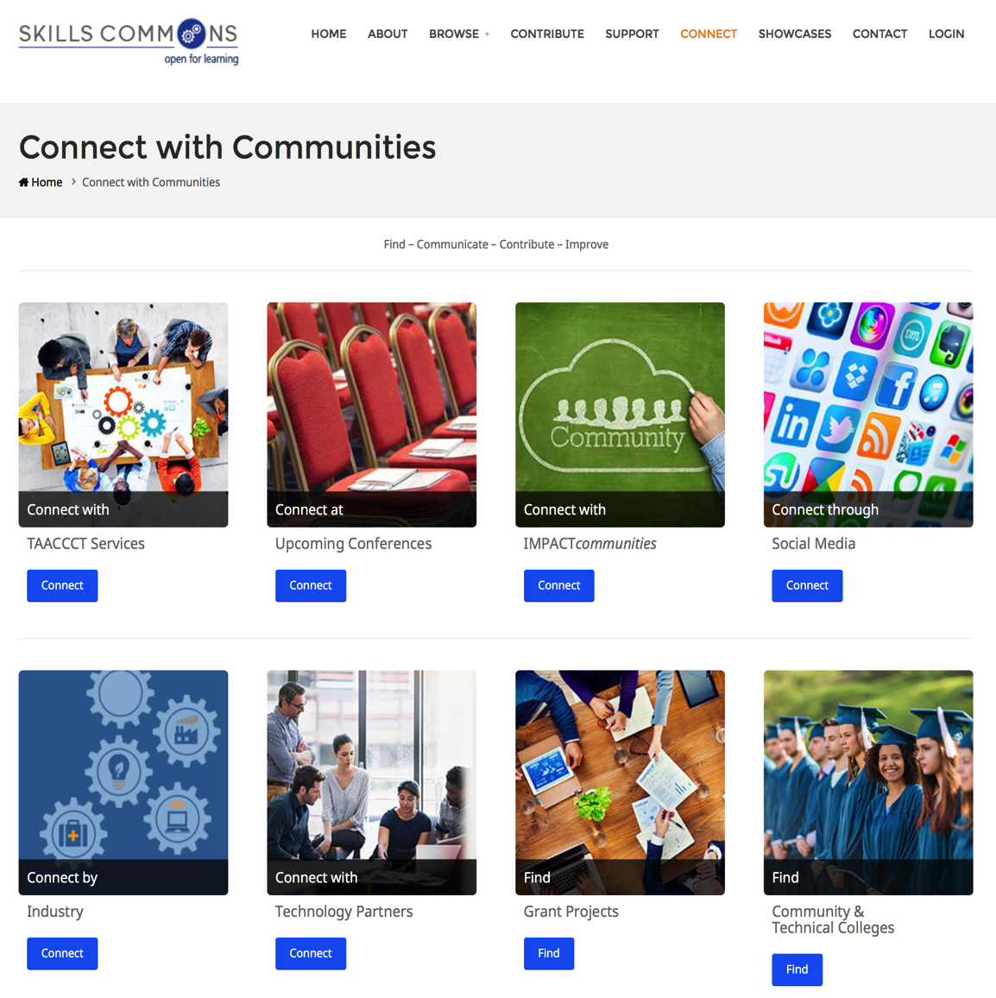
Connecting with a Technology Company

Slide 46
Makeover Technology Partnerships

Slide 47
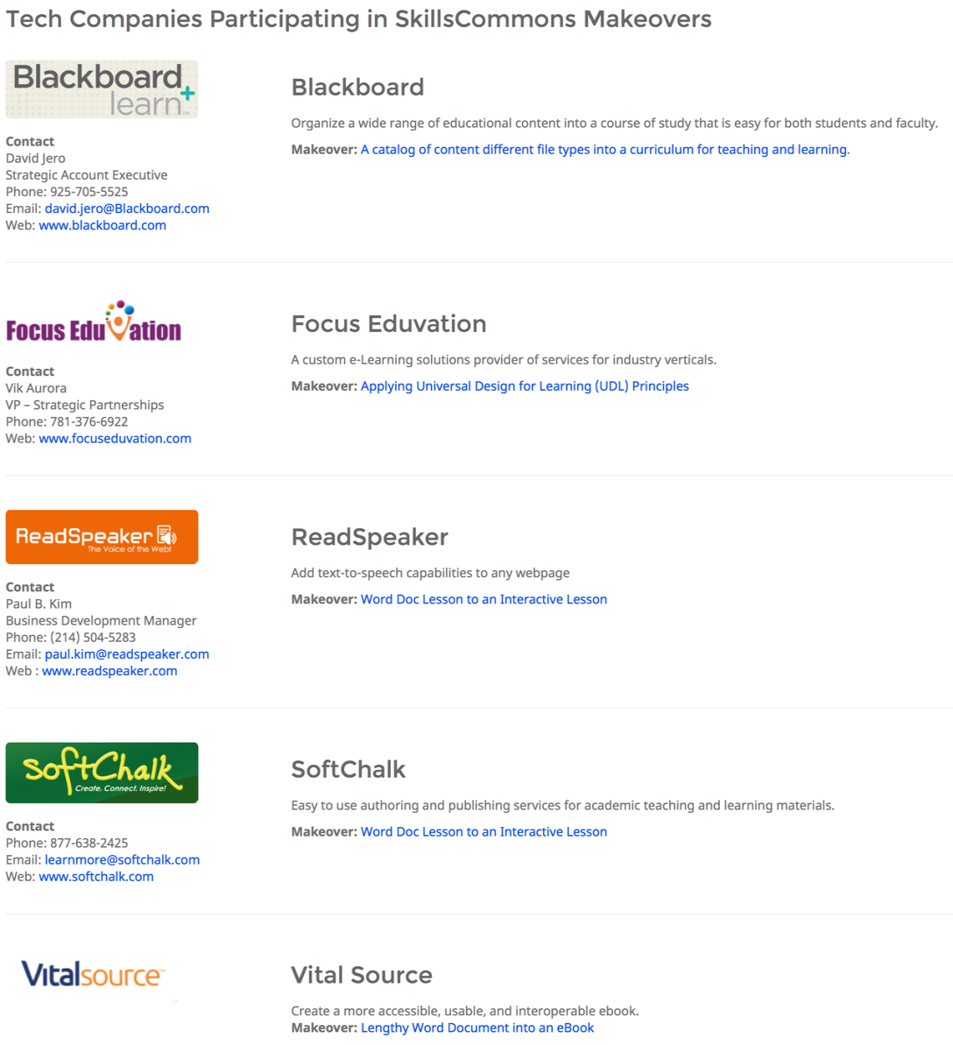
“Makeover” Tech Company Participants

Slide 48
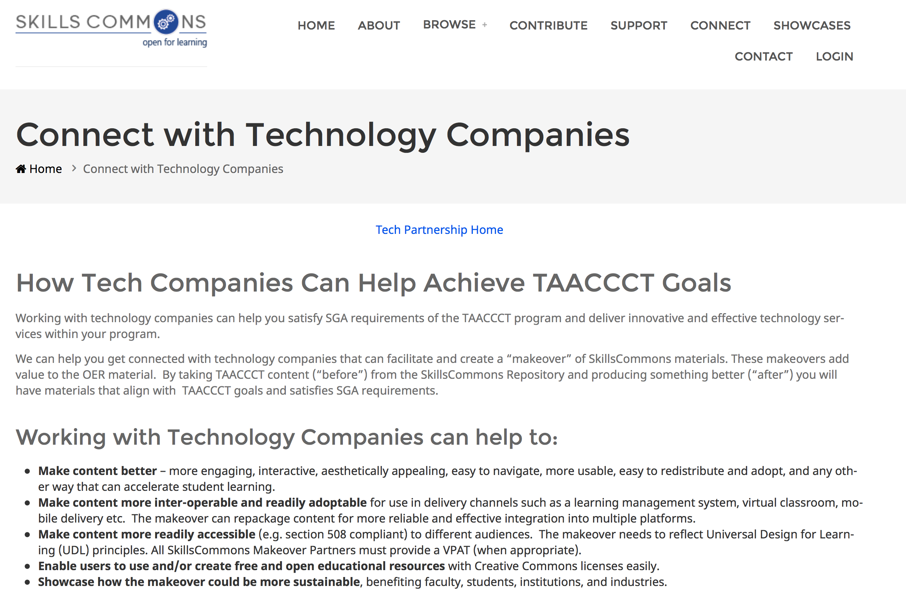
Benefits of Working with a Technology Company

Slide 49
Participant Poll
Would you be interested in connecting with a technology company to create a customized Makeover of OER?
Yes. Definitely!
Maybe, I need more information
Probably Not
Other (please enter in chat box)

Slide 50
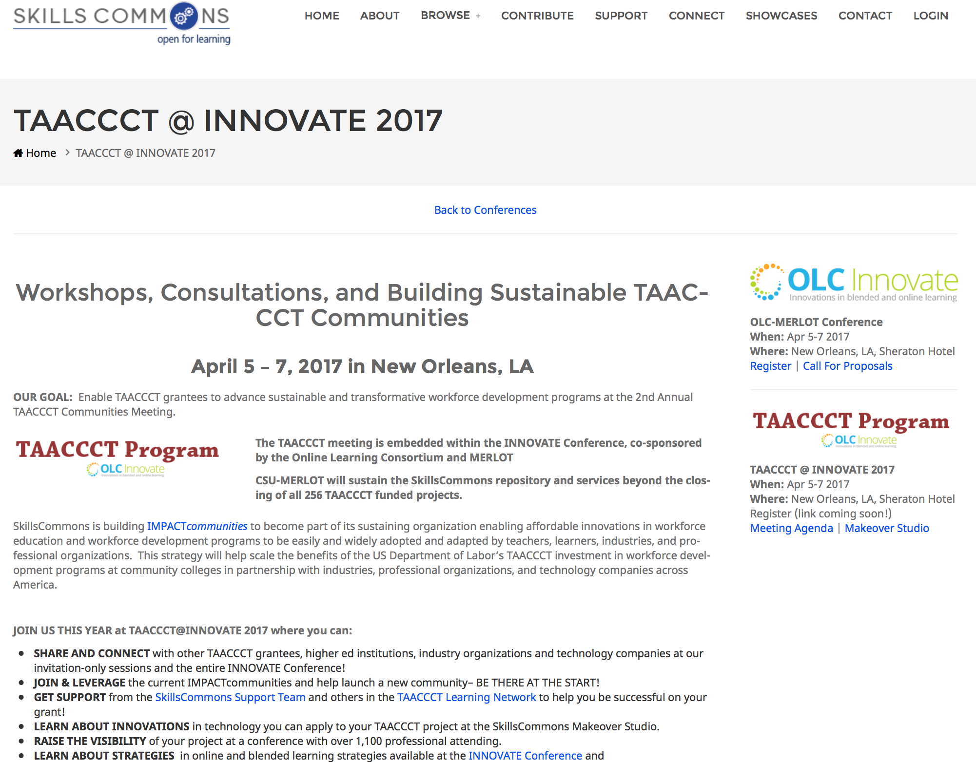
Join Us!

Slide 51
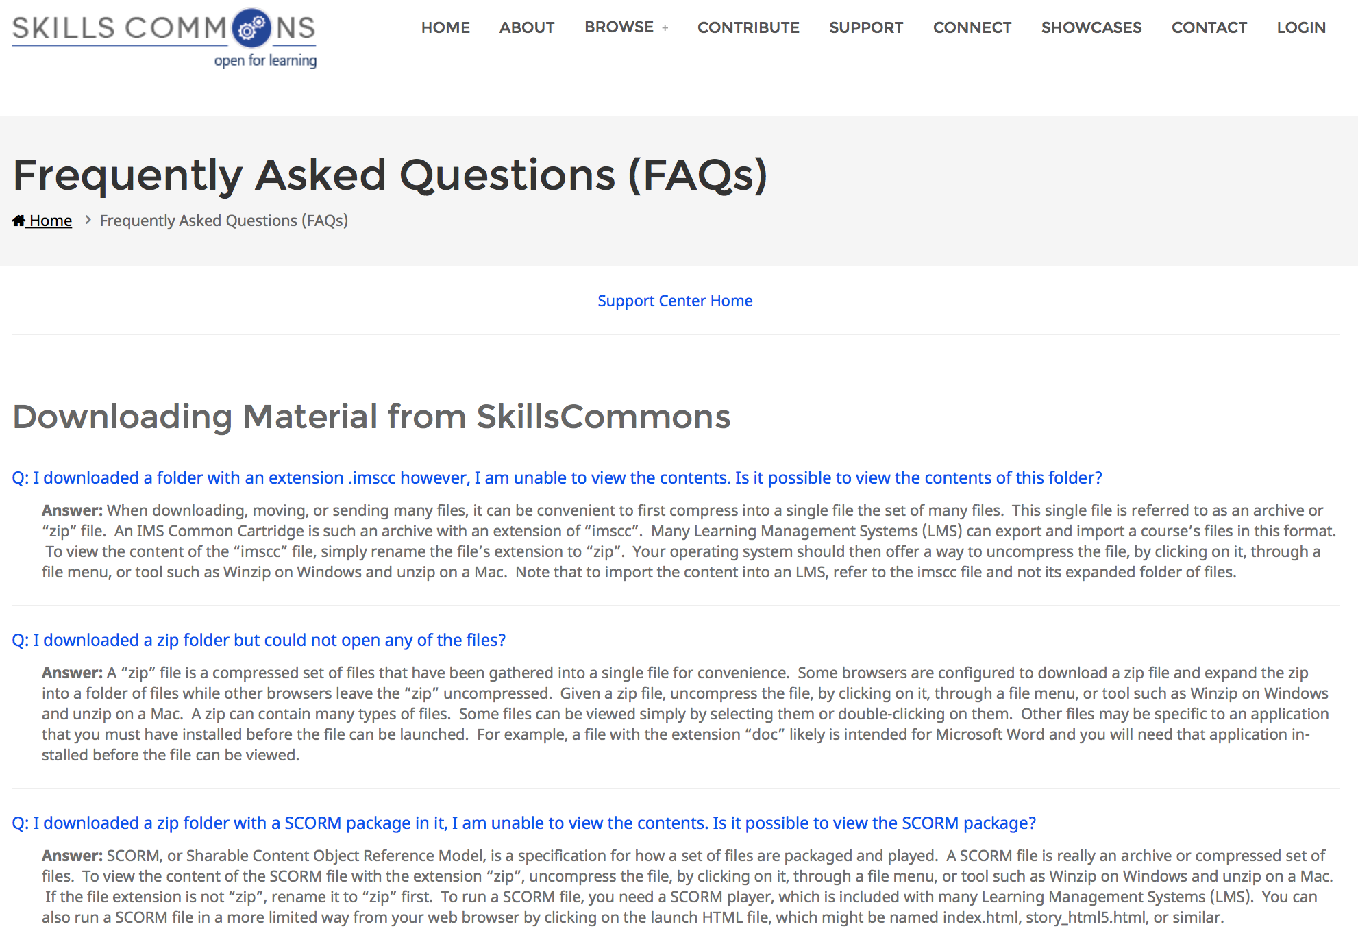
FAQs for Downloading

Slide 52
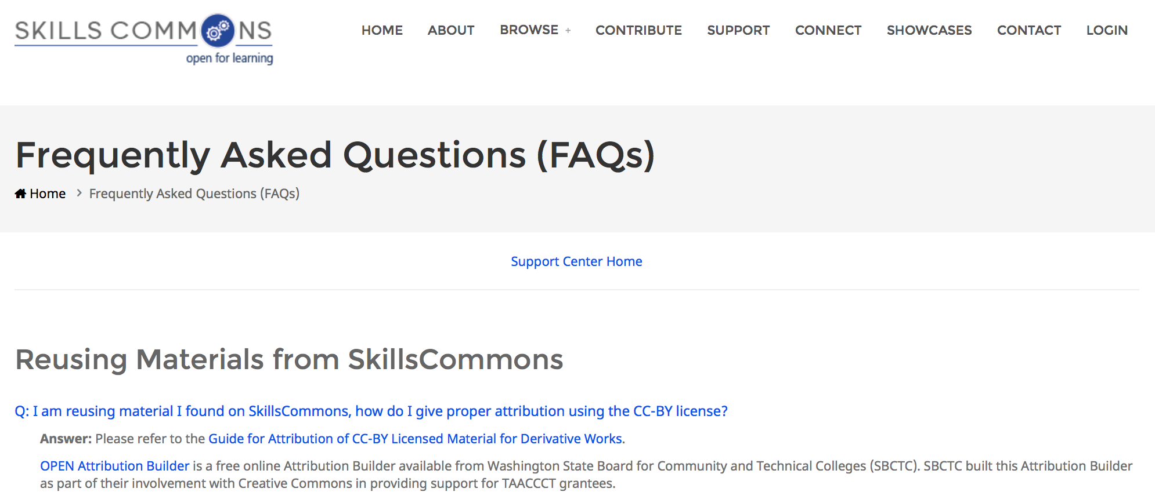
FAQs for Downloading

Slide 53
Questions?
support@skillscommons.org
Rick Lumadue: Associate Director, SkillsCommons

Slide 54
THANK YOU
This work is licensed under a Creative Commons Attribution 4.0 International License.
This workforce solution was created through a cooperative agreement between the U.S. Department of Labor's Employment and Training Administration and the California State University-Multimedia Educational Resource for Learning and Online Teaching (MERLOT).

