Slide 1

Participant Poll
What is your current role in the grant?
  Project Manager
  Faculty
  Dean/VP/Other Leadership Role
  Career Navigator/Coach
  Other (list in chat)
How far along are you in your sustainability work?
  Early stages
  Have done some sustainability work
  Have done significant sustainability work

Slide 2
Fall Round 3 TAACCCT
Sustainability Virtual Institute:
Launch Webinar
November 28, 2016
2 – 4 p.m. EST

Slide 3
TAACCCT Learning Network at a Glance
U.S. Department of Labor, Employment & Training Administration
(National)
Jobs for the Future
CalState/Merlot
Maher & Maher
American Association of Community Colleges
U.S. National Science Foundation
ATE Centers
Other Non-Federal Providers of TA and Resources for TAACCCT Grantees:
Creative Commons
CAST
The Transformative Change Initiative

Slide 4
Participant Poll
What is your current role in the grant?
  Project Manager
  Faculty
  Dean/VP/Other Leadership Role
  Career Navigator/Coach
  Other (list in chat)
How far along are you in your sustainability work?
  Early stages
  Have done some sustainability work
  Have done significant sustainability work

Slide 5
Presenters
MODERATOR:
Cheryl Martin, Program Manager, TAACCCT Grants, U.S. Department of Labor, Employment, and Training Administration.
FACILITATOR:
Jennifer Freeman, Program Director, TAACCCT Learning Network, Jobs for the Future
GRANTEES:
Rebecca Lake, Dean, Workforce and Economic Development, Illinois Network for Advanced Manufacturing (iNAM), William Rainey Harper College, Round 2
Leah Palmer, Executive Director, Arizona Advanced Manufacturing Institute (AzAMI), Mesa Community College, Round 3

Slide 6
Agenda
Welcome and Introductions
Sustainability Virtual Institute Overview
TAACCCT Sustainability Toolkit Overview
Grantee Examples
Q&A
Closure and Wrap-up

Slide 7
Sustainability Virtual Institute Overview

Slide 8
SVI Timeline
1st Coaching Call/Needs Assessment: November 15–23
Kick- Off SVI Webinar: November 28
Team Planning Calls: November 29–December 7
SVI Webinar Part 2: December 8
Final Team Planning Calls: December 9–15
Final SVI Webinar: December 16

Slide 9
Participant Question
3. What practices/policies/strategies do you want to sustain? (describe in chat)
4. What barrier to sustainability are you most concerned about? (describe in chat)

Slide 10
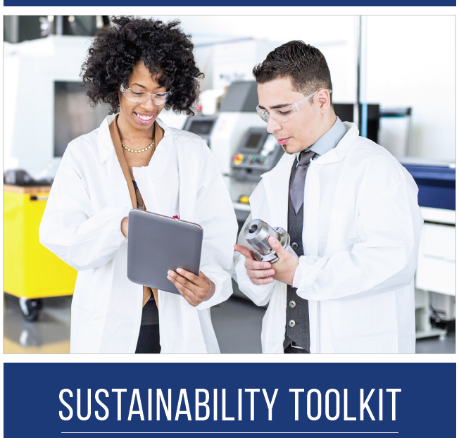
TAACCCT Sustainability Toolkit
Access the toolkit at: www.taaccct.workforcegps.org

Slide 11
Why focus on sustainability?

Slide 12
Examples
WI, CO and LA created statewide, transparent credit-for-prior-learning processes to accelerate student success
Work-Based Learning
Relationships with employers
Credit for Prior Learning
Colleges in Michigan are maintaining work-based learning models and operating them as Registered Apprenticeship programs
Colleges across the country plan to maintain and expand the strong working partnerships they have with employers.

Slide 13


AzAMI
How to Sustain your Investment
Finding Solutions…
Creating Opportunities…

Slide 14
1. Design your VISION to align with college Priorities.
AzAMI has a Vision
A Manufacturing Center of Excellence for Arizona serving as a concierge providing services and resources that meet the sector workforce demands. We Provide a front door for Industry, workforce and Education partners to find solutions and create opportunities.

Slide 15
2. Identify your Highest
IMPACT Practices worth keeping
Hosting Large Regional Manufacturing Job Fairs – Industry targeting skills and abilities from AzAMI programs.
Onsite recruitment opportunities in the college classrooms for employer visits to interview and explore internships and employment for students learning key competencies.
Skills Validation Boot Camps for accelerated Industry Certifications and provide On-Site training options for incumbent workers needing skills improvement.
Employability Skills training modules for online and classroom observations for the National Career Readiness Certifications in reading, math and navigating information
Emerging Technology - Additive Manufacturing (3D printing) as part of the core competencies training
AzAMI Open Houses and tours to recruit families, K-12 students, industry leaders, economic developers and developing community partnerships

Slide 16
3. Call upon your Champions
Create an Internal Sustainability team
B. Meet regularly with your College leadership and share success stories
C. Call upon your industry and community leaders to openly support your value and how you are making a difference

Slide 17
4. Strategies for Sustainability
A. Leverage existing people and programs to repurpose for best practices
B. Maintain key or core partnerships so that your program brand does not lose momentum
C. Identify activities that can be achieved without a formal budget (recruitment,
D. Be able to estimate the potential enrollment or funding lost if these partnerships are not sustained

Slide 18
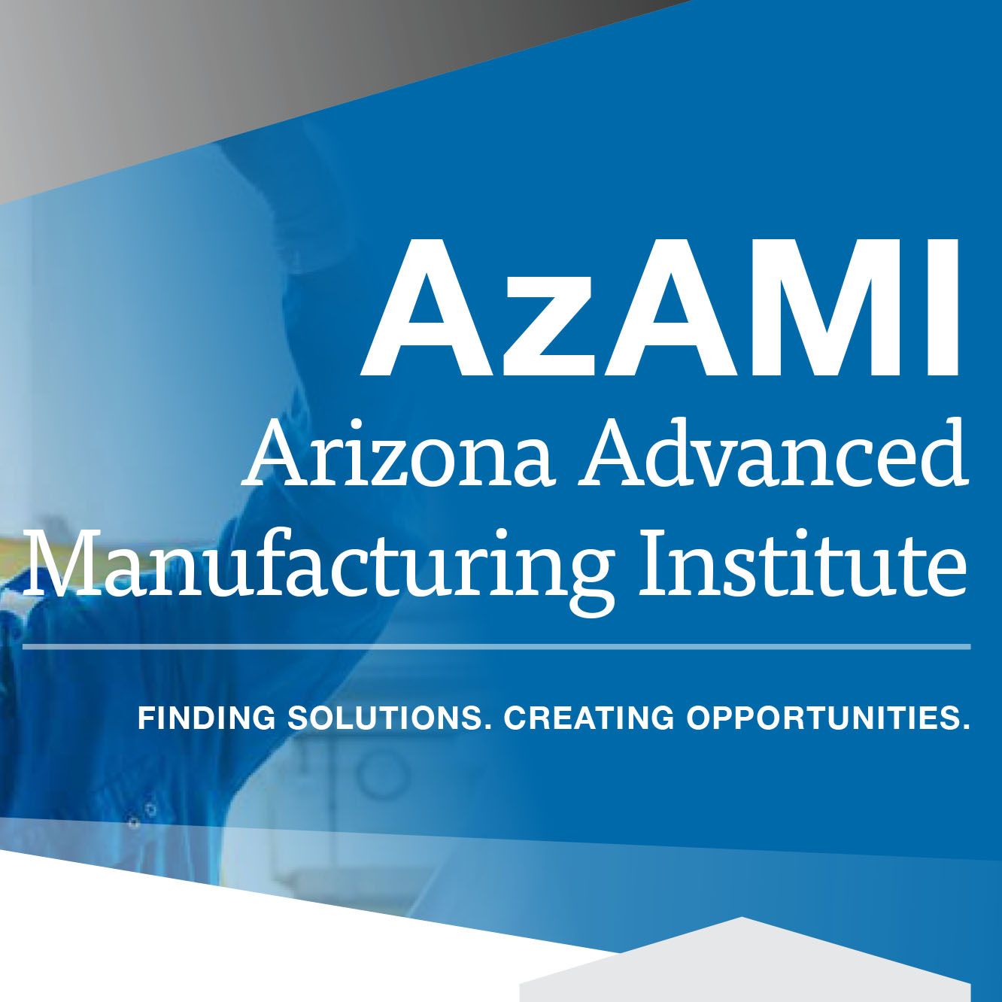
Thank You
It Takes A Village to Build Success

Slide 19
Dr. Rebecca Lake, Dean
Harper College
November 28, 2016
Visit our website: inam.net

Slide 20
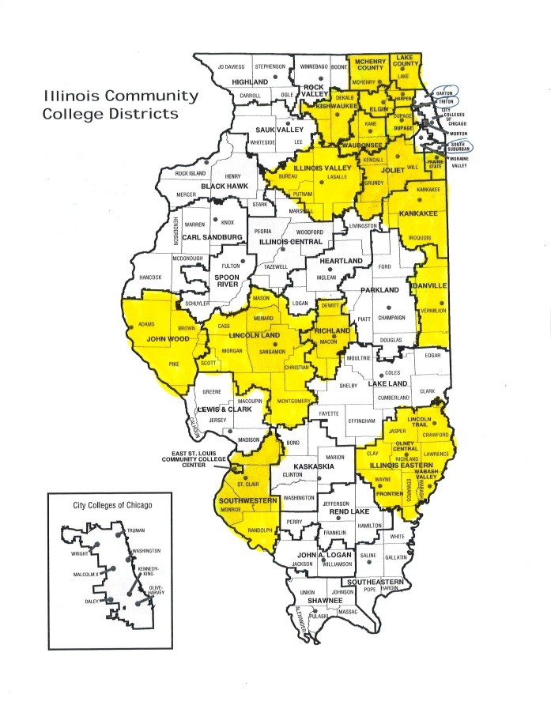
Illinois Community College Districts
TAACCCT Round 2 grant
Illinois Network for Advanced Manufacturing (INAM)
Members: 21 community college
Goal: Expand and improve the delivery of CTE programs aligned with industry-recognized credentials for student employment in high-skill advanced manufacturing occupations.
FPO
Pics Go Here

Slide 21
Sustainable Deliverables
Deliverable 1: Education Plans created for each students and a “coach or navigator” increasing
student retention and completion. This includes assisting with enrolling, courses clearly listed, advising when to take courses, etc.
Deliverable 2: Enhanced and/or new curriculum for short-term certificates written with common learning objectives.

Slide 22
Sustainable Deliverables
Deliverable 3: Equipment purchased and/or enhancement of a room or facility to augment learning.
Deliverable 4: Enhanced employers relations increasing donations of equipment and supplies; scholarship funding; hiring of students and graduates; working to align curriculum with workforce needs.
Deliverable 5: Articulation agreements signed four Universities to structure ongoing career pathways to Bachelor’s Degree in Manufacturing.

Slide 23
Q&A

Slide 24
Wrap-up and Next Steps

Slide 25
SVI Timeline
Team Planning Calls: November 29–December 7
SVI Webinar Part 2: December 8
Final Team Planning Calls: December 9–15
Final SVI Webinar: December 16

Slide 26
Thank You!
Download the new TAACCCT Sustainability Toolkit & Resources on WorkforceGPS
Download Lessons from TAACCCT Round One Consortia: The Community College Transformative Change Initiative (TCI) report
Connect with the NEW TAACCCT Community of Practice and search for TAACCCT resources at:
https://TAACCCT.workforceGPS.org
Ask questions and to connect with peers and resources at TAACCCT@dol.gov
If you want to learn more about peer mentoring email TAACCCT@dol.gov

