Slide 3
Career Pathways
The WIOA Way of Doing Business
Presented by the U.S. Departments of Labor, Education and Health and Human Services
11/30/2106

Slide 5

Jennifer Troke, Chief, Division of Youth Services, Employment and Training Administration, U.S. Department of Labor

Slide 6
Better understand the importance of building career pathways systems at the state and local levels
Learn how career pathways must be implemented within the Workforce Innovation and Opportunity Act (WIOA) context
Walkthrough of new career pathways toolkit

Slide 7
A framework for WIOA Implementation
Career Pathways Across the Federal Government:
  Office of Career, Technical and Adult Education (OCTAE/ED)
  Rehabilitative Services Administration (RSA/ED)
  Administration for Children and Families (ACF/HHS)
Overview of the Career Pathways Toolkit
Question and Answer

Slide 8
On a scale of 1 to 10, how would you rate your current knowledge of career pathways?
10! - We’re all pathways, all the time!
5-7 – Pretty good – Getting stronger every day.
2-4 - No, I am here today to learn more!
1 - Please get me up to speed, pronto.
0 - What are career pathways?

Slide 9
Tell us who you are on the CP team at state or local level.
Workforce System
Education
Human Services
Community Partner
Business
Other/Not On A Team Yet

Slide 10
Career Pathways: A framework for WIOA Implementation
The WIOA way of doing business

Slide 11

Robin Fernkas, Chief, Division of Strategic Investments, Employment and Training Administration, U.S. Department of Labor

Slide 12

WIOA Vision
The workforce system will be characterized by three critical hallmarks of excellence:
  The needs of business and workers drive workforce solutions;
  One-Stop Centers (or American Job Centers) provide excellent customer service to jobseekers and employers and focus on continuous improvement; and
  The workforce system supports strong regional economies and plays an active role in community and workforce development.
Across the system, continuous improvement is supported through evaluation, accountability, identification of best practices, and data driven decision making.

Slide 13
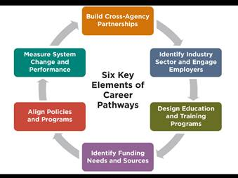
A Framework for WIOA Implementation

Slide 14
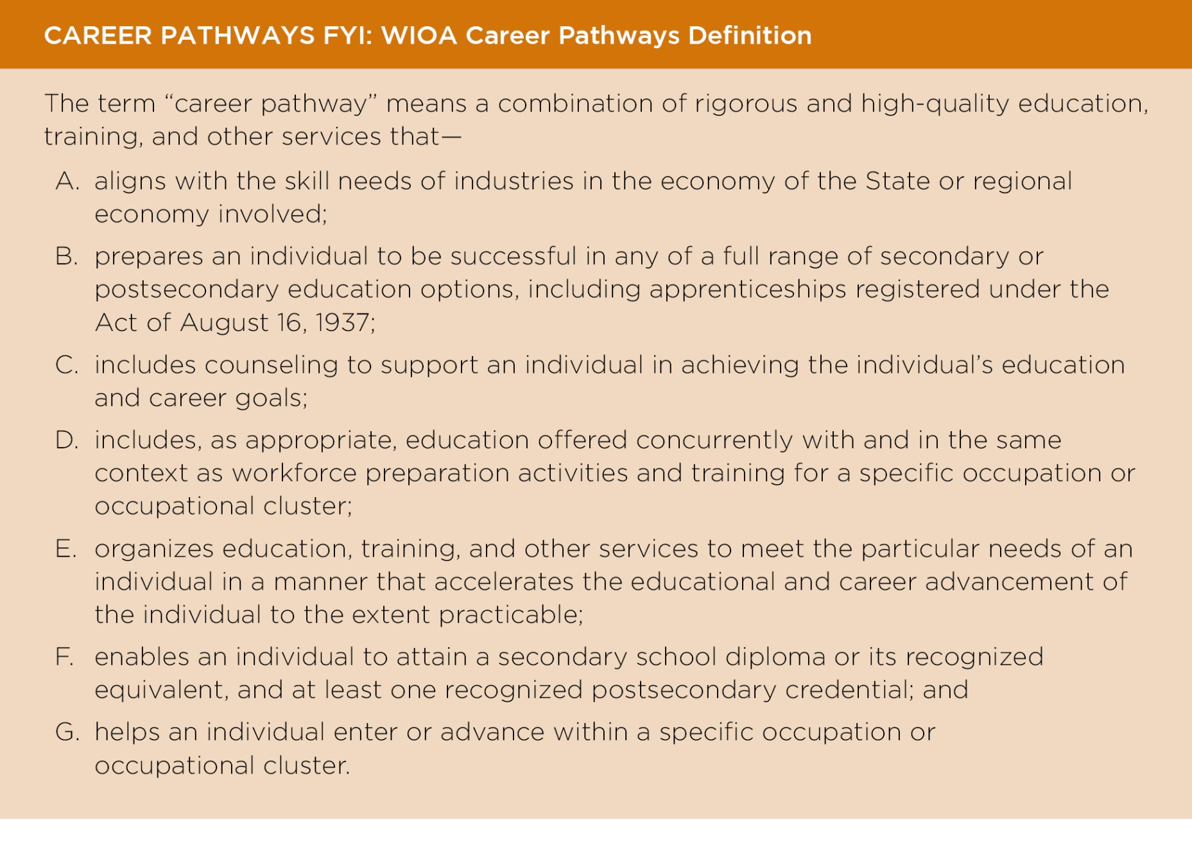

Slide 15
Subtitle A – System Alignment, Chapter 1 – State Provisions – Sec. 101 State Workforce Development Boards
Makes development of career pathways strategies a required function of the state and local workforce boards
Makes career pathways a permissible activity under all parts of the Act

Slide 16
Other Key References in Title I, Subtitle B
Chapter 2, Section 129, Youth Workforce Investment Activities
Chapter 3, Section 134, Adult and Dislocated Worker Employment and Training Activities
  Allowable Statewide Employment and Training Activities
  Required Local Employment and Training Activities, Career Services
  Permissible Local Employment and Training Activities
Chapter 4, Section 169, Evaluations and Research

Slide 17
Subtitle A – System Alignment, Chapter 2 – Local Provisions – Sec. 107 Local Workforce Development Boards
(d) FUNCTIONS OF LOCAL BOARD.—
(5) CAREER PATHWAYS DEVELOPMENT.—The local board, with representatives of secondary and postsecondary education programs, shall lead efforts in the local area to develop and implement career pathways within the local area by aligning the employment, training, education, and supportive services that are needed by adults and youth, particularly individuals with barriers to employment.

Slide 18
State Planning Information Collection Request
  Overview:
    One of WIOA’s principal areas of reform is to require States to plan across core programs and include this planning process in the Unified or Combined State Plans. This reform promotes a shared understanding of the workforce needs within each State and fosters development of more comprehensive and integrated approaches, such as career pathways and sector strategies, for addressing the needs of businesses and workers.
  (c) State Strategy:
    Describe the strategies the State will implement, including industry or sector partnerships related to in-demand industry sectors and occupations and career pathways, as required by WIOA Section 101(d)(3)(B)(D). Career pathways is defined at WIOA Section 3(7). “In-demand industry sector or occupation” is defined at WIOA Section 3(23).

Slide 19
Subtitle A – System Alignment, Chapter 2 – Local Provisions – Sec. 108 Local Plan
The local plan shall include—
(b)(3) a description of how the local board working with its partners will facilitate the development of career pathways and co-enrollment, as appropriate, in core programs; and improve access to activities leading to a recognized postsecondary credential.
Local areas are required to use youth funds to conduct an objective assessment “for the purpose of identifying appropriate services and career pathways for participants.

Slide 20

The Law: Primary Indicators of Performance
Employment Rate 2nd Quarter after Exit
(Education/Employment for youth)
Employment Rate 4th Quarter after Exit
(Education/Employment for youth)
Median Earnings in the 2nd Quarter after Exit
Credential Attainment Rate
(of those who received training or education, excluding OJT or Customized Training)

Slide 21
Primary Indicators of Performance
(continued)
5 types of measurable skill gains
(Participant based/1 gain/person/participation period)
Measurable Skill Gain
Secondary Diploma/ Equivalent
Progress toward Milestones
Secondary or Post-Secondary Transcript
Program Exit + Entry into Postsecondary Education
Educational Functioning Level Gain
Pre-Post Test
Completion of Carnegie Units
Passing Technical / Occupational Knowledge Based Exam

Slide 22
Primary Indicators of Performance
(continued)
  Effectiveness in Serving Employers
  (States choose 2; shared outcome)
  Retention with the same employer in the 2nd and 4th quarters after exit
  Employer Penetration Rate
  Repeat Business Customer Rate

Slide 23
Where is your state or local team in the process of developing strong career pathways systems?
Advanced
Intermediate
Beginner
Novice

Slide 24
Career Pathways Across the Federal Government
Our work past and present

Slide 25

Career Pathways Commitment Across Federal Government

Slide 26

Corinne Sauri, Policy Analyst
Office of Career, Technical, and Adult Education
202-245-6412
corinne.sauri@ed.gov

Slide 27
Office of Career, Technical, and Adult Education

Slide 28
Laws Supporting Career Pathways at OCTAE
Workforce Investment and Opportunity Act, Title II: Adult Education and Family Literacy Act (34 CFR 463)
  Administering the Adult Education formula grant program to the States
  Providing assistance to States to improve program quality, accountability and capacity.
  Establishing national leadership activities to enhance the quality of adult education.
Carl D. Perkins Career and Technical Education Act of 2006 (Perkins IV)
  Administering state formula and discretionary grant programs.
  Providing assistance to states to improve program quality, implementation, and accountability.
  Establishing national initiatives that help states implement rigorous career and technical education programs.
Community Colleges
  OCTAE provides national leadership to strengthen the role of community colleges in expanding access to postsecondary education for youth and adults and advancing workforce development.

Slide 29
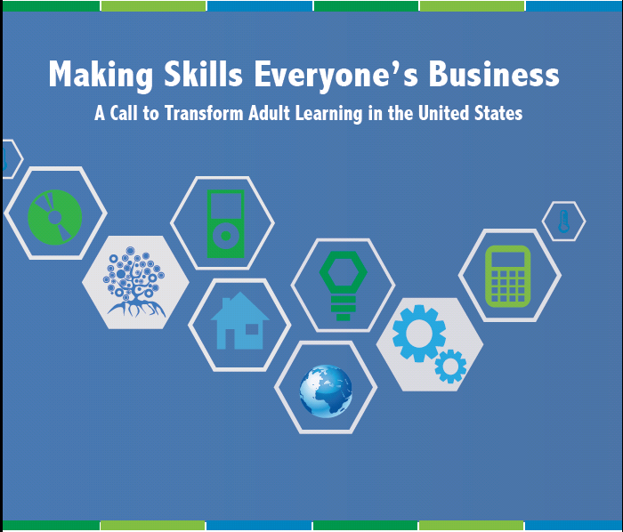
Making Skills Everyone’s Business
http://www2.ed.gov/about/offices/list/ovae/pi/AdultEd/making-skills.pdf

Slide 30
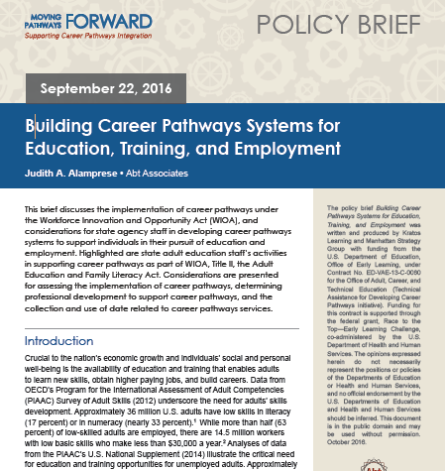
Career Pathways Policy Briefs

Slide 31
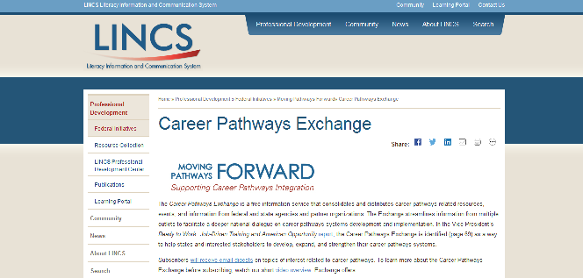
https://lincs.ed.gov/programs/movingpathways/career-pathways-exchange

Slide 32
Future Efforts to Support Career Pathways and Adult Education
Connecting English Learners with Career Pathways
Checklist to support the Ability to Benefit provisions of the Higher Education Act

Slide 33

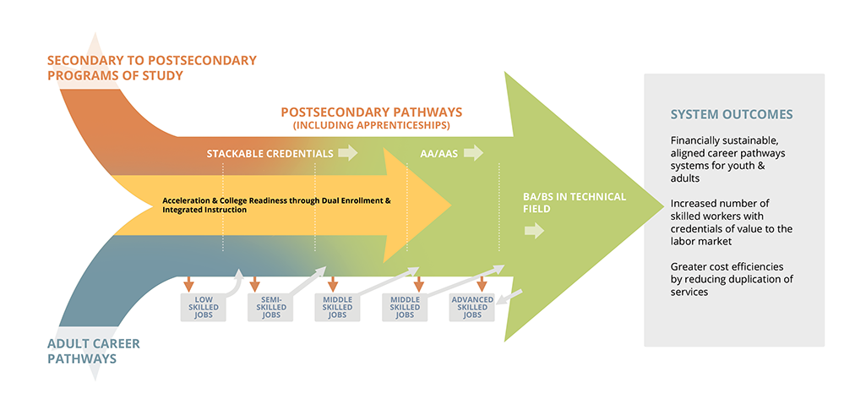


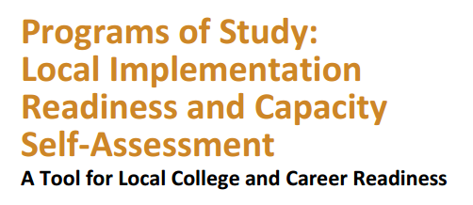

Career Pathways Projects and Research (http://cte.ed.gov)
Potential of Apprenticeships in Secondary Education

Slide 34
“Advancing Career Pathways” Meetings http://advancingcpregional.org/

Slide 35
Resources
Plug into Career Pathways updates now: https://lincs.ed.gov/programs/movingpathways/career-pathways-exchange
Perkins Collaborative Resource Network: http://cte.ed.gov
Stay up to date with the OCTAE Blog (http://sites.ed.gov/octae/) and eNewsletter (https://public.govdelivery.com/accounts/USED/subscriber/new?topic_id=USED_2)

Slide 36

Today’s Presenter
  Felipe Lulli, Project Officer, Rehabilitation Services Administration (RSA), Office of Special Education and Rehabilitative Services, U.S. Department of Education, felipe.lulli@ed.gov
    Jason Hunter, VR content expert, jason.hunter@ed.gov

Slide 37
Career Pathways for Individuals with Disabilities (CPID) Demonstration Project
Vocational Rehabilitation (VR) Services Program, Authorized by Rehabilitation Act of 1973, As Amended by Title IV of WIOA

Slide 38
Career Pathways for
Individuals with Disabilities (CPID)
Purpose: Demonstrate promising practices in the use of career pathways to enable individuals with disabilities to
  acquire marketable skills and industry-recognized credentials
  secure competitive integrated employment in high-demand, high-quality occupations
  increase their salary, wage and benefits potential
Goal: Disseminate successful practices among other Federal and State career pathways programs

Slide 39
Authorization and Administration
Funded under the Vocational Rehabilitation (VR) Services program, authorized by the Rehabilitation Act of 1973, as amended by title IV of the Workforce Innovation and Opportunity Act (WIOA)
Administrated by the Rehabilitation Services Administration (RSA), U.S. Department of Education, Office of Special Education and Rehabilitative Services

Slide 40
Vocational Rehabilitation (VR) Program
Federal-State partnership that enables individuals with disabilities, including those with the most significant disabilities, to prepare, secure, retain or regain employment
  consistent with their capabilities, interests and informed choice
  through a wide range of services ranging from career counseling to postsecondary education

Slide 41
VR and WIOA
Under WIOA, the VR program
  reaffirms that individuals with disabilities are capable of achieving high quality, competitive integrated employment
  expands services and supports for students and youth with disabilities, including pre-employment transition services
  promotes career advancement through graduate degrees, including in the STEM fields
  engages employers to develop customized employment and work-based learning opportunities such as internships and registered apprenticeships that benefit both employers and jobseekers

Slide 42
CPID: Individuals With Disabilities
Accessing Career Pathways
Adapts, customizes or creates career pathways addressing the particular needs and barriers of individuals with disabilities.
Incorporates career pathways elements of WIOA and adds other components for individuals with disabilities
  comprehensive support services such as benefits planning, educational and financial supports, self-advocacy training, family engagement, and assistive technology services
  education and training design improvements like flexible work schedules, alternative class times and locations, innovative use of technology, and other necessary accommodations

Slide 43
CPID: Project Highlights
Authorizes $3.5 million annually to the State VR agencies of Georgia, Kentucky, Nebraska, and Virginia through September 2020
Each State has a distinctive strategy
  Georgia focuses on youth with disabilities, including multi-platform social media outreach
  Kentucky promotes work-based learning including registered apprenticeships
  Nebraska uses the Upskill/Backfill model for both career advancement and entry level opportunities
  Virginia partners with the Virginia Manufacturers Association for advanced manufacturing training, certification and production

Slide 44
CPID and the Workforce System
CPID grantees
  bring the perspective of individuals with disabilities to State workforce boards and statewide career pathways workgroups
  work directly with regional workforce boards, American Job Centers, state and local education agencies, higher education and career training institutions, customized employment and training providers, social services organizations, and employers
  reach out to other Federal career pathways initiatives in their States
  describe the CPID project in their respective Unified State Plans, as mandated by WIOA sections 101(d) and 102(b)

Slide 45

Deborah List, Office of Family Assistance, Administration for Children and Families, U.S. Department of Health and Human Services
Deborah.List@ACF.hhs.gov

Slide 46
TANF & Career Pathways

Slide 47
FY 2015

Slide 48
Purposes of TANF Program
Provide assistance to needy families so children may be cared for in their own homes or in the homes of relatives
End dependence of needy parents through job preparation, work, and marriage
Prevent and reduce out-of-wedlock pregnancies
Encourage the formation and maintenance of two-parent families
48

Slide 49
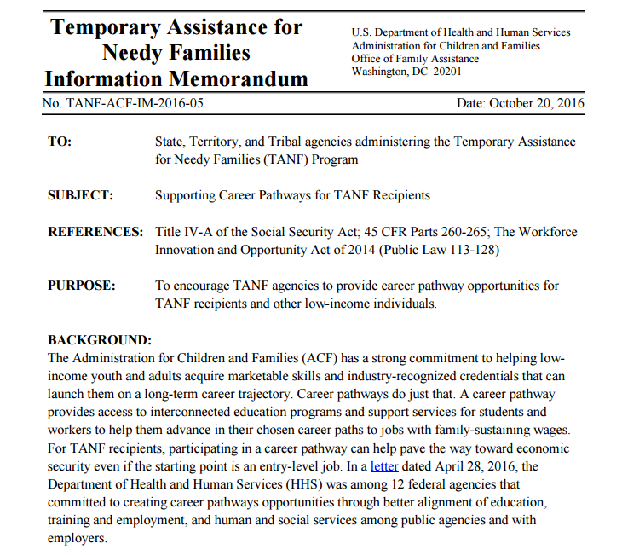
Supporting Career Pathways for TANF Recipients
http://www.acf.hhs.gov/ofa/resource/tanf-acf-im-2016-05

Slide 50
TANF Work Activities
“Core” Activities
“Non-Core” Activities
Unsubsidized employment
Subsidized private sector employment
Subsidized public sector employment
Work experience
On-the-job training
Job search /job readiness assistance
Community service programs
Vocational educational training
Providing child care to a participant in a community service program
Job skills training directly related to employment
Education directly related to employment (for those with no high school degree or equivalent)
Satisfactory attendance at secondary school or in a GED program

Slide 51
Career Pathways & TANF: Promising Strategies
TANF Partnerships
Include partners early.
Establish formal agreements.
Align service approaches to streamline support for participants.
Co-locate services.
Hire on-campus coordinators.
Engaging TANF Recipients
Create structured processes to identify & refer career pathways participants from TANF families.
Provide intensive case management supports.
Address TANF work participation requirements.

Slide 52
ACF Career Pathways Research
Pathways for Advancing Careers and Education (PACE)
HPOG Multi-Pronged Evaluation Strategy
Career Pathways Intermediate Outcomes (CPIO) Study
Employment Sector Analysis for TANF Recipients and Other Low-Income Families
  Promising Occupations Achievable through Short-Term Education or Training
  Resources for Connecting TANF Recipients to Good Jobs
  Using Data to Connect TANF Clients to Good Jobs: An Opportunity to Foster WIOA Partnerships
www.acf.hhs.gov/opre | www.careerpathways.org

Slide 53
Overview of the Career Pathways Toolkit:
An Enhanced Guide and Workbook for System Development

Slide 54
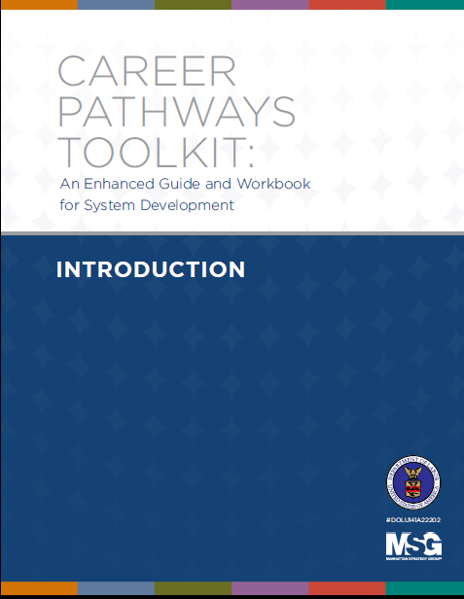
New Toolkit
Updated with WIOA References
Enhanced Content:
  Examples
  Worksheets
  Resources
Enhanced Functionality:
  Modular
  Fillable
  Interactive

Slide 55
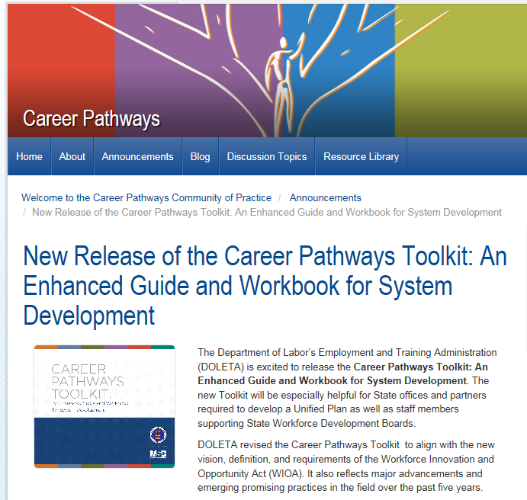
Where Do I Get It?
https://careerpathways.workforcegps.org

Slide 56
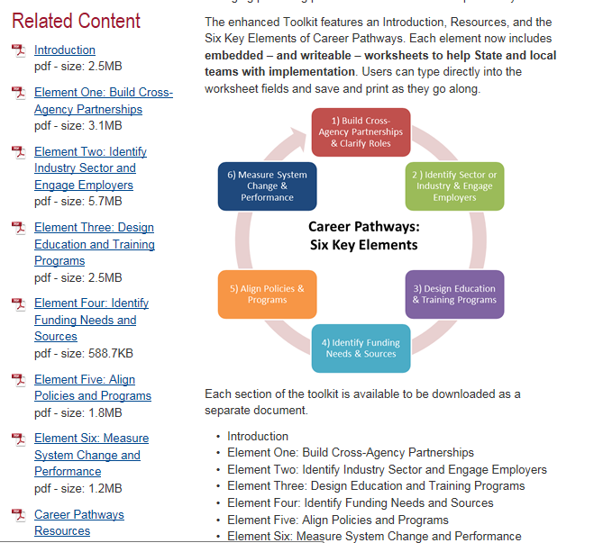
Toolkit Modules

Slide 57
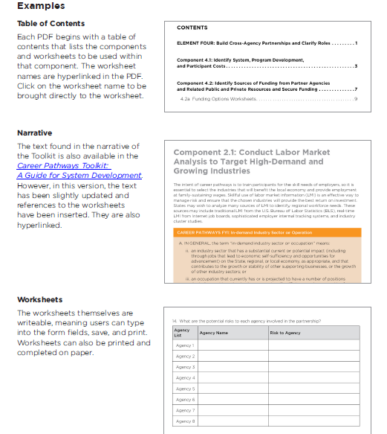
New Toolkit

Slide 58
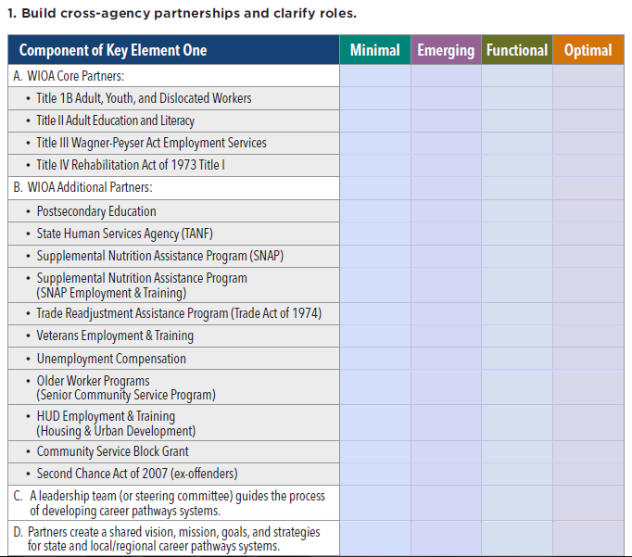
Introduction: Six Key Elements Readiness Checklist

Slide 59
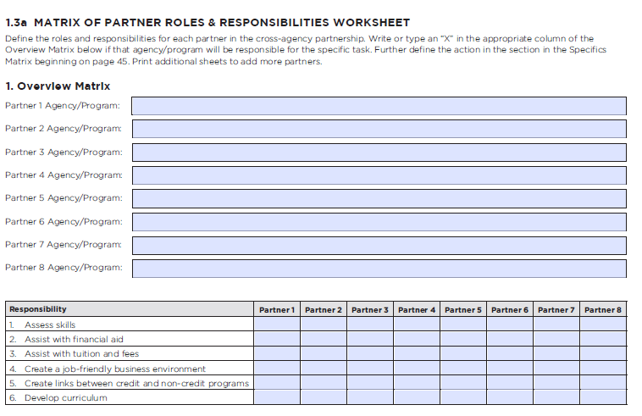
Element One: Building Cross-Agency Partnerships and Clarify Roles

Slide 60
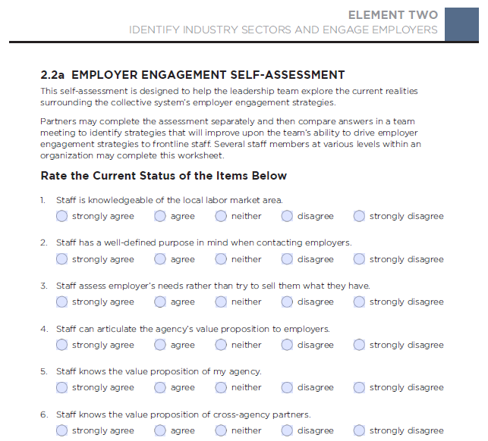
Element Two: Employer Engagement Self Assessment

Slide 61
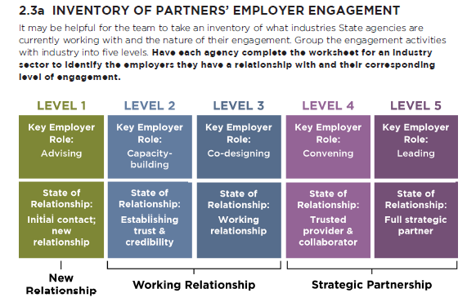
Element Two: Employer Engagement

Slide 62
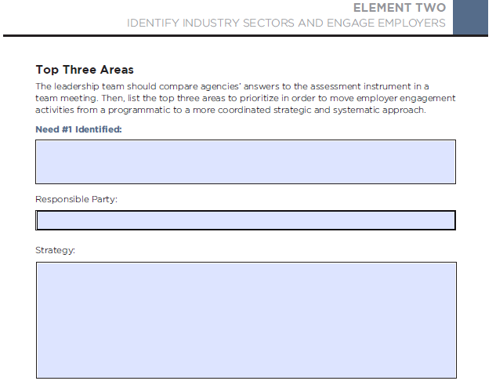
Element Two: Employer Engagement

Slide 63
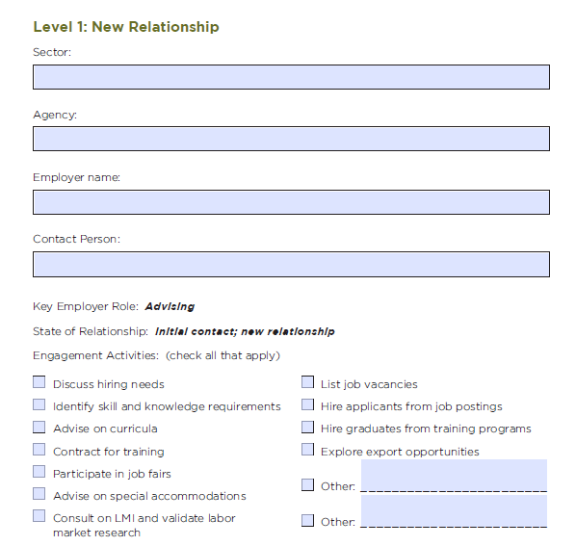
Element Two: Employer Engagement

Slide 64
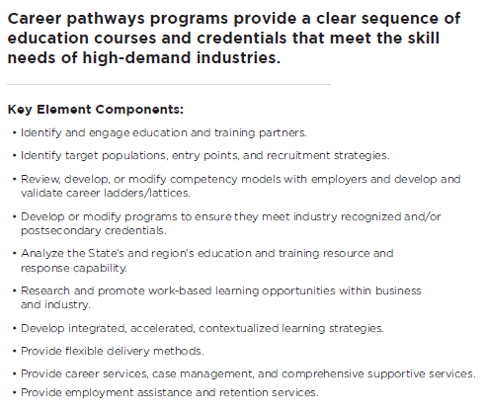
Element Three: Design Education and Training Programs

Slide 65
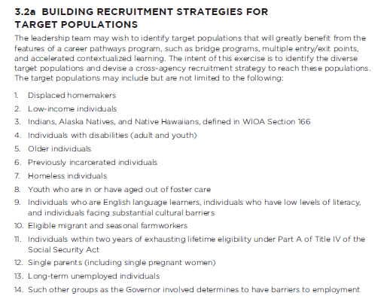
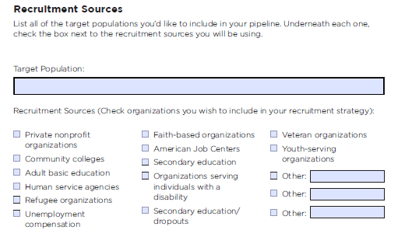
Element Three: Design Education and Training Programs

Slide 66
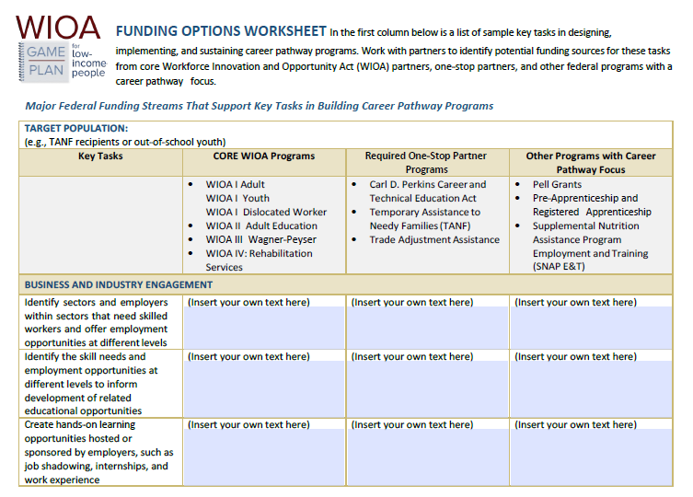
Element Four: Identify Funding Needs and Sources

Slide 67
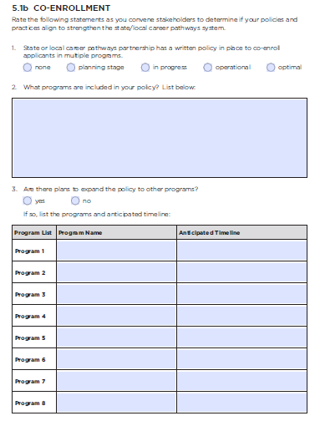
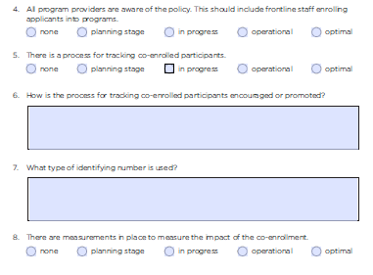
Element Five: Align Policies and Programs

Slide 68
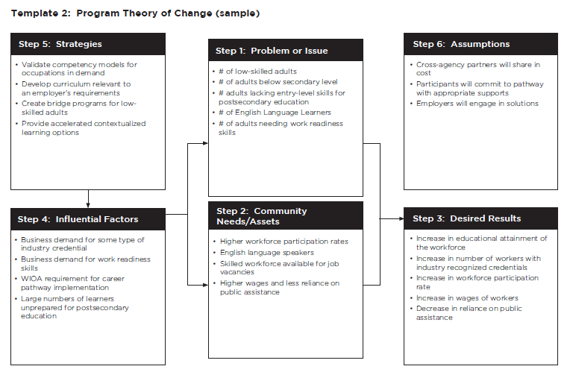
Element Six: Measure System Change and Performance

Slide 69
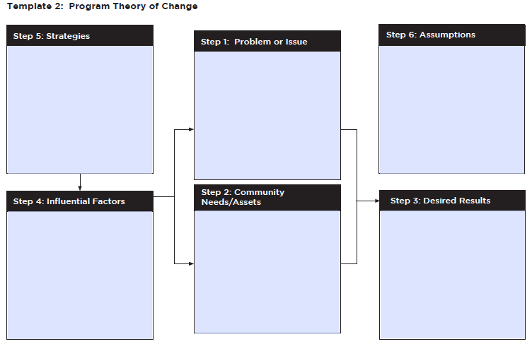
Element Six: Measure System Change and Performance

Slide 70
How might you and your team use this new enhanced toolkit?
Open Chat

Slide 71
How might the federal partners support your work in this area?

Slide 72
Final Module called “Career Pathway Resources” contains a variety of career pathways-related resources available online
Resources from ALL our federal partners
Resources categorized by type (e.g., report, webinar recording) and includes a brief description of the resource and a link to the website where the resource can be found
Available at www.careerpathways.workforcegps.org

Slide 73
