Slide 1
Voices of Opportunity:
Creating Resiliency and Building Community
U.S. DOL TAACCCT Grantee-Led Webinar | October 4, 2016

Slide 2
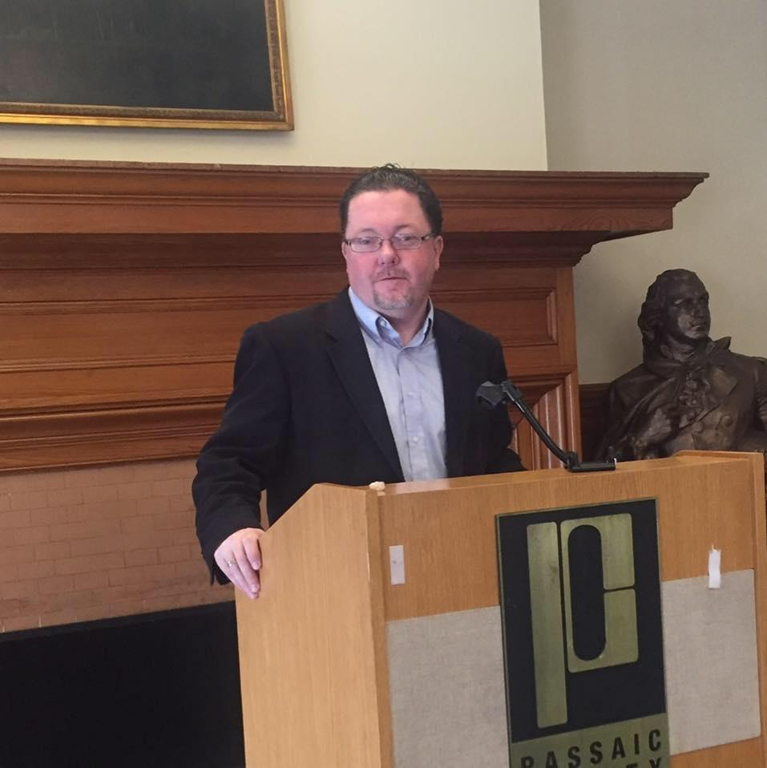
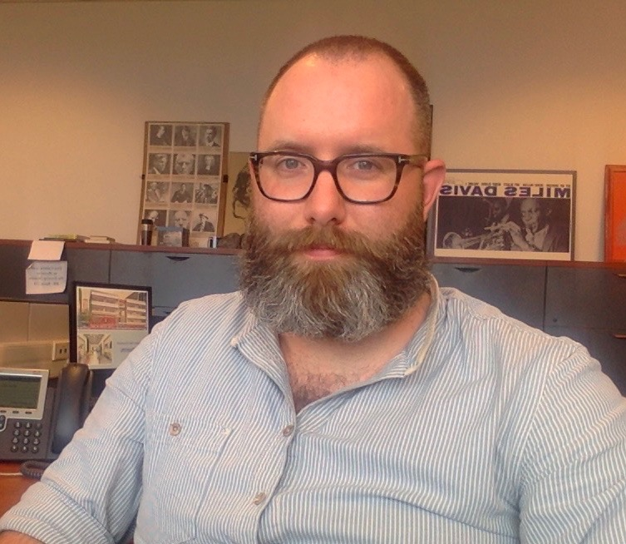
Who we are
Paul Casey
Director
Northeast Resiliency Consortium
Passaic County Community College
Meredith Hatch
Senior Associate Director
Workforce and Academic Alignment
Achieving the Dream, Inc.
Ed Fians
Content & Faculty Engagement Specialist
Northeast Resiliency Consortium
Part-Time Lecturer, Philosophy
Housatonic Community College
Voices of Opportunity: Creating Resiliency and Building Community 04Oct2016

Slide 3
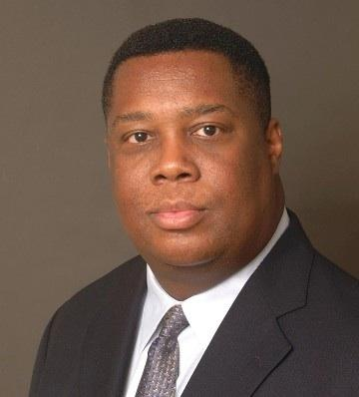
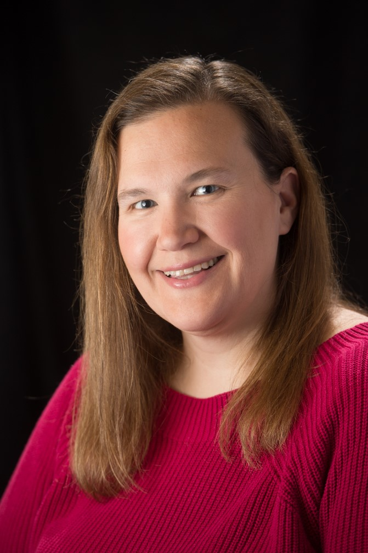
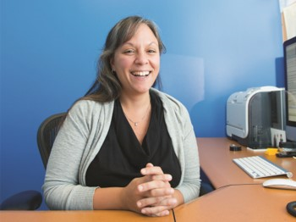
Who we are
Francesca Fiore
Assistant Dean
Workforce Development & Business Services
LaGuardia Community College
Sherwood L. Taylor
Director
Workforce Development
Atlantic Cape
Community College
Alese Mulvihill
Grant Coordinator
FORWARD program
Housatonic Community College
Voices of Opportunity: Creating Resiliency and Building Community 04Oct2016

Slide 4
Webinar overview
Introduction to our community
Why resiliency?
What does resiliency look like?
How are we integrating resiliency?
Q&A
Voices of Opportunity: Creating Resiliency and Building Community 04Oct2016

Slide 5
Poll
Who is on the webinar?
Poll with the following choices:
Administrator
Instructor
Student support staff (e.g., counselor, job developer)
Staff (other)
Why are you interested in this topic? (Write in answer)
Voices of Opportunity: Creating Resiliency and Building Community 04Oct2016

Slide 6
Why resiliency?
Our goals
Accelerate learning
Ensure students attain industry-recognized credentials
Foster innovative employer partnerships
Use new technologies
Deploy robust student support services
Our focus by sector
Healthcare
Information Technology
Environmental & Utility
Voices of Opportunity: Creating Resiliency and Building Community 04Oct2016

Slide 7
Voices of Opportunity: Creating Resiliency and Building Community 04Oct2016

Slide 8
Why resiliency?
Voices of Opportunity: Creating Resiliency and Building Community 04Oct2016

Slide 9
Why resiliency?
Using this link https://pollev.com/jffevents, please type at least one adjective to describe a resilient student
Voices of Opportunity: Creating Resiliency and Building Community 04Oct2016

Slide 10
What does resiliency look like?
Resiliency is an individual’s persistent development and application of knowledge, skills, and resources that effectively help one adapt to change and overcome adversity.
CRITICAL
THINKING
ADAPTABILITY
SELF-AWARENESS
REFLECTIVE
LEARNING
COLLABORATION
Purposeful use of reasoning to identify strengths and weaknesses of alternative approaches in diverse situations.
Successful adjustment to a variety of positive and negative conditions and circumstances.
Clear understanding of one’s qualities, characteristics, strengths and weaknesses, and how they impact one’s self and others.
Integration and application of prior and current learning to new situations.
Works with others to achieve a goal.
Voices of Opportunity: Creating Resiliency and Building Community 04Oct2016

Slide 11
Why resiliency?
Voices of Opportunity Collage
Close your eyes.
Listen.
When you hear something that reminds you of your experience OR notice a pattern in the words, type these into the CHAT FEED.
Voices of Opportunity: Creating Resiliency and Building Community 04Oct2016

Slide 12
What does resiliency look like?
Scenarios
Role play, group work, and reflective work: common techniques used across all sectors--all used in this one kind of activity
Service work = empathy, remembering when it was you...
Voices of Opportunity: Creating Resiliency and Building Community 04Oct2016

Slide 13
Resilient student
Viola is a 28-year-old part-time student (one TR morning course, one MW at night) with a four-year-old daughter; she doesn’t live with the father of the child. Viola works full-time—first, and occasionally, second shift. Her widowed mother who lives five minutes away helps out with getting her granddaughter to and from daycare, feeding her, and putting her to bed as needed. She’s training to be a social worker.
 She was offered a promotion to an off-her-feet, desk-jockey managerial position—regular 9-5 hours, more responsibility, more pay.
What should this person do?
What competency would he/she be performing?
Voices of Opportunity: Creating Resiliency and Building Community 04Oct2016

Slide 14
What does resiliency look like?
CRITICAL
THINKING
ADAPTABILITY
SELF-AWARENESS
REFLECTIVE
LEARNING
COLLABORATION
Purposeful use of reasoning to identify strengths and weaknesses of alternative approaches in diverse situations.
Successful adjustment to a variety of positive and negative conditions and circumstances.
Clear understanding of one’s qualities, characteristics, strengths and weaknesses, and how they impact one’s self and others.
Integration and application of prior and current learning to new situations.
Works with others to achieve a goal.
Voices of Opportunity: Creating Resiliency and Building Community 04Oct2016

Slide 15
Resilient faculty/staff
Charles retired from working as software engineer three years ago. He’s taken over two sections of the college’s introductory programming course. He was relatively well liked at his smaller company and was regularly tasked with mentorship of new hires; however, the company merged with another with mostly new leadership with larger multi-national-sized goals.
 The nature of IT: three years can be a decade or more in other fields in terms of new knowledge and skills.
What should this person do?
What competency would he/she be performing?
Voices of Opportunity: Creating Resiliency and Building Community 04Oct2016

Slide 16
Tools
Resiliency Competency Model
Curriculum Alignment Table
Instructional Design Table
Smart Sparrow lessons
Voices of Opportunity: Creating Resiliency and Building Community 04Oct2016

Slide 17
Resiliency Competencies

Slide 18
Competency codes
Critical thinking CT
Adaptability AD
Self-awareness SA
Reflective thinking RL
Collaboration CO
Voices of Opportunity: Creating Resiliency and Building Community 04Oct2016

Slide 19
Curriculum Alignment Table
Voices of Opportunity: Creating Resiliency and Building Community 04Oct2016

Slide 20
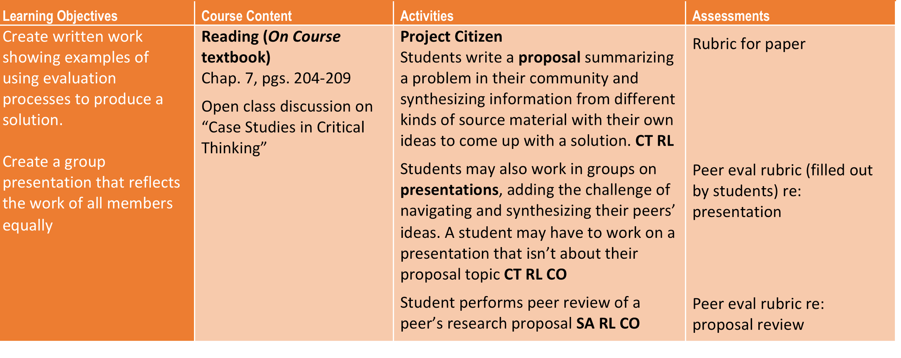
Curriculum Alignment Table
CCC IDS 105 College Success
Voices of Opportunity: Creating Resiliency and Building Community 04Oct2016

Slide 21
Instructional Design Table
Voices of Opportunity: Creating Resiliency and Building Community 04Oct2016

Slide 22
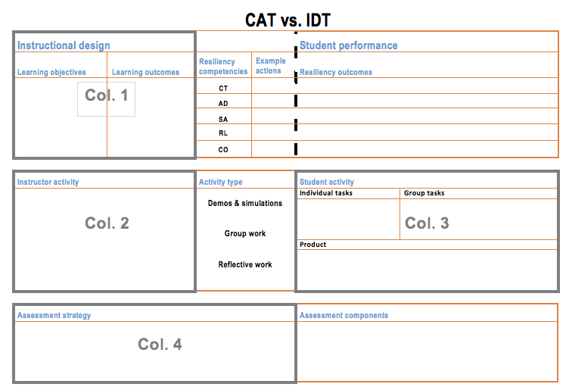
Instructional Design Table
Voices of Opportunity: Creating Resiliency and Building Community 04Oct2016

Slide 23
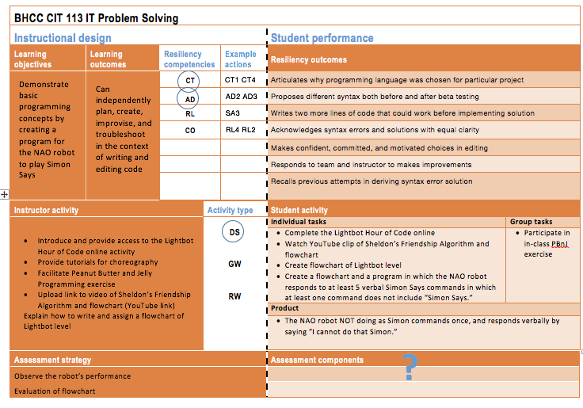
Instructional Design Table
Voices of Opportunity: Creating Resiliency and Building Community 04Oct2016

Slide 24
Smart Sparrow
Voices of Opportunity: Creating Resiliency and Building Community 04Oct2016

Slide 25
Smart Sparrow
Voices of Opportunity: Creating Resiliency and Building Community 04Oct2016

Slide 26
Impact
...on the institutional level
...at the faculty and staff level
...on the student
Voices of Opportunity: Creating Resiliency and Building Community 04Oct2016

Slide 27
Impact
Atlantic Cape Community College
Accelerate learning
Web-enhanced programs, crosswalking earned credits
Ensure students earn industry-recognized credentials
Employer partnerships, Crisis Prevention and Intervention
Foster innovative employer partnerships
Atlanticare Starts Program
Use new technologies
Simulation equipment, electronic textbook content
Deploy robust student support services
Development of our workforce team efforts to support student services
Voices of Opportunity: Creating Resiliency and Building Community 04Oct2016

Slide 28
Impact
Atlantic Cape Community College
Creation of new position: Program Coordinator, College & Career Pathways
College and Career Pathways Programs
Traditional PLA Program
Competency verification and portfolio development
Testing and Assessment
Marketing/Outreach (publications, events, web, presentations)
Reporting
Maintenance (master list, handbook)
New initiatives, new certifications
Costs, business models, and procedures
Voices of Opportunity: Creating Resiliency and Building Community 04Oct2016

Slide 29
Impact
Housatonic Community College
Community Health Worker program
CHW students are typically trusted community members, and many have never attended college.
MHFA training, self-care practices, and emotional trauma protection result in successful CHWs
Resiliency techniques used:
Motivational interviewing, conflict resolution, and communication techniques
Roleplay Scenario – CHW and Client
Client – provides negative feedback
CHW – uses methods to adapt and react
Voices of Opportunity: Creating Resiliency and Building Community 04Oct2016

Slide 30
Impact
Housatonic Community College
Community Health Worker program
Resiliency Techniques Used:
Graduation Ceremony
Utilize campus and community resources
Establish venue, provide food, & coordinate event
Goal #1 – Little-to-no cost
Goal #2 – Celebrate diversity
Other Collaborative Activities:
Coordinating a health fair
Developing a resource handbook
Promoting awareness events
Voices of Opportunity: Creating Resiliency and Building Community 04Oct2016

Slide 31
Impact
Housatonic Community College
Resiliency at Housatonic:
Building a culture of resiliency
Fun, comfortable atmosphere
How to adapt to college life
Topics include:
Classroom etiquette
Study skills
Communicating with your professor
Visit HCC’s FORWARD page to see example videos of our student orientation
Voices of Opportunity: Creating Resiliency and Building Community 04Oct2016

Slide 32
Impact
Housatonic Community College
Faculty Engagement:
Currently identifying faculty champions
Professional development opportunities
Resiliency Training at Professional Day (April 2016)
Freshmen Seminar Faculty Training (May 2016)
Using Artificial Intelligence to Develop Resiliency Skills (September 2016)
NRC Learning Event Faculty Institute (October 2016)
Voices of Opportunity: Creating Resiliency and Building Community 04Oct2016

Slide 33
Impact
LaGuardia Community College
S.A.V.E. EMT (Supporting Adults through Vocational EMT Training)
Designed for disadvantaged, non-traditional adults, reading at an 8th grade level
Comprehensive intake and support, contextualized basic skills instruction, team-taught curriculum
Supports student resiliency and places them on a sustainable career path in pre-hospital care
Voices of Opportunity: Creating Resiliency and Building Community 04Oct2016

Slide 34
Impact
LaGuardia Community College
Emergency medical personnel are uniquely positioned to prevent PTSD and other trauma related disorders
15-25% of traumatized patients will need long-term care for PTSD
LaGuardia’s eSCAPe curriculum addresses the effects of trauma in a prehospital care setting through Social Engagement, Choice and Control, Anticipation, and Planning and Organizing
Voices of Opportunity: Creating Resiliency and Building Community 04Oct2016

Slide 35
Impact
LaGuardia Community College
eSCAPe supports resiliency by making psychological competency an intrinsic part of the delivery of care
Students apply eSCAPe principles and concepts in practical skills sessions
Faculty participate in Train the Trainer workshops that teach the importance of psychological competency
More resilient students, employees, faculty, patients, and communities
Voices of Opportunity: Creating Resiliency and Building Community 04Oct2016

Slide 36
Impact
Bunker Hill Community College
Gaming/Computer Simulation:
NRC Resiliency competencies are being utilized across the curriculum by multiple departments
Mobile Apps Development
Big Data
Gaming / Computer Simulation
Web Development
By extension the competencies carry into non-NRC courses
BHCC is significant contributor to Smart Sparrow development
BHCC played a key role in the development of the NRC Resiliency Roundtables podcast
Voices of Opportunity: Creating Resiliency and Building Community 04Oct2016

Slide 37
Impact
Bunker Hill Community College
Web Development:
Program redesign based on NRC Resiliency Competency model
Four new development courses designed as NRC competency based (Spring 2017)
Will introduce Web NRC competencies for formal recognition by Curriculum Committee (Fall 2016)
Expand NRC competencies to all Web Development programs and certificates
Voices of Opportunity: Creating Resiliency and Building Community 04Oct2016

Slide 38
Impact
Students
To date, 565 students have enrolled in 25 resiliency-enhanced courses in programs of study relating to energy, healthcare, and information technology.
The retention or completion rate for these resiliency enhanced programs is 90%.
Voices of Opportunity: Creating Resiliency and Building Community 04Oct2016

Slide 39
Impact
Teachers
A small, creative, and (unironically) resilient group of users with direct impact on students’ lives and department-level pedagogy
The resiliency it takes/it took to introduce resiliency into coursework
has proven to be
is
must be
will actually be sustained if it remains
--a grassroots effort
Voices of Opportunity: Creating Resiliency and Building Community 04Oct2016

Slide 40
Impact
INFORMATION TECHNOLOGY
RE: Students & teachers
Ethical Hacking
HTML & Dreamweaver
Intro to Big Data
Intro to MIS
Intermediate Algebra with Technology
IT Problem Solving
Linux Fundamentals
Networking II
Maya Foundations
Mobile Apps
SQL Fundamentals
HEALTHCARE
Community Health Worker
Customer Healthcare Technology Specialist
EMT/Paramedic (Psychological Trauma)
Phlebotomy
ENVIRONMENTAL/ENERGY
STUDENT SUCCESS
Building Construction Systems
Green Ladders
Sustainable Resource Conservation
College/Student Success/FYE
Resiliency Bridge Training
Student Orientation
Voices of Opportunity: Creating Resiliency and Building Community 04Oct2016

Slide 41
Next Steps
SkillsCommons IMPACTcommunity: Storytelling Network IMPACTcommunity October 6 at 2:30pm EST
Prior Learning Assessment & Student Success Webinar October 6 at 1:00pm EST
NRC Resiliency Guidebook Webinar November 30 at 3:00pm EST
Pre-Conference Resiliency Workshop at DREAM 2017 February 21, 2017 in San Francisco, CA
Voices of Opportunity: Creating Resiliency and Building Community 04Oct2016

Slide 42
Questions?
Paul Casey pcasey@pccc.edu
Ed Fians efians@pccc.edu
Meredith Hatch mhatch@achievingthedream.org
Sherwood Taylor staylor@atlantic.edu
Alese Mulvihill amulvihill@hcc.commnet.edu
Francesca Fiore ffiore@lagcc.cuny.edu
Bryan Craven bcraven@bhcc.mass.edu
Voices of Opportunity: Creating Resiliency and Building Community 04Oct2016

Slide 43
Connect with us!
Voices of Opportunity: Creating Resiliency and Building Community 04Oct2016

Slide 44
Thank You!
Thank you for hanging out with us and sharing your ideas! Community-building is the very heart of this project and how it will keep going: individuals talking to each other about teaching resiliency.
"Voices of Opportunity: Creating Resiliency and Building Community” by the Northeast Resiliency Consortium is licensed under CC BY 4.0 This work is licensed under the Creative Commons Attribution 4.0 International License. To view a copy of this license, visit http://creativecommons.org/licenses/by/4.0/.
This workforce solution was funded by a grant awarded by the U.S. Department of Labor’s Employment and Training Administration. The solution was created by the grantee and does not necessarily reflect the official position of the U.S. Department of Labor. The Department of Labor makes no guarantees, warranties, or assurances of any kind, express or implied, with respect to such information, including any information on linked sites, and including, but not limited to accuracy of the information or its completeness, timeliness, usefulness, adequacy, continued availability or ownership.
Voices of Opportunity: Creating Resiliency and Building Community 04Oct2016

