Slide 1
WIOA Performance Accountability -
Core Programs
WIOA Wednesdays!
10/13/2016

Slide 2
Luke Murren (moderator)
U.S. Department of Labor
Employment and Training Administration
Karen Staha
U.S. Department of Labor
Employment and Training Administration
Cheryl Keenan
U.S. Department of Education
Office of Career, Technical, and Adult Education
Melinda Kaufman
U.S. Department of Education
Rehabilitation Services Administration

Slide 3
To provide stakeholders with a better understanding of the performance accountability provisions in Section 116 of WIOA and the accompanying regulation.
Part 1 – October 13, 2016
Performance reporting timeframes and requirements
Part 2 – November 2016
Performance reporting timeframes and requirements
The PIRL (DOL), RSA-911(RSA), NRS (OCTAE)
Participant and Reportable Individual Definitions
Statistical Adjustment Model and Negotiations
Sanctions

Slide 4
WIOA Vision
The workforce system will be characterized by three critical hallmarks of excellence:
The needs of business and workers drive workforce solutions;
One-Stop Centers (or American Job Centers) provide excellent customer service to jobseekers and employers and focus on continuous improvement; and
The workforce system supports strong regional economies and plays an active role in community and workforce development.
Across the system, continuous improvement is supported through evaluation, accountability, identification of best practices, and data driven decision making.

Slide 5
Themes of WIOA
Career Pathways
Employer engagement
Work-based learning
Sector strategies
Partnerships
Integrated Service Delivery
Data Systems
Performance measurement

Slide 6
Performance Accountability Provisions and Reporting Requirements

Slide 7
WIOA Regulations
Performance regulations (20 CFR part 677; 34 CFR part 361; and 34 CFR part 463) include:
Definition of terms
Indicators of performance
State performance reports
Establishing state levels of performance (negotiations)
Sanctions for failure to achieve adjusted levels of performance and/or failure to report
Local area performance (Title I programs)
Eligible Training Provider reporting (Title I programs)

Slide 8
WIOA Information Collection Requests
Joint Requirements (OMB No. 1205-0526)
Participant Individual Record Layout (PIRL) for jointly used data elements (ETA-9170)
RSA-911 contains joint PIRL data elements (OMB No. 1820-0508)
OCTAE’s NRS reporting tables contains joint PIRL data elements (OMB No. 1830-0027)
Annual Report template for states and local areas (ETA-9169)
Reporting cohorts for each indicator
Eligible Training Provider data element definitions (ETA-9171) – Title I only
Effectiveness in Serving Employers specifications

Slide 9
WIOA Information Collection Requests (cont.)
DOL Reporting Requirements (OMB No. 1205-0521)
Participant Individual Record Layout (PIRL) for ALL data elements to be reported to DOL (ETA-9172)
Quarterly Report template (ETA-9173)
Pay-for-Performance Report template (ETA-9174)
All found at www.doleta.gov/performance/reporting

Slide 10
WIOA Information Collection Requests (cont.)
RSA Reporting Requirements
RSA-911 Case Service Report (OMB No. 1820-0508)
All found at http://www2.ed.gov/rschstat/eval/rehab/911-data.html
Reporting Period | Collection Period | Collection Instrument | Case Type | Deliverable Date
Fiscal Year 2016 | October 1, 2015 – September 30, 2016 | RSA-911-14 | Closed | November 30, 2016
Fiscal Year 2017 | October 1, 2016 – June 30, 2017 | RSA-911-14 | Closed | August 15, 2017
Program Year 2017, First Quarter | July 1, 2017 – September 30, 2017 | RSA-911-16 | Open | November 15, 2017

Slide 11
WIOA Information Collection Requests (cont.)
AEFLA Reporting Requirements
WIOA Annual Statewide Performance Report template
AEFLA NRS Reporting Tables (OMB No. 1830-0027) – includes AEFLA tables, Narrative Report, Financial Report, and Data Quality Checklist
Documents available at:
www.doleta.gov/performance/reporting
http://www.nrsweb.org/foundations/tables.aspx

Slide 12
Primary Indicators of Performance
Part 1

Slide 13
Primary Indicators of Performance
Employment Rate 2nd Quarter after Exit
(Education/Employment for youth)
Employment Rate 4th Quarter after Exit
(Education/Employment for youth)
Median Earnings in the 2nd Quarter after Exit
Credential Attainment Rate
(of those who received training or education, excluding OJT or Customized Training)

Slide 14
Primary Indicators of Performance (continued)
5 types of measurable skill gains
(Participant based/1 gain/person/participation period)
Measurable Skill Gain
Secondary Diploma/ Equivalent
Progress toward Milestones
Secondary or Post-Secondary Transcript
Program Exit + Entry into Postsecondary Education
Educational Functioning Level Gain
Pre-Post Test
Completion of Carnegie Units
Passing Technical / Occupational Knowledge Based Exam

Slide 15
Primary Indicators of Performance (continued)
Effectiveness in Serving Employers
(States choose 2; shared outcome)
Retention with the same employer in the 2nd and 4th quarters after exit
Employer Penetration Rate
Repeat Business Customer Rate

Slide 16
WIOA Performance Accountability Part 2 will be held on Wednesday, November 2nd.

Slide 17
State and Grantee Performance Reporting
Part 2

Slide 18
Required Reports
WIOA State Annual Performance Report – Due October 15
WIOA Local Area Performance Report (Title I programs)
Submission of individual records (PIRL for Titles I and III; RSA-911 for Title IV); submission of NRS aggregate tables for Title II
Eligible Training Provider Reports (Title I programs)
DOL Narrative Report (not yet approved); Title II Narrative Report

Slide 19
Reporting Timeframes
Counts and outcomes based on a “first available” approach – same as current methodology.
All timing cohorts are available in the Joint ICR documentation.
First WIOA report is due on November 14, 2016* for Title I and III programs.
Quarterly reports due 45 days after the end of the quarter.
Annual Reports due October 15.
The annual and quarterly report templates can be found at doleta.gov/performance/reporting.

Slide 20
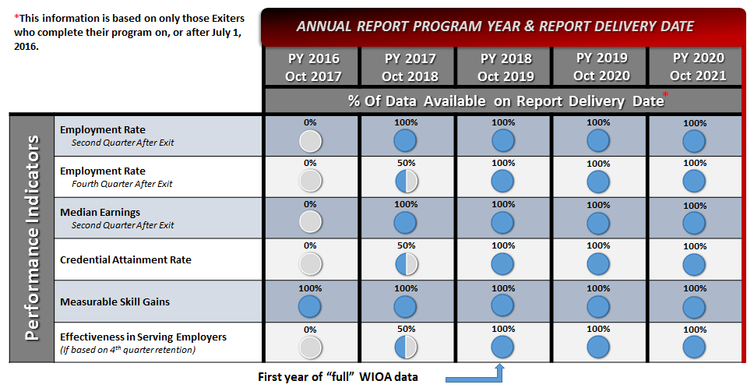
Data Availability

Slide 21
Workforce Integrated Performance System (DOL)
Will allow states/grantees to submit an individual record file OR support case management systems.
Uniform quarterly/annual reports will be automatically generated.
Common edit checks will be run to ensure accurate and consistent data.
Phase 1 (non-case management programs) went live on October 1, 2016.

Slide 22
RSA Data Reporting
Comma-delimited text file following the RSA-911 structure will be uploaded via a portal on rsa.ed.gov
Edit/validation checks will be run prior to the data being accepted
RSA will provide a list of edit checks
States will be asked to help test the system in Summer 2017.

Slide 23
DOL-Only PIRL
The Joint PIRL (ETA 9170) contains 76 data elements common to ED and DOL WIOA core programs.
States will NOT submit individual records using the Joint PIRL (ETA-9170).
States will collect and report data as required by the DOL specific PIRL ETA-9172 (DOL-only PIRL).
The DOL-only PIRL contains within it all of the common elements found in the Joint PIRL.
The data elements are coded with an “R” to indicate which funding streams require which elements.
DOL will aggregate and calculate the indicators of performance using the data submitted using the DOL-only PIRL.

Slide 24
RSA-911
States will collect and report data as required by the RSA-911 (OMB No. 1820-0508)
The RSA-911 contains 393 data elements, including the common elements found in the Joint PIRL.
Each of the data elements includes information on when it is reported (e.g., at application, at exit)
The RSA-911 is structured to group elements by the general time in which they will be reported
RSA will aggregate and calculate the indicators of performance for VR using the data submitted via the RSA-911.

Slide 25
AEFLA-NRS
The AEFLA-only NRS reporting tables (OMB No. 1830-0027) collect aggregate data and contains within it all of the common elements found in the Joint PIRL.
States will submit aggregate and disaggregated data to OCTAE, and states will calculate the indicators of performance using the data submitted through the NRS reporting tables.

Slide 26
Period of Participation
Reportable Individual
Provides identifying information;
Only uses the self-service system;
Only receives information-only services or activities;
Not included in performance outcomes.
Date of Program Entry (PIRL element 900), tracks the Date of Program Entry by requiring the initial service delivery date.
This data element must be collected for all participants.
Participant
Reportable individual;
Received services OTHER than the services described in
§ 677.150(a)(3);
Satisfies applicable programmatic requirements for the provision of services.

Slide 27
Negotiations
WIOA requires 4 elements to be considered during performance level negotiations.
How the levels involved compare with the adjusted levels of performance established for other states
An objective statistical adjustment model
The extent to which the levels involved promote continuous improvement
The extent to which the levels involved will assist the state in meeting goals established in accordance with the Government Performance and Results Act

Slide 28
Statistical Adjustment Model
The Departments have developed a fixed effect model to estimate State level performance outcomes.
A summary of the model is in Attachment II of TEGL 26-15; the full description is found on www.doleta.gov/performance
The model considers participant characteristics and the economic conditions in which they were served
For Titles I and III, the new WIOA outcomes were calculated using existing WIA and Wagner-Peyser individual records, dating back to PY2005 (PY2012 for WP).
The results of the Statistical Adjustment Model for titles I and III can be found at www.doleta.gov/performance/reporting, in Attachment IIIB (Negotiations Tool) of TEGL 26-15.

Slide 29
Sanctions
Table 1. State Program Score and State Indicator Scores
Indicator/Program | Title II Adult Education | Title IV Rehabilitative Services | Title I Adults | Title I Dislocated Workers | Title I Youth | Title III Wagner - Peyser | Average Indicator Score
Employment 2nd Quarter After Exit |  |  |  |  |  |  | 1
Employment 4th Quarter After Exit |  |  |  |  |  |  | 2
Median Earnings 2nd Quarter After Exit |  |  |  |  |  |  | 3
Credential Attainment Rate |  |  |  |  |  |  | 4
Measurable Skill Gains |  |  |  |  |  |  | 5
Effectiveness in Serving Employers |  |  |  |  |  |  | 6
Average Program Score | 7 | 8 | 9 | 10 | 11 | 12 | -
Sanction determination based on ACTUAL ÷ NEGOTIATED outcomes
Each “score” is plotted in this table; the outside numbered boxes represent the average across/down the rows/columns

Slide 30
Sanctions (cont.)
Financial sanctions based on performance failure will be applied to states if, for 2 consecutive years, the state fails to meet:
(1) 90 percent of the overall State program score for the same core program;
(2) 90 percent of the overall State indicator score for the same primary indicator; or
(3) 50 percent of the same indicator score for the same program.
Failure to report the WIOA State annual report and/or state ETP report may also lead to financial sanction
Determination of sanctions will be “phased in,” based on data availability

Slide 31
What’s Next?
Guidance
Technical Assistance
Amended ICRs
Revised data sharing agreements

Slide 32
Performance Guidance Preview
Follow-up to two performance ICRs
Joint guidance with ED
Lots of material is covered
Including questions received from DOL and ED staff and state representatives
We asked 100 people, “What topics are you most interesting in reading about in the upcoming WIOA Performance Accountability guidance document”?

Slide 33
Employment and Training Administration programs:
ETAperforms@dol.gov
www.doleta.gov/performance
www.doleta.gov/wioa
Office of Career, Technical, and Adult Education programs:
AskAEFLA@ed.gov
www.ed.gov/AEFLA
Rehabilitation Services Administration programs:
Contact State Liaison; listing at https://rsa.ed.gov/people.cfm

