Slide 2
Joint Guidance on Data Matching to Facilitate WIOA Performance Reporting and Evaluation
Dale King, U.S. Department of Education
Pam Mertens, U.S. Department of Labor
Agnes Wells, U.S. Department of Labor
Presented by:
Oct. 19, 2016
The U.S. Department of Education & The U.S. Department of Labor

Slide 3
Pam Mertens
Supervisory UI Specialist
Employment and Training Administration, U.S. Department of Labor
Dale King
Director
Family Policy Compliance Office, U.S. Department of Education
Agnes Wells
UI Program Specialist
U.S. Department of Labor

Slide 4
Provide an overview of WIOA and the joint guidance
Provide an overview of the Federal laws and regulations governing the use and disclosure of records
Family Educational Rights and Privacy Act (FERPA) at 34 CFR 99
VR regulations at 34 CFR 361.38
DOL regulations at 20 CFR part 603

Slide 5
WIOA Overview
The following final rules were published in the Federal Register (FR) on August 19, 2016:
DOL’s Workforce Innovation and Opportunity Act,
ED’s and DOL’s Workforce Innovation and Opportunity Act: Joint Rule for Unified and Combined State Plans, Performance Accountability, and the One-Stop System Joint Provisions
ED’s State Vocational Rehabilitation Services Program; State Supported Employment Services Program; Limitations on Use of Subminimum Wage and Programs, and
ED’s Activities Authorized by the Adult Education and Family Literacy Act (Title II of the Workforce Innovation and Opportunity Act).

Slide 6
Key Goals of WIOA
Helps job seekers access employment, education, training and support services
Matches employers with skilled workers
Reaffirms the role of the customer- focused one-stop delivery system
Mandates enhanced and increased coordination among key employment, education, and training programs
Focuses on performance accountability for the WIOA core programs

Slide 7
Performance Accountability and WIOA Core Programs
WIOA requires each of the core programs to be accountable for primary indicators of performance.
Adult, Dislocated Worker, and Youth programs administered by DOL
AEFLA program administered by ED
Employment Service program administered by DOL
VR program administered by ED

Slide 8
Performance Reporting
Core programs must use quarterly wage records to measure the progress of the State on the State and local performance accountability indicators.
Quarterly wage records include both interstate and intrastate wages paid to an individual.
States are required to conduct ongoing evaluations of the core programs.
ETPs under the Adult and Dislocated Worker programs must report employment outcomes for all individuals participating in an eligible program of study.
Other State or Federal laws may require reporting of employment outcomes.

Slide 9
Performance Reporting and Data Privacy and Confidentiality
Matching records to meet WIOA performance accountability, reporting, and evaluation requirements raises complex issues regarding privacy and confidentiality.
Multiple Federal laws must be considered when conducting data matching for WIOA reporting performance.
States may choose to provide greater privacy and confidentiality protections.

Slide 10
Federal Laws and Regulations Governing Use and Disclosure of Records
Family Educational Rights and Privacy Act (FERPA) regulations at 34 CFR 99
Governs the use and disclosure of personally identifiable information (PII) from education records
VR regulations at 34 CFR 361.38
Govern the use and release of personal information from VR records
DOL Regulations at 20 CFR Part 603
Govern the use and release of confidential UC information from wage records by States and State UC agencies that administer State UC laws

Slide 11
Family Educational Rights and Privacy Act (FERPA)
A Federal privacy law that affords parents the right to—
have access to their children’s education records,
seek to have the records amended, and
consent to the disclosure of personally identifiable information from education records, except as provided by law.
When a student turns 18 years old, or enters a postsecondary institution at any age, the rights under FERPA transfer from the parents to the student (“eligible student”).

Slide 12
Entities Covered Under FERPA
Educational agencies and institutions (schools, districts, postsecondary institutions)
AEFLA-eligible providers that are LEAs and postsecondary institutions
Postsecondary institutions that are ETPs

Slide 13
Entities Not Covered Under FERPA
VR agencies
State educational agencies
Community- or faith-based organizations
Public or private nonprofit agencies
Volunteer organizations
Libraries
Public housing authorities

Slide 14
Records Covered Under FERPA
Education records are those records that, with certain exceptions, are:
directly related to a student; and
maintained by an educational agency or institution, or by a party acting for the agency or institution.
Individual records of participants under WIOA are only education records protected by FERPA if they meet the above definition.
Only records of students who are or who have been in attendance at an educational agency or institution are education records.

Slide 15
Records Not Covered Under FERPA
Participant records created and maintained by eligible providers that are not educational agencies or institutions, such as non-profit organizations
Participant records created and maintained by eligible providers that are educational agencies or institutions and eligible individuals are not students enrolled in educational agencies or institutions
Participant records of VR programs

Slide 16
Disclosing Education Records
A parent or eligible student shall provide a signed and dated written consent before a school may disclose education records, except for specific exceptions.
The exception to consent most applicable to matching education records and UC wage records is FERPA’s audit or evaluation exception.

Slide 17
Audit or Evaluation Exception
Permits the disclosure of PII from education records without consent to authorized representatives of State or local educational authorities
PII from education records must be used to audit or evaluate a Federal- or State-supported education program, or to enforce or comply with Federal legal requirements that relate to those education programs

Slide 18
State or Local Educational Authority
Each State designates one or more agencies or entities that are responsible for and authorized under local, State, or Federal law to supervise, plan, coordinate, advise, audit, or evaluate elementary, secondary, or postsecondary Federal- or State-supported education programs and services in the State (i.e., State educational agency, an LEA, and a State postsecondary commission).
State agencies other than a State educational agency or State postsecondary commission might, depending on State law, also be a “State educational authority” under FERPA.
An LEA is generally considered to be both an educational agency and a local educational authority.

Slide 19
Authorized Representative
A State or local educational authority may designate an individual or entity, including a contractor or other government agency, to be its authorized representative.
The State or local educational authority may then disclose PII from education records to its authorized representative or permit its authorized representative to obtain access to PII from education records, without the prior written consent of the parent or eligible student.
Example: the State educational authority may designate a State UC agency as its authorized representative for the purpose of conducting an audit or evaluation of a Federal- or State-supported education program.

Slide 20
Conditions Governing Disclosures to Authorized Representatives
Used to audit or evaluate a Federal- or State-supported education program, or to enforce Federal legal requirements that relate to those education programs.
Use reasonable methods to ensure to the greatest extent practicable that its authorized representative is FERPA-compliant.
Must be a written agreement between the State or local educational authority and its authorized representative.
Educational authority must authorize any further disclosure to be made and ensure that all other FERPA requirements are met.

Slide 21
Education Program
Any program that is principally engaged in the provision of education, including, but not limited to, early childhood education, elementary and secondary education, postsecondary education, special education, job training, career and technical education, adult education, and any program that is administered by an educational agency or institution.
ED interprets the core programs to be education programs under FERPA for the purpose of conducting required core program audits or evaluations.

Slide 22
Vocational Rehabilitation (VR) Provisions: 34 CFR 361.38
Govern the protection, use, and release of personal information held by VR agencies
VR agencies are not considered educational agencies or institutions under FERPA
Must develop policies and procedures to safeguard the confidentiality of all personal information
No Federal requirement that a VR agency obtain informed written consent from the individual prior to releasing personal information for purposes directly related to the administration of the VR program, or for audit, evaluation, or research purposes
No specific VR content requirements for data exchange agreements; however, such agreements must be consistent with statutory and regulatory requirements of 34 CFR 361.38

Slide 23
VR Policies and Procedures to Safeguard Confidentiality
Include a requirement that data only be released when governed by a written agreement
Inform through appropriate modes of communication of the confidentiality of personal information and the conditions for accessing and releasing this information
Inform about the VR agency’s need to collect personal information and the policies governing its use
Provide explanation of policies and procedures to each individual in that individual's native language or through the appropriate mode of communication
Provide no fewer protections for individuals than State laws and regulations
Make clear that some VR records are needed to comply with WIOA performance accountability requirements and will be matched with State quarterly wage records.

Slide 24
Release of Personal Information for Audit, Evaluation, and Research
The information will be used only for the purposes for which it is provided;
The information will be released only to persons officially connected with the audit, evaluation, or research;
The information will not be released to the involved individual;
The information will be managed in a manner to safeguard confidentiality; and
The final product will not reveal any personal identifying information without the informed written consent of the involved individual or the individual's representative.

Slide 25
DOL Confidentiality and Disclosure Regulations: 20 CFR Part 603
DOL’s confidentiality and disclosure regulations at 20 CFR Part 603 govern the disclosure of wage records by States and State UC agencies
States are required to maintain the confidentiality of “any UC information which reveals the name or any identifying particular about any individual or any past or present employer or employing unit, or which could foreseeably be combined with other publicly available information to reveal any such particulars.”
Confidential UC information, including wage records, may not be disclosed except as permitted by 20 CFR Part 603

Slide 26
Mandatory and Permissive Disclosures
Mandatory disclosures – 20 CFR 603.6
Permissive disclosures – 20 CFR 603.5
Information necessary for proper and efficient administration of the UC program
Examples: TANF, child support enforcement, HUD, SNAP, and other Federal programs
The regulation permits disclosure under certain circumstances as long as the disclosure does not interfere with the proper and efficient administration of the UC program

Slide 27
Exceptions in 20 CFR 603.5 That Permit Disclosure of Wage Records
Examples of permissive disclosures under 20 CFR 603.5:
Disclosures on the basis of informed consent
Disclosures to public officials for use in the performance of official duties
Disclosures to agents or contractors of public officials

Slide 28
Informed Consent
States may disclose confidential UC information on the basis of informed consent
The entity requesting the information must obtain a written, signed release from the individual or employer whose information is being sought
The release must include a statement specifically identifying the information to be disclosed, the specific purpose for the disclosure, and all parties who may receive the information
The purpose for the disclosure must be limited to providing a service or benefit to the individual, or carrying out administration or evaluation of a public program to which the release pertains.

Slide 29
DOL Confidentiality and Disclosure Regulations: Informed Consent
Educational agencies and institutions, VR agencies, other partner programs under WIOA, and other entities, may obtain individuals’ UC wage data by informed consent if permitted by State law.
The requirements of section 603.5(d)(2)(i) (specifying the elements that must be included in a written, signed release) and section 603.10 (regarding the disclosure agreement between the entity requesting the information and the State UC agency) must be met for informed consent disclosures.

Slide 30
Disclosures to Public Officials
Under 20 CFR 603.5(e), disclosure of confidential UC information to a public official for use in the performance of his or her official duties is permissible when authorized by State law
“Public official” is defined in 20 CFR 603.2(d)(1) as “an official, agency, or public entity within the executive branch of Federal, State, or local government who (or which) has responsibility for administering or enforcing a law, or an elected official in the Federal, State, or local government.”

Slide 31
Public Postsecondary Educational Institutions as Public Officials
Under 20 CFR 603.2(d)(2) through (5), the definition of “public official” specifically includes:
Public postsecondary educational institutions which are part of the State's executive branch
Public postsecondary educational institutions which are independent of the State’s executive branch
Publicly governed, publicly funded community and technical colleges
Performance accountability and customer information agencies (PACIAs)
The chief elected official of a local Workforce Development Area
A State educational authority, agency, or institution, as those terms are used in FERPA, to the extent they are public entities

Slide 32
What Are “Official Duties?”
“Official duties” is defined in 20 CFR 603.5(e)(1) to mean administration or enforcement of law, or the execution of the official responsibilities of a Federal, State, or local elected official
In addition, 20 CFR 603.5(e)(2) includes in the definition of “official duties” the use of confidential UC information for WIOA performance accountability purposes

Slide 33
What About Non-Public Service Providers?
Only public postsecondary educational institutions that fit the 603.2 definition of public official may receive confidential UC information
All other education service providers may receive only aggregate information, unless they obtain a written, signed informed consent for each individual whose information is being sought

Slide 34
Disclosures to Agents or Contractors of Public Officials
20 CFR 603.5(f) permits disclosure of confidential UC information to an agent or contractor of a public official
The data sharing agreement must hold the public official responsible for ensuring that the agent or contractor complies with all safeguards and security requirements
The agent or contractor may not redisclose the information except as permitted by 20 CFR 603.9(c)

Slide 35
Requirements for Agreements
Before any disclosures take place, 20 CFR 603.10 requires the State UC agency to enter into a written, enforceable agreement with the agency or entity requesting confidential UC information
This is required for disclosures on the basis of informed consent and for disclosures to public officials and their agents or contractors
Similar to requirements under FERPA for disclosures to authorized representatives – see Attachment 2 in joint guidance
A written agreement is required for sharing personal information with another entity for either audit or evaluation purposes or for another program’s purpose.

Slide 36
Requirements for Agreements
Agreements must include:
A description of the specific information to be furnished and the purposes for which the information is sought
Provision for paying the State or State UC agency for the costs of furnishing the information – see 20 CFR 603.8
Provision for safeguarding the information disclosed – see 20 CFR 603.9
Provision for on-site inspections of the agency, entity, or contractor to ensure that the requirements of the agreement are being met

Slide 37
Options for Matching VR, Education and UI Wage Data
Joint guidance provides options States may use when matching records for performance accountability reporting purposes under WIOA, as well as for audits and evaluations of WIOA core programs
Discusses both options for inter- and intra-state matching of records
Not intended as an exhaustive list of options

Slide 38
Option 1:
A State Educational Authority Discloses PII from Education Records to the State UC Agency as its Authorized Representative

Slide 39
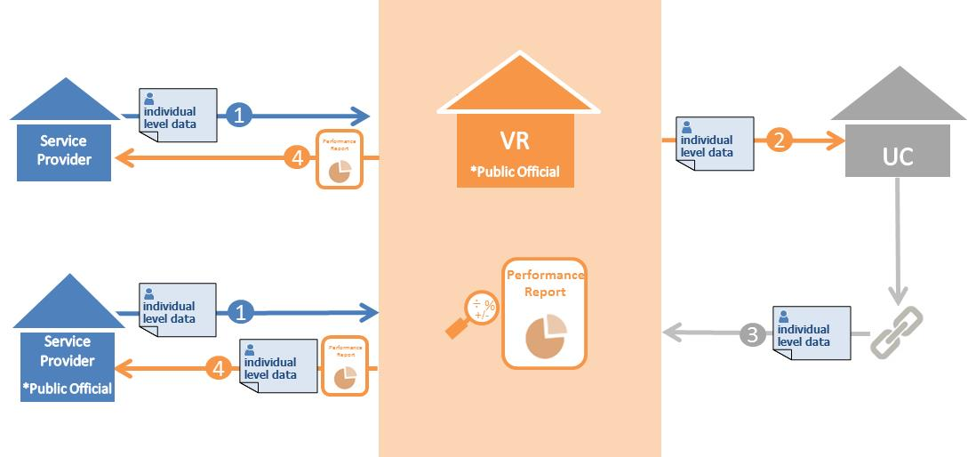
Option 6:
A State VR Agency Discloses Personal Information to the State UC Agency for Conducting an Audit or Evaluation of the VR Program

Slide 40
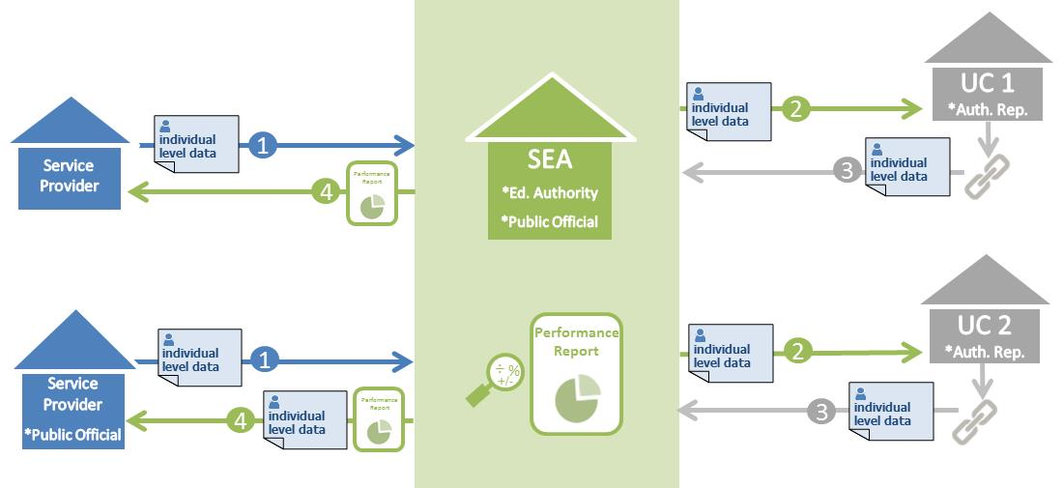
Option 7:
Multiple State UC Agencies as Authorized Representatives

Slide 41
Wage Record Interchange System 2
Extends the WRIS record-sharing model to non-DOL programs that are partners in the workforce system.
Allows these partner programs access to aggregate data through Third Party agreements with the Performance Accountability and Customer Information Agencies (PACIAs).
Existing WRIS2 agreement requires that any data exchange be conducted in a manner consistent with FERPA and applicable State law
Departments and States are working together to develop an agreement that continues the processing of interstate requests, is consistent with WIOA and addresses FERPA compliance.
We will provide further guidance regarding the re-negotiated data sharing agreement that will replace WRIS and WRIS 2 agreements when it/they are finalized.
Options 8 provide information on how to match individual level data with interstate wage records through the PACIA.

Slide 42
Governor Designates the Educational Authority as a PACIA
Educational institutions can disclose PII to the educational authority/PACIA.**
Educational authority/PACIA can query the WRIS2 for the purpose of ETP performance reporting.
Under WRIS and WRIS2, the PACIA may return only aggregate data to the educational institution.
** the Governor may only designate an Educational Authority under the definition of a PACIA in the WRIS/WRIS2 Agreements: which limits designation to those entities responsible for performance reporting under WIA Title IB

Slide 43
Option 8:
WRIS 2 - Requestor Not Subject to FERPA

Slide 44
Option 8:
WRIS 2 - Requestor Subject to FERPA and not Educational Authority as a PACIA

Slide 45
Where can I go for help?
WIOA Resource page:
https://www.doleta.gov/wioa/
Family Policy Compliance Office
Telephone: 202-260-3887
Email: FERPA@ed.gov
Website: www.ed.gov/fpco
Privacy Technical Assistance Center
Telephone: 855-249-3072
Email: privacyTA@ed.gov
Website: http://ptac.ed.gov
Office of Unemployment Insurance
Agnes Wells
Telephone: 202-693-2996
Email: Information.StateUILegal@dol.gov
Email: WRIS@dol.gov
website: http://doleta.gov/performance/wris_2.cfm

