Slide 1
REGS 101
Local Workforce Development Boards Under WIOA:
What you need to know
Employment and Training Administration
October 26, 2016

Slide 3
Today’s Moderator
Frank Stluka,
  Regional Director
  Office of State Systems
  Region 4, Dallas

Slide 4
Heather Fleck,
  Unit Chief, Governance, Office of Workforce Investment, ETA
Christina Eckenroth
  Executive Assistant, Office of the Regional Administrator, ETA Region 1, Boston
Roseana Smith
  Chief, Division of Workforce Investment, ETA Region 4, Dallas

Slide 5
The Workforce Innovation and Opportunity Act (WIOA) created smaller, nimbler, more strategic State and Local Boards.
Today we will:
  Explain key requirements for Local Board functions.
  Discuss key transparency and internal controls provisions

Slide 6
Functions of a Local Board
Consumer Choice and Training
Sunshine Policy
Staffing a Local Board
Local Board as Direct Provider
Functions of a fiscal agent
Internal controls and conflicts of interest

Slide 7

WIOA Vision
The workforce system will be characterized by three critical hallmarks of excellence:
  The needs of business and workers drive workforce solutions;
  One-Stop Centers (or American Job Centers) provide excellent customer service to jobseekers and employers and focus on continuous improvement; and
  The workforce system supports strong regional economies and plays an active role in community and workforce development.
Across the system, continuous improvement is supported through evaluation, accountability, identification of best practices, and data driven decision making.

Slide 8

Local Boards Are Key to WIOA
Local Boards are key to implementing WIOA Priorities:
Career Pathways
Employer engagement
Work-based learning
Sector strategies
Partnerships
Integrated Service Delivery

Slide 9
Local Board Vision
Serve as the strategic leader and convener of local workforce development system stakeholders.
Partner with employers and with the workforce development system
Support regional economies, and development of sector strategies and career pathways
Support high quality, customer centered service delivery.

Slide 10
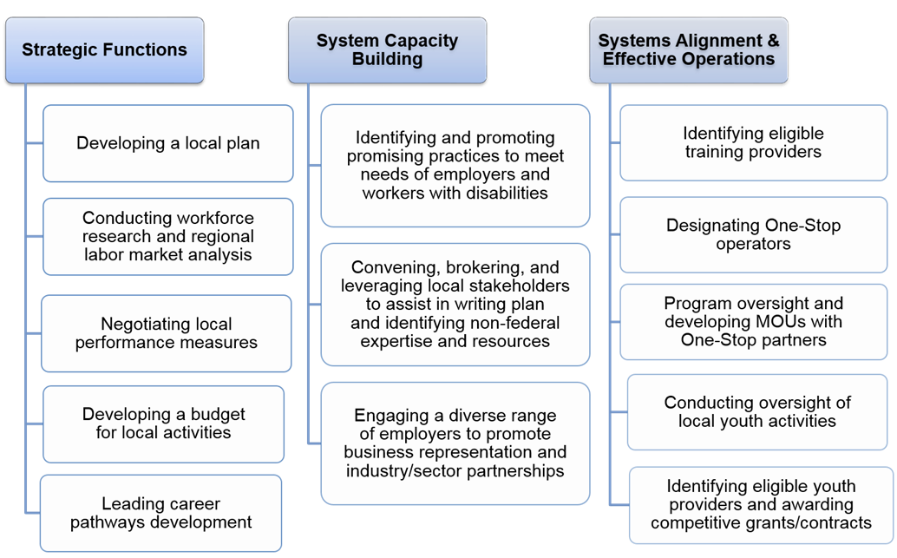
Local Board responsibilities
Selecting One-Stop Operators

Slide 11
Strategic Boards Tool Kit on ION
https://ion.workforcegps.org/resources/2016/06/27/09/30/Strategic_Board_Toolkit_Vision

Slide 12
Highlighted Responsibilities:
Today we are highlighting the following:
  679.370 (i) Oversight, monitoring use of funds, maximizing performance
  679.370 (l) Provider selection and termination.
  679.370 (m) Ensuring sufficient number and type of providers. And, competitive integrated employment.
  679.370 (o) Develop local area budget

Slide 13
Open-ended Polling question
With which functions would Local Boards appreciate technical assistance?

Slide 14

Consumers want choices!
679.380: Consumer Choice Requirements
Local Workforce Development Boards MUST provide consumers with choices for career and training services.

Slide 15
Training Providers
Maintain a comprehensive and current list of Eligible Training Providers
Ensure it is accessible, user-friendly
Includes providers who:
  specialize in serving individuals with disabilities and
  have expertise with adult education and literacy activities
Case managers and participants walk through the list together

Slide 16

Career Service Providers
Explore menu of career services and service providers in the community
Award contracts when needed
  Specialize in assisting individuals with disabilities prepare for and find employment
  Expertise in adult education and literacy

Slide 17
Things To Consider…
How do you know if you are meeting the customer choice requirements?
Are staff familiar with the list of Eligible Training Providers?
Are participants spread out across training providers?
Is there one provider of career services in the local area who has been doing it for more than a decade?
What percentage of your participants are individuals with disabilities?

Slide 18

Pop Quiz
Which of the options below illustrate ways in which a Local WDB may satisfy WIOA’s consumer choice requirements for training/career services?
  Option 1: Train case managers on the use of the ETPL
  Option 2: Offer both Coke and Pepsi in the vending machines
  Option 3: Competitively award contracts for career services providers
  Option 4: Require that the ETPL include performance and cost information on all training providers
  Option 5: Options 1, 3 and 4 above

Slide 19

“Let the Sun Shine In”
679.390: Sunshine Policy
Local Workforce Development Boards MUST conduct business in an Open Manner

Slide 20

How?
Be Accessible. Available to the public, on a regular basis through electronic means and open meetings

Slide 21
What’s Covered?
6 Things to Know from 679.390
Information about the Local Plan, or modification to the Local Plan, before submission of the plan;
List and affiliation of Local WDB members;
Selection of one-stop operators;
Award of grants or contracts to eligible training providers of workforce investment activities including
  Workforce investment activities;
  Providers of youth workforce investment activities;
Minutes of formal meetings of the Local WDB; and
Local WDB by-laws, consistent § 679.310(g)

Slide 22
Cloudy with a Chance of Violation
“Of course our information is publically available—just come to the office between 9am-4pm Tuesday – Thursday and ask the secretary to see the binder at her desk.”
“Our information is totally public. We post the members on the bulletin board at the One Stop. Anyone in the One Stop can see it.”
“We have a website where we post our members and our annual meeting. You can get a copy of the plan by request.”

Slide 23

Full Sunshine. Clear Skies.
“Go to our website for all the members, the dates and locations of our meetings, notes, and bylaws.
Read our plan. Looking for a service provider? Interested in being a service provider?
Check out our website, updated regularly.”

Slide 24

Pop Quiz
Which are covered under the Sunshine Policy?
Option 1: Information about the Local Plan, or modification to the Local Plan, before submission of the plan;
Option 2: Including the weather forecast for meetings
Option 3: Selection of one-stop operators
Option 4: Option 1 and 3
Make available to who?
Option 1: The public
Option 2: Board Members Only
Option 3: One Stop patrons
Make available when?
Option 1: Annually
Option 2: Regularly
Option 3: When the Webmaster remembers

Slide 25

Now Hiring
679.400: Staffing the Local WDB
Local Workforce Development Boards MAY hire a Director and other staff to help carry-out the boards’ functions.

Slide 26

What are the parameters?
Establish and apply an objective set of qualifications for the director
    Ensure workforce experience, skills & abilities
Assist board with its required WIOA functions
    Exceptions require a written agreement as described in 679.430

Slide 27

What are the parameters?
Salary and bonus limitations (679.400(c))
    Director and Staff
    Shall not exceed the annual rate of pay for level II of the Executive Schedule under section 5313 of title 5, United States Code
      NOT a new requirement – DOL appropriations provisions

Slide 28

Pop Quiz
What must a Local WDB do when hiring a Director to fulfill its WIOA-required functions?
  Option 1: Introduce her to the board members
  Option 2: Establish an objective set of qualifications
  Option 3: Have the Governor/CEO interview all candidates
  Option 4: All of the above

Slide 29

So You Want To Be A Service Provider?
679.410 Under what conditions may a Local Workforce Development Board directly be a provider of career services, or training services, or act as a one-stop operator?

Slide 30

How?
Can the LWDB …
How?
Provide Career Services
Through a sole source procurement (see 678.610 for the rules)
Win a competition (see 678.615)
Get agreement of the CEO and the Governor

Slide 31
So You Want To Be A One Stop Operator?
679.410 Under what conditions may a Local Workforce Development Board directly be a provider of career services, or training services, or act as a one-stop operator?

Slide 32
How?
Can the LWDB …
How?
Provide Career Services
Get agreement of the CEO and the Governor

Slide 33

News You Can Use
When the LWDB is the One Stop Operator
States ensure Certification of the One Stop Centers
See 678.800
Restrictions on the LWDB also apply to LWDB staff

Slide 34

What about Training?

Slide 35

Show Me Your Waiver
To provide training the LWDB Needs
  A waiver from the Governor (WIOA 107 (g) (1) and 679.410 (c)

Slide 36

Pop Quiz
How can a LWDB Can Be A One Stop Operator or Service Provider?
Option 1: Win a competition or sole source procurement
Option 2: Get agreement from CEO and Governor.
Option 3: Put it into the local plan.
Option 4: Options 1 & 2

Slide 37
Pop Quiz
What Does the LWDB Need to Provide Training?
  Option 1: A building
  Option 2: A waiver from the CEO
  Option 3: A waiver from the Governor

Slide 38

Paying the bills
679.420: What are the functions of the local fiscal agent?
  Chief Elected Officials may designate an entity to serve as a local fiscal agent with clearly defined roles and responsibilities.
  Governor/State may only designate a local fiscal agent in cases where the Governor serves as the local grant recipient for the local area

Slide 39
What can a fiscal agent do?
6 Things to Know
Receive funds
Ensure funds expenditures and accounting follow all OMB circulars, WIOA and its regulations, and State policies
Respond to financial audits
Maintain accounting records
Prepare financial reports
Provide technical assistances on fiscal matters to subrecipients

Slide 40
Can fiscal agents do other stuff too?
Fiscal agents cannot act without direction from the local board—they are not decision making entities but carry out certain operational functions
If a local board or State Board in a single-area state authorizes it, a fiscal agent may:
  Procure contracts and written agreements
  Conduct financial monitoring of service providers
  Ensure independent audits

Slide 41
Wearing multiple hats and
Staying out of Trouble
679.430. How do entities performing multiple functions in a local area demonstrate internal controls and prevent conflict of interest?
Local organizations often wear several hats– i.e. fiscal agent and service provider or one-stop operator and service provider.
Where multiple functions are performed by a single organization, a written agreement with the local board and CEO must clarify responsibilities, be in line with State conflict of interest policies, and demonstrate compliance with WIOA, regulations and OMB circulars

Slide 42
Scenarios that are not okay:
When the local fiscal agent makes major purchases without Local Board approval.
When the fiscal agent is also a service provider and issues payments to themselves. Firewalls are needed.
When the local fiscal agent is making policy.
When a fiscal agent is a party to contracts and procurement that it oversees.

Slide 43
Summary
Local Boards are responsible for many functions—Strategy, System Building, effective Operations.
Effective Boards do business in the open, look at the bigger picture for the local area, use staff wisely, and ensure a wide variety of organizations provide services needed in the community.
CEOs and Boards put in place lines of authority and clear separation of roles to ensure fiscal integrity.

Slide 44
WIOA Section 107
DOL-Only Rule, Part 679 Subpart A
  679.370 Functions of the Local Board
  679.380 Consumer Choice Requirements
  679.390 Sunshine Policy
  679.400 Staff to the Local Board
  679.410 Local Board Providing Direct Services
  679.420 Local Fiscal Agent
  679.430 Firewalls and Conflict of Interest Policies.

