Slide 1
TAACCCT Performance Reporting
Q&A
U.S. Department of Labor
Employment & Training Administration
September 15, 2016

Slide 2
Presenters
Cheryl Martin, Moderator
  Program Manager, TAACCCT Grants
Kristen Milstead, Presenter
  Staff Lead for Performance, TAACCCT Grants
Scott Estrada, Presenter
  Performance Specialist, Maher & Maher

Slide 3
TAACCCT Learning Network at a Glance
U.S. Department of Labor, Employment & Training Administration
(National)
Jobs for the Future
CalState/Merlot
Maher & Maher
American Association of Community Colleges
U.S. National Science Foundation
ATE Centers
Other Non-Federal Providers of TA and Resources for TAACCCT Grantees:
Creative Commons
CAST
The Transformative Change Initiative

Slide 4
New ETA-9130 Forms
Changes have been made to the ETA-9130 Basic financial report form
Information can be found here: https://www.doleta.gov/grants/financial_reporting.cfm
Changes take effect starting with the reporting period that ends on September 30, 2016
If you have any further questions about the new ETA-9130 Basic, please contact your FPO.

Slide 5
UPCOMING WEBINARS
Competency Based Education - Part 1: Effective Strategies – 9/16, 1PM ET
September Consultancy Call – External Outreach Strategies – 9/19, 4 PM ET
Competency Based Education - Part 2: Addressing Financial Aid Barriers - 9/29, 12PM ET
Voices of Opportunity: Creating Resiliency and Building Community: A Grantee-Led Webinar - 10/4, 2 PMET

Slide 6
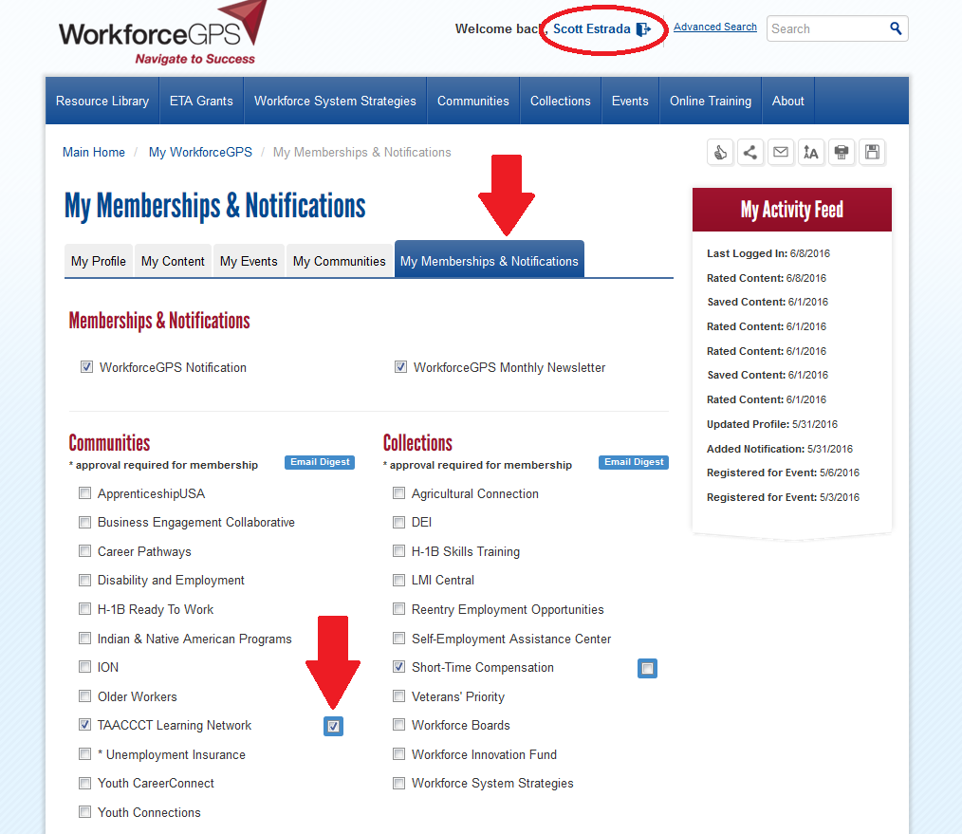
Sign up for the TAACCCT Weekly Digest

Slide 7
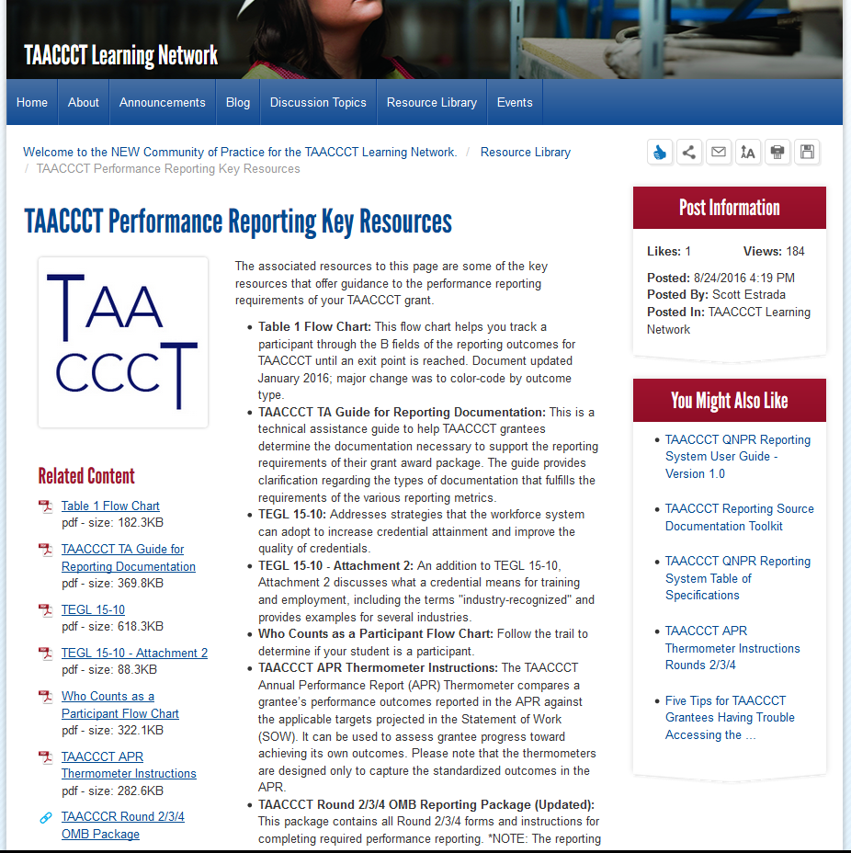
Performance Reporting Key Resources

Slide 8
Performance Reporting Key Resources
TAACCCT Round 2/3/4 OMB Reporting Package (Updated)
TAACCCT TA Guide for Reporting Documentation
Who Counts as a Participant Flow Chart
Table 1 Flow Chart
TEGL 15-10
TEGL 15-10 - Attachment 2
TAACCCT APR Thermometer Instructions

Slide 9
Agenda
Questions from YOU
Special Topic: NEW RESOURCES
  Updated OMB Package
  New Performance FAQs
Open Question Period (Limited)

Slide 10
Question #1
The TAACCCT reporting guidelines use the
terminology “acceptable form of documentation”
for each of the indicators, does that mean for
other indicators (i.e., C5 – veteran status and C9 –
TAA-eligible) there are other data sources that
could be used other than what is in the DOL
reporting guidance document (i.e., student intake
form)?

Slide 11
Question #2
Do non grant-funded credit
hours count in B.5/B.5a, the
outcomes on credit hours?

Slide 12
Question #3
If someone exits and re-
enrolls, can I count them as
a participant again?

Slide 13
Question #4
If a participant earns different
types of credentials (6a/6b/6c)
in the same year, can they
count in more than one? Or
can they only count in one of
these per year?

Slide 14
OMB Reporting Package Update
Revised August 9, 2016

Slide 15
What You Need to Know
Revisions do not change the basic requirements
Two main types of changes:
    Clarifies information that may have been ambiguously stated or disorganized
    Removes and updates outdated information

Slide 16
Clarified Information: When to Report
Grantees should report on an annual basis on every report (including final). All references that pertained or alluded to cumulative reporting have been removed.

Slide 17
Clarified Information: Strengthened and Aligned Language
Strengthened language in some of the definitions and titles to clarify what should be reported
Aligned the language (and numbering) in all documents in the package

Slide 18
Clarified Information: Administrative Data Requirements
Updated language to align with SGA language indicating that use of administrative data is preferred but not a requirement of the grant

Slide 19
Clarified Information: Other Changes
Typos and oversights
Details can be found in the document titled:
“TAACCCT OMB Package Summary of Changes in Revised Version August 9, 2016”

Slide 20
Removal of Outdated Information: Internet Links
Updated Internet links which had become obsolete

Slide 21
Removal of Outdated Information: Round 1
Elimination of all language referring to aspects of reporting that pertained only to Round 1

Slide 22
Compilation of TAACCCT FAQs
Revised August 25, 2016

Slide 23
Sections of the FAQ: What’s In It?
Introduction
Third-Party Evaluations
Performance Reporting
Fiscal Information
Deliverables/SkillsCommons
Extension of Program Activities
Closeout

Slide 24
Important Information to Know
Compiles all old questions
    Exceptions are duplicate questions and questions pertaining only to Round 1
Contains new questions
Questions in future versions will always be shaded in gray

Slide 25
Performance Reporting Section
Topics such as record retention requirements, definition of grant-funded programs of study, etc.
Also, every outcome B.1-B.10 has its own section
    Outcome subcategories have been combined with their master outcome (e.g., B.5/B.5a are in the same section)

Slide 26
Performance Reporting New Questions
Information provided through other technical assistance, but not as an FAQ
Information shared broadly for the first time by ETA

Slide 27
Other Performance Reporting Information
Performance reporting during extension
Performance reporting during closeout

Slide 28
ANNUAL PERFORMANCE REPORT & QUARTERLY NARRATIVE PROGRESS REPORT
October 1, 2016
DUE: November 14, 2016

Slide 29
WEBINAR TOPICS REQUESTED
TAACCCT GRANT CLOSEOUT:
https://www.workforcegps.org/events/2016/04/29/10/07/Round_3_TAACCCT_Close-out_Webinar
SkillsCommons:
https://www.workforcegps.org/events/2015/04/01/13/31/Orientation_Creative_Commons_Skills_Commons_A_Road_Map_Meeting_TAACCCT_Requirements
TAACCCT Credentials:
https://taaccct.workforcegps.org/resources/2016/07/22/15/37/TAACCCT_Performance_Reporting_Monthly_Webinar_Series_-_June_2016

Slide 30

Questions?

Slide 31
Poll question:
Which performance-related topic would you like to see a short presentation on in a future monthly Webinar?
Type your answer into the chat box. Please choose the topic you would like to see the most even if you have more than one.

Slide 32
Poll question:
What is your favorite thing about the fall season?
Cooler weather
Football season
Halloween
Pumpkin spice flavored food/drinks
Something else

Slide 33
Poll question:
How prepared do you feel to begin work on completing the Annual Performance Report for the year ending September 30, 2016?
Very prepared
Somewhat prepared
Somewhat unprepared
Not at all prepared

Slide 34
Poll question:
What is your biggest challenge when it comes to reporting?
(Please select only one)
Collecting data from new or attending participants
Collecting follow-up data
Collecting data from consortium members
Understanding what to report
Something else

Slide 35
UPCOMING WEBINARS
Next Month’s TAACCCT Performance Reporting Q&A
October 27, 4:00 pm EST

Slide 36
Send performance-related questions to the TAACCCT mailbox (taaccct@dol.gov)
by October 21, 2016

Slide 37
Thank you
for attending!

