Slide 1

Participant Poll
What Round of TAACCCT do you represent?
  Round 2
  Round 3
  Round 4
  Multiple
Is your TAACCCT grant currently implementing a CBE model?
  Curious about CBE; no plans to implement at this time
  Interested in starting a CBE program
  Planning a CBE program
  Implemented a CBE program
What is your current role in the grant?
  Project Manager
  Faculty
  Dean/VP/Other Leadership Role
  Career Navigator/Coach
  Other (list in chat)
What are you looking to get out of today’s webinar?

Slide 2
Competency-Based Education Webinar Series
Part 1: Effective Strategies
September 16, 2016
1:00 – 2:00 p.m. EST

Slide 3
TAACCCT Learning Network at a Glance
U.S. Department of Labor, Employment & Training Administration
(National)
Jobs for the Future
CalState/Merlot
Maher & Maher
American Association of Community Colleges
U.S. National Science Foundation
ATE Centers
Other Non-Federal Providers of TA and Resources for TAACCCT Grantees:
Creative Commons
CAST
The Transformative Change Initiative

Slide 4
Presenters
MODERATOR:
Cheryl Martin, Program Manager, TAACCCT Grants, U.S. Department of Labor, Employment, and Training Administration
FACILITATOR:
Erica Acevedo, Senior Program Manager, TAACCCT Learning Network, Jobs for the Future
PRESENTERS:
Christina Amato, Project Director, TAACCCT Grant eLearning Division, Sinclair Community College, Round 2
Stephanie Krauss, Senior Fellow, Jobs for the Future & Corporation for a Skilled Workforce
Jessica Stumpff, CBE Academic Coach, Workforce Development, Sinclair Community College, Round 4

Slide 5
Participant Poll
What Round of TAACCCT do you represent?
  Round 2
  Round 3
  Round 4
  Multiple
Is your TAACCCT grant currently implementing a CBE model?
  Curious about CBE; no plans to implement at this time
  Interested in starting a CBE program
  Planning a CBE program
  Implemented a CBE program
What is your current role in the grant?
  Project Manager
  Faculty
  Dean/VP/Other Leadership Role
  Career Navigator/Coach
  Other (list in chat)
What are you looking to get out of today’s webinar?

Slide 6
Agenda
Welcome and Introductions
An Overview of Competency-Based Education Approaches
What Does it Take to Implement CBE Models?
Q&A
What a Shift to CBE Requires
Closing

Slide 7
Stephanie Krauss
Senior Fellow, jobs for the future & Corporation for a Skilled Workforce
An Overview of Competency-Based Education

Slide 8



Why we need CBE
The problem of proxies
Access as proxy for quality
Time as proxy for progress
Completion or credential as proxy for competence

Slide 9



Is CBE a better way to learn and earn (credentials)?
Learn
Practice
Demonstrate
Move ahead based on what you know and can do
Credential as a signal of competence & readiness

Slide 10
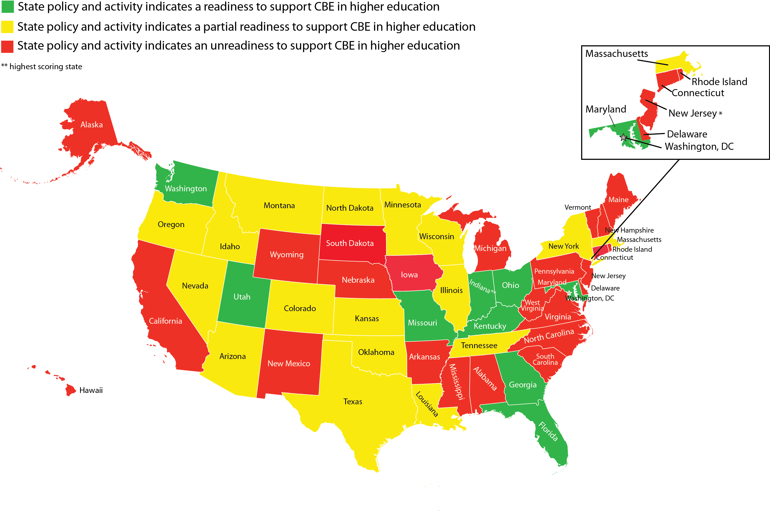
CBE in Higher Education Across the U.S.

Slide 11
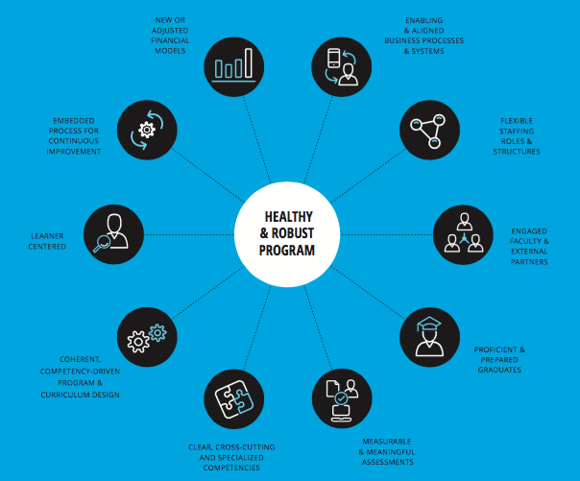
10 Shared Design Elements of CBE Programs
Credit to Public Agenda and C-BEN

Slide 12
Christi Amato, Project Director
Jessica Stumpff, Cbe coach
CBE at Sinclair Community College

Slide 13
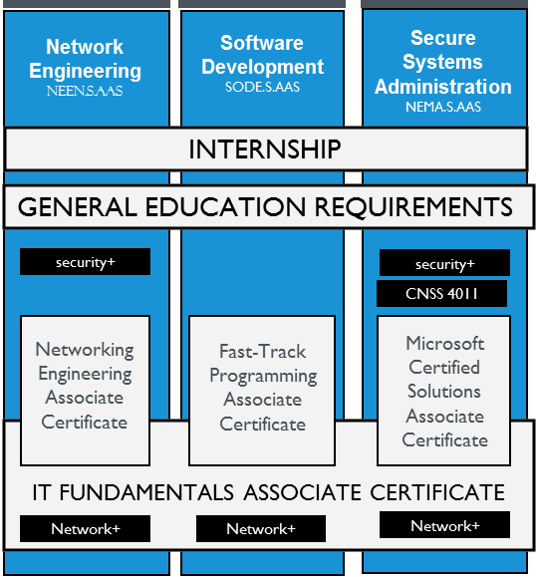
Sinclair College TAACCCT Project
Round 2 TAACCCT Grant
  Adopt and adapt IT curriculum to CBE format
  Focus: adult learners, veterans, displaced workers
  11 stacked programs, 25 courses
  Create enhanced student services platform to prepare and support CBE students

Slide 14
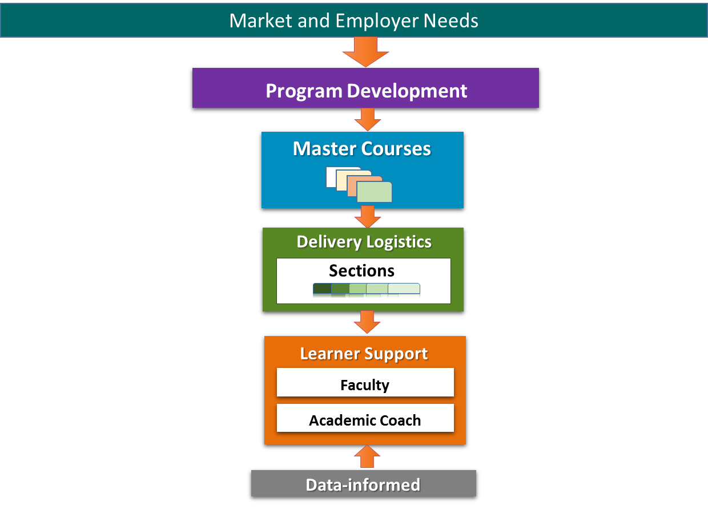
Project Framework

Slide 15
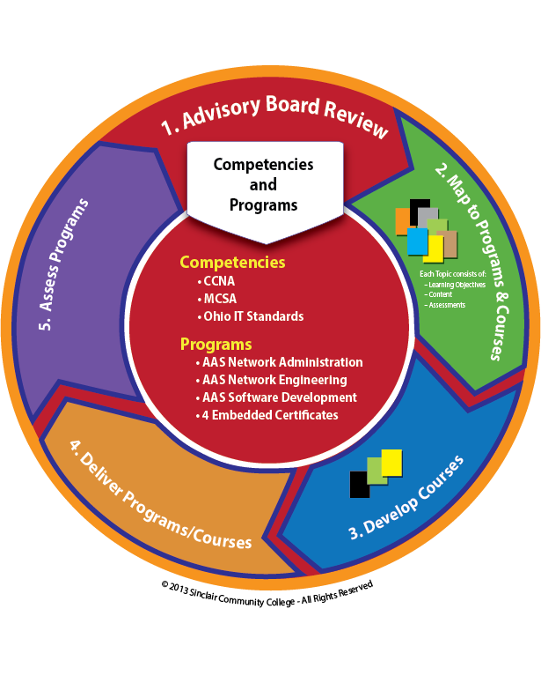
Program Development Cycle

Slide 16
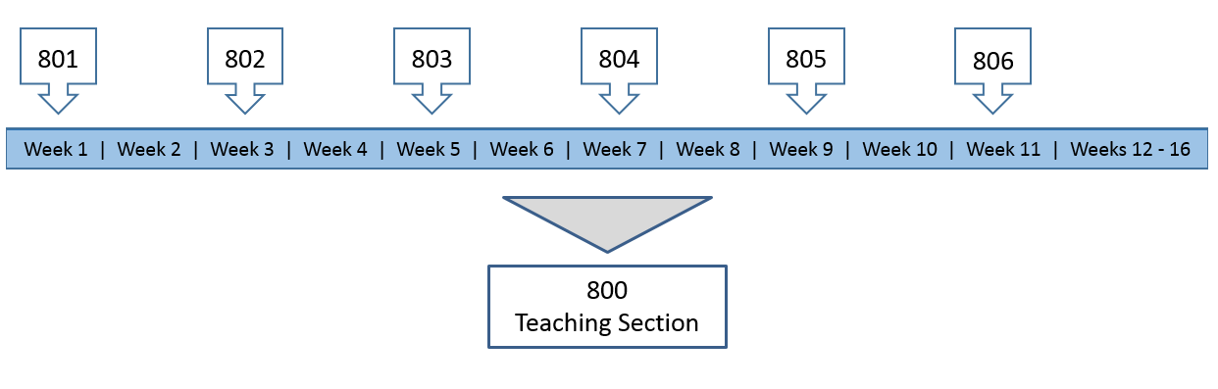
Delivery Logistics
25 flex-paced, online courses
Enrollment through week 12 of term
6 Registration sections funneled into one teaching section

Slide 17
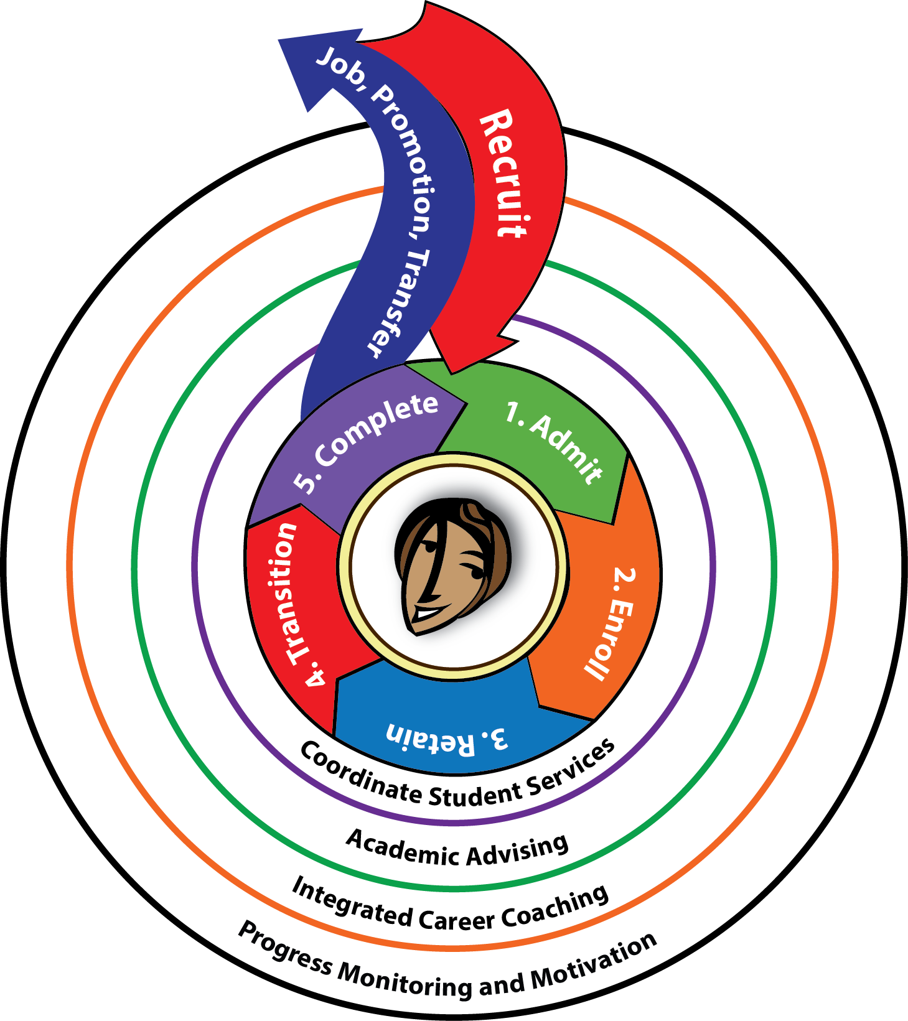
Learner Support

Slide 18
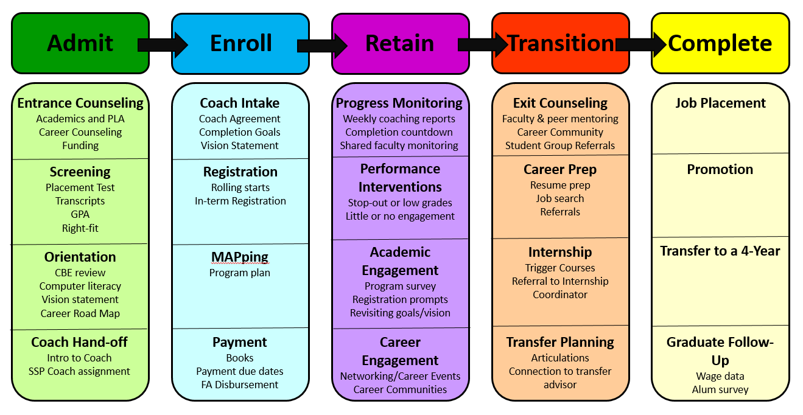
Learner Support Mapping

Slide 19
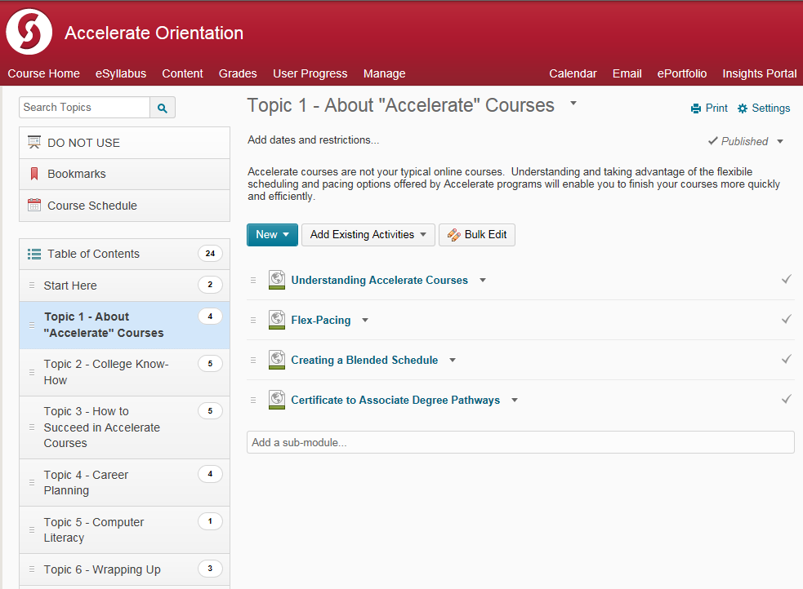
Key Considerations in Student Support
Recruitment of right-fit students
Screening and preparation for CBE
Remedial pathways

Slide 20
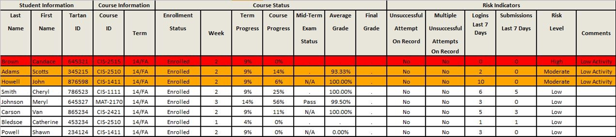
Key Considerations in Student Support
Case management
Data progress and monitoring

Slide 21
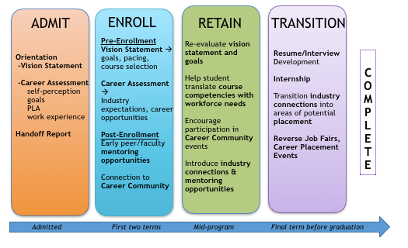
Key Considerations in Student Support
Career Coaching

Slide 22
Outcomes and Impact
Project Outcomes
76% course success rate across all CBE sections
Average completion time across all CBE courses is between 60 and 80 days
70% year-to-year retention rate
Accelerate students are credentialing at three times the rate of students in companion program
Accelerate students are ten times more likely to take an internship—and internship completers have a 90% hire rate
Impact
Two additional CBE projects in development
Scaling of best practices in student support beyond the project
Funding of CBE program management position

Slide 23
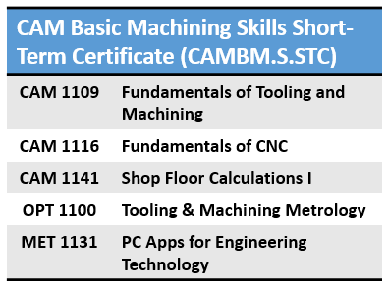

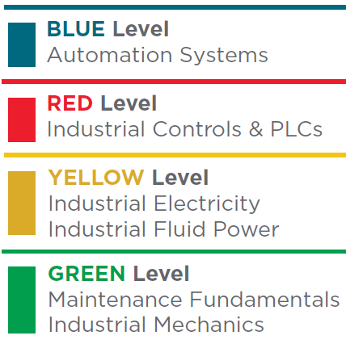
The Evolution of CBE
Round 4 TAACCCT Grant
  Create accelerated pathways to careers in Advanced Manufacturing
  Develop CBE hybrid curriculum with online lessons and hands-on labs
  2 programs: Industrial Maintenance (non-credit) & Basic Machining
  Collaboration between Workforce Development and Academic Divisions

Slide 24
Developing a Hybrid CBE Program
Best practices sustained from Round 2 TAACCCT Grant CBE Project:
  Rolling registration
  Unit-based courses
  Student support model
Special considerations in CBE hybrid programs (Round 4 TAACCCT grant):
  Transitioning away from the traditional cohort approach
  Developing a model for flexible, open labs
  Securing employer support for online/hybrid courses
  Added screening components: physical capabilities and field experience

Slide 25
Early Successes
Advanced Manufacturing students now earning a National Credential—the National Career Readiness Certificate as part of their Machining or Industrial Maintenance curriculum at Sinclair
During the first two pilot semesters, CBE machining students completed courses, on average, 2 ½ weeks faster than students in “traditional” machining courses
  Several students have completed full semester (16 week) courses in as few as 3 weeks
Students working 40+ hours a week are now enrolling at Sinclair due to the flexible scheduling opportunities of hybrid CBE programs

Slide 26
The Future of CBE
NSF Grant
  Conversion of 6 courses to hybrid CBE format
  Development of 4 brand new CBE courses
  Short-term certificate leads to an AAS in Unmanned Aerial Systems or Geographic Information Systems
Aerial Sensing Data Analytics (STC)
GIS1107 | Intro to GIS
AVT1101 | Intro to UAS
EET1158 | Aerospace Spatial Visualization
EET1121 | UAS Remote Sensing and Analysis
AVT1104 | UAS Standards, Regulations and Law
AVT2150 | Crew Resource Mgmt. for UAS
New Course | Electro-optical and Infrared (IR) data analysis
New Course | Multi-spectral and hyperspectral data analysis
New Course | Synthetic Aperture Radar (SAR)/ and LiDAR data analysis
New Course | Acoustic/CBRNE/Other data analysis

Slide 27
Challenges in CBE
Evolving HLC accreditation requirements (regular and substantive interaction)
Financial Aid eligibility
Unique program requirements and considerations
Integration into semester systems
Implementing flex-paced model into traditional Learning Management System
Faculty challenges
  Grading load
  Payload
  Intellectual property
  Timely feedback
Course structure challenges
  Level of mastery
  Retake policy
  Student progress expectations
  Course granularity

Slide 28
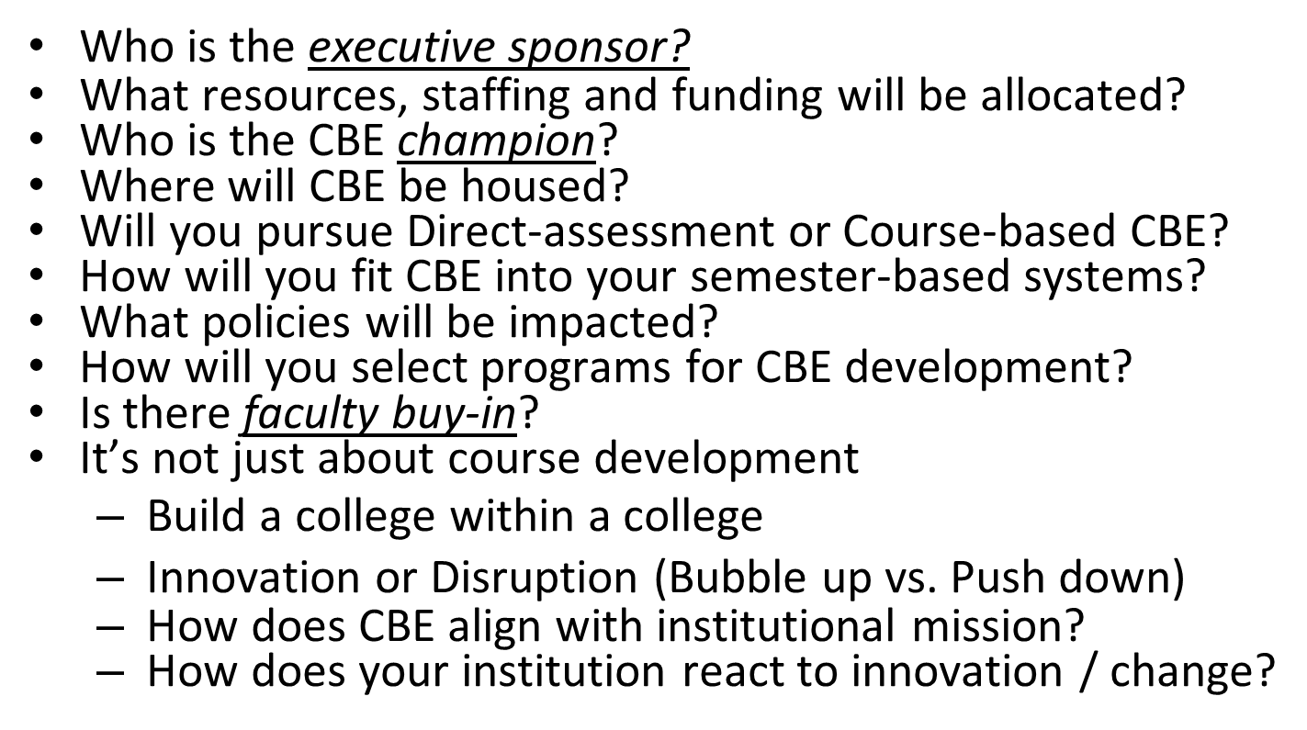
Important Considerations for all CBE Programs

Slide 29
Participant Question
5. For those engaged in CBE; what have been some challenges/roadblocks that you’ve encountered? (respond in chat)

Slide 30
Q&A

Slide 31
Stephanie Krauss
Moving Ahead: What a Shift to CBE Requires

Slide 32
How to get to healthy & robust CBE programs

Slide 33

Moving ahead: an emerging, competency-based, credentialing agenda
Empowered learners with equal access to and effective navigation of the credentialing marketplace.
Engaged employers.
Use of competencies as common currency.
4. Interoperable systems and processes.
5. Credentials that signal quality learning and qualified people.
6. Opportunities for learners and credential earners to experience social and economic mobility.
7. To ensure those involved in credentialing can tinker, innovate and find what works and why.

Slide 34
Additional CBE Resources
Shared Design Elements & Emerging Practices of Competency-Based Education Programs
The Competency-Based Education Ecosystem Framework
Adopting and Adapting Competency-Based Education Brief
Next Generation CBE: Designing Competency-Based Education for Underprepared College Learners Report
Competency-Based Education: A New Approach Webinar & Materials
Cracking the Credit Hour
Make sure and share these resources and webinar recording with your grant staff, consortium partners, and community college friends!

Slide 35
Join the Part 2 CBE Webinar!
Don’t forget to sign up for the Part 2 webinar on Addressing Financial Aid Barriers in CBE.
Thursday, September 29, 2016
12:00 – 1:00 PM ET.
Presented by: David Musser, Policy Liaison and Implementation, Federal Student Aid, U.S. Department of Education

Slide 36
Connect With Us!
Connect with the TAACCCT Learning Network team and other grantees at these upcoming in-person events:
2016 NCWE Annual Conference: Keeping the Promises of Workforce Education
October 12 – 13, Atlanta, GA. This conference has been so well attended by TAACCCT grantees in the past that this year’s agenda once again devotes a whole strand to TAACCCT. Check out the 2016 NCWE Preliminary Program.
2017 Workforce Development Institute
January 25-28, 2017, Newport Beach, CA. Next year’s institute will host a special TAACCCT Private Meet-Up on Wednesday, January 25 from 1:00 – 4:00 p.m. PT. Space is limited so please RSVP by completing this short form by Friday, January 6, 2017 to reserve your spot.

Slide 37
Thank You!
Connect with the NEW TAACCCT Community of Practice and search for TAACCCT resources at:
https://TAACCCT.workforceGPS.org
Ask questions and to connect with peers and resources at TAACCCT@dol.gov
If you want to learn more about peer mentoring email TAACCCT@dol.gov

