Slide 1
State Apprenticeship Expansion
April 3, 2017
First Round of Quarterly Performance reports (QPRs)
Office of Apprenticeship

Slide 2
Chad Aleshire
Team Lead
Investment, Operations & Performance
Office of Apprenticeship, Employment and Training Administration
Maria Brady
Multi-State Navigator
Office of Apprenticeship, Region 4
Employment and Training Administration

Slide 3
Background
Grant period of performance began November 1, 2016 and ends May 2018
18-month period of performance
First Quarterly Progress Report (QPR) due February 14, 2017
This webinar will highlight the issues that have been noted with the first submissions

Slide 4
Objectives
To provide feedback on initial SAE QPRs
To explain next steps for Q2 QPRs

Slide 5
Overview: Sections of SAE QPR
Basic and Grant Information
Section I: Information on Individuals Served by the Grant
Section II: Information on Services Provided to Individuals Under the Grant
Section III: Information on Programs/ Sponsors Served Under the Grant
Section IV: Narrative Information
Cumulative and Current Qtr Info

Slide 6
Using the QPR Template Provided
Although the template is a suggested format, if grantees choose to not use the template, all of the information must still be provided. Examples of that not happening, include:
Submission was an 11-page document listing events that are planned; no other information was provided
Another submission included a lengthy narrative that did not contain any of the required information

Slide 7
QPR – Up Front Information
Name of Grantee
Grant Number
Quarter Ending
Date of Submission
Program Contact Information
Some grantees are missing all or part of their contact information.
BOTH email and telephone numbers are required, and in some cases neither was provided.

Slide 8
Section I: Information on Individuals Served by the Grant
Grantees must enter zero if no activity is being reported (do not leave blank)
For the first quarterly report only, the current quarter figures must equal the cumulative total figures, but this wasn’t always the case
Numerous grantees included activity that has nothing to do with the Expansion Grant (e.g., highlighting Accelerator Grant activities)
Many reported large numbers of apprentices

Slide 9
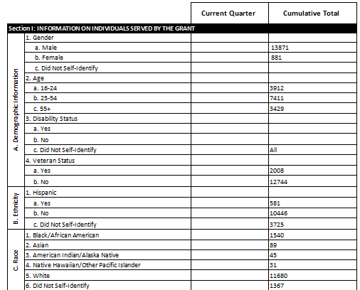
Section I Example
Grantee is reporting 14,752 apprentices
No figures reported for current quarter; should be zeros
Grantee is reporting “Disability-Did Not Self-Identify” as ALL

Slide 10
More on Section I
Several grantees are reporting high numbers of apprentices being served by the Expansion Grant and no individual records were submitted
6 grantees reported over 1,500 apprentices
1 grantee reported more than 68,000 apprentices
Section I is supposed to contain “Information on Individuals Served by the Grant” (emphasis added)
It was clear from many reports that general apprenticeship-related activities not directly related to the SAE grant were included.

Slide 11
About Individual Records (2)
States/grantees that do not utilize RAPIDS (that will need to transmit individual records):
CT, DC, DE, HI, KS, MA, MD, MN, MT, NC, NM, NY, OR, RI, VA, VT, WA, WI
11

Slide 12
Section II: Info on Services Provided to Individuals Under the Grant
Two Subsections:
Services (II.D.)
Funding Sources (II.E.)
If there is nothing to report, grantees are required to enter zeros
Many grantees left this section blank

Slide 13
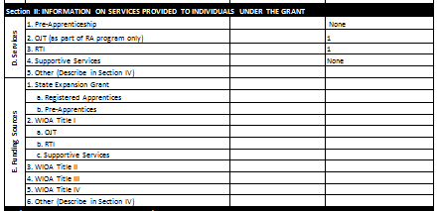
Section II Example
No figures reported for current quarter; should be zeros (and not “None”)

Slide 14
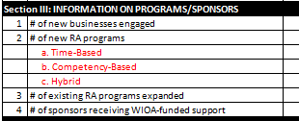
Section III: Info on Programs/ Sponsors “Served” Under Grant
Element III.1. – Report substantive engagement only as defined in reporting instructions
All figures are to be explained in IV.1.

Slide 15
Section III Example
These figures were also not described in IV.1 as “required”.
No information is reported for the current quarter and III.1. and III.4. are blank in both columns
How can 19 new programs be registered but no new businesses engaged? (doesn’t make sense)

Slide 16
Remember Individual Records!
This is a slide from our 2/6/17 initial reporting webinar.

Slide 17
Section III Example (2)
Many grantees reported new business engagement over the two-month reporting period but did not provide specific information on the businesses as required
Although individual records for programs/ sponsors sounds onerous, it doesn’t have to be
Sample from Louisiana, which reported 5 new businesses engaged during November and December 2016

Slide 19
Section IV: Narrative Information (Current Quarter Only)
This section contains narrative information on grant activities
Several grantees transmitted a separate narrative report, which is not necessary
Some grantees used the Narrative report template from their Accelerator Grants
It is recommended that grantees use the QPR Template previously provided, which has a section for narrative information

Slide 20
Item IV.1.
Item IV.1. Clarify data in Sections I through III
Item II.D.5. (Other types of services provided than those listed in Section II)
II.E.6. (Other types of funding sources utilized besides those listed)
All of Section III
Other clarifications of reported data
Many grantees did not explain their reported figures in IV.1.

Slide 21
Section IV.2.
Item IV.2. – Success Stories
Specific success stories are requested and not general information
Example from a QPR – “We had a great quarter and engaged with multiple businesses to discuss the benefits of registered apprenticeship.”
If there is nothing to report, it’s okay to say Nothing to Report

Slide 22
Section IV.4.
Item IV.4. – Describe capacity building and outreach efforts
Based on reported information, some grantees are confused by this item
The examples of what to include in this item were just examples of what might be reported
Grantees do not have to split up the response according to what was provided as example A, B, C, and D
E.g.: “A” included policy documents and tax credits… Some grantees responded and said, “A. No new policy documents or tax credits” – but the overarching inquiry is about capacity building/outreach in general

Slide 23
“Any Additional Comments”
Some of what was reported under “Any Additional Comments” should have been reported elsewhere
(e.g., under capacity building efforts or # of new businesses engaged)

Slide 24
Next steps
Each Grantee will receive an e-mail from OA with the following cc’d: FPO, OA consultant, TA coach
This email will delineate areas for improvement in the QPR Quarter 1 report.
It will include as attachments: 1) original QPR submission; 2) the QPR template; and 3) the QPR Instructions.
The e-mail will indicate that OA will not require a re-submission of Q1 reports and that we will work with the FPOs and OA consultants to review Q2 reports
Within the 30-day period from receipt of the Q2 QPR, OA will review and respond with a request for re-submission if necessary.
Grantees work directly with their FPO, OA Consultant and their TA coach if additional TA is needed to report timely and accurately.

Slide 25
REMINDER: Report Submission
Send completed QPR (in addition to individual records as appropriate) to: Apprenticeship.Grants-ETA@dol.gov
Copy your FPO
Copy your OA Consultant
Copy your TA Coach

