Slide 1
Building Leaders for the Building Trades
Construction Training And Leadership Development Integration
Department of Labor
& YouthBuild USA

Slide 3
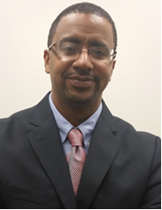
Mark W. E. Smith
Workforce Analyst
U.S. Department of Labor, Employment & Training Administration
Office of Workforce Investment- Division of Youth Services
Smith.mark.w@dol.gov

Slide 4
Objective #1: Learn to assess youth leadership development competencies in construction training through appropriate developmental benchmarks.
Objective #2: Learn to identify, integrate and assess leadership development opportunities on the worksite.
Objective #3: Learn to prepare and support construction staff to practice youth leadership development.
Objective #4: Discuss challenges and promising practices with peers in the YouthBuild network.

Slide 5
2:05 | Measuring Youth Leadership
2:25 | Leadership Competencies on the Work Site
2:45 | Leadership Skills Needed in the Trades
3:05 | Open Group Discussion

Slide 6
Joel Miranda
Senior Director for Leadership Development
YouthBuild USA
jmiranda@youthbuild.org

Slide 7
Measuring Youth Leadership
#1

Slide 8
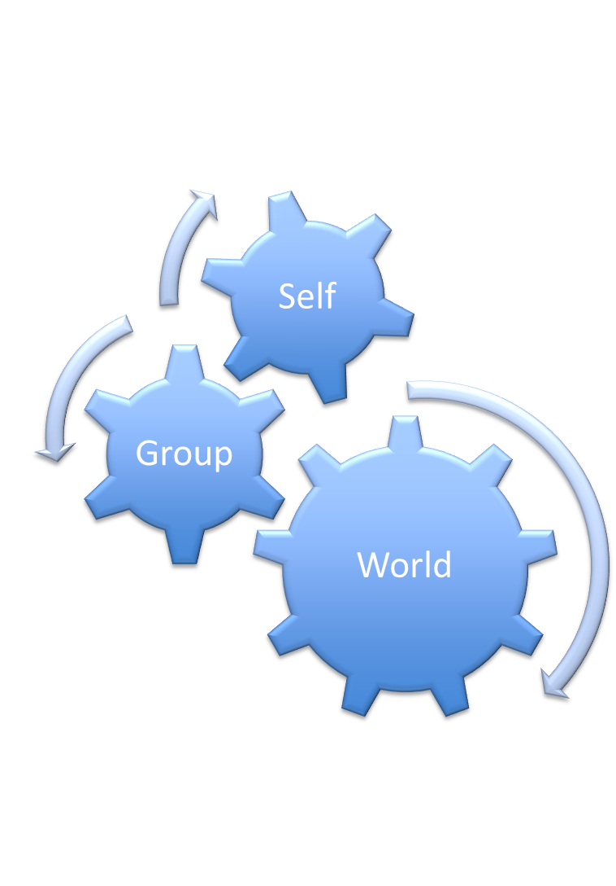
Program Outcomes and Personal Development
GED, diploma, or industry certification
Increase in literacy and numeracy
Reduced recidivism rates
Placements after exit
Retention

Slide 9
LD is the difference between...
Placed in job
Placed in PSE/PST
Living in community
Surviving
Building a career; sustaining self and family
Earning degree/certificate, developing expertise
Building self, family, and community
Thriving

Slide 10
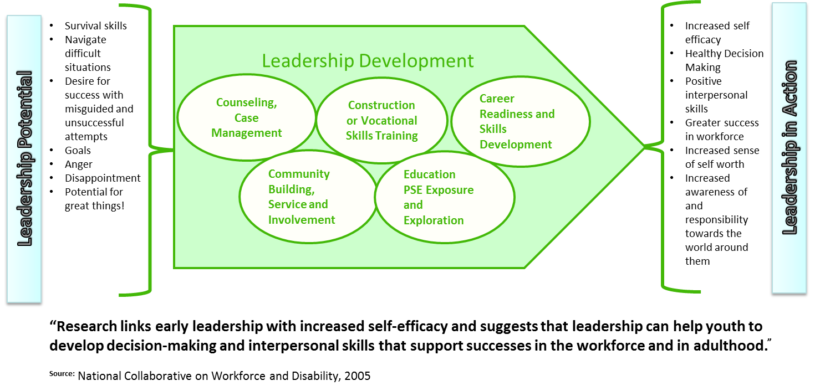
LD as a Vehicle Towards Outcomes

Slide 11
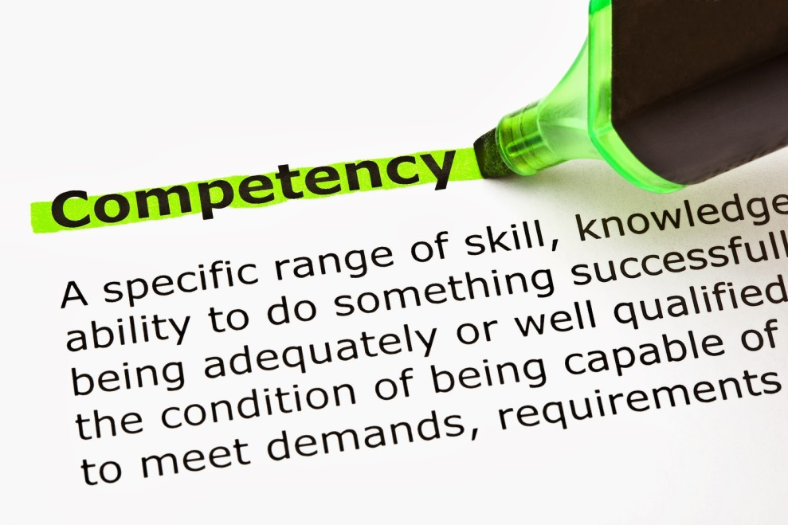
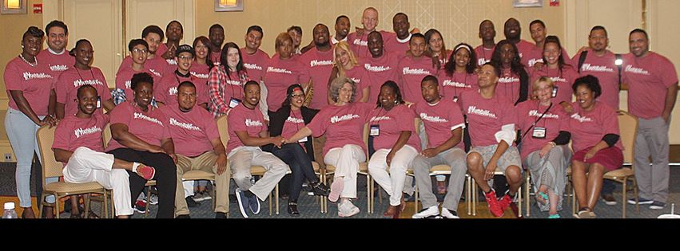
Four Pillars of Leadership Development
Leadership Development is integrated across program components
A Policy Committee is elected and supported
Leadership Competencies are defined and assessed
Ongoing engagement and development of graduates

Slide 12
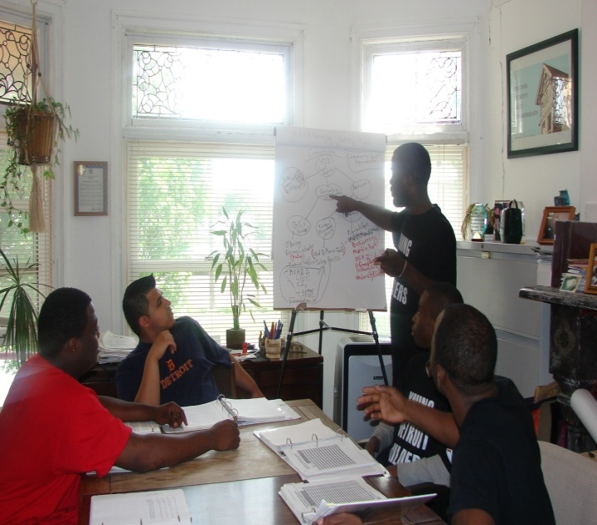
Leadership Competencies
Leadership skills can be taught, learned, and measured
YouthBuild USA’s 23 LD Competencies Include:
Personal Leadership
Small Group Leadership
Community Leadership

Slide 13
Leadership Competencies
12 Common Leadership Competencies
Managers need to have certain competencies to effectively influence the behaviors of others and ultimately achieve.
1. Interviewing and hiring
2. Delegation
3. Supervising
4. Conflict resolution
5. Emotional intelligence
6. Communication skills
7. Team building
8. Motivating
9. Coaching
10. Performance management
11. Problem solving
12. Agent for change

Slide 14
Leadership Competencies
Leading the Self:
demonstrating ethics and integrity
displaying drive and purpose
exhibiting leadership stature
increasing your capacity to learn
managing yourself
increasing self-awareness
developing adaptability
Leading Others:
communicating effectively
developing others
valuing diversity and difference
building and maintaining relationships
managing effective teams and work groups
Leading the Organization:
managing change
solving problems and making decisions
managing politics and influencing others
taking risks and innovating
setting vision and strategy
managing the work
enhancing business skills and knowledge
understanding and navigating the organization
Source: Society for Human Resource Management: Leadership Competencies http://www.shrm.org/research/articles/articles/pages/leadershipcompetencies.aspx#sthash.MqN9mNKk.dpuf

Slide 15
Leadership Competencies
Communication
2. Enthusiasm & Attitude
3. Teamwork
4. Networking
5. Problem Solving & Critical Thinking
6. Professionalism
Source:
U.S. Department of Labor, Office of Disability Employment Policy: Soft Skills to Pay the Bills — Mastering Soft Skills for Workplace Success http://www.dol.gov/odep/topics/youth/softskills/

Slide 16
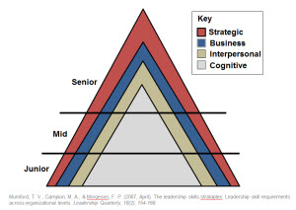
Leadership Competencies
Cognitive skills:
Comprised of skills “related to basic cognitive capacities, such as collecting, processing, and disseminating information and are the fundamental skills required for a large portion of the activities in which leaders are engaged”.
4. Strategic skills:
Conceptual skills needed to take a systems perspective to understand complexity, deal with ambiguity, and to effect influence in the organization
2. Interpersonal skills:
Related to interacting with and influencing others.
3. Business skills:
Related to specific functional areas that create the context in which leaders work”
Source:
Mumford, T., Campion, M., & Morgeson, F. (2007). The leadership skills strataplex: Leadership skill requirements across organizational levels. The Leadership Quarterly, 18, 154-166.

Slide 17
Stages of a youth’s development in the YouthBuild Program
V. Identity
^
Ferguson-Snipes Model
T
A
S
K
S
IV.
Industry
^
Achieve
integration
of identity
components
III.
Initiative
^
Strive toward
competence, integrate
skills, and build belief
in capacity for
mastery of skills
Identify self
as competent
to use skills and
learn more
II. Autonomy
^
Initial real
attempt to
collaborate toward
self development
Specific goals for
self development
(skills and orientation)
guide actions
Identify self
with the
new skills and
orientation
I.
Trust
^
Negotiate balance
of autonomy vs..
Staff authority
Autonomy expressed
within the
specific range
Trainee can be
trusted to to expand
the initial range of
permitted autonomy
Autonomy controls
no longer
needed
Feel an initial
sense of trust
and comfort
Trust becomes
codified, deeper
and
differentiated
Trusted people
relied upon for advice
concerning a new
life direction
Trusted teachers and
advisors give support
and reassurance as
trainee expresses more
industriousness
Trusted advisors
positively affirm
the trainees
new identity
STAGES

Slide 18
Ted Roan
Director of Green Construction
YouthBuild USA
troan@youthbuild.org

Slide 19
Leadership Competencies on the Worksite
#2

Slide 20
Leadership for Construction Careers
Sample Worksite Leadership Roles:
Crew chiefs
Safety coordinator
Site steward responsible for calling for breaks, cleanup, attendance
Waste recycling coordinator
Photographer who documents work
Tool captain who signs out tools and conducts inventory

Slide 21
Inventory Control

Slide 22
Natural Leadership Development Crossovers in Construction

Slide 23
Leadership Competencies on the Worksite
Additional Leadership Roles Young People Can Take:
Learn overview of entire construction process
Learn about the “why” of green building; become leaders on worksite environmental practices
Go to contract negotiations or City Hall to pull the permits
Help plan, estimate materials, schedule the work
Help solve problems such as meeting a deadline, keeping the site cleaner, improving attendance, or improving teamwork
Give tours to visitors of the site
Evaluate the performance of construction staff and each other

Slide 24
Safety First…. What do you see?

Slide 25
Student Leadership Will Notice These…
Eye protection
Fall hazard
Eyes
Hard hat
Trip Hazard

Slide 26
Peer Leaders on Projects…
Are set up for success by Construction Instructor
Develop communication skills
Problem solve
Develop teambuilding skills

Slide 27
Carpentry/Skills Challenge
A way to assess skill set
Avenue to recognize leadership skills
Observe vocal leaders and action leaders
Opportunity to exercise conflict resolution leadership
Time management

Slide 28
YouthBuild global leadership model
They used healthy, durable and efficient building practices that the students researched.
Youth in Brcko, Bosnia identified this family home to replace with this…

Slide 29
Environmental leadership
YB students demonstrating recycling to community members
Instills practices that pass on to family members
Reduces the energy consumption of YB projects
Provides additional job skills for advanced placement

Slide 30
Frank Alvarez
Regional Construction Academy Coordinator
YouthBuild Charter School of California
frankalvarez26@gmail.com

Slide 31
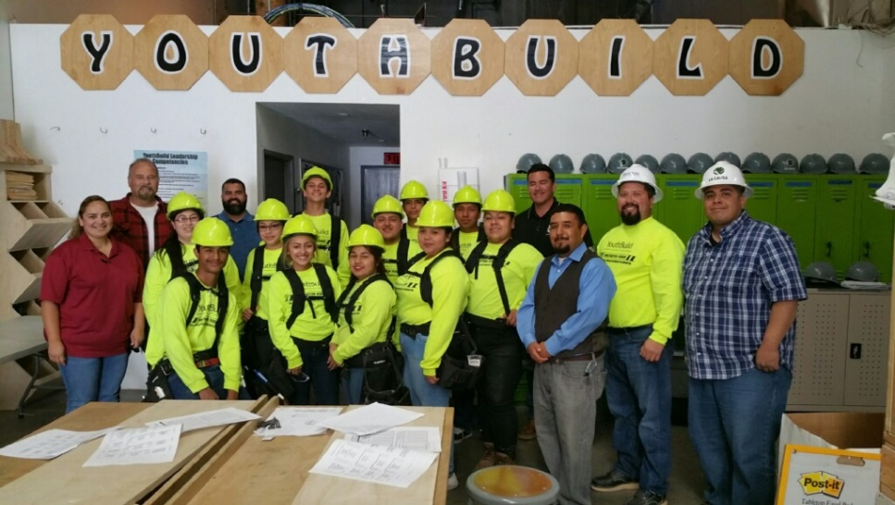
Leadership Skills Needed in the Trades
#3

Slide 32
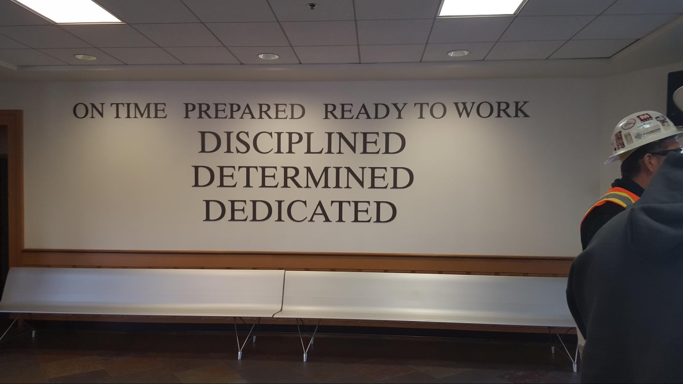
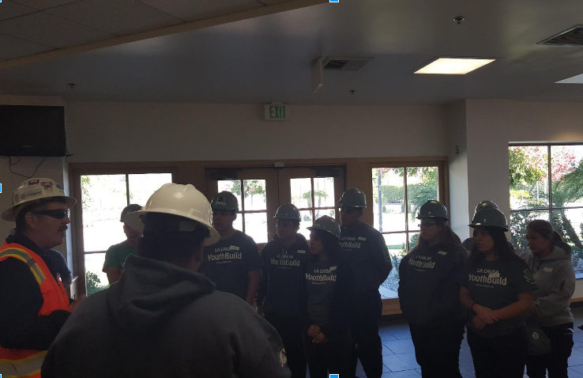
Leadership Skills Needed in the Trades
Cultural Competency
Communication
Public Speaking
Civic Engagement
Mentorship
Continuous Learning
Volunteerism
Teamwork
Critical Thinking

Slide 33
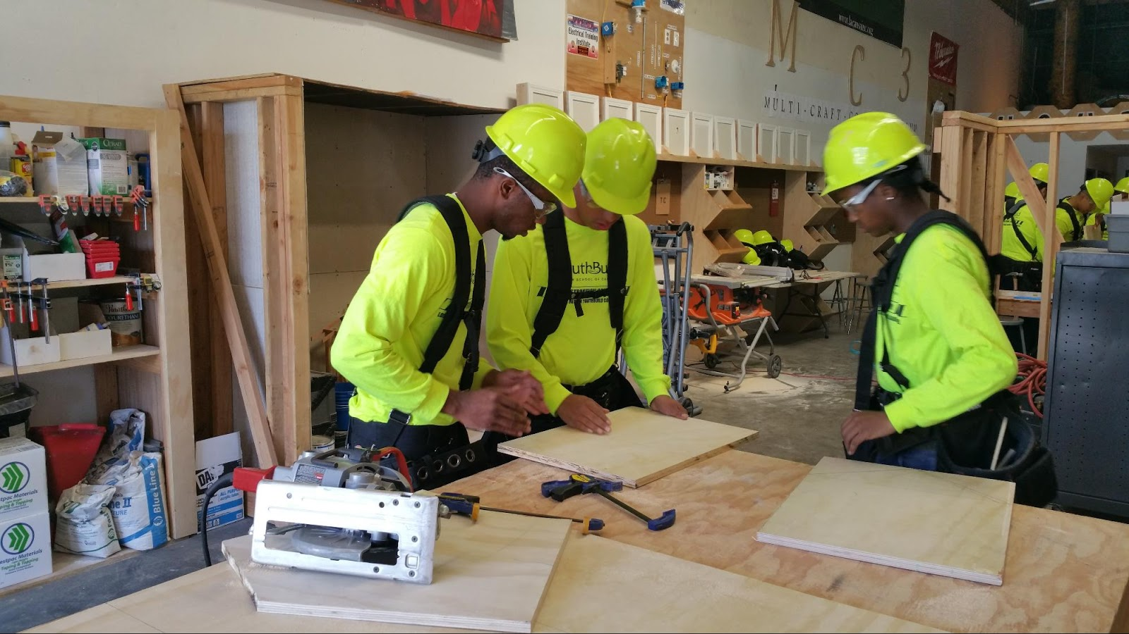
Cultural Competency & Communication
Communication is a process….
Cultural Competency is the ability to work effectively across cultures in a way that acknowledges and respect the cultures of the person or organization being served.
Sender
Receiver
Message
Feedback

Slide 34
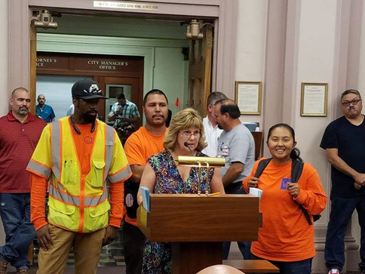
Public Speaking & Civic Engagement
Civic Engagement can include testifying in City Hall to promote your local YouthBuild and hosting town halls on youth issues.
Youth develop Public Speaking skills through participation in Leadership Classes and put it into practice on Policy Councils.

Slide 35
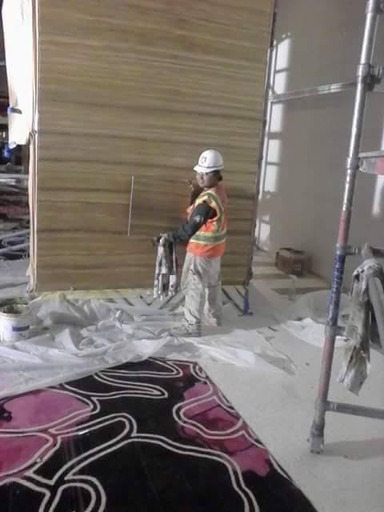
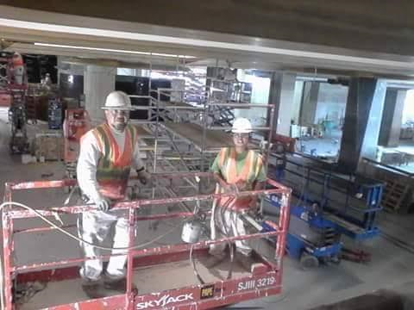
Mentorship & Continuous Learner
Mentorship never ends in the trades. As apprentices, YouthBuild grads will be matched with a Journeyman, and one day mentor an apprentice of their own.
Continuous Learners are always seeking out opportunities to learn and build new skills.

Slide 36
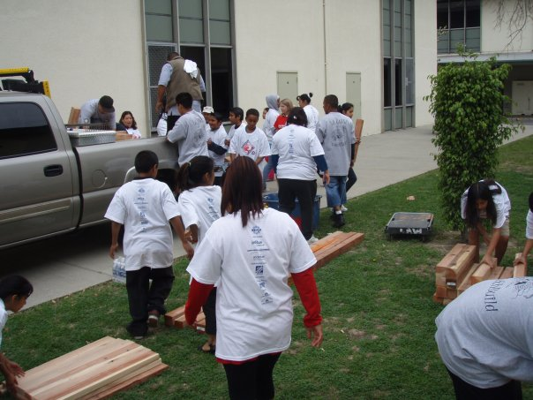
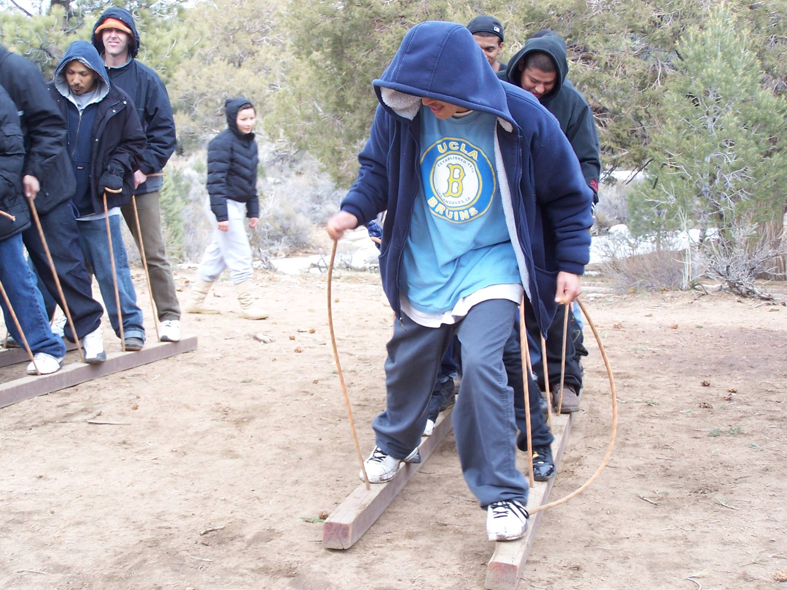
Volunteerism & Teamwork
Teamwork begins in Mental Toughness and will assist a YouthBuild grad while on the worksite as they work with a crew to finish a job safely and on time.
Volunteerism is a skill nurtured throughout YouthBuild, and can be applied in trades through their charitable work e.g. food drives and offering skilled labor for community projects.

Slide 37
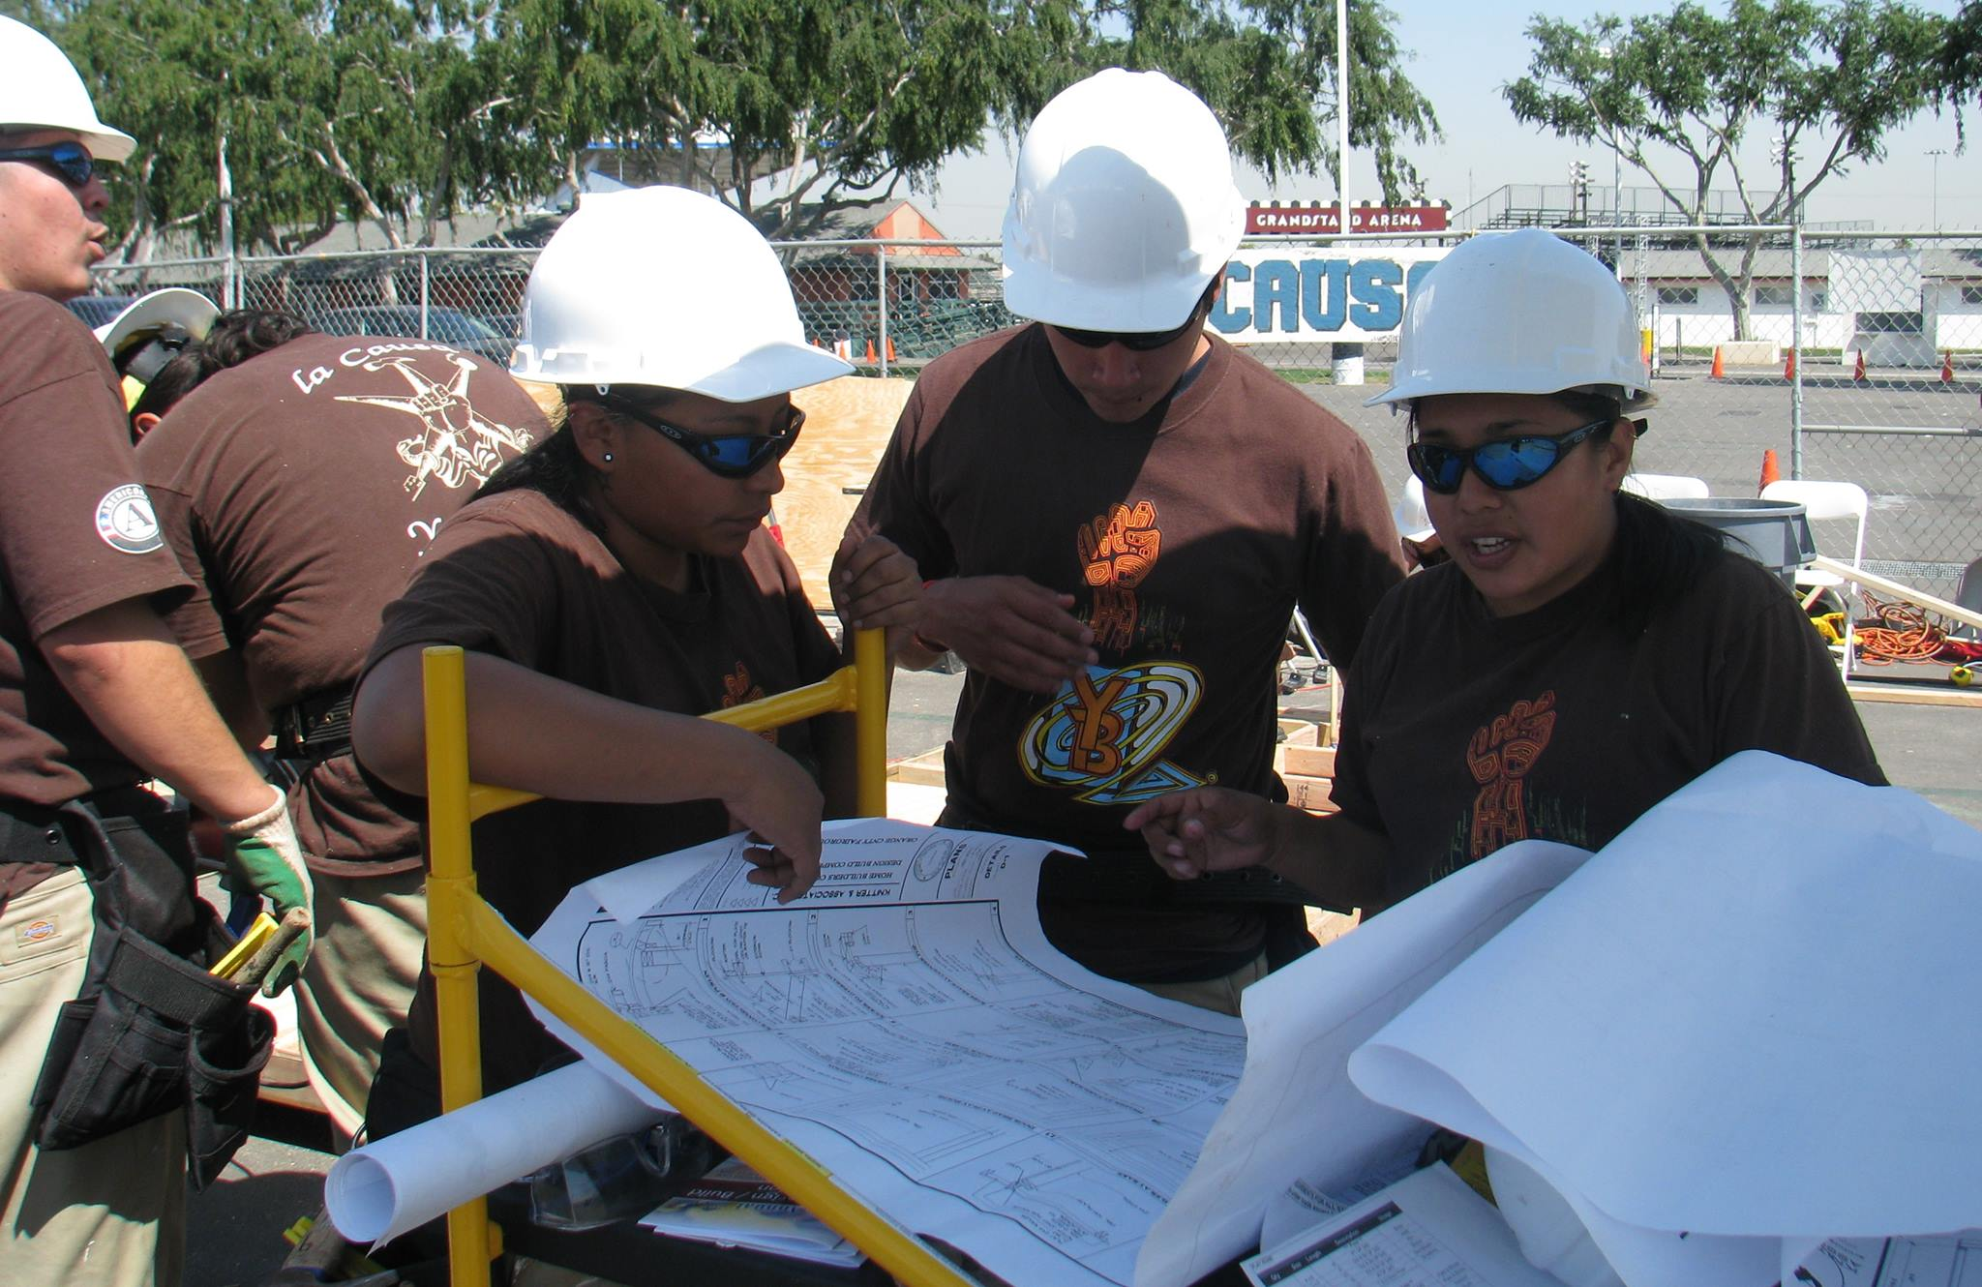
Critical Thinking
Critical Thinking is needed to quickly solve complex work tasks, while working in a fast paced environment.

Slide 38
Breakout Sessions
#4
Open Discussion Session

Slide 39
Leadership Development, Workplace & Post-Secondary Readiness Competencies
YouthBuild USA
https://youthbuild.workforcegps.org/resources/2015/07/27/13/49/Leadership-Development-Workplace-Post-Secondary-Readiness-Competencies
Life Goal Plan Template
YouthBuild USA
https://youthbuild.workforcegps.org/resources/2017/03/24/07/45/Goal-Planning-Tool/
Soft Skills to Pay the Bills — Mastering Soft Skills for Workplace Success
U.S. Department of Labor, Office of Disability Employment Policy
http://www.dol.gov/odep/topics/youth/softskills/

Slide 40
Speakers’ Contact Information
Speakers’ Contact Information
Moderator: Mark Smith
Title: Workforce Analyst/National Liaison
Organization: U.S. Department of Labor/ETA
Email: Smith.mark.w@dol.gov
Telephone: (202) 693-3747
Speaker: Joel Miranda
Title: Senior Director for Leadership Development
and Graduate Leadership Development
Organization: YouthBuild USA
Email: jmiranda@youthbuild.org
Telephone: (617) 741-8315

Slide 41
Speakers’ Contact Information
Speakers’ Contact Information Cont.
Speaker: Ted Roan
Title: Director of Green Construction
Organization: YouthBuild USA
Email: troan@youthbuild.org
Telephone: (617) 741-1259
Speaker: Frank Alvarez
Title: Regional Construction Academy Coordinator
Organization: YouthBuild Charter School of CA
Email: frankalvarez26@gmail.com
Telephone: (323) 356-5138

