Slide 2
American job center branding for the next generation workforce system
April 5, 2017

Slide 4
Wendy Havenstrite
Workforce Analyst
Employment & Training Administration, U.S. Dept. of Labor
Kim Vitelli
Deputy Administrator
Employment & Training Administration, U.S. Dept. of Labor
Katie Mueller
Policy Analyst and Communications Liaison
Wisconsin Department of Workforce Development
John Dipko
Communications Director
Wisconsin Department of Workforce Development

Slide 5
Provide high level overview of common identifier provisions under WIOA, including:
Requirements for use
The opportunity to establish a recognizable national brand
Provide resources to support common identifier implementation
Share branding successes from States

Slide 6
Guidance for the American Job Center Common Identifier
WIOA Law sec. 121(e)(4) (81 Fed. Reg. 55791 (Aug. 19, 2016))
WIOA Final Rule 20 CFR § 678.900(c)
TEGL No. 36-11, http://wdr.doleta.gov/directives/corr_doc.cfm?DOCN=7695
FAQs https://www.doleta.gov/wioa/FAQs.cfm (September 30, 2016 and February 27, 2017)

Slide 7
WIOA Vision
The workforce system will be characterized by three critical hallmarks of excellence:
The needs of business and workers drive workforce solutions;
One-Stop Centers (or American Job Centers) provide excellent customer service to jobseekers and employers and focus on continuous improvement; and
The workforce system supports strong regional economies and plays an active role in community and workforce development.
Across the system, continuous improvement is supported through evaluation, accountability, identification of best practices, and data driven decision making.

Slide 8
Poll Question
Has your state or local system moved forward with implementing the common identifier?
Yes, we have a clear plan and timetable and implementation is underway
We are working on an implementation plan
No, we were hoping it would go away

Slide 9
The One-Stop System Common Identifier

Slide 11
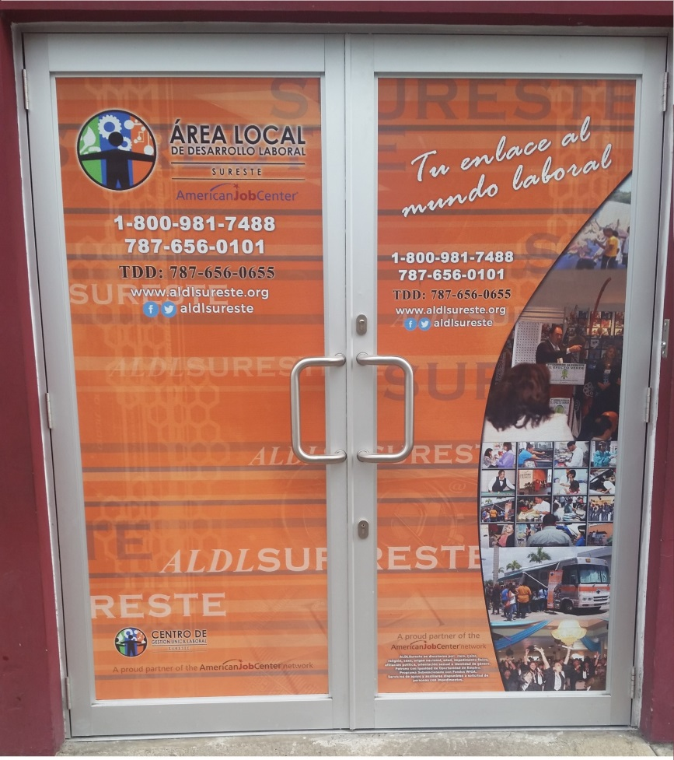
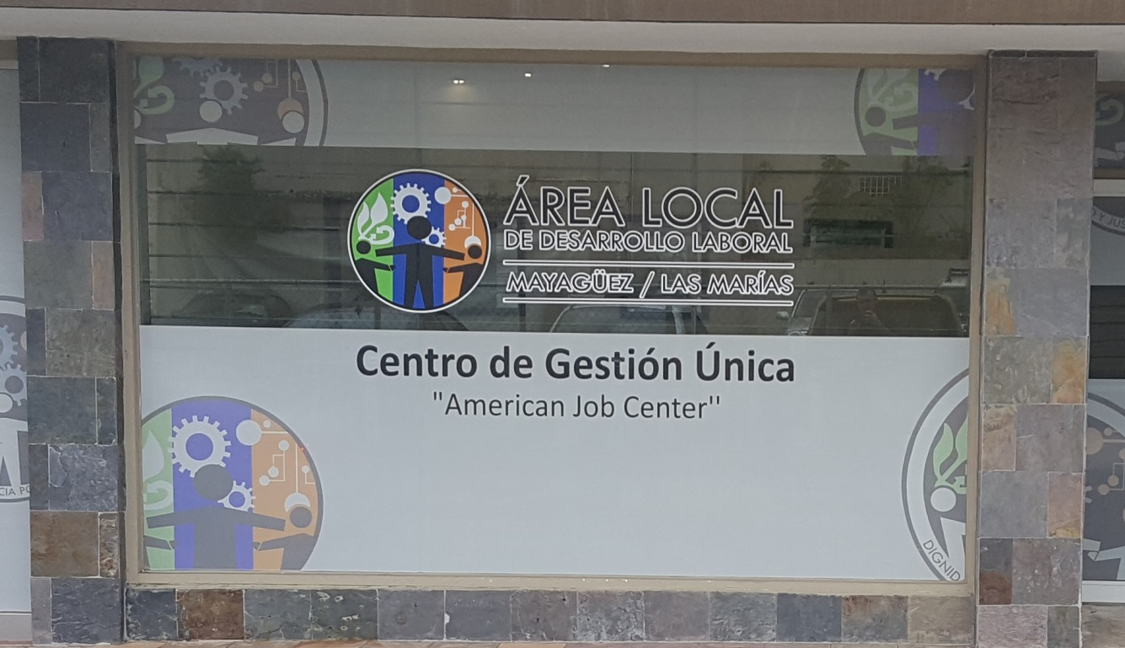
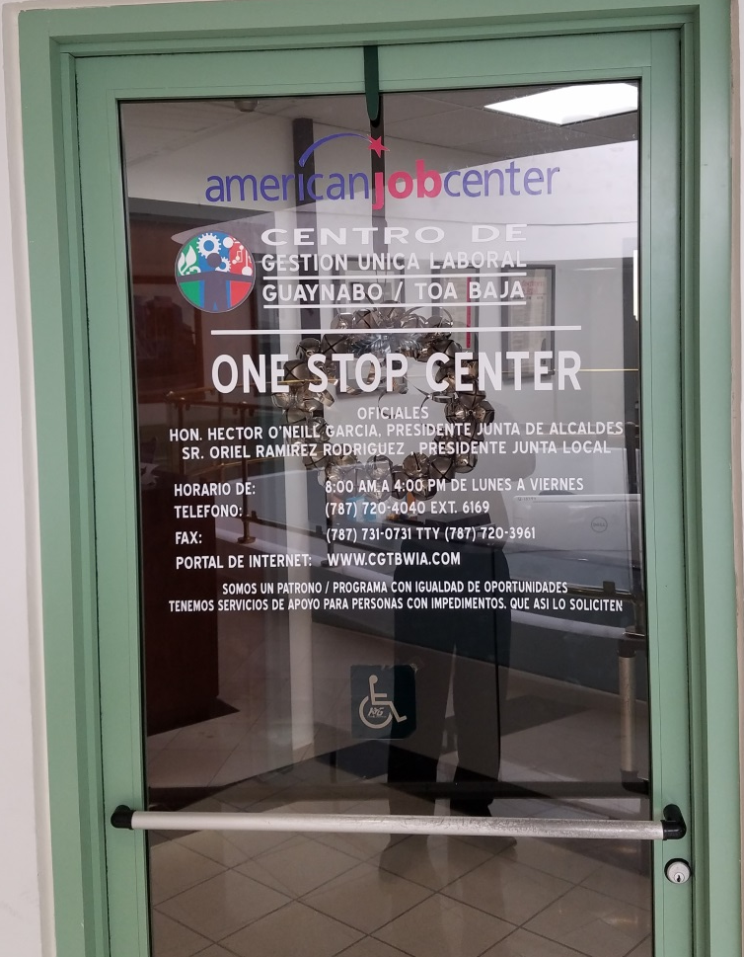
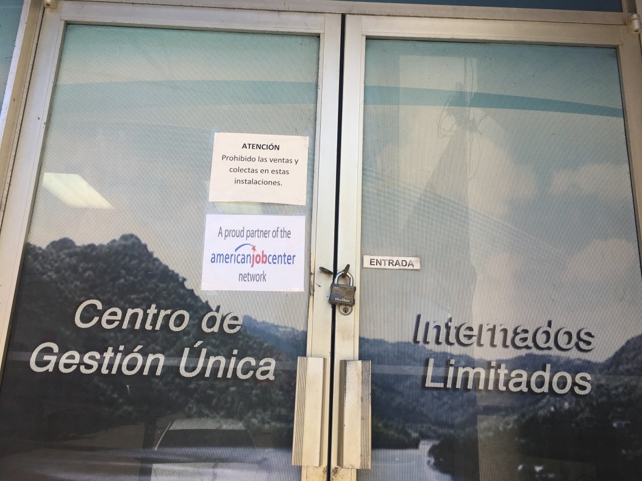

Slide 12
Frequently Asked Questions
1. What is the common identifier for the Workforce Innovation and Opportunity Act (WIOA)?
What was the deadline to co-brand all American Job Center (AJC) electronic materials?
Social Media is an electronic resource. Do we need to do some sort of common identifier or co-branding with our social media?

Slide 13
Frequently Asked Questions
4. Are core and center partners required to add the AJC logo to all their signage and printed materials? Or does this only apply to the comprehensive center location and the resource room materials distributed to customers?
5. Is this logo required on our business cards? If so, is there still a 2-inch minimum width requirement and may we print the logo on the back of the business card?

Slide 15
American Job Center Network Co-Branding
The Wisconsin Experience
John Dipko & Katie Mueller
Department of Workforce Development
AJC Branding for the Next Generation Workforce System
April 5, 2017
Webinar

Slide 16
American Job Center Co-Branding
What does this mean for us?
Department of Workforce Development
Agency has own branding & standards
Job Center of Wisconsin has distinct branding
Employment and Training
Workforce Board Monitoring
WIOA Implementation
Unemployment Insurance
Worker's Compensation
Vocational Rehabilitation

Slide 17
American Job Center Co-Branding
Agency Implementation
Not all agency work is One-Stop related
Took a broad approach to branding
Retain Job Center of Wisconsin brand
Guidance to Workforce Boards
Continue to use Job Center of Wisconsin branding
Use a broad approach to co-branding
Adult Basic Education (Title 2) Partners

Slide 18
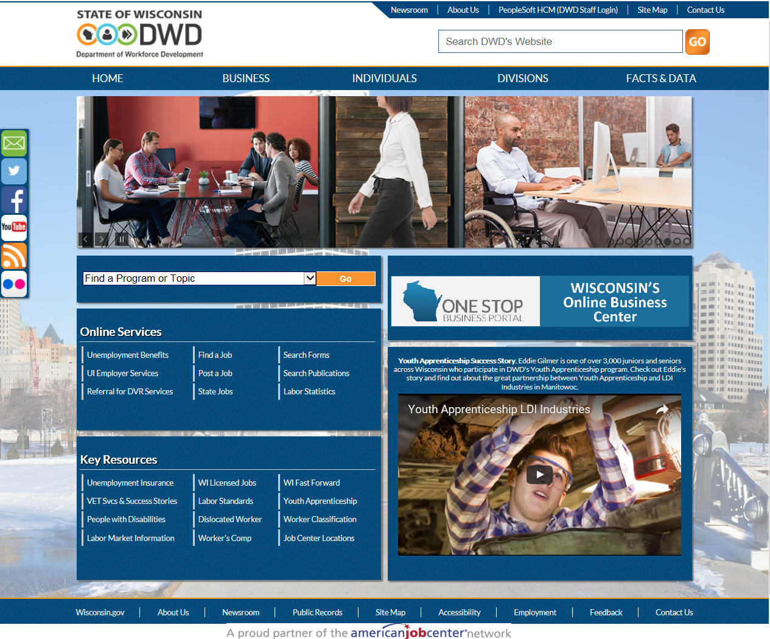
American Job Center Co-Branding

Slide 19
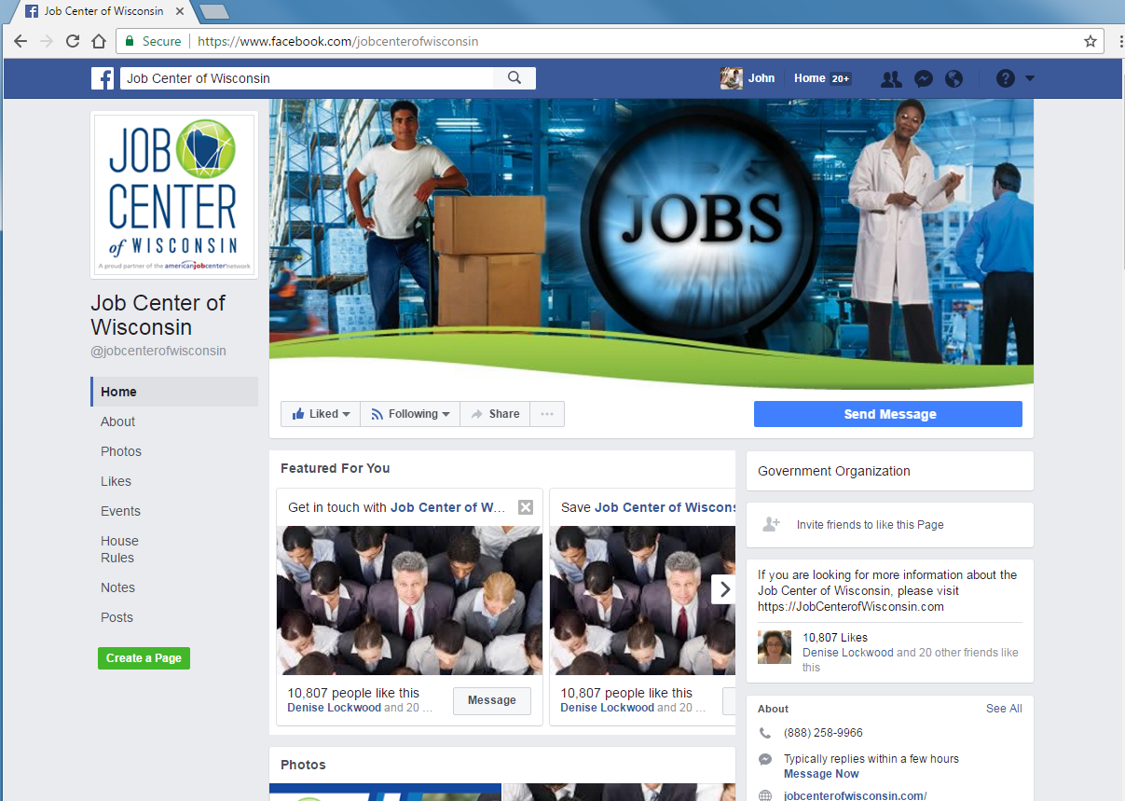
American Job Center Co-Branding
Co-Branded Social Media Accounts
DWD
Facebook
Twitter
YouTube
JCW
Facebook
Twitter

Slide 20
American Job Center Co-Branding

Slide 21
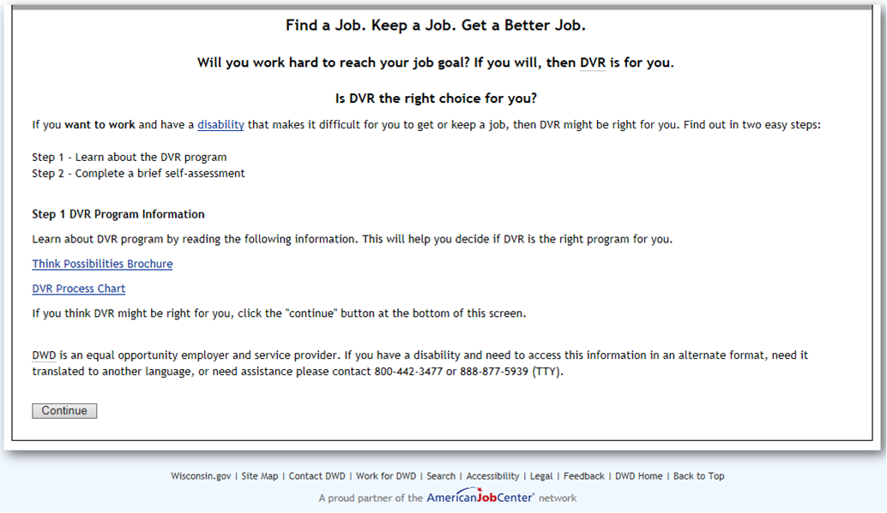
American Job Center Co-Branding

Slide 22
American Job Center Co-Branding
Keeping it Consistent is Not Easy
Recommended co-branding with current state Job Center branding
Boards have different branding throughout the state

Slide 23
American Job Center Co-Branding
A Work in Progress
Does this need the AJCN logo?
Is this part of the “One-Stop” delivery system?
A proud partner of the American Job Center network vs American Job Center Wisconsin
Educating all partners
Cost considerations
Overall Marketing Campaign
Exterior Signage

Slide 24
Questions?
John Dipko & Katie Mueller
Communications Director & Employment and Training Communications Liaison
608-266-6753/608-266-2930
John.Dipko@dwd.wi.gov Kathryn.Mueller@dwd.wi.gov

Slide 25
Terms of Use, Graphics Guide (logos in many formats and special fonts): https://www.dol.gov/ajc/
(accept the Terms of Use “button” at the bottom of the page to access logos)
AJC Network Common Identifier Fact Sheet:
https://ion.cms.workforcegps.org/resources/2016/09/30/12/11/AJC-Common-Identifier-and-Branding

Slide 26
Upcoming One-Stop Technical Assistance Events

Slide 27
Upcoming One-Stop Technical Assistance Webinars
 | Discussion on:
American Job Center Certification: A Tool to Maximize State’s Quality and Consistency of Services April 12, 2017 – 3:00pm EST | Emerging practices occurring in states evaluating effectiveness Physical and programmatic accessibility Continuous improvement
MOU Part I: Overview & Development April 26, 2017 – 3:00pm EST | Discussion of different types of MOUs and key elements Showcase a sample MOU document
To register for these events, go to https://ion.workforcegps.org/events

Slide 28
Upcoming One-Stop Technical Assistance Webinars
 | Discussion on:
Increasing Opportunity for Shared Customers: Integrated Service Delivery through the American Job Center Network May 17, 2017 – 3:00pm EST | Characteristics of Integrated Service Delivery Benefits of participating in the AJC Network Voices from the “field” w/examples and recommendations
MOU Part II: Local vs. State Funding Mechanism May 31, 2017 – 3:00pm EST | Walk-through of State and Local funding mechanism options Examples of both options
Competitive Selection of One-Stop Operators: “Deep Dive” Date TBD | In-depth dialogue re: competitive procurement process; essential contract elements; avoiding conflicts of interest; transition, implementation and monitoring
To register for these events, go to https://ion.workforcegps.org/events

Slide 30
ION Website – New Focus Areas Tab
The new Focus Areas navigation tab on the ION homepage offers a host of resources on 11 key elements of WIOA. This information was formerly housed on the WIOA Implementation Training page.

Slide 31
Thank you for joining us!

