Slide 1
Customer Centered Design Challenge
Launch of Round 4
April 2017

Slide 2
VIRGINIA HAMILTON
Regional Administrator, Region 6
San Francisco Employment and Training Administration
U.S. Department of Labor

Slide 3
Today’s conversation
Review customer-centered design basics
Hear from Paul Ventresca (Salem, MA) and Robyn Bumgardner (Commonwealth of Virginia)
What to expect from the course
How to register
Q&A

Slide 4
Be customer focused
“These proposed regulations would establish requirements of the one-stop career center system as defined under WIOA, requiring partners to collaborate to support a seamless customer-focused service delivery network.”

Slide 5
WIOA regs mention customer 140+ times.

Slide 6
Poll for participants
I’m new to customer-centered design
I know someone who has taken the class
I’m a skilled novice
I’m a pro!

Slide 7
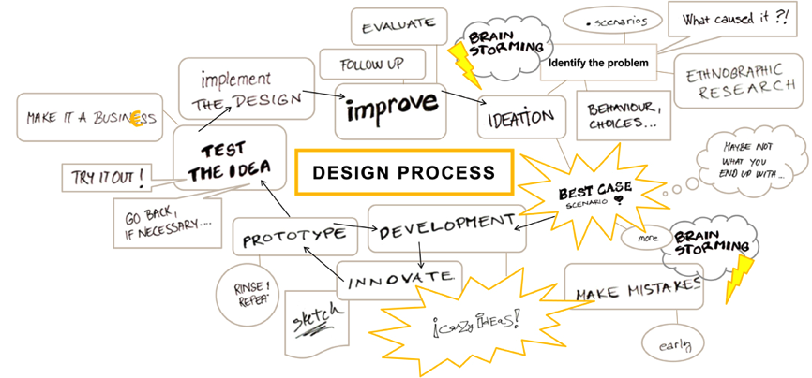
How it works
May
June - July
August
Fall
Launch webinar
Take class, prototype, test
Learning Exchange in D.C.

Slide 8
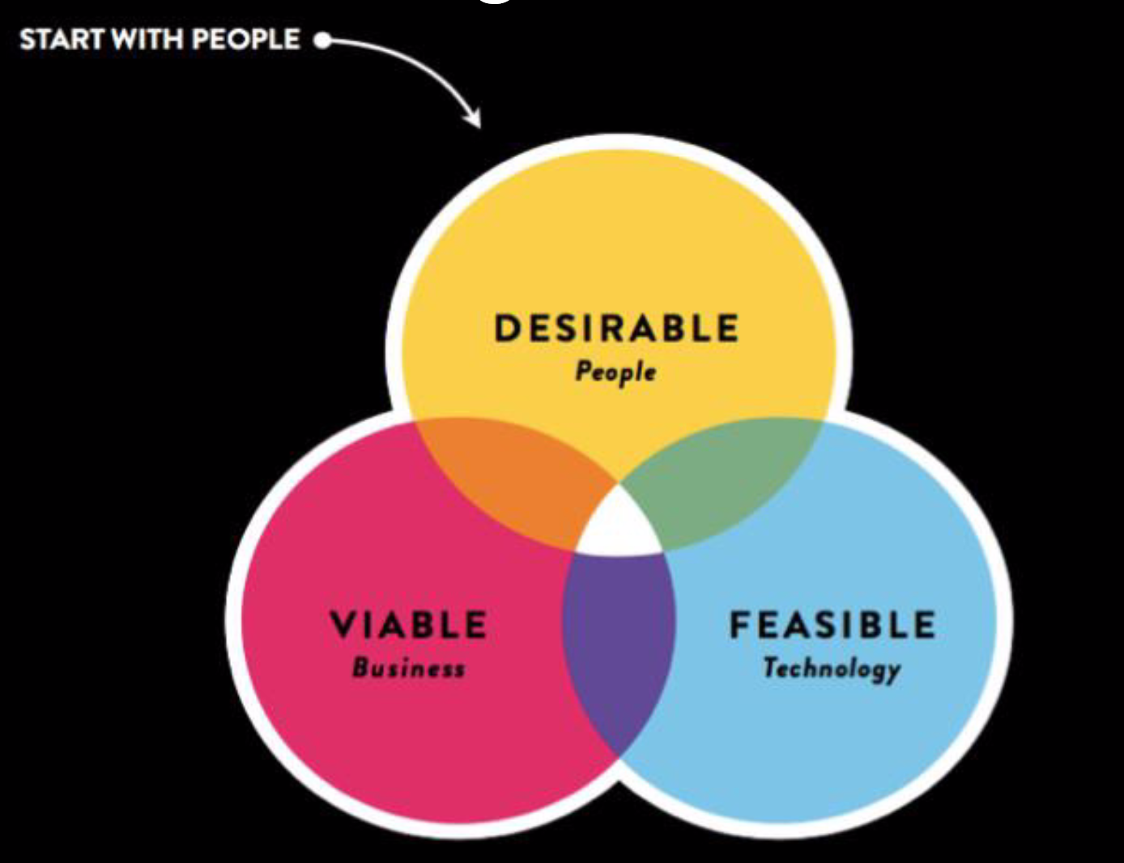
Using Customer Centered Design

Slide 9
THE HCD PROCESS
A collaborative, discovery-based journey.
Get inspired by the people you’re serving.
Start by listening to people to get new ideas about how to design for them.
Identify patterns and surprising insights to inspire new opportunities for design.
Brainstorm new ways to serve your customers.
Try out your ideas and get feedback from customers – so you can revise your prototypes and get more feedback.
Try out a pilot program and experiment with ways to implement your new ideas.

Slide 10
How might we...
assume solutions exist

Slide 11
How might we...
reduce risk and commitment

Slide 12
How might we...
do it together

Slide 13
Empathy: Observe, Engage, Immerse
Business needs are elusive
Clearly identifying the skills gap can be difficult.
Here is what we did hear
Employers voiced dissatisfaction with “quality” of local workforce.
Employers described a lack of promotable workers.
Surveys indicated a significant need for soft skills development
“Give me a person who knows how to work, and I can train them to do the job.”
-every employer, everywhere

Slide 14
Empathy: Observe, Engage, Immerse

Slide 15
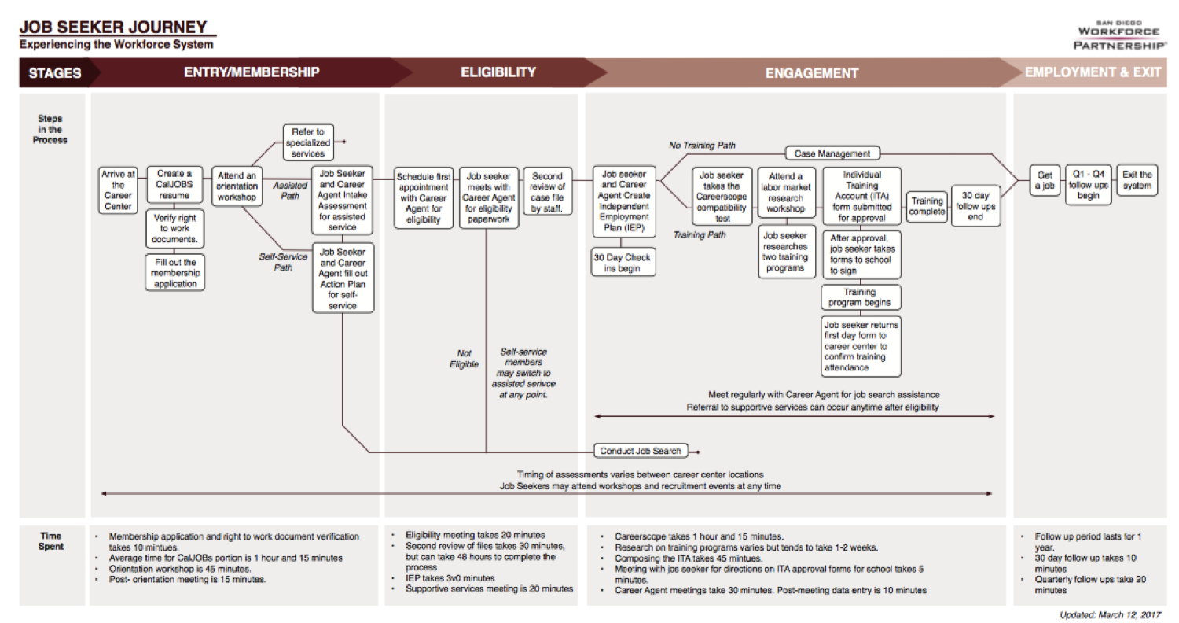
Empathy: Observe, Engage, Immerse

Slide 16
“
I’m copying a friend’s resume, but putting my words to it because I don’t know how to make one.
“
David, 18
What if?
Instead of resume-building classes, we provided templates for youth to adapt quickly, since a resume is a means to an end at this stage?

Slide 17
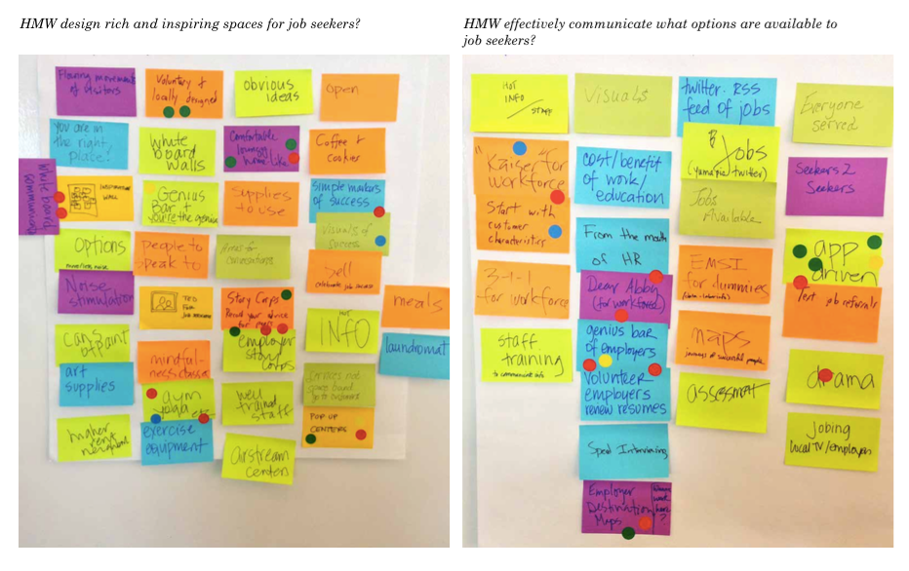
How might we...

Slide 18
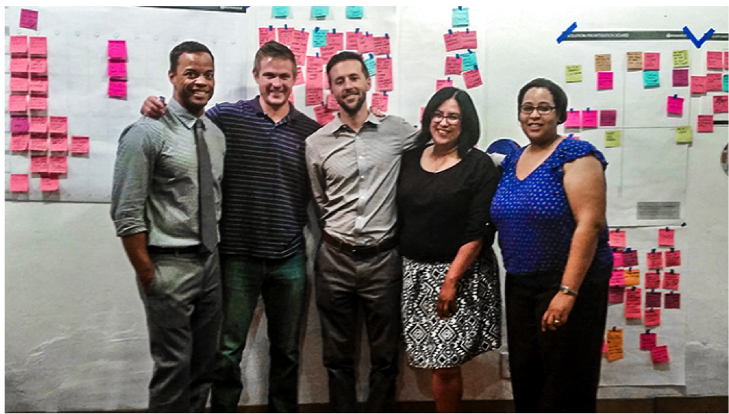
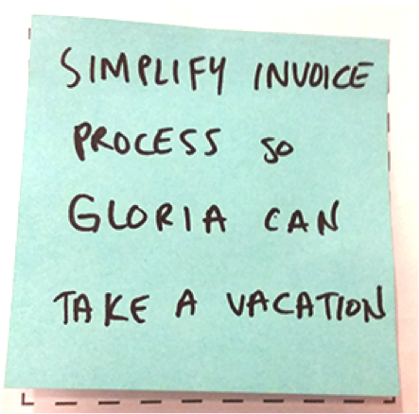

Slide 19
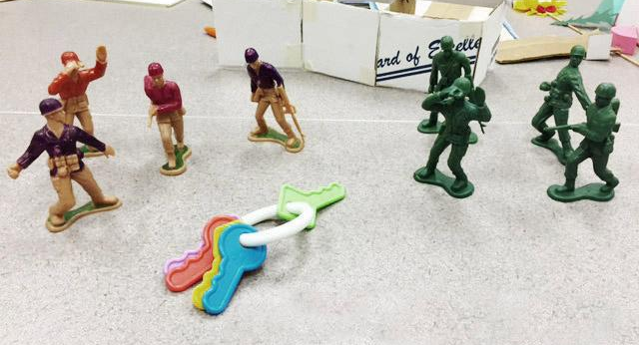
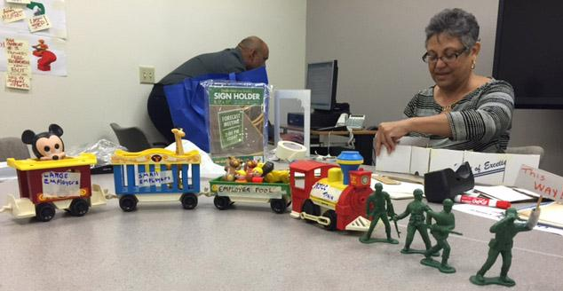
Ideate and Prototype
The key is to form one team and to be seen as one team
One team leading the way for small and large employer pool to the workforce resource center (AJCC)

Slide 21
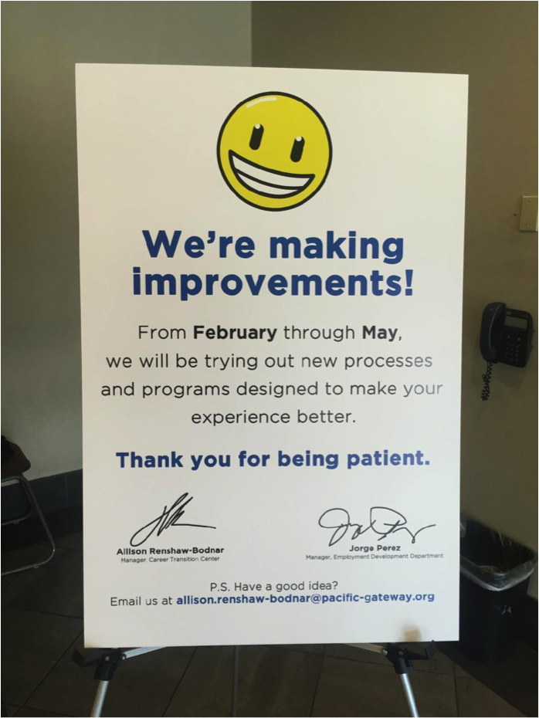
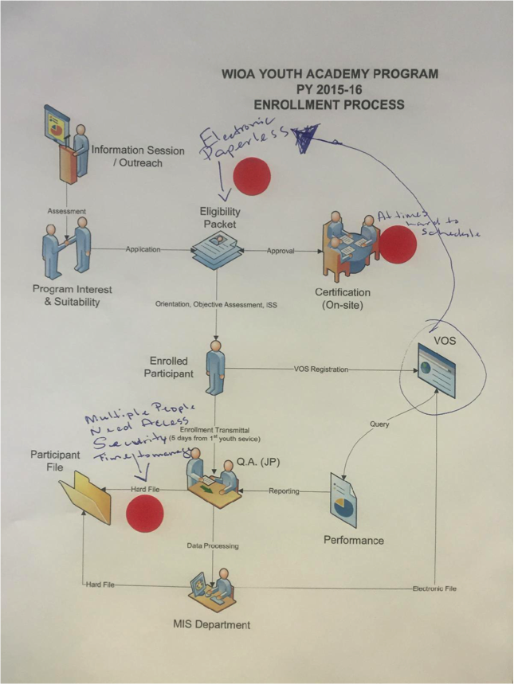
Prototype and Test

Slide 22
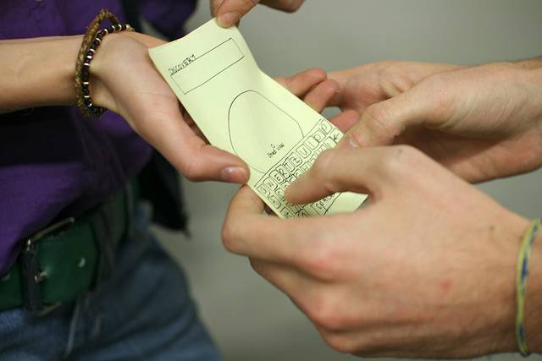

Slide 23
The outcomes
Services are designed for employers and job seekers that better meet their needs.
WIOA implementation is transformative, not “check-the-box.”
You and your Team are supported to think outside of what you know, and use tools to make implementation happen in new, creative ways.
Federal, state, and local workforce professionals have a much better understanding of who the customer is.
Service design happens in a collaborative way with all stakeholders participating.
There is capacity in the system for on-going process improvement, and agencies use design thinking as a regular practice.

Slide 24
North Shore Career Center

Slide 25
Started CCD 2015 with employer focus
How might we design a system to put employers in the center of our sector strategies and career pathway work?
New insights into how to build customer feedback into our everyday work and hold regular customer service interviews
Increase response time to companies that post on the statewide posting site with good, strong referrals mined from the database
Created new relationships to better understand career pathways on the north shore and increase the effectiveness of our sector strategies

Slide 26
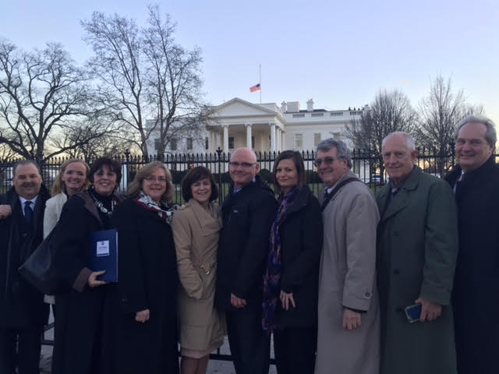
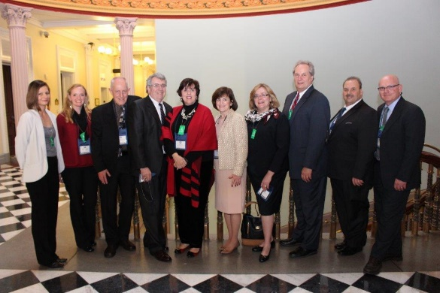
White House Learning Exchange 2015
Deepened our research on employer centered sector work and allowed for a more intense response – and more success for our employers and job seekers.

Slide 27
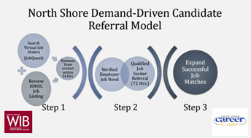
North Shore’s Demand-Driven Candidate Referral Model

Slide 28
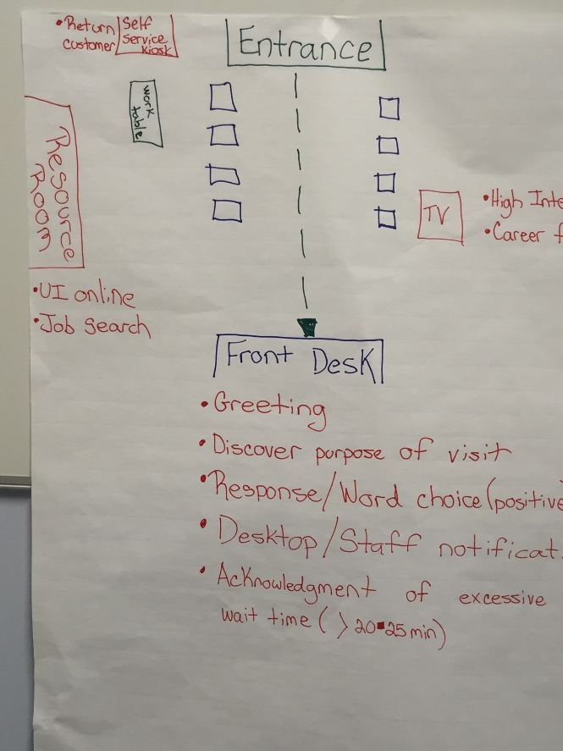
How might we
Enhance our customer’s experience at job centers?
Increase awareness for business and partners regarding “re-entry citizens” to create a better understanding of these customers?

Slide 29
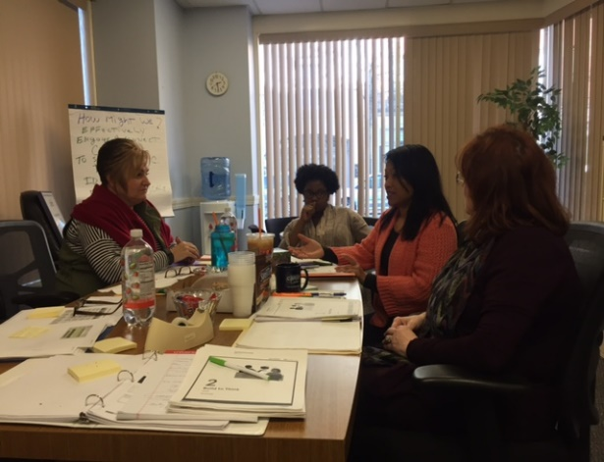
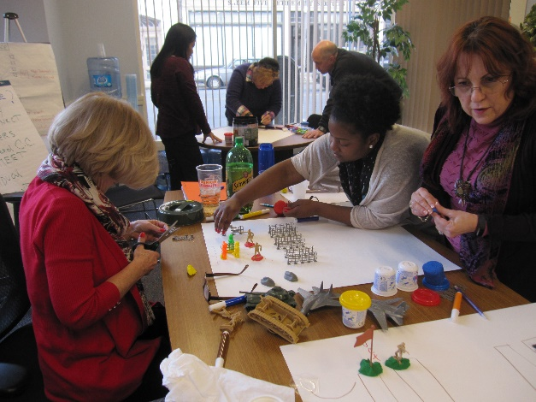
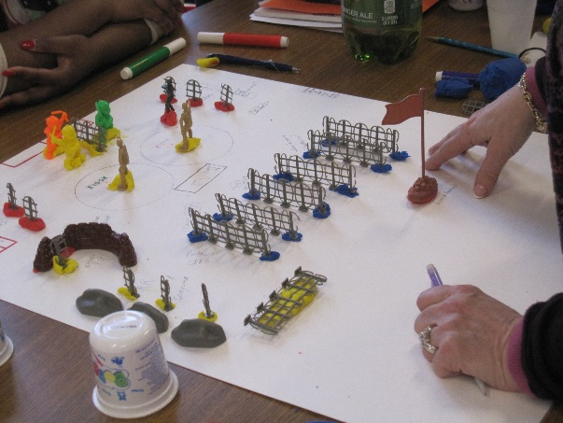
How might we
Effectively engage and connect customers to specialized career center and partner services to meet individual employment goals?
Inspiration Ideation Implementation

Slide 30
Lessons learned: this is fun
Incorporated CCD strategy into WIOA plans
Gave each team member an equal voice
Improved our communication with customers providing an easier process into the center
Implementing Lean Practices and Design Principles to ensure a deeper refinement and adjustment in culture
Expanding partnerships by working with the Professor and students in Salem State University Business School Operations and Decisions Science Department’s Lean Systems

Slide 31
Virginia connects with job seekers to improve their One-stop experience

Slide 32
VA Program Managers DOL-CCD #2 Team
Alex Berry, Coordinator of Career Pathways Grant Programming
Virginia's Community Colleges Workforce Development Services
Office: (804) 819-1675 Email: aberry@vccs.edu
Robyn Bumgardner, Reemployment Services Manager
Virginia Employment Commission
Office: (804) 692-0188 Email: robyn.bumgardner@vec.virginia.gov
Latonya English, Deputy Director
OppInc One-Stop Workforce Center
Office: 757-461-7537 Email: lenglish@hamptonroadsworks.org
Robert E. Henry, WIOA Youth, State Programs Coordinator
Virginia's Community Colleges Workforce Development Services
Office: (804) 819-1686 Email: rhenry@vccs.edu
Sinclair Hubard, State Lead, Disability Employment Initiative
Department for Aging and Rehabilitative Services
Office: (540)-214-3367 Email: Sinclair.Hubard@dars.virginia.gov
Aida Lupe Pacheco, Program Grants Manager
Virginia’s Community Colleges Workforce Development Services
Phone: 804-819-1685 Email: apacheco@vccs.edu
Sherry Pearson, Owner
Job Assistance Center
Office: 804-785-2470 Email: spearson@jacinc.net
Don Sandridge, Business Services Representative
Job Assistance Center
Office: 804-785-2470 Email: dsandridge@jacinc.net
Kristi Sargent, Center Manager
Prince William SkillSource Center
Office: Phone 703-586-6542 Email: Kristi.Sargent@myskillsource.org
Nancy J. Stephens, One-Stop Director
OppInc One-Stop Workforce Center
Office: 757-461-7537 Email: nstephens@hamptonroadsworks.org

Slide 33
How do we effectively engage our job seeker customers at the
initial job discovery phase?
Why We Took the Challenge
What Surprised Us
Evaluate CCD as a tool for transforming Virginia's Workforce System
Improve customer service because the Workforce System is confusing
Reduce barriers job seeking customers encounter when accessing services
Build bridges across silos / increase cross-program collaboration
How the CCD process helped us narrow down and focus on a single aspect of the service process.
It takes effort to set aside what we “think” and to “see” through the customer’s eyes.
To serve the participant, you need to meet them where they are.
Despite diversity on the team, our thoughts about customer service were very similar

Slide 34
Advice for your journey
Commit
This is your learning experience
Take away what you put in
Share
Team leader—ask for help
Team member—volunteer to help
Calendar
Lay out your schedule
Agree on how to handle the unexpected
Be Open
Right-brained, creative process
Especially if you are accustomed to being “in charge”
Trust
Do each exercise
May not seem rational, but it works!

Slide 35
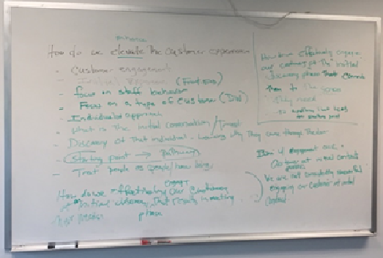
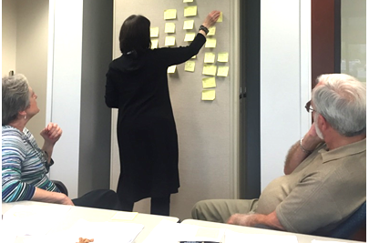
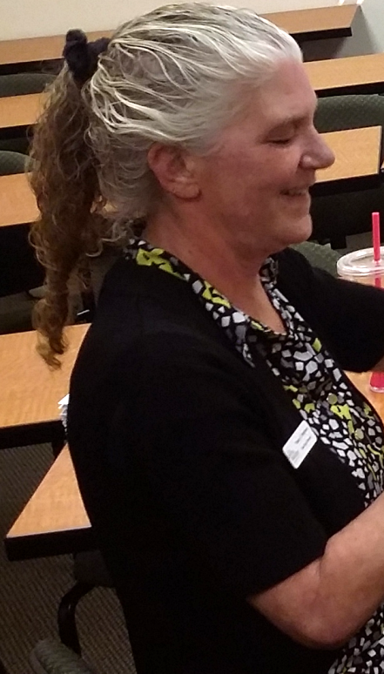
Who else is ready to take on the challenge?

Slide 36
We’re in this together.
Caitlin Docker, Code for America

Slide 37
Your Timeline
April: Form your design team
Identify your challenge
May 9: Register your team
Start the course
July 4: Course concludes
June and July: Implement prototype
April
May
June
July
August
September
Aug.: Submit application
June: Take the course
Participate in 1:1 coaching
Sept.: Selected teams
announced and visit D.C.

Slide 38
IDEO…Acumen...NovoEd...DOL
Is there a set class schedule every week?
No. There is a set curriculum to cover each week, but you are free to review the prep material and meet with your design team within each week whenever it is convenient for the group. It’s a good idea to consider your team’s availability when forming a group.
Will a certificate be awarded upon completion of the course?
Yes, subject to course completion (completion of all assignments), you will receive a statement of accomplishment signed jointly by +Acumen and IDEO.org.

Slide 39
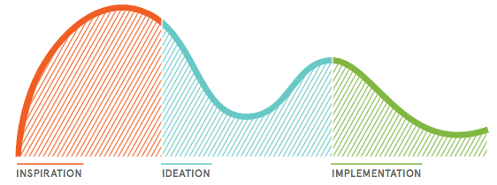
Course begins May 9th
Class 1: Introduction to Human-Centered Design—1 Week
Class 2: Inspiration Phase—2 Weeks
Class 3: Ideation Phase (Synthesis)—1 Week
Class 4: Ideation Phase (Prototyping)—2 Weeks
Class 5: Implementation Phase—1 Week

Slide 40
How the course works
Work with a team of 2-6 people for your “design team"
Apply the human-centered design methods to one of seven workforce development challenges
Explore the main human-centered design concepts through readings, case studies, and short videos
Interact and gain inspiration from design teams around the country

Slide 41
What you will learn
Equip you with the mindsets and methods of human-centered design
How to experiment with low risk
How to identify patterns and opportunities for concept development
Inspiration to approach challenges differently
Hands-on experience speaking to, prototyping for, and testing solutions with the people you’re designing for

Slide 42
Pick one “how might we” challenge
One-stop customers
How might we improve the customer experience and outcomes for our shared One-stop customers?
Employers
How might we put employers in the center of sector strategies and career pathway work?
Out of school youth
How might we design services and programs for out-of-school youth that will engage them and produce strong outcomes?

Slide 43
Pick your challenge (con’t)
Formerly incarcerated individuals
How might we help formerly incarcerated individuals obtain employment and education, develop healthy relationships, and make positive decisions?
Individuals with disabilities
How might we design services that are physically and programmatically accessible to individuals with disabilities?
English language learners
How might we improve the customer experience for English language learners across partner programs?
Leadership
How might we design and accelerate cross-sector leadership training for the workforce system?

Slide 44
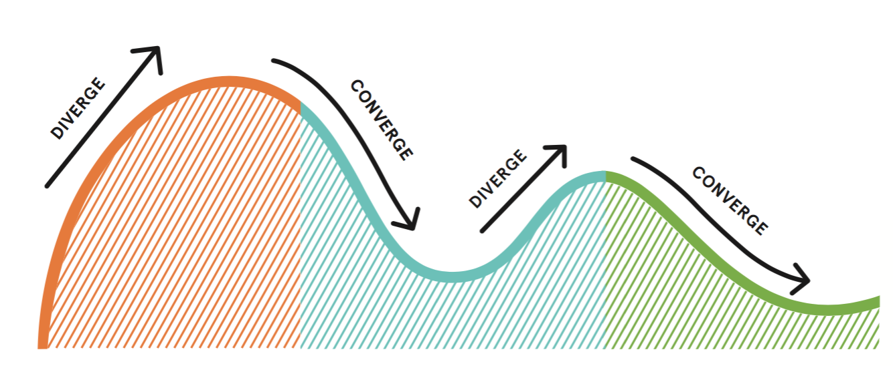
Get to “build”
Discover
Better understand your partners, users, and the challenges they face.
Brainstorm
Make sense of everything that you’ve heard, generate tons of ideas, develop a strategy.
Start building
Get to a prototyping, set metrics, and get it out into the wild!

Slide 45
Build your design team
Engage a diverse group with 5-8 members.
If the team is too small you may lose the benefits of a multidisciplinary team, but too large and it may be difficult to coordinate schedules
Select people from different backgrounds or have different skill sets. You'll have a better chance of coming up with unexpected, innovative solutions.
Include partners from
Core partner organizations
Stakeholders that “touch the customer”
Front line staff
Business services staff from various partners
Customers

Slide 46
Workload
This is a self paced, online course
Reserve at least 5 hours each week for
1-2 hours of individual work
2-3 hours of in-person (or Skype) group work

Slide 47
How to register
You’ll receive an email with a link to register your team after this webinar
Team Lead, Alternate Lead, and 4-6 others
Register your team: http://bit.ly/customerdesign4

Slide 48
Your support team
Department of Labor
Virginia Hamilton
HIP
A great bunch of coaches!
Code for America
Caitlin Docker

Slide 49
Coaching Support
Weekly communication with experienced user researchers and coaches
Tips on how to facilitate meetings
Ideas on how to narrow your “how might we” challenge
Support communicating with your partners
Sharing information with other teams and the field

Slide 50
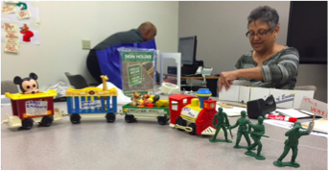
Suggested supplies
Post-it notes or scrap paper cut into squares
Pens, pencils, markers, paper, tape
Prototyping supplies
Mobile phones or a camera to document your work
Prototyping supplies: trains, toy soldiers, hardhats, mickey mouse, cardboard boxes

Slide 52
Q&A

Slide 53
Questions? ccd@hipimpact.com

