Slide 3
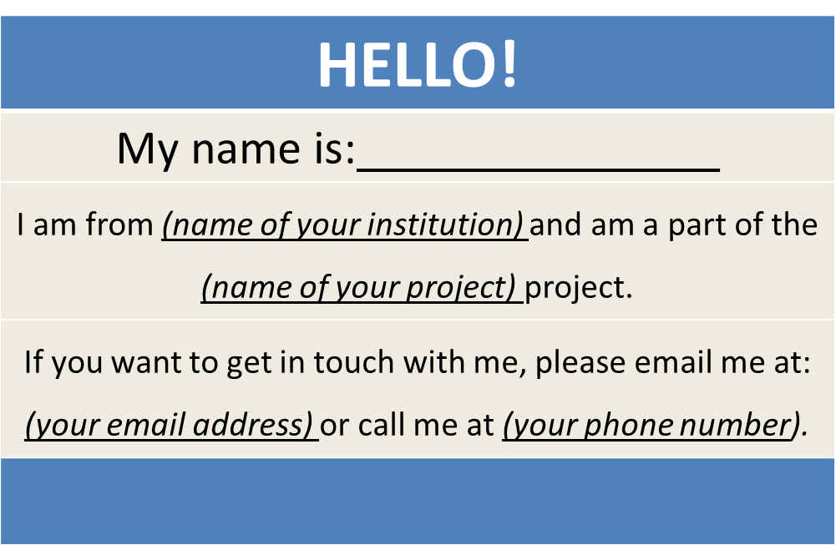
TechHire Grantees
Create a virtual name tag…

Slide 4

Grantee Polling Question
Let’s get to know who is on the call today. Using the poll, select the role that you play in your TechHire grant
Choose the answer that best reflects you (or your group):
Authorized representative
Program director/manager
IT/Data manager or staff
Training partner
5. Employer partner
6. Service Provider
7. Other (please specify!)

Slide 5
H-1B TechHire Grants Technical Assistance Launch Webinar
Jobs for the Future

Slide 6
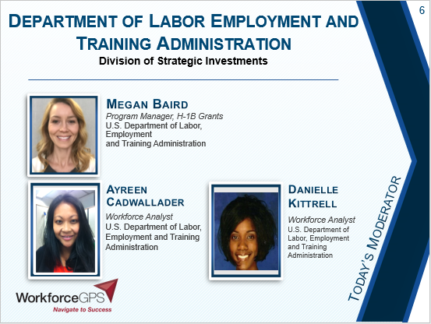
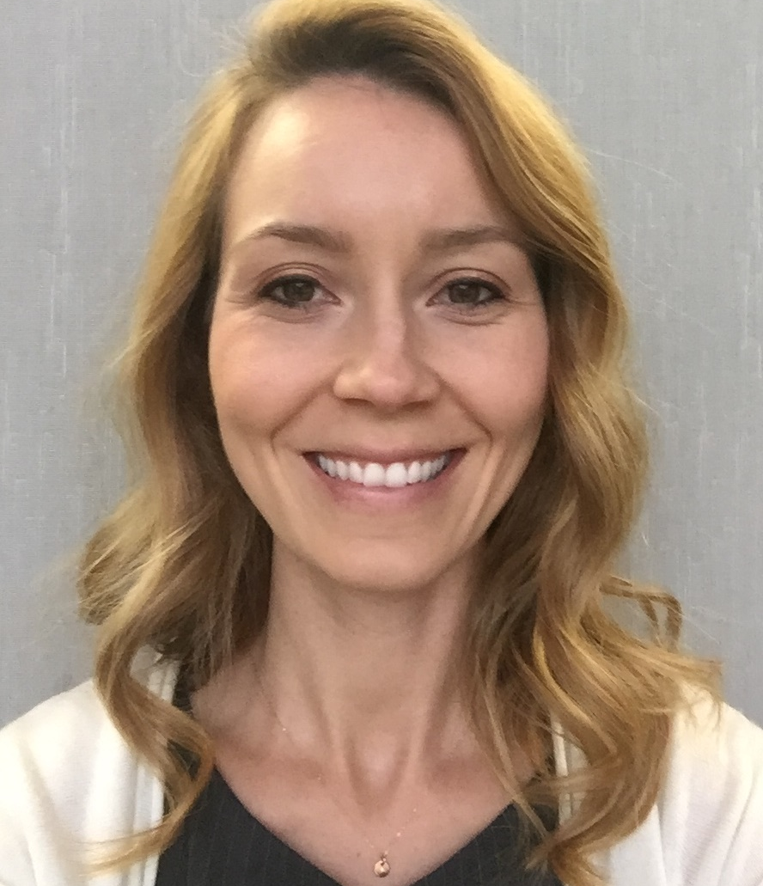

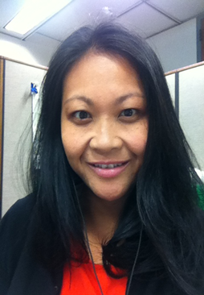

Megan Baird
Department of Labor Employment and Training Administration
Division of Strategic Investments
____________________________________________________
Program Manager, H-1B Grants
U.S. Department of Labor,
Employment
and Training Administration
Ayreen
Cadwallader
Danielle
Kittrell
Workforce Analyst
U.S. Department of Labor,
Employment and Training
Administration
Workforce Analyst
U.S. Department of
Labor, Employment
and Training
Administration

Slide 7

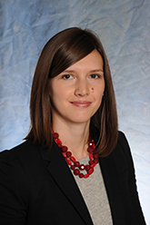
Tom Hooper
Senior Director
Jobs for the Future
Sara Lamback
Senior Program Manager
Jobs for the Future

Slide 8


Todd Cohen
Director, Strategic Initiatives
Maher & Maher
Bridget Brown
Senior Workforce Development Specialist
ICF International

Slide 9
Provide an overview of planned H-1B TechHire programmatic TA activities
Introduce the TA team (and roles) to grantees, including coaches and SMEs
Provide an overview of the coaching process, including coach/grantee matches
Alert grantees to upcoming H-1B TechHire
events and activities

Slide 10
12:00 | TechHire program overview
  Snapshot of grantees
12:15 | TechHire programmatic TA
  The TA Team
  TA Goals and objectives
  TechHire coaches: roles and introductions
12:35 | Upcoming events and activities
12:45 | Questions and discussion
1:00 | Closing

Slide 11
TechHire Program Overview
Ayreen Cadwallader
Workforce Analyst
H-1B Grants

Slide 12
TechHire Program Overview
DOL TechHire Grant Objectives:
  Expand access to accelerated learning strategies that provide the fastest paths to good jobs;
  Improve the likelihood that the TechHire Target populations complete training and enter employment;
  Connect those who received training or have the skills to employment, paid internships, and Registered Apprenticeship opportunities.

Slide 13

Overview of Grantees
DOL awarded nearly $150 million
39 public and private partnerships
  Located across 25 states, 4 of these projects are multi-state projects
  Awards range from $2.1 million to $5 million
Period of performance is 48 months
  Grant start date: July 1, 2016
  Grant end date: June 30, 2020

Slide 14
H-1B TechHire Grantees

Slide 15
TechHire grantees
Nearly 19,000 participants will be served through the
TechHire grant program
Target Populations include:
  Youth and young adults age 17-29 (33 grantees)
  Individuals with criminal records (3 grantees)
  Individuals with limited English proficiency (2 grantees)
  Individuals with disabilities (1 grantee)
H1-B Industries
  Information technology
  Advanced manufacturing
  Health care
  Financial services
  Other: Biotech, professional and technical
  services, education services

Slide 16
Grantee Polling Question
In what stage of implementation
is your TechHire project?
Choose the answer that best reflects you (or your group):
Preparation: Key staff are still being hired, identification of key policies and procedures
Early Implementation: Staff hired, initial participants recruited for service delivery
Full Implementation: Project is fully implemented and staff are providing skillful service delivery
Other (please specify in the textbox!)

Slide 17
TechHire Technical Assistance

Slide 18



The Full TechHire TA Team
Maher &
Maher
Todd Cohen
ICF
International
Brent Orrell and
Bridget Brown
Jobs for the Future
Tom Hooper and
Sara Lamback
Together, the TA team will:
  Provide TA to TechHire grantees
  Support the TechHire Program Office and your Federal Project Officer (FPO)
JFF will coordinate all TechHire TA activities

Slide 19
Overview of TechHire TA
Programmatic TA activities will help grantees achieve the goals and objectives of the TechHire program
  Activities will be offered through various different formats to best meet grantee needs, including:
    Universal: all grantees are encouraged to participate
    Targeted: activities that focus on the needs of a small group of grantees
    Individualized: one-on-one TA activities for
    individual grantees

Slide 20
TechHire TA Modalities
TA Form | Delivery Details | TA Level
Coaching Calls | Monthly calls with grantees to discuss progress and provide them with customized TA. | Individual
Virtual TA Meetings | These bi-monthly webinars and/or consultancies will draw on innovative web-based formats (e.g., facilitated chat, interactive webinars) to engage grantees and convey information on key programmatic topics | Universal
Peer Learning Groups | Quarterly small-group discussions on a specific topic; these discussions will provide an opportunity to learn from expert practitioners, including SMEs, and to share strategies across TechHire grantees | Targeted and Universal
Convenings | In-person and virtual convenings will provide opportunities for peer-to-peer learning and networking as well as
TechHire CoP | Curated resources and new resources developed by Team to support implementation. Online discussion boards moderated on the TechHire CoP on WFGPS. | Universal
Written Resource Materials | The TA team will develop materials such as resource briefs, case studies, and FAQ documents, based upon specific grantee needs. | Targeted and Universal

Slide 21
Grantee Polling Question
Peer networking is a valuable TA strategy. Which of the following types of TechHire peer learning group are you most interested in?
Choose the answer that best reflects you (or your group):
Industry-based peer groups
Peer groups based upon target populations
Peer groups based upon training strategies
Other (please specify!)

Slide 22
Potential programmatic topics
Employer engagement and creating industry-aligned sector partnerships
Participant recruitment
Tailoring training strategies for targeted populations
Using customer-centered design
Comprehensive supportive services for targeted populations
Planning for sustainability
Leveraged funding: strategies to leverage public and private resources

Slide 23
Grantee Polling Question
In what area is your TechHire partnership
particularly strong?
Choose the answer that best reflects you (or your group):
Employer engagement
Developing and maintaining partnerships
Recruitment
Other (please specify in the textbox!)

Slide 24
Responsive TA
TA topics and events will be driven by your needs. As such we’re building in several grantee
feedback loops:
  Coaching calls
  Virtual TA events/Peer calls → “TA Ideas Box”
  Convening → “White-boarding Needs”
  Online CoP → “Discussion Boards”

Slide 25
Grantee Polling Question
Which topic represents a TA need
for your partnership?
Choose the answer that best reflects you (or your group):
Understanding H-1B occupations and industries
Leveraging resources to support TechHire partnerships
Collaborating with industry partners on program design/delivery
Other (please specify!)

Slide 26
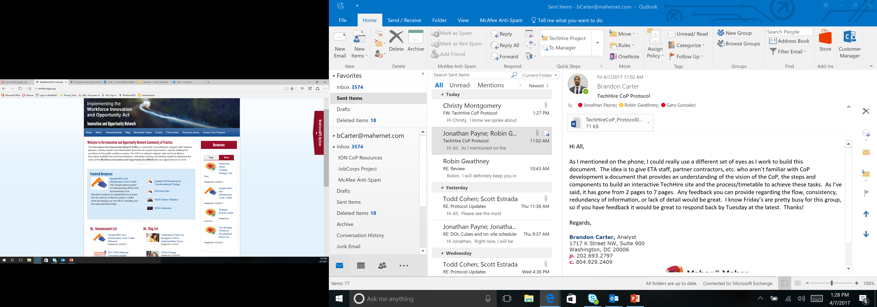
The TechHire CoP
Your centralized location to find grantee resources and information
Peer-to-peer sharing
Latest project announcements, best practices
Coming soon!

Slide 28
TechHire Coaching

Slide 29
The Role of your TechHire Coach
Federal Project Officer’s Guidance | TA Coach’s Guidance
Clarification of H-1B FOA, including definitions | Organizational structure: staffing, systems, and processes
Statement of work modifications | Participant outreach and recruitment strategies
Fiscal questions, including allowable expenditures and budget | Participant services, including case management, supportive services, and job placement
Quarterly performance outcomes against target outcomes | Training design and implementation
Other policy questions, as they arise | Employer engagement and participant placement

Slide 30
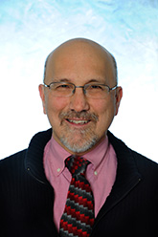

Randy Wilson
Associate Research Director
Jobs for the Future
Matt Poland
Senior Program Manager
Jobs for the Future

Slide 31
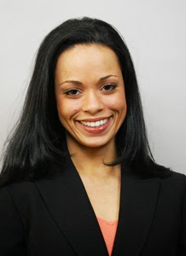
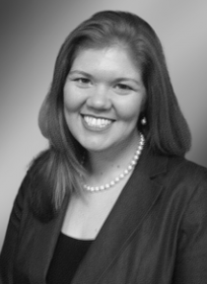
Todd Cohen
Director, Strategic Initiatives
Maher & Maher
Silvia Middleton
Senior Analyst
Maher & Maher
Christy Montgomery
Senior Analyst
Maher & Maher

Slide 32

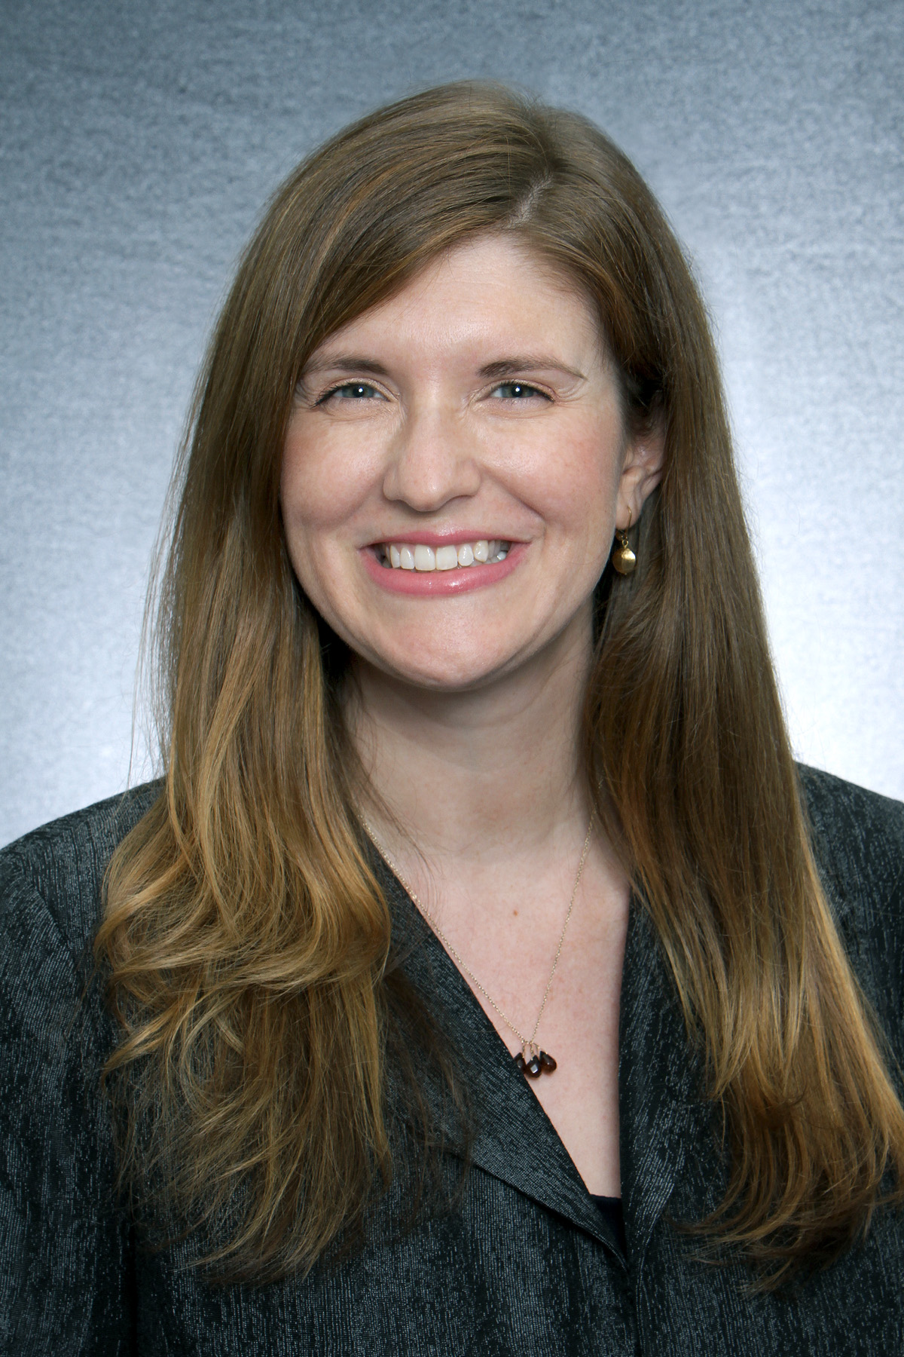

Lynn Bajorek
Senior Consultant
Maher & Maher
Venessa Marks
Senior Manager
ICF International
Jessica Kendall
Senior Technical Specialist
ICF International

Slide 33
Immediate TechHire TA Next Steps
TechHire TA Guide Release: this guide outlines our TechHire TA efforts and identifies your dedicated TA coach.
  Guide will be released via email following this webinar.
Initial Calls with TA Coach: Your TA coach will contact you via email (primary program POC) within the next week!
  Your FPO will be copied on this correspondence.

Slide 34
Other Upcoming TA Activities
April
  Grantees review TechHire TA guide
  Coaches will schedule initial calls with grantees
May
  Coaching calls
  May/June: Grantee Needs Assessment
June
  Launch of online TechHire Community of Practice (CoP)
Summer 2017
  Grantee convening (pending)
Performance Reporting Technical Assistance Coming Soon!

Slide 36

Program Contact Information
Please ensure we have the most up-to-date
program contact information!
Please send updated contact information in an email to techhire@dol.gov with:
  The name of your grant organization,
  Grant number, and
  The following information for each
  Program Contact:
    Name;
    Title;
    Address;
    Telephone number; and
    Email address

Slide 37
TechHire Grantee Mailbox
TechHire@dol.gov
To Reach your Federal Project Officer, DOL National Office and Technical Assistance Providers

Slide 38
Grantee Polling Question
How do you feel after today’s webinar?
Choose the answer that best reflects you (or your group):
Geronimo! We are ready to jumpstart our program!
TechHire What?!…We still have a few
more questions!
A little overwhelmed, but excited!

