Slide 1
Memorandums Of Understanding: Part 1
Overview and Development
04/26/17
Presented by:
U.S. Department of Labor

Slide 2
Charlotte Harris
Workforce Analyst
Office of Workforce Investment
Jennifer Friedman
Division Chief
Region 2 – Philadelphia Office

Slide 3
Provide overview on the development of the MOU to include MOU negotiations
Discuss the purpose, elements, and modification of the MOU
Share strategies from State and local workforce agencies
Upcoming One-Stop Technical Assistance Webinars

Slide 4
Intent
Implement a collaborative and good-faith approach to negotiations
Demonstrate the spirit and intent of WIOA
Ensure successful integration and implementation of partner programs in American Job Centers

Slide 5
How would you describe your organization’s current relationships with the required partners outlined in WIOA?
We have strong relationships with all required partners.
We have strong relationships with some required partners, and are working on developing partnerships with others.
We have some relationships somewhat in place and need to make connections with most other required partners.
We are at the beginning stages of partnering with most of the required partners.

Slide 6
Memorandum of Understanding (MOU)

Slide 7
Purpose of the MOU
The purpose of a Memorandum of Agreement is to establish the roles and responsibilities of the Local Workforce Development Board, the chief elected official (CEO) and the one-stop partners in relation to the management of the American Job Center network.

Slide 8
Negotiating the MOU
Introduce negotiations with a strong, joint (cross-agency) mission and vision statement. This may help set the right tone and emphasize how vital this process is to the economic growth of the area.
Strategy #1

Slide 9
Negotiating the MOU
Strategy #2
Tie the MOU components back into the goals and objectives of the area’s Regional or Local Plan, or perhaps even to the State’s Unified or Combined State Plan.

Slide 10
Negotiating the MOU
Strategy #3
Carefully analyze business and job seeker customers’ needs in consideration of:
Geographic location and infrastructure,
Population concentration, and
Employer concentration

Slide 11
Partner Representation
All required partners must be included in the MOU.
WIOA places a great deal of importance on effectively serving those individuals with barriers to employment, such as individuals with disabilities.

Slide 12
REQUIRED ONE-STOP PARTNERS |  |  | Section 121(b)(1)(B) and 20 CFR 678.400
Department of Labor | WIOA Title I Programs | Adult, Dislocated Workers, and Youth
 |  | Job Corps
 |  | YouthBuild
 |  | National Farmworker Jobs Program (NFJP)
 |  | Native American Programs
 | Wagner-Peyser (Employment Services)
 | Senior Community Service Employment Program (SCSEP)
 | Trade Adjustment Assistance (TAA) Program
 | Unemployment Compensation (UC) Programs
 | Jobs for Veterans State Grants (JVSG) Programs
 | Reentry Employment Opportunities (REO) programs authorized under sec. 212 of the Second Chance Act of 2007 (42 U.S.C. 17532) and WIOA sec. 169
Department of Education | Adult Education and Family Literacy Act program, authorized under WIOA title II
 | The State Vocational Rehabilitation Services program authorized under title I of the Rehabilitation Act of 1973 (29 U.S.C.720 et seq.), as amended by WIOA title IV
 | Career and technical education programs at the postsecondary level, authorized under the Carl D. Perkins Career and Technical Education Act of 2006
Department of Housing and Urban Development | Employment and training activities carried out by the HUD
Department of Health and Human Services | Employment and training activities carried out under the Community Services Block Grant (CSBG) Programs
 | Temporary Assistance for Needy Families (TANF)

Slide 13
Required One-Stop Partners …continued
WIOA has introduced new required partners to ensure a comprehensive one-stop delivery system.
Indian and Native American Programs (INA)
Reentry Employment Opportunities (REO) Programs
Authorized under sec. 212 of the Second Chance Act of 2007 (42 U.S.C. 17532) and
WIOA sec. 169
YouthBuild

Slide 14
Types of MOUs
Separate Partner Agreements
“Umbrella” MOUs
May only be entered into with the agreement of the CEO
Facilitate transparent and flexible agreements
Address issues related to the local American Job Center network, its Chief Elected Official (CEO), and all partners
Allow partner programs to focus on service delivery

Slide 15
Key Elements of the MOU

Slide 16
Key Elements of the MOU
20 CFR 678.500
Services
One-Stop Operating Budget
Infrastructure Funding Agreement
Referrals
Access
Duration
Other Contributors
Modification Process
Signatures
Appeals

Slide 17
Services
The MOU must include a description of the services provided through the American Job Center network.

Slide 18
One-Stop Operating Budget
The one-stop operating budget is the financial plan that one-stop partners, the CEO, and the Local WDB agree to in the MOU that will be used to achieve the goals of delivering services in a local area.

Slide 19
One-Stop Operating Budget …continued
The one-stop operating budget contains cost categories that are specifically identified in the statute:
Infrastructure Costs
Additional Costs
Must include applicable career services
May include shared operating costs and shared services that are related to the operation of the one-stop
TEGL 17-16, Infrastructure Funding of the One-Stop Delivery System

Slide 20
One-Stop Operating Budget …continued
One-Stop Operating Costs
Infrastructure Costs
Additional Costs
Must include applicable Career Services
May include Shared Operating Costs and Shared Services

Slide 21
Infrastructure Funding Agreement
The Infrastructure Funding Agreement (IFA) contains the infrastructure costs budget that is an integral component of the overall one-stop operating budget.
It is strongly recommended that the IFA be negotiated along with additional costs when developing the operating budget for the local one-stop system.
Similar to MOUs, the Local WDB may negotiate an umbrella IFA or individual IFAs for one or more of its one-stop centers.

Slide 22
Infrastructure Funding Agreement …continued
Key Elements
Effective period
Infrastructure costs budget
Identification of all one-stop partners, CEOs, and the Local WDB participating in the IFA
Description of the periodic modification and review process
Steps to reach consensus
Dispute resolution process

Slide 23
Infrastructure Funding Agreement …continued
While not required by statute, the Departments consider it essential that the IFA include the signatures of individuals with authority to bind the signatories to the IFA, including all one-stop partners, CEO, and Local WDB participating in the IFA.

Slide 24
Infrastructure Funding Agreement …continued
Funding agreements may continue to be negotiated as they have been under WIA for PY 2016.
PY 2017 final IFAs must be in place no later than January 1, 2018, or by an earlier date specified by the Governor.
For PY 2017 and all program years that follow, the IFA must be completed by the date specified by the Governor.

Slide 25
Referrals
The MOU must include methods for referral to appropriate services and activities between one-stop operators and partner programs.

Slide 26
Access
The MOU must include methods to ensure the needs of all people are addressed in providing access to services, including access to technology and materials available through the one-stop system.

Slide 27
Duration
Include provisions specifying the MOU duration and the procedures for amending it.
Include assurances that the MOU will be reviewed and, if substantial changes have occurred, renewed.
Must be renewed not less than once every three years.

Slide 28
Other Contributors
Must include contributions made to the one-stop system through other avenues, such as donations made by a non-partner entity (e.g., a local business donating computers for a learning lab).
Third-party in-kind contributions made to supplement the operation of the American Job Center must also be documented.

Slide 29
Modification Process
The MOU must include a description of the process for amending it.

Slide 30
Signatures
The MOU must contain signatures of the CEO, Local WDB director, and authorized representatives of each partner program.

Slide 31
Appeals
The MOU must be updated to reflect the final one-stop partner infrastructure cost contributions if:
A one-stop partner makes an appeal to the State regarding infrastructure costs, and
That appeal results in a change to the one-stop partner’s infrastructure cost contributions.

Slide 32
Modification of the MOU

Slide 33
Modification Requirements
The MOU must contain a description of the procedures for amending it.
Renewal of an MOU requires all parties to review and agree to all elements of the MOU and resign the MOU.
Amendment or modification of the MOU only requires the parties to review and agree to the elements of the MOU that changed.

Slide 34
When to Modify the MOU
Election of a new CEO
Ensures that the newly-elected official is aware of the local one-stop partners, as well as the terms and conditions of the MOU.
New Infrastructure Funding Agreement
Modification requirement in accordance with:
20 CFR 678.500(e)
34 CFR 361.500(e)
and 34 CFR 463.500(e)

Slide 35
Local Workforce Representatives

Slide 36
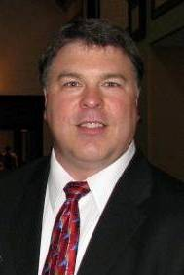
Michael Baker
Illinois Department of Commerce
Office of Employment & Training
Bethany Jaeger
CPAs and Management Consultants (Illinois)
Kerber, Eck & Braeckel LLP

Slide 37
Illinois MOU Negotiations
WIOA Wednesday – Memorandum of Understanding (MOU)
Part I: Overview & Development
April 26, 2017

Slide 38
Illinois’ state-level implementation efforts
WIOA Interagency Work Group
Composition: | State-level administrators of core and required programs authorized under WIOA (since May 2015)
Role: | Address state-level issues associated with WIOA implementation in collaboration with the Illinois Workforce Innovation Board and local partners
Examples: | Unified voice on Illinois’ approach to career services, “direct linkage,” and shared costs; conducting a state-level review of MOUs and annual budgets

Slide 39
Illinois WIOA System
Governor
The IWIB sets policy with input from the IWG
No State Partner MOU
State WIB
Interagency Work Group
Title I Commerce
Title II College Board
Title III Employment Security
Title IV Human Services
Local Area 1
Local Area 4
Local Area 8
Local Area 12
Local Area 16
Local Area 20
Local Area 2
Local Area 5
Local Area 9
Local Area 13
Local Area 17
Local Area 21
Local Area 3
Local Area 6
Local Area 10
Local Area 14
Local Area 18
Local Area 22
Local Area 7
Local Area 11
Local Area 15
Local Area 19

Slide 40
Expanding the WIOA Knowledge Base
LWIA
LWIA
LWIA
LWIA
LWIA
LWIA
LWIA
LWIA
TITLE I
TITLE II
LWIA
Level 1 Interagency Work Group
Level 2 State Technical Assistant Teams
LWIA
STAT 1
LWIA
STAT 10
STAT 2
LWIA
LWIA
STAT 9
STAT 3
LWIA
LWIA
IWG
LWIA
STAT 8
STAT 4
LWIA
LWIA
OTHER
TITLE III
LWIA
STAT 7
STAT 5
Level 3 State Partner Technical Experts
Level 4 Local Area Staff (State Programs & Required Partners)
LWIA
STAT 6
LWIA
LWIA
CMS
TITLE IV
LWIA
LWIA
LWIA
LWIA
LWIA
LWIA
LWIA
LWIA
LWIA

Slide 41
Governor’s Guidelines for Negotiating Shared Costs and Services
Purpose: Fulfills the WIOA requirement that the Governor issue guidance for negotiating costs and services for a high-functioning workforce system
Audience:
All state and local required partners
Local workforce innovation boards
Chief elected officials
Other partners integral to the administration and delivery of services
Right Click & Open Link to access Governor's Guidelines & other documents

Slide 42
Governor’s Guidelines for Negotiating Shared Costs and Services (cont.)
MOU timelines for PY17:
Negotiation period: 105 days
January 1, 2017 – April 15, 2017
Report of Outcomes and draft budget due April 15, 2017
State-level remediation period: 30 days
May 1, 2017 – May 31, 2017
Report any impasse to Federal agencies July 1, 2017
If at impasse, appeal to Interagency Work Group first, then to the Illinois Workforce Innovation Board

Slide 43
Governor’s Guidelines (cont.)
Key concepts for negotiating MOUs:
Demonstrate a commitment to integration (not just what, but how & who)
Each required partner designates an individual with authority to commit financially and programmatically on behalf of that partner to negotiate
Local board chair designates an individual as “lead MOU negotiator”
Local board chair designates a “private sector board member or other impartial individual” to lead annual budget negotiations (i.e., infrastructure funding agreement)
Local “career service matrix” includes a checklist for required partners to identify which career services they will provide and how they will make those services accessible in the comprehensive one-stop center(s)
1) Onsite program staff/contractor; 2) cross-trained staff; 3) “direct linkage” technology

Slide 44
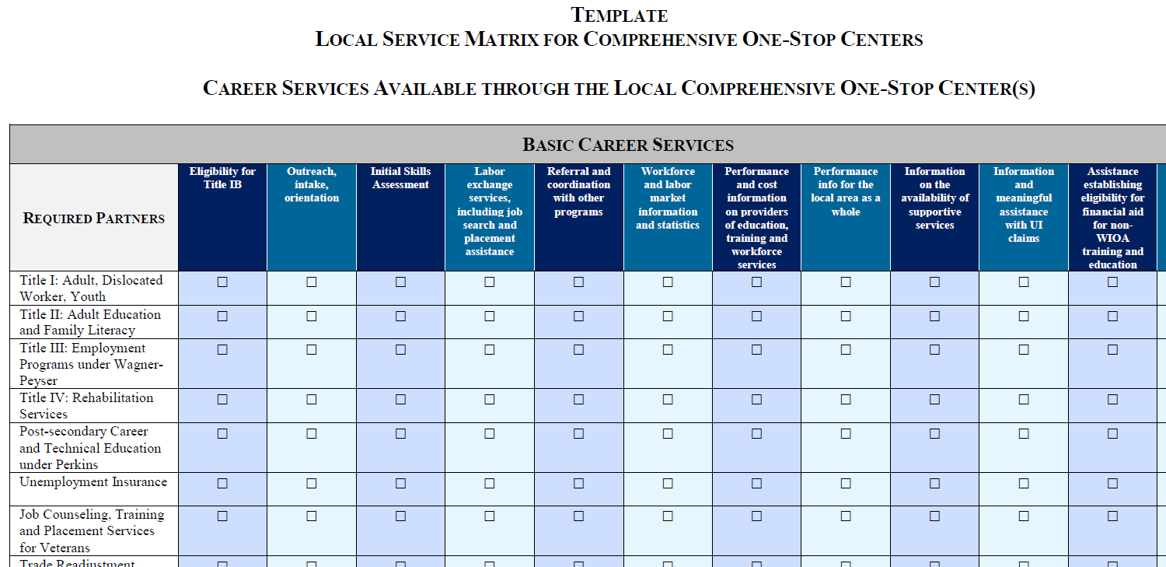

Slide 45
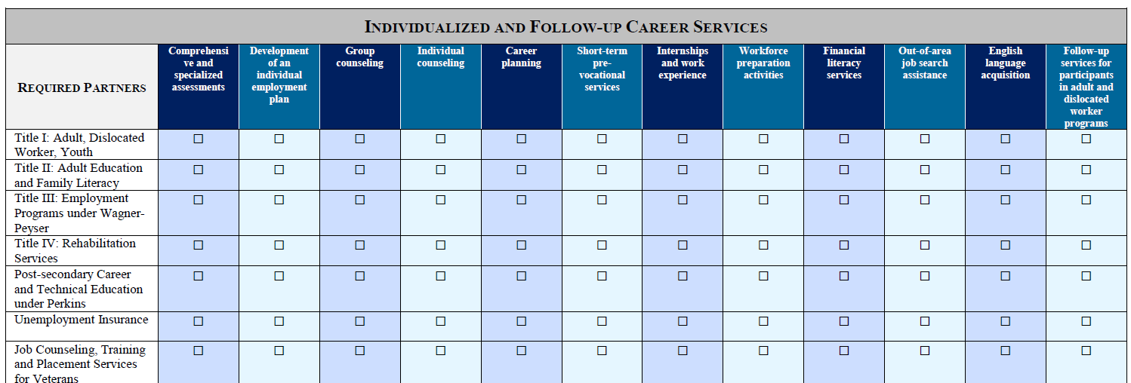

Slide 46
Governor’s Guidelines for Negotiating Shared Costs and Services (cont.)
Key concepts for negotiating infrastructure and additional shared costs:
Retain the effective date for infrastructure funding agreements in Illinois as July 1, 2017
Retain FTEs as the preferred cost allocation methodology in Illinois
Emphasize the expectation that local areas reach agreement on cost sharing (i.e., state funding mechanism = LAST RESORT)
Encourage local board chairs to designate the one-stop operator as a resource to provide staff to be cross-trained for partners who cannot commit to a full-time, onsite presence in one-stop centers
Allow cash, non-cash or third-party in-kind contributions to meet additional shared cost commitments (no in-kind staffing for infrastructure)

Slide 47
Governor’s Guidelines for Negotiating Shared Costs and Services (cont.)
Resources provided in the Governor’s Guidelines:
MOU template (required)
Infrastructure Funding Agreement spreadsheet (required)
Report of Outcomes from local MOU negotiations (required)
Timelines
Glossary
Other resources (e.g., additional requirements for providing services via “direct linkage” in Illinois)

Slide 48
Illinois MOU Template
Each section includes citations to WIOA, Final Rules and/or Governor’s Guidelines
Dot points below each section indicate required content

Slide 49
Illinois Infrastructure Funding Agreement Template
Count onsite staff providing WIOA services
Count cross-trained staff
Count offsite staff providing WIOA services via direct linkage technology

Slide 50
Illinois Infrastructure Funding Agreement Template
FTE calculations flow through each partner’s contribution for infrastructure and shared costs

Slide 51
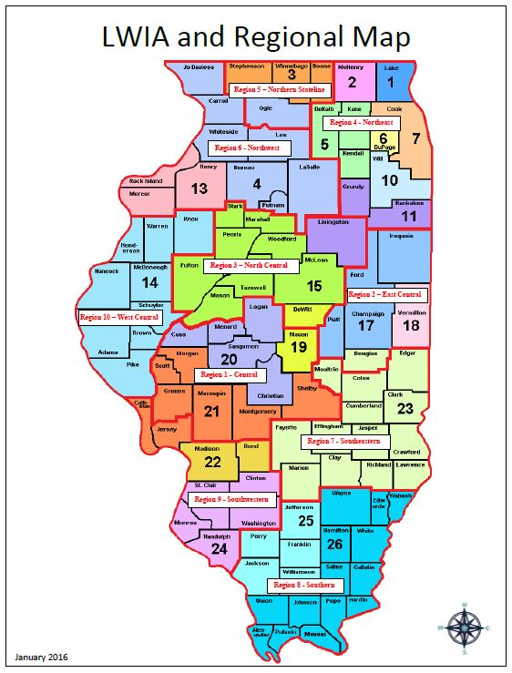
Illinois Workforce Landscape 10 Economic Development Regions 22 Local Areas

Slide 52
Technical Assistance During Negotiations
State Technical Assistance Teams (STATs) – Serve as a resource for local boards, CEOs by offering technical assistance in local areas and raise operational issues to the state-level Interagency Work group for resolution
One STAT per economic development region
Core partners represented on each team
Other required partners involved as needed
Collaborate as a team to make service integration a reality
First line of training, information and support
Monitor progress on MOU/budget negotiations (raise red flags)
Support state-level teams in 30-day remediation period

Slide 53
Technical Assistance During Negotiations (cont.)
WIOA Wednesday Webinars – Interactive webinars held regularly at 10 a.m. Wednesdays about specific WIOA implementation topics (e.g., one-stop operator procurement)
Open to the all required partners at the state and local levels
MOU FAQ – Common questions posed during WIOA Wednesday Webinars or STAT activities and addressed with a unified voice from the WIOA Interagency Work Group
Dynamic FAQ maintained on a web portal accessible to the public
https://www.illinoisworknet.com/WIOA/Resources/Pages/Advisory-Group-FAQ.aspx

Slide 54
Technical Assistance After Negotiations
State-level remediation teams – For areas reporting on April 15 that they are unable to reach agreement on an MOU, a state-level team of core program partners works with the local board chair, CEOs and required partners to facilitate agreement
State-level team can assign specific cost contributions to required partners when disagreements are minor or deemed unreasonable
PY16 Examples of State-level Remediation Success:
Example 1: Disagreement about cost allocation methodology using FTEs
State-level remediation facilitated agreement among partners to agree to “do what they did under WIA” for PY16
Example 2: Equitable distribution of rent costs based on space utilization
State-level procurement agency agreed to modify the lease and billings based on the adjusted amount of square footage used by each partner

Slide 55
Common Challenges and Resolutions so far in PY17
Common Challenge | Interagency Work Group Resolution (to date)
Delay obtaining MOU signatures from Job Corp and state-administered programs | Contacted regional Job Corp office, next steps ask PFO to assist; State legal staff of agencies administering required programs were briefed by state partners and developed a process to expedite MOU signatures for PY17.
Required partners with limited resources can’t commit to the minimum .25 FTEs | Local areas accepting less than the minimum .25 FTEs risk being non-compliant with the Governor’s Guidelines, but the Governor will determine whether an exception is warranted (anticipate additional requirements and documentation with rationale for the local decision)
Can’t get all required partners to participate in negotiations | STAT leaders identify non-responsive partners and contact the Interagency Work Group for state-level resolution; IWG requesting help from regional Job Corp office

Slide 56
Common Themes in PY16 State-level Review of MOUs
Missing signatures
Vision for the System – the vision must also include actions and timelines for implementing aspects of the vision not yet in place
MOU Development – must describe the process to negotiate the MOU and the process if consensus cannot be reached to comply with § 678.510 (c)(1)
Description of Comprehensive One-Stop Services – All required partners listed as providing services in the comprehensive one-stop center must have completed descriptions and must be reflected in the Local Service Matrices
Procurement of One-Stop Operator – must describe the functions and scope of work on the one-stop operator and the one-stop operator’s role in coordinating referrals to comply with § 678.500(b)(3)

Slide 57
Common Themes in PY16 State-level Review of MOUs
Referral Process – must describe specific arrangements to assure that individuals with barriers to employment can access services to comply with § 678.500(b)(4)
Amendment Procedures – must describe the amendment procedures and process for negotiating annual shared costs
Data Sharing – must describe how core partners will share data and collaborate to assure all core partners achieve the primary indicators of performance, as well as assure confidentiality of personally identifiable information
Renewal Provisions – describe renewal process for when substantial changes occur before the MOU expires, as required by § 678.500(b)(5) and (6)

Slide 59
Sample MOU and Infrastructure Costs Toolkit

Slide 60
Toolkit Purpose
The Sample MOU and Infrastructure Costs Toolkit includes actual portions of local MOUs and IFAs that have been developed thus far.
It may be used as a reference guide or toolkit when developing your own MOU pursuant to the requirements of section 121 of WIOA, its implementing regulations at 20 CFR part 678 and 34 CFR parts 361 and 463, and the relevant guidance.
It shows how the overall one-stop operating budget, including cost allocation methodologies and partner contributions, may be laid out in relation to the IFA.

Slide 61
Disclaimer
This Sample MOU and cost allocation analyses should not replace the local negotiations that should occur or supplant any State laws that apply in any particular State.
States and local areas are not required to develop an MOU that uses the same format of this sample because there are many other ways to develop an MOU.

Slide 62
Disclaimer …continued
Use of the language in this document does not ensure compliance with WIOA and cannot substitute for developing these documents based on careful review of WIOA, its implementing regulations and guidance, and local conditions.

Slide 63
Open Source Document
All of the information contained in this Toolkit is in the public domain and available for sharing, reproduction, and distribution, but may not be reproduced or distributed for a fee.

Slide 64
Summary
WIOA Vision & Partner Collaboration
Services tailored to meet the needs of regional employers through, for example, sector strategies.
Services tailored to meet the needs of local job seekers through career pathways, talent pipelines, and related approaches.
Focus primarily on strategies that effectively serve business and job seeker customers and promote the overall well-being of the Local community through economic growth. → Then ensure compliance.
Transparency, efficiency, elimination of duplication.

Slide 65
TEGL 16-16, One-Stop Operations Guidance for the American Job Center Network
TEGL 17-16, Infrastructure Funding of the One-Stop Delivery System

Slide 66
Upcoming One-Stop Technical Assistance Events

Slide 67
Upcoming One-Stop Technical Assistance Webinars
Competitive Selection of One-Stop Operators: “Deep Dive” May 4, 2017 | Interactive dialogue covering: Competitive Procurement Process Essential Contract Elements Avoiding Conflicts of Interest Transition, Implementation, and Monitoring
Increasing Opportunity for Shared Customers: Integrated Service Delivery through the American Job Center Network May 17, 2017 | Advice and lessons learned when building an integrated service delivery system
MOU Part II: Local vs. State Funding Mechanism May 31, 2017 | Infrastructure costs are funded either through the Local or State funding mechanism Federal partners walk participants through both options and provide examples
To register for these events, go to https://ion.workforcegps.org/events

