Slide 1
TAACCCT Performance Reporting Q&A April Topic: What You Need to Know about Performance Reporting During Program Activities Extension and During Closeout
U.S. Department of Labor
Employment & Training Administration
April 27, 2017

Slide 2
Presenters
Cheryl Martin, Moderator
Supervisory Workforce Analyst, ETA
Kristen Milstead, Presenter
Workforce Analyst, ETA

Slide 3
AGENDA
Questions from you
Performance Reporting: Six-Month Extension of Program Activities
Performance Reporting: Closeout
Additional Questions?

Slide 4
Question #1
After students earn an Airframe certificate, they would have completed a grant-funded program of study, outcome B2 - completed a TAACCCT program. If they remain in the College and go onto further education by taking courses to complete the second Powerplant credential, would they be counted under B7 - Goes onto further education, an Exit Point?

Slide 5
Question #1 Response
Incorrect assumption in question
Participants would not be counted in B.7 after completion of first certificate
B.7 is an exit point for tracking purposes
For participants who matriculate to other colleges and universities after completing at least one TAACCCT program
Instead, consider participants who complete a TAACCCT program but are still enrolled “on hold” until they exit

Slide 6
Question #2
If a participant completes their first program of study and goes onto employment and they were NOT an incumbent worker, would they be counted in B8 if they enter employment in the first quarter after they exit the college?

Slide 7
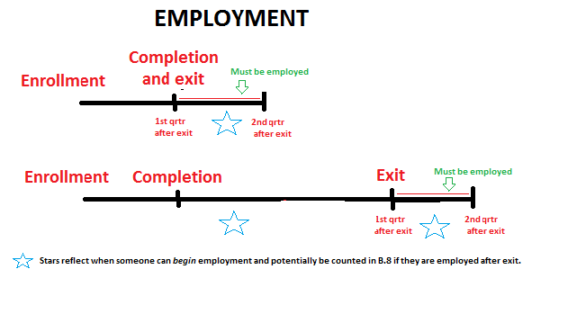
Question #2 Response
Must complete a program first prior to entering employment
Must exit prior to being counted as having entered employment

Slide 8
Question #3
Then this participant would continue to be tracked for the next 2 quarters to see if employment was retained for two successive quarters after exit from the college. If employment was retained, that person would be counted under B9 (Retained in Employment) and would then exit participant tracking. Is that correct?

Slide 9
Question #3 Response
Correct
The participant is employed or still employed after having completed and exited in the first quarter after exit
Participant must be retained in both second and third quarter after exit before being counted in B9 as having been retained in employment

Slide 10
Question #4
What if the person is not employed at Q2, would you stop tracking the person at that point since they can no longer achieve being retained in employment (that is, employed in second and third quarters after exit)?

Slide 11
Question #4 Response
Yes
Participant must be retained in both second and third quarter after exit before being counted in B9 as having been retained in employment
Should not even count them in B9 until the third quarter after exit has been reached if the participant is still retained in employment

Slide 12
Six-Month Grant-Funded Extension of Program-Activities
What You Need to Know About Performance

Slide 13
Requirements to Report
You are required to report all applicable outcomes for participants enrolled during your program activities extension as per the SGA
Program activities extension was provided to allow grantees to further meet the targets in their SOW and reflect the successes of their programs

Slide 14
Differences:TPE and APR?
Performance numbers for your final APR may be different than those in your Third-Party Evaluation (e.g., due to wage record delays, etc.)
Evaluator should state clearly the dates covered by the data they report and note that the evaluation data will be different than the data submitted in the final APR

Slide 15
Which Outcomes to Report
All applicable outcomes based on how long your program activities extension was taken
Will depend on when students enroll and complete

Slide 16
For those operating on traditional semester schedule if full six months are taken:
Certain outcomes may be counted
 |  |  |  |  |  |  |  |  |  |  |  |  | Closeout
Outcome | Oct | Nov | Dec | Jan | Feb | Mar | Apr | May | Jun | Jul | Aug | Sep | Oct | Nov | Dec
B1 (participants) | x | x | x | x | x | x
B2/B2a (completers) | x | x | x
B3 (retained) | x | x | x | x | x | x
B4 (retained in other) | x | x | x | x | x | x
B5/B5a (credits) | x | x | x
B6/B6a/B6b/B6c (credentials) | x | x | x
B7 (further education) | x | x | x | x | x | x | x | x | x | x | x | x
B8 (employment) | x | x | x | x | x | x | x | x | x | x | x | x | x | x | x
B9 (emp retention) | x | x | x | x | x | x | x | x | x | x | x | x | x | x | x
B10 (wage increase) | * | * | * | * | * | * | * | * | * | * | * | *
*incumbent workers only

Slide 17
Table Summary
Traditional semesters end at the end of a calendar year
Students who enroll in Spring semester can be counted as new participants (B.1)
Participants still enrolled March 31 would be counted in B.3 as still retained (or if they leave but go onto non-TAACCCT programs would be counted in B.4)
Completers (B.2), Credits (B.5/B.5a), Credentials (B.6/B.6a/B.6b/B.6c) generally would not be counted after December
Follow-up outcomes (B.7, B.8, B.9) are treated as normal
Incumbent worker outcome (B.10) is treated as normal

Slide 18
Other types of schedules (e.g., rolling enrollments may report all outcomes, including completers, credits and credentials, where applicable through the end of the program activities extension)

Slide 19
When to Report
Will only report one time –
Annual Reports – Year ending September 30
What is reported in the APR should reflect participant tracking records for what took place during the length of time taken for the program activities extension
Only report grant-funded outcomes in APR

Slide 20
Grant Closeout
What You Need to Know About
APR and QNPR Reporting

Slide 21
When Reports Are Due
Both APRs and QNPRs are due 45 days after period of performance end date (November 14)

Slide 22
What to Report in the APR
Annual information for the final year only
Do not report cumulative information for the entire period of performance
Applicable outcomes only
Only follow-up outcomes after March 31

Slide 23
Additional APR Data During Closeout
Report the data you have by the Nov. 14 due date
If a student meets the definition of an employment follow-up outcome or you receive this data prior to the closeout deadline (December 31), you may still count this participant in B.8 or B.9
Contact your FPO to re-open your final report if applicable and re-submit by the December 31 closeout deadline

Slide 24
What to Report in the QNPR
QNPR Final Report is cumulative!
Information on grant activities during the last quarter and cumulative information on grant activities during the entire period of performance

Slide 25
Submitting Additional Information
Additional pamphlets, reports, or other documents may be sent to the TAACCCT mailbox (please copy your FPO)
DO NOT USE THE ATTACHMENT FUNCTION IN THE REPORTING SYSTEM ASSOCIATED WITH THE QNPR
We do not have access to anything you upload and will not receive it

Slide 26
PLEASE NOTE
Please follow appropriate instructions provided for submitting the SkillsCommons deliverables and for the Third-party Evaluation
These are separate requirements from and should not be submitted in conjunction with the QNPR

Slide 27
FOR MORE INFORMATION
Compiled TAACCCT FAQ
Extension: Section VI
Closeout: Section VII

Slide 28
General Reporting Q&A

Slide 29
Thank you
for attending!

