Slide 1
Apprenticeship EEO Regulations: Understanding Sponsors’ Obligations
August 14, 2017
Revised 29 CFR Part 30

Slide 3
Please indicate which of the following best describes you:
Active Apprenticeship Sponsor
Employer (not an Apprenticeship Sponsor)
Apprenticeship Agency Staff
Other Stakeholder

Slide 4
Daniel Villao
Deputy Administrator
USDOL/ETA Office of Apprenticeship

Slide 5
Donna Lenhoff
Senior Advisor
USDOL/ETA Office of Apprenticeship
Nicholas Beadle
Special Assistant
USDOL/ETA Office of Apprenticeship

Slide 6
TODAY’S AGENDA
Welcome
Why is Equal Employment Opportunity (EEO) Still Necessary?
Comparison of Old and New EEO Regulations
Details of Implementation Timeline
Resources and Technical Assistance

Slide 7
Why is EEO Still Necessary?
Even in the year 2017…
Harassment and discrimination occur too often -
To all kinds of people, at all types of businesses -
With sometimes painful results.

Slide 8
29 CFR Part 30

Slide 9
Phase-In Schedule for Sponsors Registered with OA
 | Existing Sponsors | New Sponsors
Initial Requirements | January 18, 2017 | Upon registration
July 17, 2017 Requirements: New bases protected from discrimination Assignment of EEO responsibility Internal dissemination of equal opportunity policy Universal outreach and development of a recruitment sources list Maintenance of an environment free from harassment (including providing anti-harassment training) | July 17, 2017 | Upon registration
Further Affirmative Action Requirements | January 18, 2019 | Two years after registration

Slide 10
The Obligations That Were Phased In First
Non-discriminatory selection procedures (§30.10)
Recordkeeping (§30.12)
Complaint procedures (§30.14)
Intimidation/retaliation (§30.17)

Slide 11
Non-Discriminatory Selection Procedures
Sponsors may utilize any method for selecting apprentices, so long as it:
Complies with the Uniform Guidelines on Employee Selection Procedures (UGESP)(41 CFR part 60-3)
Is uniformly and consistently applied
Complies with title I of the Americans with Disabilities Act and implementing regulations
Is facially neutral in terms of race, color, religion, national origin, sex, sexual orientation, age, genetic information and disability

Slide 12
Non-Discriminatory Selection Procedures Technical Assistance Resource

Slide 13
Requirements Applicable to the Registration Agency
EEO Compliance Reviews
Discrimination Complaint Investigations
Sanctions for Non-Compliance with 29 CFR part 30

Slide 14
The Equal Opportunity Standards – That Were Phased In Second
Applicable to ALL sponsors, regardless of the number of apprentices they have.
Phase-In Dates for Sponsors Registered With OA:
Existing sponsors: July 17, 2017
New sponsors: Upon registration

Slide 15
Discrimination Prohibited
It is unlawful for a sponsor of a registered apprenticeship program to discriminate against an apprentice or applicant for apprenticeship on the basis of race, color, religion, national origin, sex, sexual orientation, age (40 or older), genetic information, or disability.
§30.3(a)(1)

Slide 16
Prohibited Discriminatory Acts
Discrimination with respect to the following employment actions is prohibited:
Recruitment, outreach, and selection procedures.
Hiring and/or placement, upgrading, periodic advancement, promotion, demotion, transfer, layoff, termination, right of return from layoff, and rehiring.
Rotation among work processes.
Imposition of penalties or other disciplinary action.

Slide 17
Prohibited Discriminatory Acts
Rates of pay or any other form of compensation and changes in compensation.
Conditions of work.
Hours of work and hours of training provided.
Job assignments.
Leaves of absence, sick leave, or any other leave.
Any other benefit, term, condition, or privilege associated with apprenticeship.
17

Slide 18
Affirmative Steps to Provide Equal Opportunity
All sponsors, regardless of size, must take four affirmative steps to provide equal opportunity in apprenticeship, including:
Assigning EEO responsibility
Internally disseminating equal opportunity policy
Engaging in universal outreach and developing a recruitment sources list
Maintaining an environment free from harassment
§30.3(b)

Slide 19
Assignment of EEO Responsibility
Sponsors will designate an individual(s) with appropriate authority to be responsible and accountable for overseeing the sponsor’s commitment to equal opportunity in registered apprenticeship.
The individual will be responsible for:
Monitoring activity to ensure compliance
Maintaining records
Generating and submitting any required reports to the Registration Agency
Developing and implementing AAP, if applicable
§30.3(b)(1)

Slide 20
Internal Dissemination of EO Policy: Updating the EEO Pledge
Required language for the EEO Pledge:
[Name of sponsor] will not discriminate against apprenticeship applicants or apprentices based on race, color, religion, national origin, sex (including pregnancy and gender identity), sexual orientation, genetic information, or because they are an individual with a disability or a person 40 years old or older.
[Name of sponsor] will take affirmative action to provide equal opportunity in apprenticeship and will operate the apprenticeship program as required under Title 29 of the Code of Federal Regulations, part 30.
§30.3(b)(2)

Slide 21
Internal Dissemination of EO Policy: Disseminating the EEO Pledge
Pledge dissemination must reach:
Applicants
Apprentices
Individuals connected with the administration or operation of the apprenticeship program
§30.3(b)(2)

Slide 22
Internal Dissemination of EO Policy: Disseminating the EEO Pledge
At a minimum, the updated Pledge must be:
Published in sponsors’ apprenticeship standards
Published in company handbooks, manuals, and similar documents
Posted on bulletin boards, including through electronic media
Included in apprenticeship opportunity announcements
The posted Pledge must be accessible to all apprentices and applicants.
§30.3(b)(2)

Slide 23
EEO Pledge and Complaints Notice Poster

Slide 24
Internal Dissemination of EEO Policy: Information Sessions and Recordkeeping
In addition to posting and publishing the revised EEO Pledge, sponsors must:
Conduct orientation and periodic information sessions on the sponsor’s apprenticeship EEO policy, and provide required anti-harassment training
Include at orientation/information sessions and anti-harassment trainings:
All apprentices
Journeyworkers who regularly work with apprentices
Other individuals connected with administration or operation of the apprenticeship program
Maintain records necessary to demonstrate compliance with these requirements and make them available to the Registration Agency upon request.
§30.3(b)(2)

Slide 25
Universal Outreach Efforts
Three steps are required of all sponsors:
Develop and annually update a list of recruitment sources
Identify a contact at each of these sources
Provide sources with advance notice of apprenticeship openings so they can refer candidates
Additional outreach efforts may be required after the sponsor’s first utilization analysis
§30.3(b)(3)

Slide 26
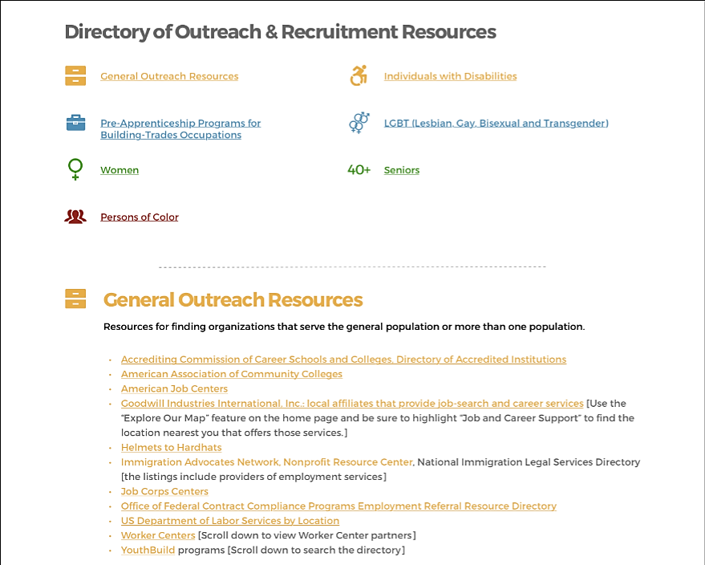
Outreach and Recruitment Resource Directory

Slide 27
Harassment, Intimidation and Retaliation
Harassment is: Actions or words that make an apprentice or group of apprentices feel uncomfortable, belittled, offended, threatened or intimidated.
This can include offensive or crude language, disparaging comments, and even sexual or other kinds of assault.
§30.3(b)(4)

Slide 28
Harassment, Intimidation and Retaliation
Harassment in Registered Apprentice programs is unlawful when it:
Is because of someone’s religion, sex, race, color, national origin, sexual orientation, disability, age, or genetic information, or because they filed an EEO complaint;
Is unwelcome; and
Creates a hostile or offensive work environment or results in an adverse employment decision.
§30.3(b)(4)

Slide 29
Harassment Prevention Requirements
Sponsors must:
Provide interactive anti-harassment training that communicates, at a minimum:
That harassing conduct will not be tolerated
The definition of harassment and the types of conduct that constitute unlawful harassment
The right to file a harassment complaint with the registration agency (for OA states, this is OA)
Make facilities and activities available to all
Establish and implement their own procedures for handling and resolving complaints about harassment or retaliation

Slide 30
Suite of Anti-Harassment Training Materials

Slide 31
Looking Ahead: 2019 Phase-In
Provisions phasing in January 18, 2019 for OA-Registered Sponsors:
Draft written AAP (§30.4(e))
Conduct initial workforce analysis for race/sex (§30.5(b))
Conduct initial workforce analysis for individuals with disabilities (§30.7(d)(2))
Conduct initial review of personnel practices (§30.9)
Begin invitations to self-identify as having a disability at pre-offer and post-offer stages (§30.11)
Disseminate one-time invitation to self-identify for all current apprentices (§30.11)

Slide 32
Looking Ahead: 2019 Phase-In
At the time of a sponsor’s first compliance review following implementation of these provisions, sponsors will also need to:
Conduct a utilization analysis for race/sex (§30.5(c)) and for individuals with disabilities (§30.7)
If necessary, set a utilization goal and assess impediments to EEO and undertake action-oriented programs (§30.6, 30.8)

Slide 33
Compliance with Other Equal Opportunity Laws: Major Federal Laws
Name of Law | Bases of Discrimination Prohibited | Entities Covered | Enforcement Agency/ Agencies | Private Lawsuit Allowed? | Available Remedies (in addition to Injunctive Relief)
Title VII of the Civil Rights Act of 1964 | Race, color, national origin, religion, sex (including pregnancy and gender identity) | Public and private employers of 15 or more employees; employment agencies; labor organizations; joint labor-management training and apprenticeship programs | Equal Employment Opportunity Commission (EEOC) and Department of Justice Civil Rights Division (CRD) | yes | Make-whole relief (back pay, front pay, lost benefits, interest); compensatory and punitive damages; attorney’s fees
Americans with Disabilities Act (ADA) | Disability | Public and private employers of 15 or more employees; employment agencies; labor organizations; joint labor-management training and apprenticeship programs | EEOC and CRD | yes | Make-whole relief; compensatory and punitive damages; attorney’s fees
Age Discrimination in Employment Act (ADEA) | Age (40 or older) | Public and private employers of 20 or more employees; labor organizations; joint labor-management training and apprenticeship programs | EEOC | Yes | Make-whole relief; double damages for willful violations; attorney’s fees

Slide 34
Compliance with Other Equal Opportunity Laws: Major Federal Laws
Name of Law | Bases of Discrimination Prohibited | Entities Covered | Enforcement Agency/ Agencies | Private Lawsuit Allowed? | Available Remedies (in addition to Injunctive Relief)
Genetic Information Non-discrimination Act (GINA) | Genetic information | Public and private employers of 15 or more employees; employment agencies; labor organizations; joint labor-management training and apprenticeship programs | EEOC and CRD | yes | Make-whole relief; compensatory and punitive damages; attorney’s fees
Executive Order 11246 | Race, color, national origin, religion, sex (including pregnancy), sexual orientation, gender identity | Federal contractors and subcontractors and federally assisted contractors and subcontractors that have contracts of more than $10,000 | DOL Office of Federal Contract Compliance Programs (OFCCP) | no | Make-whole relief
Section 503 of the Rehabilitation Act of 1973 | Disability | Federal contractors and subcontractors that have contracts of more than $15,000 | OFCCP | No | Make-whole relief
Title IX of the Education Amendments of 1972 | Sex (including pregnancy) | Education programs or activities (including apprenticeship programs) that receive Federal financial assistance | Department of Education Office of Civil Rights (OCR) | yes | Make-whole relief; compensatory damages; possibly punitive damages; attorney’s fees

Slide 35
Compliance with Other Equal Opportunity Laws: State and Local Laws
These are called “Fair Employment Practice Laws” or “mini-Title VII’s”
Generally enforced by state or local Fair Employment Practice Agencies (FEPAs)
Generally cover discrimination on bases of race, color, national origin, religion, sex (including pregnancy), disability and age

Slide 36
Compliance with Other Equal Opportunity Laws: State and Local Laws
May also cover discrimination on bases of one or more of the following:
Genetic information
Sexual orientation
Gender identity
Marital status
Family responsibilities or parental status
Political affiliation
Veteran status

Slide 37
OA Technical Assistance Resources
Resources on non-discriminatory selection procedures
EEO Pledge and complaint notice poster
EEO Pledge update addendum
Directory of National Outreach and Recruitment Resources
Suite of anti-harassment materials
Customizable PowerPoint slide show for in-person training
Video and Knowledge Checks for online training
Guide for using the PowerPoint and video
Tip Sheet for Apprentices
Managers’ Fact Sheet
FAQs

Slide 39
Equal Employment Opportunity: Advancing Diversity and Inclusion in Apprenticeship
Your source for information and resources on the updated EEO regulations for apprenticeship programs
https://www.doleta.gov/oa/eeo/

Slide 40
Donna Lenhoff
Senior Advisor
USDOL Office of Apprenticeship
Lenhoff.donna@dol.gov

