Slide 1
Navigating Language and Cultural Barriers
To Increase Access to Employment, Education, and Training Opportunities
Employment and Training Administration

Slide 3
Laura Ibañez
Unit Chief
Specialty National Programs Unit
Employment and Training Administration
U.S. Department of Labor

Slide 4
Learn about NFJP and Migrant and Seasonal Farmworkers
Discuss:
Culturally inclusive strategies
Best practices in outreach & case management
Strategies for staff hiring and development

Slide 5
National Farmworker Jobs Program
Provides career services, training services, housing assistance services, youth services, and other related assistance services to help retain agricultural jobs, including agricultural skills upgrade, or acquire new skills

Slide 6
Factors Creating Access Barriers
Geographically isolated
Limited transportation
Social and cultural isolation
Agricultural workers are far more likely to be Latino/ Hispanic (76%) and foreign born (71%)
Only 39% have schooling beyond the ninth grade
Only 33% report they can speak English “well” and nearly as many (27%) report they cannot speak English at all
(Legal Services Corporation Agricultural Worker Population Estimate Update 2015)

Slide 7
High quality of service for all customers
Section 188 of the Workforce Innovation and Opportunity Act (WIOA) prohibits discrimination because of race, color, religion, sex, national origin, age, disability, or political affiliation or belief.

Slide 8
Kathleen Nelson
Director of Workforce Development
Association of Farmworker Opportunity Program

Slide 9
Peer to Peer Exchanges
What are the NFJP Peer to Peer Exchanges
NFJP Peer Visit to Arkansas

Slide 10
NFJP Demographics Reported in 2016 (All E&T and RA-only Exiters)

Slide 11
Additional Barriers to Employment Reported in 2016

Slide 12
What Did We Learn in Arkansas
Grantees from
New York
Vermont
Ohio
Louisiana
Maryland
Arkansas
Serving workers
Immigrants and refugees from Mexico, Guatemala, Dominican Republic, Somalia, Laos, Hatti, Puerto Rico
Non-immigrant African American and Caucasian Farmworkers

Slide 13
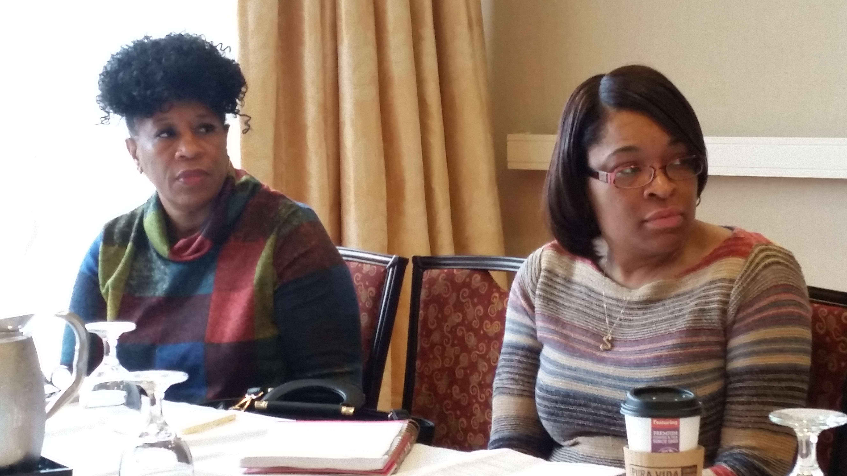
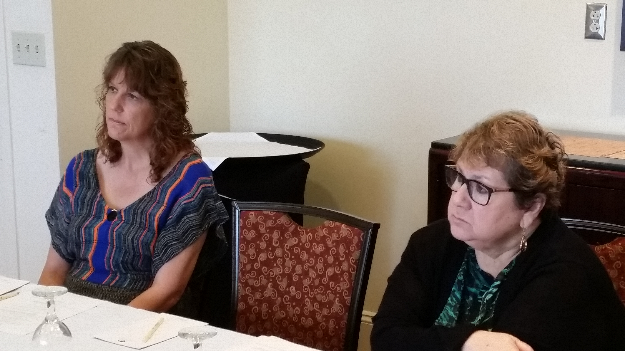
What Did We Learn in Arkansas?
Building Cultural Competency
Linguistically and Culturally Diverse Program Participants
Cultivating and Leveraging Service Partnerships
Reviewing and Improving Outreach Materials and Assessment Questions

Slide 14
What Did We Learn in Arkansas? Outreach and Assessment
Are you a Farmworker?
vs.
Have you ever done farmwork?
Are you a Veteran?
vs.
Have you ever served in the military?

Slide 15
Jennifer Shahan
State Director
Telamon Corporation,
Salisbury, MD

Slide 16
Telamon Corporation
Multi-cultural, multi-lingual Human Services Organization providing a variety of Workforce and Career Services in several states in the mid-atlantic, southeast and mid-west.

Slide 17
Person Centered Approach

Slide 18
Person Centered Approach

Slide 19
Person Centered Approach

Slide 20
Policies and Procedures for Cultural Competence

Slide 21
Cultural and Linguistic Sensitivity
Telamon MD/DE NFJP Staff Picture, 2015

Slide 22
Program Designs

Slide 23
Program Designs

Slide 24
Leads to Better Outcomes

Slide 25
Challenges

Slide 26
Dina Eden
Senior Education Analyst
Center for Employment Training

Slide 27
Our organization
Developed in 1967
Based in San Jose, California
13 centers
17 educational programs
6-8 months long
> 2000 students served annually
The mission of CET, an economic and community development corporation is to promote human development and education by providing people with marketable skills, training and supportive services that contribute to self-sufficiency.

Slide 28
Our Students – Basic Demographics
ETHNIC GROUP | %
Hispanic / Latino | 75
Black | 13
White | 6
Asian | 4
2 + Races / Other | 2
GENDER | %
Male | 63
Female | 37
AGE | %
22 – 44 | 58
0 – 21 | 31
45 - 54 | 8
55 + | 3
EDUCATION | %
High School Grad / GED | 77
Below 12th grade | 17
Below 8th grade | 2
Post high school | 2

Slide 29
Our Students – Barriers to Employment
FARMWORKER STATUS | %
Seasonal Farmworker | 23
Dependent of Farmworker | 12
OTHER BARRIERS | %
Dependent(s) under the age of 6 | 29
Food Stamps | 27
Limited English | 10
Ex-Offender | 3
Teen Parent | 2
Homeless | 1

Slide 30
Our farmworker population
7/1/16 – 6/30/17
 | All Farmworkers | % | EC Farmworkers | %
Average Reading Level | 7.7 |  | 6.7
Average Math Level | 6.9 |  | 6.2
HS Dropout | 434 | 33% | 172 | 44%
HS Equivalency (e.g. GED, HS Diploma, or equivalency) | 883 | 67% | 223 | 56%
Limited English | 275 | 21% | 50 | 13%
Total Farmworkers | 1317 |  | 395

Slide 31
PROGRAM DESIGN:
Removing Barriers Every Step of the Way
RECRUITMENT
ENROLLMENT
TRAINING
GRADUATION
JOB SEARCH
JOB PLACEMENT

Slide 32
Inclusive Strategies for Retention
RECRUITMENT
EDUCATION
STUDENT SERVICES

Slide 33
Recruitment
Targeted locations for ads
Spanish speaking recruiters and Admissions advisors
Bilingual documents
Most inquiries are from referrals

Slide 34
Bilingual Advertising

Slide 35
Bilingual Student Catalogue

Slide 36
Education
Integrated – education within our regular vocational programs
Adult Education Career Pathways – education above and beyond the scope of our regular vocational programs

Slide 37
Integrated Education

Slide 38
Integrated Education

Slide 39
Integrated education: Job Preparedness
The Job Search Process
Personal qualities, transferable skills
Job search documents
Develop and implement job search strategy
Online research on potential employers
Develop networking contacts weekly
Mock interviews
Demonstrate appropriate dress and demeanor
Post Interview follow up

Slide 40
Co-enrollment flow chart
Student does not meet benchmark in English
INITIAL ASSESSMENT
TEST
Student does not have a high school diploma
Student enrolls in VESL program
Student enrolls in GED program
Student meets benchmarks
Student enrolls in vocational program

Slide 43
VESL Program

Slide 44
Goals of VESL Program
Oral and written workplace communication skills
Introductions, in person and by telephone
Greetings – customers, employers
Grammar – present, past, future tenses
Speaking with enthusiasm
Basic writing business letter (intermediate)

Slide 45
Goals of VESL Program
Terminology
Describe basic job position, functions and tasks
Identify common tools, equipment, and materials
Understand instructions for using machines, tools, equipment, manuals, etc.

Slide 46
GED Program
Reading English
Speaking English
HS Diploma or GED
Writing English
Math

Slide 47
Student Services
Instructional Unit Team
Federal Financial Aid
Supportive Services
Job Assistance

Slide 48
Student Services: Instructional unit team
Student, all program instructors, and other school official (center director, training manager, financial aid officer, etc.)
Weekly
Student progress
Addresses barriers
Follow-up

Slide 49
Student Services: Federal Financial Aid
Need-based
WIOA-167 students receive biweekly stipend for attendance
Title IV funds (eligible if they are enrolled in “career pathway program”)
Students without high school diploma must meet “Ability to Benefit” test requirements

Slide 50
Student Services: Job Assistance
Job placement (community partnerships)
Job retention

Slide 51
Student Services: Supportive Services
Row Labels | Clothing | DMV | Food | Housing | Medical | Other | Transportation | Utility
El Centro | 9 |  | 24 | 9 | 1 |  | 58 | 10
Coachella |  |  | 1 |  |  |  | 1
Salinas | 1 |  | 2 | 2 | 1 |  | 4
Soledad | 9 | 1 |  | 1 | 104 | 1 | 2
Oxnard |  |  | 13 | 1 | 4 |  | 20
Colton |  |  |  |  | 2 |  | 3
San Diego | 2 |  |  |  |  | 2 | 3
Santa Maria |  |  | 4 | 2 | 7 |  | 5
Vine |  |  | 31 | 1 | 2 | 2 | 16 | 2
Watsonville | 2 |  |  | 1 |  | 1 | 7 | 1
Grand Total | 23 | 1 | 75 | 17 | 121 | 6 | 119 | 13

Slide 52
Resources
Training and Employment Notice on how to increase services to English Language Learners (ELL) with substantial cultural and language barriers to employment: https://wdr.doleta.gov/directives/attach/TEN/TEN_28-16_Change_1_acc.pdf

Slide 53
Additional Resources
Expanding Apprenticeship for Minorities: examples from across the country, research on what works, as well as toolkits and guides: https://apprenticeshipusa.workforcegps.org/resources/2017/03/10/15/45/Expanding-Apprenticeship-for-Minorities
Success with Hard-to-Serve Clients Through Community Partnerships: https://farmworker.workforcegps.org/sitecore/content/global/resources/2015/06/01/11/17/Success_Hard_to_Serve_Clients_Through_Community_Part

Slide 54
How do you feel after today’s webinar?
Inspired!
A little overwhelmed…
Huh…

Slide 55
Next Steps
Send Follow-up Questions:
nelson@afop.org
Attend AFOP’s National Conference
September 19-21, 2017
Contact your FPO with concerns or questions…

Slide 56
NFJP Webpage
https://www.doleta.gov/Farmworker/html/NFJP.cfm
WorkforceGPS
https://farmworker.workforcegps.org/
Migrant and seasonal Farmworkers Monitor Advocate System
https://www.doleta.gov/programs/msfw.cfm
Association of Farmworker Opportunity Programs
http://afop.org/

