Slide 3
Grantee Polling Question
Let’s get to know who is on the call today. Using the poll, select the role that you play in your TechHire grant
Choose the answer that best reflects you (or your group):
Authorized representative
Program director/manager
IT/Data manager or staff
Training partner
5. Employer partner
6. Service Provider
7. Other (please specify!)

Slide 4
H-1B TechHire Grants Webinar “Understanding Trends in Tech-Based Careers Using Labor Market Information and Real-time Data”
DOL/ETA

Slide 5
Megan Baird
Department of Labor Employment and Training Administration
Division of Strategic Investments
____________________________________________________
Program Manager
U.S. Department of Labor, Employment and Training Administration

Slide 6
Michael Wolf
Division Chief
U.S. Bureau of Labor Statistics, Occupational Employment Projections
Rebecca Rust
Assistant Commissioner
U.S. Bureau of Labor Statistics, Employment and Unemployment Statistics

Slide 7
Stephen Lynch
Director, Workforce and Economic Development Services
Burning Glass Technologies
Sara Lamback
Senior Program Manager
Jobs for the Future
Akeelah Harrell
Program Manager
Jobs for the Future

Slide 8
Learn how to better understand labor market trends using available labor market information and other data resources to support understanding current and emerging trends in H-1B occupations and industries.
Gain an understanding of the various types of labor market information and how these data can support TechHire projects and participant placement.
Understand how these resources can be leveraged for continuous improvement within TechHire projects.

Slide 9
1:00 | Introduction and Framing
1:10 | Labor Market Information (LMI) Overview
1:30 | Understanding Jobs in Demand
1:50 | Trends in Tech-based Jobs
2:10 | Implications for TechHire Projects
2:15 | Discussion and Questions
2:30 | Next Steps and Closing

Slide 10
Grantee Polling Question
What is your level of experience using labor market data and other related resources, such as real-time job postings?
Choose the answer that best reflects you (or your group):
Beginner: I’m new to LMI and rarely draw on these data to support my work.
Intermediate: I have a basic understanding of LMI tools and concepts and draw on the data occasionally and/or when necessary.
Advanced: I am an experienced user of LMI data; I use both real-time resources and data from federal, state, and/or local sources regularly.
Not sure.

Slide 11
Labor Market Information (LMI) Overview
Michael Wolf
Office of Occupational Statistics and
Employment Projections
TechHire Webinar
August 29, 2017

Slide 12
What LMI can tell you
How many people work in an occupation
What the average wages are
How much the occupation is projected to grow
How many openings are expected for new workers
What education, knowledge, skills, and abilities are needed to work in an occupation

Slide 13
Web Developers and Electrical Engineering Technicians
National | Employment | Wages | Growth Rate | Annual Openings
Web Developers | 129,540 | $66,130 | 26.6% | 5,900
Electrical Engineering Technicians | 134,870 | 62,190 | 3.6% | 12,900
California | Employment | Wages | Growth Rate | Annual Openings
Web Developers | 22,650 | $76,920 | 48.3% | 1,500
Electrical Engineering Technicians | 24,250 | 64,740 | 6.6% | 710
San Diego | Employment | Wages | Growth Rate | Annual Openings
Web Developers | 2,140 | $61,200 | 37.7% | 100
Electrical Engineering Technicians | 2,910 | 63,900 | 17.9% | 120

Slide 14
In-Demand Computer Occupations
Annual openings, projected 2014-24

Slide 15
Occupational Employment Statistics (OES) overview
Joint program between U.S. Bureau of Labor Statistics (BLS) and state workforce agencies
Data are based on employer survey
Sample comes from businesses reporting to state unemployment insurance (UI) programs
Sample designed to be statistically representative by industry and area
Total sample size 1.2 million business establishments, collected over a 3-year period

Slide 16
OES Data Elements
Employment and wage estimates by occupation for over 800 occupations
Employment
Mean and percentile wages (10th, 25th, 50th/median, 75th, 90th)
Relative standard errors for employment and mean wage estimates (measure of sampling error)
For most occupations, both hourly and annual wage estimates produced
Assumes standard full-time schedule (2,080 hours)
For some occupations that don’t have standard schedule, only hourly or only annual wage estimates produced

Slide 17
OES Estimates Available
Cross-industry occupational employment and wage estimates by geographic area
Over 580 local areas (metropolitan statistical areas, metro divisions, and nonmetropolitan areas); nation; states and District of Columbia; and Guam, Puerto Rico, and U.S. Virgin Islands
Industry-specific estimates—national level only
Over 430 2-digit, 3-digit, 4-digit, and selected 5- and 6-digit NAICS industries and industry aggregations
Estimates by ownership (public/private)
Private sector cross-industry; federal, state, and local government; schools and hospitals by ownership

Slide 18
Employment Projections Overview
10-year projections produced every two years
Current set covers 2014-2024, 2016-26 to be released in October
Covers over 800 occupations and 300 industries
Prepared at the national level by BLS, by states for state and local areas in partnership with BLS and ETA
Projections of net employment change and total openings

Slide 19
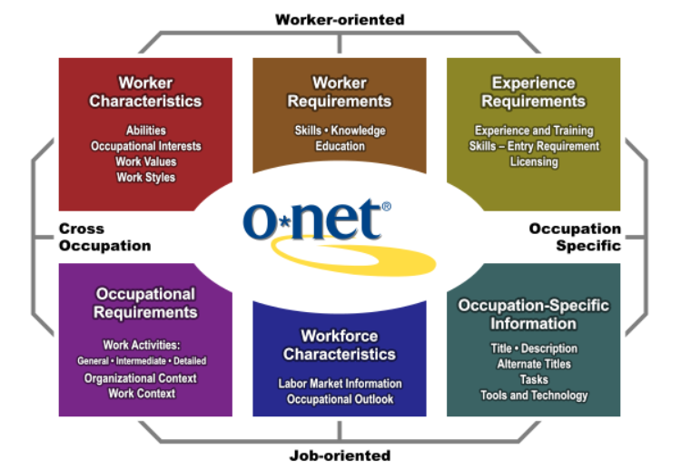
O*NET Content Model

Slide 20
Web Developers

Slide 21
Strengths of LMI
Comprehensive information on all sectors of the economy
Collected through robust, statistically rigorous, and transparent methods
Consistent methods and taxonomy to compare across dimensions
Geographies
Time
Surveys

Slide 22
Limitations of LMI
Time lag between collection and publication of data
Use of established taxonomies limits information on new or emerging occupations
Less data available, or less reliable data, for small geographic areas and small occupations

Slide 23
Michael Wolf
Division Chief
Employment Projections Program
www.bls.gov/emp 202-691-5714 wolf.michael@bls.gov

Slide 25
Grantee Polling Question
Which of the following types of LMI data have you used to support your TechHire project?
Please check all that apply for you (or your group):
Occupational trends
Industry trends or projections
Real-time job posting data
Skills Data from O*Net
Other (please describe)

Slide 26
How to Determine Jobs in Demand
What methods do states use?
TechHire Webinar
Rebecca Rust
Office of Occupational Statistics and
Employment Projections
August 29, 2017

Slide 27
How To Determine Jobs in Demand
Use of LMI can improve the alignment of education and training to better meet the hiring demands of business
This can be done by determining in-demand occupations

Slide 28
How to Determine Jobs in Demand Using BLS and State/Area Projections
Fastest growing occupations (by percent) from the state’s Employment Projections program
It could be all those occupations growing faster than the average or some other selected growth rate threshold percent
Fastest growing occupations (by percent) from the state’s Employment Projections program that also meet a selected wage threshold
It could be those fastest growing occupations that pay a wage equal to or greater than $15.00 per hour, for example
Fastest growing occupations (by percent) from the state’s Employment Projections program that also meet a selected threshold for number of new jobs
It could be those fastest growing occupations that also gain at least a 1,000 new jobs or more per year, for example

Slide 29
How to Determine Jobs in Demand Using BLS and State/Area Projections
Fastest growing occupations (by percent) from the state’s Employment Projections program that come from specified targeted industries for economic development
Manufacturing could be targeted, for example
Fastest growing occupations (by percent) from the state’s Employment Projections program for a specified education/training level
It could be for the fastest occupations requiring more than a high school degree but less than a bachelor’s degree, for example
Highest number of job openings from the state’s Employment Projections program
Job openings include new jobs and openings from replacement needs
Highest number of new jobs (by specified level) from the state’s Employment Projections program
This listing could have thresholds added on as shown above, such as wages, targeted industries, and/or education levels

Slide 30
How to Determine Jobs in Demand Using alternative data bases or customized employer needs
Highest number of job openings or fastest gain in openings from a Job Vacancy Survey or Skills-Gap Survey
This could be from a state survey that asks employers about unmet hiring needs
Highest number of online job ads or fastest gain in job ads by occupation
This could be from the state’s job bank or other source, such as Help Wanted OnLine from the Conference Board, for example
Highest number or fastest growing online job ads and/or those hardest to fill
This could be reposted online jobs
Largest gap between occupational demand and supply
This could be comparing demand occupations (from Employment Projections or online ads) compared to supply (which could be training completers and job seekers registered in the state’s career centers)
Employer needs for customized training to meet specific hiring needs
This could be from business partnerships, a new firm opening up in an area, or from coordination efforts of business, workforce, economic development, and education all working together

Slide 31
Improved Alignment of Education and Training with the Hiring Needs of Business Using In-Demand Occupations… Does What?
This improved alignment drives the allocation of training resources, leading to:
Higher placement and retention rates
Improved reemployment
Lowered UI benefit and welfare costs
Stronger business expansion and retention
Expanded economic growth
Improved standards of living

Slide 32
Quick Overview of Real-Time Labor Market Information (LMI)
What is it: Labor market data that are continuously updated in real-time (hourly, daily, etc.) using web scraping technology

Slide 33
Short-Term Demand Indicator - Online Job Ads
Measures real-time occupational demand captured by online job ads from many sources
Provides deduplicated job openings (ads) obtained by spidering technology
Began in 2005 with the Conference Board in response to declining classified ads in newspapers, started receiving data in 2009
Is supplemental to traditional LMI, but not a substitute
Reports showing hiring demand for the nation, states, and local areas are available every month

Slide 34
Benefits to Real-Time LMI (online job ads)
Current (updated daily, can be hourly)
Geographically comprehensive
Nation, State, MSA, County, City; customized areas
Actual posted openings – not estimates
Leading indicator
Includes new and emerging occupations
Useful for keyword searches
STEM, Cyber Security, SQL

Slide 35
Real-Time LMI Data Uses During a Recession
States are to train workers for jobs in demand, according to federal law
During the depths of a recession traditional LMI may show little or few jobs in demand
Traditional LMI is based on net job gains and losses by month
During a recession many industries are in decline
States must find jobs for the unemployed even when industries are in decline

Slide 36
Real-Time LMI Data Uses During a Recession (continued)
Industries with a net decline in employment still have hiring needs (example, manufacturing)
States use real time LMI to catch the churning in the job market

Slide 37
Real-Time LMI Data Caveats and Limitations
Not all jobs are advertised on the Internet
More high-end jobs are advertised
Entry-level jobs are not broadly represented
Some trades and union jobs are not typically advertised online
Manufacturing, construction, agriculture seem less represented
Some employers are just resume fishing
Some job ads could still be duplicated
One job ad may cover multiple openings
Employers may be recruiting out of area

Slide 38
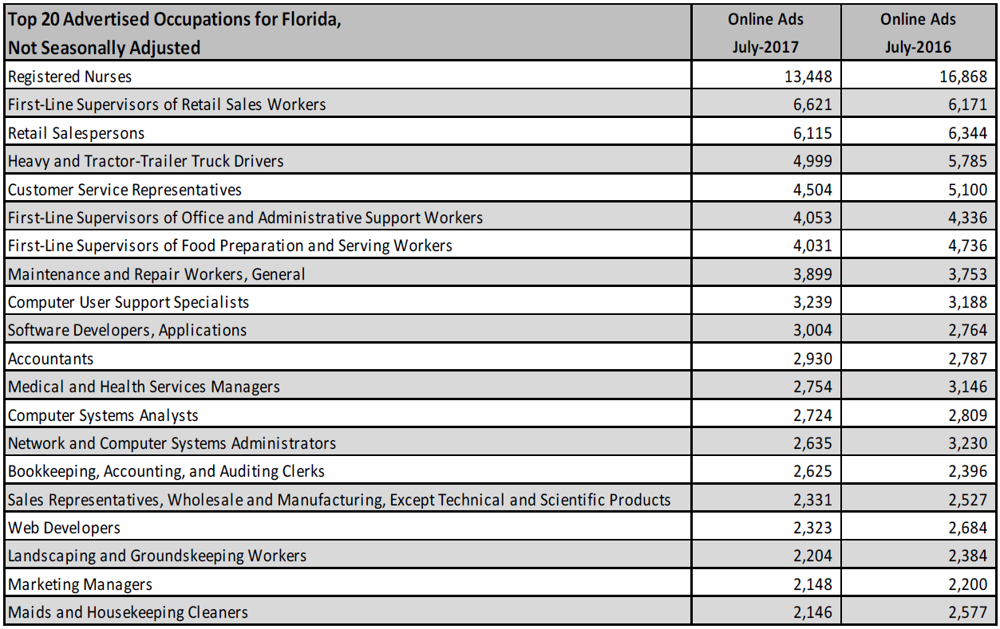
Real-Time LMI Help-Wanted Online Occupations In Demand
Source: The Conference Board, Help Wanted OnLine

Slide 39
Rebecca Rust Associate Commissioner Office of Occupational Statistics and Employment Projections www.bls.gov/emp
202-691-5701
rust.rebecca@bls.gov

Slide 41
Understanding Trends in Tech-Based Careers Using LMI and Real-time Data
Stephen Lynch

Slide 42
Jobs Have a Genome
AND EDUCATION NEEDS A MAP
Jobs are bundles of skills
Education is also built around skills
Mapping between skills and jobs creates a powerful, ongoing bridge between education and work

Slide 43
A Big Data Engine Enables Us to
Map the Genome of Jobs
Drawing conclusions
Insight from in-demand skills and real-life career patterns
A common language
Proprietary taxonomy for valid comparisons
Tagging and structuring
70+ elements of metadata
Capturing job market data
3.4 million active, unique jobs daily
Rich Data:
50,000 sources
700 MILLION jobs
250 MILLION resumes/year

Slide 44
Jobs are Changing
More jobs are “hybrids” merging skills from different fields
The tech revolution has broken down skill barriers
That means no one training program can cover everything

Slide 45
A Classic Linear Genome
WELDER
WELDING
Mig and Tig Welding
Repair
Inspection
Gas-metal Arc Welding
Flux Core Welding
Calipers
Shielded Metal Arc Welding
Schematic Diagrams
29,308
JOB COUNT
LAST 12 MONTHS
6.8%
INCREASE SINCE 2013
$39,598
SOFT SKILLS
Detail oriented
Work area maintenance
Quality assurance
AVG. SALARY

Slide 46
Mapping a Hybrid Genome
DATA SCIENTIST
SOFT SKILLS
Problem Solving
Writing
Teamwork
Presentation skills
PROGRMMING SKILLS
Python
SQL
Hadoop
R
DATA SKILLS
Predictive Models
Tableau
MapReduce
15,133
JOB COUNT
2016
424%
INCREASE SINCE 2013
BUSINESS SKILLS
Data Visualization
Business Process
Economics
Strategic Planning
$132,486
MEAN SALARY

Slide 47
Align Training to Local Employer Needs
Top Software Skills in Demand for Software Engineers
New York, NY
Java 45%
SQL 35%
JavaScript 27%
Python 26%
Linux 21%
Albany, NY
SQL 41%
Java 39%
Oracle 36%
JavaScript 26%
XML 22%
Buffalo, NY
SQL 40%
Java 24%
.NET 20%
Microsoft C# 18%
Javascript 20%
Different markets demand different software skills from software engineers

Slide 48
Align Training to Local Employer Needs
A Tale of 4 IT Roles in CA Markets Ranked by Postings
ROLE | RANK BY MARKET
 | Fresno | San Francisco | Los Angeles
Computer User Support Specialist | 1 | 10 | 2
Web Developer | 10 | 2 | 3
Database Administrator | 7 | 12 | 8
Cyber/Information Security Engineer/Analyst | 13 | 9 | 10

Slide 49
Identify Local Employer Pain Points
Hybrid Tech Role Demand and TTF Data
ROLE | Miami MSA | Milwaukee MSA
Web Developer | 22 days | 33 days
Mobile Applications Developer | 27 days | 39 days
Marketing Manger | 49 days | 41 days
Product Manager | 71 days | 46 days
Marketing Specialist | 41 days | 34 days

Slide 50
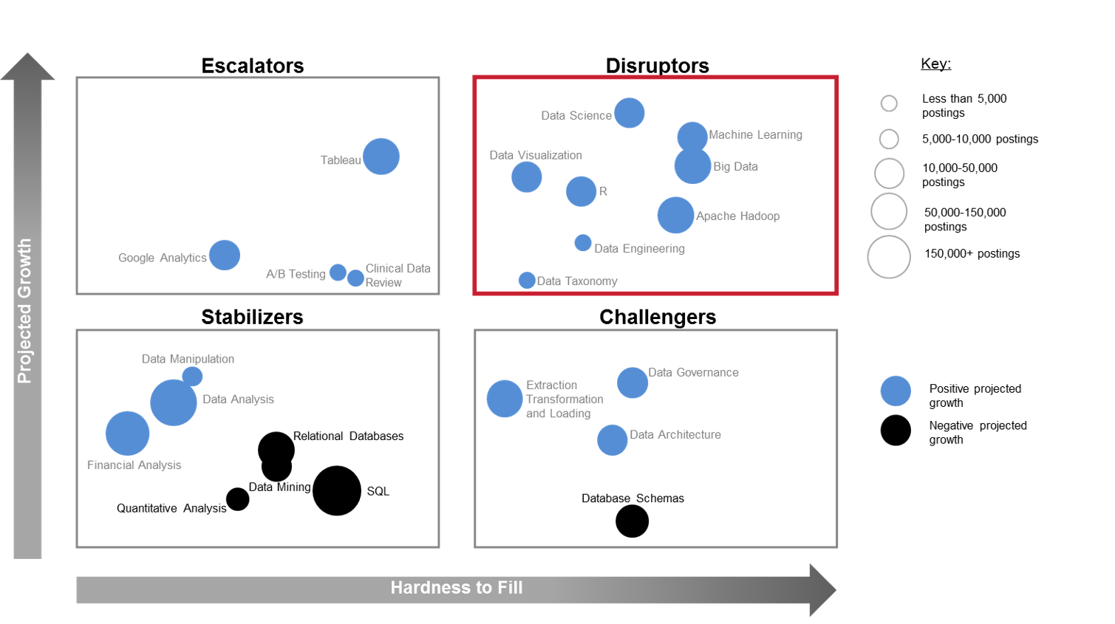
Not All Skills are Equal
BUILD PROGRAMS TO ADDRESS HOTSPOTS
50

Slide 51
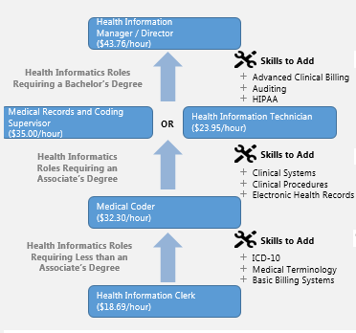
Waze for Careers
SKILLS ANALYSIS INFORMS PATHWAYS
Identify career ladders and skills essential to job-to-job transfers
Our pathway maps provide structure for training content
Reorient training programs around upward mobility

Slide 52
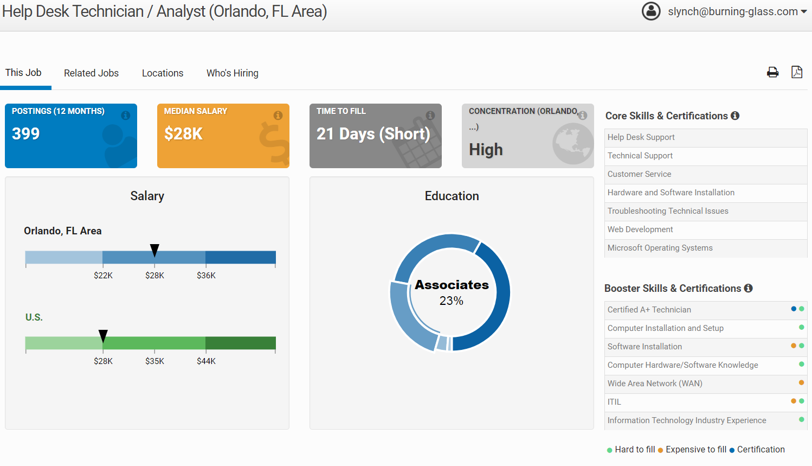
Show Them What They Need

Slide 53
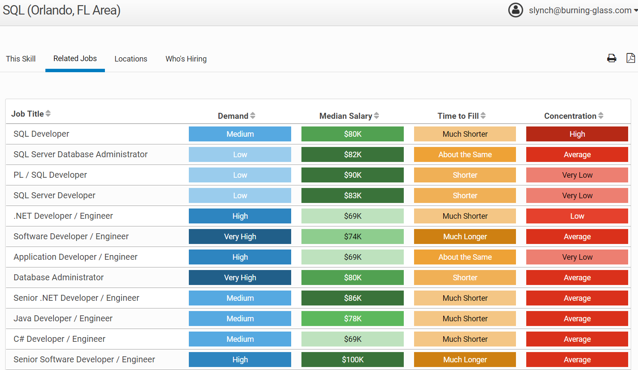
Show Them Where They Can Go

Slide 54
Skills Drive Success in Traditional and Alternative Work Arrangements
 | Top IT Skills (Total postings) | Highest Paying Skills (Mean advertised salary) | Fastest Growing Skills (24 month projections) | Hardest to Fill IT Skills (Mean posting duration)
1. | SQL | MapReduce | Data Science | Cloud Security
2. | Java | Pig | Ansible | Jboss Application Server
3. | Oracle | Machine Learning | Docker | Metadata Design
4. | Javascript | Natural Language Processing | Oracle Cloud | Solaris
5. | Linux | Apache Hive | Microsoft Azure | Integration Architecture
6. | SAP | Cerner | ElasticSearch | Distributed Computing
7. | .NET | Scala | AngularJS | Information Architecture
8. | C++ | Data Science | Tableau | Apache Kafka
9. | Sharepoint | SAP Technical Architecture | GruntJS | Web Services Security
10. | jQuery | Apache Hadoop | Machine Learning | Cloud Computing

Slide 56
Grantee Polling Question
The BLS listing of Methods Used to Determine Jobs in Demand was collected from a survey of state LMI shops. Are you using any additional methods to determine in-demand (tech) jobs, that are not already addressed during this webinar. Do any of you have different methods (whether formal or informal) that you have used to stay up to date on labor market information for your proposed TechHire grant occupations and industries?
Please use the chat function below!

Slide 57
Applying LMI and Real-Time Data to TechHire
Sara Lamback

Slide 58
Data Applications
Curriculum Content
OUTCOMES: Align learning outcomes to identified skill and qualification requirements
Employer
Engagement
OUTCOMES: Spur and enhance conversations with employers
Demand-Driven Programming
OUTCOMES: Match and revise program offerings to economic demand
Career Guidance
OUTCOMES: Improve matching for student employment

Slide 59
Curricular Design and Review
LMI can foster better alignment between programs and employer demand

Slide 60
Process to Identify Employers for Engagement
Industry outlook
Examine highest ranked industries by employment size, wage, growth, or competitive effect
Occupation profiles
Examine top occupations, job titles, wages, and skills/credentials needed for entry or progression
Employer targets
Identify employers to target for engagement

Slide 61
Use Visuals to Convey Data to Employers and other Stakeholders

Slide 62
Grantee Polling Question
What examples or best practices in using LMI and real-time data could you share?
Please type your response into the chat box!

Slide 63
Grantee Polling Question
Describe how you plan to integrate what you’ve learned in this webinar into your TechHire program
Please type your answer into the chat box!

Slide 65
Resource Links
O*Net Online Bright Outlook Occupations
https://www.onetonline.org/find/bright?b=0
LMI Central: Workforce GPS
https://lmi.workforcegps.org
Burning Glass: Hybrid Jobs—How Business and Technology Skills are Merging to Create High Opportunity Hybrid Jobs:
http://burning-glass.com/research/hybrid-jobs

Slide 66
Upcoming TA Next Steps
Please stay tuned for upcoming TA Events, including:
September: Peer learning call
October: Small peer group discussions
November: TechHire Virtual Institute
Ongoing: Monthly calls with TA coaches

Slide 67
Grantee Polling Question
How do you feel after today’s webinar?
Choose the answer that best reflects you (or your group):
Geronimo! We are excited to apply these data and other resources to our TechHire project.
LMI What?!…We still have a few more questions!
A little overwhelmed, but excited!

Slide 69
For More Information:
Rebecca Rust Associate Commissioner Office of Occupational Statistics and Employment Projections www.bls.gov/emp
202-691-5701
rust.rebecca@bls.gov
Michael Wolf
Division Chief
Employment Projections Program
www.bls.gov/emp 202-691-5714 wolf.michael@bls.gov
Stephen J. Lynch
Director of Workforce & Economic Development Services
Burning Glass Technologies
slynch@burning-glass.com

Slide 70
TechHire Grantee Mailbox TechHire@dol.gov To Reach your Federal Project Officer, DOL National Office and Technical Assistance Providers

