Slide 1
Comprehensive Service Delivery for Youth
December 5, 2017
Effective Uses of WIOA Youth Funds

Slide 3
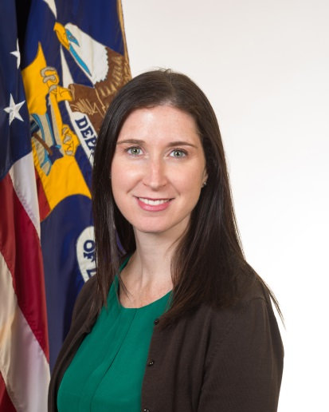
Sara Hastings
Unit Chief / Division of Youth Services, Employment and Training Administration/ USDOL

Slide 4
What we heard from you: Your TA Needs
Recruiting and retaining youth
How best to serve OSY
Linkages to mental health treatment
Program design
Professional development
Keeping youth engaged
Engaging and empowering youth
Trauma-informed care

Slide 5
Jessica Clayton, MSW
Program and Development Director/Spokane Area Workforce Development Council
jclayton@wdcspokane.com

Slide 6
Trina Clayeux, PhD
Director/
Next Generation Zone - NorthEast Washington ESD 101
trinac@nextgenzone.org
Stacey Wells, CPRW
WIOA Program Manager/
Next Generation Zone/Goodwill Industries of the Inland Northwest
staceyw@nextgenzone.org

Slide 7
Gain an understanding of what’s meant by a “comprehensive array of youth services”
Learn about Spokane Area Workforce Development Council’s approach to youth service delivery
Leave with a clear picture of what the Next Generation Zone offers and how it is achieved
Get answers to questions and spark some ideas that help you enhance your local youth efforts

Slide 8
A comprehensive array of youth services
Beyond the assessment, ISS, and the 14 program elements

Slide 9
What does it take? What are the essentials of a comprehensive service delivery?
Let’s hear from you. Type in the chat box.
What do you think the essentials are to being able to delivery comprehensive services?
What does it take to offer comprehensive services?

Slide 10
What it takes: The essentials
Strong leadership and a vision
Key partnerships in place, including employer partnerships
Leveraging of multiple resources
Well-trained and qualified professional staff
Customer-centered/ positive youth development approaches to delivery
Ability to assess, evaluate, learn and improve

Slide 11
What aspect(s) of delivering comprehensive services continues to challenge you?
Engaging out-of-school youth
Retaining out-of-school youth
Providing work-based learning/ work experience opportunities
Partnership building
Assessment and evaluation for program improvement
All of the above

Slide 12
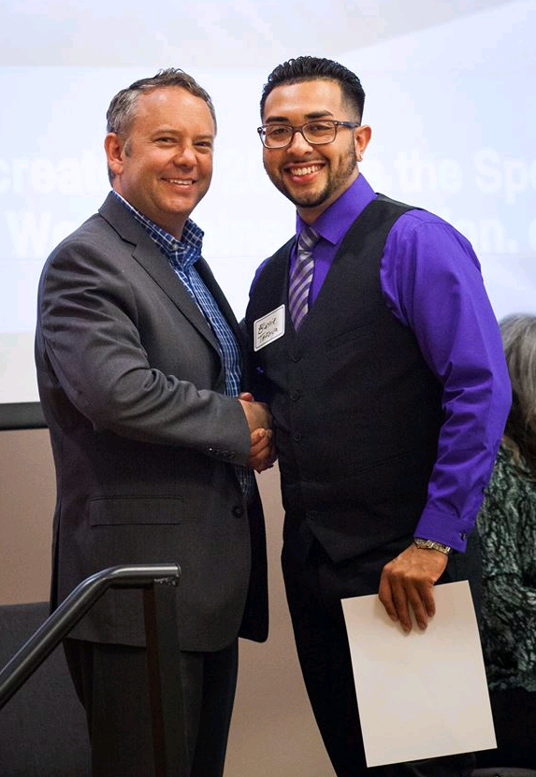
1

Slide 13
2
Key Demographics
Population 409,945
Total Labor Force – 231,638
Unemployment – 6.3% (August 2016)
Youth Unemployment – 13% (Ages 16-24)
Major industries – Healthcare, Transportation, Advanced Manufacturing, Professional Services

Slide 14
Next Generation Zone
3

Slide 15
What is the Next Generation Zone?
4
Fully integrated youth one-stop center.
By braiding resources, we provide services to all youth in Spokane County.
Focus on out-of-school youth (98% OSY).
On-site high school equivalency classroom.
Heavy focus on re-engagement practices.
Staff connect youth with work-based learning, employment, connection to post-secondary opportunities.

Slide 16
On-site partner programs…
5
WIOA Title I Youth (provided by a consortium of agencies)
Community Colleges of Spokane (Title II)
Open Doors Reengagement Program (WA State)
Vocational Rehabilitation (Title IV)
Job Corps
YouthBuild
AmeriCorps
Community-based organizations including: housing provider, health insurance assistance, and more.

Slide 17
The Next Generation Zone youth experience
6
Focus on quality of youth experience
Creating a sense of belonging and putting relationships first.
Seamless service delivery & invisibility of funding sources
Meeting essential needs
Safety, security, nutrition

Slide 18
Our philosophy…
7
Trauma-informed practices
Safety, Consistency, Predictability
Youth-centered design
Emphasis on staff professional development
Includes the whole youth workforce system not just specific programs/funding sources
Common case management philosophy
Parenting v. partnering
Enabling v. empowering
Saving v. self-sufficiency
Continuous improvement and evaluation
Innovation, flexibility, problem solving

Slide 19
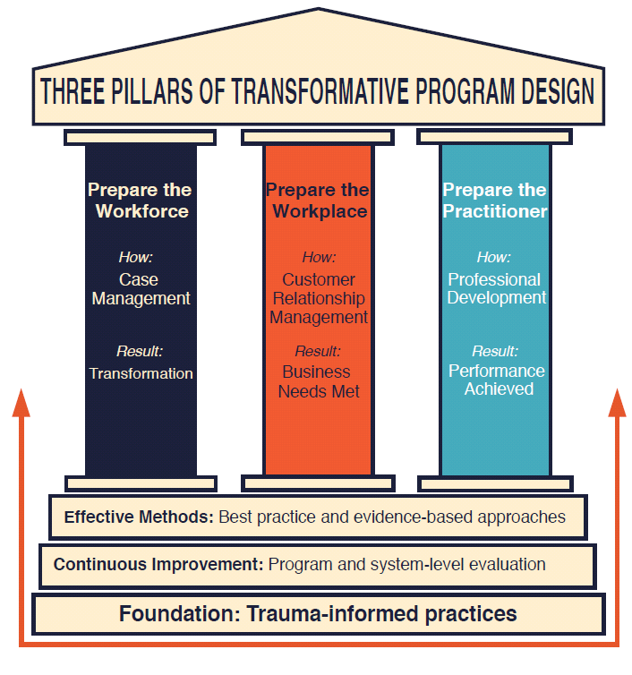
8

Slide 20
Braided funding staff positions
9
College & Career Navigator
Focuses on placement and retention of youth in to post-secondary education and training.
Mental Health Specialist
Focuses on crisis intervention and referral/soft hand off to a community provider when necessary.
On deck: Health Education
Will deliver health education classes to youth including smoking cessation, wellness for work, nutrition, and positive parenting.

Slide 21
WIOA Program Elements 21st Century Career Skills Academy
10
Our 21st Century Skills Academy is a 36-hour course that starts at the ground up, from career exploration to teaching crucial work-readiness skills. As a pre-requisite for a work-experience, the Academy provides young adults with foundational knowledge for success on the job and in life. Content includes career exploration, personality assessments, leadership development, guest speakers, and a wide array of engaging activities.
8 WIOA Program Elements are woven in to the Academy–
Notes:
STACEY’S SLIDE
As a pre-requisite for a work-experience, the Academy provides young adults with foundational knowledge for success on the job and in life.
Non-cognitive skills development is a focus of the course and is built in to the curriculum. The foundational tenet of the Academy is relationships—all staff rotate through teaching various content pieces, which results in the young adult having a village of staff wrapped around them and their goals.
Relationships and youth engagement are key components of all program offerings, and the curriculum has been thoughtfully designed to incorporate program elements, have a fun and supportive atmosphere, and be a value-add to both youth and business alike.

Slide 22
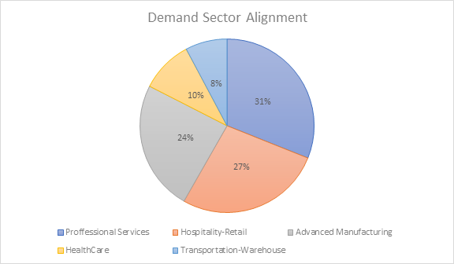
Work-based learning
11

Slide 23
Other key components
12
Leadership at all levels believe in the “why”
Workforce board is committed to the vision and strategies
A focused effort on diversifying funding-
In 2016, we raised over $500,000 to supplement our WIOA Youth Formula funds. Including leveraged funds, this brings our center wide operational expenses to about 50% WIOA and 50% non-WIOA!
Business sponsorships, annual donors, individual/family donors, private philanthropic foundations, community foundations

Slide 24
By the Numbers… (PY16)
13
Average wage at placement: $12.21/hr
21st Century Skills Academy Graduates: 84
Youth enrolled in WIOA funding stream = 418
Youth employed and/or entering postsecondary education = 148
National Career Readiness Certificates earned = 57
97% of young adults remain engaged after graduation & placement
Fall to Winter college retention rate is 100%; Fall-to-Fall rate 64%.
HSE Graduates = 123 (40% increase over last year!)

Slide 25
Why a youth one-stop?
14
Create and sculpt your unique brand
Harness the power of partnership
Horizontal integration of funds and programs
Braid & blend funds for maximum flexibility
Diversify resources and increase sustainability
Transformative Relationships → Transformative Results

Slide 27
Youth Cohort Challenge: Apply Now!
Is effectively engaging and retaining OSY a challenge in your local area?
Apply to be part of a diverse and dynamic group consisting of participants from around the country that focuses on tackling this issue head-on?
The Cohort process will cover 12 weeks during February-April, 2018. Applications are due December 15, 2017.
https://youth.workforcegps.org/announcements/2017/11/21/15/48/Youth_Cohort_Challenge-__Short_Applications_Due_December_15-_2017

Slide 28
The Power of Relationships: Workplace Mentoring with Youth
January 9, 2018

Slide 29
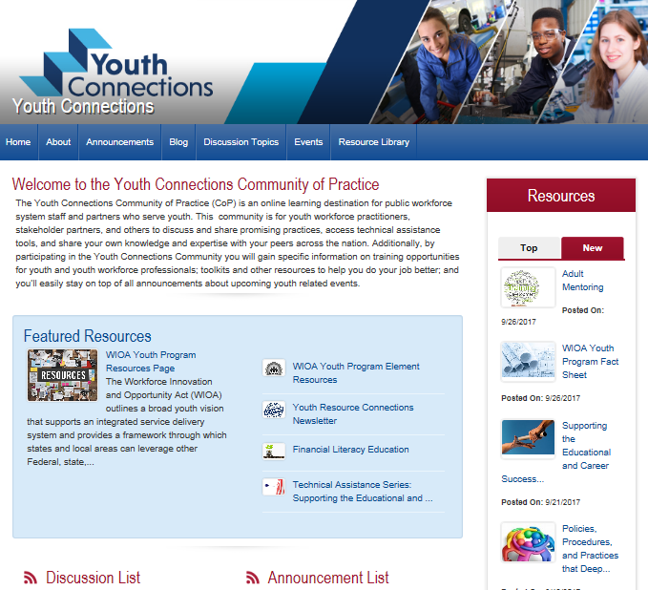
youth.workforcegps.org

Slide 30
Ways to Engage and Connect: DOL and your colleagues need to hear from you!
1st things 1st: Become a GPS member and use the Member Directory
Share your work
Submit a Resource on WorkforceGPS.
Send us your lessons learned and successful strategies to share with the field to youth.services@dol.gov
Participate in Discussion Threads

