Slide 1
EMPLOYER ENGAGEMENT TO SUPPORT PEOPLE WITH DISABILITIES IN THE LABOR FORCE
December 11, 2017

Slide 2

David Jones
  Workforce Analyst
    Employment and Training Administration (ETA)
    U.S. Department of Labor

Slide 3
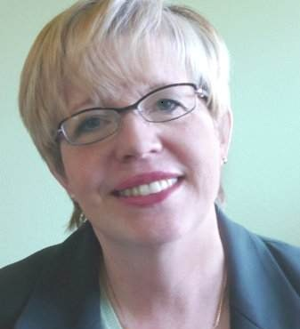

Kathleen West-Evans
  Director of Business Relations
    National Employment Team (NET)
    Council of State Administrators of Vocational Rehabilitation (CSAVR)
Josh Christianson
  Project Director
    Partnership on Employment & Accessible Technology (PEAT)

Slide 4
Understand the WIOA guiding principles surrounding employer engagement and promote innovative work-based training.
Highlight successful strategies and barriers in bridging the disability population with employers to enter the labor force.
Gain insights on current and emerging accessible workplace technology to foster solutions.

Slide 5
A Common Mission - Seamless Service Delivery for Disability Population
1
American Job Centers (AJCs) – In Program Year 2015, 156,000 individuals with disabilities found work through AJC services.
Vocational Rehabilitation (VR) Agencies – In Program Year 2015, 188,244 individuals with disabilities obtained employment outcomes through VR services.

Slide 6
Strategic Alignment Across Programs to Serve Employers
1
WIOA establishes VR as a core program partner to help achieve State workforce vision and goals. AJCs and VR align through:
  State Plan – Jointly ensuring employment and training services are coordinated and complement each other to meet employers’ needs.
  Performance – Jointly establishing new performance measure on the effectiveness in serving employers.

Slide 7
A Connection with State and Local Workforce Boards
1
WIOA establishes VR as required members of State and Local Workforce Development Boards. At the same table through:
  Jointly promoting the use of industry and sector partnerships, and
  Jointly responsible for activities to meet the workforce needs of local and regional employers.

Slide 8
Supporting Employers -
Meeting Workforce Needs
1
WIOA establishes that local areas can use funds for demonstrated effective strategies that meet employers’ workforce needs.
  Iowa – Organizing Reverse Career Fairs
  South Dakota – Building Pathways: Targeted Occupations Business Interview and Tour
Work Opportunity Tax Credit (WOTC)
  Employers are eligible to receive tax credit for hiring individuals with disabilities.

Slide 9
Bridging Training Opportunities to Support Employers
1
WIOA emphasizes that training leads to industry recognized credentials for in-demand jobs.
Access to emerging training opportunities for developing technology skills through public-private partnerships:
  TechHire Partnership Grants
  Apprenticeships

Slide 10
1
Disability Storyboards: AJC Customer Flow Scenarios
  The second storyboard focuses on an employer seeking guidance to hire and accommodate workers with disabilities.
    https://ion.workforcegps.org/resources/2017/07/19/10/02/AJC_Customer_Flow_Scenarios
An Emerging LifeChanger Program
  Pilot recently launched by Cisco that expanded worldwide to hire nearly 100 talented people with disabilities.
    https://www.cisco.com/c/dam/en_us/about/inclusion-collaboration/life-changer.pdf
The Playlists: Disability Resources for WIOA Practitioners
  Playlist 6 focuses on “Employer Engagement Strategies to Recruit and Retain Individuals with Disabilities.”
    https://disability.workforcegps.org/resources/2017/02/15/22/14/The_Playlists_Disability_Resources_for_WIOA_Practitioners
Work Opportunity Tax Credit
  Work Opportunity Tax Credit (WOTC) is a Federal tax credit available to employers for hiring individuals from different target groups including individuals with disabilities.
    https://www.doleta.gov/business/incentives/opptax/
Query WIOA State Plans
  RSA online site enabling users to conduct word search in State Plans such as “Business Services” or “Employer Engagement”
    https://rsa.ed.gov/ad-hoc-query-wioa.cfm?usp=Y
ETA WorkforceGPS Tools
  ETA online resources to support strengthening employer engagement activities.
    https://businessengagement.workforcegps.org/
    https://apprenticeshipusa.workforcegps.org/resources/2017/03/10/16/09/Expanding-Apprenticeship-for-Individuals-with-Disabilities
    https://disability.workforcegps.org/
Notes:
On this page, we have listed 6 resources and would like to highlight some of them further:
The first is what we simply call “The Playlists” – This is a Disability Resource Guide for WIOA Practitioners that was jointly developed by Dept. of Education and Labor staff. There are 10 playlists that contains resources and Playlist 6 focuses on Employer Engagement strategies. The Playlist has been our most popular resource on our Disability Employment Page.
The second resource to highlight are Storyboards- This TA resource came out this summer. There are five storyboards in total and two of them have a disability theme focus. One storyboard is from the perspective of the employer named “Charles” in seeking to recruit PWD and the story goes through how that dialogue may occur. This is great resource for front line staff. Because of great continued interest, these have recently been made available in Spanish.
Finally, WorkforceGPS- At ETA, we are working hard to make sure you have the latest information. Three sites to highlight:
Business Engagement Page – A lot of good resources surrounding Sector Strategies
Apprenticeship Page – This link is focused on making the connection with disability community
Disability and EmploymentWorkforceGPS- An online Resource Destination ---

Slide 11
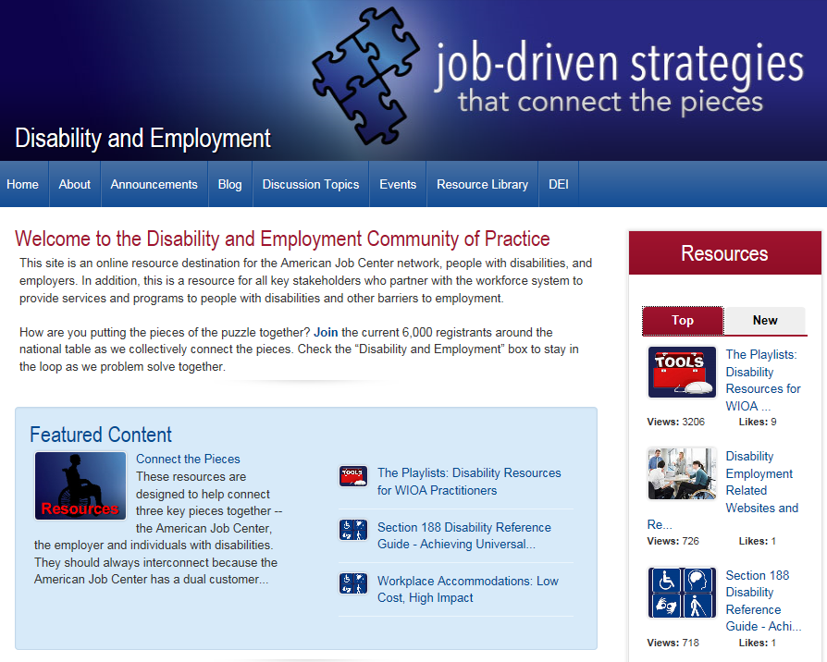
“Connect the Pieces” on Disability.WorkforceGPS.org
1

Slide 12
A Senior Cisco Executive
The benefits to Cisco are far greater than most realize. The people we have hired under this program have great loyalty, work ethic, and customer empathy.
Cisco LifeChanger Program – Transforming Lives Through Technology

Slide 13
The Dual Customer - Connecting Candidates with Disabilities and Employers
Kathleen West-Evans, MPA,CRC
Director of Business Relations
National Employment Team (NET)
Council of State Administrators of Vocational Rehabilitation (CSAVR)

Slide 14
Vocational Rehabilitation’s (VR) Dual Customer Approach
2
CSAVR: National Organization; 79 agencies – every state, territories and Washington, D.C. location
Serving a range of individuals with disabilities, including Veterans
  Individualized Plan for Employment (IPE)
  Focus on Careers
Serving business as a customer: what we learned and are developing with business customers
The NET: VR’s National Employment Team (NET)
  Cross State Infrastructure
  Business Services

Slide 15
WIOA Amendments to the Rehabilitation Act of 1973
2
Expansion from the 1998 Amendments
  Building business relations at the national, state and local level;
  Services to business includes education, consultation and technical assistance;
  Cross state collaboration to serve business;
  Business on State Rehabilitation Councils; and
  Ability to support retention and rapid response
Bringing the specialization to the larger workforce team

Slide 16
National Employment Team (NET) and the Talent Acquisition Portal (TAP)
2
Range of Business Services:
  Pre-employment supports
  Recruitment and Hiring
  Retention
  Staff Training
  Worksite Assessment – Accommodations and Assistive Technology
  Diversity and Inclusion Programs
  Compliance Support
  Financial Support and Tax Credits/Deductions
  Customer Services and Marketing
  Strategic Planning

Slide 17
National Employment Team (NET) and the Talent Acquisition Portal (TAP)
2
Talent Acquisition Portal (TAP): A Centralized Talent Pool
  Accessible Platform
  National in Scope
  Connecting Candidates with Disabilities and Employers
  Virtual Hiring Events and Career Fairs

Slide 18
Business Partnership Models
2
CVS Health: Retail, distribution, corporate
  Pharmacy Tech Training
Hyatt: Culinary Arts training on-site
Lowe’s: Distribution, retail and corporate
Microsoft: Autism Initiative, Imagine Academy
Starbucks: Business based training – roasting plants and retail, work based experience
Wells Fargo: National recruitment strategy

Slide 19
2
CSAVR Investing In America Publication – Spring 2017
  Highlights of success stories, business partnerships, and emerging initiatives occurring on the front lines across America.
    http://neweditions.net/products/business-roundtable-report-employer-engagement-vocational-rehabilitation-vr
An Emerging Autism Hiring Program
  Microsoft recruitment, retention, and career development strategy to increase employees with disabilities in its workforce.
    https://www.microsoft.com/en-us/diversity/inside-microsoft/cross-disability/hiring.aspx
Vocational Rehabilitation Business Roundtable Report
  Employer Engagement in Vocational Rehabilitation Report. Resource outlining recommendations for (1) improved employer engagement and (2) meeting the needs of businesses.
    http://neweditions.net/products/business-roundtable-report-employer-engagement-vocational-rehabilitation-vr
CSAVR Online Resource Page
  Resource includes historical conference presentations, position papers, additional resource links, and listing of current State VR Directors.
    https://www.csavr.org/resources

Slide 20
Mixed reality is:
The digital and physical world becoming one
Currently available in a head-set apparatus
Poised to change the way we work and do business in the future
All of the Above

Slide 21
Mixed reality is:
Answer: #4. All of above. All three accurately describe “mixed reality”
The digital and physical world becoming one
Currently available in a head-set apparatus
Poised to change the way we work and do business in the future

Slide 22
Examining Solutions- Current and Emerging Accessible Workplace Technology Tools
Josh Christianson
Project Director
Partnership on Employment &
Accessible Technology (PEAT)

Slide 23
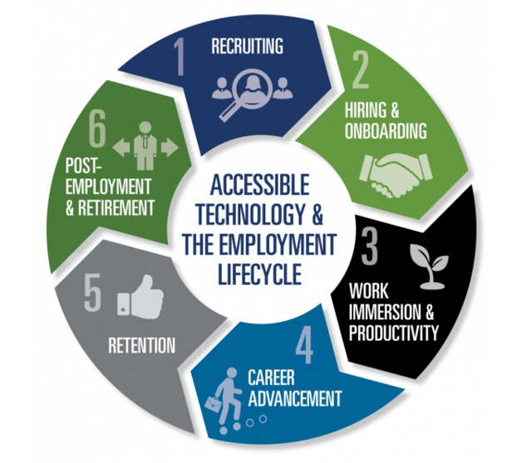
The Employment Lifecycle
3
Recruiting
Hiring & Onboarding
Work Immersion & Productivity
Career Advancement
Retention
Post-Employment & Retirement

Slide 24
Pre-Employment Stage
3
Companies are increasingly using online tools to assist with recruitment, sorting, and screening of applicants.
PEAT researched and reported findings in a report titled “eRecruiting & Accessibility: Is HR Technology Hurting Your Bottom Line?”
  46 percent of people rated their last experience applying for a job online as “difficult to impossible.”
  Of the 46 percent, 9 percent were unable to complete the application and 24 percent required assistance from the employer.

Slide 25
Pre-Employment Stage
3
Leading eRecruiting accessibility issues include:
  Complex navigation
  Timeout restrictions
  Lack of video captioning
  No alternative text for images
  Poor screen contrast
  Inaccessible form fields
Business solutions to these challenges
  Making employers aware and recommending increased flexibility on the application process.

Slide 26
Employment Stage
3
During the employment stage, some barriers that exist for workers with disabilities related to technology include:
  Work Immersion and Productivity
  Career Advancement
  Retention

Slide 27
Employment Stage
3
Accessible Technology
  Technology used by people with a wide range of functional abilities.
Assistive Technology
  Technology used by people in order to perform or improve functions that might otherwise be difficult or impossible.
Examples - Accessible and Assistive Technology
Universal and Inclusive Design

Slide 28
Employment Stage
3
PEAT developed several key resources as possible solutions for employers in this stage:
  TalentWorks – An online guide to help employers improve the accessibility of the technology they use throughout the entire employment lifecycle.
  BuyIT! – An online guide to help employers ensure the information and collection technologies tools (ICT) the business buys work for everyone.

Slide 29
Post-Employment and Retirement Stage
3
  The use of technology continues after an employee leaves a job:
    Completing online job exit forms and accessing statements;
    Accessing past performance records for another job; and
    Continued administration of benefits and retirement planning

Slide 30
The Future of Technology in the Labor Force
3
  The rapid advancement of technology inventions could break down barriers further for people with disabilities in the labor force.
    Live Video
    Mixed Reality
    Artificial Intelligence

Slide 31
3
Policy Matters
  Resource that contains information pertaining to policies such as Section 508, ADA, WIOA, and other relevant topics.
    https://www.peatworks.org/policy-matters
Buy IT!
  Resource that supports employers and their purchasing staff in building accessibility and usability into their ICT procurement process.
    https://www.peatworks.org/buy-IT/
TalentWorks
  Resource that helps employers and HR professionals make their eRecruiting technologies accessible to all job seekers–including those with disabilities
    https://www.peatworks.org/talentworks
Creative Recruiting Strategies for the Digital Age
  A PowerPoint resource that outlines the top five creative recruitment strategies for the digital age.
    http://www.peatworks.org/content/webinars/2017/11/XceptionalHR
American Job Center (AJC) Resources to Support Accessibility
  Resource links to support AJCs to improve accessibility to people with disabilities.
    American Job Centers and Digital Access: A Guide to Accessible ICT
    WIOA and Accessible Technology: Five Things AJCs Need to Know
    Digital Accessibility Checklist for American Job Centers
    WIOA and Accessible Technology: A Presentation Deck for AJCs

Slide 32
Any Questions?

Slide 33
Kathleen West-Evans
  Director of Business Relations
    Council of State Administrators of Vocational Rehabilitation (CSAVR)
      Kwest-evans@rehabnetwork.org
Josh Christianson
  Project Director
    Partnership on Employment & Accessible Technology (PEAT)
      Jchristianson@peatworks.org

Slide 34
The Power of Relationships: Workplace
Mentoring with Youth
https://www.workforcegps.org/events/2017/11/10/09/03/The-Power-of-Relationships-Workplace-Mentoring-with-Youth
    January 09, 2018

