Slide 2
A Model Career Pathways Network:
December 4, 2017
NFJP, Columbia Basin College, & Benton Franklin Workforce System

Slide 4
Getting to know our partners: What role do you play in creating access to Career Pathways?
Workforce Professional (provide direct service)
Educator
Administrator or Policymaker
Employer
Other

Slide 5
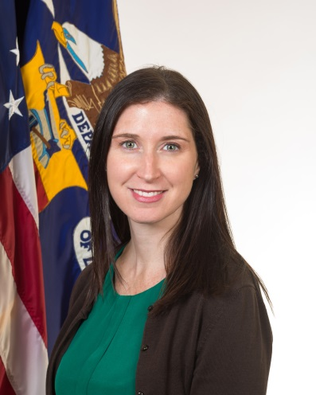
Sara Hastings
Division of Youth Services, U.S. Department of Labor

Slide 6
Career Pathways Framework
Introduction to *NFJP and OIC of Washington
Partnership between OIC, CBC, & WorkSource
Career Pathways in Practice
*National Farm Jobs Program and Opportunities Industrialization Center

Slide 7
How familiar are you with Career Pathways?
Very familiar
Somewhat familiar
I don’t know anything

Slide 8
Career Pathways Framework
A Framework for WIOA Implementation

Slide 10
Career Pathways: A WIOA Implementation Framework
Build Cross-Agency Partnerships
Identify Industry Sector and Engage Employers
Design Education and Training Programs
Identify Funding Needs and Sources
Align Policies and Programs
Measure System Change and Performance
Six Key Elements of Career Pathways

Slide 11
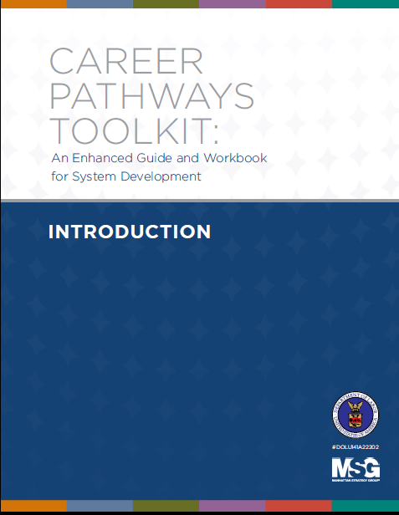
Career Pathways Toolkit: An Enhanced Guide and Workbook for System Development
Updated with WIOA References
Enhanced Content:
Examples
Worksheets
Resources
Enhanced Functionality:
Modular
Fillable
Interactive

Slide 12
Toolkit Modules

Slide 13
Where Do I Get the Toolkit?
https://careerpathways.workforcegps.org

Slide 14
Leonor Rico Barker
Business Services Manager OIC of Washington
Michelle Mann
Director, Worker Retraining Program
Columbia Basin College

Slide 15
Janese Thatcher
Dean for Career & Technical Education
Columbia Basin College
Leticia Torres
Adult, Dislocated Worker and Youth Programs Manager
WorkSource Columbia Basin

Slide 16
NFJP & OIC of Washington
The National Farmworker Jobs Program (NFJP) provides Career Services and Training for migrant and seasonal farmworkers (MSFWs) and their dependents. Opportunities Industrialization Center of Washington is the grantee in Washington State.

Slide 17
A little about NFJP and OIC’s work
Serves 700 MSFWs and their dependents annually
Located in the highest agricultural producing areas of the state
Co-located in 4 of the American Job Centers in the 7 areas that we serve
Assess existing and transferable skills
Develop individualized career plans
Provide work supports and follow up services
Facilitate access to training and work based learning opportunities

Slide 18
Columbia Basin College
CBC is a comprehensive two-year college that provides quality education and effective job preparation.

Slide 19
A little about CBC
Serving an area population of 290,000 in SE Washington state
7,450 students
Thirty-three 2-year degrees
Eight 4-year degrees
Forty 1-year certificates
Twenty-four short term certificates
Substantial engagement by area employers on advisory committees
Need for all levels of education to meet their workforce needs
Existing partnerships with WIOA contractors to provide training that leads to year-round employment

Slide 20
WorkSource Columbia Basin
The American Job Service Center for The State of Washington is a partnership of state and local government agencies (including Employment Security), colleges and non-profit organizations that offer employment services for job seekers and businesses.
WorkSource is an equal opportunity employer/program. Auxiliary aids and services are available upon request to individuals with disabilities. Washington Relay Services: 711

Slide 21
A little about WorkSource
Includes partners from all 4 WIOA Titles
Provides over 2,000 Staff Assisted Services to job Seekers each month
Recognized as a statewide leader in case noting practices
Adopts Customer Centered Approach to service delivery
Co-enrolls across programs to maximize value and efficiency

Slide 22
How WorkSource fits into the Career Pathway Partnership
Provides Labor Market Information
Identifies funding resources to fill gaps
Builds awareness of career pathways through career exploration
Leads student recruitment efforts
Provides tuition assistance, support services, and work experience and On The Job Training (OJT)
Collaborates continuously to create new opportunities

Slide 23
Our Career Pathway Journey
Opportunities Industrialization Center (OIC) of Washington
&
Columbia Basin College

Slide 24
Engaging Cross-Agency Partnerships
We had an existing partnership and were looking for opportunities to expand training options
CBC understood the barriers to education for the WIOA eligible students
Limited English proficiency
Low basic skills
Engaged partner programs to support workers and make the course sustainable
Utilized WorkSource to market Basic Industrial Maintenance program information
Serve the needs of both our business customers and job seekers

Slide 25
Researching the Industry Sector & Engaging Employers
Identified the industry needs based on worker skills and confirmed it with Labor Market Information (LMI)
Contacted maintenance managers, not HR, who have the practical knowledge of the work to determine the best course components
CBC recognized as the source of training skilled workers
Used CBC brand recognition to engage employers in the conversation of developing the Basic Industrial Maintenance (BIM) certificate

Slide 26
Best Fit for Our Customers: Education & Training Program Design
The existing college-level Basic Industrial Maintenance (BIM) program was modified to include the most relevant skills and offered as a short-term, non-credit certificate
Blueprints & Drawings
Basic Electricity
Fundamentals of Maintenance
Basic Welding
Only required basic skills assessments for program entry
Instructors were able to see beyond the barriers and recognize the capabilities of each student
Subsequent certificates are offered for college credit

Slide 27
Leveraging Existing Funding & Resources
Marketed the BIM training at WorkSource during unemployment insurance orientations
OIC posted the training on Craig's List and Facebook
Shared BIM information with HR personnel undergoing seasonal layoffs
Utilized existing NFJP and WIOA program funds to pay student tuition and provide support services
Included all necessary materials in the cost of training
Tuition
Books
Tools
Safety equipment

Slide 28
Creating Flexibility for Our Customers: Aligning Policies & Programs
OIC and CBC created a flexible registration process to allow easier access to educational pathways that lead to family wage jobs
Initial course was offered during winter when the seasonal unemployment rate for MSFWs is high
Basic skills assessments were conducted at OIC
Components of the course are now offered a la carte to accommodate job seekers and employers
This makes open enrollment throughout the year possible

Slide 29
“Communication Kept Us Nimble”: Measuring System Change & Performance
Based on employer feedback we emphasized certain subject areas to accommodate their production
Example: Food production uses more pneumatics than hydraulics
Communication kept us nimble, we evaluated our work throughout the process
Communication with students and instructors was vital
All students were provided ongoing support and follow up services

Slide 31
Webinar on Combating Sexual Harassment & Human Trafficking
The training will include strategies to:
Identify sexual harassment and human trafficking
Document issues of sexual harassment and human trafficking
Refer cases to appropriate enforcement agencies
Promote trauma-informed services
And learn about select best practices
January 25, 2018

Slide 32
National Farmworker Jobs Program
https://www.doleta.gov/Farmworker/html/NFJP.cfm
Migrant and Seasonal Farmworkers Monitor Advocate System
https://www.doleta.gov/programs/msfw.cfm
Association of Farmworker Opportunity Programs
http://afop.org/
WorkforceGPS
https://farmworker.workforcegps.org/

Slide 33
Sara Hastings
Unit Chief, Division of Youth Services
U.S. Department of Labor
Hastings.Sara@dol.gov
Leonor Rico
Business Services Manager
Opportunities Industrialization Center (OIC)
Le.Ri@YVOIC.org
Michelle M. Mann
Director, Worker Retraining Program
Columbia Basin College
mmann@columbiabasin.edu
Janese Thatcher, Ed.D.
Dean for Career & Technical Education
Columbia Basin College
Jthatcher@columbiabasin.edu
Leticia Torres, CWDP
Adult, Dislocated Worker and Youth Programs Manager
WorkSource Columbia Basin
LTorres@esd.wa.gov

