Slide 1
Understanding Grant Closeout for TAACCCT Round 3
U.S. Department of Labor
Employment & Training Administration
February 9, 2017

Slide 2
TAACCCT Learning Network at a Glance
U.S. Department of Labor, Employment & Training Administration
(National)
Jobs for the Future
CalState/Merlot
Maher & Maher
American Association of Community Colleges
U.S. National Science Foundation
ATE Centers
Other Non-Federal Providers of TA and Resources for TAACCCT Grantees:
Creative Commons
CAST
The Transformative Change Initiative
2

Slide 3
Presenters
Cheryl Martin
Program Manager, TAACCT, U.S. Department of Labor, Employment and Training Administration
Latonya Torrence
Division Chief, Division of Policy, Review and Resolution, U.S. Department of Labor, Employment and Training Administration
Meron Assefa
Closeout Grant Officer, U.S. Department of Labor, Employment and Training Administration
Avery Malone
Closeout Grant Officer, U.S. Department of Labor, Employment and Training Administration
3

Slide 4
Agenda
Key Dates
Telling the Round 3 Story
Showcasing your innovations!
Final Performance Reports and Other Numbers
Submitting Grant Products and Deliverables
Closeout Process
4

Slide 5
Participant Poll
What Round of TAACCCT do you represent?
  Round 3
  Round 4
  Multiple
If you’re a Round 3 Consortium Grant, are you the Lead or a Member?
  Lead
  Member
Have you been through closeout for a TAACCCT Grant before?
  Yes
  No
What are you looking to get out of today’s webinar?
Type in Chat box

Slide 6
Overview
Cheryl Martin
Division of Strategic Investments
USDOL/ETA Office of Workforce Investments

Slide 7
Key Dates for TAACCCT Round 3
Round 3 Start Date | Oct. 1, 2013
Submit Interim Third-Party Evaluation | Per your eval plan
WE ARE HERE: 40+ months into 48 months | Feb. 9, 2017
Data Validity Letters (if applicable) | Early spring 2017
End Date for Grant-Funded Program Activities (extended from Sep. 30, 2016) | Mar. 31, 2017
Finalize data-gathering, reporting, third-party evaluation, posting of product deliverables | Apr 1, 2017 – Sep. 30, 2017
Submit Final Third-Party Evaluation | Due Sep. 30, 2017
Round 3 End Date | Sep. 30, 2017
Submit Final APR, QNPR, 9130 | Nov. 14, 2017 (45 days)
Remaining Closeout Documentation | Dec. 30, 2017 (90 days)
6

Slide 8

TELLING THE ROUND 3 STORY
What is your legacy?
We encourage you to share the following – either in your QNPR, or via email to TAACCCT mailbox (TAACCCT@dol.gov). E.g.,
In what TAACCCT strategy area(s) have you experienced the greatest success?
Please describe the new policies, practices or programs that have had the greatest impact on student credential and job attainment.
What will be sustained and/or institutionalized and scaled to reach more students?
Any “ripple effects”/surprising outcomes as a result of your work?
Please share any prepared documents, videos or other materials that illustrate your TAACCCT story! (Send to TAACCCT@dol.gov)
7

Slide 9
Third Party Evaluations (TPEs)
Due Sep. 30, 2017
    May use different data than final performance report (e.g., report on early cohorts)
    If questions, send to TAACCCTeval@urban.org and/or TAACCCT mailbox
See Round 2 Guidance
    Use Round 2 guidance on TPEs – included today; will add small changes plus some examples
    Suggested outline Executive Summary will benefit you and us!
    Webinar on TPEs in April

Slide 10
Key Closeout Differences for Round 3
No differences for single institution grants
For consortiums:
    As always, Round 3 consortium leads will gather performance data and report in aggregate for the entire consortium.
    For Round 3 only, each consortium member with its own grant number will:
      Receive a separate close-out letter and conduct close-out separately.
      Submit their own financial reports (9130s).
      Need its own Indirect Cost Rate agreement.
8

Slide 11
Final Performance and
Progress Reports
(and other numbers)
Cheryl Martin
Division of Strategic Investments
ETA Office of Workforce Investments

Slide 12
Heads Up
Round 3 Grantees will receive data validity letters in early spring, for any issues identified with data submitted to date.
Use Consolidated FAQ document (Aug 2016)
PLEASE NOTE: This information supersedes that provided in any earlier closeout Webinars.
10

Slide 13
Final Progress Reports
The last Quarterly Progress and Annual Performance Reports will serve as the grant’s Final Performance and Outcomes Report.
  Consortium leads gather information and report for entire consortium – as in previous years
  The final QNPR will provide both quarterly and cumulative information on grant activity
  The final APR will provide annual information on grant activity from October 1, 2016 to September 30, 2017 (the fourth year only)
    The system will automatically aggregate all four years in the “thermometer” reports to provide cumulative data
11

Slide 14
When to Report
Reporting Requirement:
Not later than 45 days after the end of the reporting period.
For grants ending September 30, 2017:
  Final QNPR is due not later than November 14, 2017
  Final APR is due not later than November 14, 2017
12

Slide 15
What to Report
Final Quarterly Narrative Progress Report
  Information on grant activities during the last quarter and cumulative information on grant activities during the entire period of performance
    Fine to attach a supplemental document if there is not enough space
  For example: Section C: Status Update on Employer Involvement
  This quarter: One new employer interested in hiring graduates
  Cumulative: Seven employers total hired graduates throughout the grant period
13

Slide 16
What to Report
Final Annual Performance Report
  The final APR will reflect the activities since the third year APR, that is, your fourth year program activities (plus any B.8 or B.9 activities that occur during the closeout period; see Compiled FAQs Section VII.D.4)
  Grantees may use the fourth year as a follow-up year, or use the first six months to continue grant-funded program activities and the final six months for follow-up
  Either way, you will submit only one time, and this final APR should be submitted by November 14, 2017
14

Slide 17
What to Report
Annual Performance Report: The first six months
Grantees may use the first six months of the final year to continue grant-funded program activities.
    If a grantee chooses this option, they may continue to report on all outcomes (B.1 –B.10) for the first six months of this final year
    During the final six months of the grant period, only follow-up outcomes (B.7-B.10) should be reported
    If grantees do not choose the six-month option, they should be reporting only follow-up outcomes (B.7-B.10) in their final Annual Report
15

Slide 18
Supporting Documentation for Final Report
Program Activities Reported for the First Six Months
    You must have participant and financial records to support the aggregate data submitted
    For example, that individual students were tracked and reported as participants in outcome B.1 months 37-42.
    PLEASE NOTE: No grant funds can be spent on programmatic activities in the final six months of the grant, and only outcomes paid for with grant funds may be reported in your APR.
16

Slide 19
FAQ
How Do We Report Additional Follow-Up Outcomes That Were Achieved During the Grant Closeout Period?
    If a student meets the definition of B.8 or B.9 during the closeout period (Oct. 1 – Dec. 31) you may count them in B.8 or B.9 as a follow-up outcome.
    Report the numbers you have by the Nov. 14, 2017 performance reporting due date. If you want to amend your reports with any additional follow-up outcomes during the closeout period, contact your FPO to request that your final APR be unlocked.
See Question VII.D.4 in Compiled FAQs
17

Slide 20
FAQ
How Long Should We Keep Our Files Accessible Before Putting Them In Archives?
  Please follow your institution’s policies, which must be consistent with federal requirements.
  Federal requirements on record retention state that all records pertinent to the grant agreement shall be retained for a period of three years.
  The three year clock may reset if there is an audit or open investigation.
  http://www.doleta.gov/grants/pdf/TAG_PartII_July2011.pdf
See Question III.B.2 in Compiled FAQs
18

Slide 21
FAQ
Can We Save E-files, DVDs, disks, etc., and Destroy All Paper Files?
  See above. Please also ensure there are adequate measures in place to safeguard Personally Identifiable Information (PII). Please see TEGL 39-11 for additional guidance at
  http://wdr.doleta.gov/directives/attach/TEGL/TEGL_39_11_Acc.pdf
See Question III.B.3 in Compiled FAQs
19

Slide 22
FAQ
Where and How Should We Store or Destroy Participant Files?
  It is the responsibility of the grantee to ensure that all participant files are stored and retained in accordance with federal regulation, as well as state and organization policies. Part II - Chapter 14 of the One-Stop Comprehensive Financial Management Technical Assistance Guide addresses records retention.
See Question III.B.1 in Compiled FAQs
20

Slide 23
FAQ
Question: How did we do? Or, what do the numbers tell you about how we did?
Standardized Outcomes
Use the Thermometer Report
https://taaccct.workforcegps.org/resources/2015/06/16/21/50/TAACCCT_APR_Thermometer_Instructions_Rounds_2-3-4
21

Slide 24


Slide 25
Product Submission Process

Slide 26
Grant Products and Deliverables
Creative Commons Attribution License
  Grantees will license to the public all work created with the support of the grant under a Creative Commons Attribution 3.0 (CC BY) license;
  Grantee will release all new source code developed or created with grant funds under an open license acceptable to either the Free Software Foundation and/or the Open Source Initiative; and
  Work that must be licensed under the CC BY includes both new content created with the grant funds and modifications made to pre-existing, grantee-owned content using grant funds.
23

Slide 27
Grant Products and Deliverables
Third Party Review of Deliverables
  Grantees will be required to identify third-party subject matter experts to conduct reviews of the deliverables produced through the grant.
  Grantees must provide the Department with the results of the review and the qualifications of the reviewer(s) at the time the deliverables are provided to the Department.
24

Slide 28
Grant Products and Deliverables
TAACCCT Repository of OER
  www.skillscommons.org
  Support: support@skillscommons.org
BEGIN UPLOADING PRODUCTS
AS SOON AS POSSIBLE!
  Managed through USDOL cooperative agreement with California State University – MERLOT (Multimedia Education Resources for Learning and Online Technology
25

Slide 29
FAQ
Question: Can I use Creative Commons 4.0 Attribution License?
Answer: Yes
Question: Do I have to use Creative Commons 4.0 Attribution License?
Answer: No
See Question V.G.2 in Compiled FAQs
26

Slide 30
FAQ
What is the SGA Requirement for Subject matter experts’ reviews of grant-created content and industry partner participation?
According to the Round 3 SGA in Section III.D.5 (pp. 30-31):
Grantees will be required to identify third-party subject matter experts to conduct reviews of the deliverables produced through the grant. Applicants should allot funds in their budgets for the independent review of their deliverables by appropriate subject matter experts. Subject matter experts are individuals with demonstrated experience in developing and/or implementing similar deliverables. These experts could include applicants’ peers, such as representatives from neighboring education and training providers. The applicant must provide the Department with the results of the review and the qualifications of the reviewer(s) at the time the deliverables are provided to the Department.
See Question V.C.4 in Compiled FAQs
These reviews, along with the credential of reviewers and any related materials should be submitted to https://www.skillscommons.org.
27

Slide 31
FAQ
What are deliverables?
According to the SGA, the Department considers curricula, course materials, teacher guides, and other products developed with grant funds to be grant deliverables. These items were identified in each grantee’s statement of work as deliverables and are to be submitted to the Department according to the workplan or prior to the end of the period of performance.
See Question V.B.1 in Compiled FAQs
28

Slide 32
FAQ
Are Outreach Materials and other Program Support Materials Considered Grant Deliverables?
Although program management and implementation tools, outreach materials, and other program support materials are tangible items that could be considered “works” produced through your grant project, these items are not necessarily considered deliverables unless explicitly described as such in a grantee’s SOW. Grantees should use their discretion in consultation with their FPO about which of these to submit to the Department.
See Question V.B.3 in Compiled FAQs
29

Slide 33
FAQ
Are activities and costs related to reviewing and posting deliverables allowable during the final year (or six months)?
Costs related to reviewing (including third-party review), finalizing, and posting grant deliverables (i.e. curriculum, course materials, etc.) to Skillscommons.org are not considered program development or delivery, and accordingly, grantees may continue to incur costs for these activities throughout the entire grant period.
See Question VI.C.2 in Compiled FAQs
30

Slide 35
Grant Closeout Process
Avery Malone, Meron Assefa
Division of Policy Review and Resolution
ETA Office of Grants Management

Slide 36
What is Grant Closeout?
The completion of the grant life cycle
The official end of the government’s relationship with the grantee
29 CFR Part 95, Subpart D – After-the-Award Requirements
  Part 95.70- .73
29 CFR Part 97, Subpart D – After-the-Grant Requirements
  Part 97.50 – .52
Why do we close a grant in the first place?
32

Slide 37
Differences for TAACCCT Round 3
No differences for single institution grants
For Round 3 only,
    Each consortium member with its own grant number will:
      Receive a separate close-out letter and conduct close-out separately.
      Submit their own financial reports (9130s).
      Need its own Indirect Cost Rate agreement.
      List of equipment
33

Slide 38
Who We Are
Office of Grants Management
  Division of Policy, Review and Resolution (Latonya Torrence)
  Policy Units
  Audit Unit
    Grant Officer and 5 Resolution Specialists
  Closeout Unit
    Grant Officer and 7 Resolution Specialists
      Close approximately 700 – 1,000 grants a year
34

Slide 39
Preparing for Closeout
We track anticipated workload one year out
Not less than quarterly, OIST runs a report that identifies grants whose period of performance end date is approaching
The OIST report is then compared against information identified in the E-Grants Closeout System
Not Less than 7 days prior to POP end date – Closeout specialist sends out initial closeout notification letter to grantee
35

Slide 40
Closeout Begins
Within 45 days after POP end date – Grantee must submit final 9130 for last quarter. Checks Line 6 as “Final.”
Approx. 70-75 days after POP end date – Specialist sends follow up reminder to grantee to submit all documents.
90 days after POP end date – Grantee must submit all remaining closeout documentation.
  29 CFR 95.71(a) and 29 CFR 97.50(b)
  Grantee may not direct charge staff time to work on closeout of grant after POP end date.
36

Slide 41
Closeout Continues
91+ days after POP end – Compliance and reconciliation
All grants should be closed within 1 year of expiration (DLMS-2 Chapter 800)
38

Slide 42
Closeout Deadlines – Round 3 Grantees
September 30, 2017 – Grant expires, closeout begins.
November 14, 2017 – Final quarterly 9130 due.
December 30, 2017 – Closeout 9130 and remaining closeout documents due. Last day to draw down funds without permission from closeout unit.
39

Slide 43
Notification Letter
Dear Grantee,
This email is to notify you that your grant TC222251360A48 with the Employment and Training
Administration (ETA) will expire/expired on 09/30/2017.
If you agree with the expiration date, as specified at 29 CFR 95.71, you are required to submit electronically all the closeout forms in your specified closeout package in the Grant Closeout System (GCS) no later than 90 days from the expiration date.
NOTE: After you have completed the final expenditure report(s) Form 9130, you must certify the
closeout financial report(s) as well.
The Grant Closeout System (GCS) is accessed via the following URL:
https://www.doleta.gov/grants/grant_closeout.cfm
Please enter the password assigned to you for your financial reporting to log into your Financial
Reporting System home page, and then click on the Grant Closeout System menu on this page to
go to the GCS system.
You will receive the Grant Closeout System End User's manual in another email shortly. Please use
the End User's Manual and the Closeout Instructions posted in the Grant Closeout System to assist you
in doing your closeout reporting.
Inquires should be directed to the Resolution Specialist.
Sincerely

Slide 44
End User Manual
Dear Grantee,
Please find the Grant Closeout System (GCS) End User’s Manual in the attachment and use it to assist you in doing your closeout reporting in the GCS system. the URL for GCS system is:
https://www.doleta.gov/grants/grant_closeout.cfm
Inquiries should be directed to the Resolution Specialist.
41

Slide 45
Elements of the Grant Closeout Package
Documents to be submitted:
  Final Quarter 9130 and Closeout 9130
  Grantee’s Release
  Government Property Inventory Certification
    Inventory List
  Grantee’s Detail Statement of Costs
    NICRA & breakdown
  Grantee’s Assignment of Refunds, Rebates and Credits
  Grantee’s Close-out Tax Certification
37

Slide 46
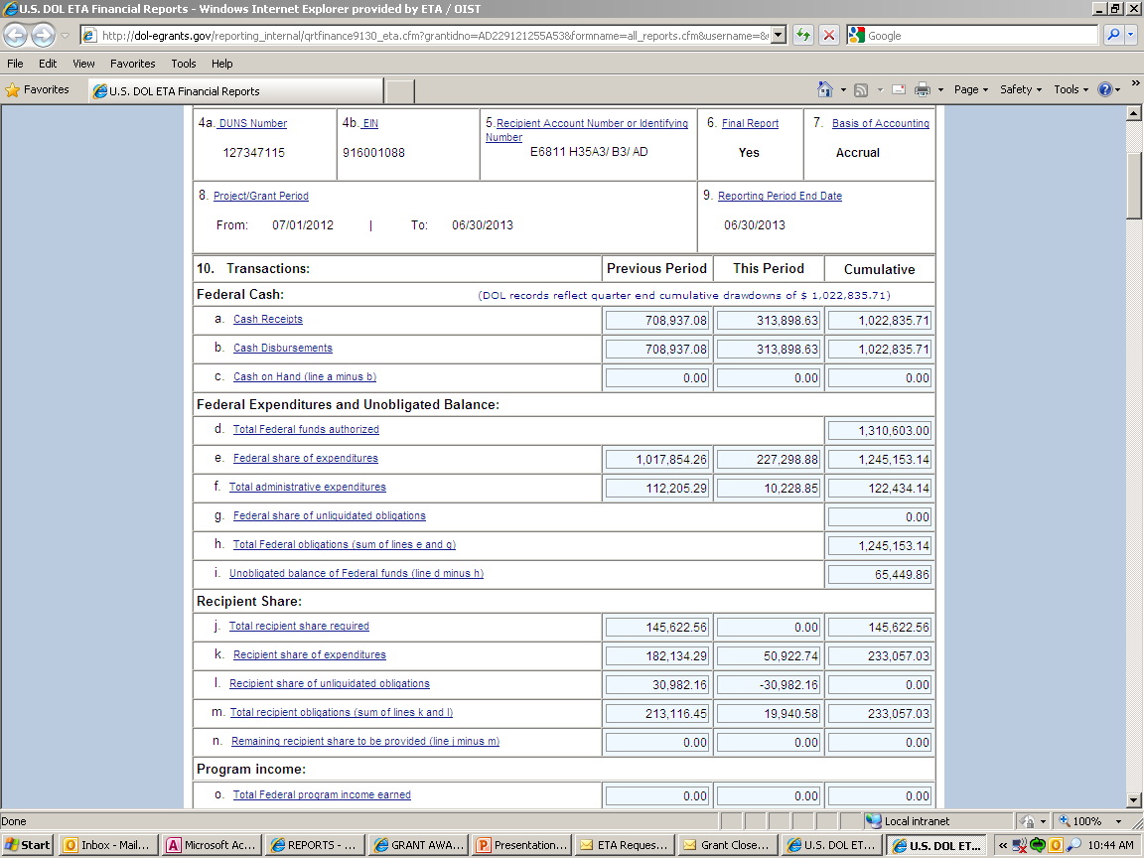
Final Quarterly 9130
45

Slide 47
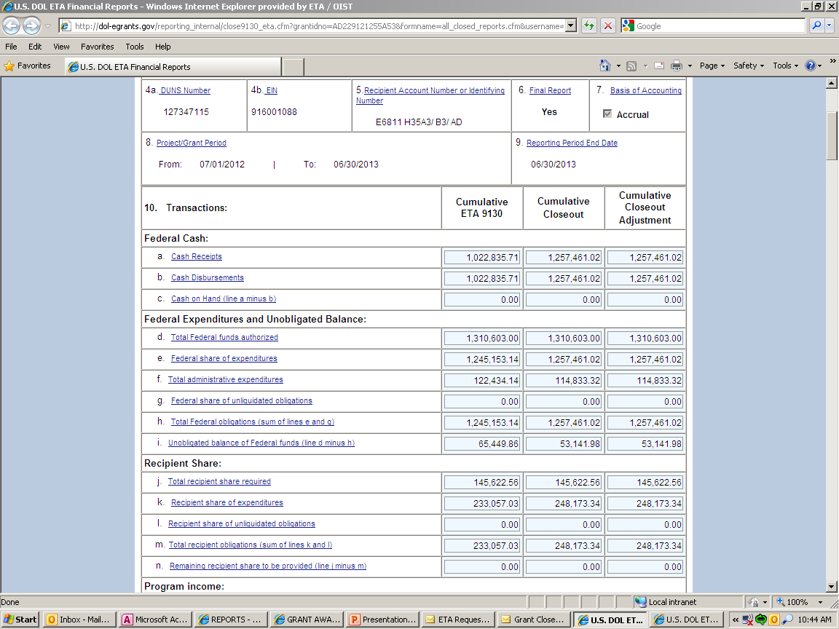
Closeout Financial Report (Closeout 9130)
46

Slide 48
Final Quarterly 9130/Closeout 9130
47

Slide 49
Liquidation of Obligation
In closeout, grantee may only liquidate obligations incurred during POP – not incur new obligations
Grantee may not direct charge staff time to work on closeout of grant after POP end date
48

Slide 50
Compliance
Drawdowns & Administrative Costs
  There is a 10% limitation on administrative costs. 10% of grant award amount.
49

Slide 51
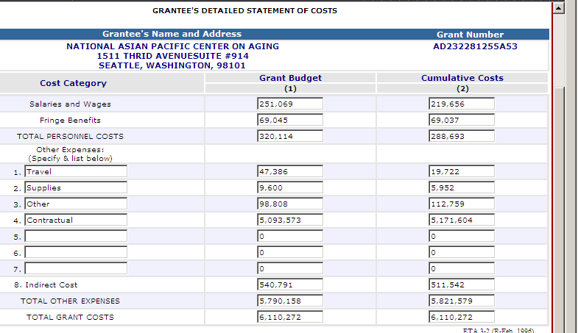
Compliance – Budget and Costs
50

Slide 52
Budget Realignments in Closeout
Grantee provides written justification to FPO
FPO determines if appropriate
FPO sends justification with a recommendation to closeout specialist for documenting the grant file
51

Slide 53
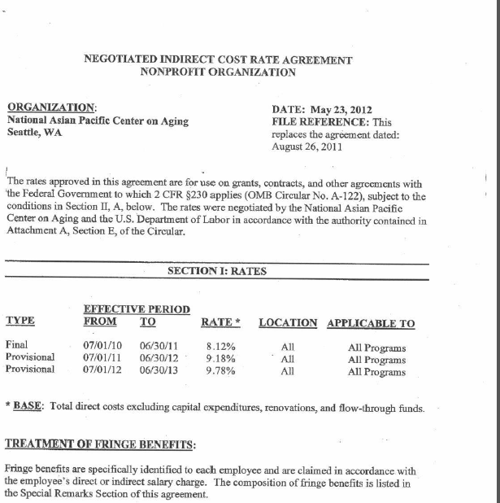
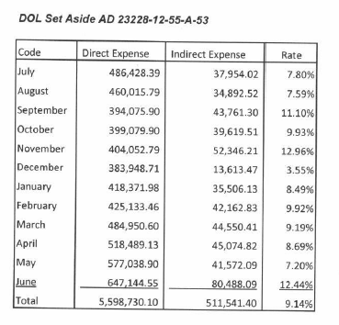
Compliance – Indirect Costs
52

Slide 54
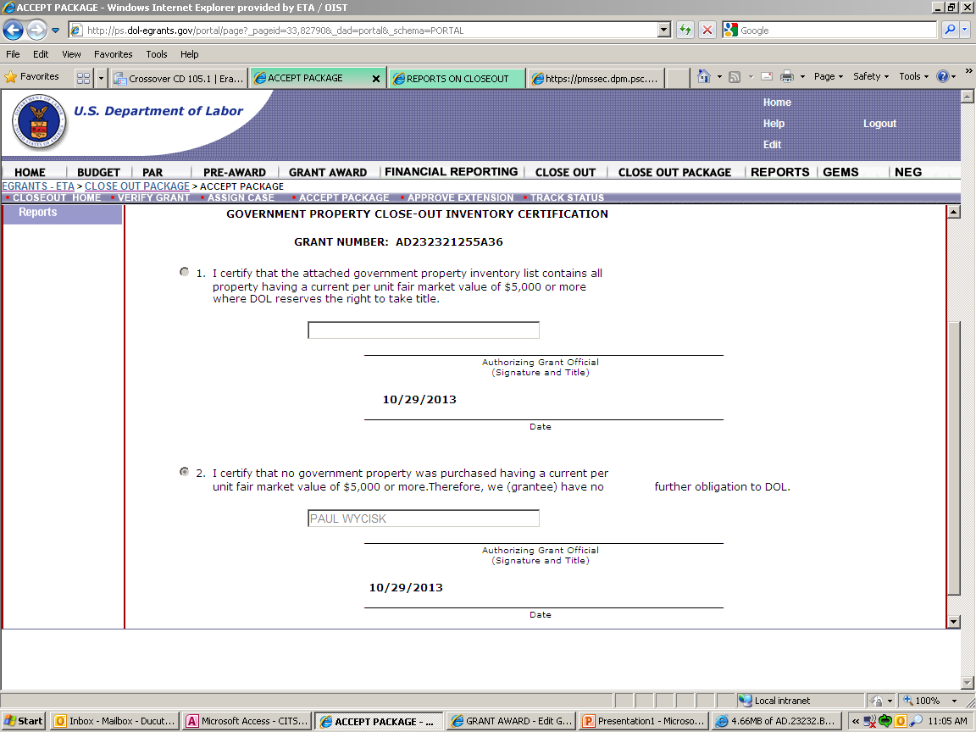
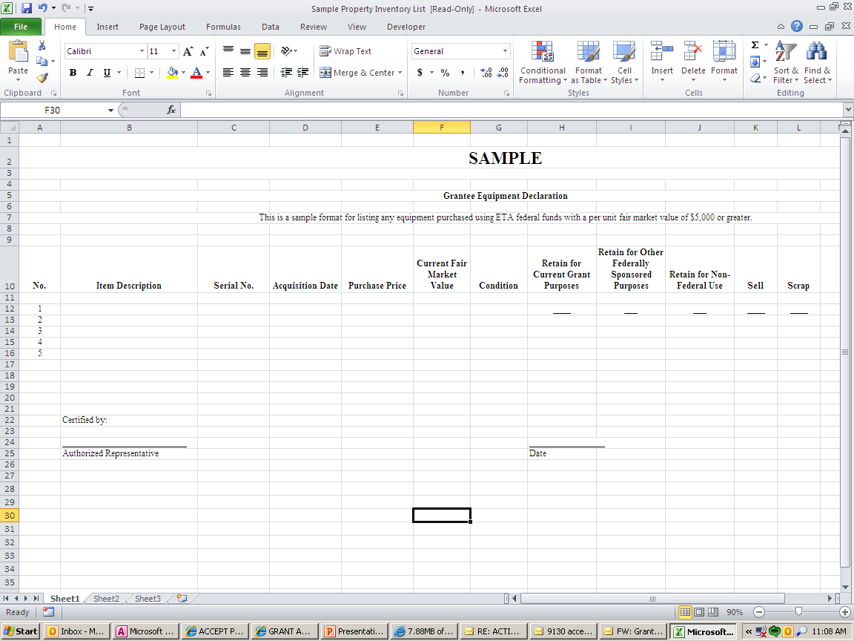
Property Certification Form
53

Slide 55
Submission Confirmation Letter
From: etareporting.auto-email@dol.gov [mailto:etareporting.auto-email@dol.gov]
Sent: Thursday, February 04, 2016 9:27 AM
To: Mathew, Joe - ETA
Cc: Daniels, Stephen - ETA;
Subject: Submission confirmation of Closeout Report
Please do not respond to this message!!!
Closeout Report
Grant Number: TC222441460A0
Has been successfully submitted on 9/30/16 09:26A.M.
And is now certified
42

Slide 56
Preliminary Settlement Letter
43

Slide 57
Common Misunderstandings
Expenditure amount higher than drawdown amount.
They need to match.
Completing the equipment form correctly.
Misunderstand all required forms and documents to be submitted.
54

Slide 58
Common issues Which Delay Closeout
Non-responsive grantees
Refunds
Equipment disposition
9130 issues
Administrative cost issues
Indirect cost issues
Question and disallowed costs/ID’s and FD’s
Budget realignments
55

Slide 59
Refunds
29 CFR 97.50(d), 97.51(b)
29 CFR 95.71(d), 95.72(a)
Grant closeout does not affect recipients obligation to return funds due to DOL as a result of refund.
Prompt refund of any balances of unobligated funds.
Refunds may require revising final expenditure report.
Refunds can be electronically through PMS or via check.
56

Slide 60
Frequently Asked Questions
Does marking “Yes” on Box 6 on the ETA 9130 trigger the closeout process?
Grant ends September 30, when does the grantee need to submit the final 9130 and the Closeout 9130?
    November 14, 2017/December 30, 2017
When is the last time I can draw down funds?
    December 30, 2017
Can stand-in costs be used to pay disallowed costs?
57

Slide 61
58

Slide 62

Thank You!
Please refer to the TAACCCT Compiled FAQs included in the handouts with this webinar. It will also be posted with the recording of this webinar.
Find resources for TAACCCT success at:
https://taaccct.workforcegps.org/
Subscribe to TLN resources, ask questions or connect with peers at TAACCCT@dol.gov
59

