Slide 1
WIOA Wednesday: Making the Most of ION
Your WIOA Starting Point
Presented by the U.S. Department of Labor
1/4/2016

Slide 2
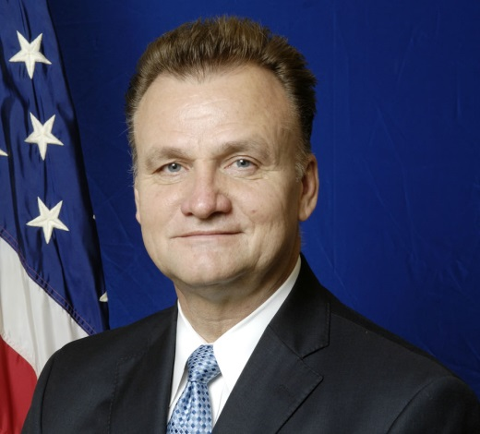
Byron Zuidema
Deputy Assistant Secretary
U.S. Department of Labor’s Employment & Training Administration
Stephanie R. South
Workforce Analyst
U.S. Department of Labor’s Employment & Training Administration

Slide 4
Take a closer look at Innovation and Opportunity Network (ION), expanding upon what you already know about this WIOA-focused Community of Practice
Cover recent site enhancements
Explain how you can use your WorkforceGPS membership to make the most out of ION

Slide 5
The Purpose of ION
Recent Site Enhancements
WorkforceGPS & ION
Coming Soon to WorkforceGPS!
Questions
Resources & Closing

Slide 6
How often do you visit ION?
Daily
Weekly
Monthly
Never

Slide 7
The Purpose of ION
Got WIOA? ION does.

Slide 8
The Purpose of ION
WIOA Implementation Content Collector
Your Starting Point…
For TA, information sharing, & training needed to implement the vision of WIOA
Your Interagency Bookmark
You’ll Find:
Interagency Links to:
Regulations
FAQs
Guidance
Technical Assistance
WIOA Events (in-person & virtual)
Cross-Cutting Strategies & Promising Practices
Peer-to-Peer Interaction
Assessment Tool

Slide 9
Recent Site Enhancements
Making ION Easier to Use

Slide 10
Recent Site Enhancements
WIOA Wednesday Events
WIOA Implementation Training Page
Focus Areas Tab
WIOA 101
Financial & Grants Management
One-stops/American Job Centers
Performance Accountability
Services to Adult Job Seekers & Workers
Services to Businesses & Employers
Services to Youth
State & Local Governance
System Alignment
Target Populations & National Programs
Wagner-Peyser Employment Services & Unemployment Insurance

Slide 11
ION Focus Areas

Slide 12
ION Focus Areas
Financial & Grants Management
One-Stops/ American Job
Centers
Performance
Accountability
Services to Adult Job Seekers &
Workers
Services to Businesses &
Employers
WIOA 101
Target Populations &
National Programs
Wagner-Peyser Employment Services & UI
Services to Youth
System
Alignment
State & Local
Governance

Slide 13
ION Focus Areas

Slide 14
How useful are the WIOA Wednesday Webinars to your work?
Very Useful
Somewhat Useful
Not Useful
What are WIOA Wednesdays?

Slide 15
WorkforceGPS & ION
Membership has its perks!

Slide 16
WorkforceGPS & ION
ION is accessible to everyone at all times:
Search for Resources
Access Resources
But using ION in conjunction with a WorkforceGPS account allows you to:
Save Resources
Share Resources
Sign-Up for Events
Sign-Up for Notifications

Slide 17
My WorkforceGPS

Slide 18
Search & Save

Slide 19
Easily Find Everything You Need

Slide 20
Stay Current

Slide 21
Are you signed up to receive the ION Weekly Digest?
Yes
No
I didn’t know I could sign up for a weekly digest!

Slide 22
Register Today!

Slide 23
Coming to WorkforceGPS in 2017
WorkforceGPS Membership Directory
View Fellow Community Members
Access to Your Peers
Member-to-Member Chat
New Communities of Practice & Collections
More ETA Staff Picks
ION Peer Learning Group Calls

Slide 24
How likely are you to participate in Peer Learning Group calls?
Very Likely
Somewhat Likely
Not Interested in Participating
What are Peer Learning Group calls?

Slide 26
What topics and/or kinds of resources would you like to see more of on ION?
Please visit https://ion.workforcegps.org/discussions,
Click on the Making the Most Out of ION discussion topic, and
Enter your answer in the form of a comment.

Slide 27
ION
https://ion.workforcegps.org/
WorkforceGPS
https://www.workforcegps.org/
Register for an Account
Sign up for a free WorkforceGPS account today!
https://www.workforcegps.org/register

Slide 28
Contact Information
For questions regarding the information in this webinar or to share additional thoughts on ION, send an email to*: DOL.WIOA@dol.gov.
*Please use ION as the subject line.

