Slide 1

Equal Employment Opportunity
What the new Regulations
mean for You
USDOL Office of Apprenticeship

Slide 2
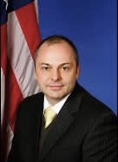


John Ladd
Administrator
USDOL/ETA Office of Apprenticeship
Zachary Boren
Division Chief
USDOL/ETA Office of Apprenticeship
Jim Foti
Senior Policy Advisor
USDOL/ETA Office of Apprenticeship

Slide 3
Welcome
Benefits of Diversity
Why New EEO Regulations?
Overview of New EEO Regulations
Technical Assistance & Resources
Q & A
Wrap-up

Slide 4
Benefits of a Diverse Workforce
How EEO is Good for Business

Slide 5
How DOL is Supporting Diversity
Contracted with four National Equity Partners
$50.5 million in 37 State Apprenticeship Expansion grants
  Diversify apprenticeship programs by expanding and marketing apprenticeship to new sectors and underserved populations
Created guide: “Pre-Apprenticeship: Pathways for Women into High-Wage Careers”

Slide 6
Why Diversity Matters
Quantitative
Qualitative
Companies in the top 25% for racial and ethnic diversity are 35% more likely to have financial returns above their respective national industry medians.
Companies in the top 25% for gender diversity are 15% more likely to have financial returns above their respective national industry medians.
Well-managed, diverse teams have the potential to outperform homogenous teams as they draw on a greater pool of ideas.
Workplace diversity translates into better servicing of customers and markets, increased business competitiveness and success.

Slide 7
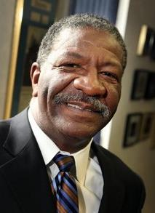
Lonnie Coleman
President
Coleman Spohn Corporation
Member, Advisory Committee on Apprenticeship

Slide 8
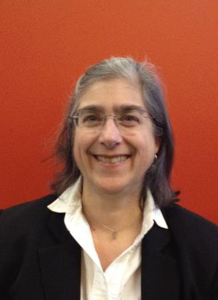
Connie Ashbrook
Executive Director
Oregon Tradeswomen, Inc.
Member, Advisory Committee on Apprenticeship

Slide 9
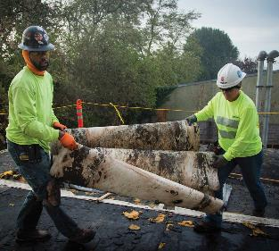
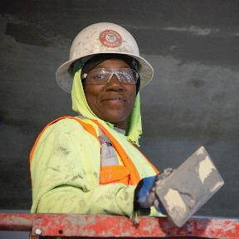
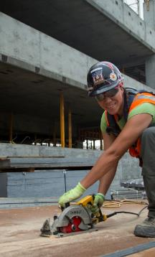
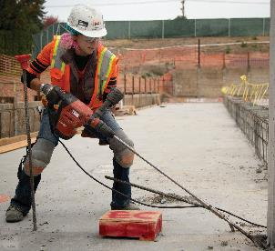
Oregon Tradeswomen, Inc.
Oregon Tradeswomen believes that the revised Rule provides Sponsors with improved guidance and standards on providing Registered Apprenticeship opportunities to all populations. Some of the features that our organization thinks are important are:
Anti-harassment training
Procedure for resolving complaints
Greater focus on including people with disabilities
Recruitment obligations that will help reach out to women
From Roofer to Cement Mason, Carpenter, Laborer and more – women have shown they excel in construction apprenticeships.

Slide 10
Why is the USDOL Implementing new EEO Regulations?
What you can expect

Slide 11
Why did DOL update the EEO Regulations?
Regulations have not been updated in 40 years, despite a large shift in the overall demographics of the country.
Updating and modernizing the rules will help employers to attract a larger and more diverse applicant pool.
Clarifying and streamlining the regulations will make it easier for sponsors to comply.
These changes will bring the regulations into accord with the current landscape of civil rights statutes and developing case law.

Slide 12
Key Changes
Simplified and clarified instructions and expectations
New apprenticeship programs have more time to develop initial affirmative action programs (AAPs)
All apprenticeship programs have additional flexibility in how often they must update their plans
Creates a more flexible framework for providing technical assistance
Provides guidance to work with those apprenticeship programs not meeting their responsibilities in order to bring them back into compliance

Slide 13
An Overview of the New
Apprenticeship EEO Regulations
A high-Level View of the Apprenticeship EEO Regulations

Slide 14
What is New/Updated in 29 CFR 30?
Extends protections against discrimination
Improves and clarifies affirmative steps to ensure equal opportunity in apprenticeship
Provides flexibility – new programs up to two years to develop initial AAPs, existing programs will have 2 years to comply with many of the AAP obligations
Better defines the process for analyzing the talent available and for achieving diversity goals
Introduces affirmative steps for employing people with disabilities in apprenticeship
Clarifies the outreach, recruitment, and retention activities expected of sponsors

Slide 15
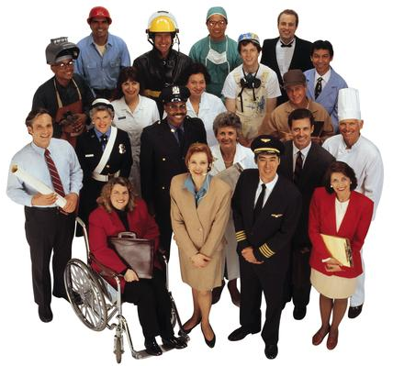
Who is covered by these protections? Protected Populations/Groups
The previous rule prohibited discrimination in the recruitment, selection, employment and training of apprentices on the basis of race, color, religion, national origin, and sex.
The updated final rule expands protected groups to include disability, age, sexual orientation, and genetic information.

Slide 16
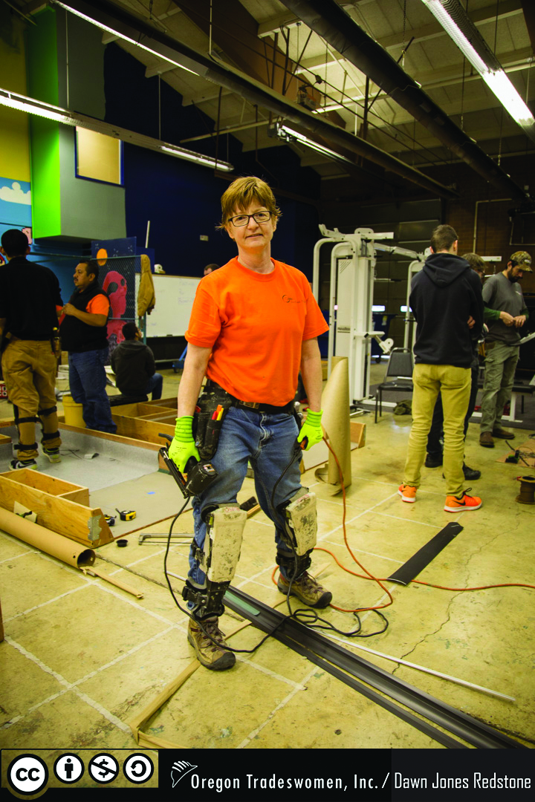
All Sponsors’ General Obligations to Ensure Equal Opportunity
Assign responsibility to an individual(s) to oversee EEO efforts
Distribute the EEO policy and conducting orientation and information sessions
Conduct outreach and recruitment and providing notice about openings
Keep the workplace free from harassment, intimidation, and retaliation (anti-harassment training and complaint procedures)
Conduct outreach and recruitment and providing notice about openings

Slide 17

Sponsor AAP Obligations
(sponsors with 5 or more Apprentices)
Similar to the previous rule, larger sponsors work with registration agencies to develop affirmative action plans (AAPs) to ensure equal opportunity in recruitment, selection, employment, and training of apprentices.
The final rule allows new program sponsors up to 2 years to establish initial AAPs.
Existing sponsors will have 2 years from the effective date to develop an AAP in line with the new rule.

Slide 18

Utilization Analyses and Goals for Race/Sex/Ethnicity
Structure and function similar to previous regulations: sponsors work with registration agencies to perform a utilization analysis (comparing their apprenticeship workforce to the qualified individuals available in the relevant labor market).
Technical Assistance and an electronic tool will be provided.
Set utilization goals if underutilized
Engage in targeted outreach, recruitment, and retention activities, if underutilized.

Slide 19

New Focus on Apprenticeships for Individuals with Disabilities
Final rule adds disability as an element of sponsors’ affirmative action programs.
Establishes an aspirational utilization goal that seven percent of programs’ apprentices be individuals with disabilities.
Sponsors will invite apprentice applicants and hires to self-ID as having a disability, use this data to measure its outreach and recruitment efforts.

Slide 20

State Apprenticeship Agency Plans
Within 1 year of the effective date, SAAs must submit to OA a State EEO plan that:
  Includes, at a minimum, draft State apprenticeship authorizing language or legislation corresponding to the requirements of 29 CFR part 30; and
  Requires all apprenticeship programs registered with the State to comply with the State’s EEO plan within 180 days from approval of the State plan

Slide 21
Technical Assistance & Resources
HOW DOL Can help you meet the new requirements

Slide 22
Technical Assistance
Phase 1
Winter 2017: Information Sharing
Phase 2
Spring 2017: Guidance and Support
Phase 3
Summer/Fall 2017: Specialized TA
General Technical Assistance
Priority Policy Guidance
Launch of Clearinghouse of Resources and E-Tools
Specialized Technical Assistance
Fact Sheets
Support

Slide 23
ApprenticeshipUSA EEO Website
  The place to find all of the latest guidance on the new Equal Employment Opportunity regulations around Registered Apprenticeship
    www.doleta.gov/oa/eeo/
What’s on the Website?
Apprenticeship EEO FAQs
  Answers to frequently asked questions on the new Apprenticeship EEO regulations
Apprenticeship EEO Overview Fact Sheet
  Get the facts on the new Apprenticeship EEO regulations
Pre-Apprenticeship: Pathways for Women into High-Wage Careers
  Information and resources to help community-based organizations and other workforce intermediaries build and sustain quality pre-apprenticeship programs
Apprenticeship EEO Final Rule
  The final approved language of the new EEO regulations.

Slide 24
Screen Share

Slide 25
Implementation Timeline

Slide 27
Apprenticeship.usa@dol.gov
202-693-2796

