Slide 1

WIOA Performance Accountability guidance overview
Today’s Focus:
Credential Attainment and Measurable Skill Gains
January 11, 2017

Slide 2

Presented by:
U.S. Department of Labor
Employment and Training Administration
U.S. Department of Education
Office of Career, Technical and Adult Education Rehabilitation Services Administration

Slide 3
  Overview of guidance and new terminology
  Discuss the credential attainment indicator for WIOA core programs
  Discuss the measurable skill gains indicator for WIOA core programs
  Technical Assistance
  New Qs & As

Slide 4
Karen Staha
  Director, Division of Strategic Planning and Performance
  Office of Policy Development and Research
  Employment and Training Administration
  U.S. Department of Labor
Cheryl Keenan
  Director, Division of Adult Education and Literacy
  Office of Career, Technical and Adult Education
  U.S. Department of Education
Melinda Giancola
  Chief, Data Collection and Analysis Unit
  Rehabilitation Services Administration
  U.S. Department of Education

Slide 5
Andy Ridgeway
  Supervisory Workforce Analyst
  ETA, Office of Workforce Investment
  Division of WIOA Adult Services and Workforce System
  U.S. Department of Labor
Evan Rosenberg
  Workforce Development Specialist
  ETA, Office of Workforce Investment
  Division of Youth Services
  U.S. Department of Labor
Alan Tucker
  Management and Program Analyst
  Office of Career, Technical, and Adult Education
  Division of Adult Education and Literacy
  U.S. Department of Education

Slide 6
Guidance Overview:
Indicators of Performance
Employment Rate – 2nd & 4th Quarters After Exit
  Title I Youth Education and Employment Rate
Median Earnings – 2nd Quarter After Exit
Credential Attainment
Measurable Skill Gains
Effectiveness in Serving Employers

Slide 7
Guidance Overview:
Categories of Enrollment & Other Terms
Reportable Individual
Participant
Date of Exit from the Program
Self Service & Information-Only Activities
Period of Participation
Career Services & Training Services
Incumbent Worker Training Under Title I

Slide 8
Credential Attainment Indicator

Slide 9
Credential Attainment Indicator
Percentage of participants enrolled in education or training program (excluding on the job training (OJT) and customized training) who attain a recognized postsecondary credential or secondary school diploma within 1 year after program exit

Slide 10
Credential Attainment Rate
  Only includes those who received training or education (excluding OJT or Customized Training) in denominator
  Includes both secondary school diploma/equivalent and postsecondary credential
  Credential can be obtained during the program or within 1 year following exit
  If participant obtains secondary school diploma or equivalent, in order to count in the numerator, they must also be employed or in an education/training program leading to a postsecondary credential within 1 year after exit

Slide 11
Types of Postsecondary Credential/Diplomas
  Secondary School diploma or recognized equivalent
  Associate’s degree
  Bachelor’s degree
  Occupational licensure
  Occupational certificate, including Registered Apprenticeship and Career and Technical Education educational certificates
  Occupational certification
  Other recognized certificates of industry/occupational skills completion sufficient to qualify for entry-level or advancement in employment

Slide 12
Postsecondary Credential –
Definition Highlights
  Awarded in recognition of an individual’s attainment of measurable technical or industry/occupational skills necessary to obtain employment or advance within an industry/occupation
  Technical or industry/occupational skills based on standards developed or endorsed by employers or industry associations

Slide 13
Postsecondary Credential –
Definition Highlights (cont.)
  Neither certificates awarded by workforce development boards nor work readiness certificates are included because neither document the measurable technical or industry/occupational skills
  Must recognize technology or industry/occupational skills for specific industry/occupation rather than general skills related to safety, hygiene, etc., even if general skills certificates are broadly required to qualify for entry-level employment or advancement in employment

Slide 14
Definition – Secondary School Diploma
A secondary diploma (or alternate diploma) is one that is recognized by a State and that is included for accountability purposes under the Elementary and Secondary Education Act of 1965 (ESEA), as amended by the Every Student Succeeds Act (ESSA).
A secondary school equivalency certification signifies that a student has completed the requirements for a high school education. The types of recognized equivalents, for those not covered under ESEA, are those recognized by a State.

Slide 15
Examples of…
…Secondary school diplomas, alternate diplomas, and recognized equivalents by individual States include:
  Obtaining certification of attaining passing scores on a State-recognized high school equivalency test
  Earning a secondary school diploma or State-recognized equivalent through a credit-bearing secondary education program
  Obtaining certification of passing a State-recognized competency-based assessment
  Completion of a specified number of college credits

Slide 16
Operational Parameters by Program
Who is Included in the Indicator – Title I
  Title I Adult and DW – Only individuals in training count in the indicator (excludes OJT and customized training)
  Title I Youth – All ISY are included, certain OSY are included
    OSY in occupational skills training, secondary or postsecondary while in program, plus a few others

Slide 17
Operational Parameters by Program
Who is Included in the Indicator – Title II
  Title II
    For postsecondary credential: Participants who were co-enrolled in a postsecondary education or training program

Slide 18
Operational Parameters by Program
Who is Included in the Indicator – Title III
  Title III – All Title III-only participants are EXCLUDED

Slide 19
Operational Parameters by Program
Who is Included in the Indicator – Title IV
  Title IV
    Participants in education or training program leading to recognized postsecondary credential
    Participants enrolled in secondary education and who have attainment of a secondary school diploma or equivalent identified on their Individualized Plan for Employment (IPE)

Slide 20
Examples – Credentials that DO Count
Examples of Credentials that Meet the Definition:
  Certified Nursing Assistant (CNA) License
    Example of Occupational Licensure
  Automotive Service Excellence (ASE) Certification
    Example of Occupational Certification
States must follow definition—not feasible to rule on each individual credential

Slide 21
Examples – Credentials that DO NOT Count
Examples of common certificates that do not meet the credential definition:
  Occupational Safety and Health Administration (OSHA) 10 Hour Course that provides awareness of job-related common safety and health hazards
  Work/Career Readiness Certificates
  Completion of an Assistive Technology training program (e.g., screen reading software)
  Completion of Orientation and Mobility training

Slide 22
Credential Ex. - Christopher
Christopher became a participant in a secondary education program in October 2016.
He exited the program in November 2016 and later reentered the secondary education program in February 2017.
In March 2017, he obtained a secondary school equivalency diploma and exited the program.
Chris got a job in May 2017.

Slide 23
Credential Ex. - Christopher
  Christopher is included twice in the denominator for the secondary credential component of the credential indicator because he had two periods of participation within the program year.
  He is credited twice with the achievement of a secondary credential, once in each period of participation because the credential occurred within 1 year of exit in both periods.
  Further, Chris was employed 1 year from exit allowing these achievements to be counted.

Slide 24
Credential Qs & As
  Q: Is Incumbent Worker Training excluded from the credential attainment rate?
  A: Incumbent Workers are excluded from all WIOA Performance Indicators. States will report on characteristics, services and outcomes of these individuals; however, they will not be included in performance calculations.

Slide 25
Credential Qs & As
  Q: How do we measure items that do not have certificates for the programs? For example, some technology trainings do not provide a credential but a certificate of completion. Would that count?
  A: A certificate of completion would typically not meet the definition of credential. The certificate/credential must meet the definition provided in the Act and further clarified in guidance.

Slide 26
Credential Qs & As
Q: Title I Adult and DW participants in customized training are excluded from the credential measure. What is customized training?
A: The definition can be found in Attachment 1 of the guidance. Customized Training is training that:
  a. is designed to meet the specific requirements of an employer (including a group of employers);
  b. is conducted with a commitment by the employer to employ an individual upon successful completion of the training; and
  c. for which the employer pays---(i) a significant portion of the cost of training; and (ii) in the case of customized training involving an employer located in multiple local areas in the State, a significant portion of the cost of the training, as determined by the Governor of the State, taking into account the size of the employer and such other factors as the Governor determines to be appropriate.

Slide 27
Credential Qs & As
Q: How does an apprenticeship fit with the credential measure?
A: One of the acceptable types of credentials is an occupational certificate, which includes a certificate of completion of a Registered Apprenticeship

Slide 28
Credential Qs & As
Q: If a participant completes a postsecondary program and receives a certificate of completion but does not follow through to obtain a license, is it counted as a credential?
A: No. A certificate of completion is not counted as a credential unless it meets the credential definition provided in the guidance.

Slide 29
Credential Qs & As
Q: If a participant enters the program below the 9th grade level of instruction and then advances to the 9th grade level over the course of the program, should the participant be counted in the credential indicator for secondary credential?
A: Yes. Participants who advance into the 9th grade level of instruction through the course of the program should be included in the secondary credential component of the credential indicator upon exit.

Slide 30
Credential Qs & As
Q: Are adult education participants, including ESL students, counted in the postsecondary education component of the credential Indicator?
A: Only adult education participants who are co-enrolled in a postsecondary education or training program should be included in the postsecondary credential component of the credential indicator. This applies to participants regardless of whether they are enrolled in ESL, ABE, or ASE.

Slide 31
Credential Qs & As
Q: A participant in the VR program is attending college, which is being paid for through VR (title IV) funds. The participant is also co-enrolled in a title I program. If the participant earns a credential by attaining a degree, would the title I and title IV programs both receive credit in the credential attainment rate indicator?
A: Yes. All applicable performance outcomes can be shared between programs, because other programs may have assisted the participant in attaining employment, a credential, or a measurable skill gain.

Slide 32
Credential Qs & As
Q: At what point is a participant who exits a core program, who is eligible for inclusion in the credential attainment rate calculation, included in the credential attainment rate calculation?
A: A participant is included in the credential attainment rate calculation one year after exit. For example, if a participant earned an associate’s degree and exited the VR program in the first quarter of PY17, he would appear in the numerator and the denominator of the credential attainment rate calculation for PY18. If he was enrolled in an associate’s degree program and exited the program the first quarter of PY17, but still had not earned the degree within 365 days of exit, he would only appear in the denominator of the calculation in PY18.

Slide 33
Measurable Skill Gains

Slide 34
Five Types of Measurable Skill Gains
Achievement of at least one educational functioning level, if receiving instruction below postsecondary education level
Attainment of secondary school diploma or equivalent
Secondary or postsecondary transcript for sufficient number of credit hours
  Secondary: transcript or report card for 1 semester
  Postsecondary: at least 12 hours per semester or, for part-time students, a total of at least 12 hours over 2 completed consecutive semesters

Slide 35
Five Types of Measurable Skill Gains (cont.)
Satisfactory progress report toward an established milestone from an employer or training provider
Passage of an exam required for an occupation or progress attaining technical/occupational skills as evidenced by trade-related benchmarks

Slide 36
Three Ways To Measure Educational Functioning Level Gain
Programs may measure measurable skill gains type #1, educational functioning level gain by:
  Comparing initial educational functioning level, as measured by a pre-test, with the participant’s educational functioning level, as measured by a post-test;
  Awarding of credits or Carnegie units for States that offer adult high school programs that lead to a secondary school diploma or its recognized equivalent may measure; or
  Enrolling in postsecondary education and training during the program year if the participant exits a program below the postsecondary level.

Slide 37
Operational Parameters
– Measurable Skill Gain
All participants who, during a program year, are in an education or training program that leads to a recognized postsecondary credential or employment are counted in the calculation of this indicator

Slide 38
Operational Parameters by Program
Who is Included in the Indicator – Title I
  Title I Adult and DW – Only individuals in training count in the indicator (includes OJT and customized training)
  Title I Youth – All ISY are included, certain OSY are included
    OSY in occupational skills training, secondary or postsecondary while in program, plus a few others

Slide 39
Operational Parameters by Program
Who is Included in the Indicator:
  Title II – All adult education participants are included
  Title III – All Title III-only participants are EXCLUDED
  Title IV – All participants enrolled in an education or training program identified on their IPE are included

Slide 40
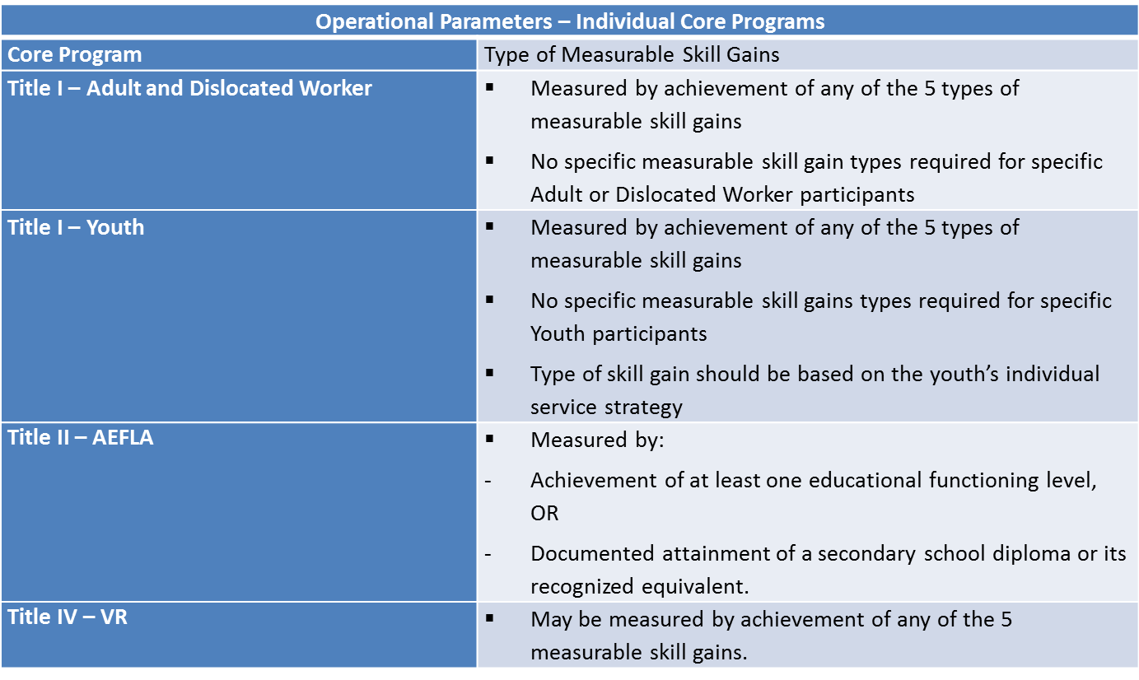
Operational Parameters – Types of MSG
The appropriate types of measurable skill gains for each core program focus performance accountability under measurable skill gain on the services that are allowable under the respective statutory provisions

Slide 41
Measurable Skill Gains Ex. – Carmen
Carmen became a participant in September 2016 in ESL Level 4. She attended until the class ended in December 2016. Before the class ended she took a post-test and achieved a level gain. Carmen did not return to the ESL program for further study.
    In PY 2016-17, Carmen achieved one measurable skill gain because she advanced one educational functioning level as measured by a pre-test and post-test.

Slide 42
Measurable Skill Gains Ex. – Tony
Tony became a participant in September 2016. In January 2017 he took a post-test which documented he achieved one educational functioning level. In February, he obtained his secondary school equivalency diploma.
    Tony achieved one measurable skill gain in the PY 2016-17 reporting period. Although he achieved two types of gain in the reporting period, an EFL gain and a secondary school credential, only one measurable skill gain is credited.

Slide 43
Measurable Skill Gains Qs & As
Q: Am I understanding correctly that there will be a significant number of participants who although they are not subject to the credential attainment indicator are indeed subject to the skill gain indicator?
A: Yes. There may be participants who are excluded from the Credential Attainment indicator and are included in the Measurable Skill Gain indicator. For example, for title I Adult and DW those in OJT and customized training are not included in the credential indicator, but are included in the measurable skill gains indicator. For title I Youth, the participants included in the two indicators are the same with the exception that credential is an exit-based measure, whereas measurable skill gains is not exit-based.

Slide 44
Measurable Skill Gains Qs & As
Q: If a participant is carried over from PY 2015 but is still in occupational skills training or high school equivalency training, can we enter measurable skills gains if after 7/1/2016 they show academic progress through a report card/transcript or passage of an exam that is required for the occupation?
A: Yes. If the participant is still in education or training during PY 2016 and achieves one of the types of measurable skill gains during PY 2016, they would count as a success in the indicator in PY 2016.

Slide 45
Measurable Skill Gains Qs & As
Q: Can a customer have multiple positives in the measurable skill gains indicator?
A: If a participant achieves more than one type of gain during a period of participation, then only one gain per participant is counted towards the measurable skill gains indicator for that reporting period. If the participant participates in parts of two program years and makes measurable skill gains in both program years, one gain in each of those program years would count in the indicator.

Slide 46
Measurable Skill Gains Qs & As
Q: If a participant successfully completes a work experience, will they count in the measurable skills gains performance indicator?
A: No. The participant must be in an education or training to be included in the measurable skill gains indicator. Work experience is not considered education or training; therefore, participation in work experience alone would not put the participant in the denominator for the measurable skill gains indicator.

Slide 47
Measurable Skill Gains Qs & As
Q: Does enrollment in developmental education classes count for the “enter postsecondary education” component of the measurable skill gains indicator?
A: Yes. Entry into developmental education classes will count as entry into postsecondary education and can be counted towards an educational functioning level (EFL) achievement.

Slide 48
Measurable Skill Gains Qs & As
Q: Can ESL participants be credited for entry into postsecondary education under measurable skill gains if they are not enrolled in ASE?
A: Yes. Entry into postsecondary education is one way to measure educational functioning level gain as part of the measurable skill gains indicator. Any student who enters postsecondary education after exit is counted as achieving a measurable skill gain, regardless of whether they are enrolled ABE, ESL or ASE.

Slide 49
Measurable Skill Gains Qs & As
Q: If a participant is enrolled in one of the core programs during multiple program years, are they able to earn more than one measurable skill gains during their time in the program?
A: Yes. They are able to count one measurable skill gains per period of participation. For example, if VR is paying for a participant to attend college, the participant could receive a measurable skill gains each year that they are in college, if the participant earns a sufficient number of credit hours in consecutive semesters during the program year.

Slide 50
WIOA Performance Accountability – What’s Next?
Technical Assistance
  Performance Accountability Webcast Modules – Multiple release dates beginning February 2017
  Next convening – April 2017 in Dallas, TX
Guidance (To be published jointly with ETA, OCTAE, RSA)
  Supplemental Wage Information Guidance
  ETP Reporting Guidance
  Data Validation Guidance
  WIOA Annual Report Guidance
  Sanctions Policy Guidance
  Customer Satisfaction Guidance
  Fiscal and MIS/Integration Data Systems Guidance

Slide 51
Poll Question
After reading the joint performance accountability guidance and attending this webinar, what topic(s) would you like to receive more technical assistance?
  Employment Rate Indicators
  Credential Attainment
  Median Earnings
  Measurable Skill Gains
  Effectiveness in Serving Employers
  Incumbent Workers
  Reportable Individuals
  Self Service & Information-Only Activities
  Other

Slide 52

Resources
Workforce Innovation and Opportunity Act, Pub. 113-128
WIOA Joint Rule for United and Combined State Plans, Performance Accountability, and the One-Stop System Joint Provisions, 81 Fed. Reg. 55791 (Aug. 19, 2016)
http://www.ed.gov/aefla; Program Memorandum 17-2: Performance Accountability Guidance for Workforce Innovation and Opportunity Act (WIOA) Title I, Title II, Title III and Title IV Core Programs.
http://www2.ed.gov/about/offices/list/osers/rsa/wioa/TAC-17-01 — "Performance Accountability Guidance for Workforce Innovation and Opportunity Act Title I, Title II, Title III and Title IV Core Programs“
https://wdr.doleta.gov/directives/corr_doc.cfm?DOCN=8226: Training and Employment Guidance Letter No. 10-16 (December 19, 2016)

