Slide 2
YouthBuild Webinar Series:
YouthBuild Match Requirements and Review of Changes in the 9130
OGM - DPRR

Slide 4

Mark Smith
Moderator
Workforce Analyst/National Liaison
U.S. Department of Labor

Slide 5

Chanel Castañeda
Grants Management Specialist
USDOL-ETA
Office of Grants Management - DPRR

Slide 6
Objective #1
  Define match and leveraged resources
Objective #2
  Accurately report match expenditures and leveraged resources
Objective #3
  Discuss allowable costs under the YouthBuild program
Objective #4
  Discuss the new ETA-9130 form and its changes

Slide 7
Match/ Cost-Sharing

Slide 8
Match vs. Other Leveraged Resources
Match (Cost-Sharing)
Other Leveraged Resources
Required by statue, FOA, or grant agreement
YouthBuild: 25% of Grant Award amount
Contribute to the objective of the ETA grant
  Federal
  Recipient Share
YouthBuild: Anything above 25% of Grant Award amount

Slide 9
What is Match?
Cost-sharing or matching (2 CFR 200.29)
  The portion of project costs not paid by Federal funds (unless otherwise authorized by Federal statute)
  See also – 2 CFR 200.306 (Cost-Sharing or matching)
  Additional non-Federal funds expended to support grant objectives
  When required by statute or the FOA, as a condition of funding
  Must be spent on allowable grant activities

Slide 10
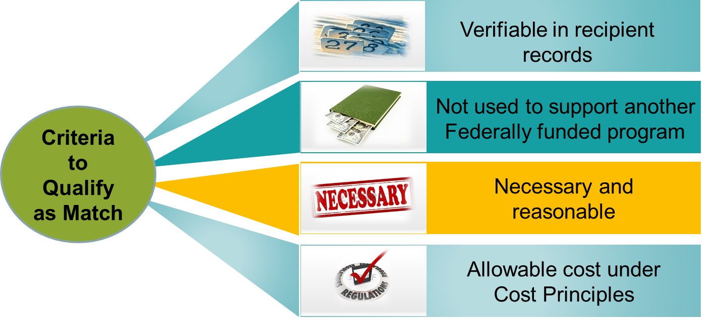
Basic Criteria for Match
2 CFR 200.306(b)

Slide 11

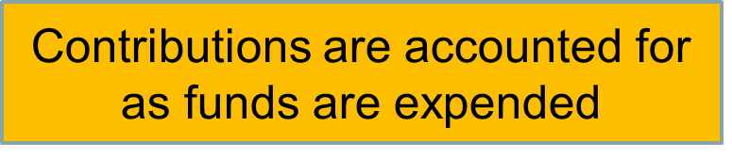
Basic Criteria for Match (Cont.)
DOL exception at 2900.8

Slide 12
Two Types of Match Expenditures
Non-Federal cash expenditures
In-kind contributions
Funds or services provided and paid for by recipient or subrecipient form non-Federal funds
Payment for services that are allowable under the grant
3rd party cash contributions to recipient that are spent by the recipient on allowable costs
Products, space, or services provided by a third-party organization and not paid for by recipient or subrecipient

Slide 13
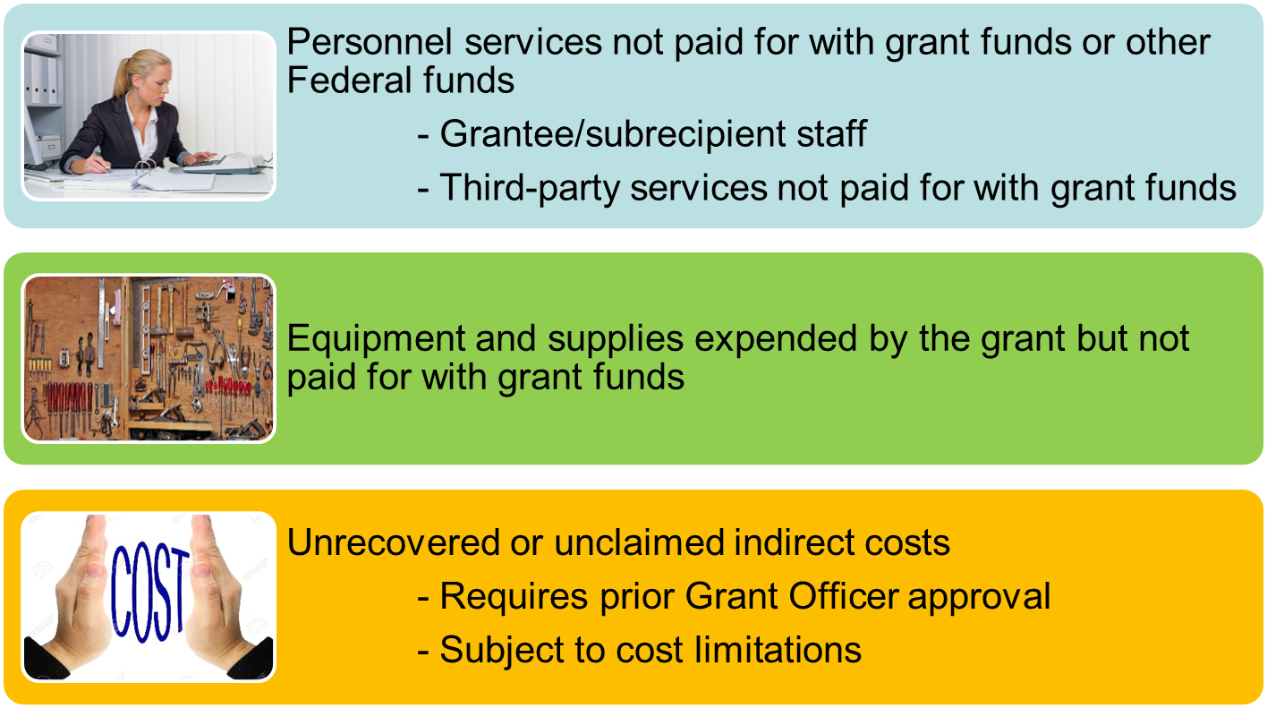
Match Examples

Slide 14
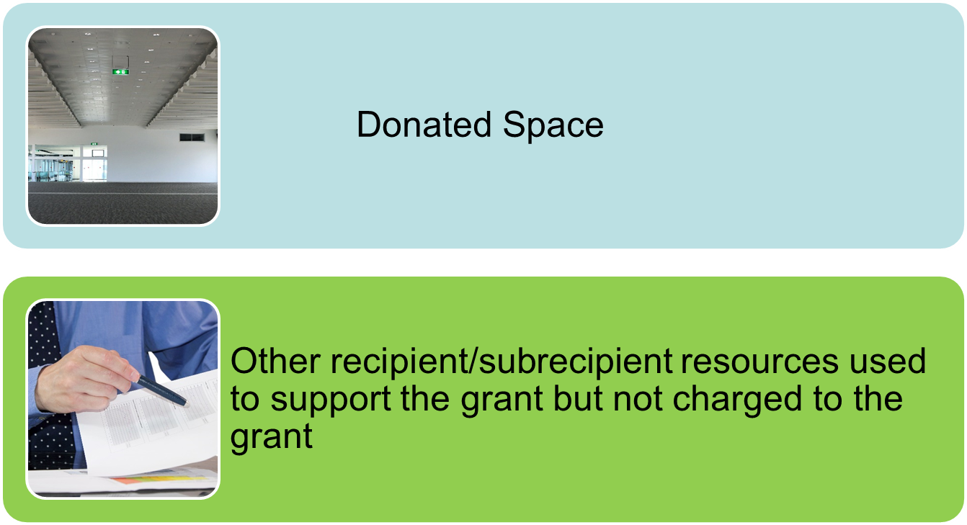
Match Examples (Cont.)

Slide 15
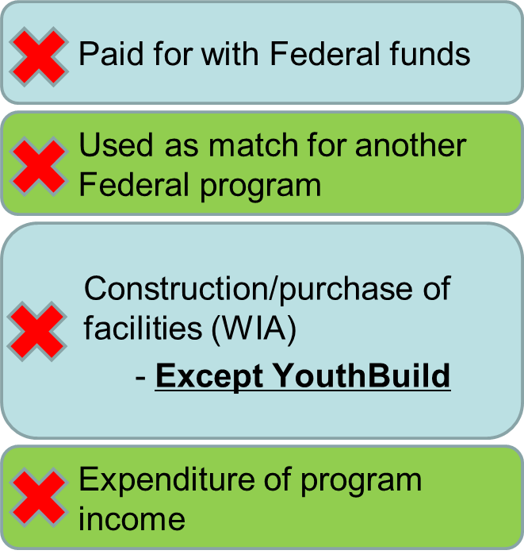

Match Exclusions

Slide 16
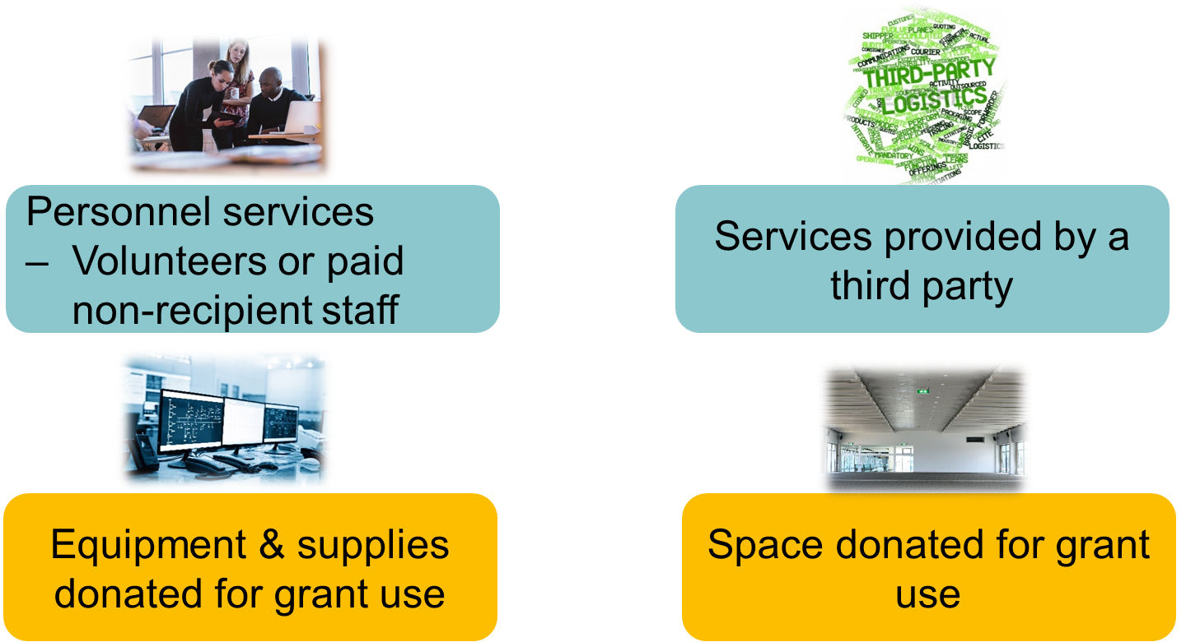
In-Kind Contribution Examples

Slide 17
Valuation Standards for Match
Uniform Guidance narrowed and strengthened valuation standards
Donated real and personal property, supplies, etc.
  Fair market value at time of donation
  Appraisal required for donated buildings and space use
2 CFR 200.306 and 200.434

Slide 18
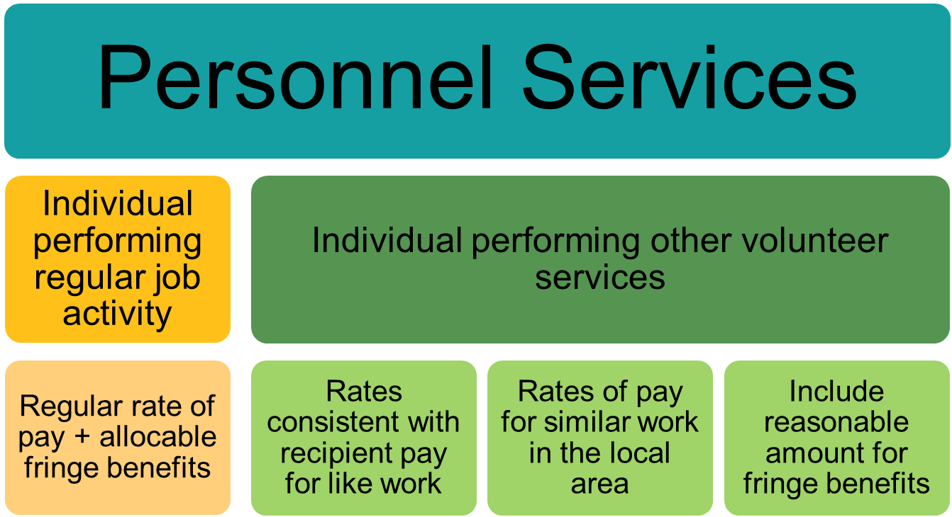
Valuation of In-Kind Contributions

Slide 19
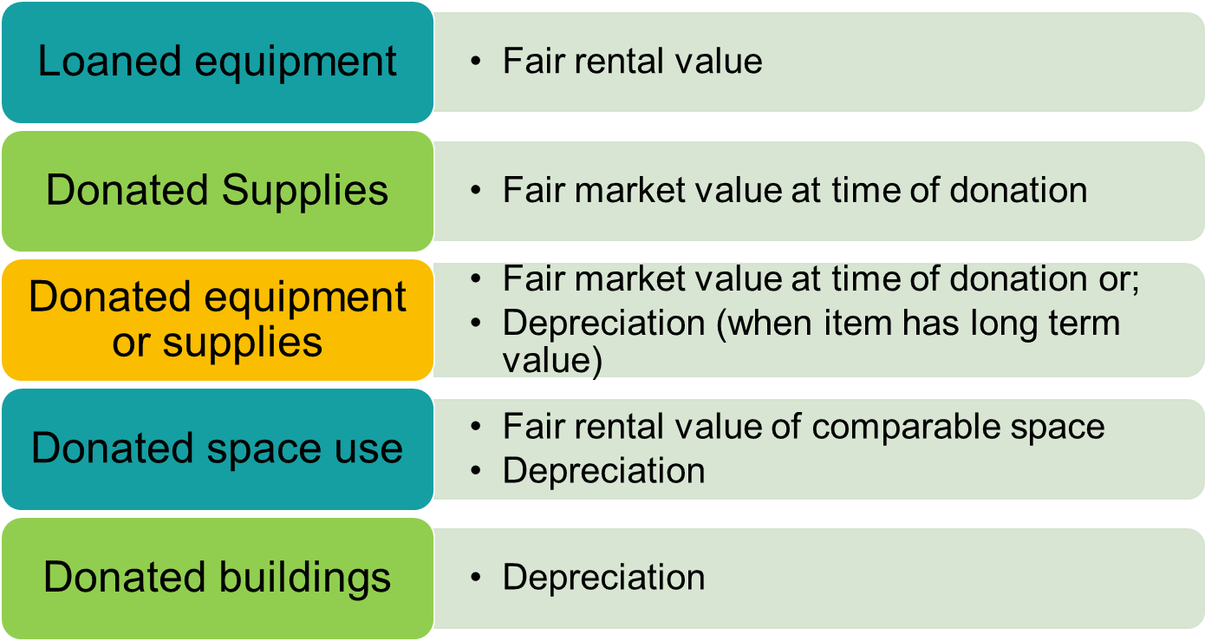
Valuation of In-Kind Contributions (Cont.)

Slide 20
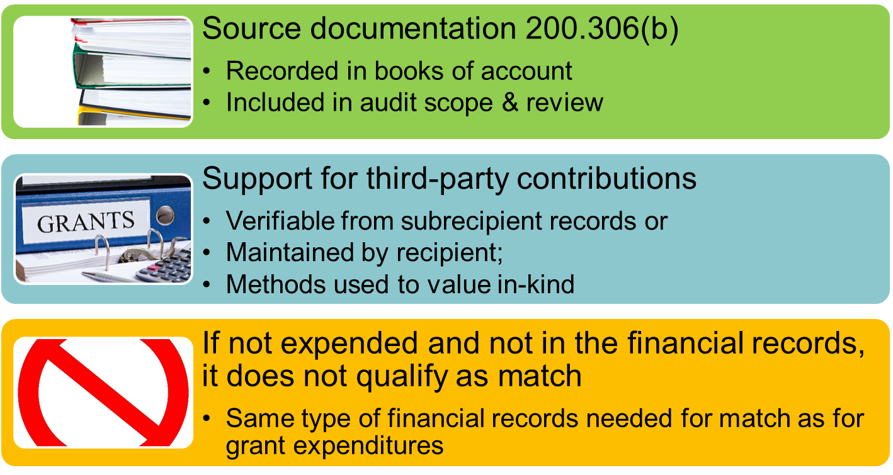
Documentation

Slide 21
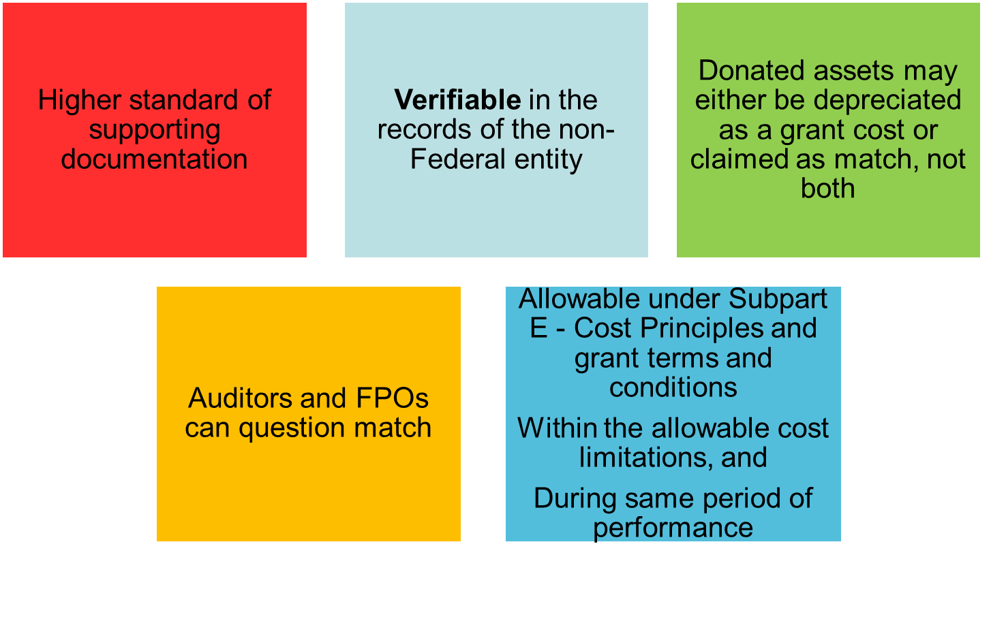
Summary of Uniform Guidance Provisions

Slide 22
Leveraged Resources

Slide 23
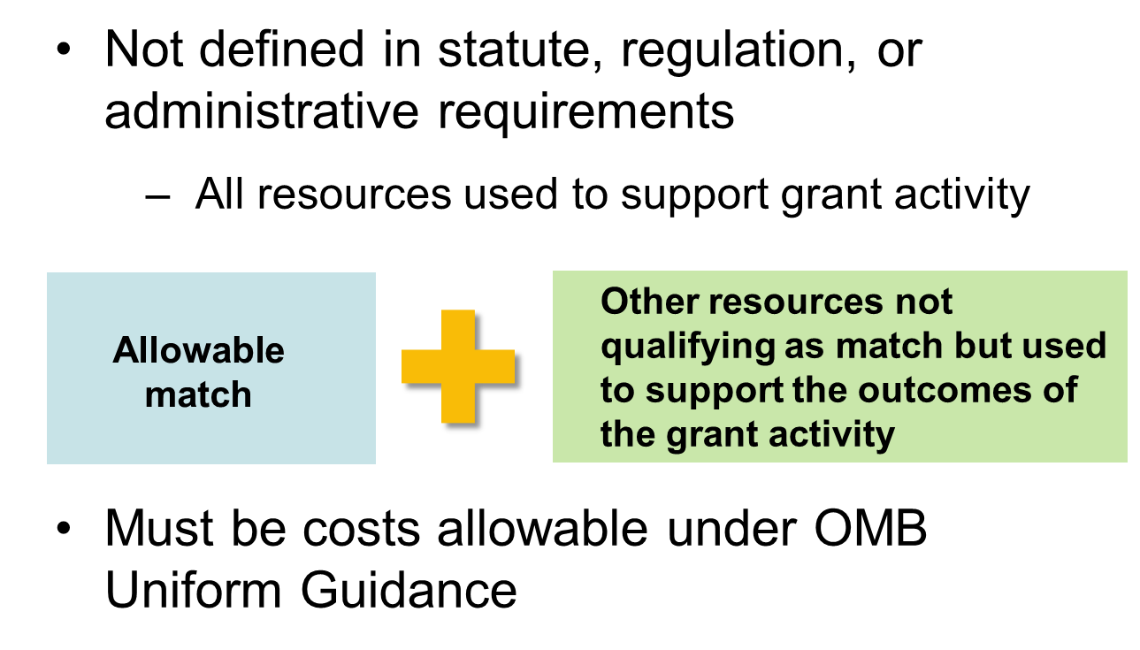
What are Leveraged Resources?

Slide 24
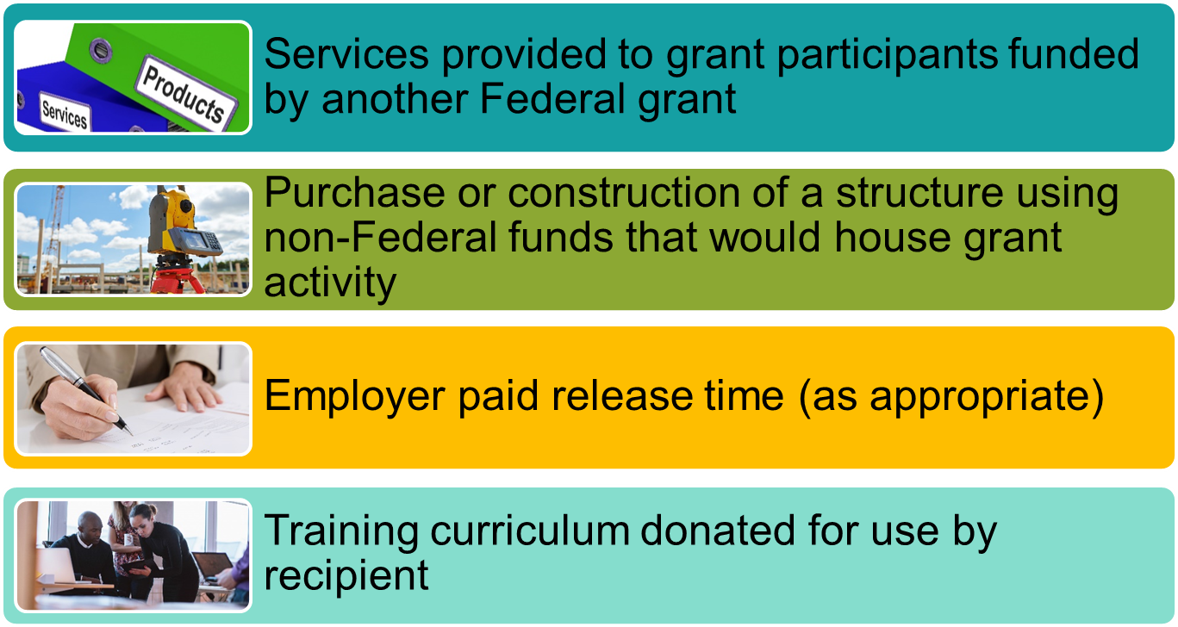
Examples of Leveraged Resources?
Note: Valuation of leveraged resources follows same requirements as match

Slide 25
Summary of YouthBuild Provisions
YouthBuild 2016 FOA
  Must provide new cash or in-kind resources as match during the grant period equivalent to exactly 25% of the total Federal share of costs
  Neither prior investments nor Federal resources may be counted towards the matching funds threshold, including funds that were originally provided through Federal funding
  DOL encourages additional cost sharing above 25% to be committed as leveraged resources
    Cover costs or materials that are not allowable under YB grant
    Must count, document, and report

Slide 26
Reporting standards
For Match & Leveraged Resources

Slide 27
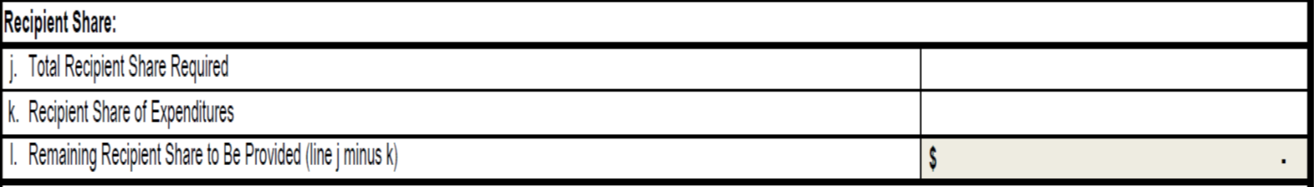
Reporting on ETA-9130 Form
Match and non-federal leveraged resources
  Report in Recipient Share section (lines 10j through 10l)
Federal leveraged resources
  Report on line item 11a (Other Federal Funds Expended)

Slide 28
ETA 9130: Recipient Share Section
10j
Total Recipient Share Required
Total match requirement. It will be listed on the SF-424a (Section A, Column F “Non-Federal”
10k
Recipient Share of Expenditures
Any non-Federal funds expended by the grantee for grant related expenditures
10l
Remaining Recipient Share to be Provided
Sum of line items 10j (Total Recipient Share Required) less 10k (Recipient Share of Expenditures)
If no match requirement = 0
Must be allowable costs and would have otherwise been paid out using grant funds
Includes both match and non-Federal leveraged resources
Auto-calculated

Slide 29
Reporting Match & Leveraged Resources
DOL exception 2 CFR 2900.8
Grantee can only record match expenditures when expended, not received
  Grantee must account for funds used for cost-sharing within their accounting systems as the funds are expended

Slide 30
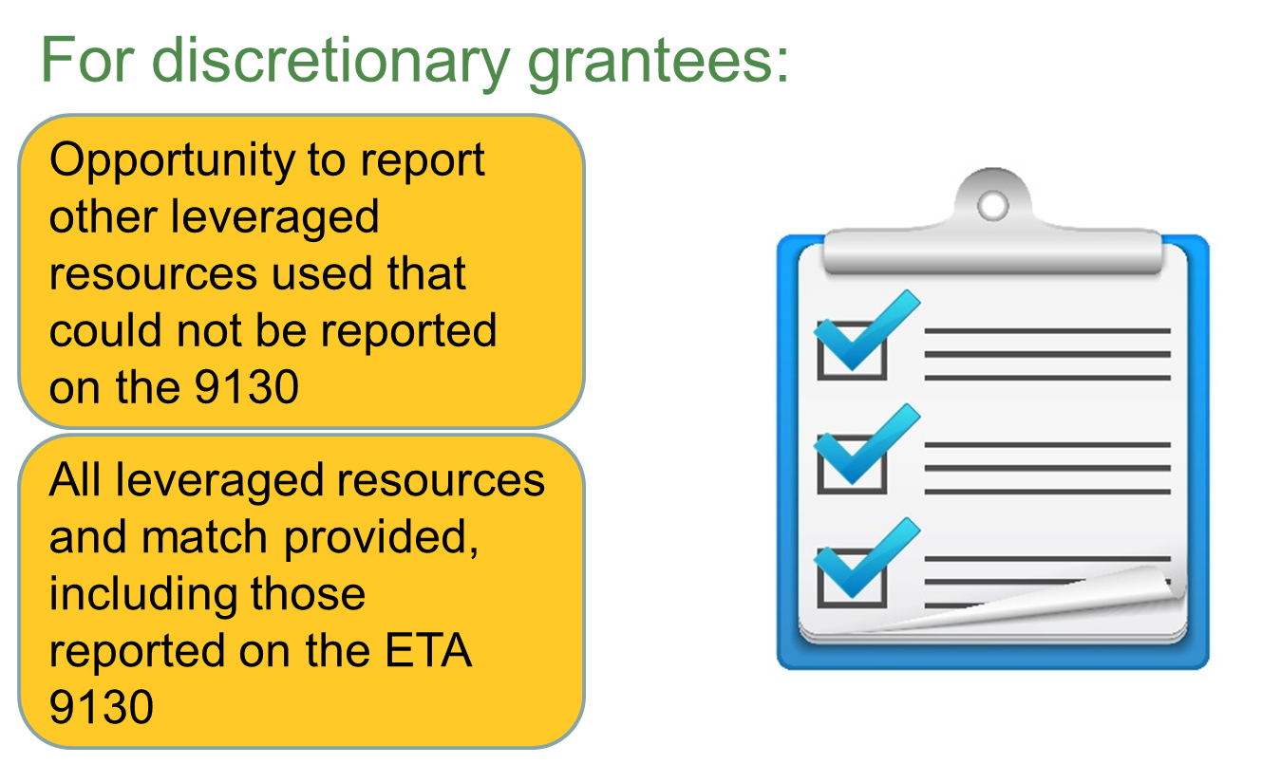
Quarterly Narrative Progress Report

Slide 31
Common Mistakes

Slide 32
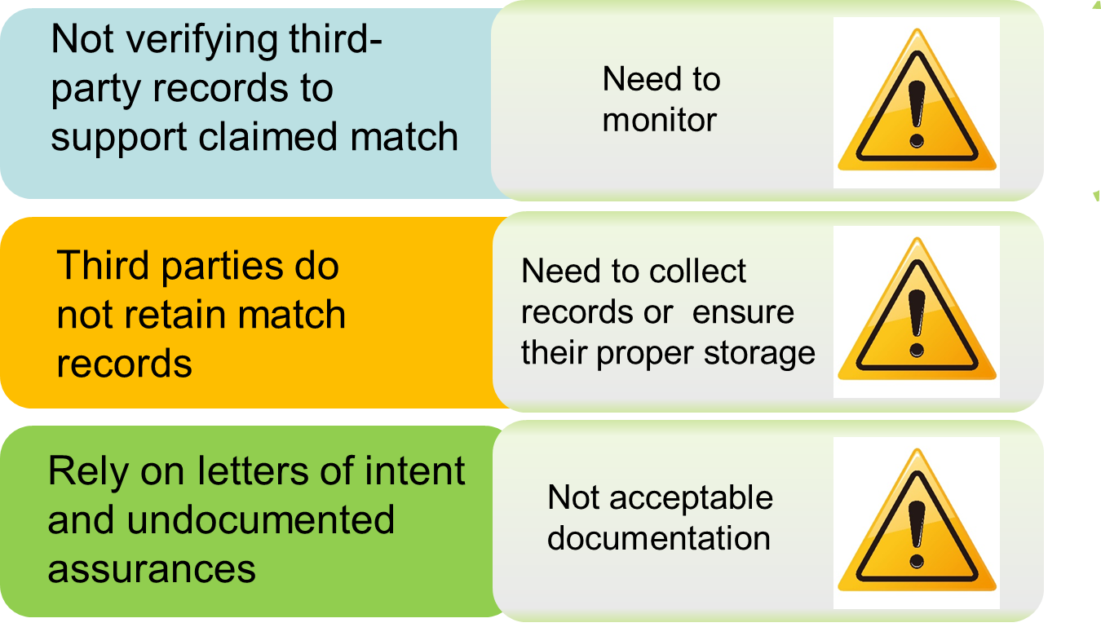
Common Mistakes

Slide 33
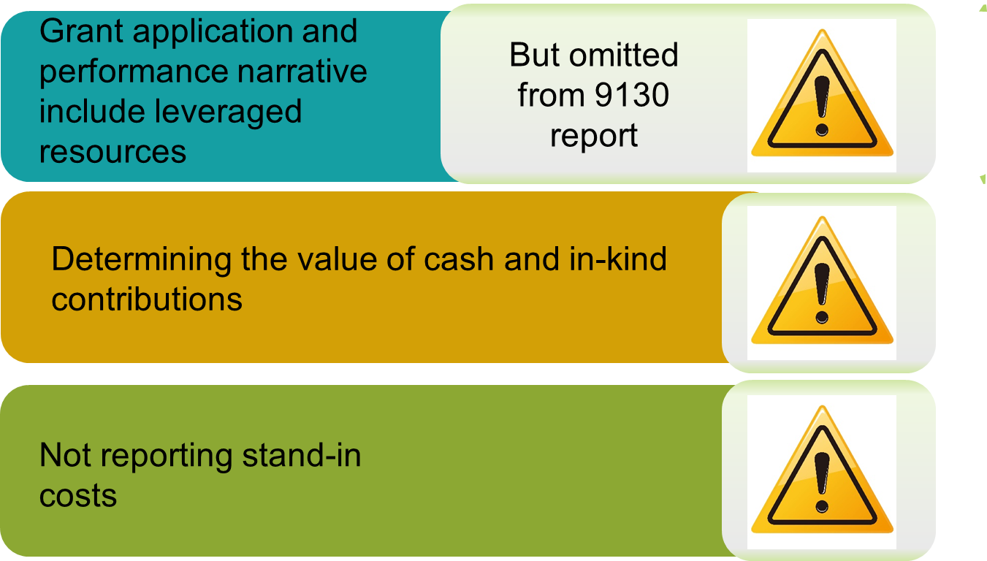
Common Mistakes (Cont.)

Slide 34
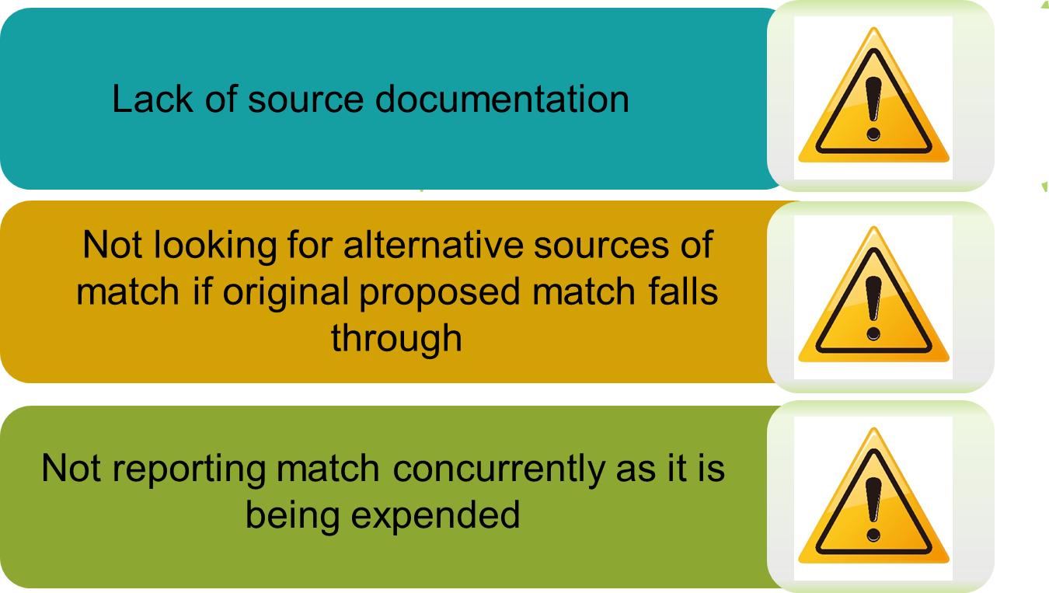
Common Mistakes (Cont.)

Slide 35
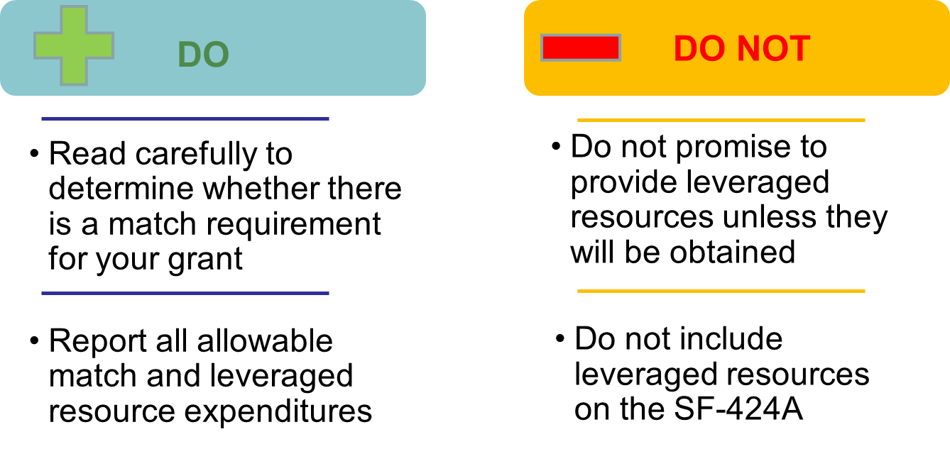
Some Do’s and Dont’s

Slide 36
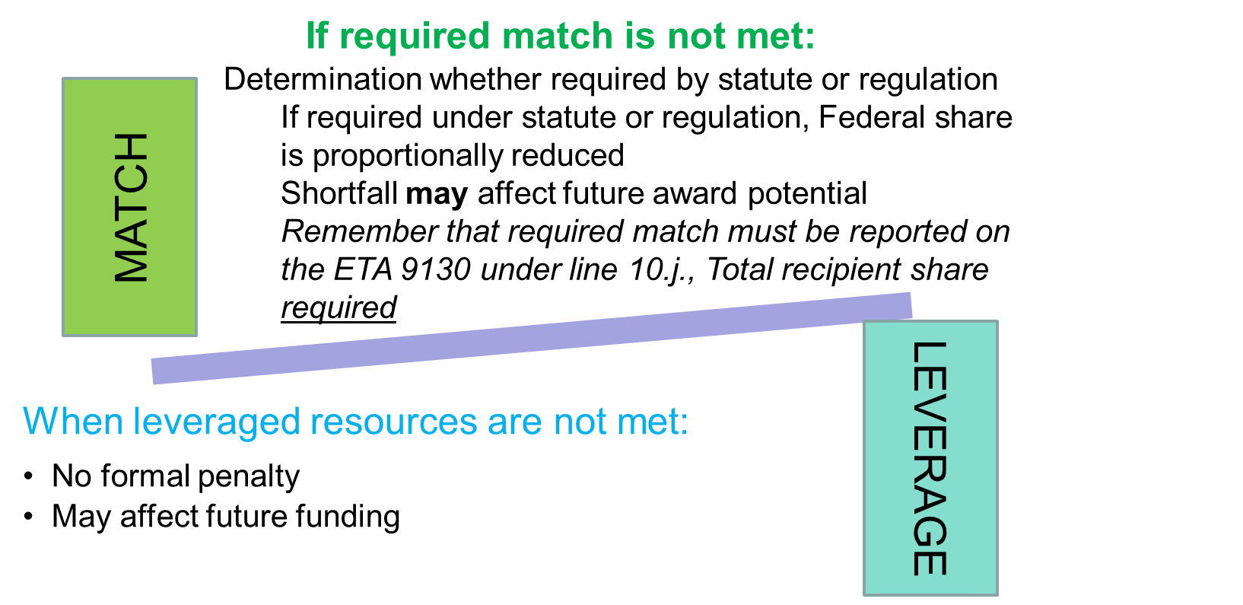
Closeout

Slide 37
Financial Reporting
Allowable costs under the YouthBuild program

Slide 38
Keep in Mind… WIOA Law & Regulations
Sec. 171
WIOA Law
20 CFR Part 668
WIOA Regulations

Slide 39
YouthBuild Cost Limitations
WIOA sec. 171(c)(2)(C)(i)
  Increase in maximum percentage (15%) for supervision and training on the rehab of community and other public use facilities
Salary & Bonus Limitations
  Executive Level II
  Public Law 109-234 and TEGL 5-06
20 CFR 688.520(a)
  Administrative limit to 10% of grant award

Slide 40
Real Property Costs under YouthBuild
WIOA Regulations: 20 CFR 688.550
The following activities associated with real property are allowable solely for the purpose of training YouthBuild participants:
  Rehabilitation of existing structures
  Construction of buildings
    Both for the use by homeless individuals and families or low-income families or for use as transitional housing
  Construction or rehabilitation of community or other public facilities
    only 15% of the grant award is allowable (see 20 CFR 688.520(b))

Slide 41
Real Property Costs under YouthBuild (Cont.)
The costs for acquisition of buildings are allowable with prior Grant Officer approval and only under the following conditions:
  Solely for training purposes
  Based on the proportionate share
The following costs are allowable to the extent allocable to training YB participants:
  Trainees’ tools and clothing including personal protective equipment
  On-site trainee supervisors
  Construction management
  Relocation of buildings
  Architecture fees
The following costs are unallowable:
  The cost of acquisition of land
  Brokerage fees

Slide 42
Participant Costs under YouthBuild
Allowable participant costs include (WIOA Regulation - 20 CFR 688.560):
The costs of payments to participants engaged in eligible work-related YouthBuild activities
Needs-based payments
Supportive services
Additional benefits to exiters and are receiving follow-up services, may include:
  Tuition assistance for obtaining college credits
  Scholarships to registered apprenticeship or technical education program
  Employer or Government-sponsored health program

Slide 43
Other Allowable Costs/ Activities under YouthBuild
Counseling services and related activities, such as:
  Comprehensive guidance and counseling on:
    Drug and alcohol abuse
    Referrals to mental health services
    Referrals to victim services
Mental Toughness (TEGL 14-09)
  Unallowable costs: rope courses, travel costs or speaker fees
  Allowable: recruitment and eligibility determination
Supportive services and needs-based payments necessary to enable individuals to participant in program

Slide 44
Wages, Stipends, or Benefits under YouthBuild
Provisions of wages, stipends, or benefits to participants in the program are allowable
WIOA Law 171(c)(2) – grantees may provide wage or stipends for work experiences
  Must have written policies
Understanding the difference between using stipend or wage as the payment type has specific implication in relation to the IRS deduction
Incentive payments are allowable
  Recognition and achievement directly tied to training activities and work experience

Slide 45
ETA-9130 Form

Slide 46
Background
Updates to the ETA 9130 form
  Due to the passing of Workforce Innovation and Opportunity Act (WIOA)
    Numerous new statutory requirements
  Add the Uniform Guidance and DOL’s Exceptions
Approval Date: April 13, 2016
Expiration Date: October 2019
New forms became available in e-Reporting system beginning on Oct 1 , 2016
  Grantees were to use the new forms for the Sept 30, 2016 reporting quarter

Slide 47
Sections of the ETA-9130 Report
Basic Information (Sections 1-9)
Federal Cash Section (10a-10c)
Federal Expenditures (10d–10i)
Recipient Share (10j-10l)
Program Income (10m-10o)
Additional Expenditure Data Required (Section 11)
Remarks (Section 12)
Indirect Expenditures (Section 13) – FINAL only

Slide 48
Across the Board Changes
Affects all ETA-9130s, including the Basic form
Unique Entity Identifier
  Line item 4a was renamed Unique Entity Identifier, as prescribed by 2 CFR 200.210
  Currently using the DUNS number
Basis of Reporting
  Line item 7 was renamed “Basis of Reporting”

Slide 49
Across the Board Changes (Cont.)
Expenditures
  Instructions have been updated to reflect the Uniform Guidance definition of Expenditures at 2 CFR 200.34(c)
Recipient Share (match and leveraged resources)
  Instructions updated to reflect DOL’s exception at 2 CFR 2900.8
Program Income
  Updated to reflect additional guidance at 2 CFR 200.305(b)(5)

Slide 50
Across the Board Changes (Cont.)
Certification
  Certification language at the bottom of the report has changed to reflect the Uniform Guidance (2 CFR 200.415)

Slide 51
ETA-9130: Indirect Expenditures Section
NEW section for ETA-9130 form
Report Section 13 on FINAL report only
Direct grant recipients are required to report in Section 13:
  If they have a negotiated and approved ICR and
  Charging indirect costs to their ETA grant
Recipients using an approved CAP, and/or have subrecipient data will not report in Section 13
Multiple entries may be entered in each of the fields in Section 13

Slide 52
Indirect Expenditures Section (Cont.)
13a – Type of Rate
Dropdown box
Grantee to select the type of rate:
13b - Rate
Actual rate(s) to be applied to the base during the grant’s POP
Agrees to NICRA
13c – Rate Approval Date
The date(s) on which the indirect cost rate(s) was approved
Final, Fixed, Fixed with Carry-forward, De Minimis, or other

Slide 53
Indirect Expenditures Section (Cont.)
13d – Period From/ Period To
Separated by two fields
13e - Base
The amount of distribution base that the rate(s) is applied
13f – Amount Charged
Manual calculation of 13b * 13e
Ensure that the time period entered corresponds to the grant period on line item 8
Outlined in the NICRA
Maximum amount that the grantee could potentially charge as indirect costs to its ETA grant

Slide 54
Indirect Expenditures Section (Cont.)
13g – Federal Share
The Federal Share of indirect costs calculated in 13f (Amount Charged)
13h - Totals
Manual calculations of 13e (Base), 13f (Amount Charged), and 13g (Federal Share)
This amount may be equal to or lesser than the amount entered in 13f
No edit checks for this box

Slide 57
WorkforceGPS
  YouthBuild Community of Practice
    https://youthbuild.workforcegps.org/
Uniform Guidance (2 CFR 200)
  USDOL’s exceptions (2 CFR 2900)
    http://www.ecfr.gov/cgi-bin/text-idx?tpl=/ecfrbrowse/Title02/2cfr200_main_02.tpl
TEGL 2-16
  Revised ETA-9130 Financial Report, Instructions, and Additional Guidance
    http://wdr.doleta.gov/directives/attach/TEGL/TEGL_2-16_acc.pdf
ETA-9130
  Form and Instructions
    https://www.doleta.gov/grants/financial_reporting.cfm

Slide 58

Speakers’ Contact Information
Speakers’ Contact Information Cont.
Moderator: Mark Smith
Title: Workforce Analyst/National Liaison
Organization: U.S. Department of Labor
Email: smith.mark.w@DOL.gov
Telephone: (202) 693-3747
Speaker: Chanel Castańeda
Title: Grants Management Specialist
Organization: U.S. Department of Labor
Email: castaneda.chanel@dol.gov
Telephone: (312) 596-5453
Notes:
Mark

