Slide 1
Telling TAACCCT Tales
Using StoryTelling to Share Project Successes
StoryTelling Network IMPACTcommunity
January 31, 2017

Slide 2
TAACCCT Learning Network at a Glance
Other Non-Federal Providers of TA and Resources for TAACCCT Grantees:
Creative Commons
CAST
The Transformative Change Initiative
U.S. Department of Labor, Employment & Training Administration
(National)
U.S. National Science Foundation
Jobs for the Future
CalState/Merlot
ATE Centers
Maher & Maher
American Association of Community Colleges

Slide 3
Sign up for the TAACCCT Weekly Digest

Slide 4
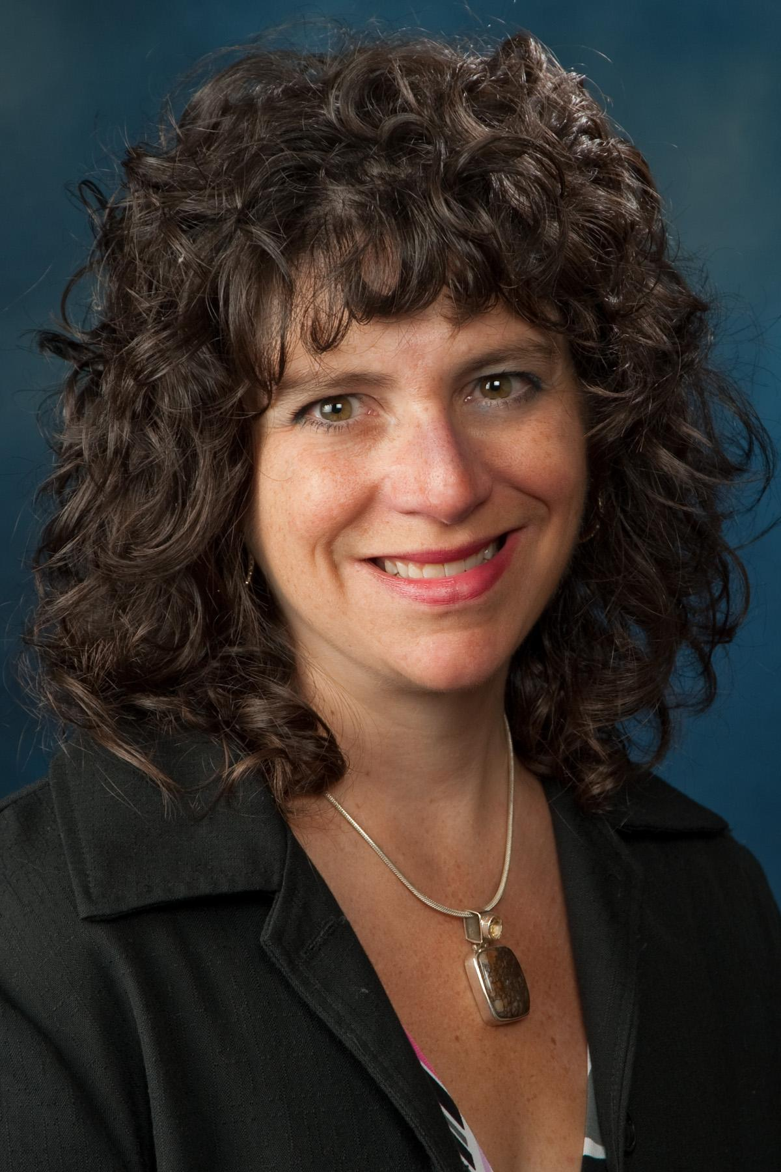
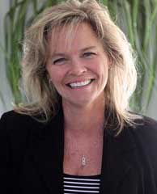
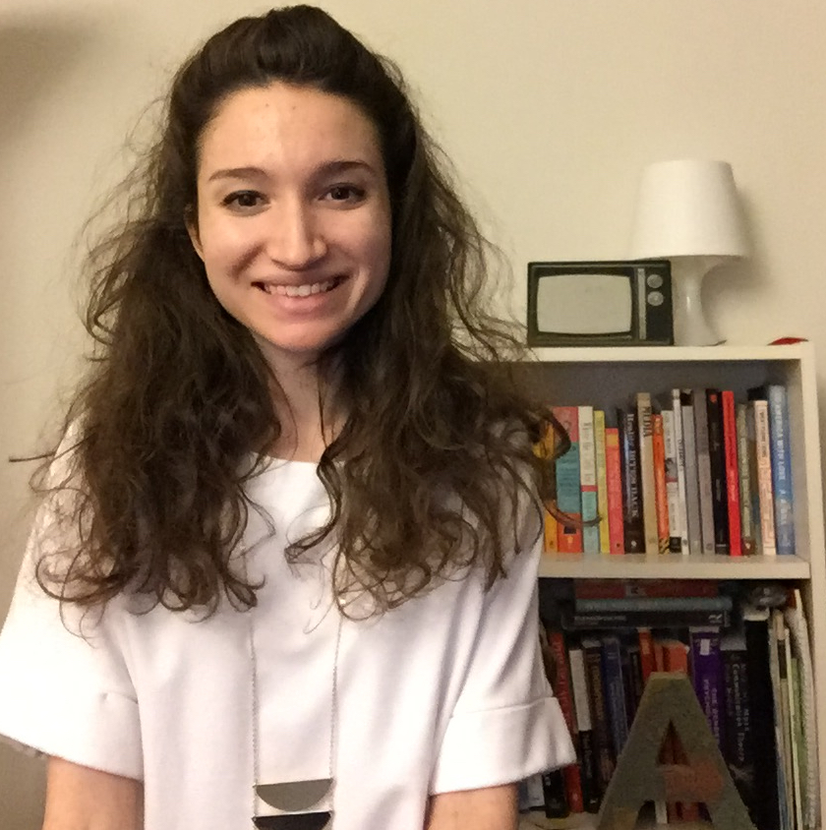
Who We Are
Helene Mancuso
Project Manager
TAACCCT Grant
Kathy Spada
Project Manager
INTERFACE Consortium
Maria Fieth
Program Manager, Communications & Community
Skills Commons
Nanticoke, PA
Wausau, WI
Long Beach, CA
Alexandra Shinert
Communications/Program Assistant
Northeast Resiliency Consortium
Nicolette van der Lee
Program Coordinator
Office of Continuing Education & Training & Sustainable Living
Institute of Maui
Paterson, NJ
Kahului, HI

Slide 5
Webinar Overview
Who We Are
Introduction to the Storytelling Initiative & IMPACTcommunity
Introduction to the StoryTelling Rubric
Our StoryTelling processes
Components of the StoryTelling Rubric
Call to action/next steps

Slide 6
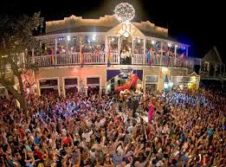
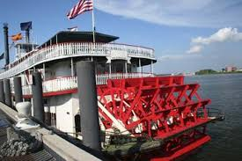
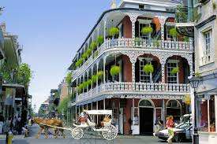
Introduction to StoryTelling Initiative

Slide 7
What Keeps You Up at Night?

Slide 8
What Keeps Us Up at Night...

Slide 9
What Keeps Us Up at Night

Slide 10
What Keeps Us Up at Night

Slide 11
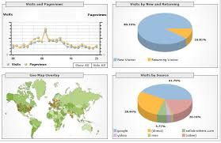
What Keeps Us Up at Night

Slide 12
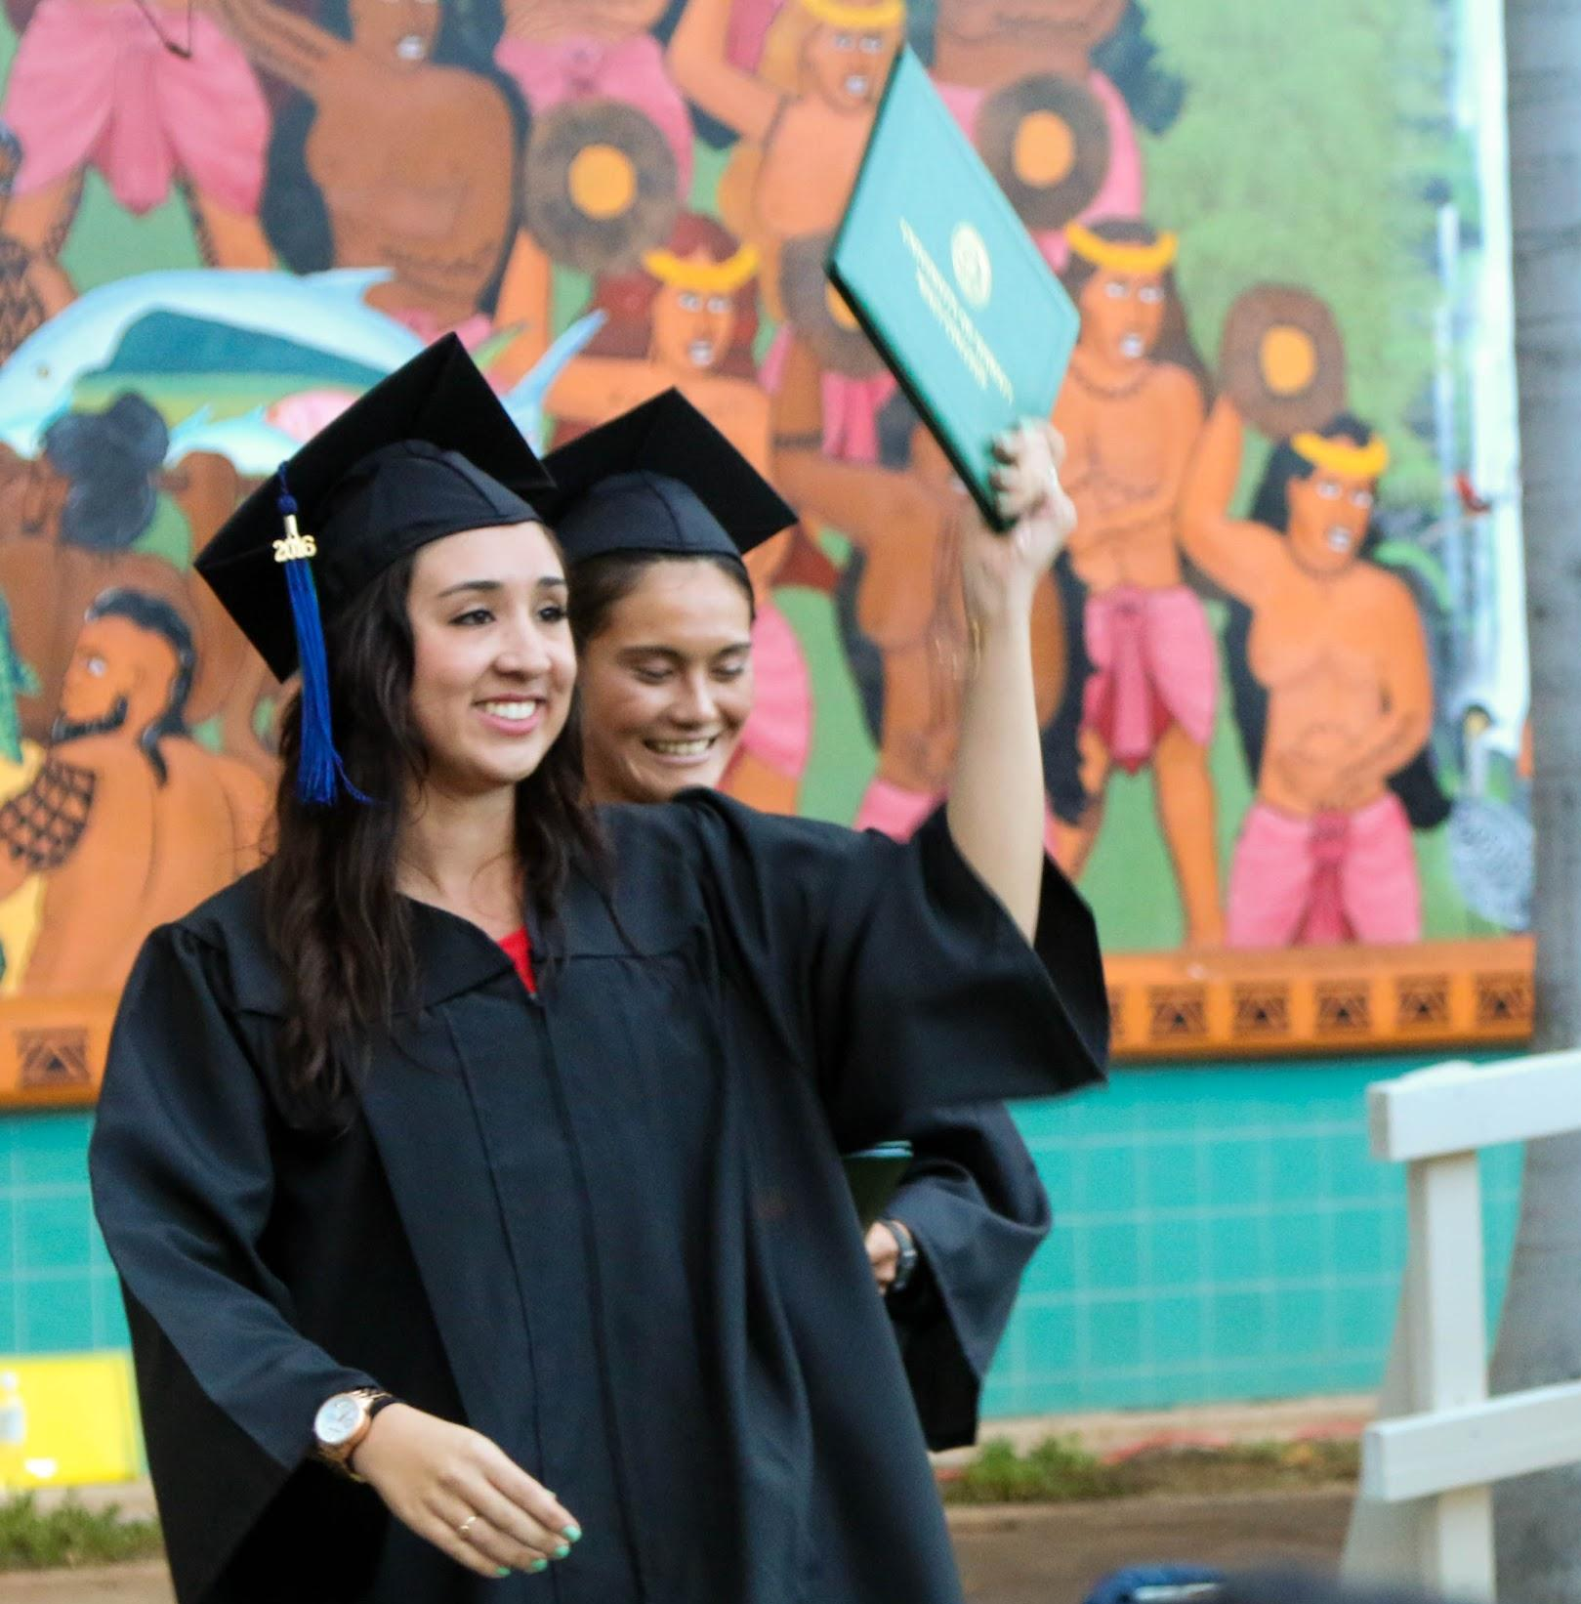
What Keeps Us Up at Night

Slide 13
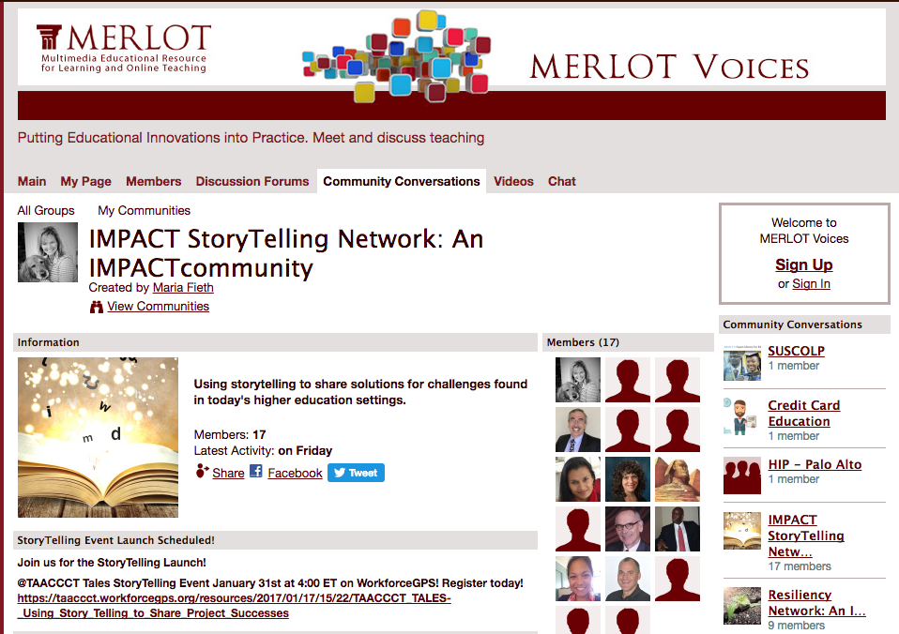
Forming a StoryTelling Network
StoryTelling Rubric
CATEGORY | 1- Needs Improvement | 2- Acceptable | 3- Exemplary
An Effective Character | Lacks a central character | One character or multiple character | Three-dimensional charismatic character
Plot Moves the Story Forward | Lacks a plot | Plot incomplete | Features an action-oriented story
Authenticity (Voice) | Lacks authenticity | Resonates somewhat | Resonates with the audience
Action-Oriented Emotions | Lacks any sense of emotion | Leaves the audience mostly unmoved | Engages the audience
A Hook | Lacks a reason to stay engaged | Lacks an early connection | Immediate and lasting connection
Resonates with the Audience | Doesn’t make the presentation about the audience | Lacks clear relevancy | Gives audience a reason to stay engaged
http://voices.merlot.org/group/storytelling-impactcommunity

Slide 14
Interactive StoryTelling Rubric

Slide 15
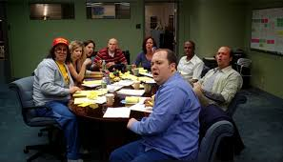
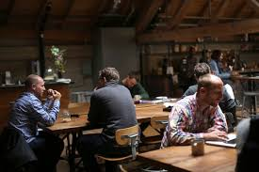
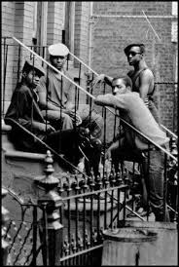
Writer’s Room (Sharing Processes)

Slide 16
Talking Story in Hawaiʻi
How We Used the Storytelling Rubric
TAACCCT ROUND 2 GRANT

Slide 17
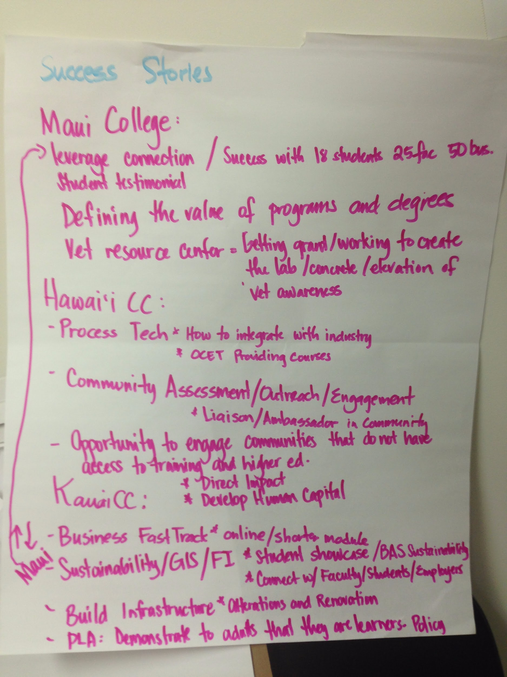
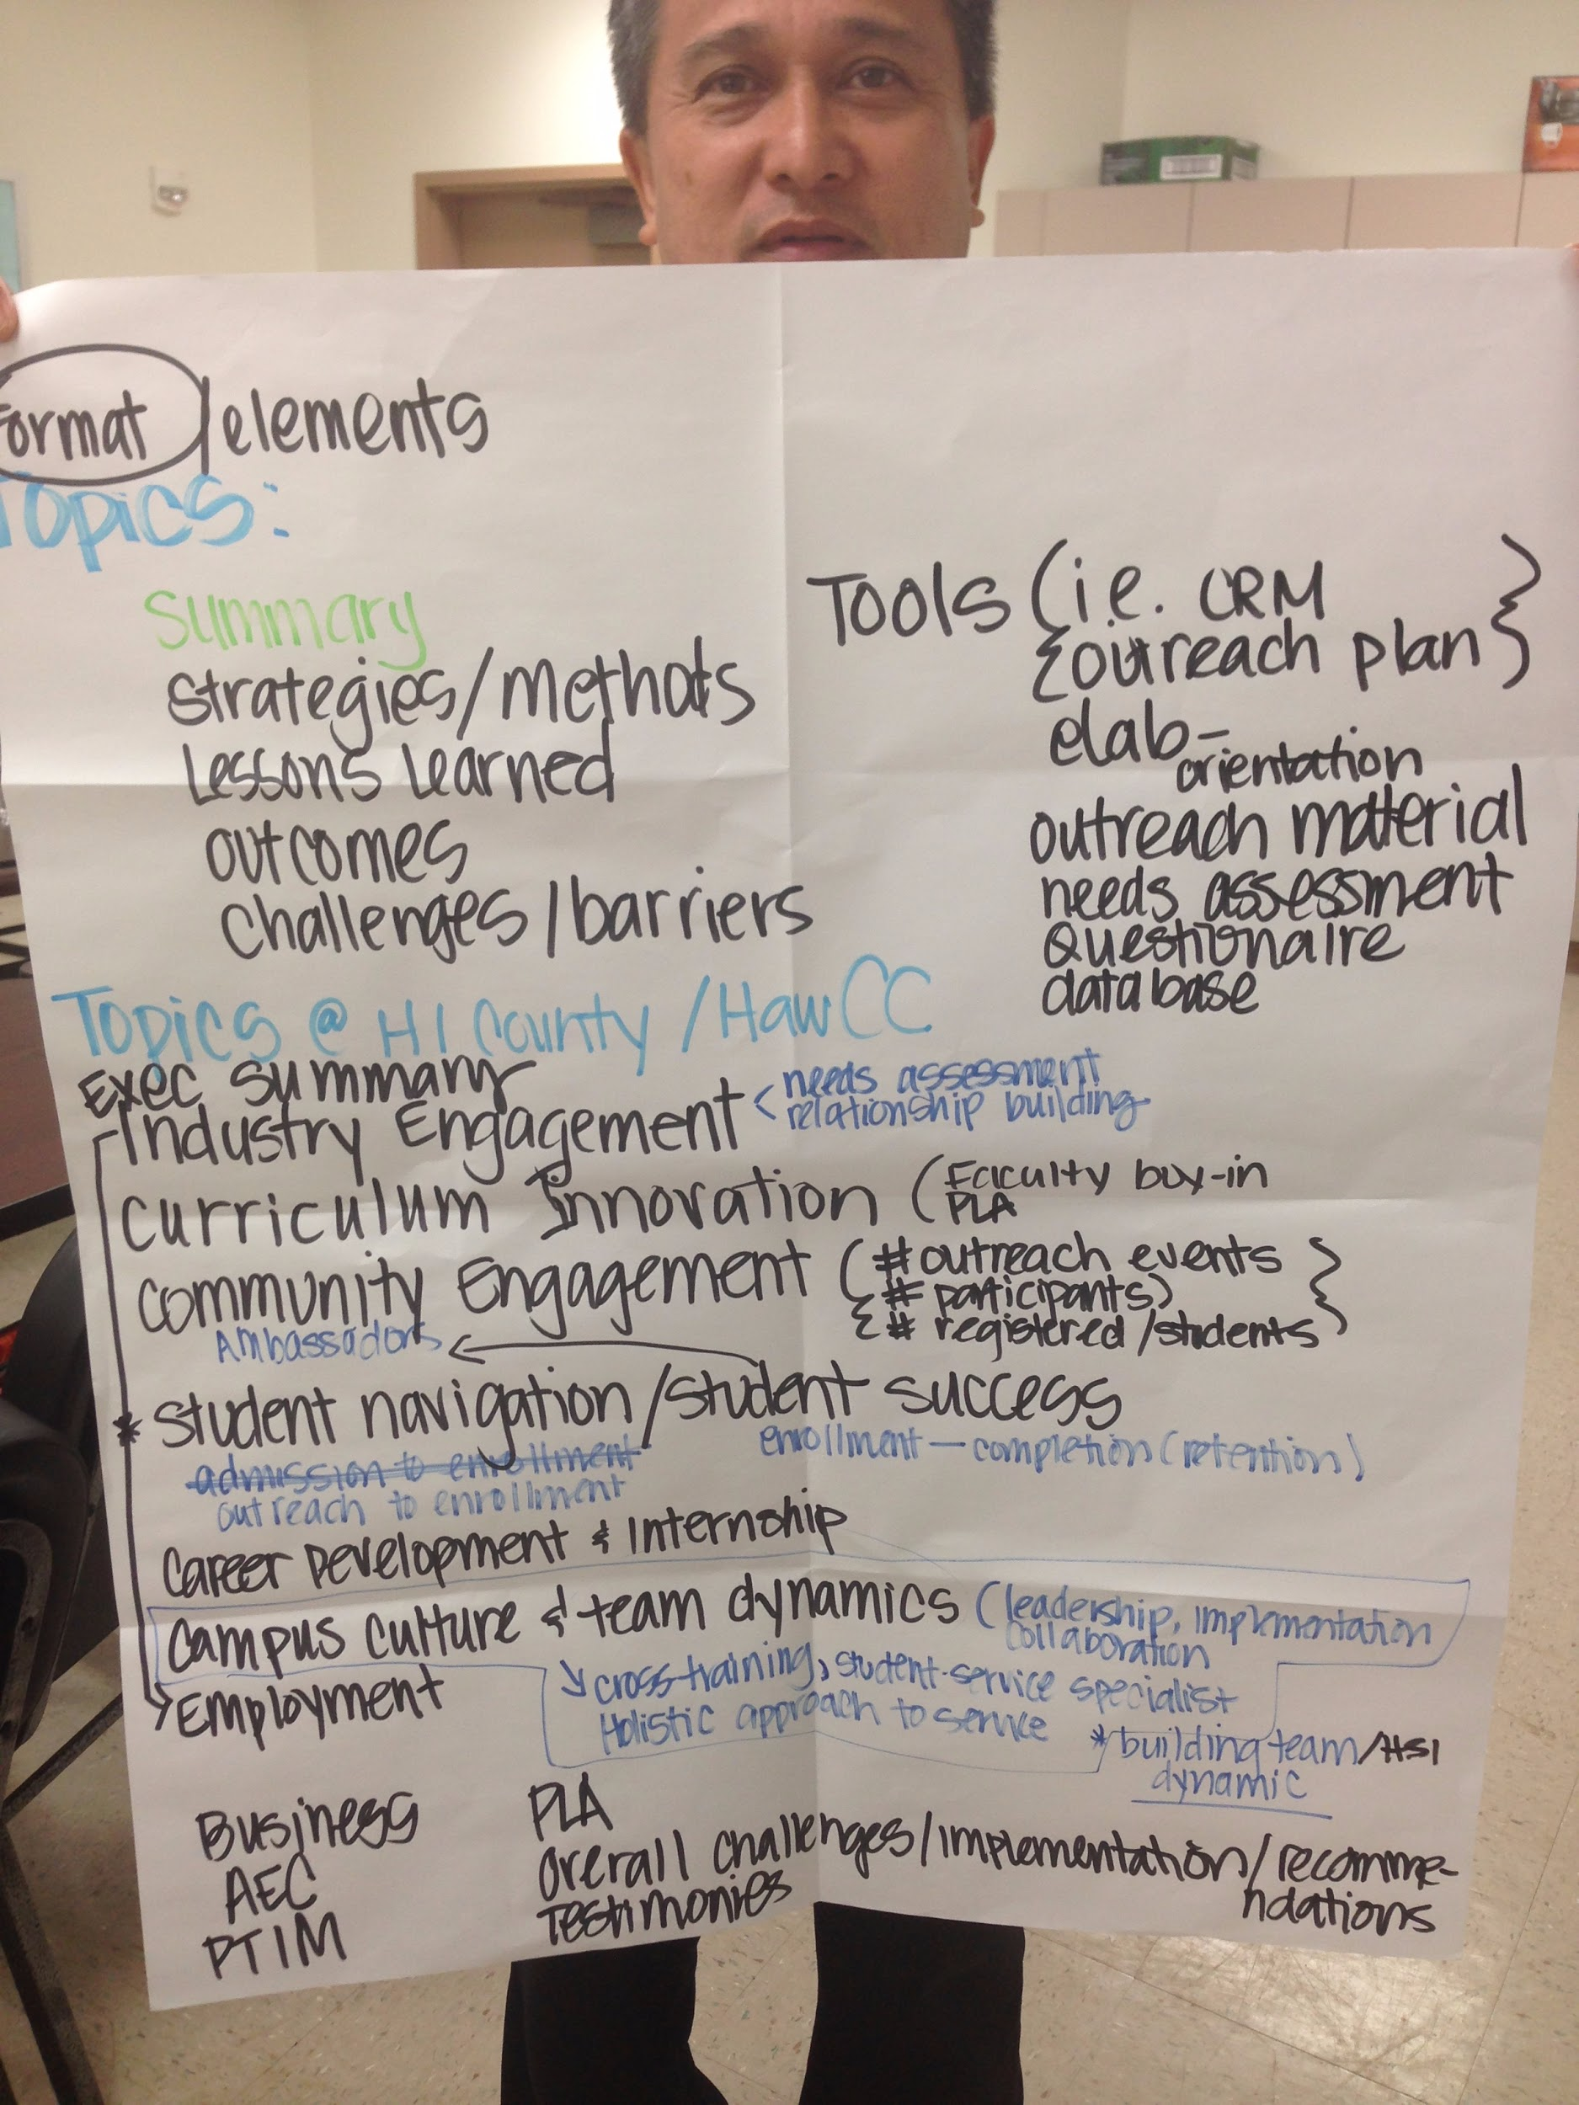
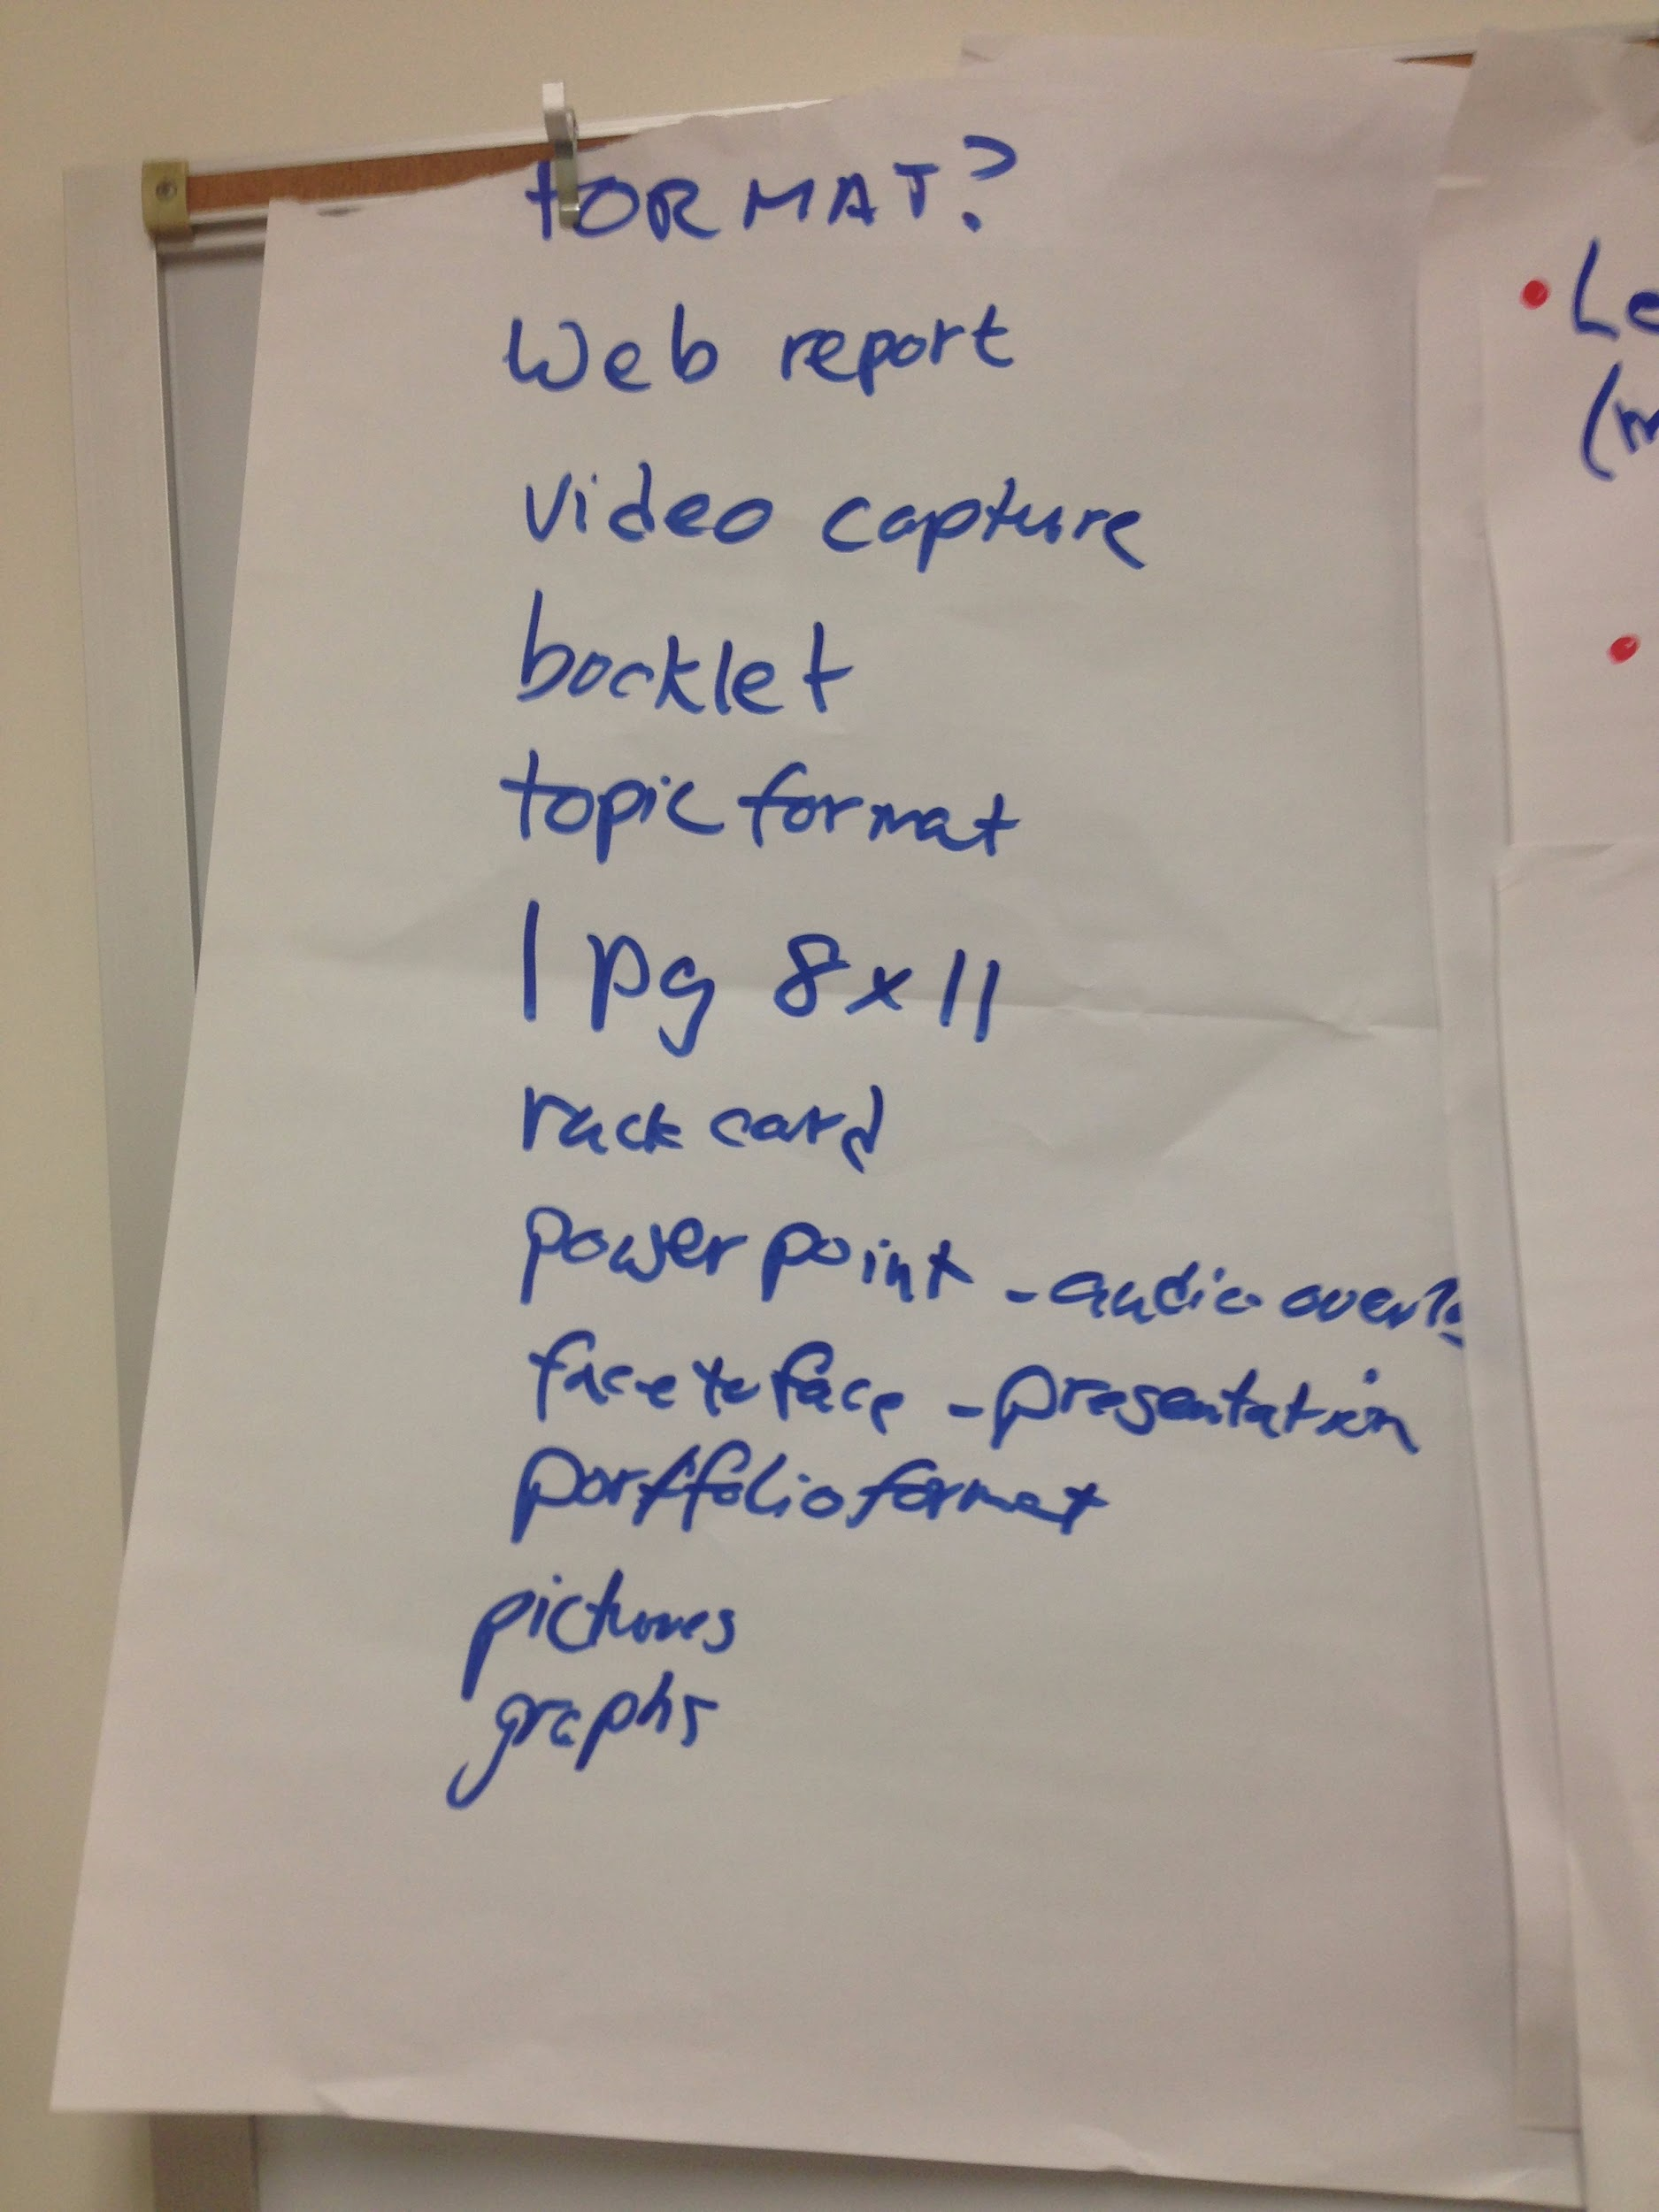
CONNECTING ACROSS THE ISLANDS:
Conceptualizing the Stories

Slide 18
USING THE STORYTELLING RUBRIC
RUBRIC | IDEAS (What we did) | SOLUTIONS (How we did it)
Effective Character | Identify stakeholders who had compelling stories to share | Interviews with real people.
Plot | Identify the Problem: Lack of student support services and resources | Wrote 3-Act script
Authenticity | Let real people tell the story behind the story | Individual voices
Action-Oriented Emotions | Always asked ourselves, “So what?” | Asked questions that elicited an emotional response
A “Hook” | What was the underlying problem that buying stuff was trying to solve? | Focused on how to help students succeed
Resonates with the Audience | Asked ourselves, “Will people connect with what we are trying to say? | Let the stakeholders tell their story in their own words

Slide 19
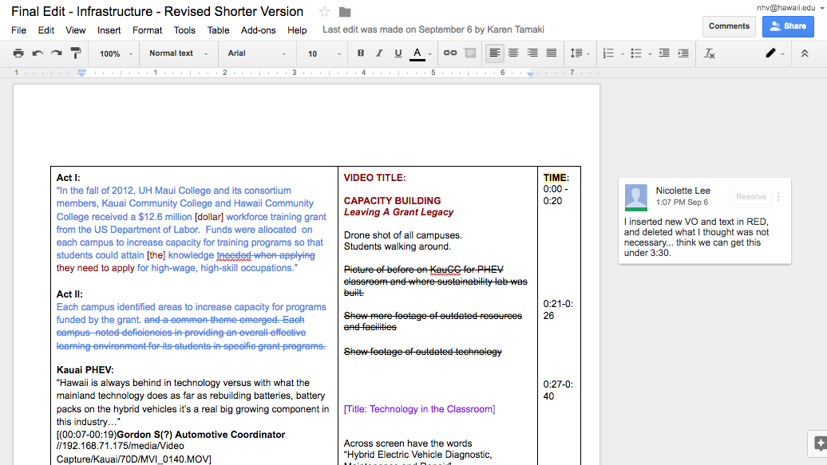
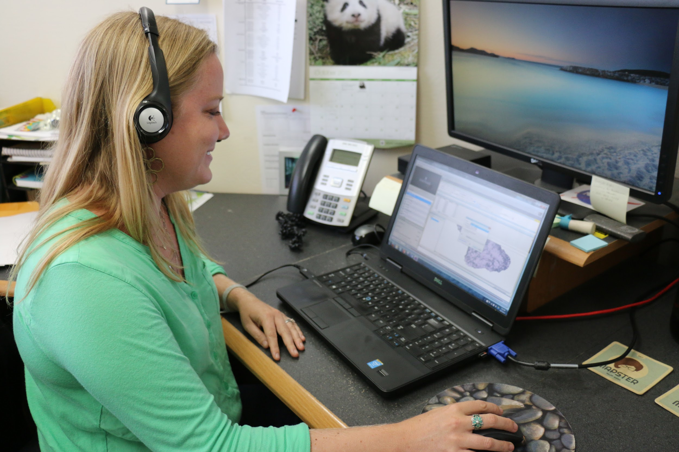
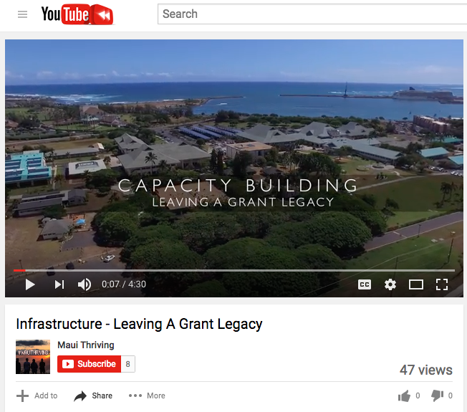
OUR PROCESS
WRITING
PRODUCTION
POSTPRODUCTION
SHARING
1
Collaboration in Google Drive
2
Interviews in the field
3
Editing and Revisions
4
YouTube, social media, email

Slide 20
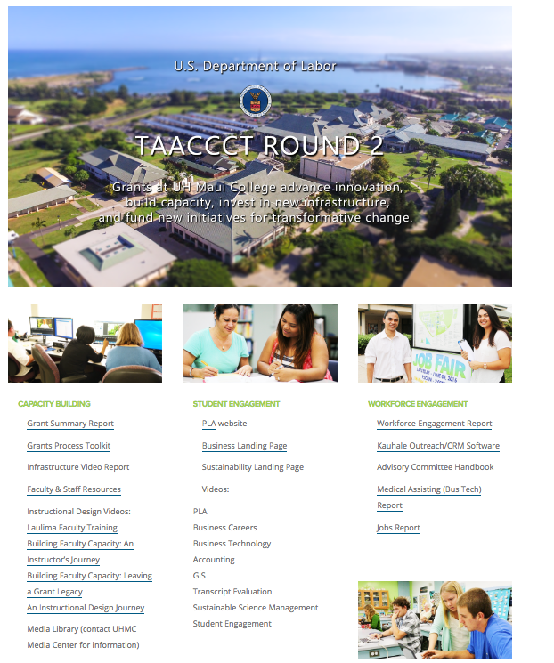
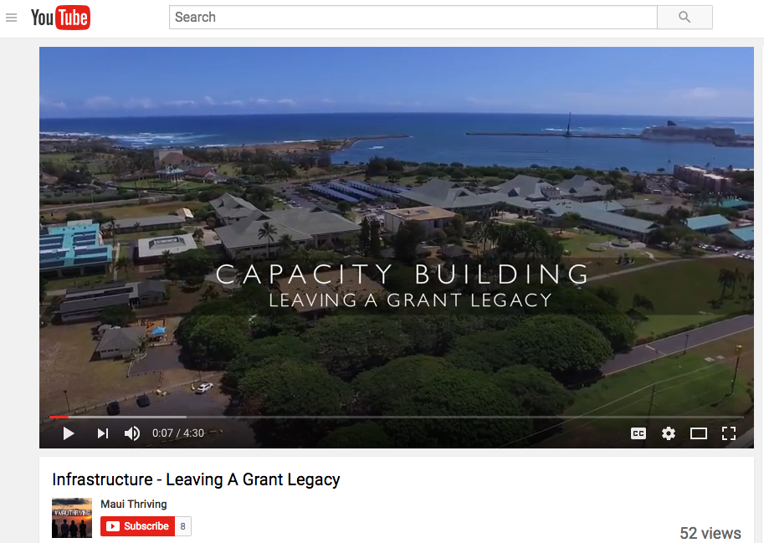
Sharing Our Stories
https://www.youtube.com/watch?v=agPOc3Jl2dQ
maui.hawaii.edu/grants/taaccct-round-2/

Slide 21
The Process
Oral Tradition
Live
Organic
Common Challenges
Shared Strategies
Conscious Collaboration

Slide 22
The Tale of the Cheetah
Successful Business Engagement
Universal themes
Replicable Relationships
Mutually Beneficial

Slide 23
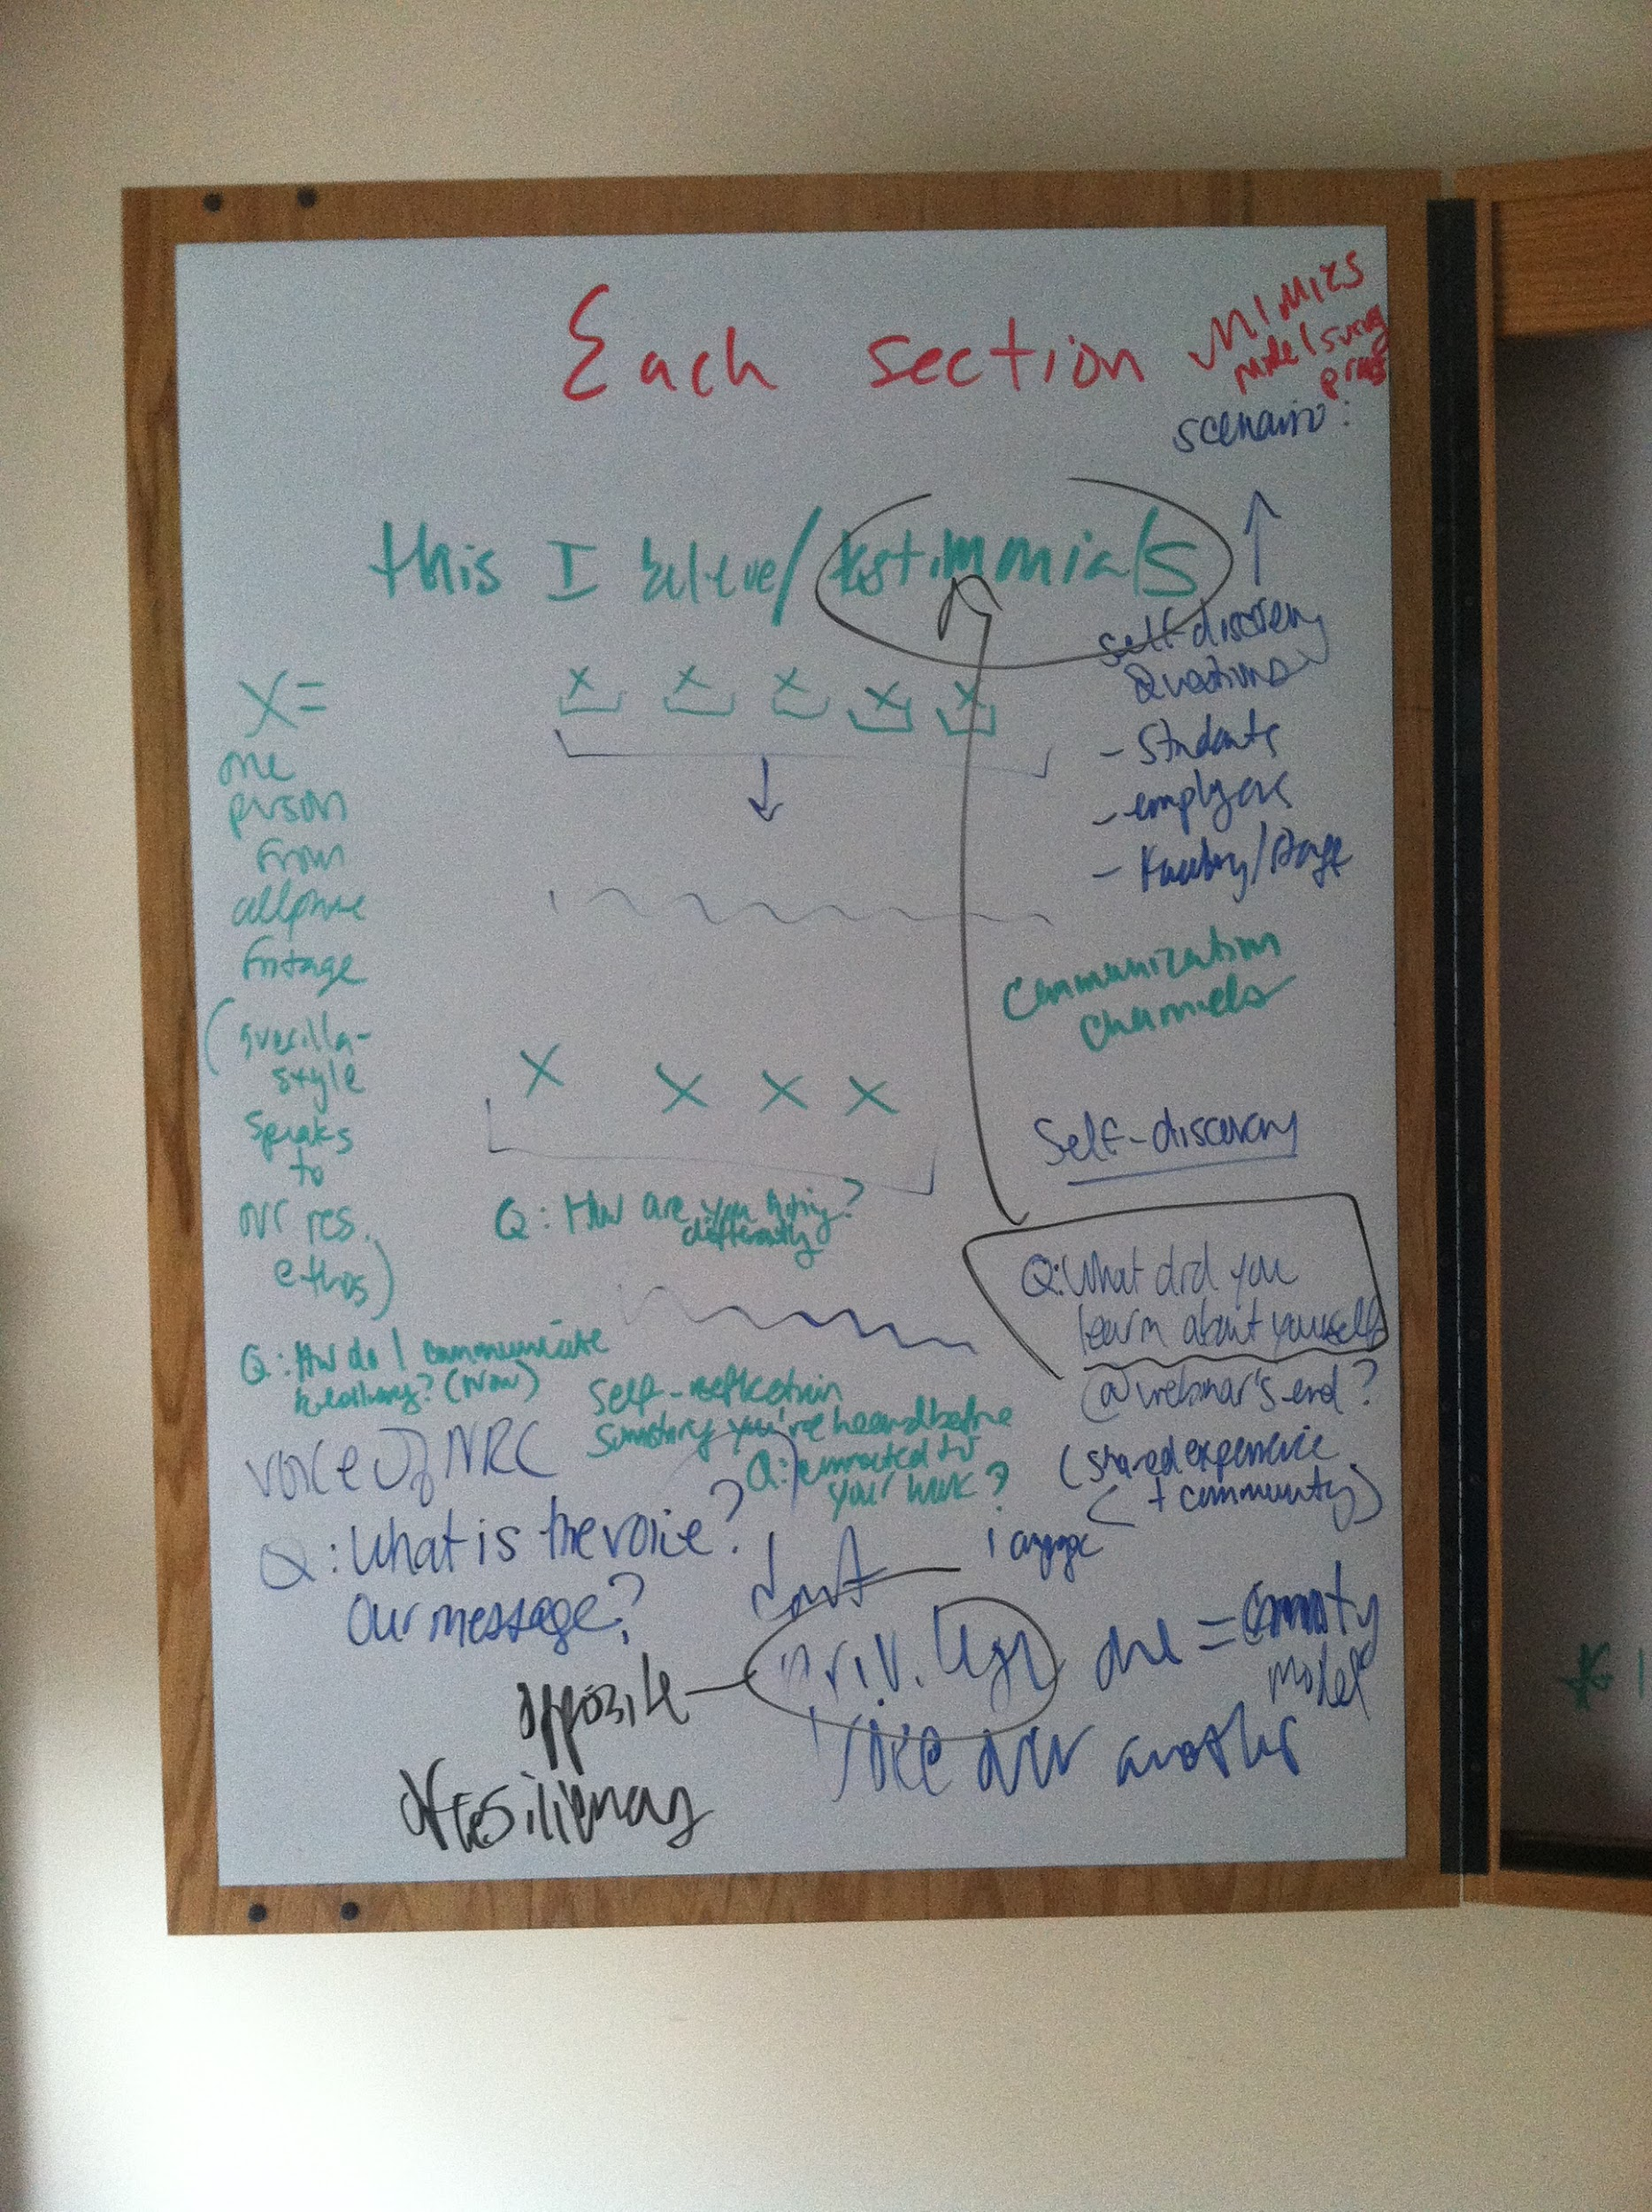
Voices of Opportunity: concept
Answer the following questions (in no particular order):
· Q: What have you learned about yourself from your involvement in the NRC?
· Q: What are you most proud of? Or what’s your biggest accomplishment?
· Q: What has been most challenging?

Slide 24
Voices of Opportunity: production
The themes below emerged across stories from individuals in our community. Their voices were arranged in a series of vignettes to construct the NRC story.
Our Story:
PEOPLE
LEARNING
STUDENTS
RESILIENCY

Slide 25
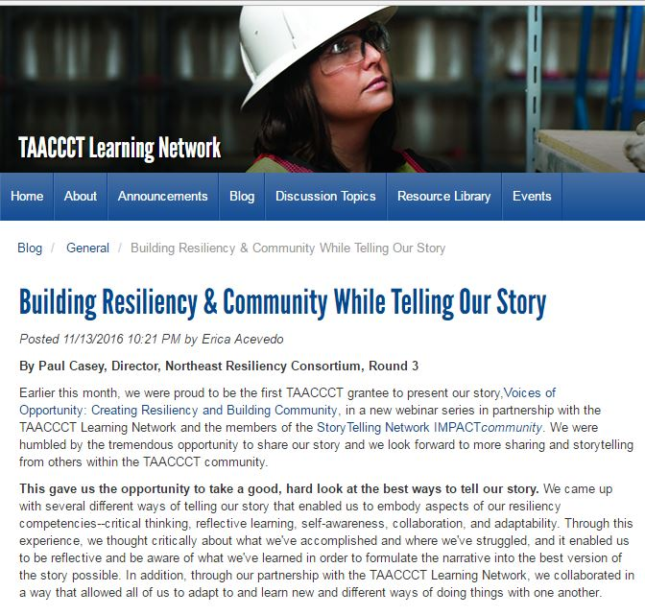
Voices of Opportunity: big reveal!
TAACCCT Voices of Opportunity:
Creating Resiliency and Building Community
A Grantee-Led Webinar

Slide 26
Bringing the Story into Focus
Story Excerpt: The formal summit offered students a valuable learning experience outside of traditional guest speaker presentations or organized student events. It gave them insight on industry trends and potential career paths, allowed them to network with experienced IT and cyber security professionals and provided them with information about the realities and risks of today’s technological environment.

Slide 27
Bringing the Story into Focus
Story Excerpt: A relatively new class in the Network Security program called “Security Design” utilizes the data center by giving students the opportunity to work on pseudo web pages. Students can test the strength and weakness of web security, thereby gauging a web page’s strength against network attacks.
TAACCCT 3 INTERFACE students believe that the new student data center provides, “a great learning opportunity,” along with, “real-world experience.”

Slide 28
Components of the StoryTelling Rubric
An Effective Character
Plot Moves the Story Forward
Authenticity (voice)
Action-oriented Emotions
A “Hook”
Resonates
with the Audience

Slide 29
Components of the StoryTelling Rubric
An Effective Character
Plot Moves the Story Forward
Authenticity (voice)
Action-oriented Emotions
A “Hook”
Resonates
with the Audience

Slide 30
Components of the StoryTelling Rubric
An Effective Character
Plot Moves the Story Forward
Authenticity (voice)
Action-oriented Emotions
A “Hook”
Resonates
with the Audience

Slide 31
Components of the StoryTelling Rubric
An Effective Character
Plot Moves the Story Forward
Authenticity (voice)
Action-oriented Emotions
A “Hook”
Resonates
with the Audience

Slide 32
Components of the StoryTelling Rubric
An Effective Character
Plot Moves the Story Forward
Authenticity (voice)
Action-oriented Emotions
A “Hook”
Resonates
with the Audience

Slide 33
Components of the StoryTelling Rubric
An Effective Character
Plot Moves the Story Forward
Authenticity (voice)
Action-oriented Emotions
A “Hook”
Resonates
with the Audience

Slide 34
Join Our
IMPACT Community

Slide 35
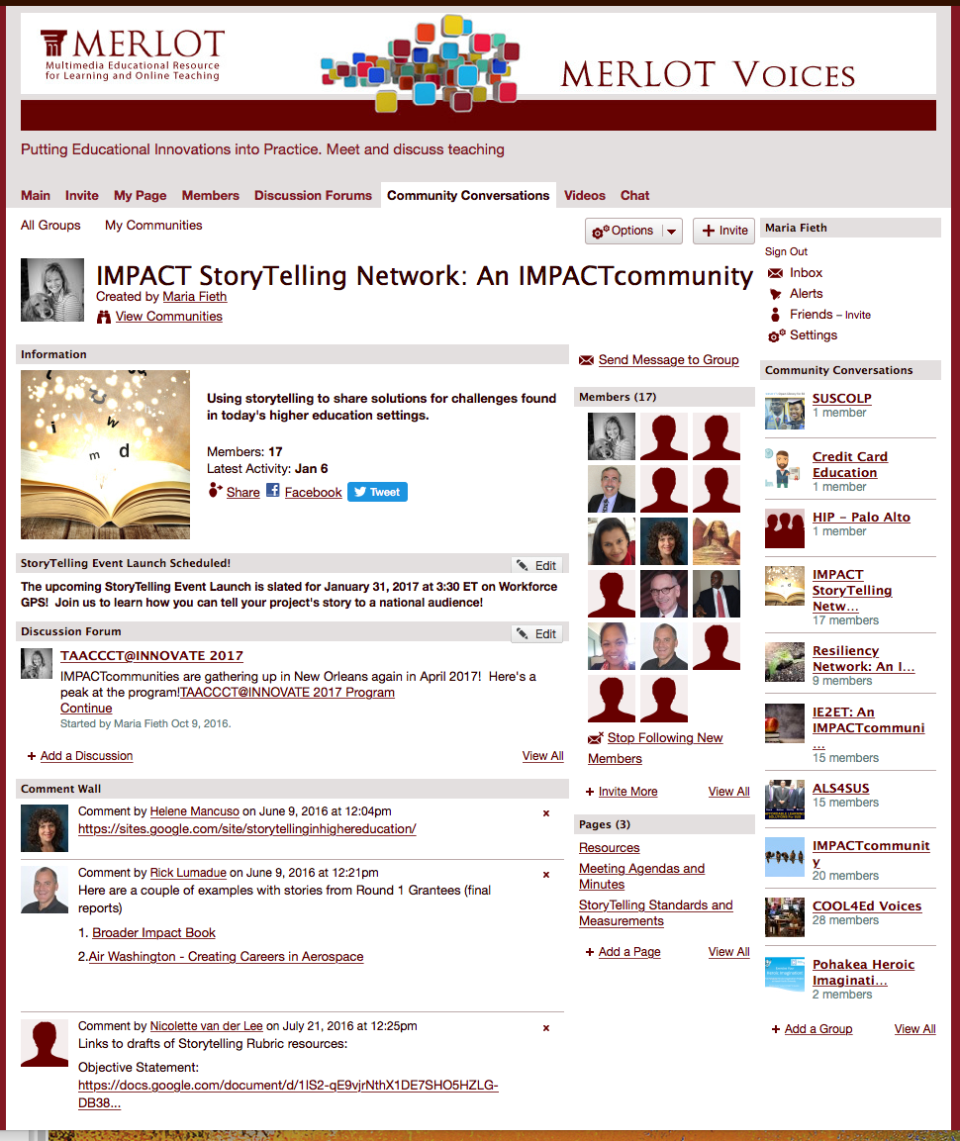
You are Invited!
> Join our next StoryTelling Community Conversation
> Sign up as a member of the MERLOT Voices website (FREE and easy!) http://voices.merlot.org/group/storytelling-impactcommunity
> Share your Stories (submit through Our Tell Your Story form) https://docs.google.com/forms/d/e/1FAIpQLSeizjTFsX-c2hab6tX8o1Mbmmsa3IAj56CTsWqZvwwnhkJnIw/viewform

Slide 36
The end!
Thank you!
Hope to talk
to you soon!
Helene Mancuso, hmancuso@luzerne.edu
Alexandra Shinert, ashinert@pccc.edu
Kathy Spada, Spada@ntc.edu
Nicolette van der Lee, nhv@hawaii.edu
Maria Fieth, mfieth@calstate.edu
"StoryTelling Network IMPACTcommunity Event" by Community Members, CSU-MERLOT's SkillsCommons is licensed under CC BY 4.0

Slide 37
UPCOMING WEBINARS
2017 TAACCCT Round 3 Closeout
February 9, 2017 1:00 pm EST
TAACCCT February Consultancy Call
February 13, 2017 4:00 pm EST

