Slide 2
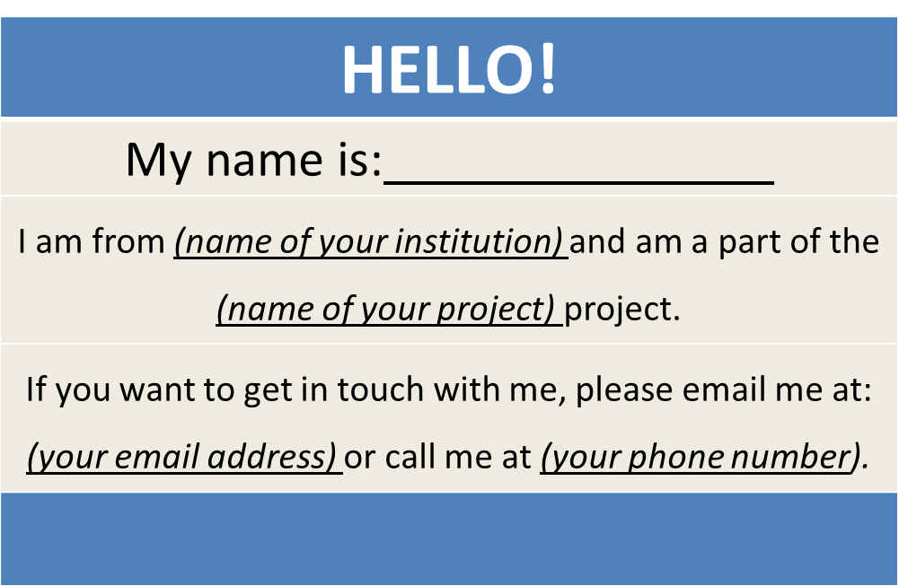
America’s Promise Grantees
Create a virtual name tag…

Slide 3

Grantee Polling Question
Let’s get to know who is on the call today. Using the poll, select the role that you play in your America’s Promise grant
Choose the answer that best reflects you (or your group):
Authorized Representative
Program Director/Manager
3. Training Partner
4. Other (please specify!)

Slide 4
H-1B America’s Promise
Promising Practices for Program Implementation
H-1B America’s Promise Grant Program

Slide 5



Gregory Scheib
Moderator: Workforce Analyst
U.S. Department of Labor
Division of Strategic Investments
Employment and Training Administration
Erika Humphrey
TA Coach, High Impact Partners

Slide 6


Michael Laidlaw
TA Coach, High Impact Partners
Bruce Rankin
TA Coach, American Association of Community Colleges

Slide 7
This webinar will provide program implementation strategies and tips on four topics:
Forecasting and projecting staffing needs to support your America’s Promise project
Effectively leveraging existing resources and partnerships
Measuring progress regularly
Incorporating sustainability strategies early in the grant period of performance.

Slide 8
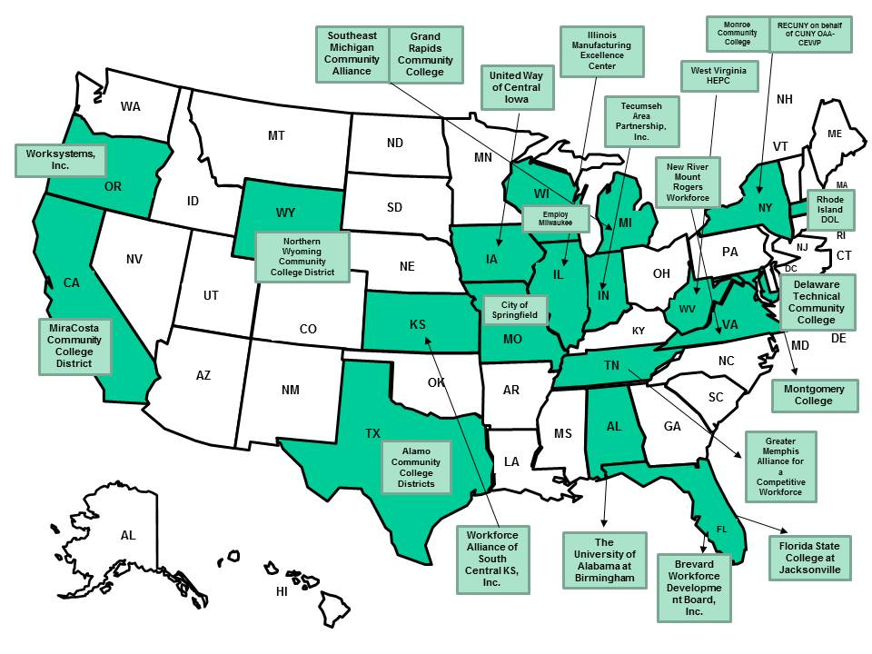
H-1B America’s Promise Grantees

Slide 9
Grantee Polling Question
Which program implementation area has been your main focus over the last month?
Choose the answers that best reflect where you are in the grant cycle
Staffing
Training Design
Partnership Development (employer, training, or supportive services partnerships)
Outreach and Recruitment
Participant Retention
Other: Specify in the textbox

Slide 10
Program Implementation Strategies and Tips
Tip 1:
forecasting and projecting staffing needs to support Your Grant

Slide 11
Grantee Polling Question
Which areas do you have dedicated staff to focus on specific programmatic areas of the grant?
Outreach and recruitment
Employer engagement
Participant retention
Job placements

Slide 12
forecasting and projecting staffing needs to support your project
Critical Components of Planning / Forecasting
Convene stakeholders to identify and assess available resources and specific contributions.
Discuss with partners what staffing resources can be leveraged (when your core grant staff consists of one or two full-time individuals).
Determine capability GAP between requirements and available resources (now and the future)

Slide 13
forecasting and projecting staffing needs to support your project
Use “What if” analysis to strategically evaluate different staffing scenarios to forecast and project staffing needs:
  Stakeholders don’t live up to commitments?
  Forecasted priorities and competencies don’t match the evolved reality (recruitment vs. retention efforts)?
  The “Internal” organizational structure changes, can the forecasted team strive?

Slide 14
Program Implementation Strategies and Tips
Tip 2:
effectively leveraging existing resources and partnerships

Slide 15
effectively leveraging existing resources and partnerships
You Have Available Resources
Take Advantage of Them!!!
  The Public Workforce System
    Workforce Boards and American Job Centers
  Employer Partners/Economic Development Agencies
  Education/Training Providers
  Community Based Organizations

Slide 16
effectively leveraging existing resources and partnerships
  The Public Workforce System – Workforce Boards and American Job Centers.
  Build time into your schedule for regular calls and meetings with your local board
  Leverage available services delivered through American Job Centers
    Ensure that they are integrated into your recruitment strategy
  Follow up on leveraged or braided funding strategies
  Access state data systems (where available) to quantify employment outcomes

Slide 17
effectively leveraging existing resources and partnerships
Employer Partners / Economic Development Agencies
  Employer input and validation
  Work-based learning opportunities
  Financial and material support
  Outreach and program support

Slide 18
effectively leveraging existing resources and partnerships
Education / Training Providers
  Reconfirm your plans
  Coordinate recruitment and admissions
  Establish your tracking system
  Build in reviews to ensure alignment

Slide 19
effectively leveraging existing resources and partnerships
Community Based Organizations
  Potential conduit to reach targeted populations
  May provide supportive services to improve persistence and completion rates
  Helpful in understanding barriers to success

Slide 20
Grantee Polling Question
How often do you communicate
with your “Core” partners?
Mark the one that applies
Weekly
Monthly
Quarterly
As Needed

Slide 21
effectively leveraging existing resources and partnerships
Communication Plan
Good two-way communication among all stakeholders is key for the success of the project. A communication plan facilitates effective and efficient communications with the various audiences having a major stake in the project.
    Communication objectives
    Communication method and frequency
    Aligns partnership roles/responsibilities with the project scope
    Assessment of your communication efforts
Components of a Good Communication Plan

Slide 22
effectively leveraging existing resources and partnerships
Communication Plan
For More Information
We have provided a Communication Plan Template, available for download webinar resource section. This template provides a framework to manage and coordinate the wide variety of communications that will take place during the life of the grant. The communication plan covers: who will receive the communications, how the communications will be delivered, what information will be communicated, who communicates, and the frequency of the communications.

Slide 23
Grantee Polling Question
How will you leverage your existing partnerships?
Mark all that will apply
Identify additional resources
Leverage community assets
Serve in an advisory capacity
Open doors in the community
Expand your program's capacity
Support program sustainability

Slide 25
Program Implementation Strategies and Tips
Tip 3: Measuring Your Progress regularly

Slide 26
Measuring Progress regularly
  Use your proposal work plans as a tracking tool
  Conduct regular risk assessments
    Compare technical progress with your implementation schedule and align with costs incurred
    Include your partners’ and training providers’ performance in these assessments
  Leverage available case management tools to create a performance “dashboard”

Slide 27
Measuring Progress regularly
Sample Tool: Project Work Plan

Slide 28
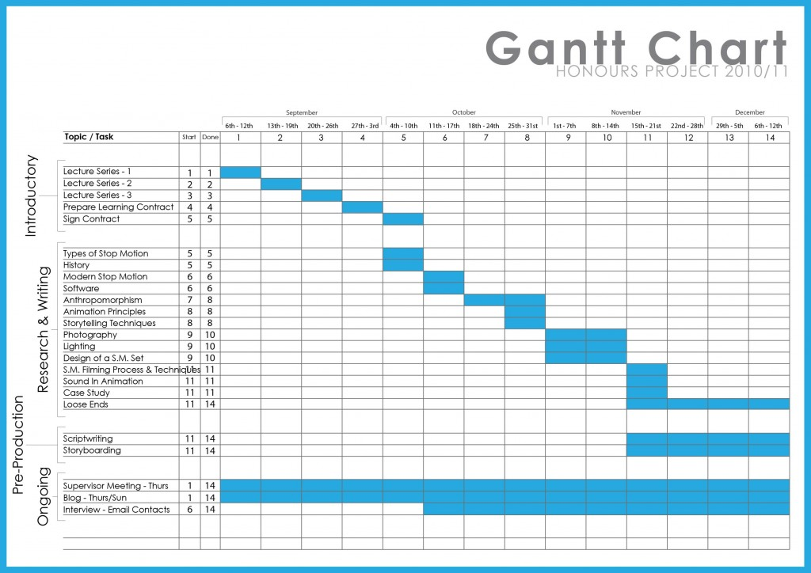
Measuring Progress regularly
Sample Tool:

Slide 29
Program Implementation Strategies and Tips
Tip 4: incorporating sustainability strategies early in YOUR grant period

Slide 30
incorporating sustainability strategies early in YOUR grant period
Planning for long-term program sustainability should begin during the early stages of program implementation because in year one you can begin to assess various elements of your program and evaluate what program elements are achieving your organization’s desired outcomes. You can use these results to guide sustainability action planning early in the grant with stakeholders. Too often sustainability plans are ignored until the last 6-8 months of the grant life-cycle.

Slide 31
incorporating sustainability strategies early in YOUR grant period
Sustaining Your Program Begins on Day One!
    Have conversations early with your partners and share your goals for sustainability.
    Think about the best way to involve your partners early and make the most of the resources they may offer.
    Keep track of what funding may be available both from local and national foundations as well as the state and federal level.
Year 1

Slide 32
incorporating sustainability strategies early in YOUR grant period
    Highlight “program” success in the media and amongst the community
    As you move into Year 2, begin to identify what resources are needed to sustain the project
For More Information
We have provided a link to a Sustainability Guide. The purpose of the Guide is to help you work through the key steps in the process of planning for the Sustainability on an on-going basis.
https://www.doleta.gov/business/PDF/SustainGuide.pdf

Slide 34
Grantee Polling Question
What TA Topics Would You Like to
See Featured in the Near Future?
You can chose more than one answer
Supportive Services
Partnership Development (employer, training or supportive services partnerships)
Outreach and Recruitment
Participant Retention
Other: Specify in the textbox

Slide 35
Upcoming TA Activities
August
  Webinar: Participant Outreach and Recruitment Strategies
  September
  Peer-to-Peer Virtual Chat: Integrated Supportive Services
  Webinar: Building Strategic Employer Partnerships for Career Pathways in the Community and the Region

Slide 36
America’s Promise Grantee Mailbox
AmericasPromise@dol.gov and copy your FPO

