Slide 1
TAACCCT Student Recruitment: Strategies for Success
July 10, 2017
2:00 – 3:00 p.m. EST

Slide 2
Presenters
Facilitator:
Christian Lagarde, Project Manager, Workforce and Economic Development, American Association of Community Colleges
Presenter:
Diana Nastasia, Associate Project Manager, Building Illinois Bioeconomy Consortium, Southern Illinois University Edwardsville
Courtney Breckenridge, Project Manager, Building Illinois Bioeconomy Consortium, Southern Illinois University Edwardsville
Shannon McGhee, Account Director, Hawthorne Strategy Group
Moderator:
Eugenie Agia, Workforce Analyst, TAACCCT Grants, U.S. Department of Labor, Employment and Training Administration

Slide 3
TAACCCT Announcements
TAACCCT Announcements
2017 Round 4 TAACCCT Convening
Washington DC
September 26-27
Call for Presentations
Round 4 grantees are invited to submit a proposal to present at the upcoming Round 4 TAACCCT Convening
Proposal should highlight innovations related to the themes described below. Strategies that emphasize scaling and sustainability are especially encouraged!
Proposals will be accepted through Friday, July 28, 2017
This process is managed by consortium leads, so if you're a consortium member, please work with your lead.
Email TAACCCT mailbox with more questions

Slide 4
LESSONS LEARNED FROM
A TAACCCT
BIOECONOMY CONSORTIUM

Slide 5
OUR PARTNERSHIP

Slide 6
Bioeconomy in a Nutshell

Slide 7
Background
2014: U.S. Department of Labor awards the Building Illinois’ Bioeconomy consortium $10 million through a Trade Adjustment Assistance Community College and Career Training (TAACCCT) grant (Round 4)
2016: Building Illinois’ Bioeconomy consortium partners sign Memorandum of Understanding for the purpose of providing multiple pathways for students to meet education and career goals
2016-2017: articulation agreements

Slide 8
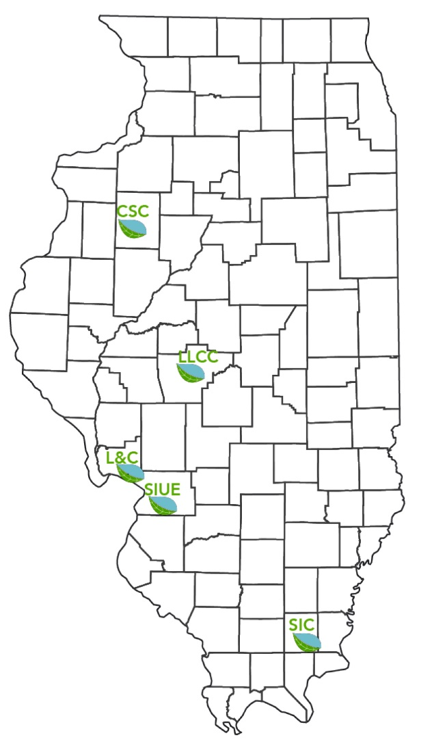
Partner Schools
Spanning the state of Illinois
One university, four community colleges
Southern Illinois University Edwardsville (SIUE)
Lewis and Clark Community College (L&C)
Southeastern Illinois College (SIC)
Lincoln Land Community College (LLCC)
Carl Sandburg College (CS)

Slide 9
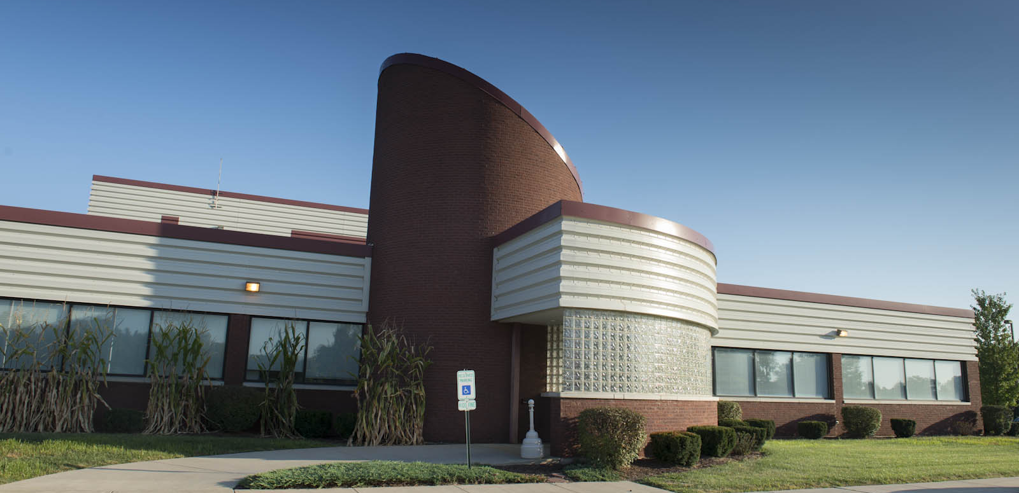
Lead School (SIUE)
Hands-on experiences
Two research and training centers
The National Corn-to-Ethanol Research Center (NCERC)
Public-private partnership
Commercial testing of products, technologies, and ideas
The Environmental Resources Training Center (ERTC)
Designated by IEPA as the Illinois center for continuing education of personnel of drinking water and waste water treatment systems

Slide 10
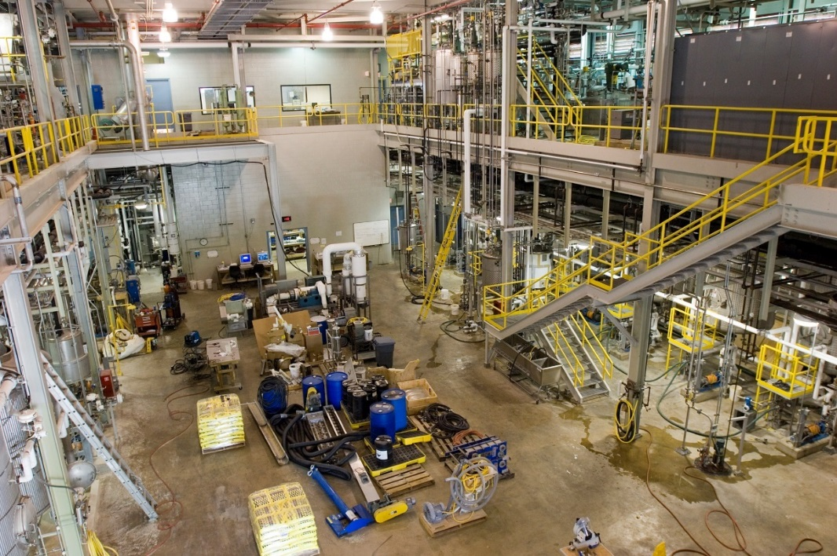
Resources
Dedicated case managers
Partnerships with local community development and employment & training agencies
Emsi Career Coach and Analyst
Corporation for a Skilled Workforce (CSW)
Hawthorne Strategy Group
Council for Adult and Experiential Learning (CAEL)

Slide 11
OUR APPROACH

Slide 12
Our Mission & Vision
developing of a well-trained quality workforce by merging the collective strengths and resources of each partner school with a network of committed regional employers
preparing residents of Illinois and neighboring states for in demand, high wage jobs in the bioeconomy

Slide 13
Our Values
Foster partnerships between industry and education
Develop flexible, targeted training programs
Promote bioeconomy jobs and career paths
Streamline process for connecting displaced and disadvantaged workers to programs

Slide 14
Bioeconomy Career Clusters
Energy and Manufacturing
Lead Mechanical Engineer
Civil / Environmental Engineer
Agriculture, Life and Physical Sciences
Senior Plant Scientist
Infrastructure
Plant Manager
Industrial Equipment Manager
Operations, Management and Business
Plant Sciences Technician
Computational Science Technician
Plant Operator
Education, Communication and Outreach
Business Operations Manager
Biological Scientist
Business Operations Assistant
Communications Manager
Education Program Specialist
Educational Aide
Policy Analyst
Entry → Mid → Advanced

Slide 15
Clusters in Our Region
Energy and Manufacturing
Agriculture, Life and Physical Sciences
Infrastructure and Logistics
Operations, Management and Business
Education, Communication and Outreach

Slide 16
Sectors our Programs Cover
Bioprocessing
Converting organic matter (like corn) or waste into products that we use every day, like plastic or fuel.
Biofuels
A form of bioprocessing, which focuses on turning organic matter (like corn or food waste) into fuel.
Water Management
Treatment of waste or drinking water in a government or private facility, as well as in agriculture watersheds.
Restoration Ecology
The preservation and restoration of forestry and natural environments (like forests and plains).
Process Maintenance
The operation behind any manufacturing facility, including both machine and computer process systems.
Integrative Studies
Business, marketing, HR, communications, accounting and other professional positions needed to support bio-based industries.

Slide 17
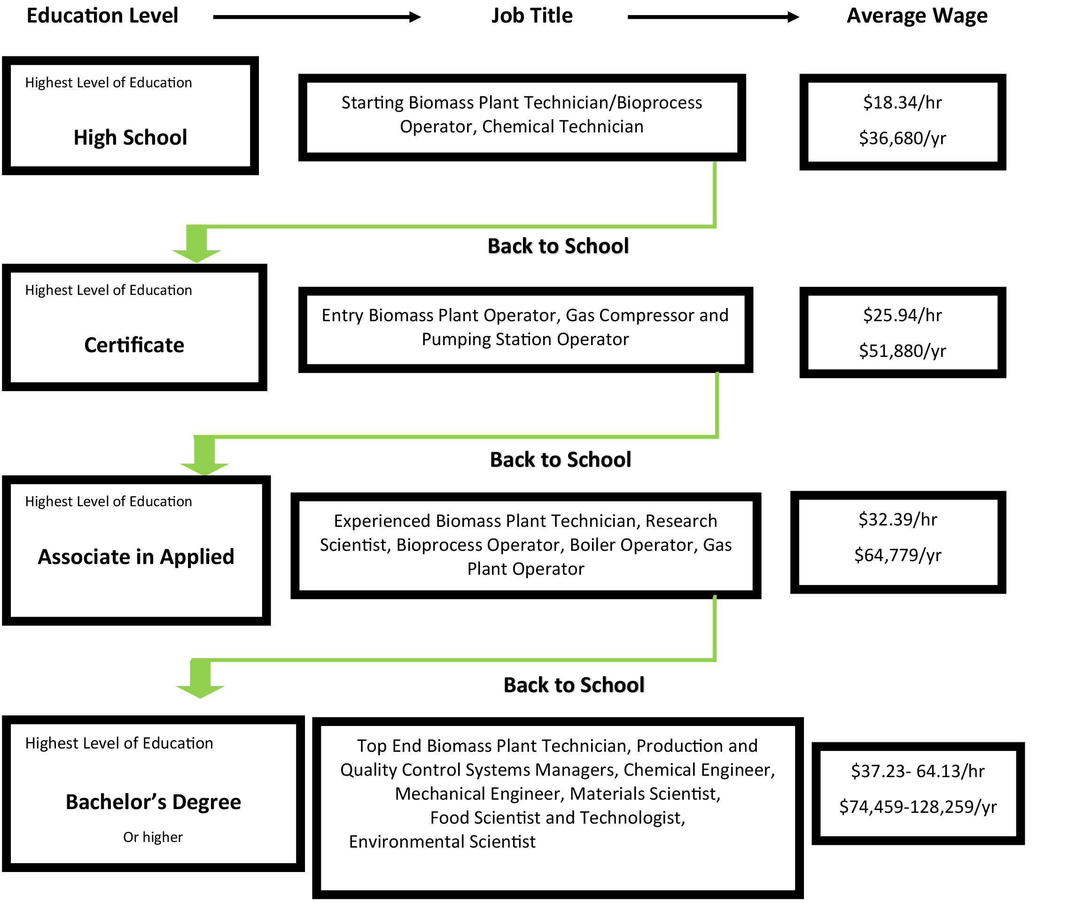
Bioprocess Career Pathway
Community College
Science
SIUE

Slide 18
Marketing Lessons Learned

Slide 19
First: We Want to Hear from You
What would you like to learn most from this marketing section
of the webinar?
Tell us through the chat panel!

Slide 20
POLL QUESTION
What is the most useful marketing channel in reaching your audiences?
Earned Media
Employer outreach
Materials development
Social Media
Webinars
Other (option to type in original response)

Slide 21
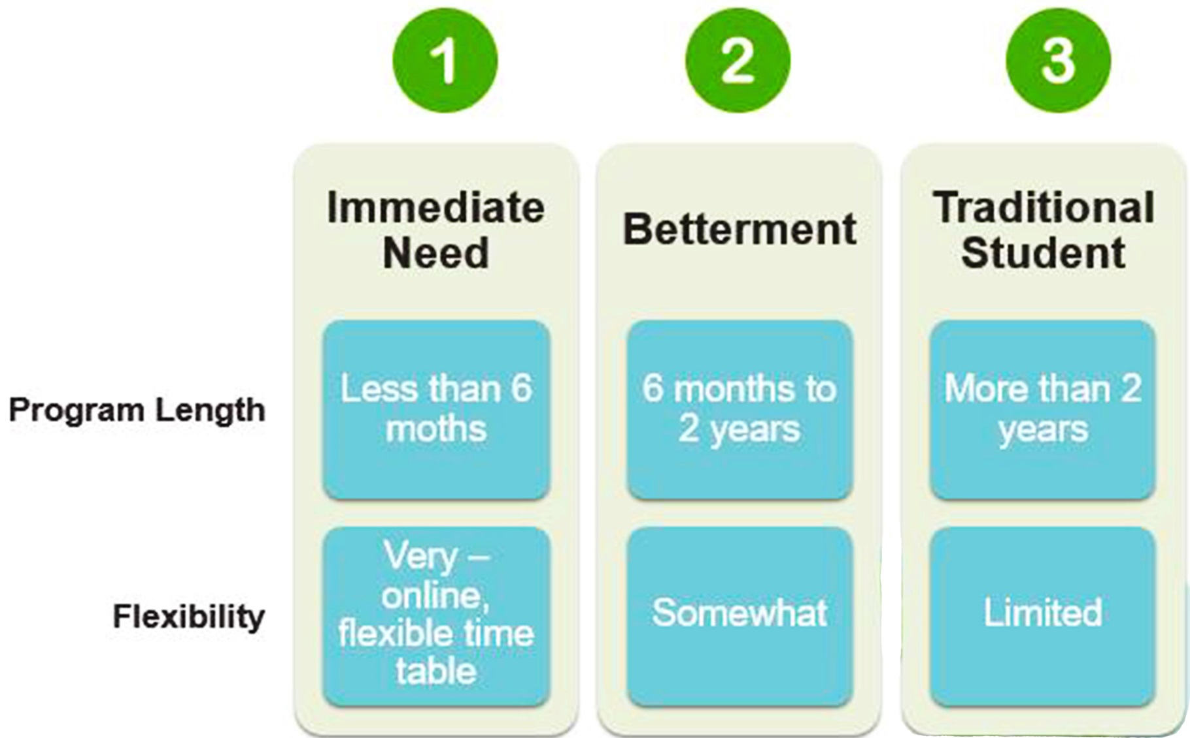
Identify Audience
Think About Basic Needs and How your Programs Fit

Slide 22
Figure Out Issues of Audience Category
Immediate Need audience is broad, with individuals unified by a need to gain employment quickly, maintain benefits, or increase paycheck power
 | Current State | Future State
Believe What do they believe about higher education or more training? Do they think it’s attainable in general? | Lack of belief in job growth State of Illinois fears Language barriers Afraid of school environment | Possibility, attainability When education and industry are linked, outcomes are better Programs help achieve better
Think What do they think about specific BIB programs? Do they think it’s helpful, or not? | Job training doesn’t work to get what’s needed Programs don’t teach skills needed | Connection between better paying job and certificate or degrees Can picture themselves in programs
Feel What are their emotions about going back to school or getting more training? | Overwhelmed Lack of confidence Angry | Hopeful Optimistic
Do What does all of this make them do? | Shut down | Reach out Enjoy

Slide 23
Write Messaging Designed to Move To Action
 | Immediate | Betterment | Traditional Student
Challenges | Pre-held beliefs | Urgency Price | Awareness
Motivators | Length of time to outcome | Increased skill or income Opportunity | Interest
Calls to Action | See Case Manager | See Case Manager | Register
Figure out Where Best to Point to for Enrollment

Slide 24
Show Clearly the Outcome
Community College
Science
SIUE

Slide 25
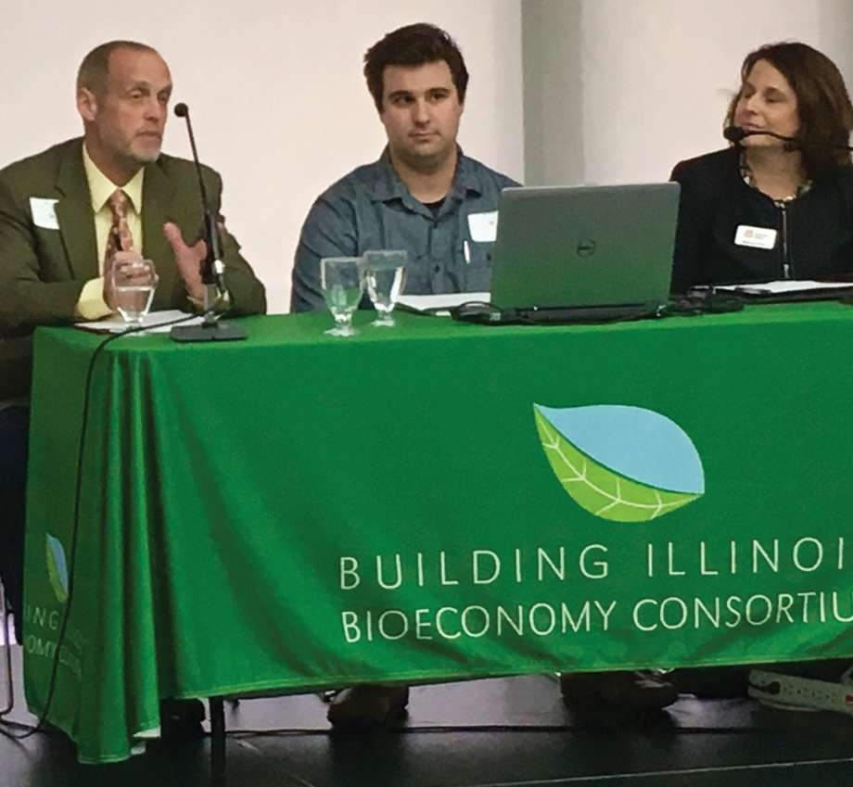
Show Existing Resources to Meet Audiences Where They Are
Head Start parents in East St. Louis
Laid off steelworkers in Granite City, IL
Current staff of energy employers
Veterans, air force base families
Amazon Career Choice beneficiaries
New immigrants in St. Louis Metro area
Farmers in Southern and Central Illinois

Slide 26
Develop an Intake Mechanism
Tips to Avoid Losing Candidates / Hurting Reputation with Limited Staff and Resources
Develop partnerships with organizations who help with areas you don’t (e.g. soft skills)
Develop an auto response telling common times for reply to help ease response time drop-off
Keep a database (even through spreadsheets) of candidate contact information so you can check in
How do interested applicants get in touch with you?
Where do you send them if you can’t help?
How do you reply quickly with limited staff?
How do you track them through their journey to ensure they get into training?

Slide 27
POLL QUESTION
Where do you see the most potential for growth in your marketing efforts?
Earned Media
Employer outreach
Materials development
Social Media
Webinars
Other (option to type in original answer)

Slide 28
Spend Marketing Time Wisely
A Lot of Time | Less Time
Managing social media every day | Develop a toolkit for partners so they can help you get the word out (example included)
Developing tailored fact sheets/flyers for every event | Develop one core piece that includes short key information (salary range, number of jobs, etc.) and where candidates apply. Order a lot, use at every event and spend more facetime
Using every marketing channel | Determine the ones that matter most for your audience and focus in. For most audiences… facetime/interaction is the most important

Slide 29
OUR
SUSTAINABILITY EFFORTS

Slide 30
SIUE as Anchor Institution Regionally
Accessibility of programs (equity)
K-12 intervention
Targeted information
Environment that prioritizes student learning
Case management
Hybrid and online learning
Hands-on and experiential learning
Tutoring, mentoring, coaching, learning communities
PLA, credit/non-credit balance, “earn and learn”
Employability of graduates
Soft skills training
Employer engagement

Slide 31
Further Employer Engagement
From sector partnerships to mapping and engaging the cluster or energy and water sectors regionally
From advisory boards to sector partnerships
Partnerships with county-based workforce, economic, and community development agencies
Further grant writing partnerships

Slide 32
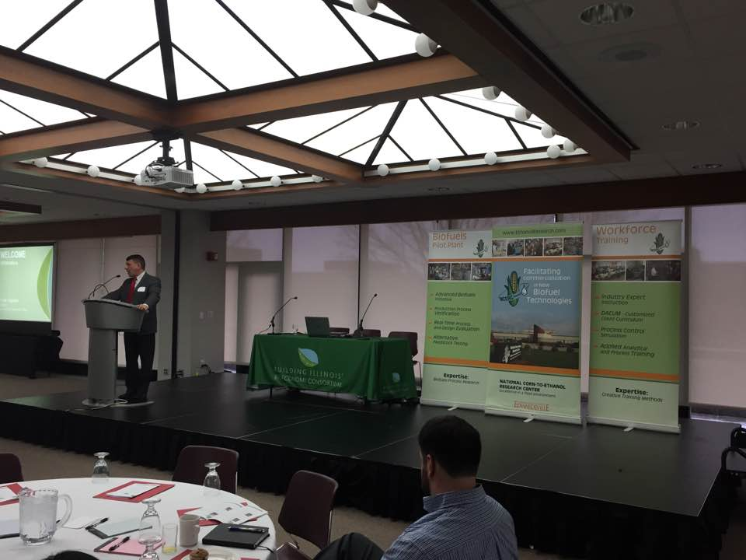
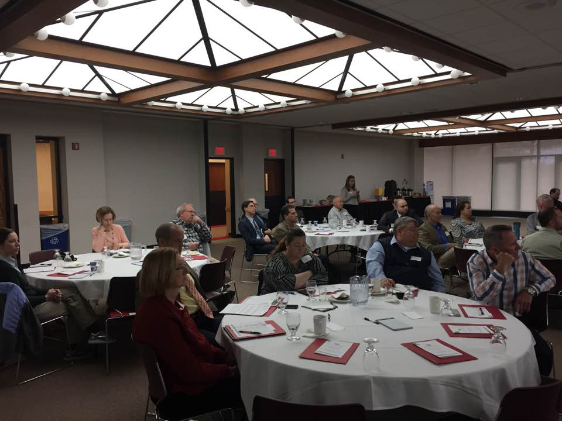
Ongoing and Expanded Targeted Information & Outreach
Visits to high schools,
community organizations
Events
Speakers bureau
Earned media
Thought leadership

Slide 34
Thank You!
Connect with the NEW TAACCCT Community of Practice and search for TAACCCT resources at:
https://TAACCCT.workforceGPS.org
Ask questions and to connect with peers and resources at TAACCCT@dol.gov
If you want to learn more about peer mentoring email TAACCCT@dol.gov

